Slide 1
IDENTIFY THESE PAIRS OF PEOPLE ON THE COVER OF ROLLING STONE MAGAZINE IN THE 1970'S

Slide 2
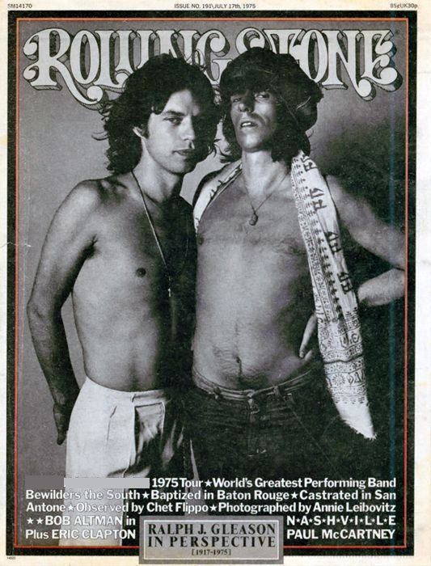
Question 1:

Slide 3
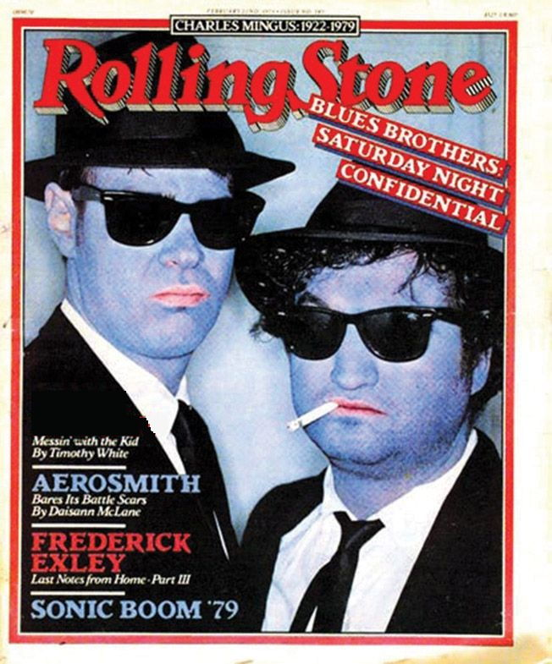
Question 2:

Slide 4
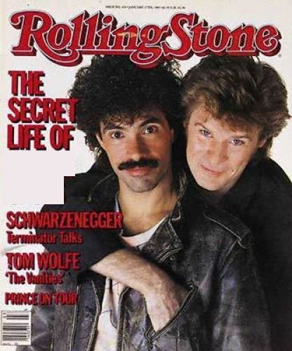
Question 3:

Slide 5
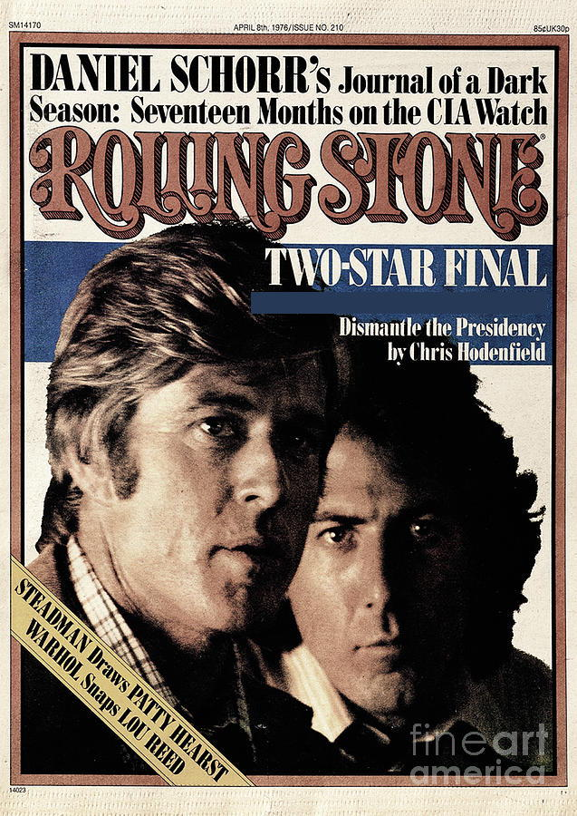
Question 4:

Slide 6
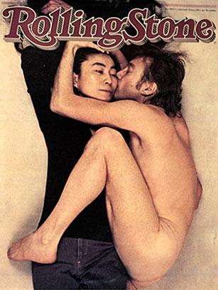
Question 5:

Slide 7
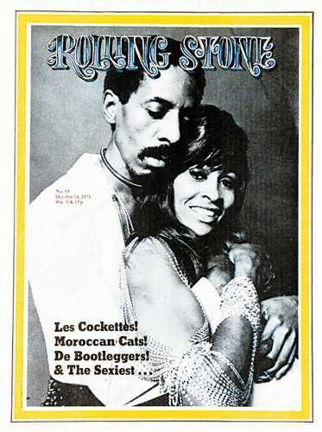
Question 6:

Slide 8
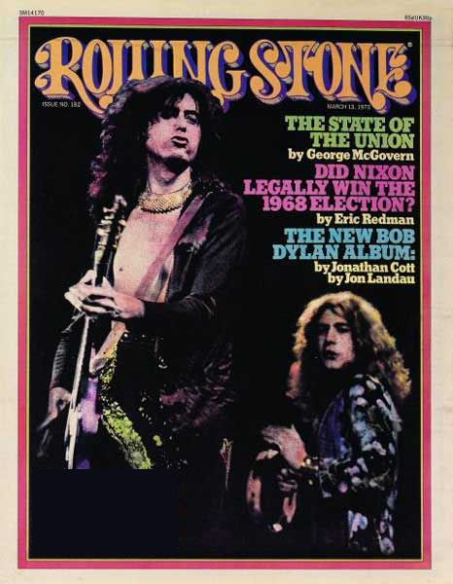
Question 7:

Slide 9
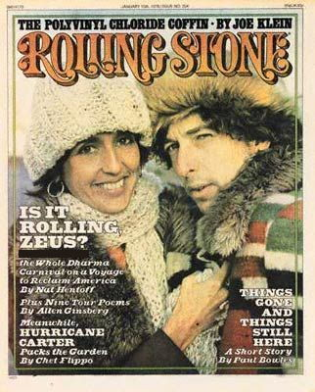
Question 8:

Slide 10
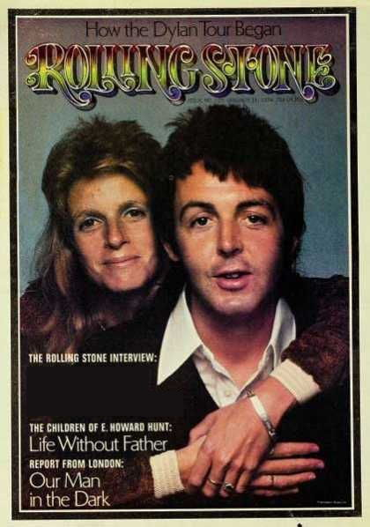
Question 9:

Slide 11
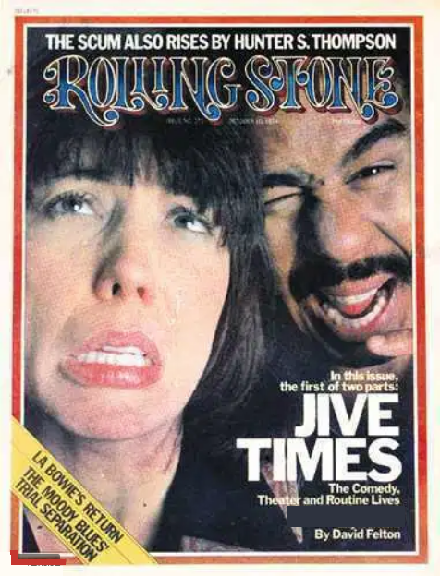
Question 10:

Slide 12
The End
Answers will be provided shortly

Slide 13
Question 1:
KEITH RICHARDS & MICK JAGGER

Slide 14
Question 2:
DAN AYKROYD & JOHN BELUSHI

Slide 15
Question 3:
DARYL HALL & JOHN OATES

Slide 16
Question 4:
ROBERT REDFORD & DUSTIN HOFFMAN

Slide 17
Question 5:
YOKO ONO & JOHN LENNON

Slide 18
Question 6:
IKE & TINA TURNER

Slide 19
Question 7:
ROBERT PLANT & JIMMY PAGE

Slide 20
Question 8:
JOAN BAEZ & BOB DYLAN

Slide 21
Question 9:
LINDA & PAUL MCCARTNEY

Slide 22
Question 10:
LILY TOMLIN & RICHARD PRYOR

