Slide 1
IDENTIFY THESE CELEBRITY COUPLES (NO PARTIAL CREDIT)

Slide 2
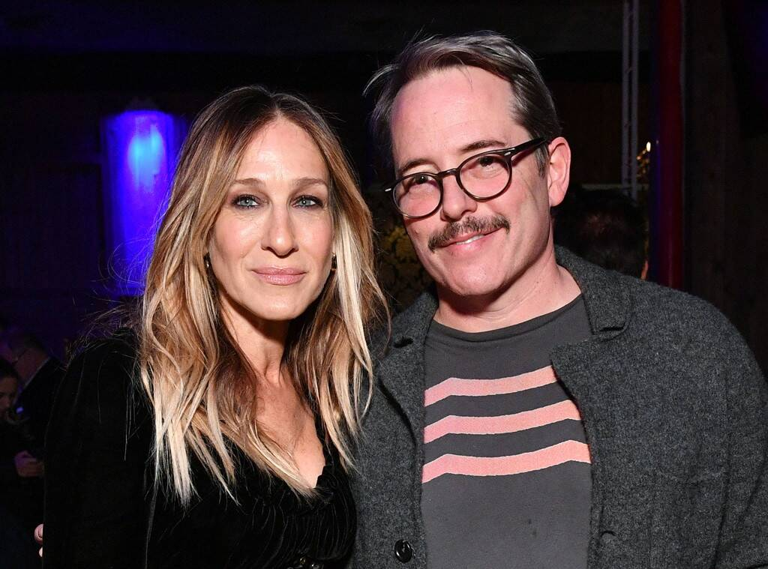
Question 1:

Slide 3
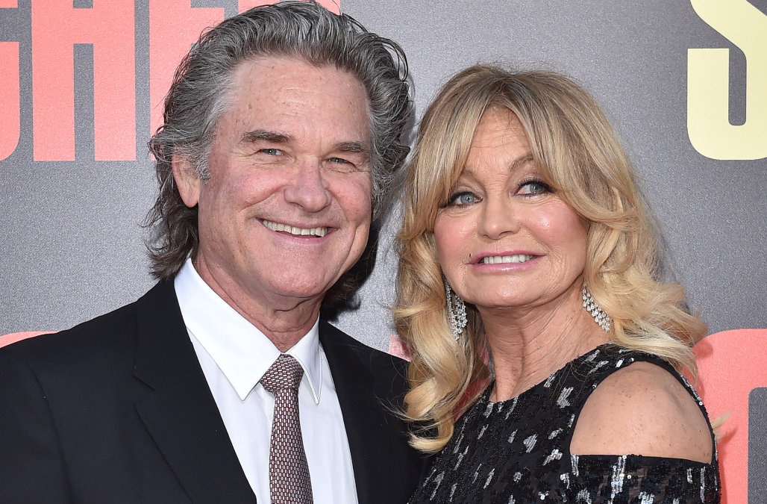
Question 2:

Slide 4
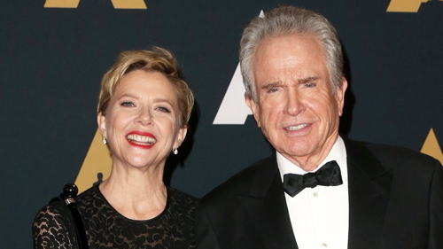
Question 3:

Slide 5
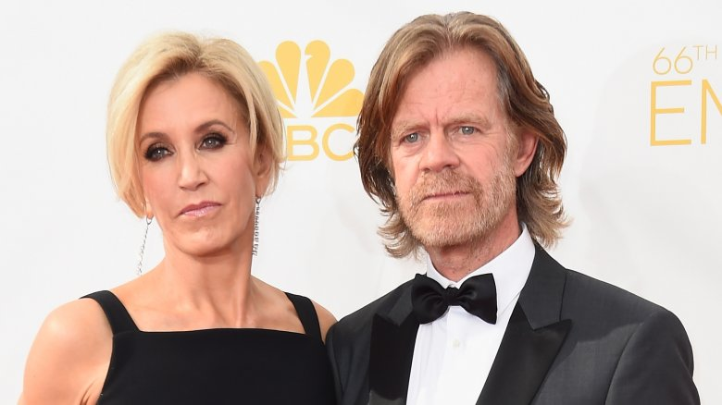
Question 4:

Slide 6
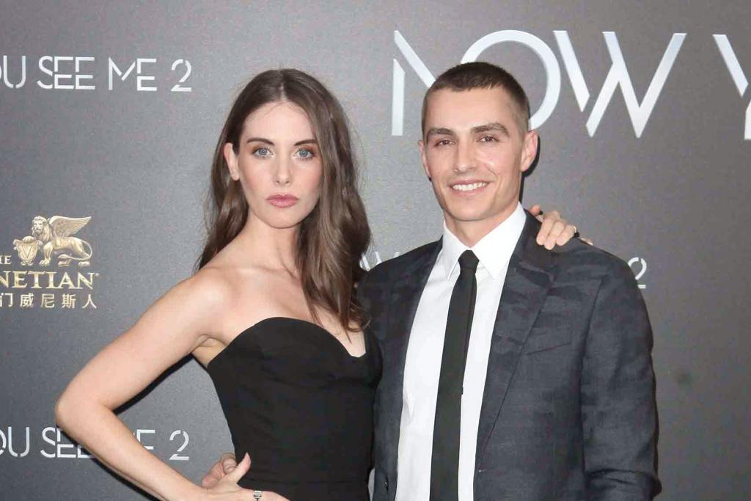
Question 5:

Slide 7
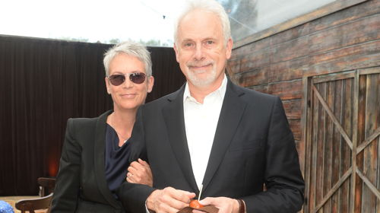
Question 6:

Slide 8
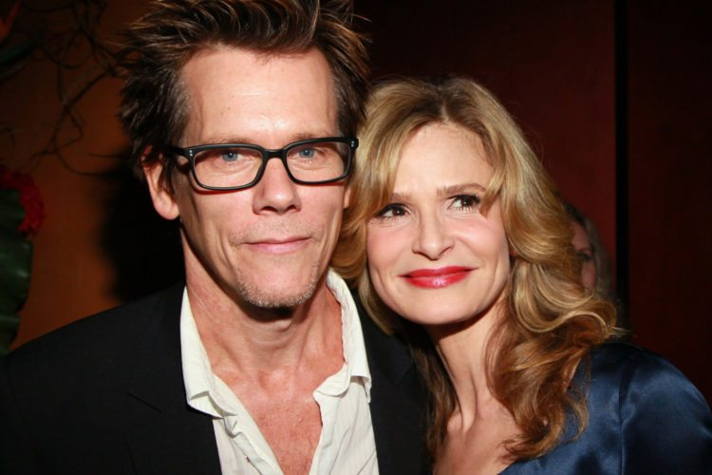
Question 7:

Slide 9
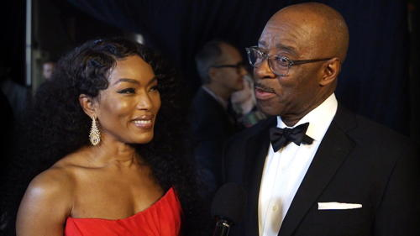
Question 8:

Slide 10
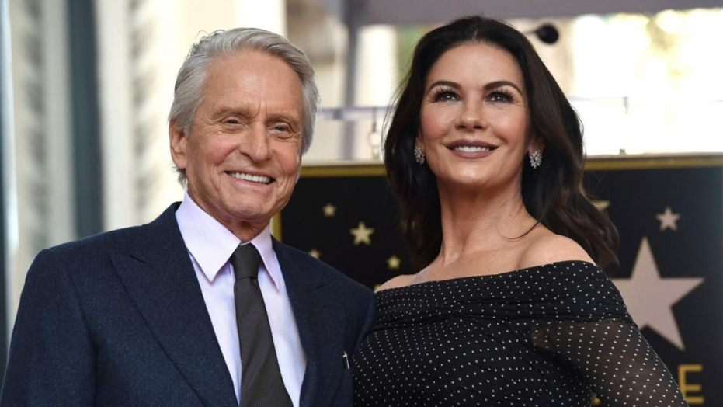
Question 9:

Slide 11
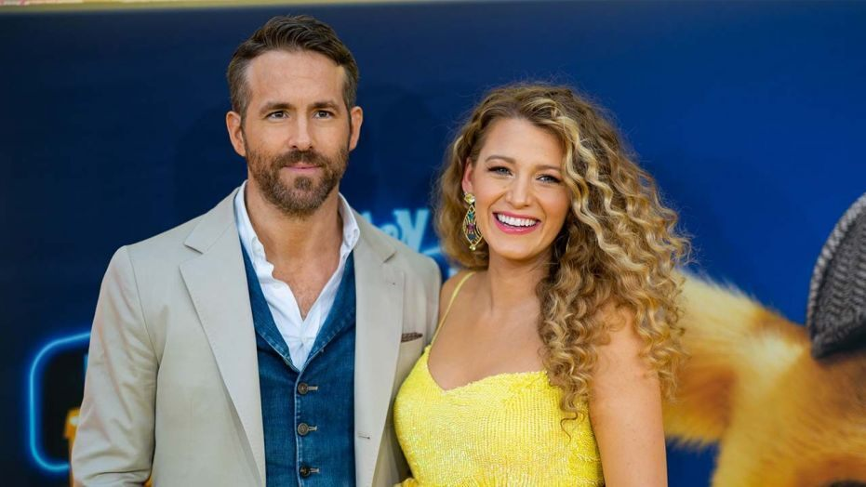
Question 10:

Slide 12
The End
Answers will be provided shortly

Slide 13
Question 1:
SARAH JESSICA PARKER & MATTHEW BRODERICK

Slide 14
Question 2:
KURT RUSSELL & GOLDIE HAWN

Slide 15
Question 3:
ANNETTE BENING & WARREN BEATTY

Slide 16
Question 4:
FELICITY HUFFMAN & WILLIAM H. MACY

Slide 17
Question 5:
ALISON BRIE & DAVE FRANCO

Slide 18
Question 6:
JAMIE LEE CURTIS & CHRISTOPHER GUEST

Slide 19
Question 7:
KEVIN BACON & KYRA SEDGWICK

Slide 20
Question 8:
ANGELA BASSETT & COURTNEY B. VANCE

Slide 21
Question 9:
MICHAEL DOUGLAS & CATHERINE ZETA–JONES

Slide 22
Question 10:
RYAN REYNOLDS & BLAKE LIVELY

