Slide 1
COMMON THREAD

Slide 2
Question 1:
WHAT NEW ZEALAND SINGER'S SONG "ROYALS" WON GRAMMYS FOR "SONG OF THE YEAR" AND "BEST POP SOLO PERFORMANCE"?

Slide 3
Question 2:
WHAT IS THE FIRST NAME OF THE CEO OF FACEBOOK?

Slide 4
Question 3:
WHAT IS GOOGLE'S VERSION OF POWERPOINT CALLED?

Slide 5
Question 4:
IN NEWTON'S 2ND LAW OF MOTION, WHAT DOES m STAND FOR?

Slide 6
Question 5:
WHAT IS THE LAST NAME OF THE ACTOR WHO PLAYED THE HUSBAND OF "FLORENCE FOSTER JENKINS"?

Slide 7
Question 6:
WHAT IS SAN JOSE'S NHL TEAM?

Slide 8
Question 7:
IN "FINDING NEMO", WHAT WORD DO THE SEAGULLS REPEAT OVER AND OVER WHEN CHASING NEMO?

Slide 9
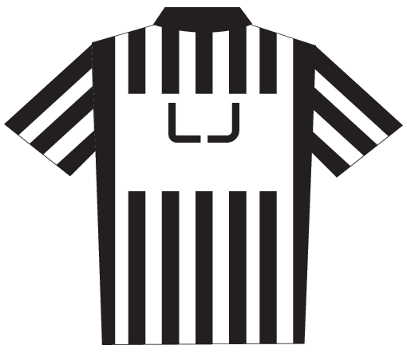
Question 8:
WHAT DOES THE "L" STAND FOR ON THIS THIS NFL OFFICIAL UNIFORM?

Slide 10
Question 9:
FINISH THE LYRIC FROM THE CHORDETTE'S SONG "MR. SANDMAN": "GIVE HIM THE WORD THAT I'M NO ____"?

Slide 11
Question 10:
WHAT DO ALL THESE ANSWERS HAVE IN COMMON?

Slide 12
ANSWERS WILL BE PROVIDED SHORTLY

Slide 13
Question 1:
WHAT NEW ZEALAND SINGER'S SONG "ROYALS" WON GRAMMYS FOR "SONG OF THE YEAR" AND "BEST POP SOLO PERFORMANCE"?
LORDE

Slide 14
Question 2:
WHAT IS THE FIRST NAME OF THE CEO OF FACEBOOK?
MARK (ZUCKERBERG)

Slide 15
Question 3:
WHAT IS GOOGLE'S VERSION OF POWERPOINT CALLED?
SLIDES

Slide 16
Question 4:
IN NEWTON'S 2ND LAW OF MOTION, WHAT DOES m STAND FOR?
MASS

Slide 17
Question 5:
WHAT IS THE LAST NAME OF THE ACTOR WHO PLAYED THE HUSBAND OF "FLORENCE FOSTER JENKINS"?
(HUGH) GRANT

Slide 18
Question 6:
WHAT IS SAN JOSE'S NHL TEAM?
SHARKS

Slide 19
Question 7:
IN "FINDING NEMO", WHAT WORD DO THE SEAGULLS REPEAT OVER AND OVER WHEN CHASING NEMO?
MINE

Slide 20
Question 8:
WHAT DOES THE "L" STAND FOR ON THIS THIS NFL OFFICIAL UNIFORM?
LINE (JUDGE)

Slide 21
Question 9:
FINISH THE LYRIC FROM THE CHORDETTE'S SONG "MR. SANDMAN": "GIVE HIM THE WORD THAT I'M NO ____"?
ROVER

Slide 22
Question 10:
WHAT DO ALL THESE ANSWERS HAVE IN COMMON?
CAN FOLLOW THE WORD "LAND"

