Slide 1
COMMON THREAD

Slide 2
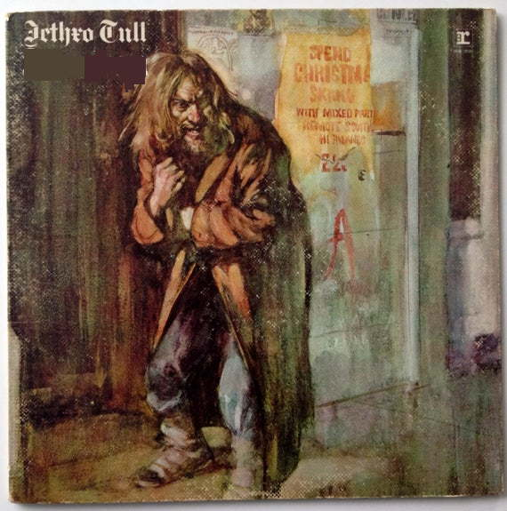
Question 1:
WHAT WAS JETHRO TULL'S FIRST TOP-10 ALBUM?

Slide 3
Question 2:
WHAT KIND OF LEGUMES ARE MOST COMMON IN CREOLE COOKING?

Slide 4
Question 3:
WHAT PUNCTUATION MARK APPEARS IN THE TITLE OF ALL 6 "MISSION IMPOSSIBLE" FILMS?

Slide 5

Question 4:
WHAT CALIFORNIA RESEARCH FACILITY HAS THIS LOGO ?

Slide 6
Question 5:
WHO, ALONG WITH JOHN WATSON AND IVAN PAVLOV, IS CONSIDERED A PIONEER OF MODERN BEHAVIORISM?

Slide 7
Question 6:
WHAT WAS THE NAME OF THE SUPERHERO PORTRAYED BY PAUL REUBENS IN THE 1999 FILM "MYSTERY MEN"?

Slide 8
Question 7:
FOR WHAT FILM DID JEFF BRIDGES WIN AN OSCAR FOR BEST ACTOR FOR PORTRAYING A COUNTRY SINGER?

Slide 9
Question 8:
WHAT ADJECTIVAL PHRASE REFERS TO A SARCASTIC STATEMENT MADE WITH MOCK SERIOUSNESS?

Slide 10
Question 9:
IN WHAT 1983 FILM DOES STEVE MARTIN PLAY DR. HFUHRUHURR?

Slide 11
Question 10:
WHAT DO ALL THESE ANSWERS HAVE IN COMMON?

Slide 12
ANSWERS WILL BE PROVIDED SHORTLY

Slide 13
Question 1:
WHAT WAS JETHRO TULL'S FIRST TOP-10 ALBUM?
AQUALUNG

Slide 14
Question 2:
WHAT KIND OF LEGUMES ARE MOST COMMON IN CREOLE COOKING?
KIDNEY BEANS

Slide 15
Question 3:
WHAT PUNCTUATION MARK APPEARS IN THE TITLE OF ALL 6 "MISSION IMPOSSIBLE" FILMS?
A COLON

Slide 16
Question 4:
WHAT CALIFORNIA RESEARCH FACILITY HAS THIS LOGO ?
LAWRENCE LIVERMORE NATIONAL LABORATORY

Slide 17
Question 5:
WHO, ALONG WITH JOHN WATSON AND IVAN PAVLOV, IS CONSIDERED A PIONEER OF MODERN BEHAVIORISM?
B. F. SKINNER

Slide 18
Question 6:
WHAT WAS THE NAME OF THE SUPERHERO PORTRAYED BY PAUL REUBENS IN THE 1999 FILM "MYSTERY MEN"?
THE SPLEEN

Slide 19
Question 7:
FOR WHAT FILM DID JEFF BRIDGES WIN AN OSCAR FOR BEST ACTOR FOR PORTRAYING A COUNTRY SINGER?
CRAZY HEART

Slide 20
Question 8:
WHAT ADJECTIVAL PHRASE REFERS TO A SARCASTIC STATEMENT MADE WITH MOCK SERIOUSNESS?
TONGUE – IN – CHEEK

Slide 21
Question 9:
IN WHAT 1983 FILM DOES STEVE MARTIN PLAY DR. HFUHRUHURR?
THE MAN WITH TWO BRAINS

Slide 22
Question 10:
WHAT DO ALL THESE ANSWERS HAVE IN COMMON?
CONTAIN NAMES OF ORGANS

