Slide 1
COMMON THREAD

Slide 2
Question 1:
WHAT TV SHOW IS HUGH LAURIE MOST FAMOUS FOR?

Slide 3
Question 2:
WHAT WORD DO BRITS USE FOR "ELEVATOR"?

Slide 4
Question 3:
WHAT 2003 "TORTURE HORROR" FILM AND ITS 7 SEQUELS HAVE MADE OVER $1 BILLION?

Slide 5
Question 4:
WHAT IS GOOGLE'S VERSION OF MICROSOFT'S "ACCESS" CALLED?

Slide 6
Question 5:
WHEN WEIGHING GEMSTONES, A CARAT IS 200 mg. WHAT IS 1% OF A CARAT CALLED?

Slide 7
Question 6:
WHAT DOES THE SECOND "S" STAND FOR IN "ISS"?

Slide 8
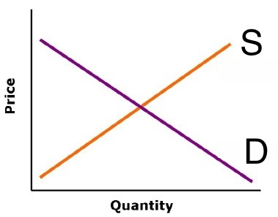
Question 7:
WHAT DOES "S" STAND FOR IN THIS GRAPH?

Slide 9
Question 8:
IN BASEBALL, WHAT EVENT DOES NOT AFFECT YOUR BATTING AVERAGE BUT INCREASES YOUR ON-BASE-PERCENTAGE?

Slide 10
Question 9:
WHAT IS THE SHORTEST TITLE OF A PIXAR FILM?

Slide 11
Question 10:
WHAT DO ALL THESE ANSWERS HAVE IN COMMON?

Slide 12
ANSWERS WILL BE PROVIDED SHORTLY

Slide 13
Question 1:
WHAT TV SHOW IS HUGH LAURIE MOST FAMOUS FOR?
HOUSE

Slide 14
Question 2:
WHAT WORD DO BRITS USE FOR "ELEVATOR"?
LIFT

Slide 15
Question 3:
WHAT 2003 "TORTURE HORROR" FILM AND ITS 7 SEQUELS HAVE MADE OVER $1 BILLION?
SAW

Slide 16
Question 4:
WHAT IS GOOGLE'S VERSION OF MICROSOFT'S "ACCESS" CALLED?
BASE

Slide 17
Question 5:
WHEN WEIGHING GEMSTONES, A CARAT IS 200 mg. WHAT IS 1% OF A CARAT CALLED?
POINT

Slide 18
Question 6:
WHAT DOES THE SECOND "S" STAND FOR IN "ISS"?
(INTERNATIONAL SPACE) STATION

Slide 19
Question 7:
WHAT DOES "S" STAND FOR IN THIS GRAPH?
SUPPLY

Slide 20
Question 8:
IN BASEBALL, WHAT EVENT DOES NOT AFFECT YOUR BATTING AVERAGE BUT INCREASES YOUR ON-BASE-PERCENTAGE?
WALK

Slide 21
Question 9:
WHAT IS THE SHORTEST TITLE OF A PIXAR FILM?
UP

Slide 22
Question 10:
WHAT DO ALL THESE ANSWERS HAVE IN COMMON?
CAN FOLLOW THE WORD "POWER"

