Slide 1
COMMON THREAD

Slide 2
Question 1:
WHAT IS MEASURED IN JOULES?

Slide 3
Question 2:
WHAT ANIMAL IS PICTURED IN THE LOGO OF THE WORLD WIDE FUND FOR NATURE?

Slide 4
Question 3:
WHAT HITCHCOCK FILM SET A NEW LEVEL OF ACCEPTABILITY FOR VIOLENCE, DEVIANT BEHAVIOR, AND SEXUALITY IN AMERICAN MOVIES?

Slide 5
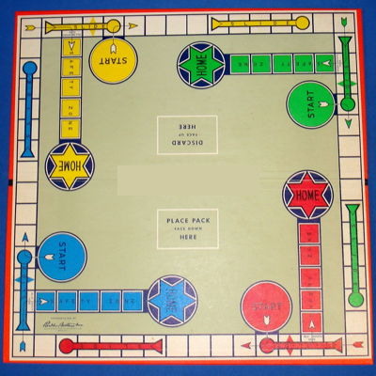
Question 4:
WHAT GAME HAS THIS BOARD?

Slide 6
Question 5:
WHAT 1985 FILM STARS JOHN TRAVOLTA AS A REPORTER AND JAMIE LEE CURTIS AS A WORKOUT INSTRUCTOR?

Slide 7
Question 6:
WHAT IS NICKELBACK'S BEST-SELLING SINGLE, WHICH FEATURES THE VOICE OF BILLY GIBBONS?

Slide 8
Question 7:
WHAT IS THE MOST POPULATED CITY IN THE CARIBBEAN?

Slide 9
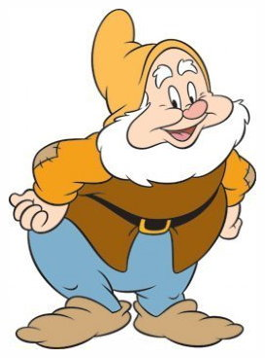
Question 8:
WHICH ONE OF THE SEVEN DWARFS IS THIS?

Slide 10
Question 9:
WHAT IS THE ACRONYM FOR THE CONDITION SOMETIMES KNOWN AS "WINTER DEPRESSION"?

Slide 11
Question 10:
WHAT DO ALL THESE ANSWERS HAVE IN COMMON?

Slide 12
ANSWERS WILL BE PROVIDED SHORTLY

Slide 13
Question 1:
WHAT IS MEASURED IN JOULES?
WORK

Slide 14
Question 2:
WHAT ANIMAL IS PICTURED IN THE LOGO OF THE WORLD WIDE FUND FOR NATURE?
PANDA

Slide 15
Question 3:
WHAT HITCHCOCK FILM SET A NEW LEVEL OF ACCEPTABILITY FOR VIOLENCE, DEVIANT BEHAVIOR, AND SEXUALITY IN AMERICAN MOVIES?
PSYCHO

Slide 16
Question 4:
WHAT GAME HAS THIS BOARD?
SORRY!

Slide 17
Question 5:
WHAT 1985 FILM STARS JOHN TRAVOLTA AS A REPORTER AND JAMIE LEE CURTIS AS A WORKOUT INSTRUCTOR?
PERFECT

Slide 18
Question 6:
WHAT IS NICKELBACK'S BEST-SELLING SINGLE, WHICH FEATURES THE VOICE OF BILLY GIBBONS?
ROCKSTAR

Slide 19
Question 7:
WHAT IS THE MOST POPULATED CITY IN THE CARIBBEAN?
HAVANA

Slide 20
Question 8:
WHICH ONE OF THE SEVEN DWARFS IS THIS?
HAPPY

Slide 21
Question 9:
WHAT IS THE ACRONYM FOR THE CONDITION SOMETIMES KNOWN AS "WINTER DEPRESSION"?
SAD (SEASONAL AFFECTIVE DISORDER)

Slide 22
Question 10:
WHAT DO ALL THESE ANSWERS HAVE IN COMMON?
TITLES OF #1 SONGS IN THE LAST 5 YEARS

