Slide 1
COMMON THREAD

Slide 2
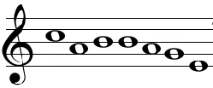
Question 1:
WHAT NOTES ARE THESE?

Slide 3
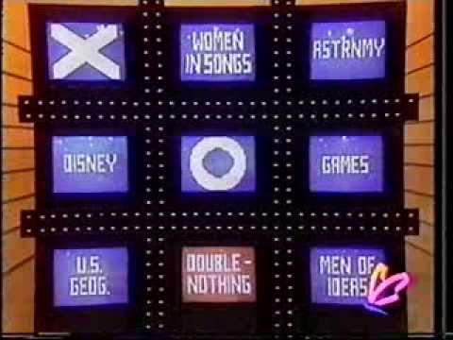
Question 2:
WHAT WAS THE LAST WORD IN THE NAME OF THIS GAME SHOW?

Slide 4
Question 3:
WHAT WAS THE FIRST MATERIAL RECYCLED, IN 9TH CENTURY JAPAN?

Slide 5
Question 4:
WHAT IS THE MOST POPULAR TYPE OF CHEESE IN THE U.K. AND THE SECOND MOST POPULAR IN THE U.S.?

Slide 6
Question 5:
WHAT IS THE NAME OF THE CANINE CENTRAL CHARACTER OF "THE CALL OF THE WILD"?

Slide 7
Question 6:
IN "WALLACE & GROMIT", WHAT FOOD IS WALLACE ESPECIALLY FOND OF?

Slide 8
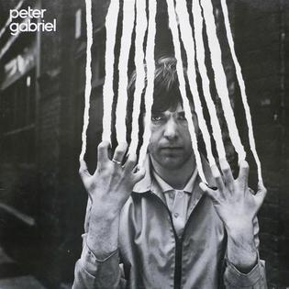
Question 7:
BY WHAT NAME IS THIS PETER GABRIEL ALBUM USUALLY KNOWN?

Slide 9
Question 8:
WHO SANG "GUITAR MAN"?

Slide 10
Question 9:
ON WHAT 12-SEASON TV SHOW DID EMILY DESCHANEL PLAY A FORENSIC ANTHROPOLOGIST?

Slide 11
Question 10:
WHAT DO ALL THESE ANSWERS HAVE IN COMMON?

Slide 12
ANSWERS WILL BE PROVIDED SHORTLY

Slide 13
Question 1:
WHAT NOTES ARE THESE?
CABBAGE

Slide 14
Question 2:
WHAT WAS THE LAST WORD IN THE NAME OF THIS GAME SHOW?
(TIC – TAC –) DOUGH

Slide 15
Question 3:
WHAT WAS THE FIRST MATERIAL RECYCLED, IN 9TH CENTURY JAPAN?
PAPER

Slide 16
Question 4:
WHAT IS THE MOST POPULAR TYPE OF CHEESE IN THE U.K. AND THE SECOND MOST POPULAR IN THE U.S.?
CHEDDAR

Slide 17
Question 5:
WHAT IS THE NAME OF THE CANINE CENTRAL CHARACTER OF "THE CALL OF THE WILD"?
BUCK

Slide 18
Question 6:
IN "WALLACE & GROMIT", WHAT FOOD IS WALLACE ESPECIALLY FOND OF?
CHEESE

Slide 19
Question 7:
BY WHAT NAME IS THIS PETER GABRIEL ALBUM USUALLY KNOWN?
SCRATCH

Slide 20
Question 8:
WHO SANG "GUITAR MAN"?
BREAD

Slide 21
Question 9:
ON WHAT 12-SEASON TV SHOW DID EMILY DESCHANEL PLAY A FORENSIC ANTHROPOLOGIST?
BONES

Slide 22
Question 10:
WHAT DO ALL THESE ANSWERS HAVE IN COMMON?
SLANG TERMS FOR MONEY

