Slide 1
COMMON THREAD

Slide 2
Question 1:
WHAT SEAFARING CHARACTER IS FEATURED IN HERGÉ'S "ADVENTURES OF TIN TIN"?

Slide 3
Question 2:
ACCORDING TO THE NURSERY RHYME, WHO COULD EAT NO FAT?

Slide 4
Question 3:
WHAT IS THE HIGHEST SUMMIT OF THE SOUTHERN FRONT RANGE OF THE ROCKY MOUNTAINS?

Slide 5
Question 4:
WHICH PART OF THE BODY IS STROKED IN ORDER TO TEST THE BABINSKI REFLEX?

Slide 6
Question 5:
WHAT BACTERIA IS BLAMED FOR THE COLLAPSE OF THE AZTEC SOCIETY?

Slide 7
Question 6:
WHAT INSTRUMENT DID GEDDY LEE PLAY FOR RUSH?

Slide 8
Question 7:
WHAT UNSUCCESSFUL SCIENCE FICTION WRITER CHARACTER APPEARS IN 6 OF KURT VONNEGUT'S NOVELS?

Slide 9
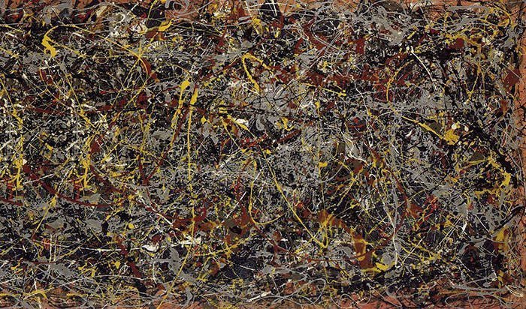
Question 8:
WHO PAINTED THIS PAINTING?

Slide 10
Question 9:
WHAT "SESAME STREET" CHARACTER IS FAMOUS FOR SINGING "I LOVE TRASH"?

Slide 11
Question 10:
WHAT DO ALL THESE ANSWERS HAVE IN COMMON?

Slide 12
ANSWERS WILL BE PROVIDED SHORTLY

Slide 13
Question 1:
WHAT SEAFARING CHARACTER IS FEATURED IN HERGÉ'S "ADVENTURES OF TIN TIN"?
CAPTAIN HADDOCK

Slide 14
Question 2:
ACCORDING TO THE NURSERY RHYME, WHO COULD EAT NO FAT?
JACK SPRAT

Slide 15
Question 3:
WHAT IS THE HIGHEST SUMMIT OF THE SOUTHERN FRONT RANGE OF THE ROCKY MOUNTAINS?
PIKES PEAK

Slide 16
Question 4:
WHICH PART OF THE BODY IS STROKED IN ORDER TO TEST THE BABINSKI REFLEX?
SOLE OF YOUR FEET

Slide 17
Question 5:
WHAT BACTERIA IS BLAMED FOR THE COLLAPSE OF THE AZTEC SOCIETY?
SALMONELLA

Slide 18
Question 6:
WHAT INSTRUMENT DID GEDDY LEE PLAY FOR RUSH?
BASS GUITAR

Slide 19
Question 7:
WHAT UNSUCCESSFUL SCIENCE FICTION WRITER CHARACTER APPEARS IN 6 OF KURT VONNEGUT'S NOVELS?
KILGORE TROUT

Slide 20
Question 8:
WHO PAINTED THIS PAINTING?
JACKSON POLLOCK

Slide 21
Question 9:
WHAT "SESAME STREET" CHARACTER IS FAMOUS FOR SINGING "I LOVE TRASH"?
OSCAR THE GROUCH

Slide 22
Question 10:
WHAT DO ALL THESE ANSWERS HAVE IN COMMON?
CONTAIN NAMES OF FISH

