Slide 1
SURPRISE COMMON THREAD

Slide 2
Question 1:
IN THE COMIC STRIP, WHAT IS THE NAME OF BLONDIE'S HUSBAND?

Slide 3
Question 2:
DURING WHAT DECADE DID REM SLEEP BECOME ASSOCIATED WITH DREAMS? THE 1930'S, 1940'S OR 1950'S?

Slide 4
Question 3:
HOW MANY STARS APPEAR ON THE CITY FLAG OF CHICAGO?

Slide 5
Question 4:
GENESIS CHAPTERS 6-9 IS MOSTLY ABOUT WHAT BIBLICAL CHARACTER?

Slide 6
Question 5:
WHICH ARE LARGER, MALE OR FEMALE EAGLES?

Slide 7
Question 6:
WHAT WAS THE NAME OF THE BAND WHO SANG "MMM MMM MMM MMM"?

Slide 8
Question 7:
WHAT DO THE POLICE FIRE AT FLEEING VEHICLES IN JAPAN?

Slide 9
Question 8:
WHAT IS THE MOST POPULAR ICE CREAM FLAVOR IN THE U.S.?

Slide 10
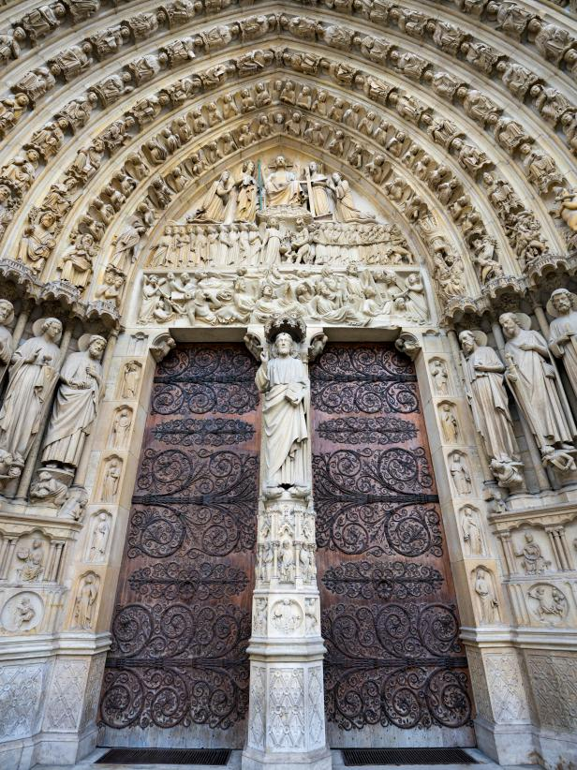
Question 9:
WHAT STRUCTURE HAD THE DOORS BELOW?

Slide 11
Question 10:
SURPRISE! WHAT DO ALL THESE QUESTIONS HAVE IN COMMON?

Slide 12
ANSWERS WILL BE PROVIDED SHORTLY

Slide 13
Question 1:
IN THE COMIC STRIP, WHAT IS THE NAME OF BLONDIE'S HUSBAND?
DAGWOOD

Slide 14
Question 2:
DURING WHAT DECADE DID REM SLEEP BECOME ASSOCIATED WITH DREAMS? THE 1930'S, 1940'S OR 1950'S?
1950'S

Slide 15
Question 3:
HOW MANY STARS APPEAR ON THE CITY FLAG OF CHICAGO?
4

Slide 16
Question 4:
GENESIS CHAPTERS 6-9 IS MOSTLY ABOUT WHAT BIBLICAL CHARACTER?
NOAH

Slide 17
Question 5:
WHICH ARE LARGER, MALE OR FEMALE EAGLES?
FEMALE

Slide 18
Question 6:
WHAT WAS THE NAME OF THE BAND WHO SANG "MMM MMM MMM MMM"?
CRASH TEST DUMMIES

Slide 19
Question 7:
WHAT DO THE POLICE FIRE AT FLEEING VEHICLES IN JAPAN?
PAINT BALLS

Slide 20
Question 8:
WHAT IS THE MOST POPULAR ICE CREAM FLAVOR IN THE U.S.?
VANILLA

Slide 21
Question 9:
WHAT STRUCTURE HAD THE DOORS BELOW?
NOTRE DAME CATHEDRAL

Slide 22
Question 10:
SURPRISE! WHAT DO ALL THESE QUESTIONS HAVE IN COMMON?
THEY CONTAIN NAMES OF MUSICAL GROUPS

