Slide 1
TV SHOW COMMON THREAD

Slide 2
Question 1:
WHAT TV SHOW DID DICK CLARK HOST 1956-1989?

Slide 3
Question 2:
WHAT ABC SOAP OPERA FOLLOWED THE LIVES OF THE LORD FAMILY 1968-2012?

Slide 4
Question 3:
WHAT ABC SOAP OPERA FOLLOWED THE LIVES OF THE CHANDLER AND MARTIN FAMILIES 1970-2011?

Slide 5
Question 4:
ON WHAT 1985-1992 TV SHOW DID WILL SMITH RISE TO FAME?

Slide 6
Question 5:
ON WHAT 2003-2010 TV SHOW DID A TEAM OF COPS INVESTIGATE OLD UNSOLVED MURDERS?

Slide 7
Question 6:
ON WHAT 2014-2020 TV SHOW DID VIOLA DAVIS PLAY A LAW PROFESSOR?

Slide 8
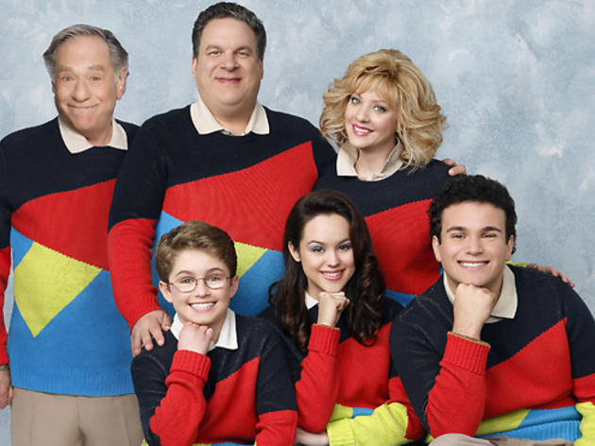
Question 7:
WHAT SHOW HAD THIS CAST?

Slide 9
Question 8:
ON WHAT 1972-1985 ANIMATED TV SHOW DID BILL COSBY VOICE MOST OF THE CHARACTERS?

Slide 10
Question 9:
WHAT SHOW STARRING DANNY DEVITO IS NOW THE LONGEST-RUNNING LIVE-ACTION SITCOM?

Slide 11
Question 10:
WHAT DO ALL THESE TV SHOWS HAVE IN COMMON?

Slide 12
ANSWERS WILL BE PROVIDED SHORTLY

Slide 13
Question 1:
WHAT TV SHOW DID DICK CLARK HOST 1956-1989?
AMERICAN BANDSTAND

Slide 14
Question 2:
WHAT ABC SOAP OPERA FOLLOWED THE LIVES OF THE LORD FAMILY 1968-2012?
ONE LIFE TO LIVE

Slide 15
Question 3:
WHAT ABC SOAP OPERA FOLLOWED THE LIVES OF THE CHANDLER AND MARTIN FAMILIES 1970-2011?
ALL MY CHILDREN

Slide 16
Question 4:
ON WHAT 1985-1992 TV SHOW DID WILL SMITH RISE TO FAME?
THE FRESH PRINCE OF BEL–AIR

Slide 17
Question 5:
ON WHAT 2003-2010 TV SHOW DID A TEAM OF COPS INVESTIGATE OLD UNSOLVED MURDERS?
COLD CASE

Slide 18
Question 6:
ON WHAT 2014-2020 TV SHOW DID VIOLA DAVIS PLAY A LAW PROFESSOR?
HOW TO GET AWAY WITH MURDER

Slide 19
Question 7:
WHAT SHOW HAD THIS CAST?
THE GOLDBERGS

Slide 20
Question 8:
ON WHAT 1972-1985 ANIMATED TV SHOW DID BILL COSBY VOICE MOST OF THE CHARACTERS?
FAT ALBERT AND THE COSBY KIDS

Slide 21
Question 9:
WHAT SHOW STARRING DANNY DEVITO IS NOW THE LONGEST-RUNNING LIVE-ACTION SITCOM?
IT'S ALWAYS SUNNY IN PHILADELPHIA

Slide 22
Question 10:
WHAT DO ALL THESE TV SHOWS HAVE IN COMMON?
SET IN PENNSYLVANIA

