Slide 1
SAME INITIALS

Slide 2
Question 1:
WHO WON 2 EMMYS FOR HIS ROLE ON "BOSTON LEGAL", BUT IS MUCH BETTER KNOWN FOR HIS ROLE ON THE ORIGINAL SERIES OF "STAR TREK"?

Slide 3
Question 2:
WHO PLAYED THE TITLE CHARACTER IN THE "BLADE" TRILOGY?

Slide 4
Question 3:
WHO IS THE ONLY ACTOR TO HAVE 8 CONSECUTIVE FILMS GROSS $100 MILLION DOMESTICALLY?

Slide 5
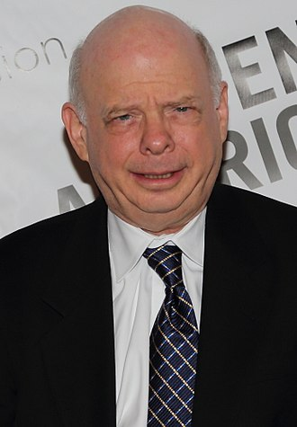
Question 4:
NAME THIS ACTOR FROM "THE PRINCESS BRIDE" AND "YOUNG SHELDON"?

Slide 6
Question 5:
WHOSE PLAYS ARE PERFORMED MORE THAN ANY OTHER PLAYWRIGHT?

Slide 7
Question 6:
WHAT 1962-1982 LEFT-FIELDER HELPED THE PITTSBURGH PIRATES WIN 2 WORLD SERIES?

Slide 8
Question 7:
THE 2 MOST POPULAR BLACK FEMALE COMICS ARE WHOOPIE GOLDBERG AND WHO?

Slide 9
Question 8:
WHAT PUZZLE MAKER EDITS THE NEW YORK TIMES CROSSWORD PUZZLE?

Slide 10
Question 9:
WHAT SCOTTISH NOVELIST WROTE "IVANHOE" AND "ROB ROY"?

Slide 11
Question 10:
WHO SERVED AS LINCOLN'S SECRETARY OF STATE, NEGOTIATING THE PURCHASE OF ALASKA IN 1867?

Slide 12
The End
Answers will be provided shortly

Slide 13
Question 1:
WHO WON 2 EMMYS FOR HIS ROLE ON "BOSTON LEGAL", BUT IS MUCH BETTER KNOWN FOR HIS ROLE ON THE ORIGINAL SERIES OF "STAR TREK"?
WILLIAM SHATNER

Slide 14
Question 2:
WHO PLAYED THE TITLE CHARACTER IN THE "BLADE" TRILOGY?
WESLEY SNIPES

Slide 15
Question 3:
WHO IS THE ONLY ACTOR TO HAVE 8 CONSECUTIVE FILMS GROSS $100 MILLION DOMESTICALLY?
WILL SMITH

Slide 16
Question 4:
NAME THIS ACTOR FROM "THE PRINCESS BRIDE" AND "YOUNG SHELDON"?
WALLACE SHAWN

Slide 17
Question 5:
WHOSE PLAYS ARE PERFORMED MORE THAN ANY OTHER PLAYWRIGHT?
WILLIAM SHAKESPEARE

Slide 18
Question 6:
WHAT 1962-1982 LEFT-FIELDER HELPED THE PITTSBURGH PIRATES WIN 2 WORLD SERIES?
WILLIE STARGELL

Slide 19
Question 7:
THE 2 MOST POPULAR BLACK FEMALE COMICS ARE WHOOPIE GOLDBERG AND WHO?
WANDA SYKES

Slide 20
Question 8:
WHAT PUZZLE MAKER EDITS THE NEW YORK TIMES CROSSWORD PUZZLE?
WILL SHORTZ

Slide 21
Question 9:
WHAT SCOTTISH NOVELIST WROTE "IVANHOE" AND "ROB ROY"?
WALTER SCOTT

Slide 22
Question 10:
WHO SERVED AS LINCOLN'S SECRETARY OF STATE, NEGOTIATING THE PURCHASE OF ALASKA IN 1867?
WILLIAM SEWARD

