Slide 1
STARTS WITH X

Slide 2
Question 1:
WHAT IS THE ONLY CHEMICAL ELEMENT THAT STARTS WITH X?

Slide 3
Question 2:
WHAT IS THE ONLY GREEK LETTER THAT STARTS WITH X?

Slide 4
Question 3:
WHAT MUSICAL INSTRUMENT'S NAME COMES FROM GREEK, MEANING "SOUND OF WOOD"?

Slide 5
Question 4:
HOW DO YOU WRITE 98 IN ROMAN NUMERALS?

Slide 6
Question 5:
WHAT IS THE WOODY PART OF PLANTS CALLED?

Slide 7

Question 6:
WHAT COMPANY HAS THIS LOGO?

Slide 8
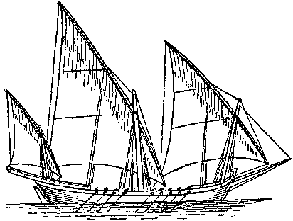
Question 7:
WHAT SORT OF MEDITERRANEAN SAILING SHIP WAS THIS?

Slide 9
Question 8:
WHAT IS THE BRAND NAME OF THE DRUG ALPRAZOLAM?

Slide 10
Question 9:
WHAT ACTUAL KING OF PERSIA 486-465 BC WAS PORTRAYED AS THE ANTAGONIST OF THE HISTORICAL FANTASY FILM "300"?

Slide 11
Question 10:
WHAT WARRIOR PRINCESS DID LUCY LAWLESS PORTRAY ON TV 1995-2001?

Slide 12
ANSWERS WILL BE PROVIDED SHORTLY

Slide 13
Question 1:
WHAT IS THE ONLY CHEMICAL ELEMENT THAT STARTS WITH X?
XENON

Slide 14
Question 2:
WHAT IS THE ONLY GREEK LETTER THAT STARTS WITH X?
XI

Slide 15
Question 3:
WHAT MUSICAL INSTRUMENT'S NAME COMES FROM GREEK, MEANING "SOUND OF WOOD"?
XYLOPHONE

Slide 16
Question 4:
HOW DO YOU WRITE 98 IN ROMAN NUMERALS?
XCVIII

Slide 17
Question 5:
WHAT IS THE WOODY PART OF PLANTS CALLED?
XYLEM

Slide 18
Question 6:
WHAT COMPANY HAS THIS LOGO?
XEROX

Slide 19
Question 7:
WHAT SORT OF MEDITERRANEAN SAILING SHIP WAS THIS?
XEBEC

Slide 20
Question 8:
WHAT IS THE BRAND NAME OF THE DRUG ALPRAZOLAM?
XANAX

Slide 21
Question 9:
WHAT ACTUAL KING OF PERSIA 486-465 BC WAS PORTRAYED AS THE ANTAGONIST OF THE HISTORICAL FANTASY FILM "300"?
XERXES

Slide 22
Question 10:
WHAT WARRIOR PRINCESS DID LUCY LAWLESS PORTRAY ON TV 1995-2001?
XENA

