Slide 1
TOP

Slide 2
Question 1:
IN THE MOVIE "TOP GUN", VAL KILMER'S CHARACTER IS NICKNAMED "ICEBERG". WHAT IS THE NICKNAME OF TOM CRUISE'S CHARACTER?

Slide 3
Question 2:
WHO PLAYS LEAD GUITAR FOR ZZ TOP?

Slide 4
Question 3:
WHAT DANCING COUPLE THAT DID 10 MUSICAL FILMS TOGETHER STARRED IN THE 1935 FILM "TOP HAT"?

Slide 5
Question 4:
TOP, BOTTOM, UP, DOWN, STRANGE, AND CHARM ARE THE 6 TYPES OF WHAT?

Slide 6
Question 5:
IN THE U.S. ARMY, WHAT RANK IS COMMONLY NICKNAMED "TOP" BECAUSE IT IS AT THE TOP OF A COMPANY'S ENLISTED RANKS?

Slide 7
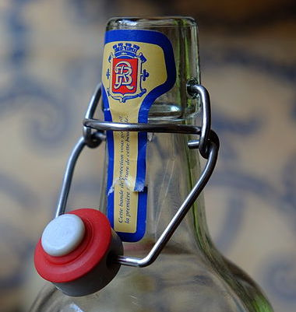
Question 6:
WAS THE "FLIP-TOP" INVENTED IN THE 18TH, 19TH, OR 20TH CENTURY?

Slide 8
Question 7:
MANY GROUPS HAVE SONGS TITLED "TOP OF THE WORLD", BUT ONLY ONE MADE IT TO THE TOP OF CHARTS, IN 1972. WHO SANG THAT SONG?

Slide 9
Question 8:
"ROCKY TOP" IS ONE OF THE 10 OFFICIAL STATE SONGS OF WHAT U.S. STATE?

Slide 10
Question 9:
THE ACTION FILMS "TOP DOG" AND "OVER THE TOP" BOTH STARRED 1 OF CHUCK NORRIS AND SYLVESTER STALLONE. WHICH ONE WAS NORRIS IN?

Slide 11
Question 10:
STOVE TOP INSTANT STUFFING WAS FIRST AVAILABLE IN WHAT DECADE? THE 50'S, 60'S OR 70'S?

Slide 12
The End
Answers will be provided shortly

Slide 13
Question 1:
IN THE MOVIE "TOP GUN", VAL KILMER'S CHARACTER IS NICKNAMED "ICEBERG". WHAT IS THE NICKNAME OF TOM CRUISE'S CHARACTER?
MAVERICK

Slide 14
Question 2:
WHO PLAYS LEAD GUITAR FOR ZZ TOP?
BILLY GIBBONS

Slide 15
Question 3:
WHAT DANCING COUPLE THAT DID 10 MUSICAL FILMS TOGETHER STARRED IN THE 1935 FILM "TOP HAT"?
FRED ASTAIRE & GINGER ROGERS

Slide 16
Question 4:
TOP, BOTTOM, UP, DOWN, STRANGE, AND CHARM ARE THE 6 TYPES OF WHAT?
QUARK

Slide 17
Question 5:
IN THE U.S. ARMY, WHAT RANK IS COMMONLY NICKNAMED "TOP" BECAUSE IT IS AT THE TOP OF A COMPANY'S ENLISTED RANKS?
(FIRST) SERGEANT

Slide 18
Question 6:
WAS THE "FLIP-TOP" INVENTED IN THE 18TH, 19TH, OR 20TH CENTURY?
19TH

Slide 19
Question 7:
MANY GROUPS HAVE SONGS TITLED "TOP OF THE WORLD", BUT ONLY ONE MADE IT TO THE TOP OF CHARTS, IN 1972. WHO SANG THAT SONG?
THE CARPENTERS

Slide 20
Question 8:
"ROCKY TOP" IS ONE OF THE 10 OFFICIAL STATE SONGS OF WHAT U.S. STATE?
TENNESSEE

Slide 21
Question 9:
THE ACTION FILMS "TOP DOG" AND "OVER THE TOP" BOTH STARRED 1 OF CHUCK NORRIS AND SYLVESTER STALLONE. WHICH ONE WAS NORRIS IN?
TOP DOG

Slide 22
Question 10:
STOVE TOP INSTANT STUFFING WAS FIRST AVAILABLE IN WHAT DECADE? THE 50'S, 60'S OR 70'S?
70'S

