Slide 1
THE FACES OF WHAT TWO MALE CELEBRITIES HAVE BEEN COMBINED IN THESE IMAGES? (½ POINT FOR ONE)

Slide 2
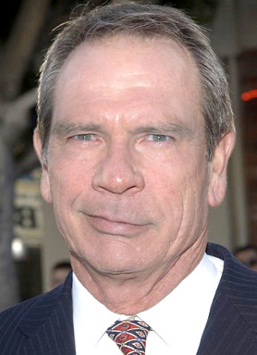
Question 1:

Slide 3
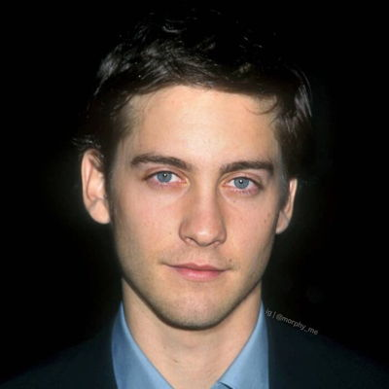
Question 2:

Slide 4
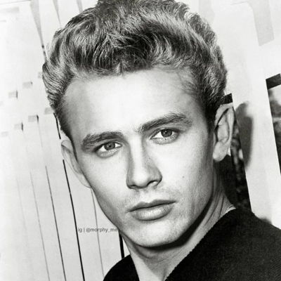
Question 3:

Slide 5
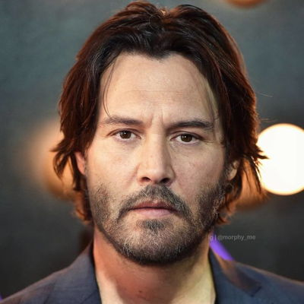
Question 4:

Slide 6
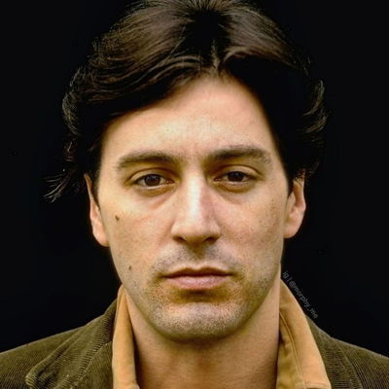
Question 5:

Slide 7
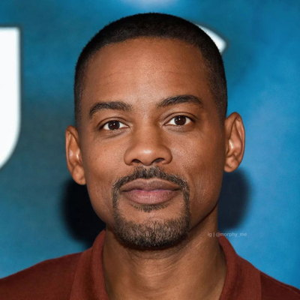
Question 6:

Slide 8
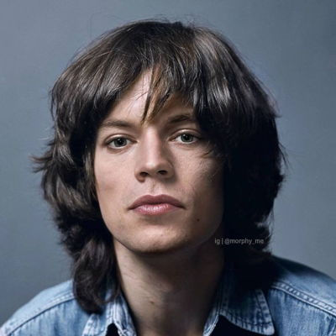
Question 7:

Slide 9
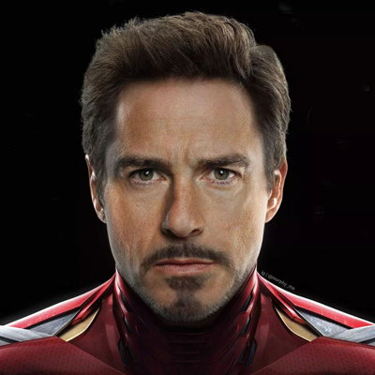
Question 8:

Slide 10
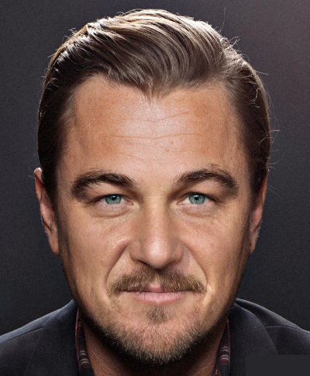
Question 9:

Slide 11
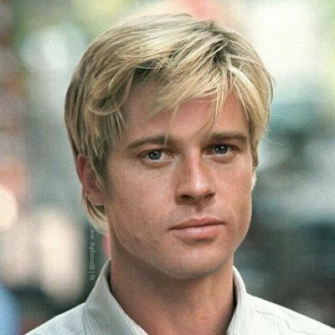
Question 10:

Slide 12
ANSWERS WILL BE PROVIDED SHORTLY

Slide 13
Question 1:
TOMMY LEE JONES & HARRISON FORD

Slide 14
Question 2:
TOBEY MAGUIRE & JAKE GYLLENHAAL

Slide 15
Question 3:
JAMES DEAN & JAMES FRANCO

Slide 16
Question 4:
KEANU REEVES & JOHNNY DEPP

Slide 17
Question 5:
ROBERT DE NIRO & AL PACINO

Slide 18
Question 6:
WILL SMITH & CHRIS ROCK

Slide 19
Question 7:
MICK JAGGER & HARRY STYLES

Slide 20
Question 8:
ROBERT DOWNEY JR & TOM CRUISE

Slide 21
Question 9:
LEONARDO DICAPRIO & SEAN PENN

Slide 22
Question 10:
BRAD PITT & ROBERT REDFORD

