Slide 1
CIS 6180: Final Project Presentation
Eye Tracking Event Detection and Classification
By Erich MacLean, B. ENG
emacle05@uoguelph.ca

Slide 2
Introduction
What is eye tracking?
How is eye tracking performed?
What can be measured using eye tracking?
What is eye tracking used for?
Notes:
Eye tracking is a technology that is used to measure the movement and position of the eye. Eye tracking can be used to obtain a variety of information, including where someone is looking. Typically, these technologies are used in research and healthcare industries, but can also be used in applications such as gaming headsets or in automotive applications.

Slide 3
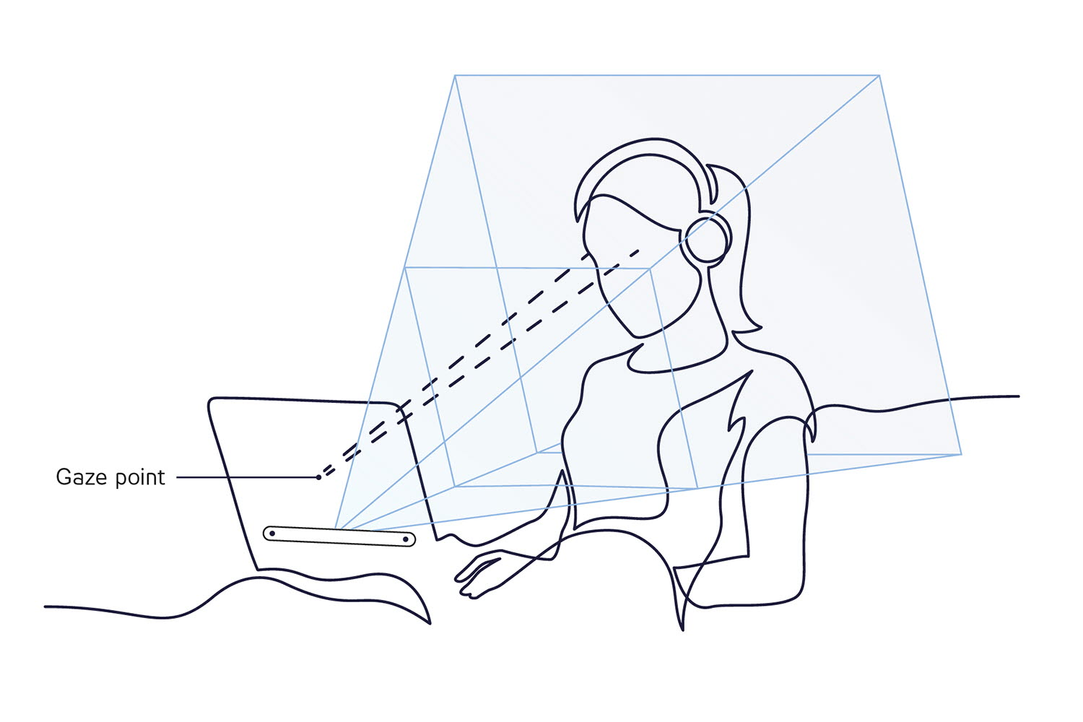
Pupil-Corneal Reflection
Notes:
This point in space is also known as the gaze point. The gaze point is either a point in 2D space or 3D space depending on the type of eye tracking performed.

Slide 4
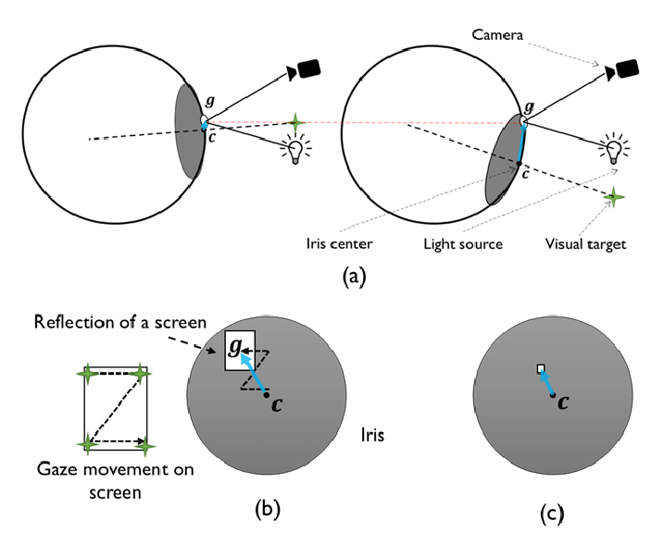
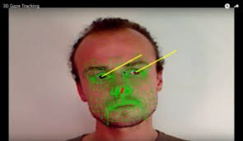
Eye Tracking Methods
Notes:
Eye tracking uses camera and sensor-based technology to perform these measurements. Camera-based eye tracking attempts to capture the location of the pupil relative to facial features, whereas sensor-based methods will measure the distance from the pupil to the outer membrane of the eye, also known as the cornea, to find where a person’s gaze is directed. We can use this gaze point, including the start and end locations of the gaze from each eye to engineer new features.

Slide 5
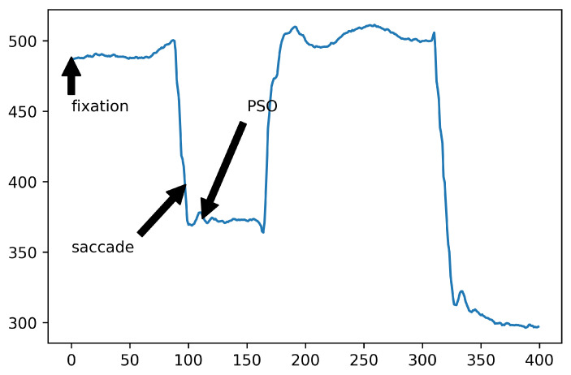
Eye Tracking Events
Fixations
Saccades
Post-saccadic oscillations
Glissades
Ocular drifts
Smooth pursuit
Notes:
Common features in literature and eye tracking research are fixations, which is when the eyes converge onto a single target for a certain amount of time, or a saccade, which is when the eyes move between fixations. There are other types of events as well, such as post saccadic oscillations, which is when the eye overshoots the target of fixation and must correct itself. There are glissades where the eye undershoots the target of fixation. There are several other types as well that depend on external factors such as head movement or the movement of the target that is fixated upon, but fixations and saccades are the main event types.

Slide 6
Problem Statement
Develop an unsupervised machine learning pipeline that will take raw gaze data and attempt to classify eye tracking events
Notes:
The two main events, fixations and saccades are often determined using threshold techniques, using either the speed of the eye movement or the distance travelled between two points in time in the eye tracking. This provides a variable ground truth for eye tracking techniques based on the threshold that is used. Rather than using supervised machine learning to classify based on these threshold-based rules, unsupervised machine learning will be implemented to make predictions of eye tracking events. Success of the models will be determined by comparing to different threshold classifications.

Slide 7
Dataset
B. Caren, E. Ziraldo.“Comparing Visual Fixations between Initially Stopped and In-motion Turn Across Path Hazards”, Society of Automotive Engineers. 04/11/2023.
DRiVE Lab, University of Guelph
72 Participants
20000 Records per Participant
21 Raw Data Features
Notes:
The Dataset used is an eye tracking set from B. Caren and E. Ziraldo from the University of Guelph DRiVE lab. In the study that was conducted, 72 participants operated a full body vehicle simulator while wearing eye tracking glasses. Each drive was 15 minutes long, and the glasses recorded roughly 20000 records per participant at around 60Hz. The data contained includes a time stamp for the record, gaze position in 2D, gaze position in 3D, Gaze origin for the left and right eyes, gaze direction for left and right eyes, and the pupil diameter for the left and right eyes. This is roughly 1.5 million records included in the dataset, which totals to be 754 megabytes.
https://trid.trb.org/view/2156115

Slide 8
Preprocessing
Excel Files
Pandas and PySpark
Missing values
Time stamp organization
pyspark.pandas API
Exploratory Data Analysis
Presplit Training, Testing and Validation
Notes:
In terms of the preprocessing of this data, all the files are Excel format. Pandas is used to read in the dataset initially. Interpolation is used to fill in any null values in the dataset, which is the most common technique in literature for this type of data. To properly classify the eye tracking events, the time stamps need to be merged onto the records so that every two records, overlapping, are on the same row of the dataframe. Then the data is converted to a PySpark dataframe. The PySpark implementation uses pyspark.pandas, which just overlays PySpark with the pandas API. Once this is done, the EDA is performed on the dataset. It is important to note that for the nature of the participant-based distribution of this dataset, the participants are randomly, but presplit into training, testing and validation. This ensures reproducible results and avoids leakage in the dataset between the three categories.

Slide 9
Modelling
Unsupervised Models:
K-Means
Fuzzy C-Means
PCA
Training Data 70%
Test Data 15 %
Validation Data 15%
Threshold Techniques (I-VT, I-DT)
Notes:
Because the purpose of this project is to compare the performance of the unsupervised models not to themselves but to the threshold techniques, only a small selection of models were chosen. These models were selected based on the type, and on their performance for unsupervised models. All three models have good performance. The algorithm was trained using a train test validate split of 70-15-15. This can be used because there is a significant amount of data available to train and evaluate the model without requiring any form of cross validation techniques. The other factor in the modelling was applying the speed (I-VT) and distance (I-DT) thresholds to the data. In this case, the models were compared to a speed threshold of 0.5 pixels/second, and a distance threshold of 1 degree.

Slide 10
EDA Results

Slide 11
Machine Learning Results

Slide 12
Conclusions

