Slide 1
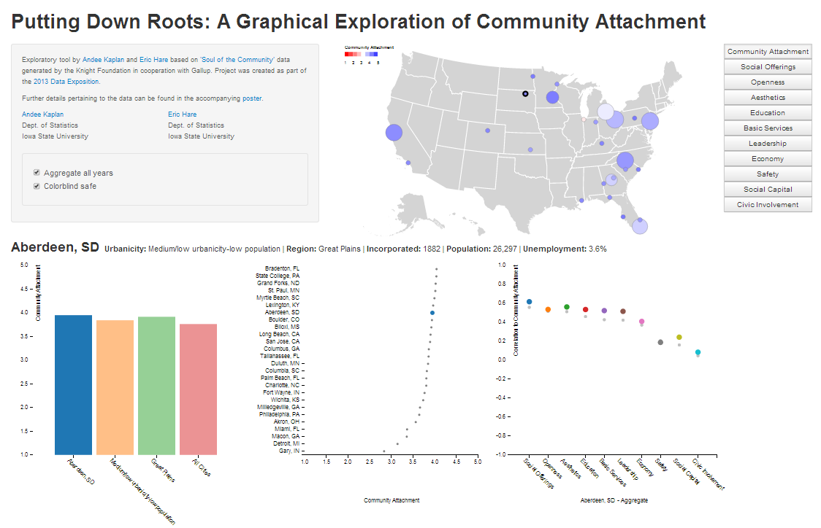
1
2
3

Slide 2
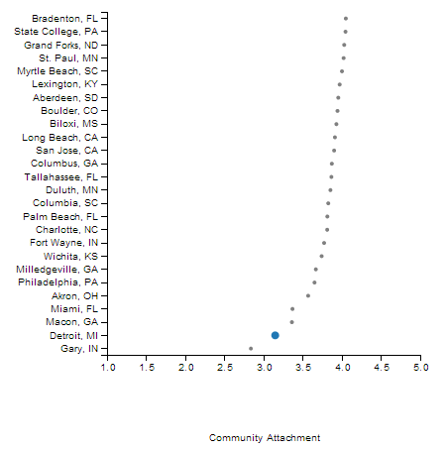
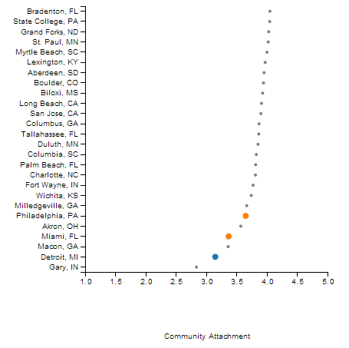
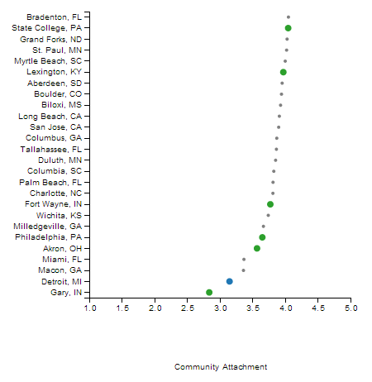
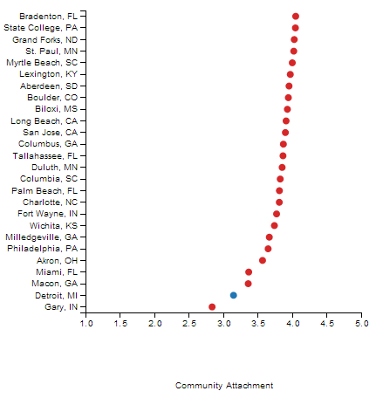
1
2
3
4

Slide 3

Server Side
Client Side
Interactive Tool
User Controls
D3
javascript
(general)
Shiny
Binding
Binding
Shiny
plyr, reshape2
rjson
Data formatting

