Slide 1
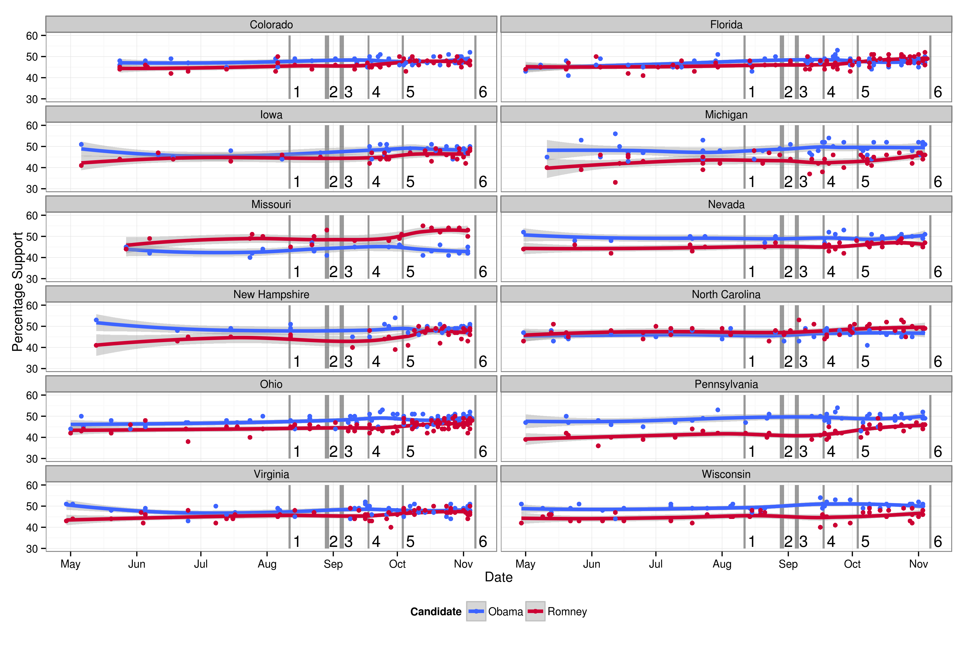
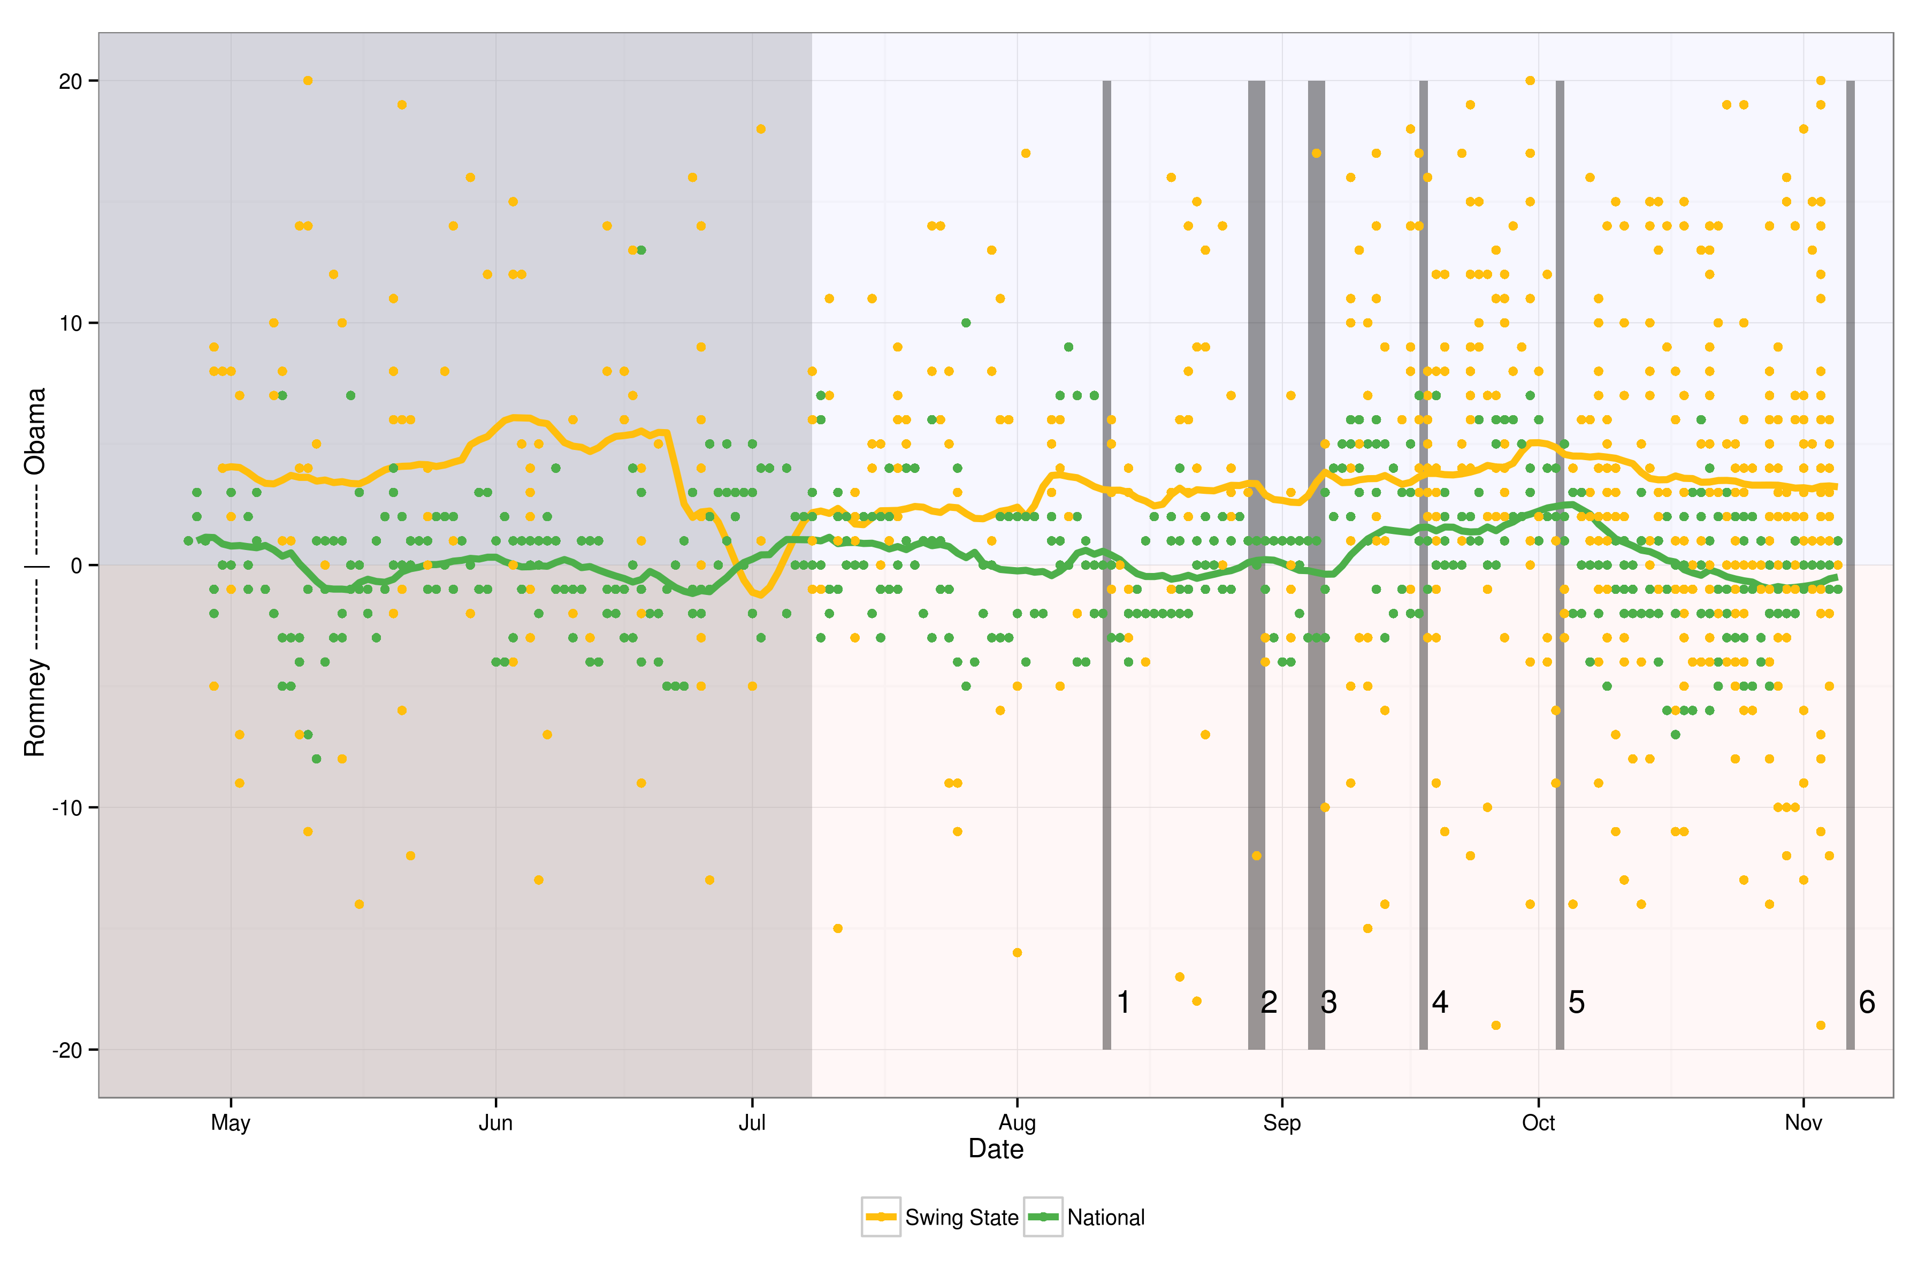
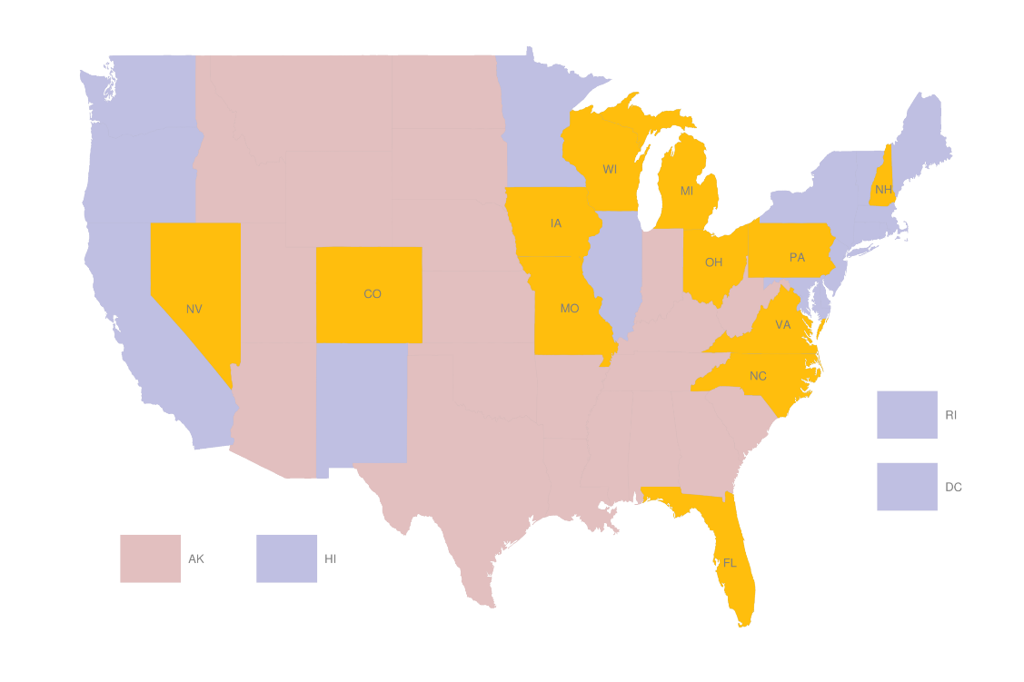
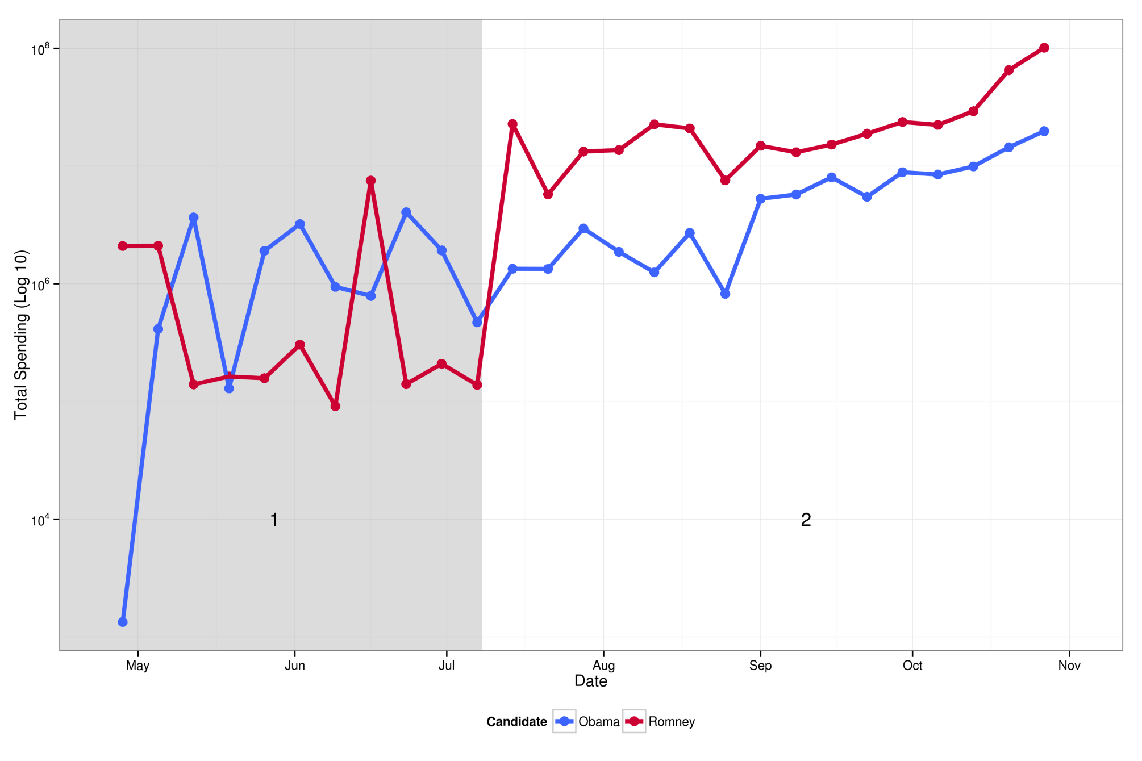
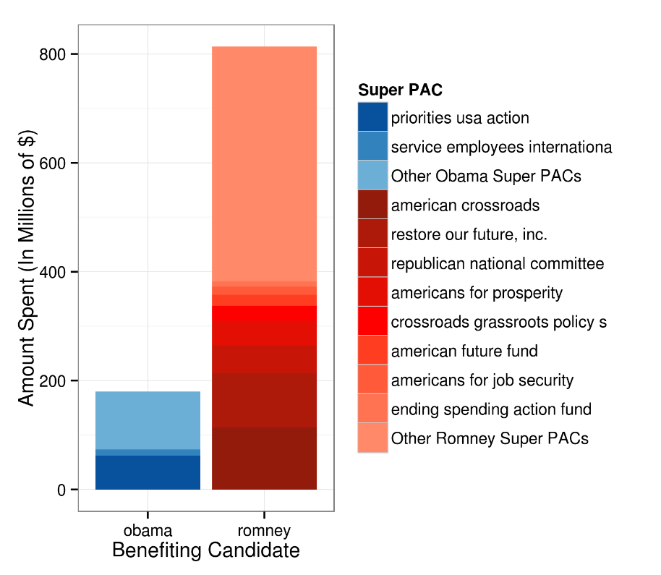
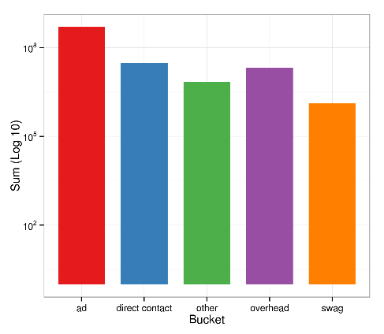
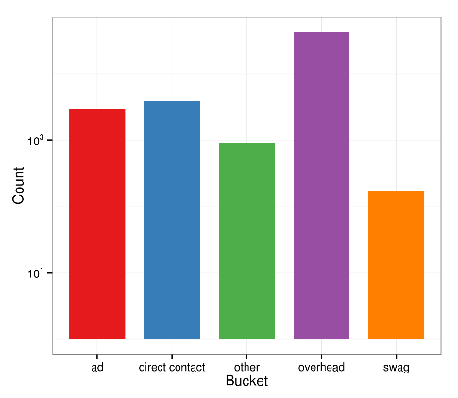
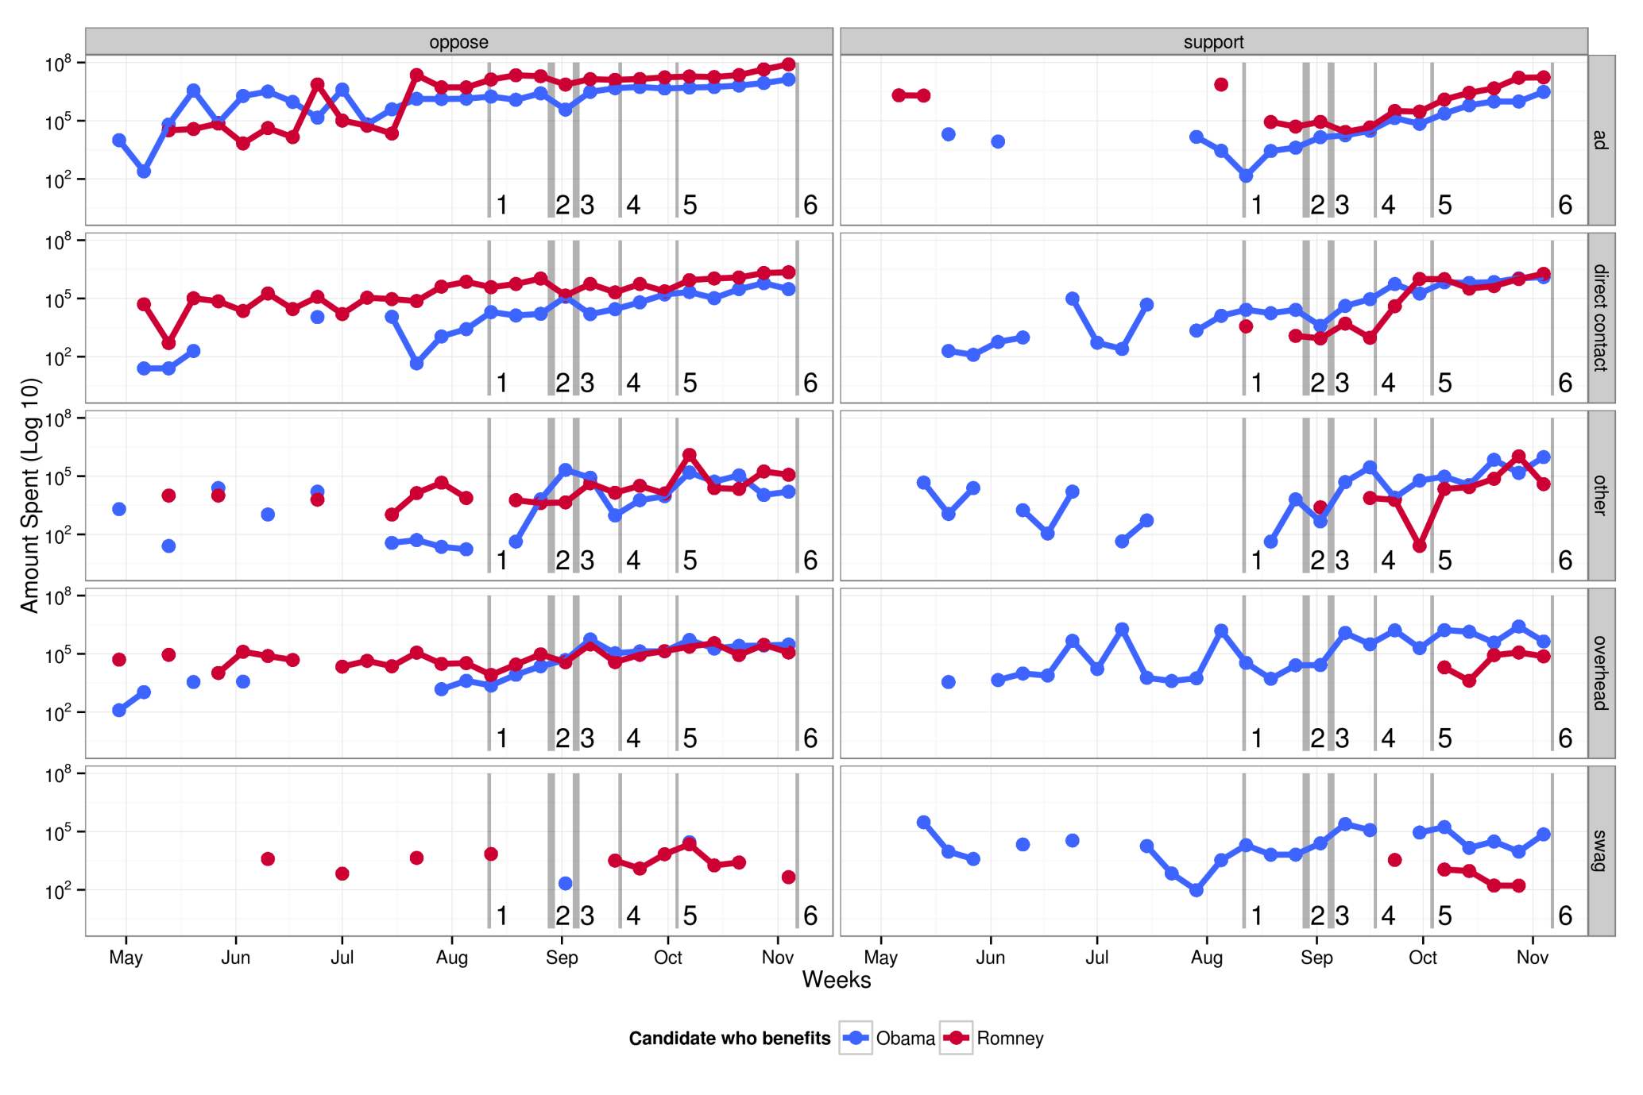
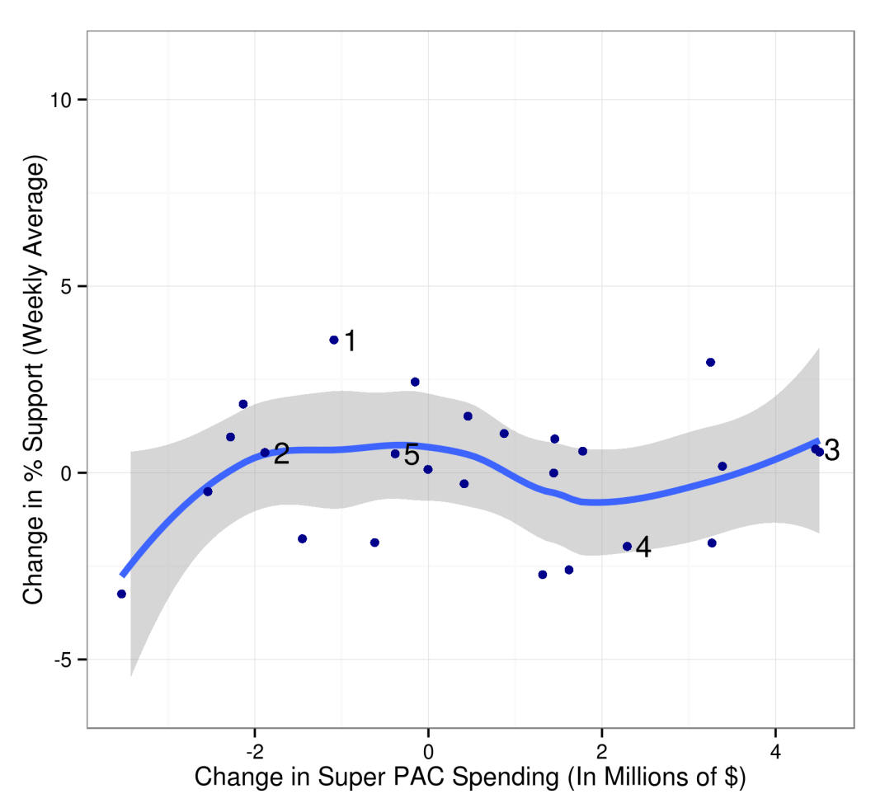
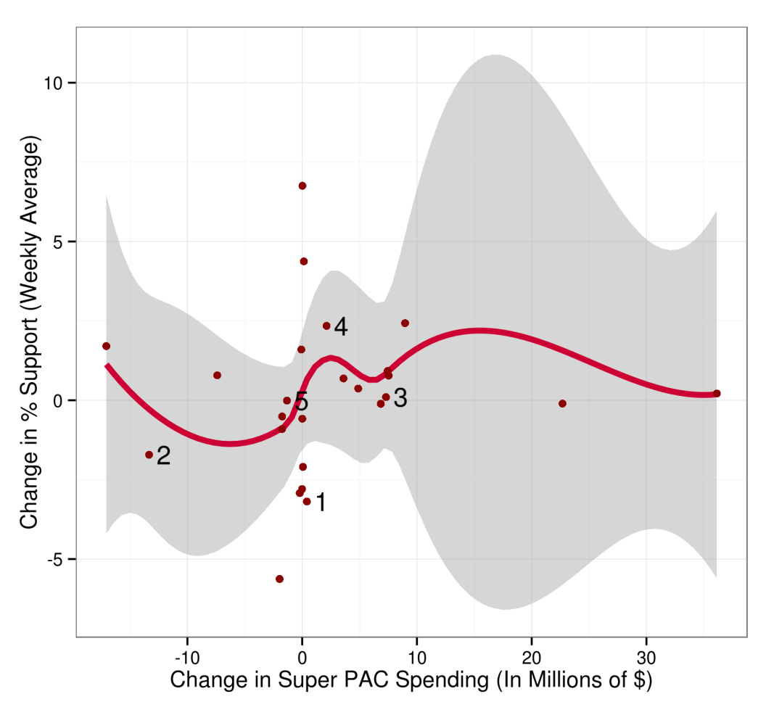
Can You Buy a President? Politics After the Tillman Act
Eric Hare, Andee Kaplan, Heike Hofmann, Dianne Cook
Department of Statistics, Iowa State University
Introduction
Polling and Spending Analysis
Results
The 2010 Citizens United ruling ushered in a new era of election campaign spending by allowing Super PACs to spend an almost limitless amount. What was the nature of this spending, and how did it impact the results of the election?
Polling by Swing State
The plot on the right displays polling averages for Mr. Obama and Mr. Romney by swing state. Important events are indicated on the plot as follows:
Paul Ryan VP selection
(2) Republican National Convention
(3) Democratic National Convention
(4) 47% video leaked
(5) ﬁrst presidential debate
(6) election day.
Background
Swing States
Our spending analysis focuses on the country as a whole, as well as several swing states from the 2012 Election. The swing states are highlighted in yellow in the map below.
Spending by Candidate
The left plot displays total weekly spending by Super PACs, on a log scale, benefitting each candidate. The shaded region (1) indicates a period of lower spending by the Romney-benefitting Super PACs. Note the Obama-benefitting Super PACs’ relatively steady spending throughout both the early shaded and later non-shaded region.
The right plot shows the total spending by the top Super PACs split by candidate. The cumulative amounts spent are displayed vertically, by the benefiting candidate.
Effect of Spending on Polling
Above we can see the polling margin (Obama - Romney) over time, colored by swing states versus the national polls. The six event markers previously used are displayed. It can be seen that Mr. Obama consistently maintained an advantage in swing states relative to his national numbers
The shaded region from the Spending by Candidate plot is displayed once again. It does not seem that this spending increase had a measurable eﬀect on the overall trend in the polls at this time.
Buckets
We’ve identified different categories of spending and grouped them into what we call Buckets. The buckets are:
Ad | Advertisement spending, including television, radio, and online
Direct Contact | Direct voter contact, such as canvassing
Overhead | Expenditures related to the ongoing cost of running an Super PAC, including salary, rent, consultants, fundraising, and travel
Swag | Clothing, signs, and other promotional material
Other | All expenses that do not ﬁt into the above buckets
Conclusion
Spending by Bucket
This plot displays the total weekly spending by Super PACs in support or opposition of the two candidates. The six event markers are indicated as in the Polling by Swing State plot above.
It can be observed that the Romney-benefitting Super PACs maintained a consistently higher level of opposition advertisement spending, while the Obama-benefitting Super PACs tended to spend more on overhead and swag.
Ultimately, our ﬁndings suggest that it is not clear whether the existence of Super PACs had a measurable impact on the outcome of the presidential race. Instead, the events that garnered large amounts of media coverage, such as the 47% video and the ﬁrst presidential debate, seem to have had the most noticeable eﬀect on the polling.
Tools
R
Packages: XML, ggplot2, plyr, reshape2, lubridate, scales, RColorBrewer, zoo, forecast
Ad Advertisement spending, including television, radio, and online
Direct Contact Direct voter contact, such as canvassing
Overhead Expenditures related to the ongoing cost of running an Super PAC, including salary, rent, consultants, fundraising, and travel
Swag Clothing, signs, and other promotional material
Other All expenses that do not ﬁt into the above buckets

