Slide 1
Tuning Ohai

Slide 2
Objectives
After completing this module, you should be able to:
Describe how you configure the node to automatically load ohai plugins
Describe how to enable ohai hints
Describe how to remove plugins that you do not want executed
Describe where you can find more information about better Ohai performance
Notes:
There are some ways that you can go about running ohai a bit smoother, we’re going to describe how you would be able to configure the node to automatically load ohai plugins and enable hints on those nodes. We are also able to remove plugins that we don’t want to be executed on the node. Last we’ll point you to some information about how to get better performance out of ohai.

Slide 3
Run Ohai Smoother
There are a few more things to learn about Ohai that could help increase performance.
Configure the node to automatically load ohai plugins
Enable ohai hints
Remove plugins that you do not want executed
Choose only the plugins you want executed
Notes:
So this section is going to going to give you some information on how to better set up ohai.

Slide 4
Node Configuration File
All nodes have a configuration file that contain details about node, overrides, and other data. This is the client.rb file on the node.
Notes:
The node configuration file for how ohai is supposed to run with chef-client is found within the client.rb file.

Slide 5
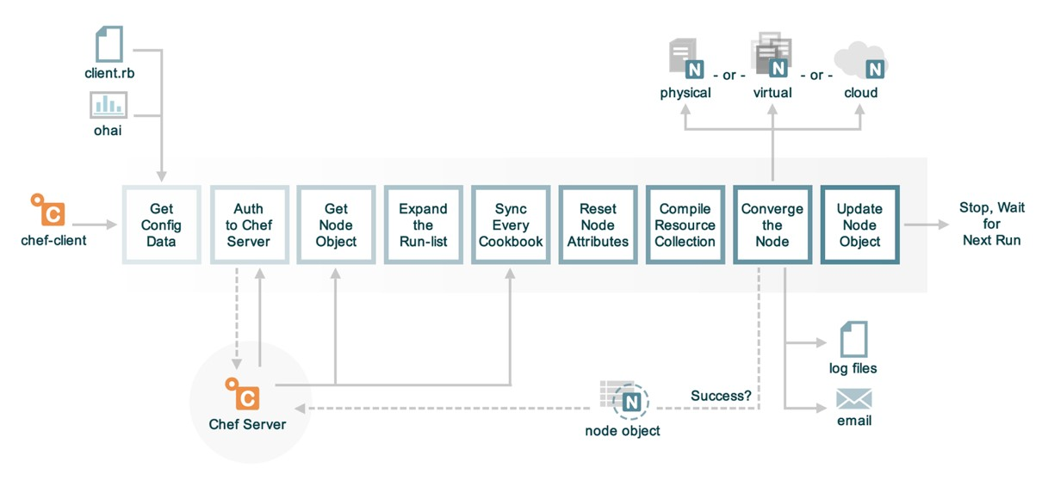
The Anatomy of a chef-client Run
Notes:
So this node configuration file, the client.rb is loaded at the beginning of every chef-client run. It is the master file for the chef-client run, and you can define it using a template if you so desire, using the chef-client cookbook.

Slide 6
chef-client cookbook
The chef-client cookbook contains a number of useful recipes:
service (default)
Run chef-client as a service, converging at a periodic interval
delete_validation
Remove the organization validation key [SECURITY ISSUE]
config
Define node configuration
https://supermarket.chef.io/cookbooks/chef-client
Notes:
The chef-client cookbook itself is a configuration cookbook to set up the chef-client as a service. Meaning that it runs on some regular schedule, it allows you to configure this easily. The service recipe, or default recipe, calls chef-client as a service causing the node to converge on a periodic interval.

Slide 7
Viewing the chef-client config Recipe
~/cookbooks/chef-client/recipes/config.rb
# ... OTHER RESOURCES ...
template "#{node['chef_client']['conf_dir']}/client.rb" do
source 'client.rb.erb'
owner d_owner
group node['root_group']
mode '0644'
variables(
chef_config: node['chef_client']['config'],
chef_requires: chef_requires,
ohai_disabled_plugins: node['ohai']['disabled_plugins'],
start_handlers: node['chef_client']['config']['start_handlers'],
report_handlers: node['chef_client']['config']['report_handlers'],
exception_handlers: node['chef_client']['config']['exception_handlers']
)
Notes:
Source code for chef-client cookbook: https://github.com/chef-cookbooks/chef-client
Link to chef-client::config.rb https://github.com/chef-cookbooks/chef-client/blob/master/recipes/config.rb
Within this cookbook there is also a recipe called config. This recipe can be used to configure the client.rb file. This config.rb file will create the client.rb file from a template and notice the variables that can be passed into that template. If I want to have a template for that client.rb file I can pass in variables that can configure things like ohai. In particular, you can disable certain ohai plugins using the ohai_disabled_plugins variable. All you will need to do is call this config.rb recipe, and make sure that you have defined a node attribute called ‘ohai/disabled_plugins’.

Slide 8
Investigate client.rb.erb
~/cookbooks/chef-client/templates/default/client.rb.erb
# ... OTHER STATEMENTS ...
<% unless node["ohai"]["plugin_path"].nil? -%>
ohai.plugin_path << "<%= node["ohai"]["plugin_path"] %>"
<% end -%>
<% unless @ohai_disabled_plugins.empty? -%>
ohai.disabled_plugins = [<%= @ohai_disabled_plugins.map { |k| k.match(/:/) ? k.gsub(/^:/, '').to_sym.inspect : k.inspect }.join(",") %>]
<% end -%>
# ... OTHER STATEMENTS ...
Notes:
You can also set things like the plugin path, which is usually within that /etc/chef/ohai directory.

Slide 9
The Work
Add the chef-client cookbook to your cookbook collection
Provide attributes in a wrapper cookbook, role, or environment for:
node['ohai']['plugin_path']
Add chef-client cookbook to every node's run list
Notes:
With the combination of this template, you can go in and adjust things like where chef keeps plugins, and also what plugins should be disabled.

Slide 10
Run Ohai Smoother
There are a few more things to learn about Ohai that could help increase performance.
Configure the node to automatically load ohai plugins
Enable ohai hints
Remove plugins that you do not want executed
Choose only the plugins you want executed

Slide 11
Not all Node Plugins are Executed
Some of the plugins will not automatically run against your node. This is particularly true of the cloud provider plugins. As the node does not often know the environment in which is being run.
Notes:
Now, not all ohai plugins are going to be executed automatically. The reason for this is that the node is often not going to know the environment that is it is going to be run.

Slide 12
Ohai Hints
For those plugins that are not executed you can leave them a hint file that will ensure they are executed.
Notes:
The way that we can force a plugin to run is using ohai hints. These are things that are typically packaged with ohai and just need to be enabled. Although you can write your own ohai hints as well.

Slide 13
The Work
Add the ohai cookbook to your cookbook collection
Define a recipe that uses the ohai cookbook's ohai_hint resource
Add this recipe to every node's run list
https://github.com/chef-cookbooks/ohai
Notes:
Within that ‘ohai’ community cookbook you’ll remember that one of the custom resources provided is that ohai_hint resource.

Slide 14
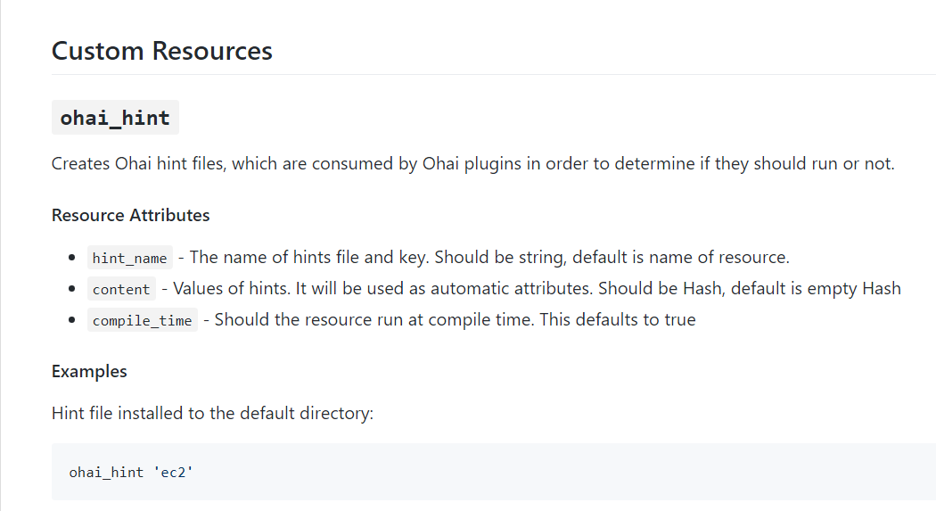

Slide 15
Run Ohai Smoother
There are a few more things to learn about Ohai that could help increase performance.
Configure the node to automatically load ohai plugins
Enable ohai hints
Remove plugins that you do not want executed
Choose only the plugins you want executed

Slide 16
Investigate client.rb.erb
~/cookbooks/chef-client/templates/default/client.rb.erb
<% unless node["ohai"]["plugin_path"].nil? -%>
ohai.plugin_path << "<%= node["ohai"]["plugin_path"] %>"
<% end -%>
<% unless @ohai_disabled_plugins.empty? -%>
ohai.disabled_plugins = [<%= @ohai_disabled_plugins.map { |k| k.match(/:/) ? k.gsub(/^:/, '').to_sym.inspect : k.inspect }.join(",") %>]
<% end -%>
https://github.com/chef-cookbooks/chef-client/blob/master/templates/default/client.rb.erb
Notes:
Finally, we discussed disabling plugins as well, this the client.rb.erb template. If you want to disable a plugin, all you need to do is call that client.rb recipe from the chef-client cookbook and make sure that the ‘ohai/disabled_plugins’ node attribute is defined.

Slide 17
Viewing the chef-client config Recipe
~/cookbooks/chef-client/recipes/config.rb
template "#{node['chef_client']['conf_dir']}/client.rb" do
source 'client.rb.erb'
owner d_owner
group node['root_group']
mode '0644'
variables(
chef_config: node['chef_client']['config'],
chef_requires: chef_requires,
ohai_disabled_plugins: node['ohai']['disabled_plugins'],
start_handlers: node['chef_client']['config']['start_handlers'],
report_handlers: node['chef_client']['config']['report_handlers'],
exception_handlers: node['chef_client']['config']['exception_handlers']
)
Notes:
And for its values, you would just set it equal to the plugins that you wish to be disabled.

Slide 18
The Work
Add the chef-client cookbook to your cookbook collection
Select attributes you want to remove
Find the name of the plugin that provides those attributes
Provide attributes in a wrapper cookbook, role, or environment for:
node['ohai']['disabled_plugins']
Add chef-client cookbook to every node's run list
Notes:
Disabling plugins are a way to restrict that information that’s added to the node object during a chef-client run.

Slide 19
Run Ohai Smoother
There are a few more things to learn about Ohai that could help increase performance.
Configure the node to automatically load ohai plugins
Enable ohai hints
Remove plugins that you do not want executed
Choose only the plugins you want executed

Slide 20
Whitelist Node Attributes
When it seems like you are disabling far too many plugins and you want to consider attacking it from the other side:
https://docs.chef.io/ohai.html#whitelist-attributes
Notes:
You can also go the opposite direction and instead of blacklisting node attributes by disabling them, you can also create a whitelist if you preferred to do so. This is typically going to be preferable if you are dealing with huge amounts of scale. Typically you want to think about what happens if you are in a situation that you have over five thousand nodes per chef server. In this context you want to think about the size of these node objects that we’re working with. When you converge a node, be aware that the node object is going to be indexed on the chef server and sent to and from each node during the chef-client run. Be careful, because if you have over five thousand nodes all hitting your chef server in a fifteen minute convergence interval, if they are shipping up and down huge node objects there’s a chance that you could DOS your chef server. At scale you want to think about only allowing for certain node attributes that are pertinent instead of removing node attributes.

Slide 21
Run Ohai Smoother
There are a few more things to learn about Ohai that could help increase performance.
Configure the node to automatically load ohai plugins
Enable ohai hints
Remove plugins that you do not want executed
Choose only the plugins you want executed

Slide 22
Q&A
What questions can we answer for you?

