Slide 1

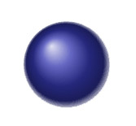
News - Week 2
Facebook released Detectron on 23/02/18, an amazing object detection system based on deep learning.
Understanding Detectron: https://tryolabs.com/blog/2018/01/18/faster-r-cnn-down-the-rabbit-hole-of-modern-object-detection/
Code: https://github.com/facebookresearch/Detectron

