Slide 1
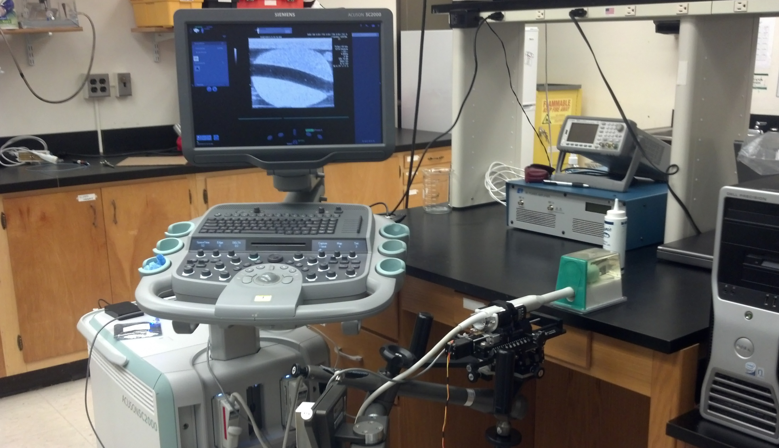
ER7B
Prostate Phantom
Optical Feedback
Stepper Motor

