Slide 1
Identify chroma feature for chord recognition
December, 2022

Slide 2
Agenda
Music concepts
Project description
Pitch extraction
Chroma identification
Results

Slide 3
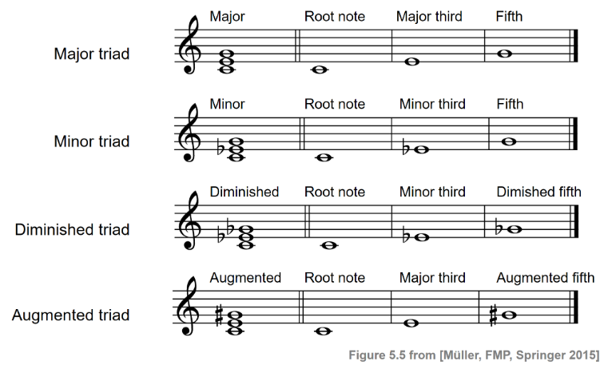
What is a chord?
Several notes that sound simultaneously.
  2 notes: dyad
  3 notes: triad
  4 notes: tetrad
What’s a note?
  A named pitch: A, B, C…
What’s a pitch?
  A sound in a certain frequency: A=440 Hz, C=261 Hz

Slide 4
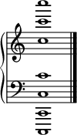
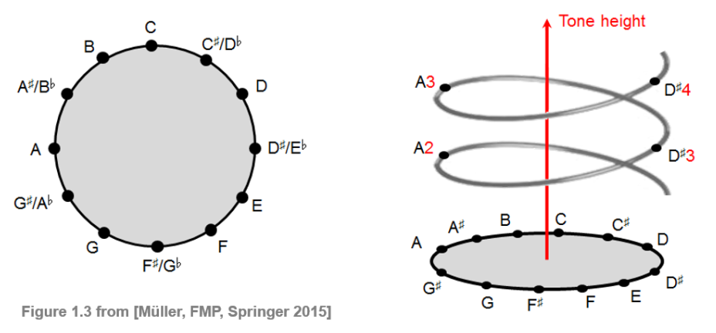
What is a chroma? 1/2
All pitches equally spaced in frequency domain, belongs to the same Pitch Class.
A pitch can be separated in two components: tone height and chroma.
A Chroma is a way to categorize pitches from the same Pitch Class.
  C2 and C5 both have the same chroma value C
All C from C1 to C7

Slide 5
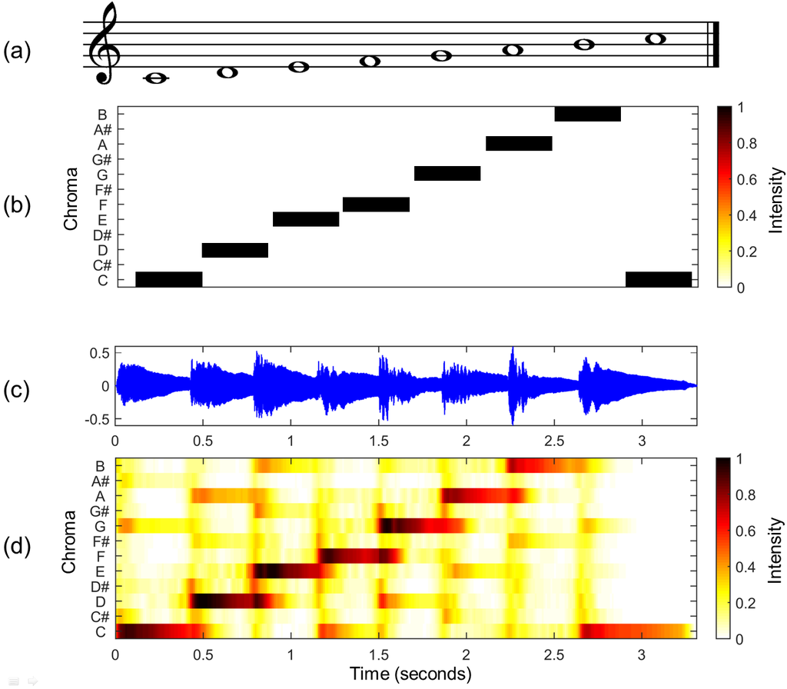
What is a chroma? 2/2
A Chromagram shows the presence of all chromas in an audio signal for a given time window.

Slide 6
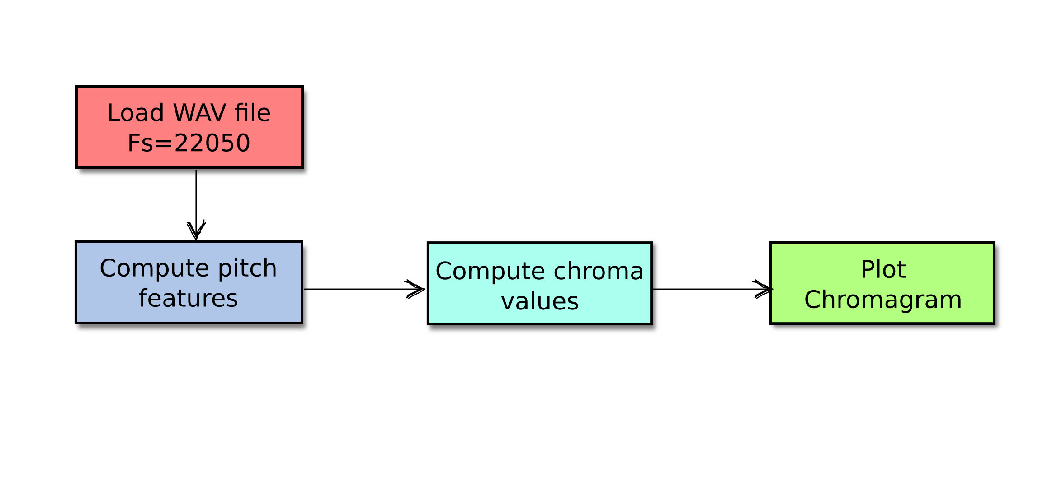
Objective
For a given audio signal, compute and display the chroma values found.

Slide 7
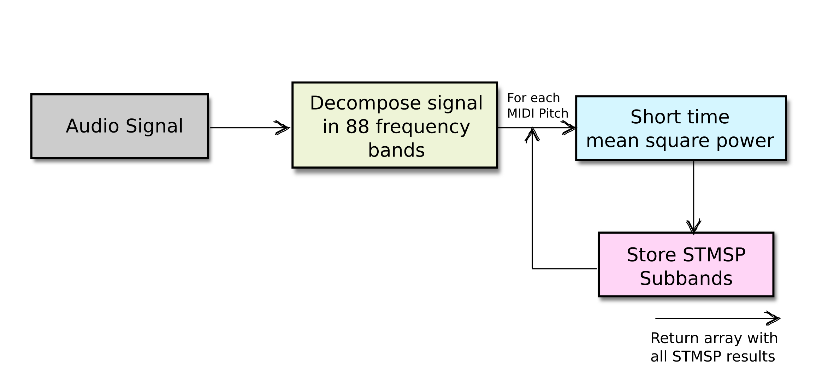
Compute pitch
Use a predefined filter bank to decompose signal in 88 sub-bands. (MIDI 21 to 108)
On each MIDI pitch compute the STMSP
Save the result in an array and return

Slide 8
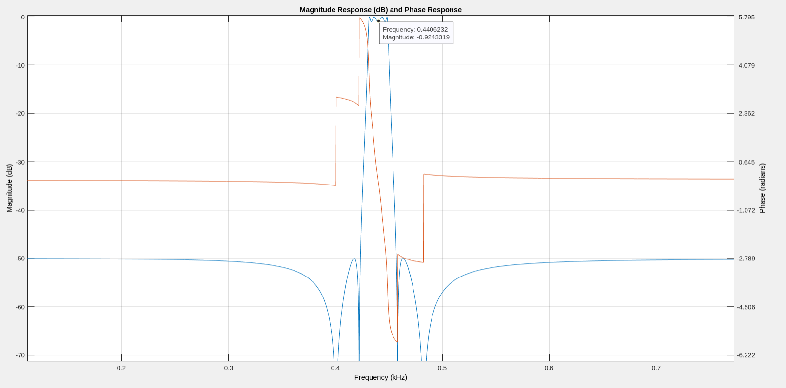
Decomposing the signal
Predefined filters created by paper’s authors.
Band pass filter for
A4 = 440 Hz

Slide 9
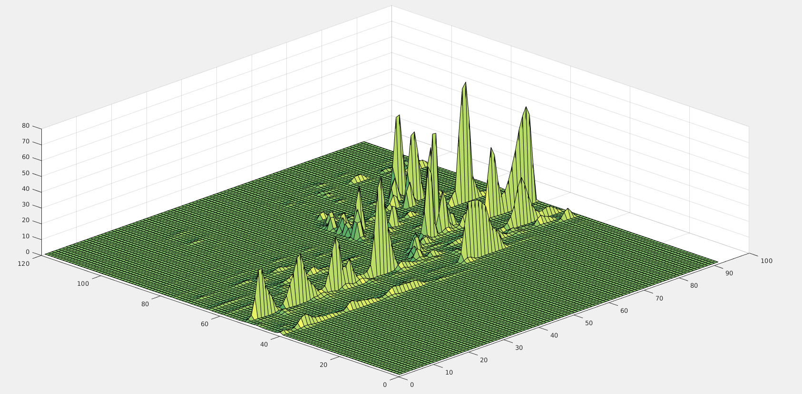
Pitches detected
MIDI bands

Slide 10
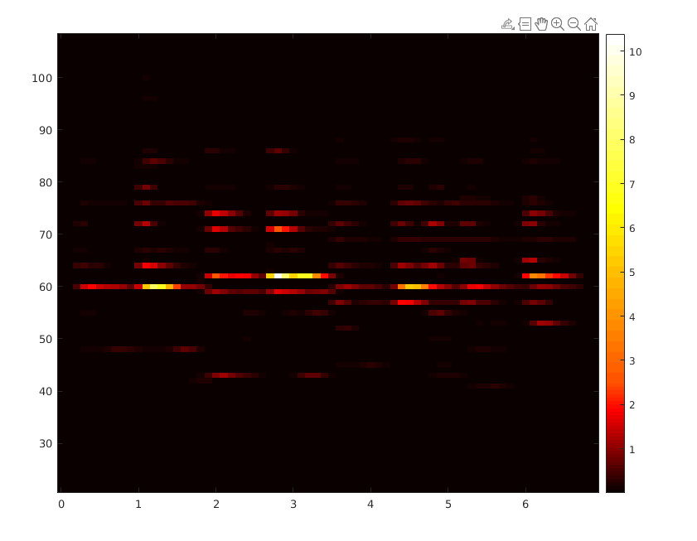
Pitches colormap
MIDI 60
C4

Slide 11
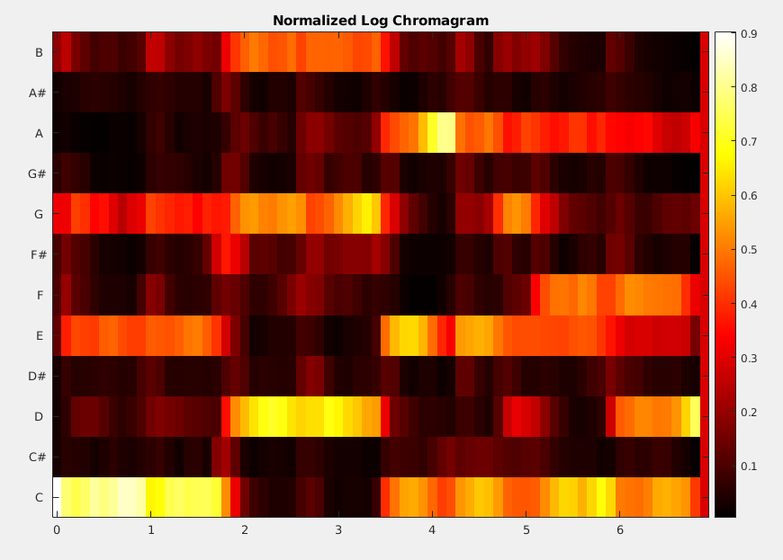
Chroma detection
The first chord is identified correctly.
The notes marked in red were wrong
Am in yellow seems to be correct.
Am
G
F
C

Slide 12
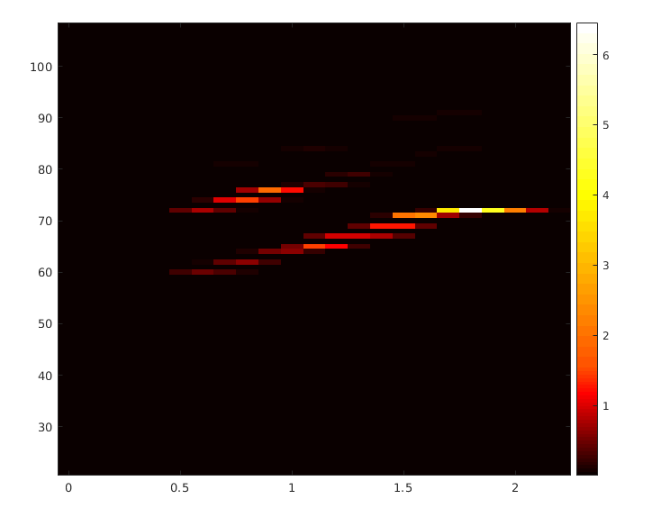
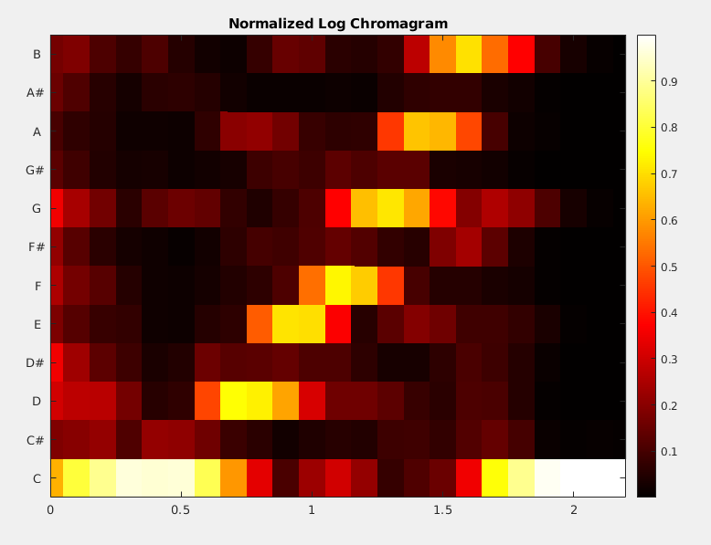
Trying sample audio
A scale C to B identified correctly

