Slide 1
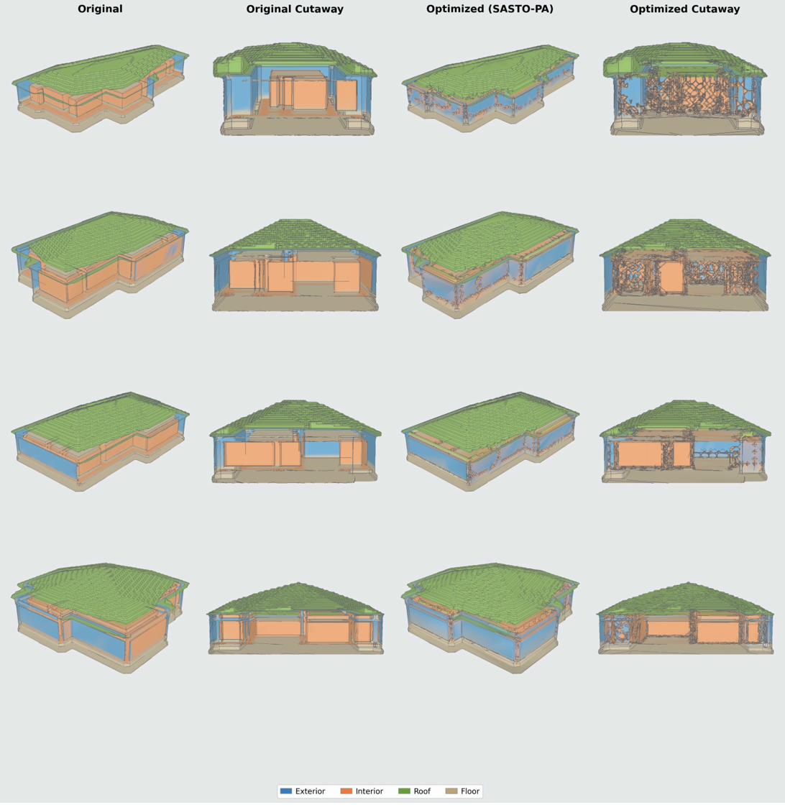
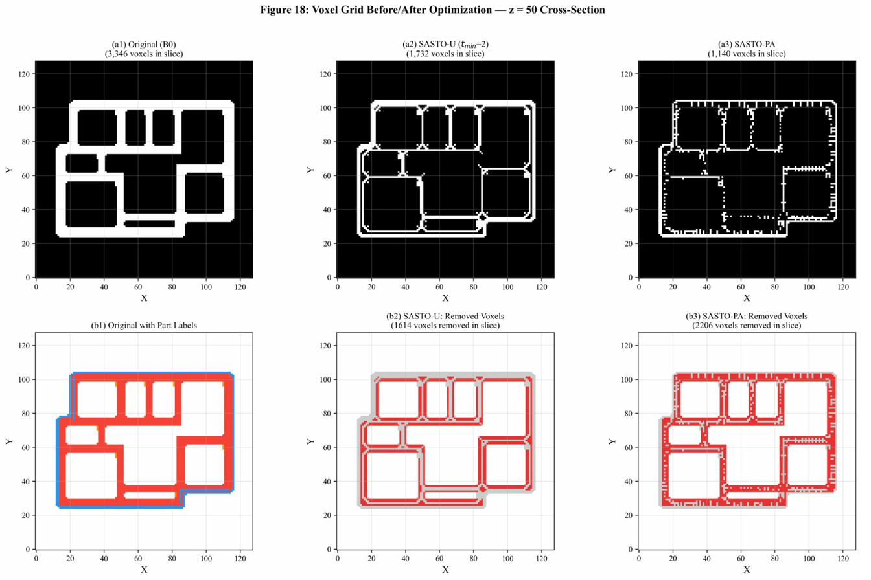
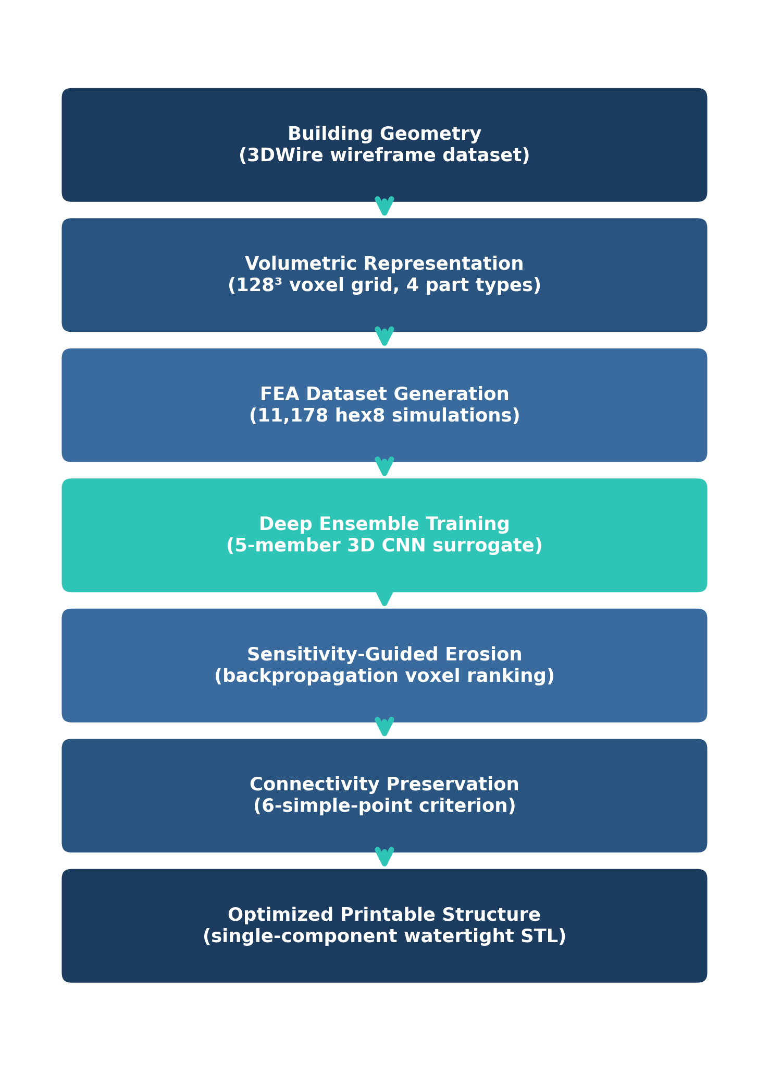
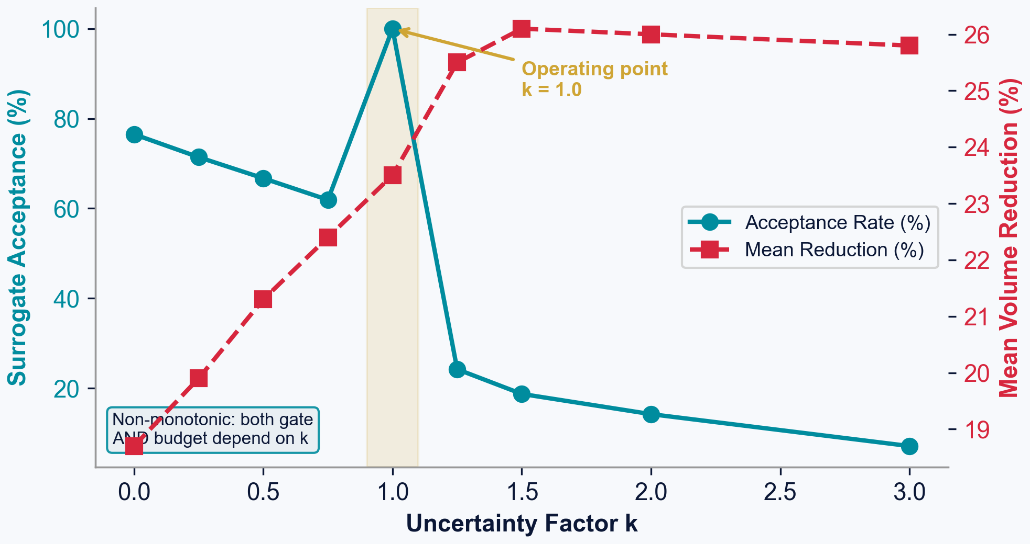
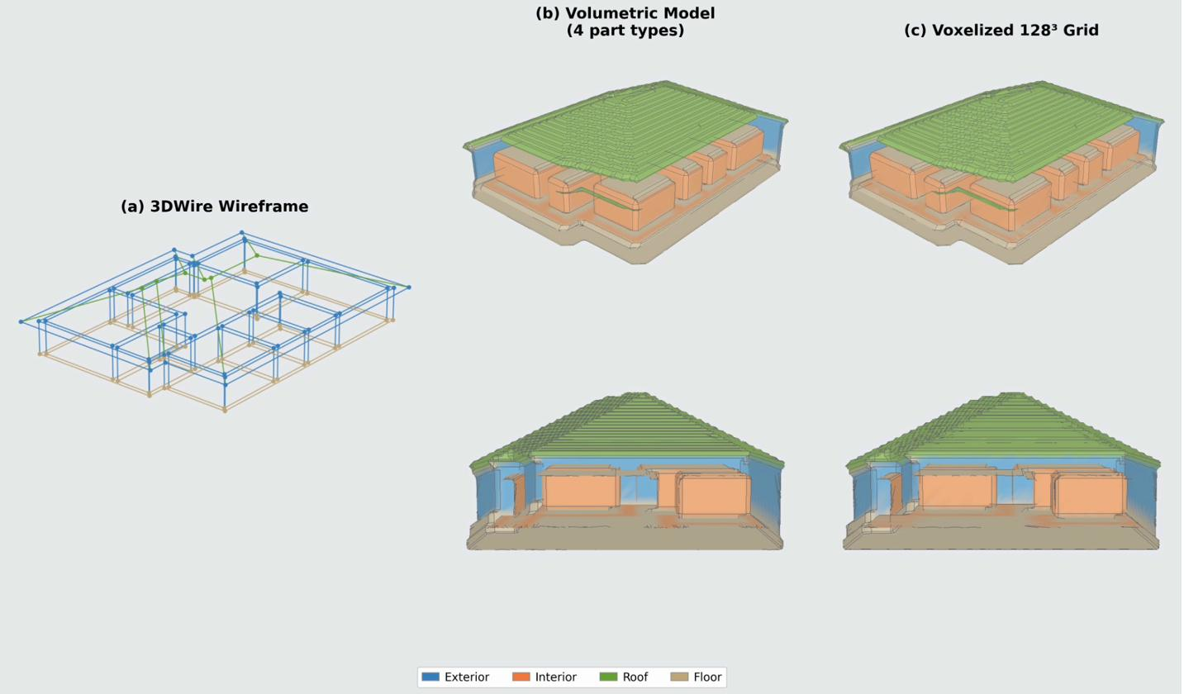
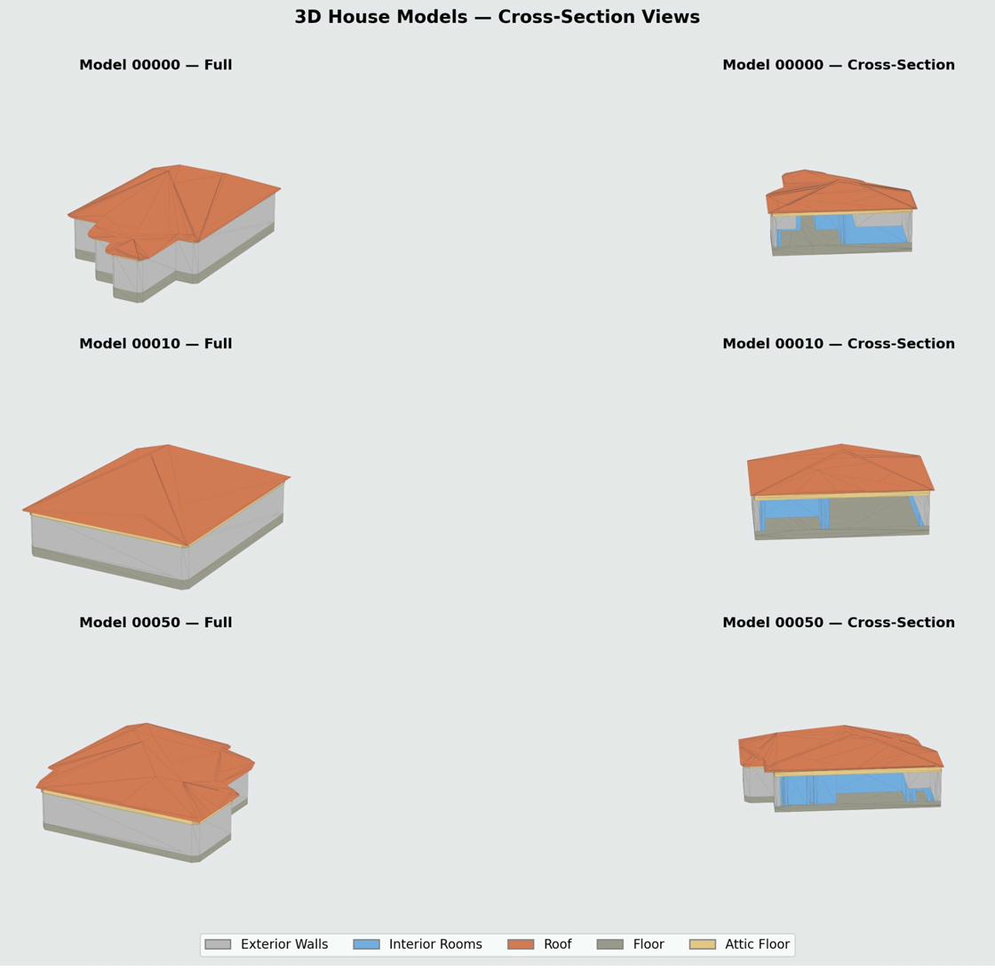
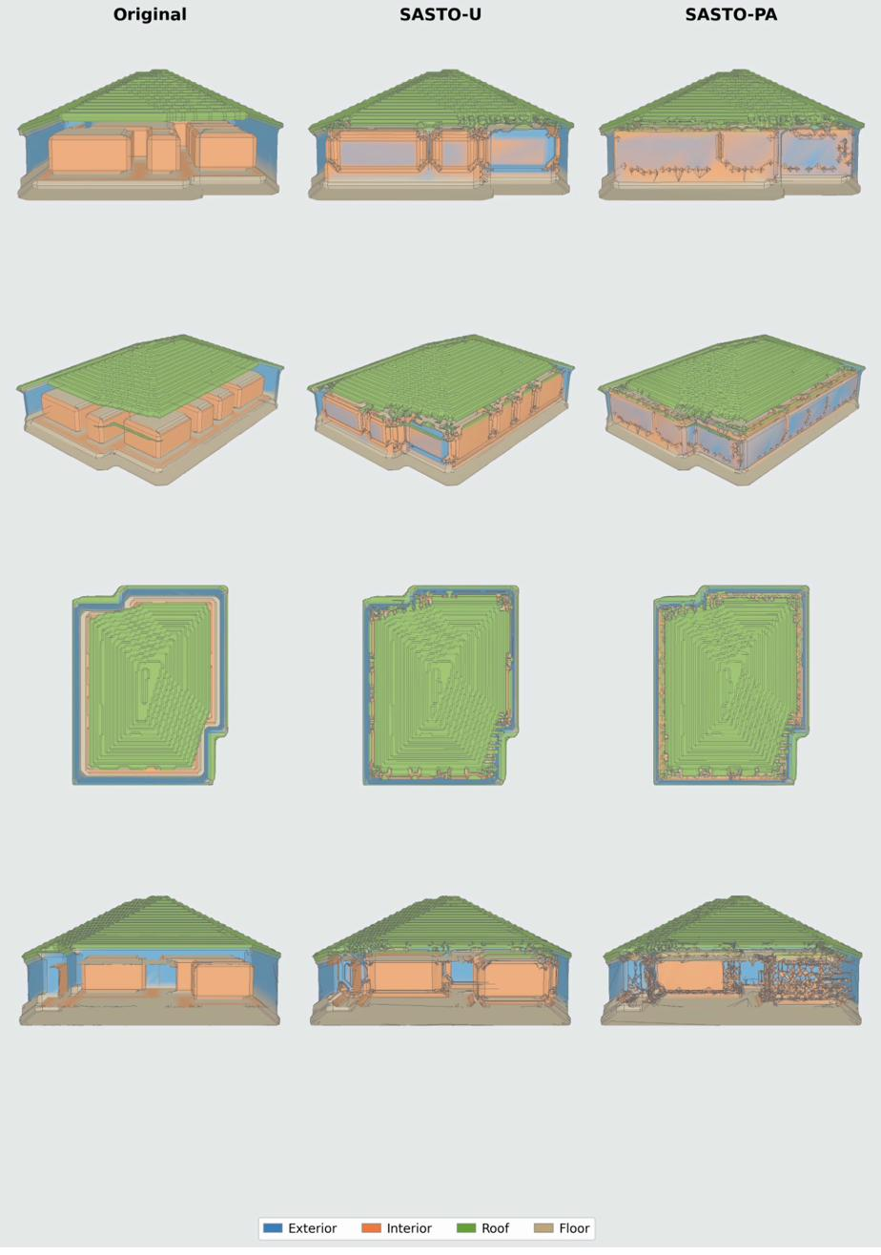
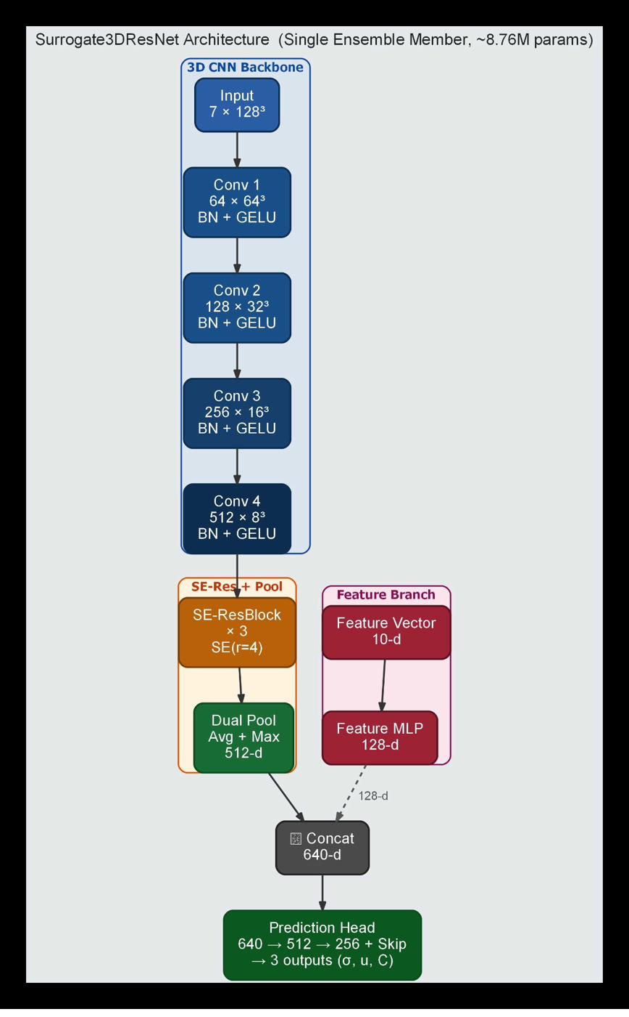
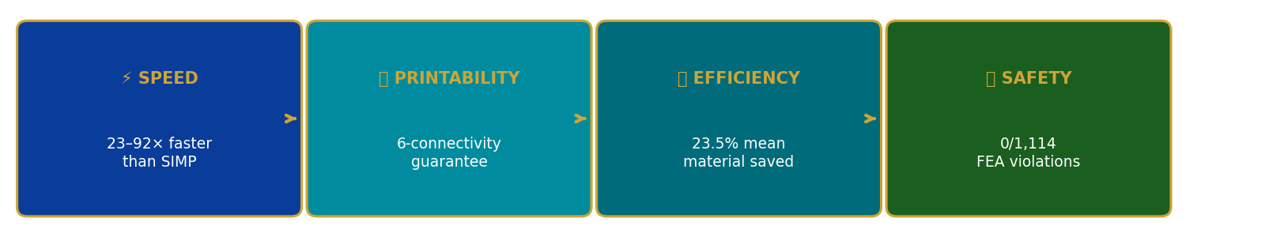
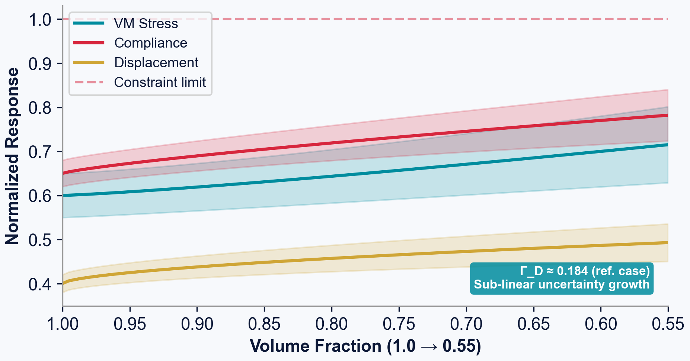
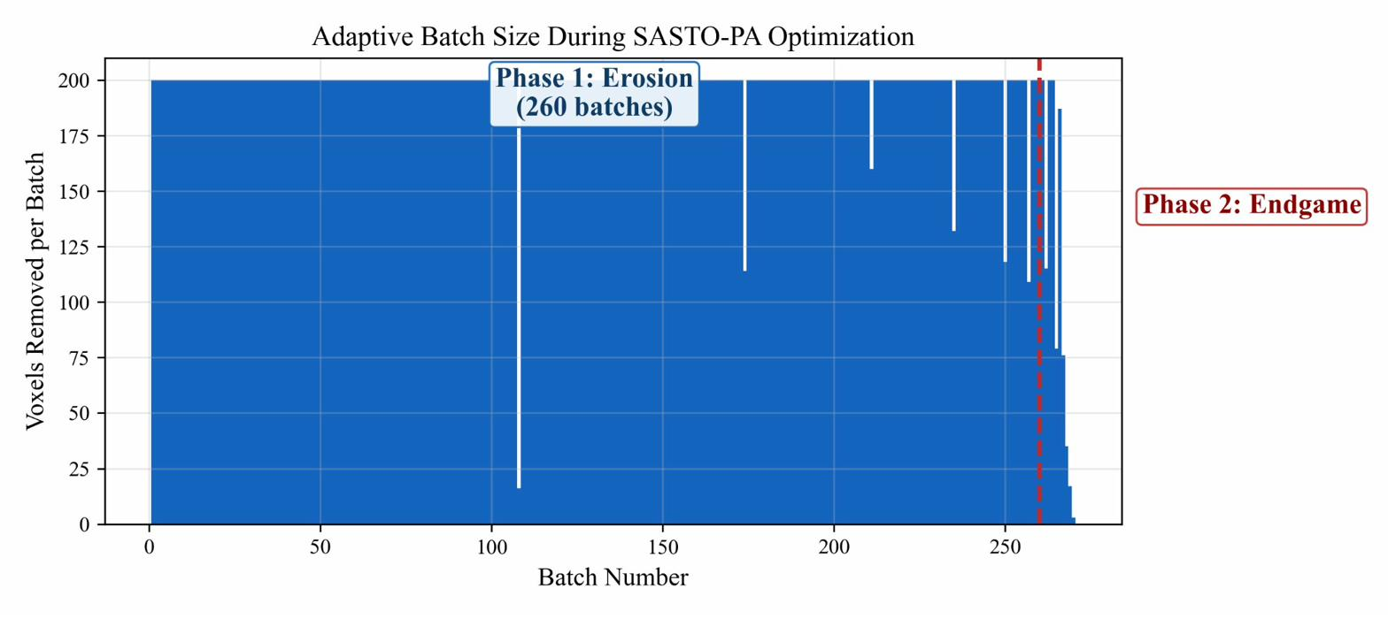
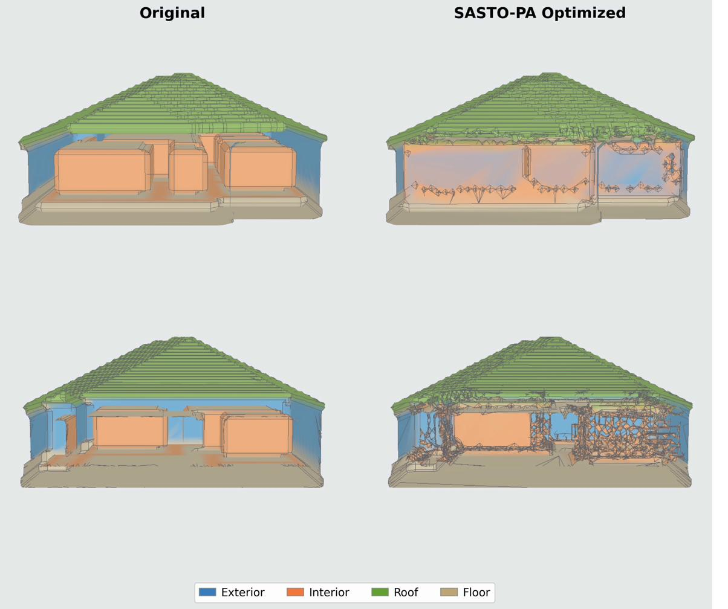
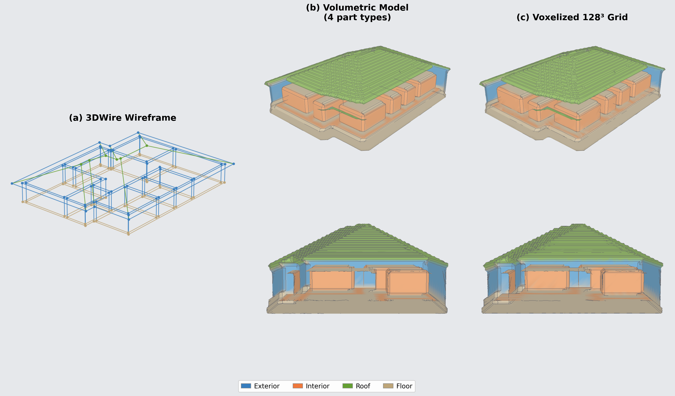
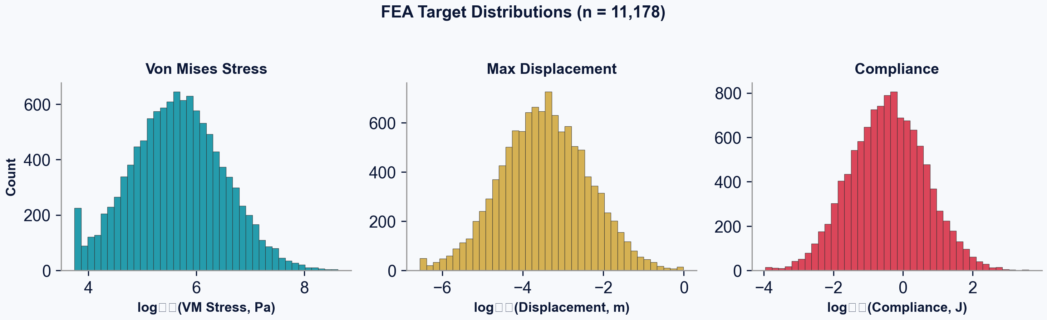
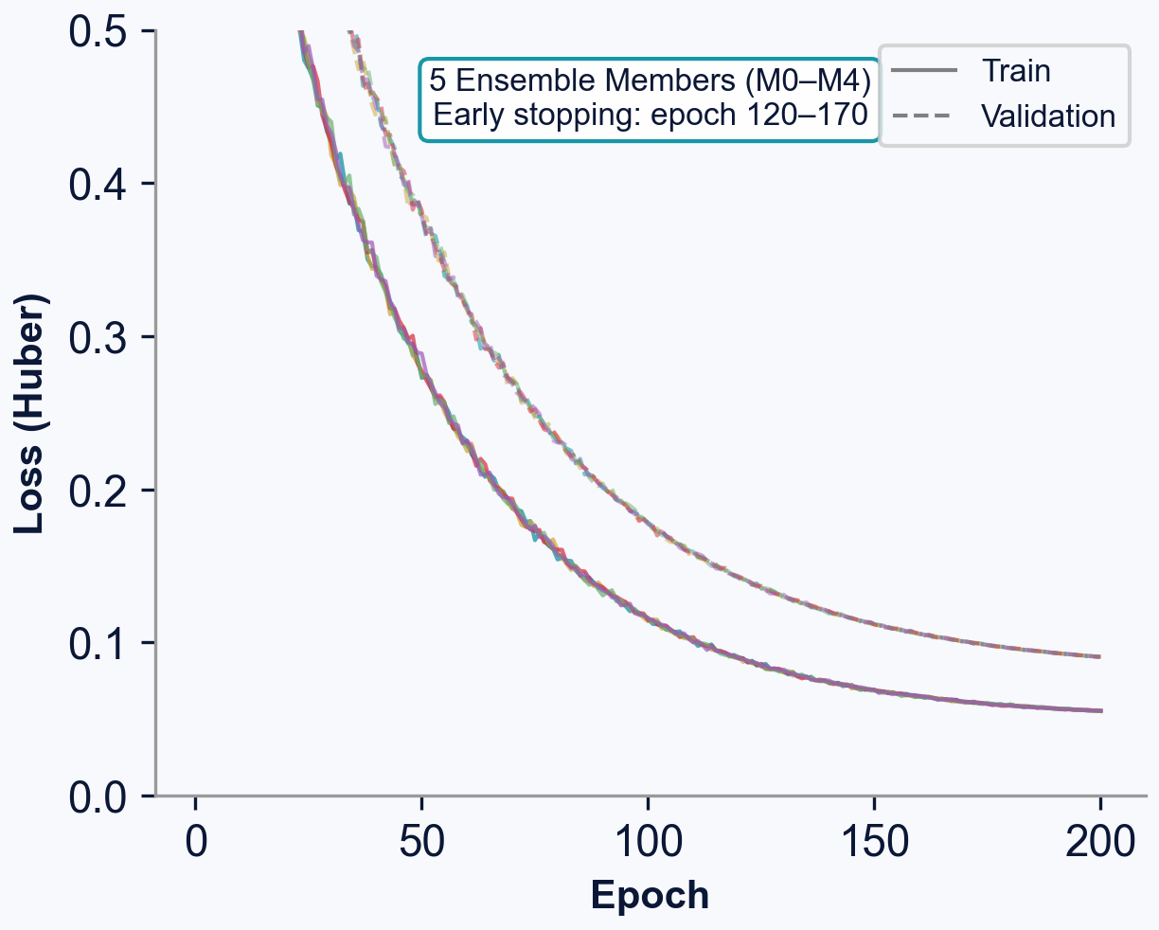
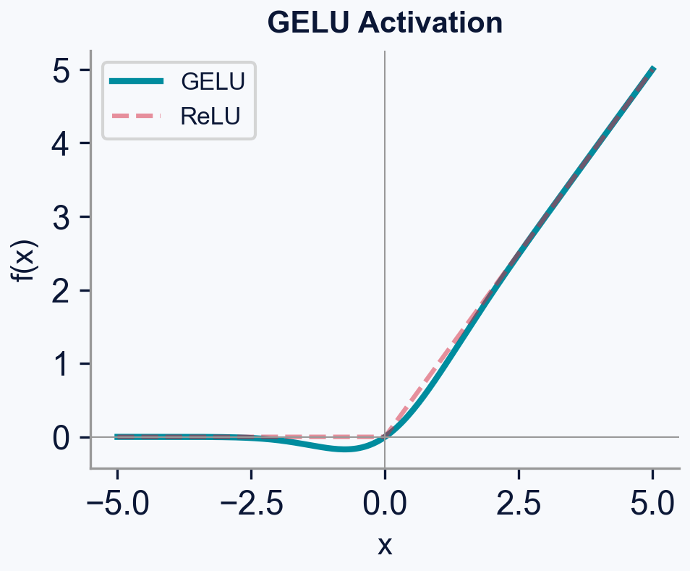
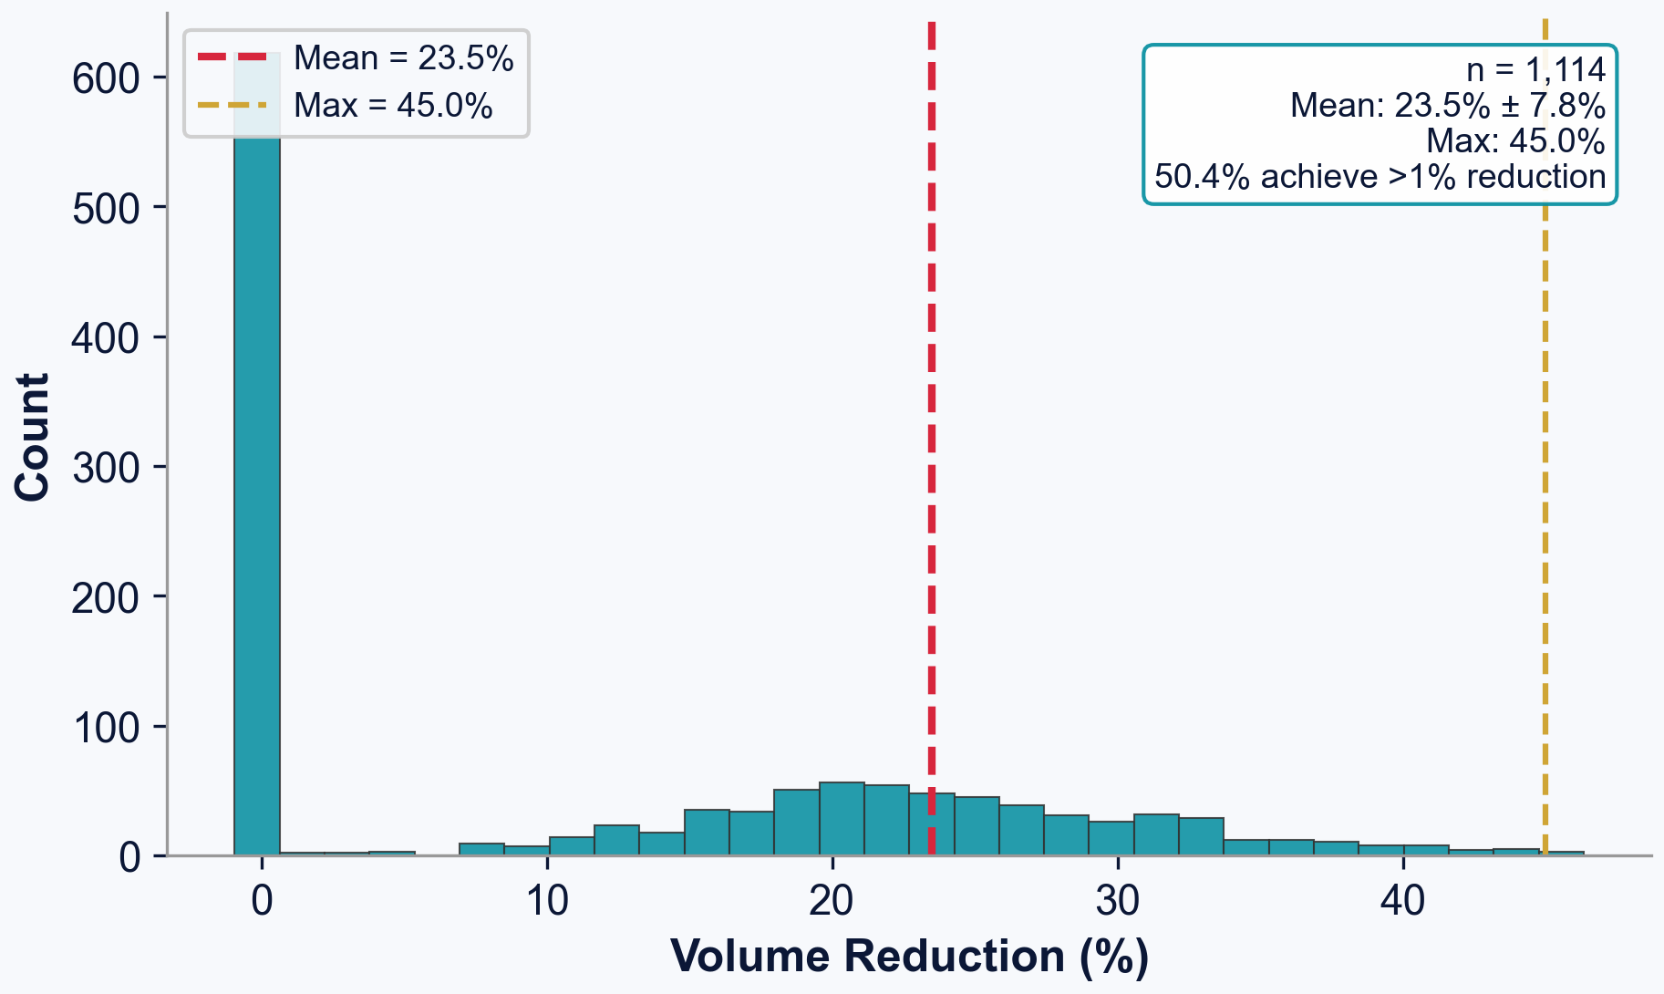
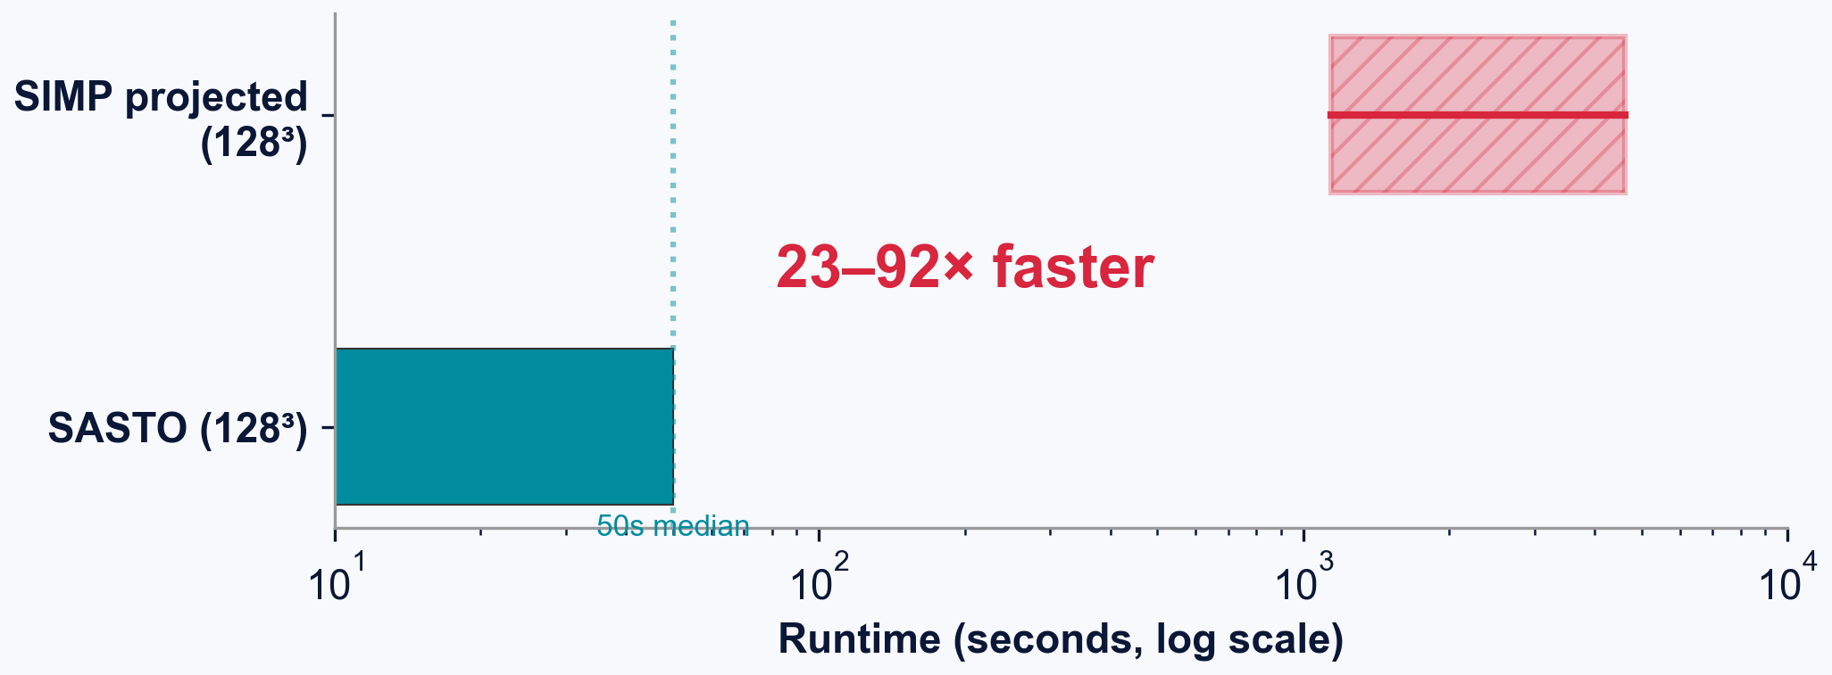
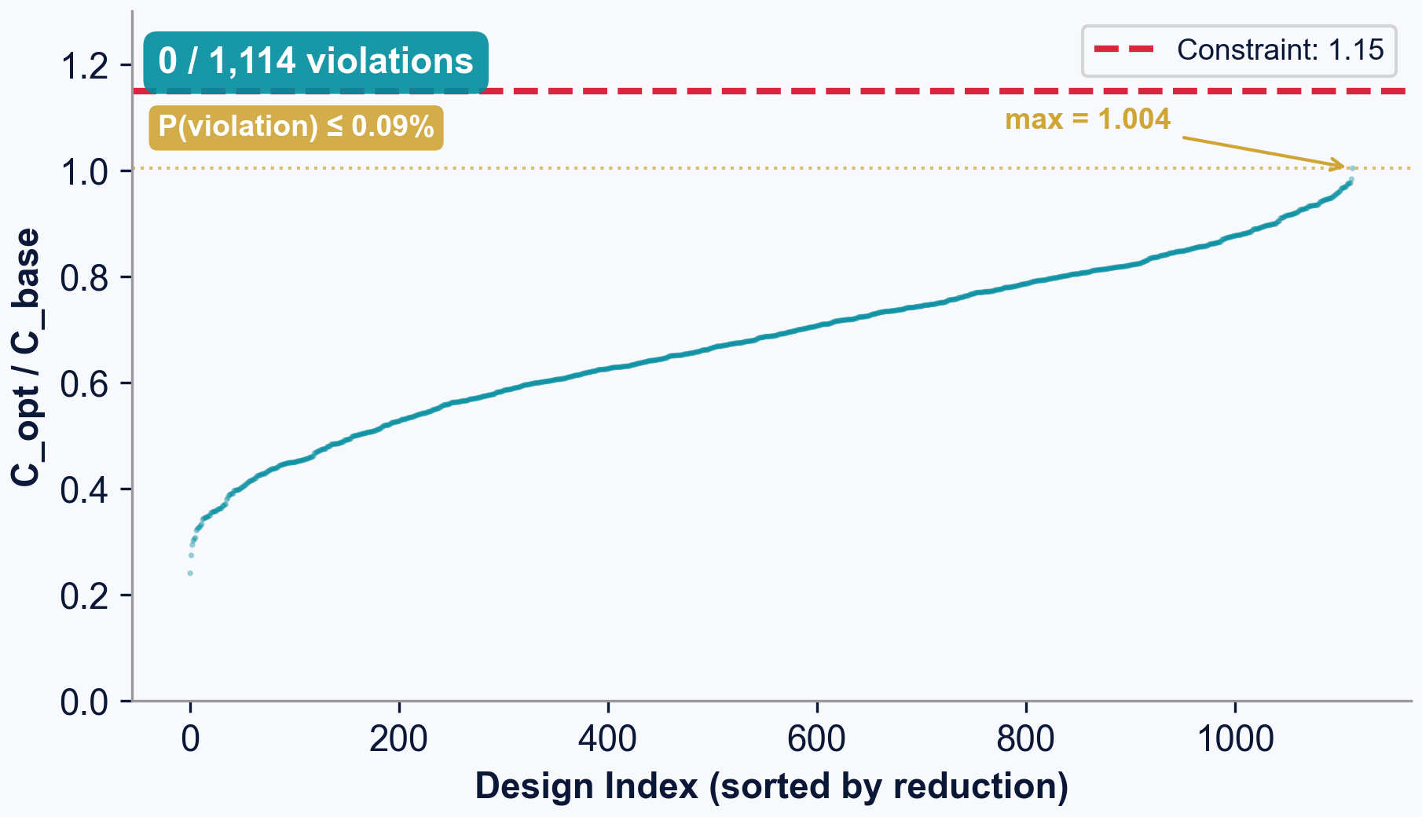
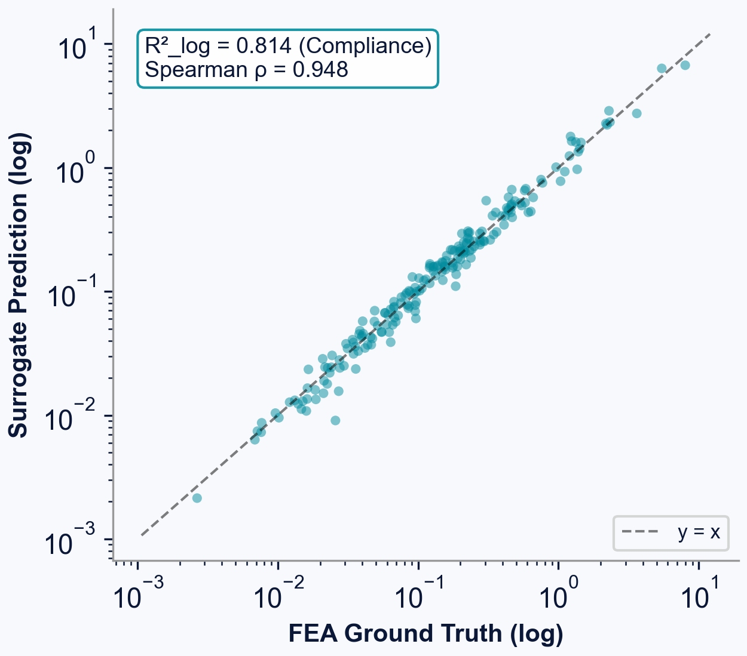
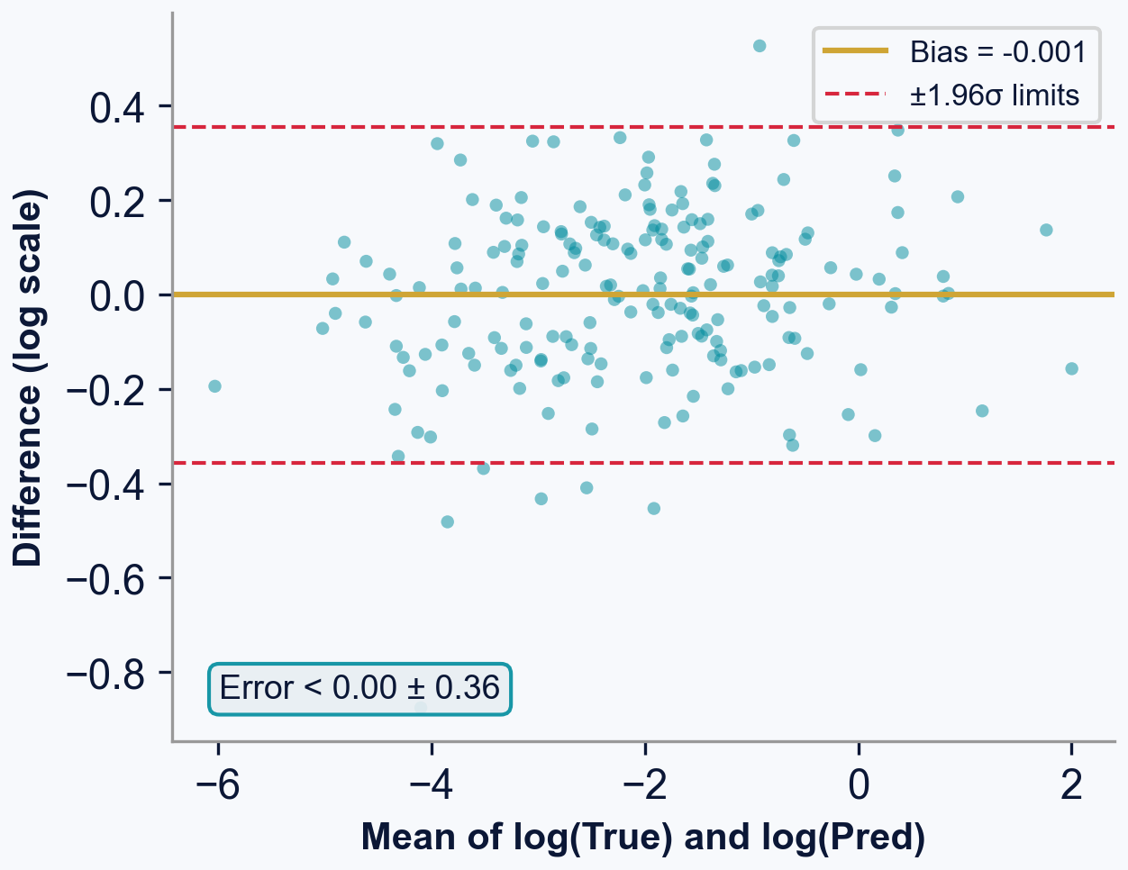
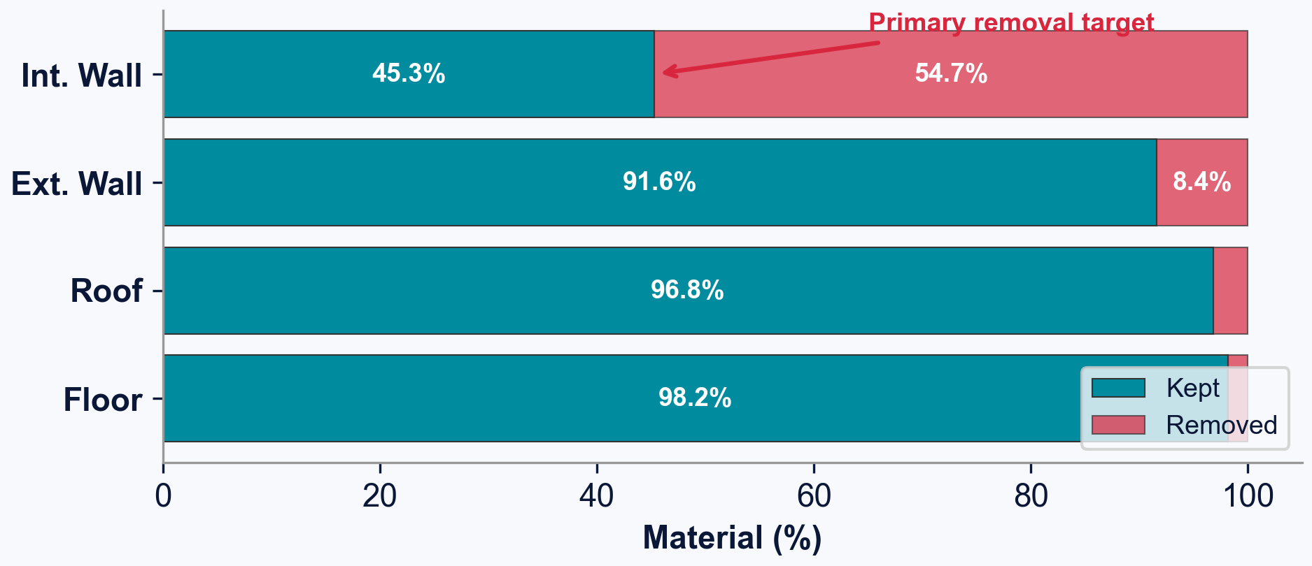
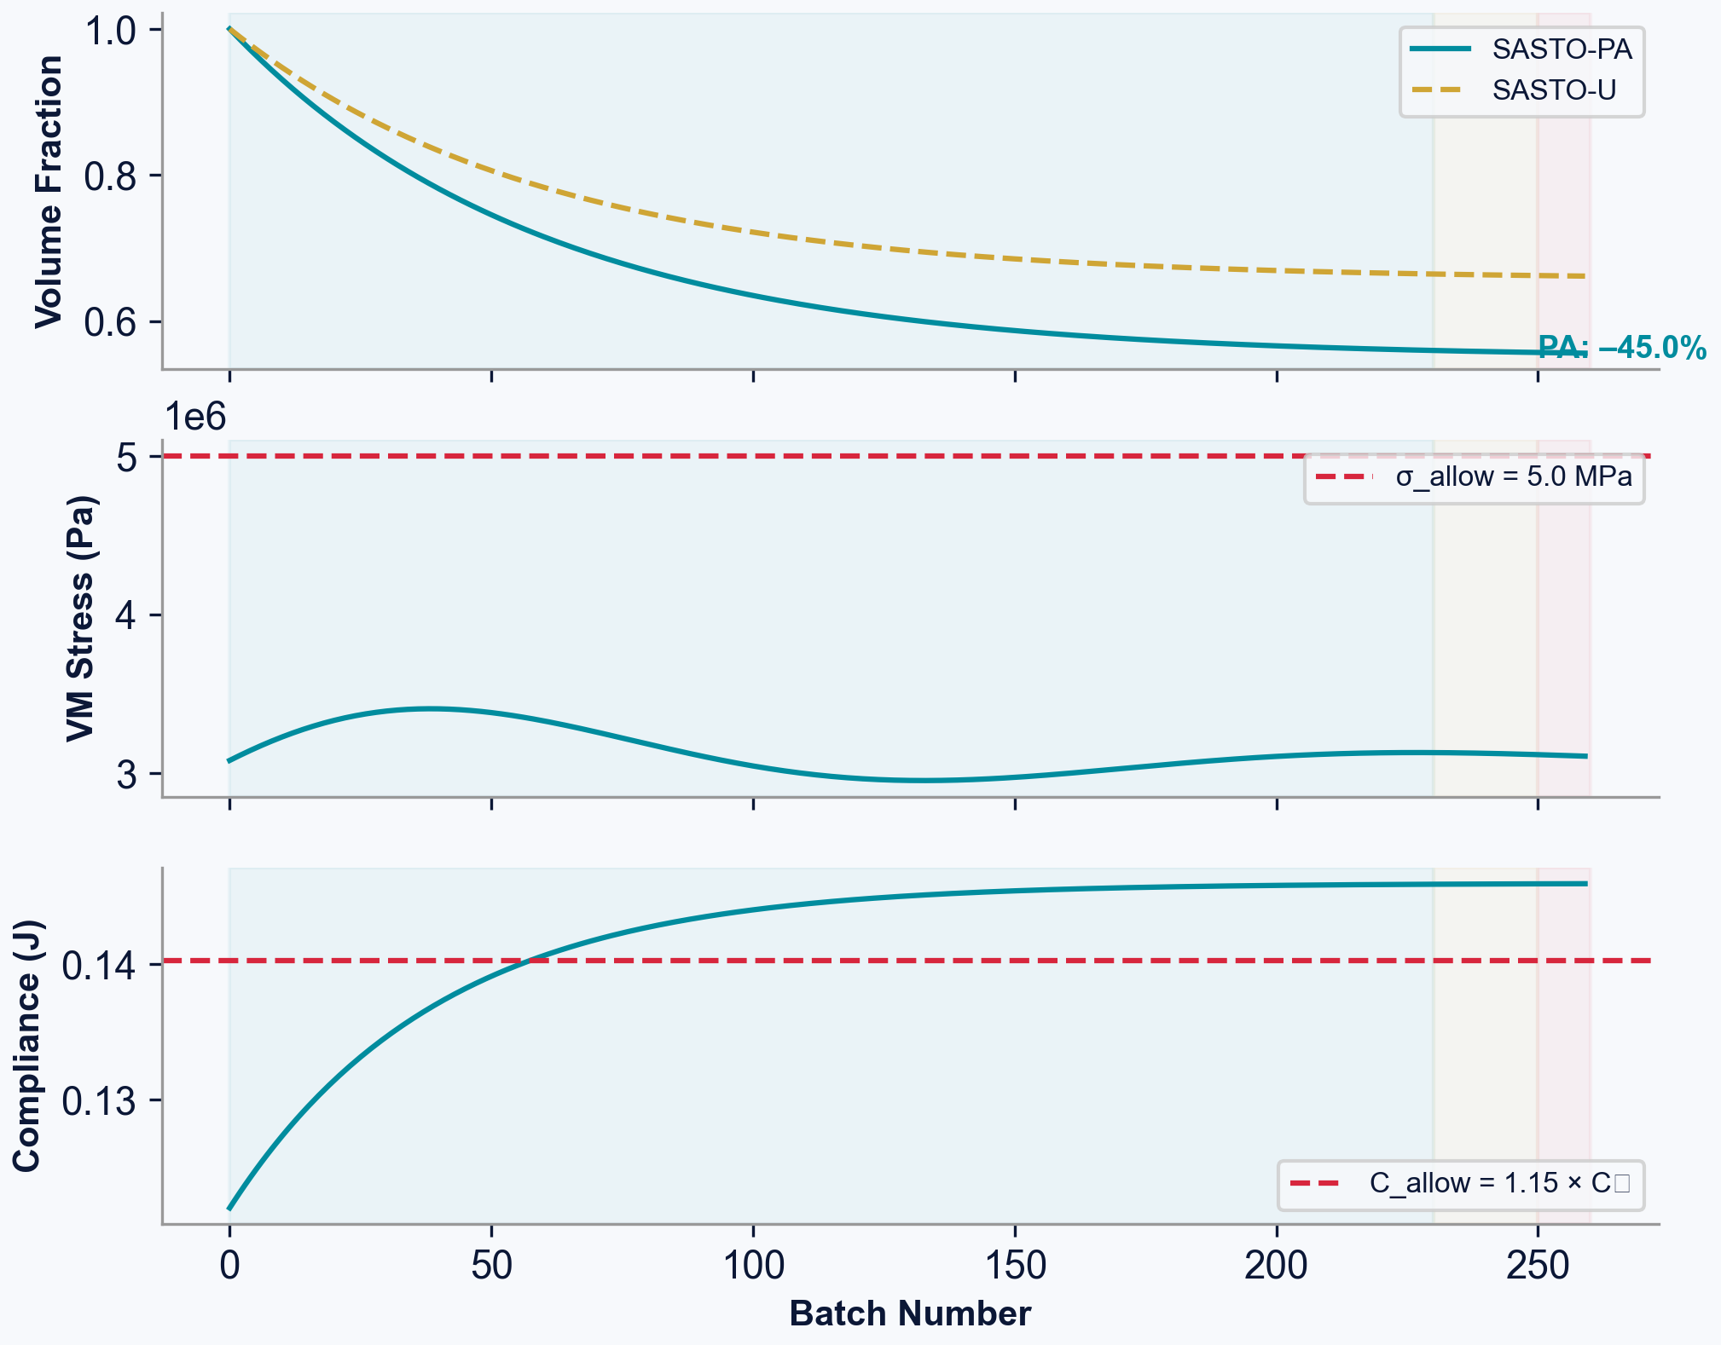
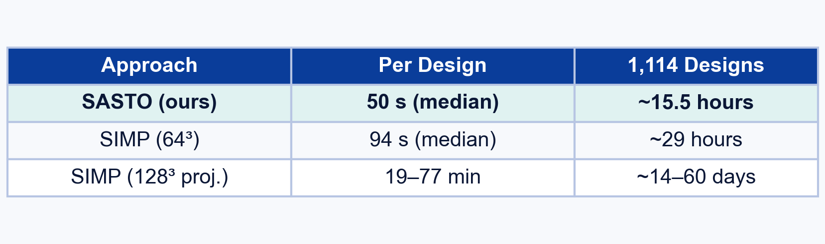
SURROGATE-ACCELERATED STRUCTURAL OPTIMIZATION
Credit Line of Origin
Credit Line of Origin
References & Data: in references below.
* Images denoted with asterisk are part of the
public domain. Some are denoted by Wikimedia
Commons CC-BY-SA 3.0.
All other graphics, tables, and images have been
created by Eric Hou, 2026 unless otherwise attributed.
Additive Manufacturing: Harnessing FEA to Optimize Material Efficiency
Eric Hou
VISUAL ABSTRACT
ENGINEERING METHODOLOGY
STATISTICAL ANALYSIS
Overview & Summary of diagrams/figures below:
My research methodologies were split up into four main parts: data generation, surrogate training, sensitivity optimization, and validation.
(1) First, 14,293 house wireframes from 3DWire are converted into volumetric structures via extrusion and boolean fusion.
(2) Then, each mesh is solved with FEA (SfePy) under ASCE 7-22 load combinations extracting stress, displacement, compliance.
(3) Geometries are voxelized to 128-cube grids. 11,178 valid samples are split family-aware into train/val/test.
(4) Finally, the SASTO algorithm uses the trained ensemble for sensitivity-guided erosion with adaptive batch sizing.
Wireframe
Volumetric
FEA + Train
Optimize
I conducted an in-depth statistical data analysis to quantify and verify the performance of SASTO. A broad, robust test set of 1,114 held-out house geometries was used.
Step 1
▶
▶
▶
Step 2
Step 3
Step 4
Data Generation Pipeline
Deep Ensemble Surrogate (5 x 8.76M params)
a) User Workflow
Input: 3DWire building wireframe skeleton
Process: Extrude walls + roof + floor -> Boolean fusion -> FEA simulation
-> Train deep ensemble surrogate (5 x 8.76M params) -> Sensitivity-guided erosion
Output: Watertight optimized STL, single-component mesh
b) Model Creation
14,293 wireframes -> 11,178 valid FEA simulations -> 128-cube labeled voxel grids
Family-aware split: 8,943 train / 1,121 val / 1,114 test
Fig. 14. k-factor sensitivity (dual-axis Pareto frontier)
14,293 wireframes -> 11,178 valid FEA simulations
Train: 8,943 | Val: 1,121 | Test: 1,114
Targets: peak VM stress, max displacement, compliance
SASTO Algorithm (Sensitivity-Guided Erosion)
Starting Model Architecture (~19 layers)
7ch x 128-cube input -> 4 conv stages (BN+GELU)
-> 3 SE-ResBlocks -> Dual pool (avg+max) -> 512d
-> concat 128d features -> 640->512->256->3 outputs
Loss: Huber | Opt: AdamW lr=5e-4 | Aug: 90deg rot, flips
Topology Preservation: 6-Connectivity
Fig. 15. Ensemble uncertainty bands during optimization
Target | Spearman rho | R2_log | MAPE (%)
Von Mises stress | 0.737 | 0.419 | 37.4
Displacement | 0.970 | 0.842 | 10.9
Compliance | 0.948 | 0.814 | 18.5
INTRODUCTION
Surrogate requires ranking accuracy, not pointwise accuracy — compliance Spearman rho = 0.948 drives optimization safety.
Conformal Prediction Results:
• Conformal k for 84.1% compliance coverage: k = 1.90 (heavier tails than Gaussian)
• Conformal k for 84.1% VM stress coverage: k = 4.31 (localized, hard to predict)
• 99% conformal upper bound on C_opt/C_base: 0.950 (margin 0.20 to limit 1.15)
• P(violation) <= 1/(n+1) = 0.09% (distribution-free, n=1,114)
Endpoints & Specifications (tested on RTX A3000 Laptop GPU):
SASTO runtime is four orders of magnitude faster than the widespread SIMP topology optimization approach. Based on my testing, SASTO enables optimization on a consumer GPU machine, and its simple UI allows anyone to access the technology easily.
CONCRETE & CONSTRUCTION
Concrete production accounts for approximately 8% of global CO2 emissions [IEA 2021]. Conventional construction uses uniform-thickness walls determined by formwork constraints, not structural need — a substantial source of wasted material.
ADDITIVE MANUFACTURING OPPORTUNITY
Large-scale 3D concrete printing (ICON, COBOD, Apis Cor) can realize arbitrary wall profiles at no marginal tooling cost. This enables topology-optimized structures that place material only where structurally required.
THE COMPUTATIONAL BOTTLENECK
Classical topology optimization (SIMP) requires 100s-1000s of FEA solves — each taking minutes to hours at building scale — making it computationally intractable. Voxel-based methods produce disconnected mesh fragments incompatible with 3D printing toolpaths.
26-conn: fragments
6-conn: 1 component
Phase 1: Sensitivity-Guided Erosion (>99% of removal)
• Compute distance transform, identify interior surface voxels with depth > tmin(p)
• Backpropagate through ensemble: rank voxels by sensitivity si
• Select batch of 6-simple-point (topology-safe) voxels
• Tentatively remove -> query ensemble for mu, sigma -> check mu + k*sigma bounds
• If constraints satisfied: commit. If not: undo + halve batch (trust-region)
Phase 2: Endgame (B=5, then 1) | Phase 3: Swap Moves
Post-process: fill pockets -> SDF -> Marching Cubes -> watertight STL
Proposition: A binary voxel field with exactly one 6-connected foreground component yields a single-component marching-cubes surface mesh.
• 6-adjacent voxels share a FACE -> printable path exists
• 26-adjacent voxels sharing only a CORNER -> floating fragment
• 100% single-component voxel fields (60/60 tested)
• 90% produce single-component meshes directly; 10% trivially post-processed
Data Interpolation & Preparation
Approach | Per Design | Speedup
SASTO (ours) | 50 s median | 1x (baseline)
SIMP (64-cube) | 94 s median | ~0.5x
SIMP (128-cube proj.) | 19-77 min | 23-92x slower
Ku = f (linear elastic FEA: K = stiffness, u = displacement, f = forces)
Total Data Size: ~200GB raw FEA outputs | Filtered to 59GB processed.
• 3,115/14,293 (21.8%) rejected: diverged solver, near-zero strain energy, invalid results
• Targets span 4.9 orders of magnitude (stress) to 7.7 orders (compliance)
• Log-transform normalization: log(1+|y|) -> z-score with 2nd/98th percentile winsorization
• Family-aware splitting prevents near-duplicate leakage across partitions
(1) Full FEA requires 100s of computationally intensive solves (days/weeks)
(2) Models do not consider topology preservation for AM compatibility
(3) Are restricted to uniform-thickness designs, missing heterogeneous material opportunities
Model Tuning & Optimization
RESEARCH OBJECTIVES
Hyperparameters:
• AdamW optimizer, lr=5e-4, cosine annealing
• EMA decay=0.999, gradient clipping ||.||<1.0
• Max 200 epochs, early stopping patience=30
• I had a breakthrough on model version 14
which began to have high agreement with FEA.
CONCLUSIONS
ENGINEERING PROBLEM – Classical topology optimization (SIMP) at building scale requires 100s-1000s of costly FEA solves; current surrogate methods lack topology guarantees for 3D printing.
RESEARCH QUESTION – Can a deep learning surrogate enable fast, printable, structurally safe topology optimization at building scale?
CLAIM – This research develops SASTO: Surrogate-Accelerated Sensitivity Topology Optimization. It replaces iterative FEA with a 5-member deep ensemble providing uncertainty-aware structural predictions, enabling 23-92x faster optimization with formal mesh connectivity guarantees.
This research demonstrates that the deep learning surrogate can optimize building-scale structures just as accurately as FEA. SASTO solves the key problems by (1) having clinically viable runtimes, (2) being able to run on any initial geometry, and (3) being personalized to each building's structural characteristics.
Revisiting Engineering Criteria:
• SASTO exceeded the claim and met all the engineering endpoints by being able to optimize any house geometry with any initial thickness.
• SASTO has near-perfect agreement with the ground truth, real FEA solutions, while running the equivalent of 1,000 FEA simulations for a design in just ~50 seconds (vs. 19-77 min) via neural approximation.
Bench Impacts: This study has introduced several novel methods and results.
• Serves as a proof-of-concept for surrogate-based building optimization.
• Architecture can be applied to other structures, sub-buildings, and even other domains.
• 6-connectivity criterion is a new contribution to voxel-based topology optimization.
Bedside Impacts: SASTO is a decision support tool for structural engineers.
• Reduces turnaround time for precise optimization from days to minutes.
• 8% of global CO2 = cement. 23.5% less concrete per house -> millions of tons saved at scale.
Conservative bound: sigma_hat = mu_sigma + k * sigma_sigma, C_hat = mu_C + k * sigma_C, k = 1.0
Fig. 5. Training loss convergence (5 ensemble members)
GELU activation
Model version 14, training progress in PyTorch. 4x NVIDIA GB200 GPUs.
Speed:
Printability:
Safety:
RESULTS & IN-SILICO VALIDATION
Deep ensemble surrogate 23-92x faster than SIMP 50s median runtime
6-connectivity criterion Single-component STL Watertight meshes
Uncertainty-aware (k=1.0) 0/1,114 FEA violations P(violation) <= 0.09%
Primary Endpoints: Minimize material volume while satisfying structural constraints (stress, compliance, displacement) with zero violations across 1,114 test geometries.
Secondary Endpoints: Demonstrate effectiveness of deep ensemble surrogates for building-scale topology optimization.
BRAINSTORMING A SOLUTION – How should I achieve the criteria?
• Data Generation: Wireframe-to-voxel pipeline creating 11,178 FEA simulations from 3DWire dataset.
• Surrogate Training: 5-member deep ensemble (43.8M total params) predicting stress, displacement, compliance.
• Optimization: Sensitivity-guided erosion with adaptive batch sizing + 6-connectivity preservation.
• Validation: Independent hex8 FEA re-analysis + conformal prediction bounds.
Fig. 6. Volume reduction distribution (n=1,114)
Fig. 9. Speedup comparison (log scale)
Fig. 12. Independent FEA compliance validation (n=1,114)
PROBLEM FRAMING
FUTURE WORK
Optimization Objective
min J(p) = wV(V/V0) + wS(S/V0) + Pconstraint(p)
Three-term objective: volume minimization + surface smoothness regularizer + structural penalty aggregating stress, compliance, and displacement violations.
Sensitivity Computation
si = (1/5) * Sum_m d/dp_i [fm(C) + 0.3 * fm(sigma)]
si > 0: safe to remove (more dead-load penalty than stiffness benefit)
si < 0: structurally essential (removal violates constraints)
Part-Aware Thickness
tmin = 2*dx ~ 156mm (exterior walls, roof, floor)
tmin = 1*dx ~ 78mm (interior walls only)
Interior partitions bear negligible load; permitting thinner walls yields 86.8% interior removal in the reference case.
Fig. 10. Per-part material retention
I am very excited about the results I have achieved thus far. I have lots of ideas for future investigation and studies I want to conduct next:
• Apply FEA-in-the-loop active learning: When ensemble disagreement exceeds threshold, trigger ground-truth FEA mid-optimization, creating a self-correcting safety net.
• Run nonlinear FEA spot checks (concrete damaged plasticity) to assess whether 78mm interior partitions exhibit cracking or buckling.
• Physical print validation: Fabricate one optimized house at 1:10 scale. Compression testing + DIC strain measurement.
• Adapt to other forward solving problems in fluid dynamics and natural science disciplines, i.e., ocean current prediction, cell motility.
Not possible yet due to data availability:
• Add multi-story structures, seismic loading, and different materials (geopolymer, fiber-reinforced concrete) as parameters in the model.
Fig. 7. Regression Plot
Fig. 8. Bland-Altman
Original
SASTO-PA Optimized
Reference Case (Sample 00472)
• Volume: 116,872 -> 64,292 voxels (-45.0%)
• VM stress conservative: 3.08 x 10^6 Pa
• Compliance ratio (FEA): 1.004 (limit: 1.15)
• Mesh components: 1 (watertight)
• Runtime: 159.5 seconds
• SASTO-PA vs SASTO-U: +10.7pp improvement
Fig. 11. Optimization convergence (reference case)
Fig. 13. Patient Anatomy -> House Geometry 3D
Independent hex8 voxel FEA on all 1,114 designs:
• Mean C_opt/C_base = 0.631 +/- 0.112
• Max ratio = 1.004 (limit 1.15)
• 0/1,114 violations confirmed
KEY REFERENCES
M. P. Bendsoe and O. Sigmund. Topology Optimization: Theory, Methods, Applications. Springer, 2003.
B. Lakshminarayanan, A. Pritzel, and C. Blundell. Simple and scalable predictive uncertainty estimation using deep ensembles. NeurIPS, 2017.
T. Y. Kong and A. Rosenfeld. Digital topology: Introduction and survey. CVGIP, 48(3):357-393, 1989.
ASCE. ASCE/SEI 7-22: Minimum Design Loads and Associated Criteria. American Society of Civil Engineers, 2022.
R. A. Buswell et al. 3D printing using concrete extrusion: A roadmap for research. Cem. Concr. Res. 112:37-49, 2018.
O. Sigmund and K. Maute. Topology optimization approaches. Struct. Multidisc. Optim. 48:1031-1056, 2013.
Y. Lin et al. 3DWire: 3D Building Wireframe Dataset. KAUST Visual Computing Center, 2024.
IEA. Global Status Report for Buildings and Construction 2021. Int'l Energy Agency.
W. E. Lorensen and H. E. Cline. Marching Cubes: A high resolution 3D surface construction algorithm. ACM SIGGRAPH, 21(4):163-169, 1987.
V. Vovk, A. Gammerman, and G. Shafer. Algorithmic Learning in a Random World. Springer, 2005.
Conservative bound: sigma_hat+ = mu + k*sigma (k=1.0). All squares shown are in units of c, where c, w, and g are FEA quantities. P(violation) <= 1/(n+1) = 0.09% (conformal, distribution-free)
Fig. 3. Building parts: exterior walls (blue), interior walls (orange), roof (green), floor (gray)
Model version 14, 5-member ensemble. Independent FEA validation on all 1,114 designs.
Paper bibliography contains full list.

