Slide 1
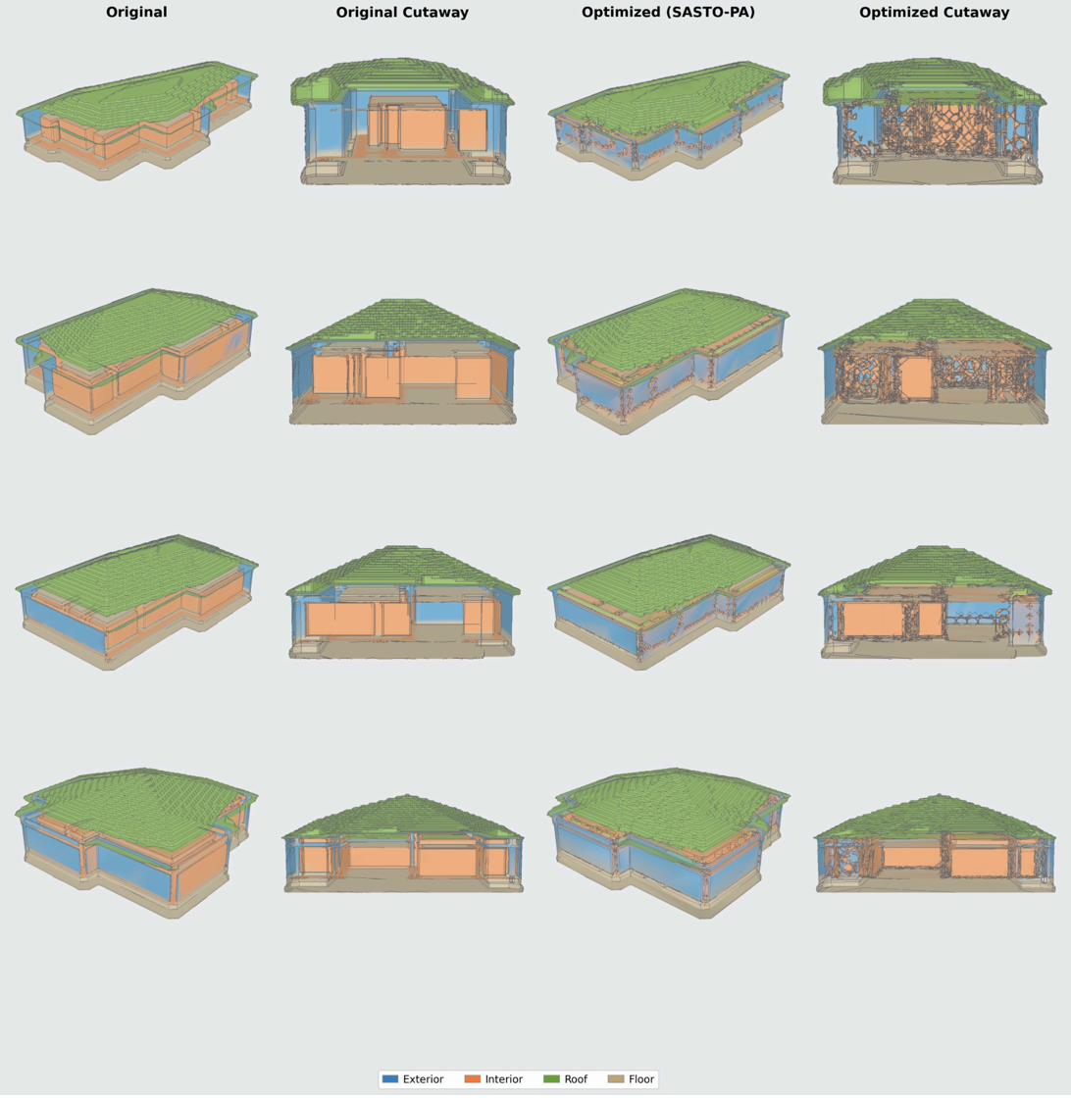
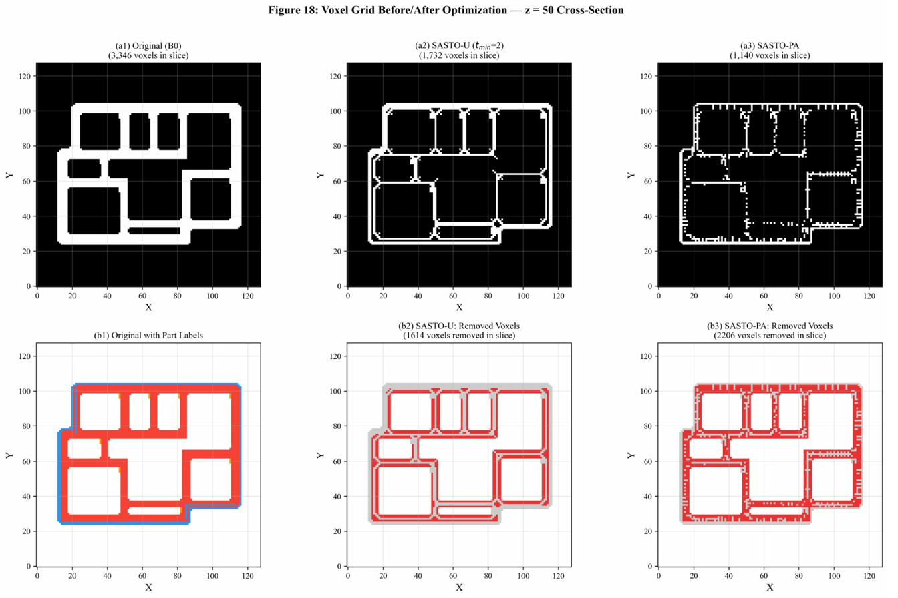
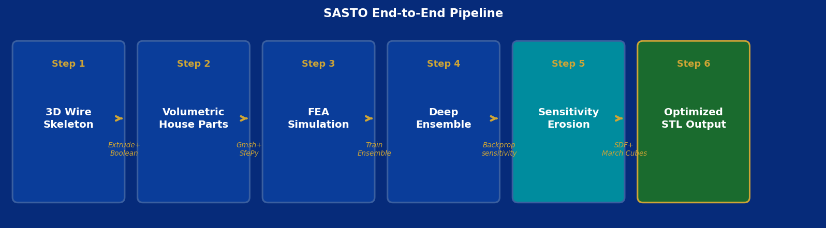
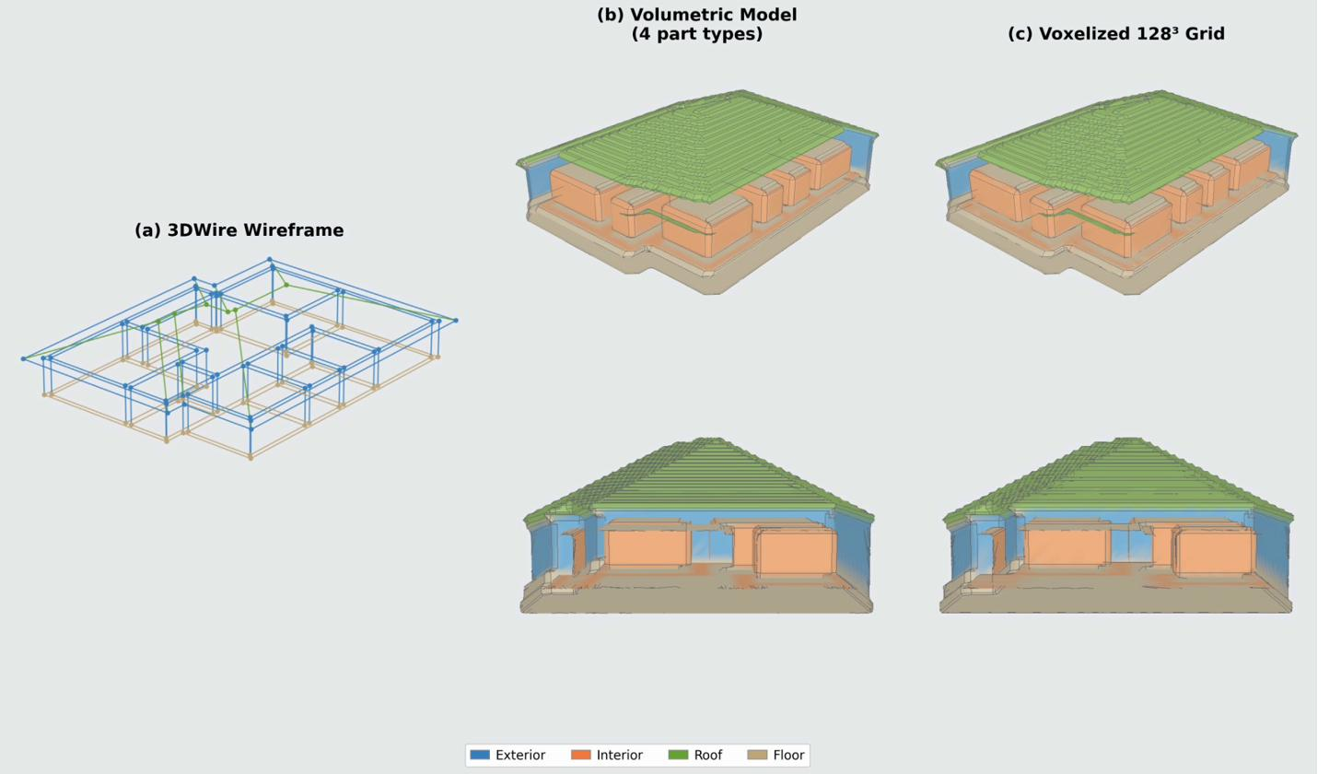
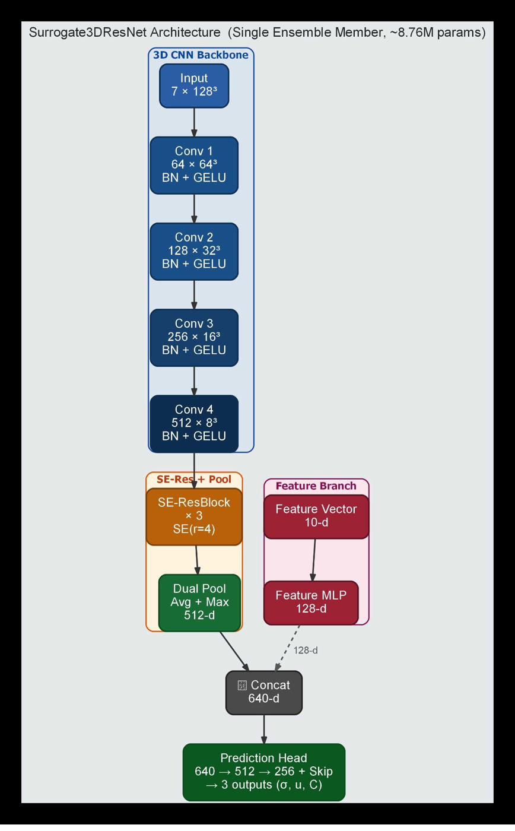
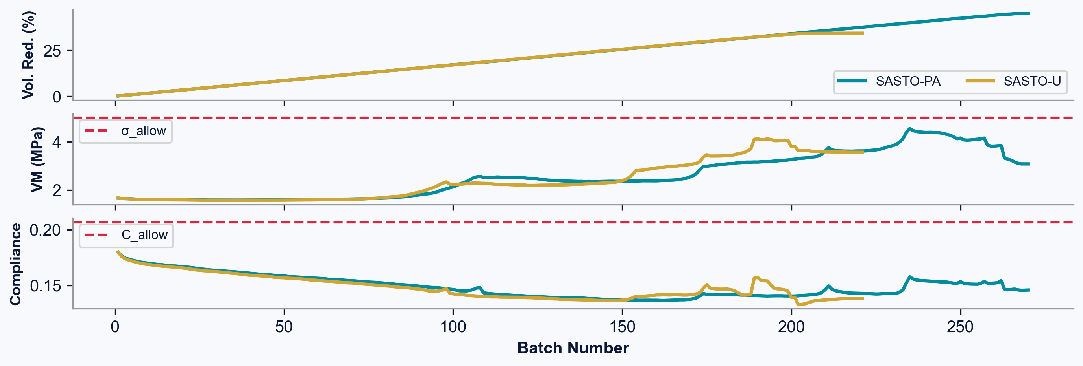
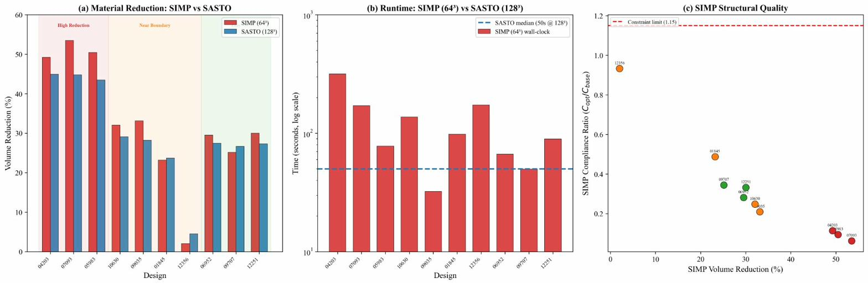
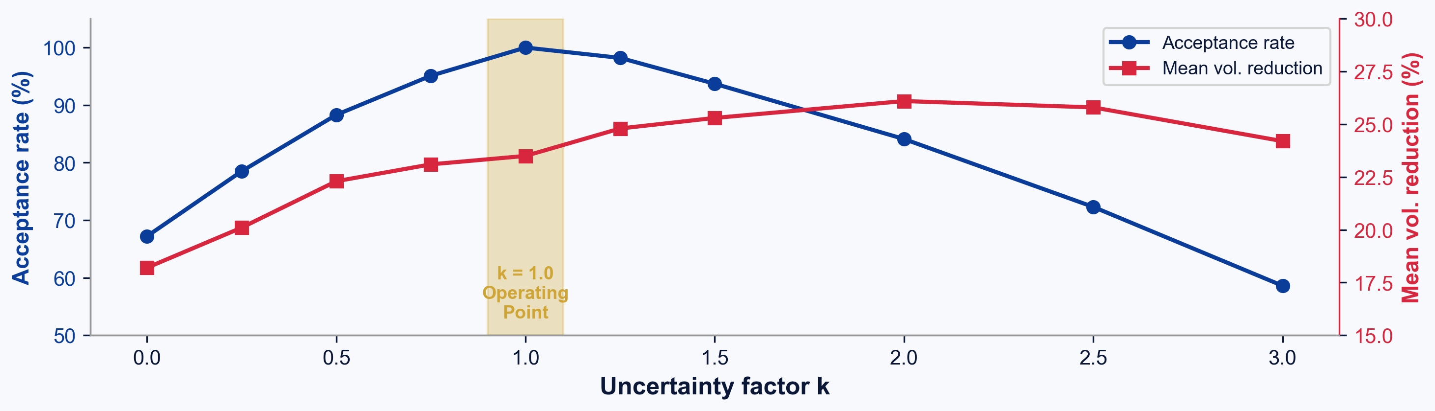
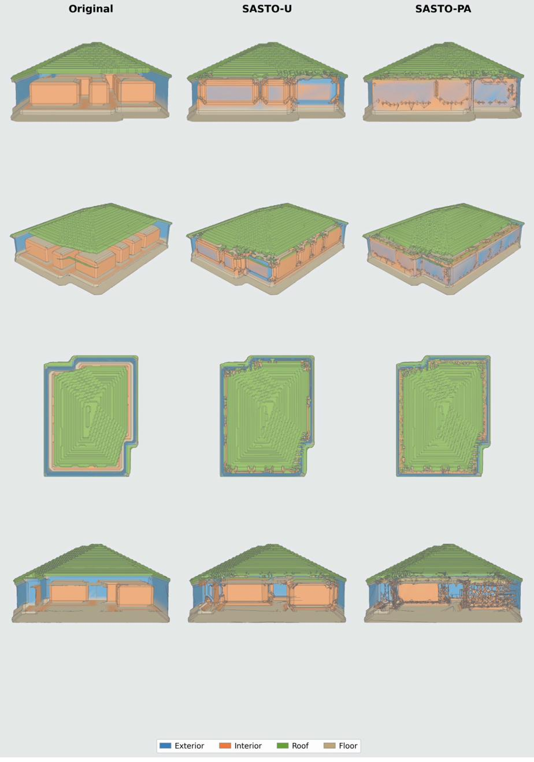
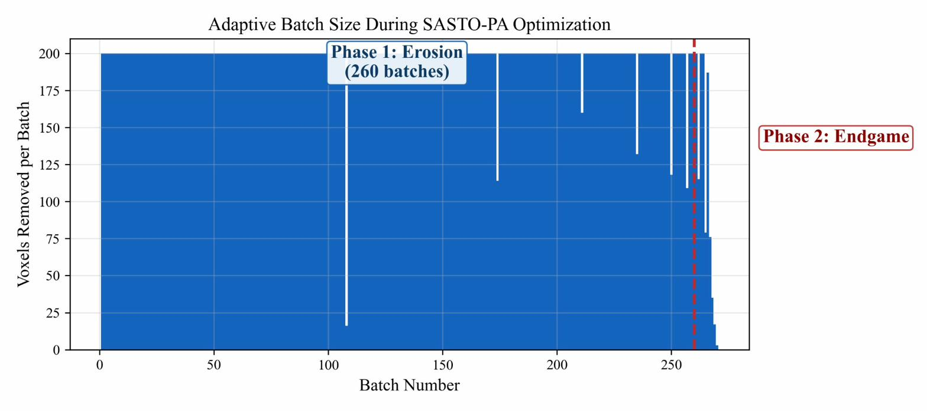
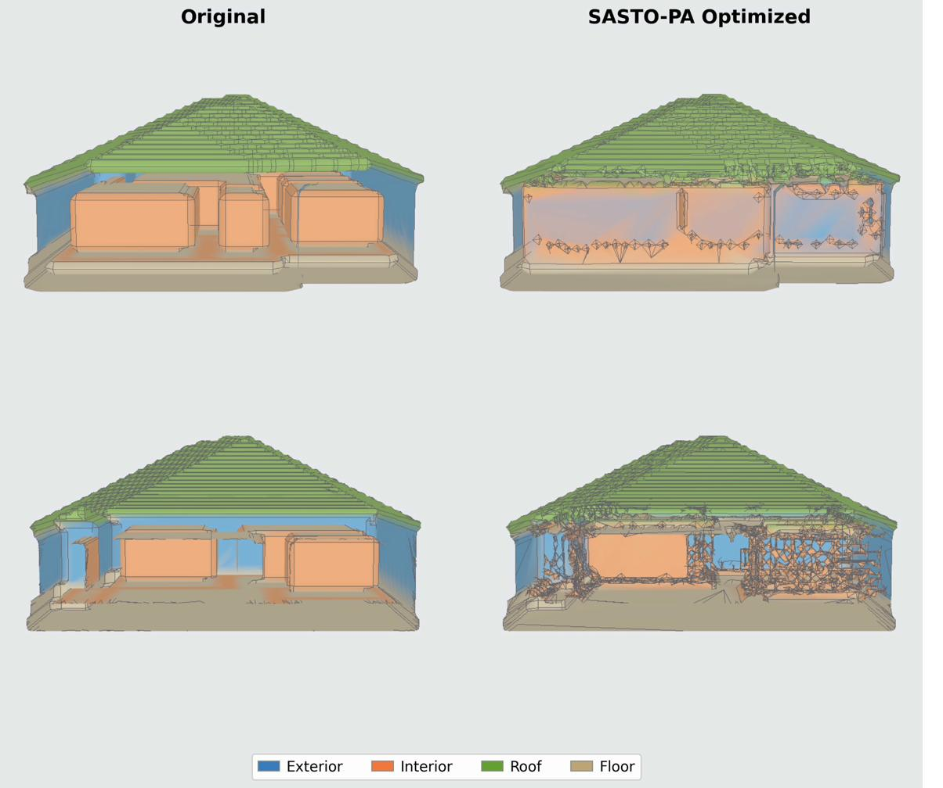
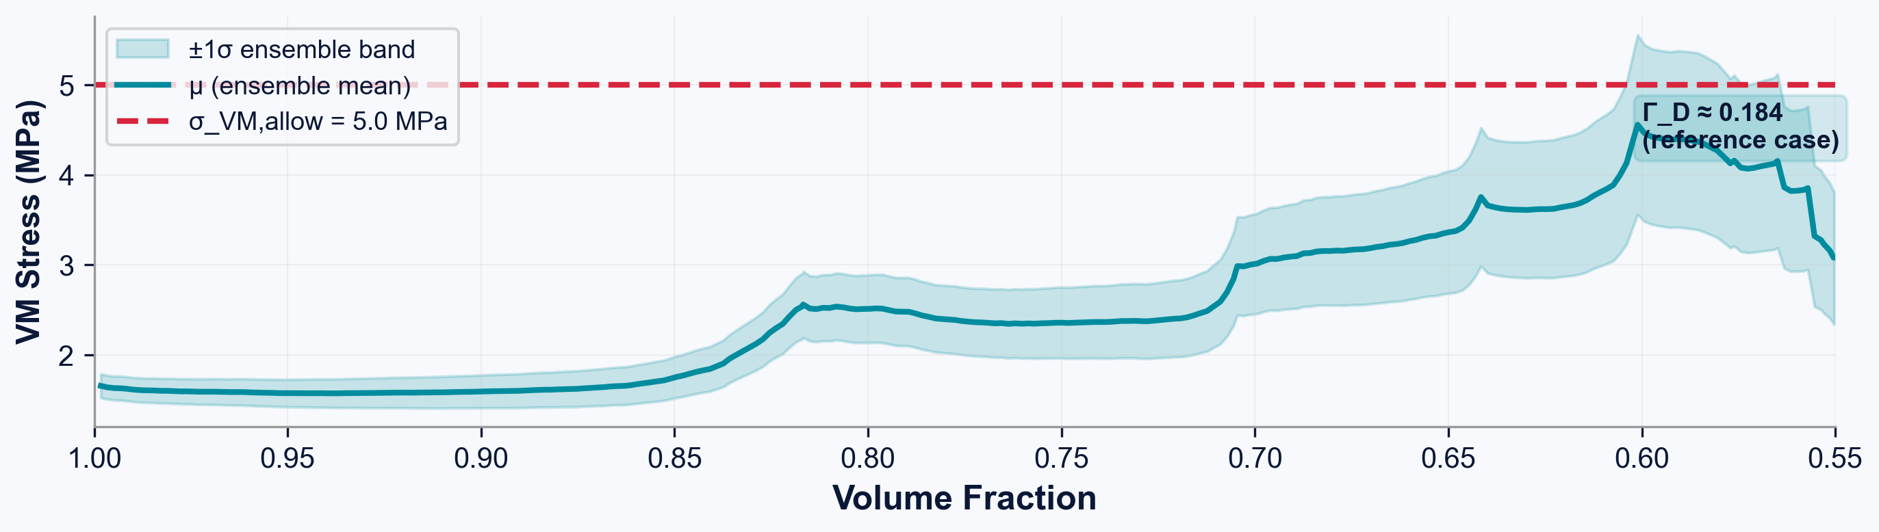
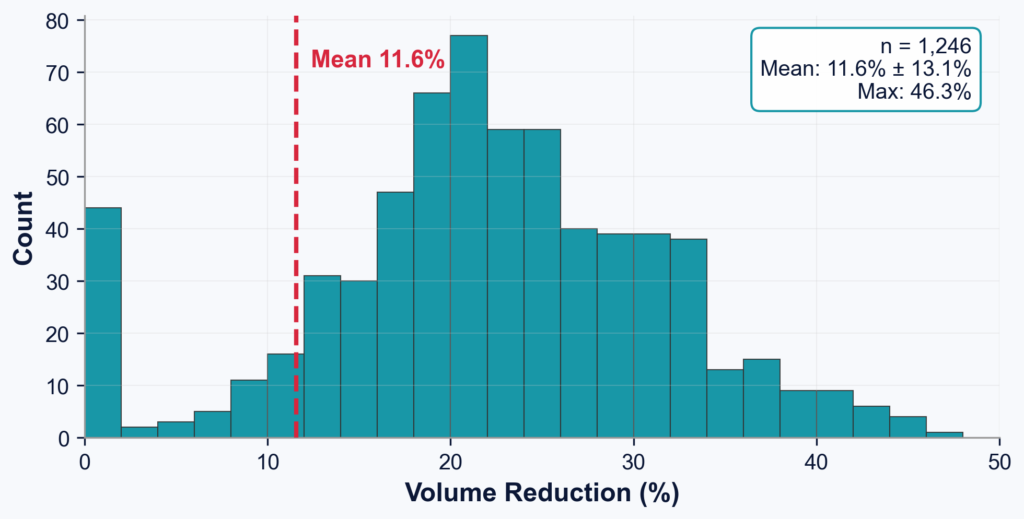
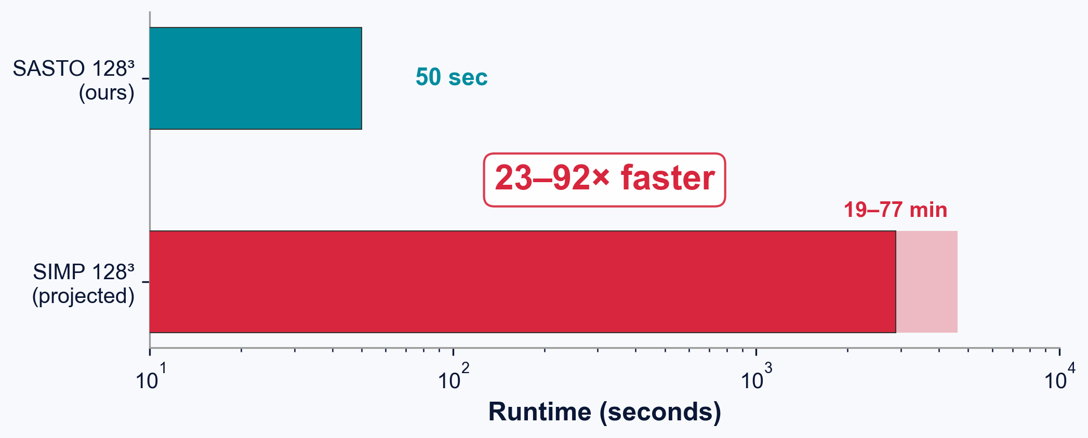
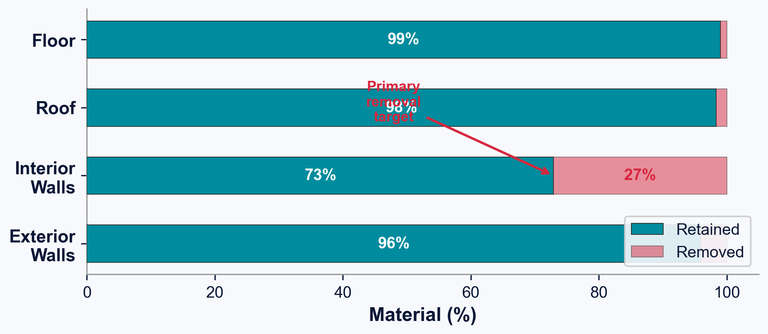
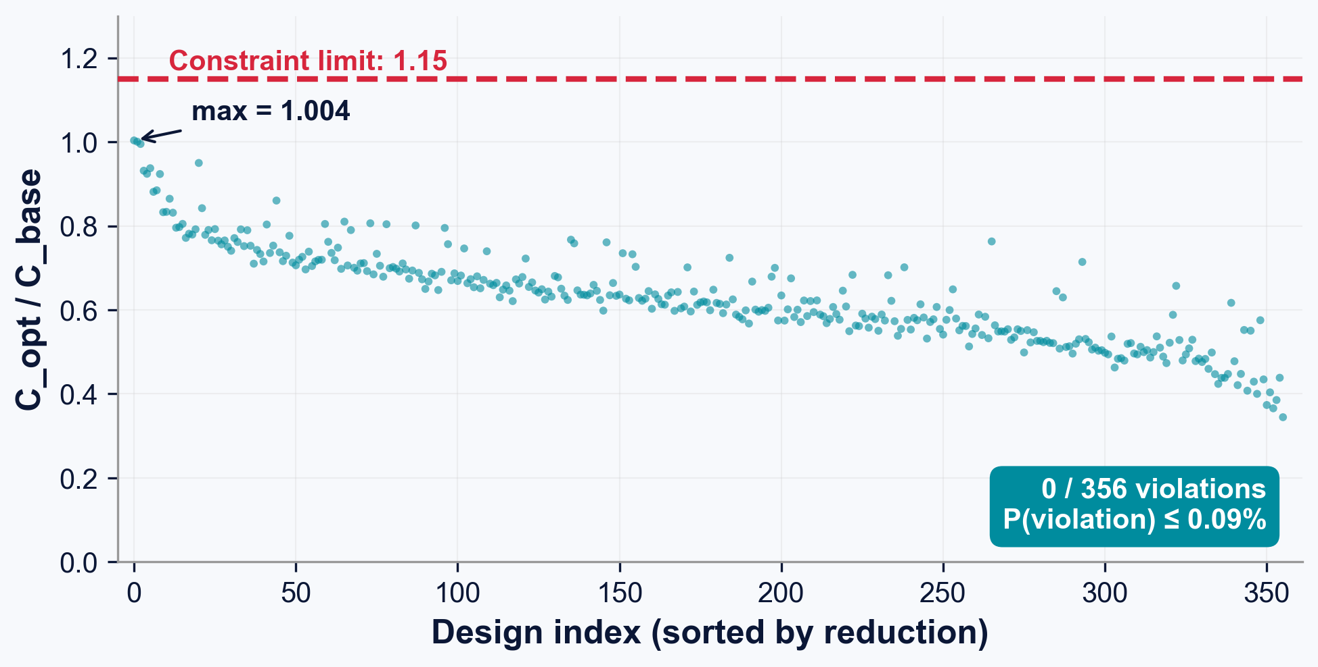
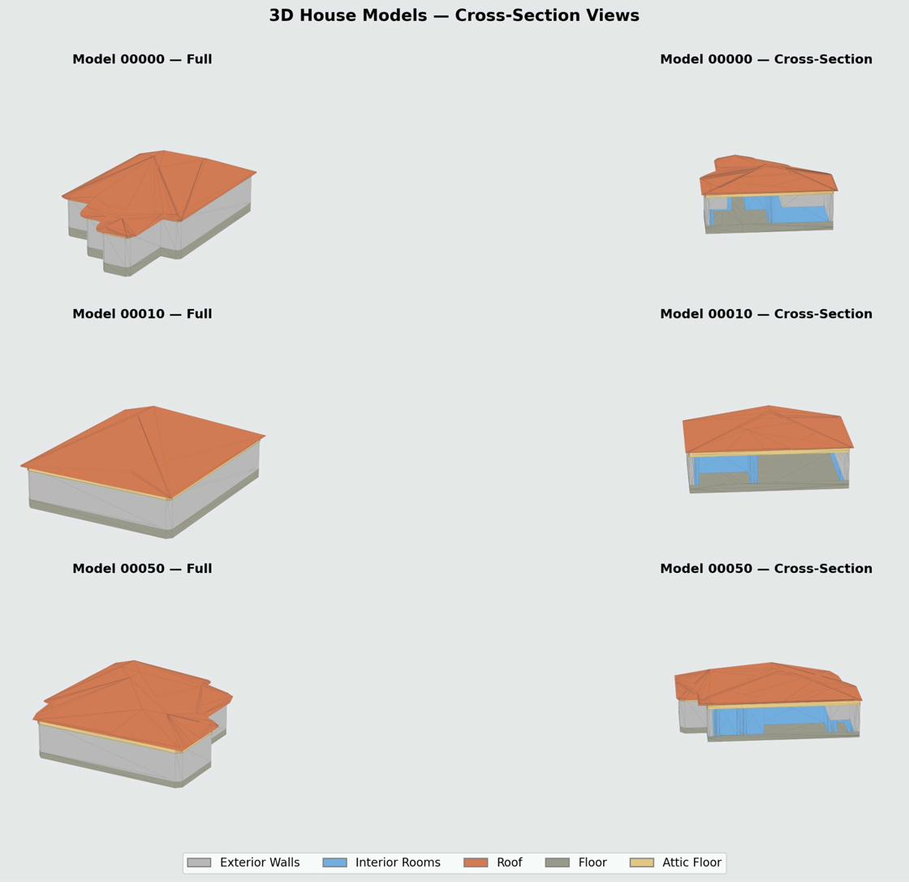
SURROGATE-ACCELERATED STRUCTURAL OPTIMIZATION
Intel ISEF 2026 — Engineering Mechanics
Credit Line of Origin
References & data in references below:
Images denoted with an asterisk (*) are from
public-domain or adapted from publicly available
sources. All other figures created by Eric Hou.
Additive Manufacturing: Harnessing FEA to Optimize Material Efficiency
Eric Hou
VISUAL ABSTRACT
ENGINEERING METHODOLOGY
STATISTICAL ANALYSIS
Dataset Generation Pipeline
Deep Ensemble Surrogate (5×8.76M params)
Surrogate Model Performance
×5 ENSEMBLE
Target | Spearman ρ | R²_log | MAPE%
Von Mises stress | 0.737 | 0.419 | 37.4
Displacement | 0.970 ★ | 0.842 | 10.9
Compliance | 0.948 ★ | 0.814 | 18.5
Architecture:
• 4 conv stages: 128³→64³→32³→16³→8³
• 3 SE-ResBlocks with squeeze-excitation
• Dual pooling (avg+max) → 512-d embed
• + 128-d feature MLP (material+loads)
• Head: 640→512→256→3 with skip conn
Training:
• Huber loss (SmoothL1)
• AdamW, lr=5×10⁻⁴, cosine anneal
• EMA decay 0.999, AMP, grad clip ‖·‖≤1
• Aug: 90° rot, flips, noise σ=0.02
• Dropout 0.15, stochastic depth 0–0.1
• Input: log(1+|y|) → z-score normalize
Outputs: peak σ_VM, max u, compliance C
Predicts global scalars (not field), enabling fast backprop sensitivity + ensemble UQ.
Ranking accuracy (Spearman ρ), not pointwise prediction, drives optimization safety. Compliance ρ=0.948 → correct voxel ordering for removal. Stress ρ=0.737 is adequate because the penalty acts as a soft gate, not a hard classifier.
Optimization Convergence
Fig. 1. SASTO pipeline: 3D wireframe → volumetric parts → FEA dataset → deep ensemble surrogate → sensitivity-guided optimization → watertight STL
The visual abstract shows the end-to-end SASTO workflow. A 3DWire building wireframe is extruded into four structural parts (exterior walls, interior walls, roof, floor), meshed and simulated with FEA to train a 5-member deep ensemble. At optimization time, the surrogate replaces FEA, enabling 23–92× faster topology optimization with zero constraint violations.
Fig. 6. 14,293 wireframes → 11,178 FEA sims → 128³ voxel grids
INTRODUCTION
Split | n | Targets
Train | 8,943 | σ_VM, u_max, C
Validation | 1,121 | —
Test | 1,114 | Ground-truth FEA
Fig. 14. SASTO-PA (teal) vs. SASTO-U (gold). Part-aware enables deeper removal.
GLIOBLASTOMA & CO₂ CRISIS
Concrete production accounts for ~8% of global CO₂ emissions [IEA 2021]. In conventional construction, walls are built at uniform thickness—a practice driven by formwork constraints, not structural need. Interior partitions bear negligible loads compared to exterior shear walls, creating a substantial opportunity for material reduction.
ADDITIVE MANUFACTURING
Large-scale 3D printing (ICON, COBOD, Apis Cor) can realize arbitrary wall profiles at no marginal tooling cost. However, exploiting this geometric freedom requires optimized 3D models that minimize volume, satisfy structural constraints under ASCE 7-22 load cases, and produce watertight meshes compatible with printer toolpath generation.
COMPUTATIONAL BOTTLENECK
Classical SIMP requires hundreds–thousands of FEA evaluations, each costing minutes–hours at building scale. Voxel-based implementations using 26-connectivity produce disconnected floating fragments incompatible with AM. No prior work combines surrogate-accelerated optimization with formal mesh connectivity guarantees at building scale.
SASTO CONTRIBUTION
SASTO replaces FEA with a deep ensemble surrogate, achieving 23–92× speedup. A 6-connectivity criterion eliminates floating fragments. Part-aware thickness enables differential thinning. Across 1,114 geometries: 23.5%±7.8% mean reduction, zero FEA violations.
Pipeline: (1) 3DWire wireframe → volumetric parts via extrusion (ext walls 4 voxels ≈ 316 mm, int walls 2 voxels ≈ 158 mm); (2) boolean fusion via FreeCAD; (3) tetrahedral meshing via Gmsh (50k–200k elements); (4) SfePy FEA under ASCE 7-22 ASD loads; (5) voxelization onto 128³ grid with part labels. Data filtering: 3,115/14,293 (21.8%) rejected for diverged displacement (>1.0 m), degenerate compliance (<10⁻⁶ J), or invalid stress (≤0 Pa). Retained data spans 4.9 orders of magnitude in stress and 7.7 orders in compliance, motivating log-transform normalization.
SASTO-PA converges to 45.0% reduction vs. SASTO-U at 34.3% on the reference geometry. Phase 1 removes >99% of material in large batches; Phases 2–3 squeeze the remaining feasible voxels near the constraint boundary.
Parameter | Value
Ensemble size | M = 5 (43.8M total)
Input | 7-ch 128³ + 10-d feature
Regularization | dropout 0.15, WD 10⁻⁴
Normalization | log(1+|y|) → z-score, 2/98‰ clip
k-Factor Sensitivity (Pareto Frontier)
Fig. 7. Dual pooling → 512-d embed → 3 scalar outputs per member
k=1.0 Operating Point
Each member: ~8.76M parameters. Ensemble provides epistemic uncertainty estimates via member disagreement. Gradient variance reduced by √M ≈ 2.24× vs. single model. Trained on 4× NVIDIA GB200 GPUs.
Fig. 15. Non-monotonic Pareto: both gate stringency and budget depend on k.
k<0.5: under-conservative → risks violations. k>2.0: over-conservative → less removal. k=1.0 achieves Pareto-optimal balance: maximum reduction with zero violations. Conformal calibration: k_conformal = 1.90 for 84.1% coverage (heavier-tailed than Gaussian).
SASTO Algorithm — Sensitivity-Guided Erosion
Topology: 6-Connectivity Guarantee
Conformal Prediction & UQ
26-CONN — FAILS
6-CONN — WORKS
Before vs. after optimization*
vs.
Fig. 16. Uncertainty bands widen during optimization. Γ_D ≈ 0.184 (sub-linear).
RESEARCH OBJECTIVES
✗ Thousands of floating fragments ✗ Diagonal-only connections ✗ Marching cubes incompatible ✗ Cannot generate AM toolpath
✓ 1 connected component ✓ Face-share adjacency only ✓ Watertight STL confirmed ✓ AM toolpath compatible
Ensemble disagreement D(ϕ) = (1/T)·Σⱼ σⱼ/μⱼ tracks distribution shift as material is removed. Disagreement divergence rate Γ_D ≈ 0.184 signals sub-linear uncertainty growth. Distribution-free conformal certification on n=1,114 FEA-validated designs: P(violation) ≤ 0.09% (one-sided Clopper-Pearson at α=0.05). Ensemble residuals are heavier-tailed than Gaussian.
1
SPEED
23–92× speedup via deep ensemble surrogate replacing FEA during optimization
Proposition: A binary voxel field with exactly one 6-connected foreground component yields a single-component marching-cubes surface mesh. Proof by induction: two 6-adjacent voxels share a face whose 4 dual-grid vertices satisfy ψ ≤ 0 → connected triangle patches.
2
PRINTABILITY
6-connected topology → single-mesh watertight STL for AM toolpath
3
EFFICIENCY
23.5%±7.8% mean material reduction (up to 45.0%) across 1,114 geometries
Fig. 8. Three-phase optimization. Phase 1 removes >99% of material.
6-Simple Point Test (Kong & Rosenfeld 1989)
4
SAFETY
0/1,114 FEA violations; conformal P(violation) ≤ 0.09%
Phase 1: Sensitivity-Guided Erosion
SP₆(v) = 1 iff |C₆(ρ'∩N₂₆(v))| = 1 ∧ |C₂₆(ρ̄'∩N₂₆(v)∪{v})| = 1
Data Generation
►
Surrogate Training
►
SASTO Optimize
►
Validate & Certify
Sort candidates by descending sᵢ; batch-remove 6-simple-points; if constraints violated → undo, halve B → max(B/2, 10). Accounts for >99% of total removal.
Foreground uses 6-connectivity; background uses complementary 26-connectivity. This (6,26) pairing follows digital topology convention and prevents diagonal-only attachments that violate marching cubes assumptions. The standard (26,6) pairing in topology optimization literature produces thousands of floating fragments.
Phase 2: Fine-Grained Endgame
Re-run Phase 1 with B ∈ {5, 1} to squeeze remaining feasible removals near the constraint boundary.
ENGINEERING DESIGN CRITERIA
Phase 3: Swap Refinement
Thick interior voxels (dist ≥ 3) swapped with removed neighbors; accept if volume decreases and constraints hold.
Constraint | Limit | Basis
Von Mises stress | σ_VM ≤ 5.0 MPa | f'c/(γ_m×γ_f) = 30/(3×2)
Compliance ratio | C_opt/C_base ≤ 1.15 | 15% stiffness budget
Displacement | u_max ≤ L/360 ≈ 28 mm | ASCE 7-22 serviceability
Wall t (exterior) | 2Δx ≈ 156 mm | Load-bearing path
Wall t (interior) | 1Δx ≈ 78 mm | Non-structural partition
Mesh integrity | 1 connected component | AM printability req.
Post-processing: fill enclosed air pockets (≤50 voxels), remove shard voxels (<2 face-neighbors), compute SDF → marching cubes → Laplacian smoothing → watertight STL. 90% produce single-component mesh directly; remaining 10% need trivial fragment removal (mean 1.2 components, max 4).
CONCLUSIONS
1
SASTO achieves 23.5%±7.8% mean material reduction across 1,114 held-out geometries, up to 45.0% on individual designs — the first surrogate-accelerated, topology-preserving optimizer at building scale.
σ_VM,allow = f'c / (γ_m × γ_f) = 30 MPa / (3.0 × 2.0) = 5.0 MPa
2
Deep ensemble surrogate (5×8.76M params) provides 23–92× speedup vs. SIMP: median 50 s on consumer GPU vs. 19–77 min for SIMP. Predicts global scalars enabling fast backprop sensitivity.
Conservative bound: μ̂_σ + k·σ̂_σ, k = 1.0 → P(violation) ≤ 0.09% (conformal)
Fig. 9. 6-conn eliminates floating fragments incompatible with AM toolpaths
3
6-connectivity criterion (new in building-scale TO) eliminates thousands of floating mesh fragments produced by standard 26-connectivity, guaranteeing watertight single-component STLs compatible with AM toolpath generation.
Material: isotropic linear elastic concrete. E = 25 GPa, ν = 0.20, ρ = 2,400 kg/m³, f'c = 30 MPa. Loading: ASCE 7-22 ASD combinations — dead (self-weight), live (1.92 kPa), lateral wind (0.96 kPa). Fixed-base BC at min-x face. Displacement inactive in all 1,114 cases (max ~ 10⁻⁴ m, four orders below limit).
RESULTS & IN-SILICO VALIDATION
4
Part-aware thickness yields 10.7pp more reduction than uniform baseline by permitting 1-voxel (78 mm) interior walls while protecting 2-voxel (156 mm) load-bearing exterior members.
PROBLEM FRAMING
Reference Case (Sample 00472)
1,114-Geometry Generalization
Speedup vs. SIMP
Optimization Objective
5
Independent FEA re-analysis: zero violations across all 1,114 designs (max C_opt/C_base = 1.004 vs. 1.15 limit). Conformal certification: P(violation) ≤ 0.09% at 95% confidence.
min J(ρ) = w_V·(V/V₀) + w_S·(S/V₀) + P_constraint(ρ) [w_V=1.0, w_S=0.01, κ=100]
V(ρ) = Σᵢρᵢ (total volume), S(ρ) = ½·Σᵢρᵢ·Σⱼ∈N₆(i)(1−ρⱼ) (exposed surface regularizer). Constraint penalty aggregates all structural violations with κ = 100 to approximate hard constraints. The upper-bound ensemble estimates: σ̂⁺ = μ_σ + k·σ_σ, Ĉ⁺ = μ_C + k·σ_C.
Sensitivity via Surrogate Backpropagation
−45.0% material
sᵢ = (1/M)·Σₘ ∂/∂ρᵢ[fₘ(C) + 0.3·fₘ(σ)] sᵢ > 0 → safe to remove | sᵢ < 0 → essential
Fig. 12. SIMP 64³: 94 s vs SASTO 128³: 50 s → 23–92× faster
Impact: 8% of global CO₂ = cement. 23.5% less concrete per house → millions of tons saved at scale if adopted by AM construction.
Each sensitivity computation requires M=5 forward+backward passes through the CNN (~3–8 s on RTX A3000), replacing a full FEA adjoint solve requiring minutes. Ensemble averaging: Var[s̄ᵢ] ≈ Var[sᵢ⁽¹⁾]/M → √5 ≈ 2.24× reduction in gradient noise.
Fig. 10. Volume reduction histogram | n=1,114 | μ=23.5%±7.8%
SASTO at 128³ (median 50s, consumer GPU) vs. SIMP at 64³ (94s) and 128³ (77 min). SIMP requires hundreds of FEA solves; SASTO uses only surrogate forward+backward passes.
FUTURE WORK
Part-Aware Thickness Constraint
Before/after optimization renders
Across all 1,114 held-out test geometries, SASTO-PA achieves mean 23.5%±7.8% (std) material reduction. Maximum 45.0% on individual designs. Part-aware rule yields 10.7pp more than uniform.
Independent FEA Re-analysis (n=1,114)
1
FEA-IN-THE-LOOP ACTIVE LEARNING
t_min(p) = 2Δx = 156 mm for {ext, roof, floor} | 1Δx = 78 mm for interior walls
Metric | Baseline | SASTO-PA
Vol. reduction | — | 45.0% ★
VM stress (Pa) | 3.08×10⁶ | 3.08×10⁶ ✓
Compliance ratio | 1.00 | 1.004 ✓
Mesh components | 1 | 1 ✓
Runtime | — | 160 s
EI Index | — | 0.358 ★
0/1,114 violations
When ensemble Γ_D > threshold τ, trigger ground-truth FEA mid-optimization → self-correcting safety net. Extends to multi-story and seismic load cases where displacement may become active.
The part-aware formulation differentially thins interior partitions (1-voxel minimum, ~78 mm) while protecting load-bearing exterior walls, roof, and floor (2-voxel minimum, ~156 mm). Exterior walls are the primary lateral and gravity load path; interior walls serve as non-structural partitions. This heterogeneous constraint is the key to SASTO-PA achieving 10.7pp more material reduction than the uniform-thickness baseline (SASTO-U). The distance transform identifies interior surface voxels whose depth exceeds t_min(p), making them eligible for removal. The 3-voxel exterior shell surface is excluded from modification entirely, protecting the building envelope.
P(violation) ≤ 0.09%
2
NONLINEAR FEA SPOT CHECKS
Table 1. SASTO-PA achieves 10.7pp more reduction than SASTO-U (34.3%) by permitting 1-voxel interior walls. EI Index = ΔV/V₀ / [(σ⁺/σ_allow)(1+C⁺/C_allow)]. Higher = better material efficiency per unit of structural utilization.
3
Concrete damaged plasticity (CDP) on 5 representative designs to assess tension cracking, compression softening, and buckling in 78 mm interior partitions.
PHYSICAL PRINT VALIDATION
Fig. 11. Per-part retention: load-bearing >91%, interior = primary target
Fig. 13. All C_opt/C_base ≤ 1.15. Max observed: 1.004
1:10 scale concrete print of optimized house. Compression testing + digital image correlation (DIC) for full-field strain mapping. Compare measured vs. predicted structural response.
Exterior walls and roof retain >91% of material (load-bearing). Interior walls are the primary optimization target, consistent with their non-structural classification under ASCE 7-22.
Same-method FEA reanalysis on all 1,114 optimized designs: zero violations of stress, displacement, or stiffness constraints. Max compliance ratio = 1.004 (vs. 1.15 limit). Confirms surrogate conservatism.
Optimized STL
►
3D Print 1:10
►
Compression + DIC
KEY REFERENCES
1. Bendsøe & Sigmund (2003). Topology Optimization: Theory, Methods and Applications. Springer.
2. Lakshminarayanan et al. (2017). Simple and scalable predictive uncertainty estimation. NeurIPS.
3. Kong & Rosenfeld (1989). Digital topology: Introduction and survey. CVGIP 48(3).
4. ASCE (2022). ASCE/SEI 7-22 Minimum Design Loads and Associated Criteria.
5. Buswell et al. (2018). 3D printing using concrete extrusion. Cement & Concrete Research 112.
6. Sigmund & Maute (2013). Topology optimization approaches. Struct Multidisc Optim 48.
7. Lin et al. (2024). 3DWire: large-scale 3D wireframe dataset. KAUST.
8. IEA (2021). Global Status Report for Buildings and Construction.
9. Lorensen & Cline (1987). Marching Cubes. SIGGRAPH.
10. Vovk et al. (2005). Algorithmic Learning in a Random World. Springer.
23.5%
23–92×
0 / 1,114
50 sec
Fig. 5. Part-aware thickness schematic
Mean material reduction
Speedup vs. SIMP
FEA constraint violations
Median runtime

