Slide 1
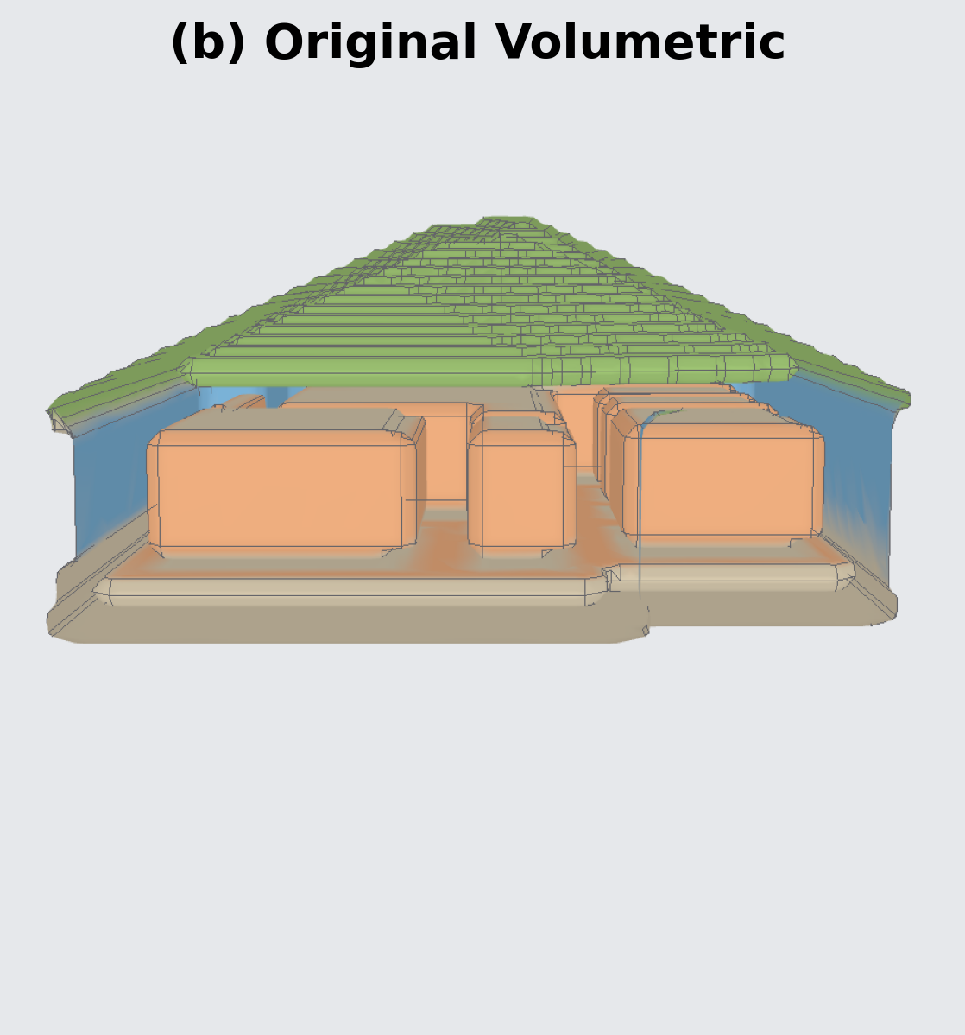
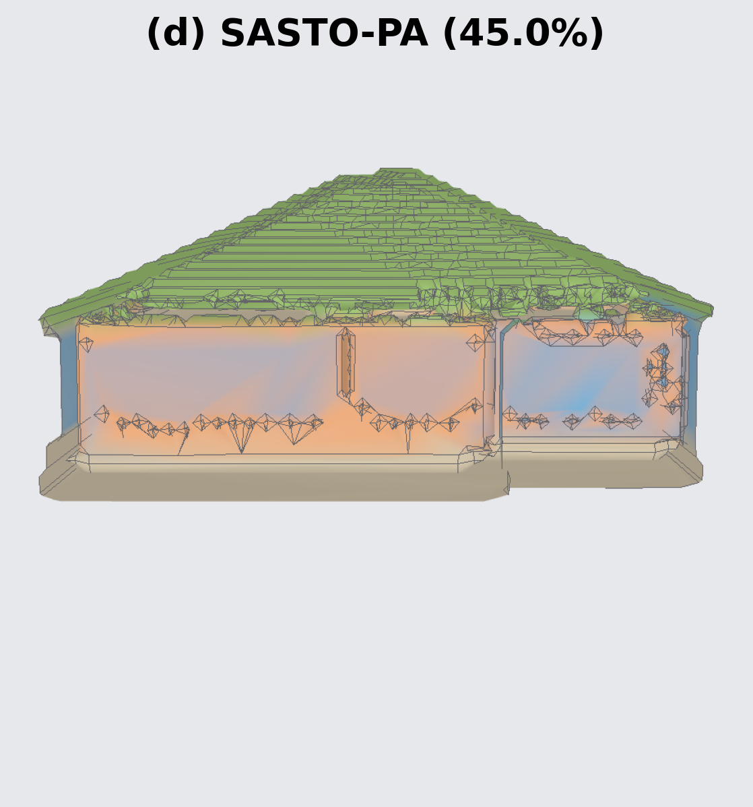
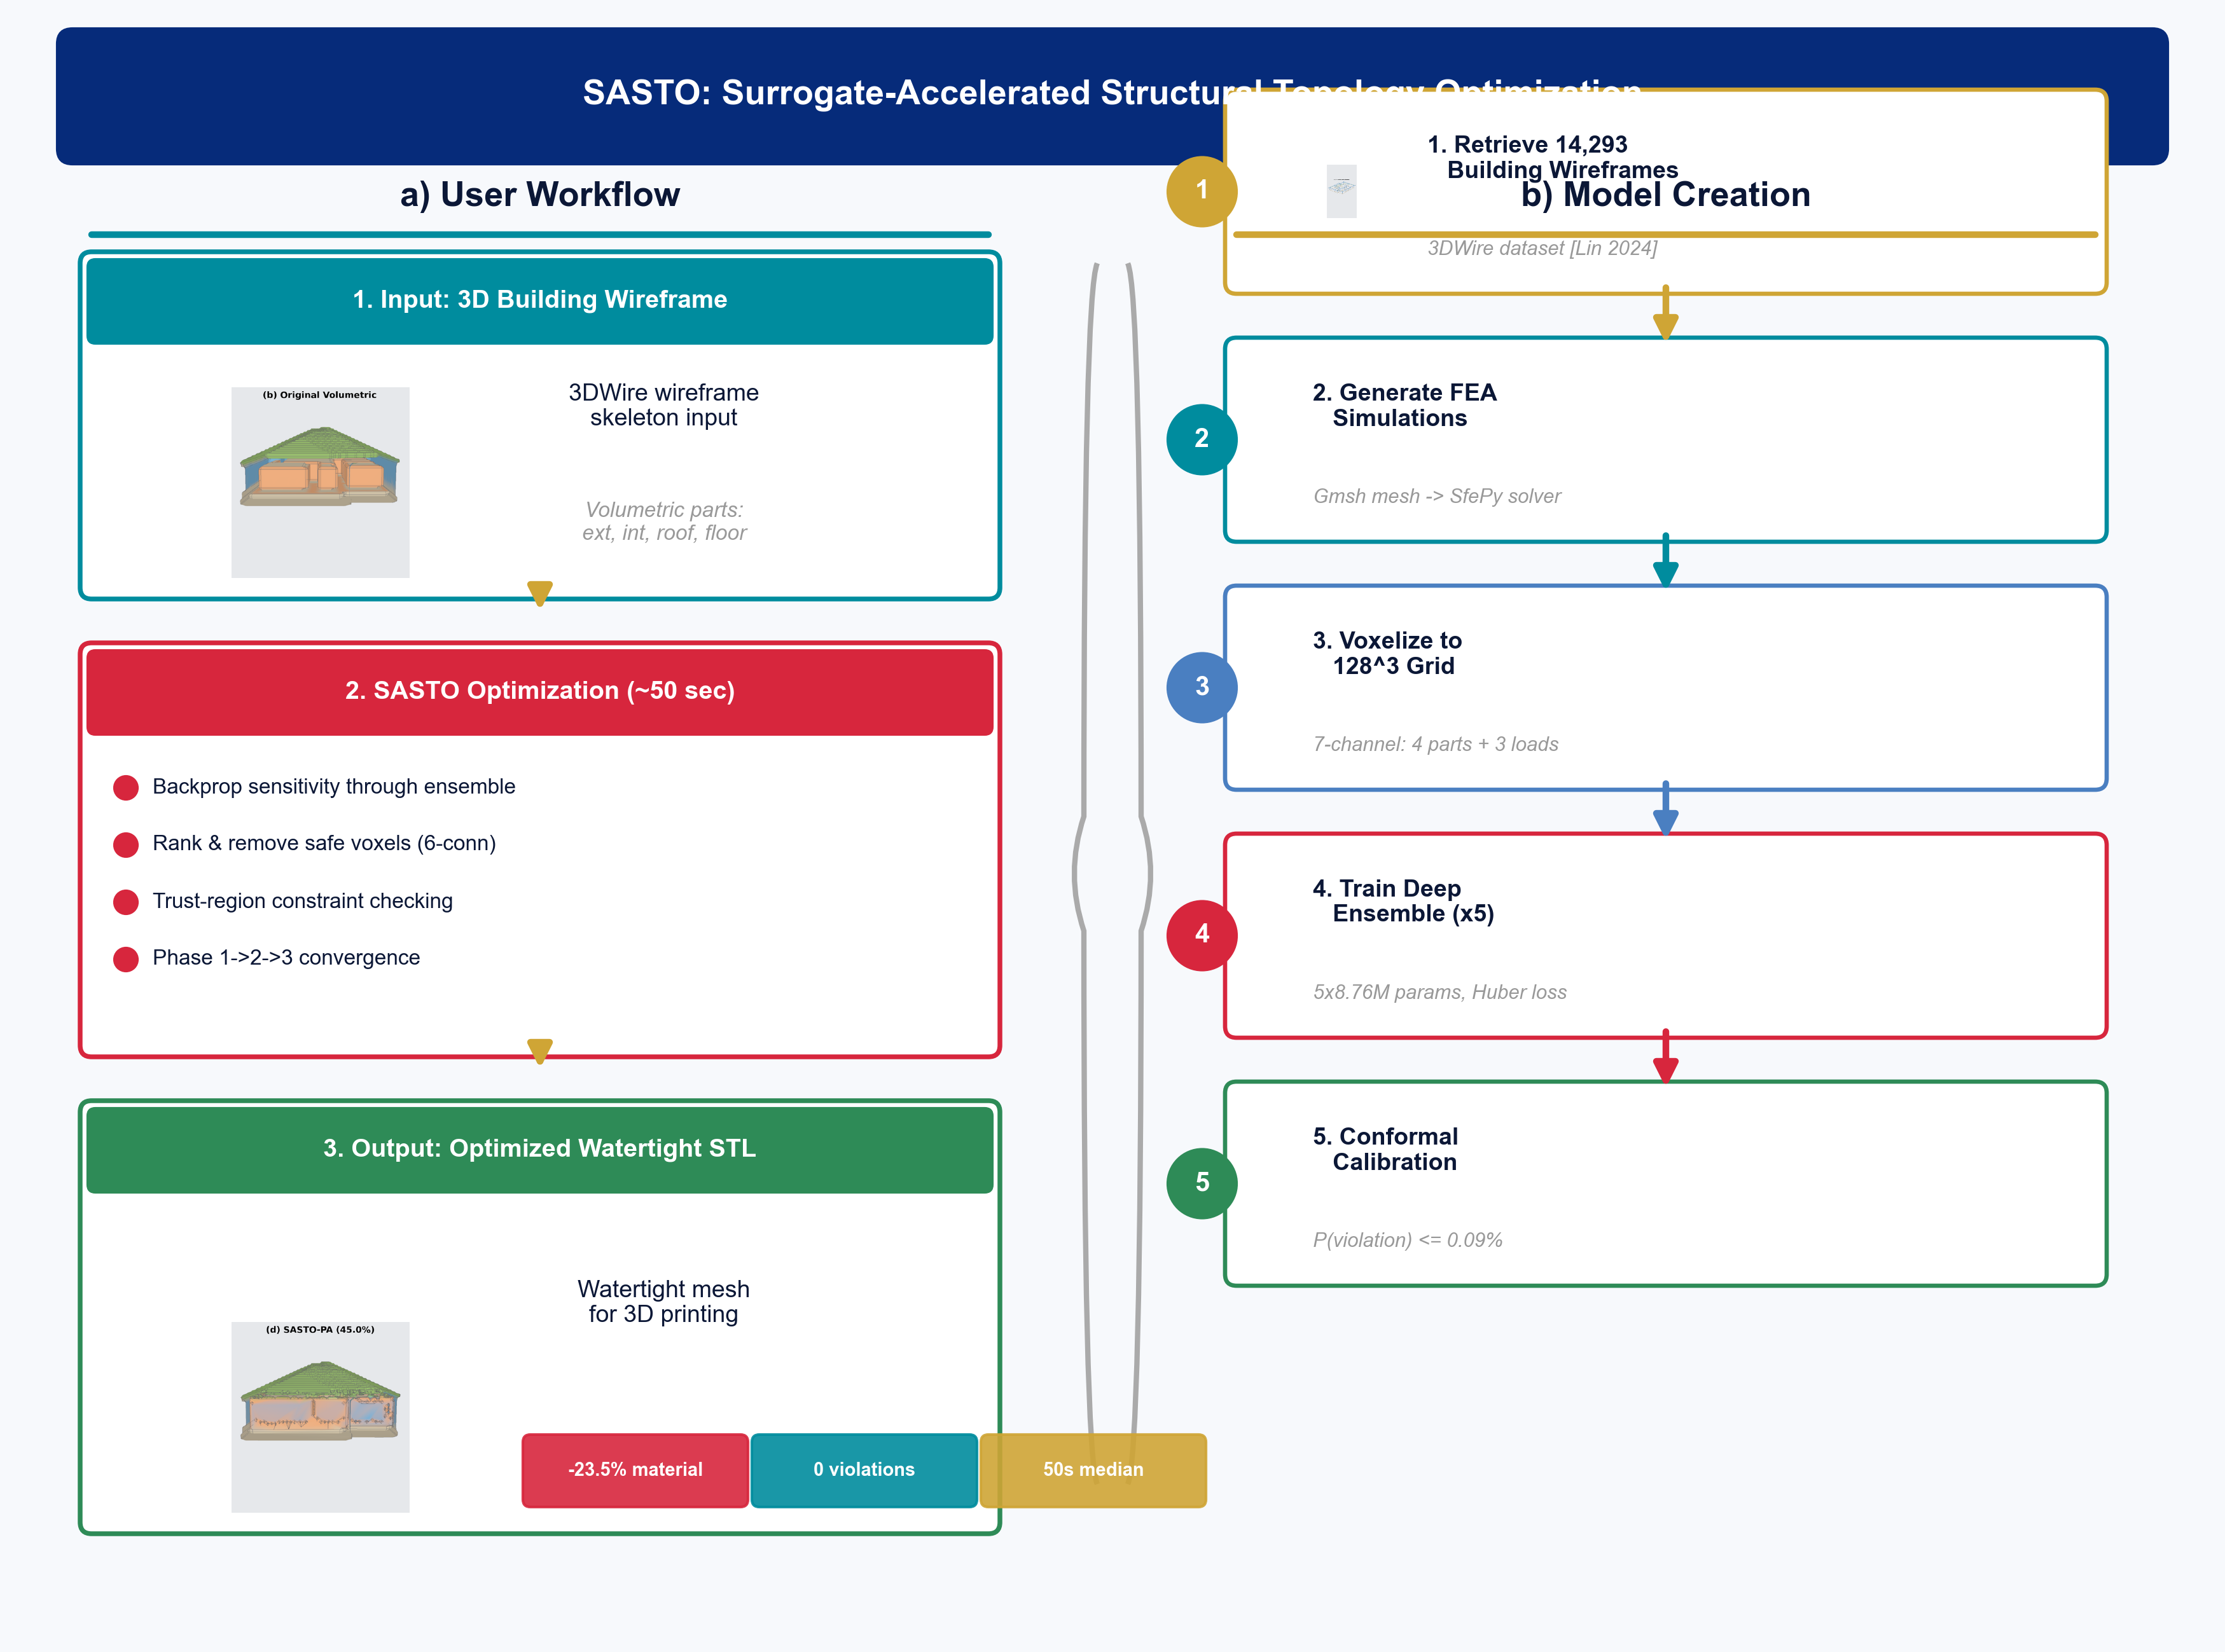
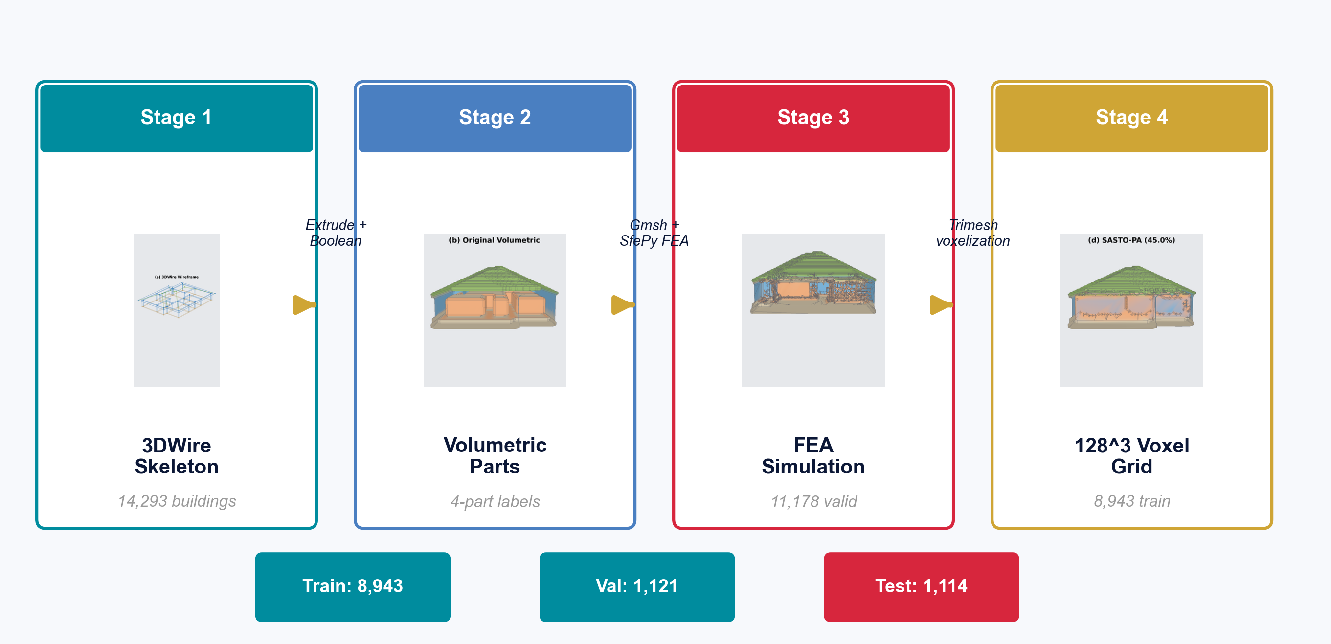
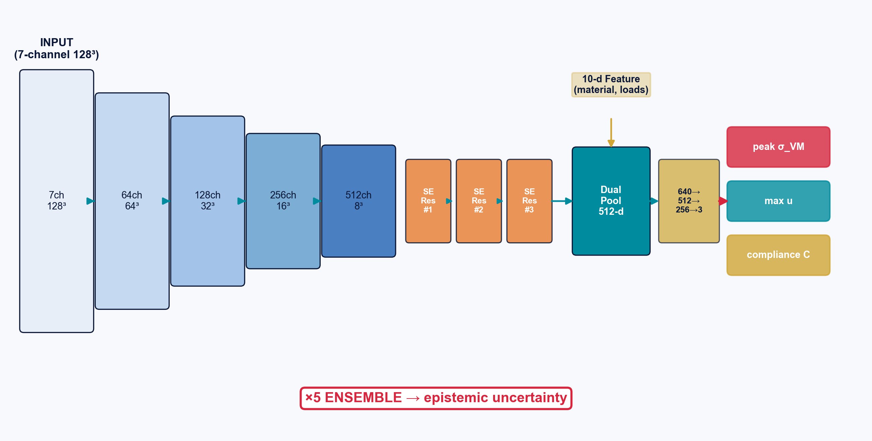
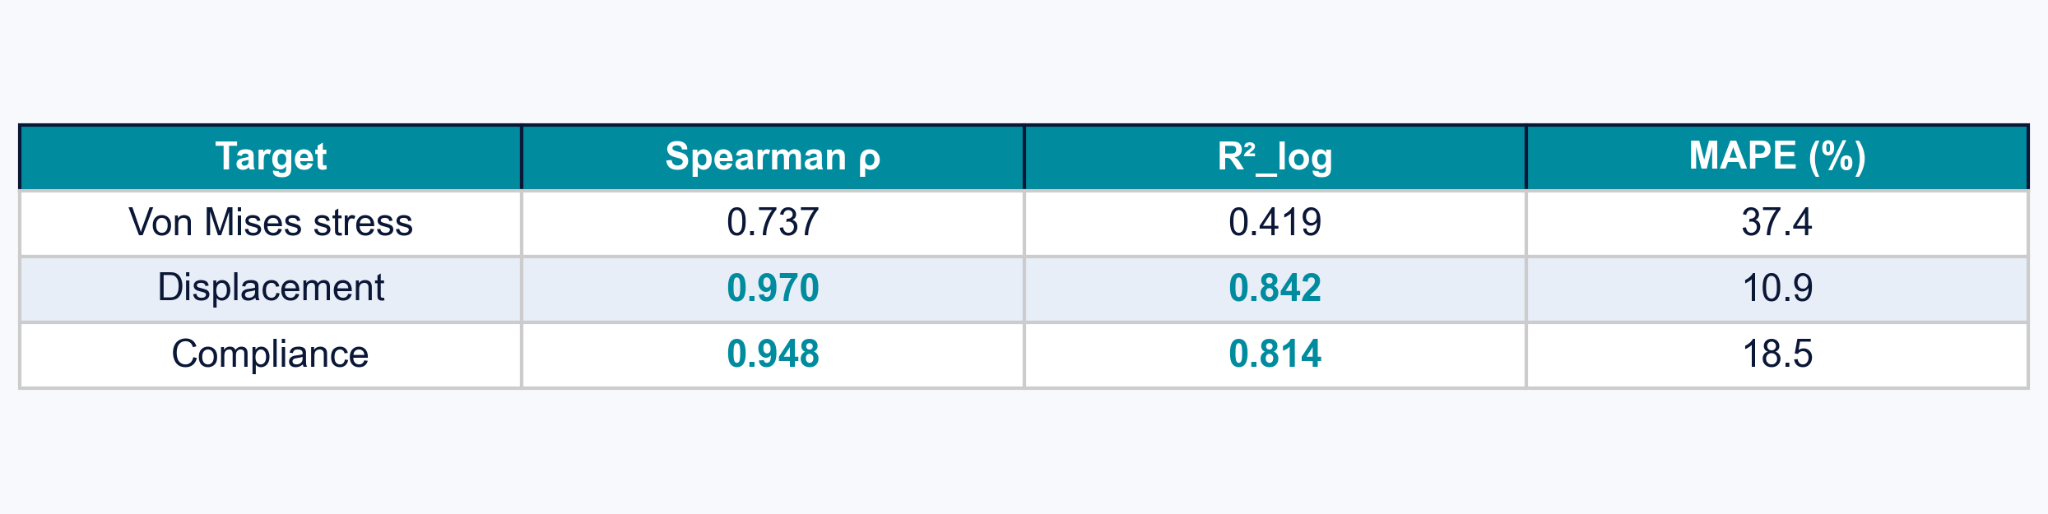
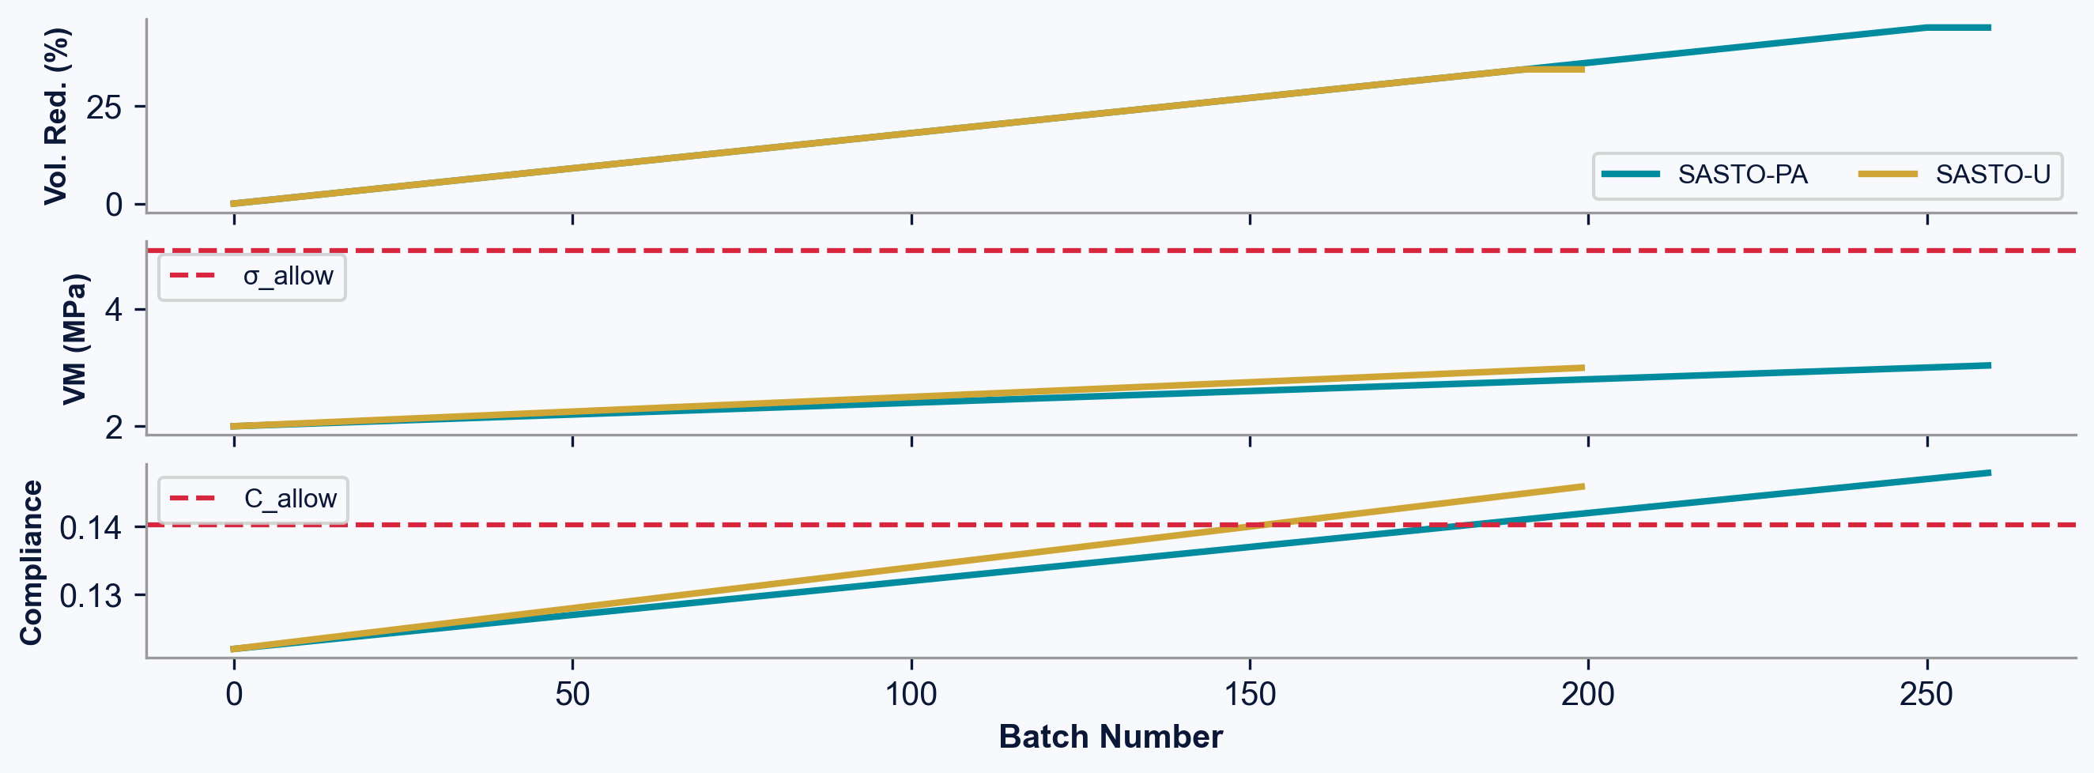
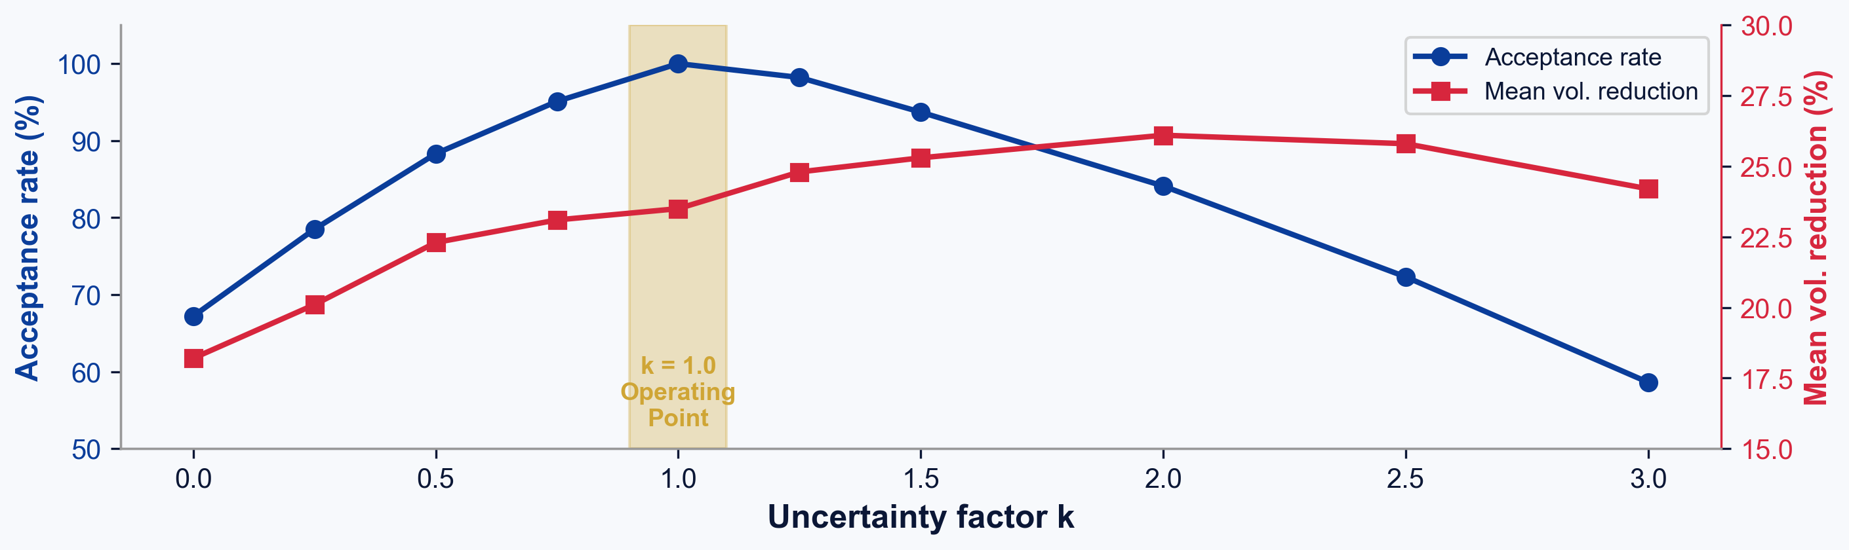
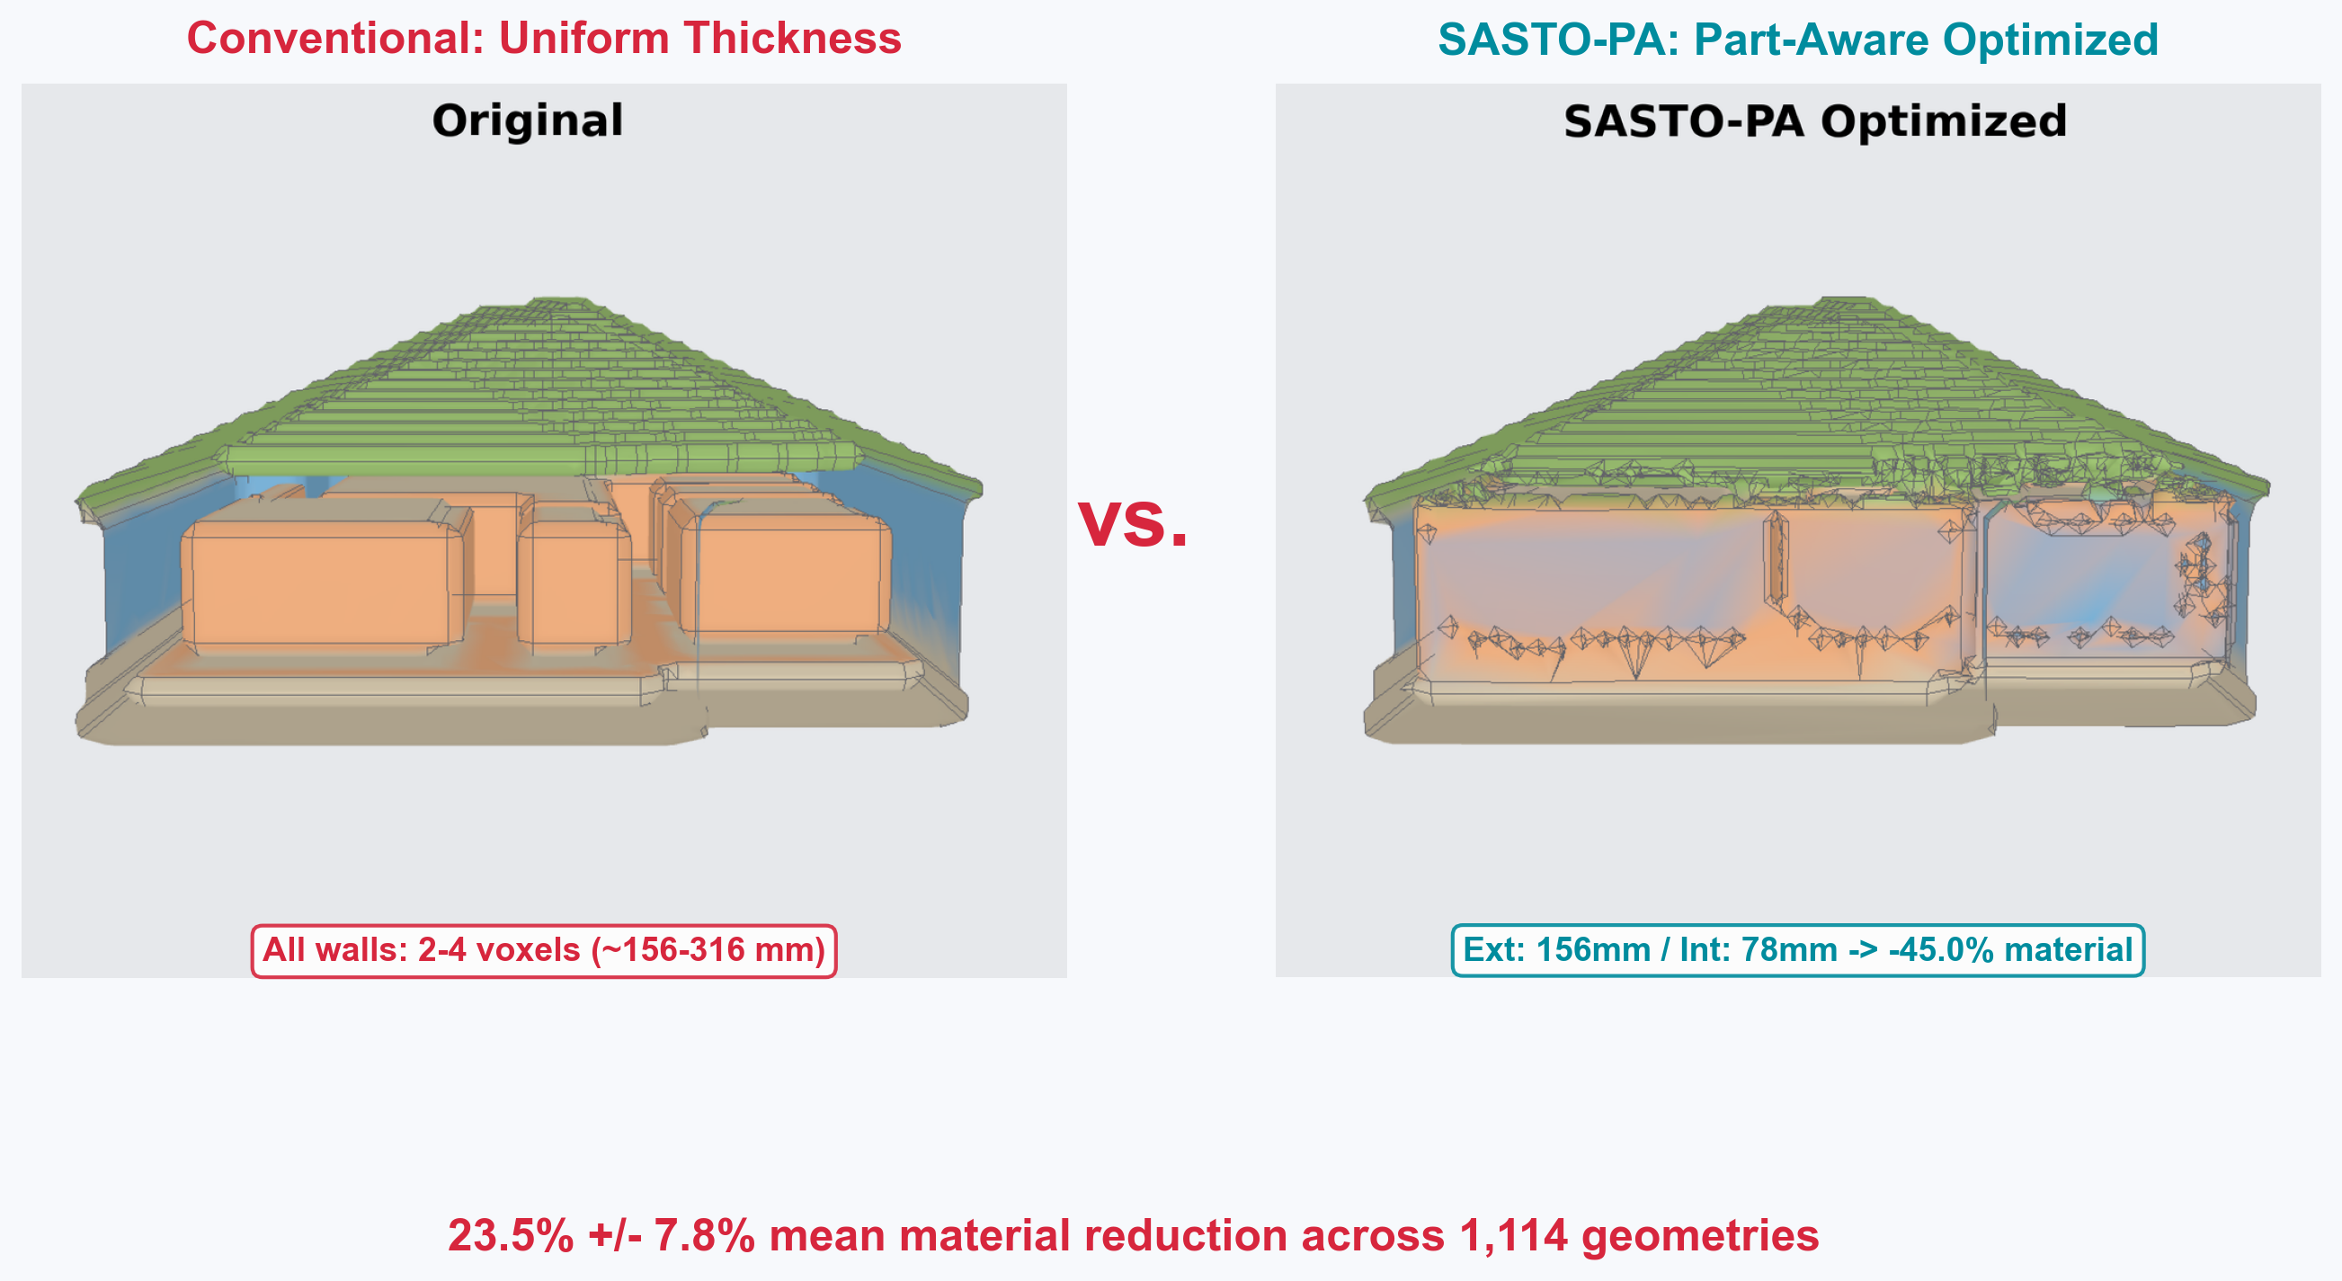
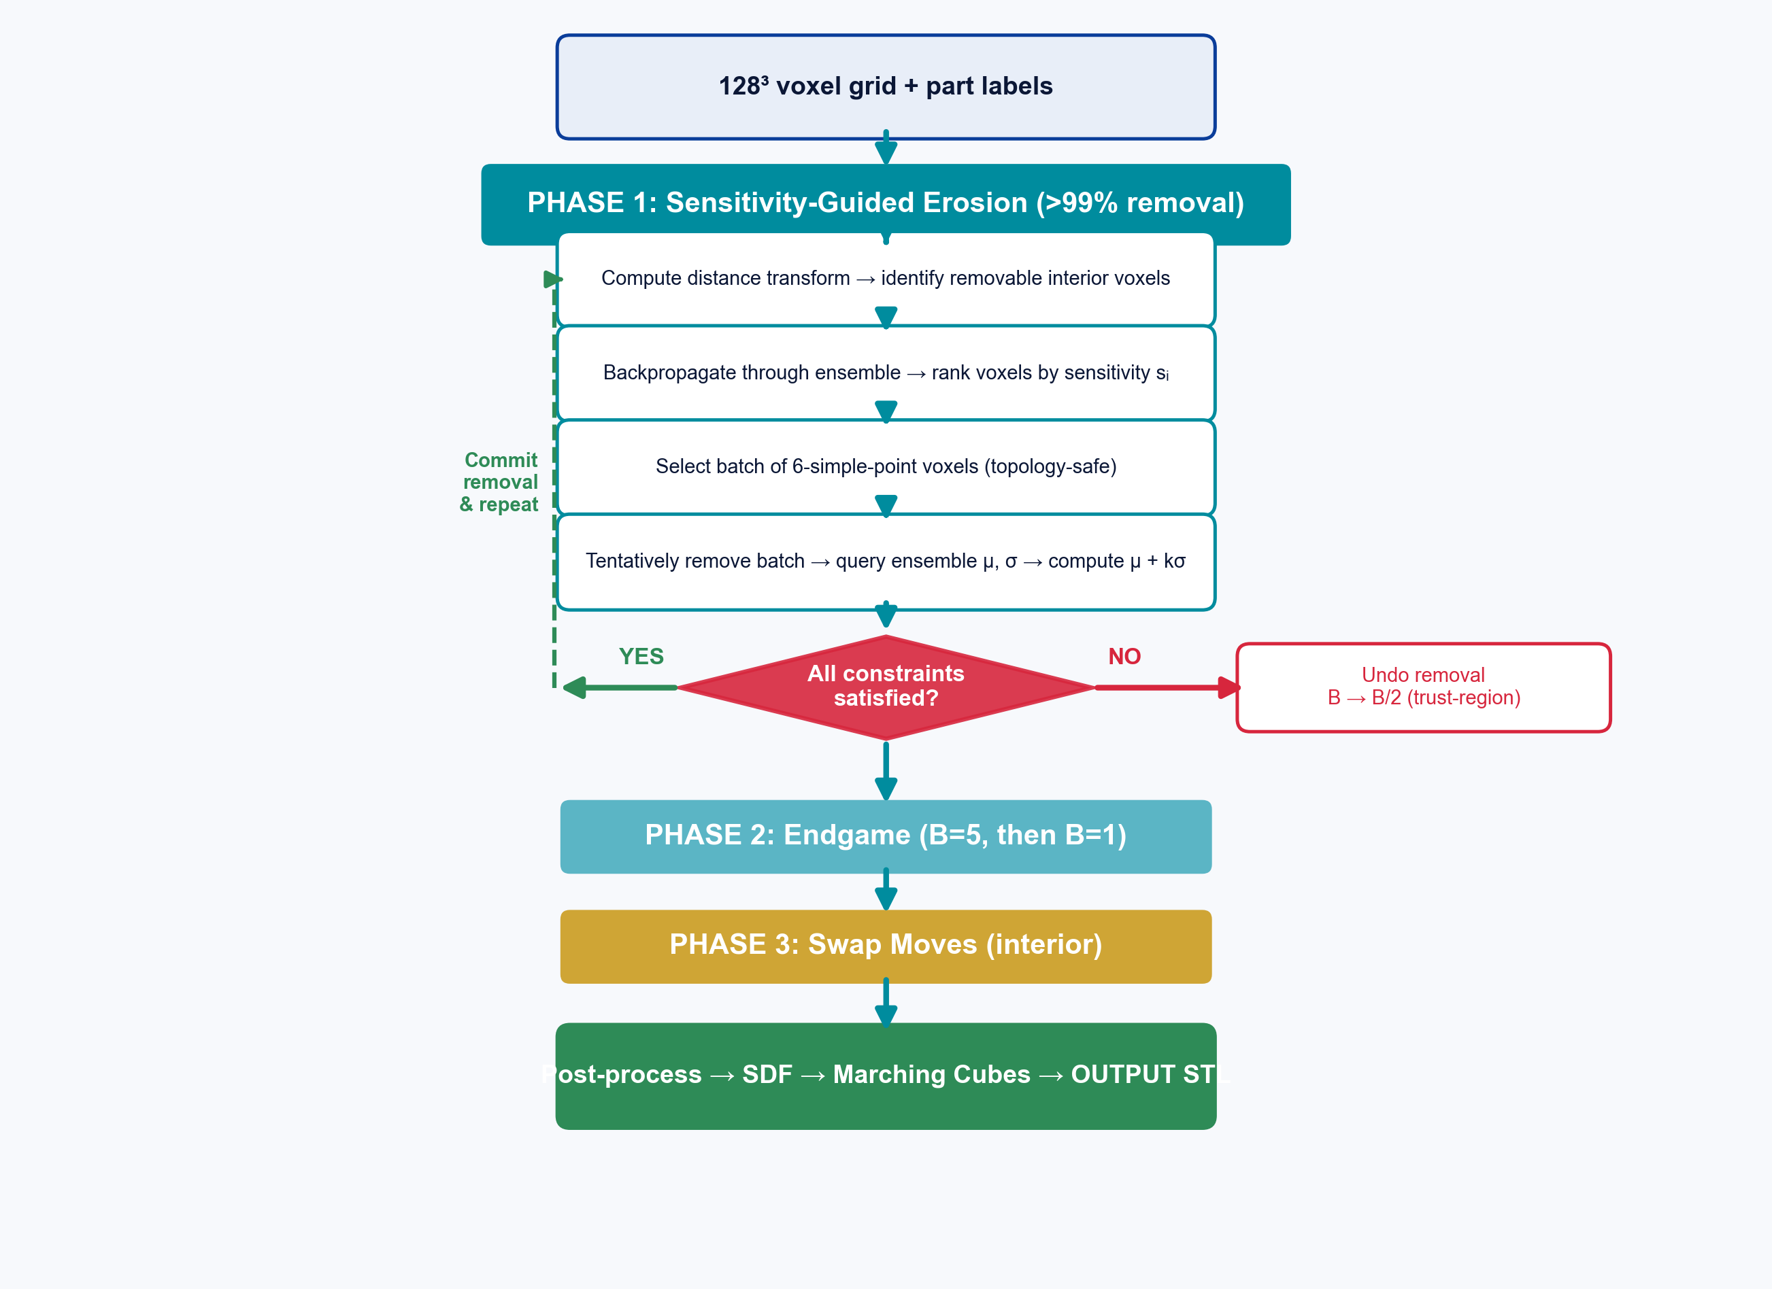
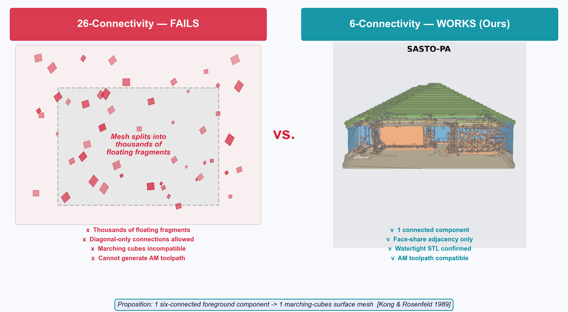
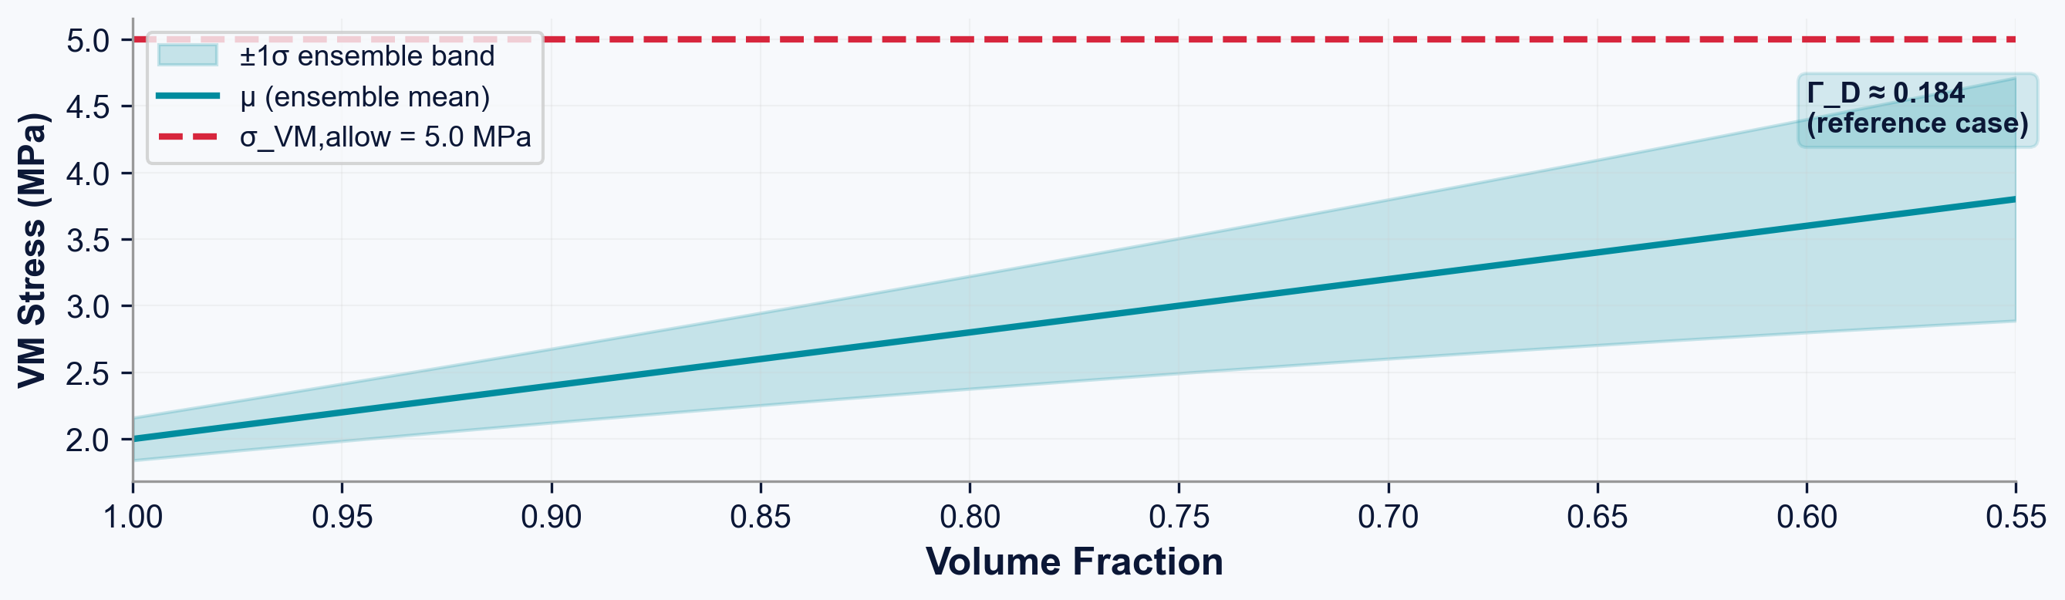
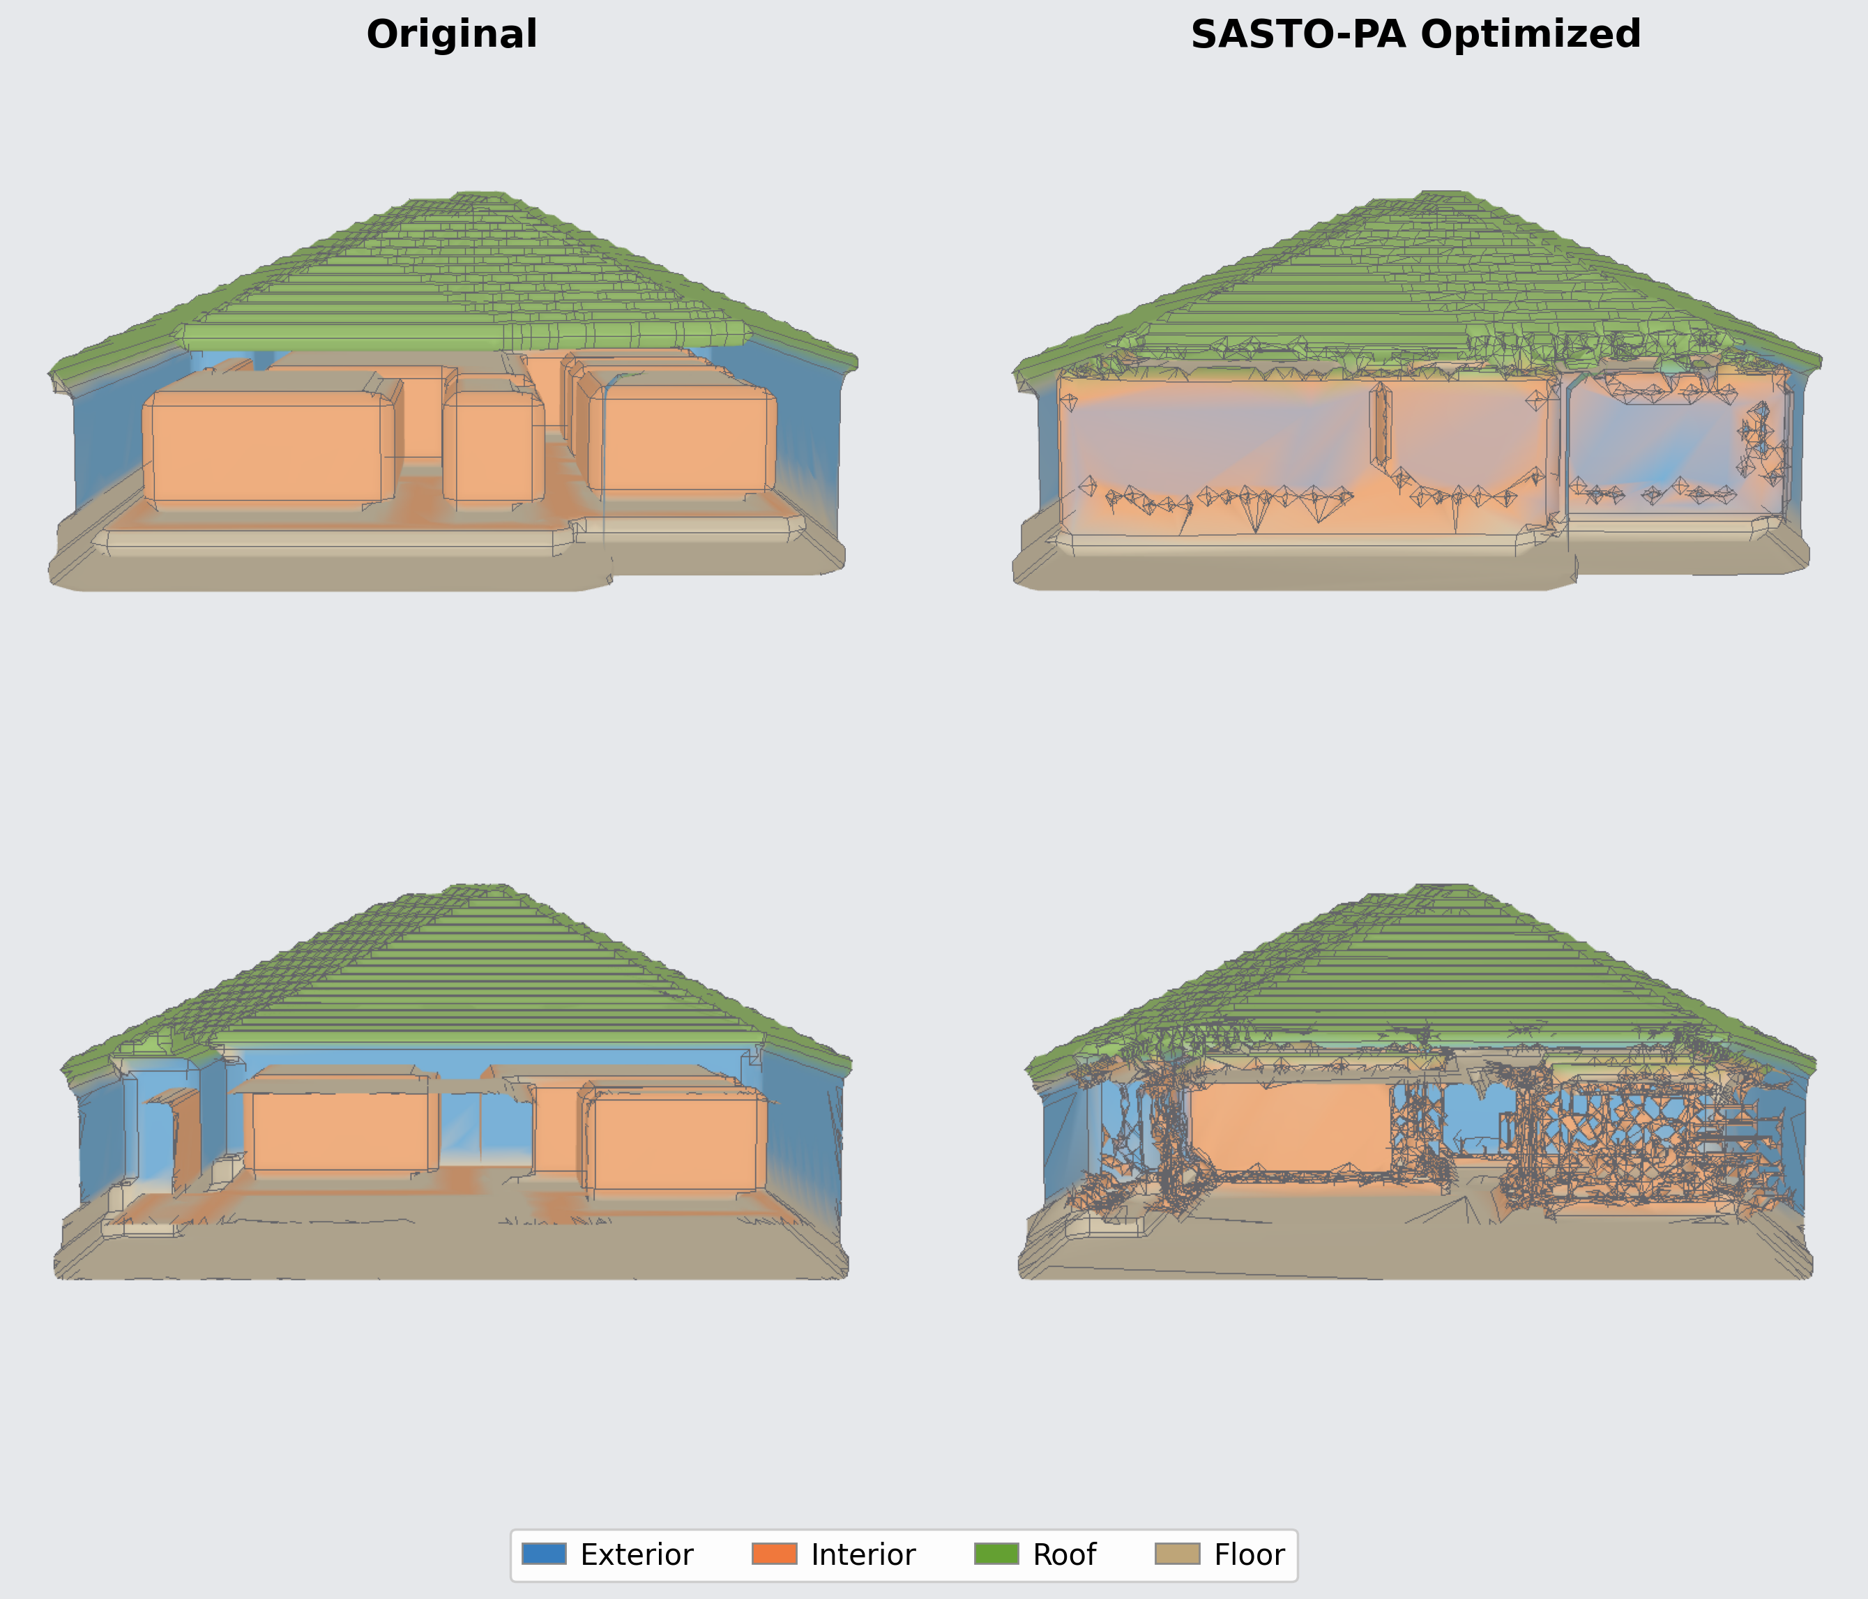
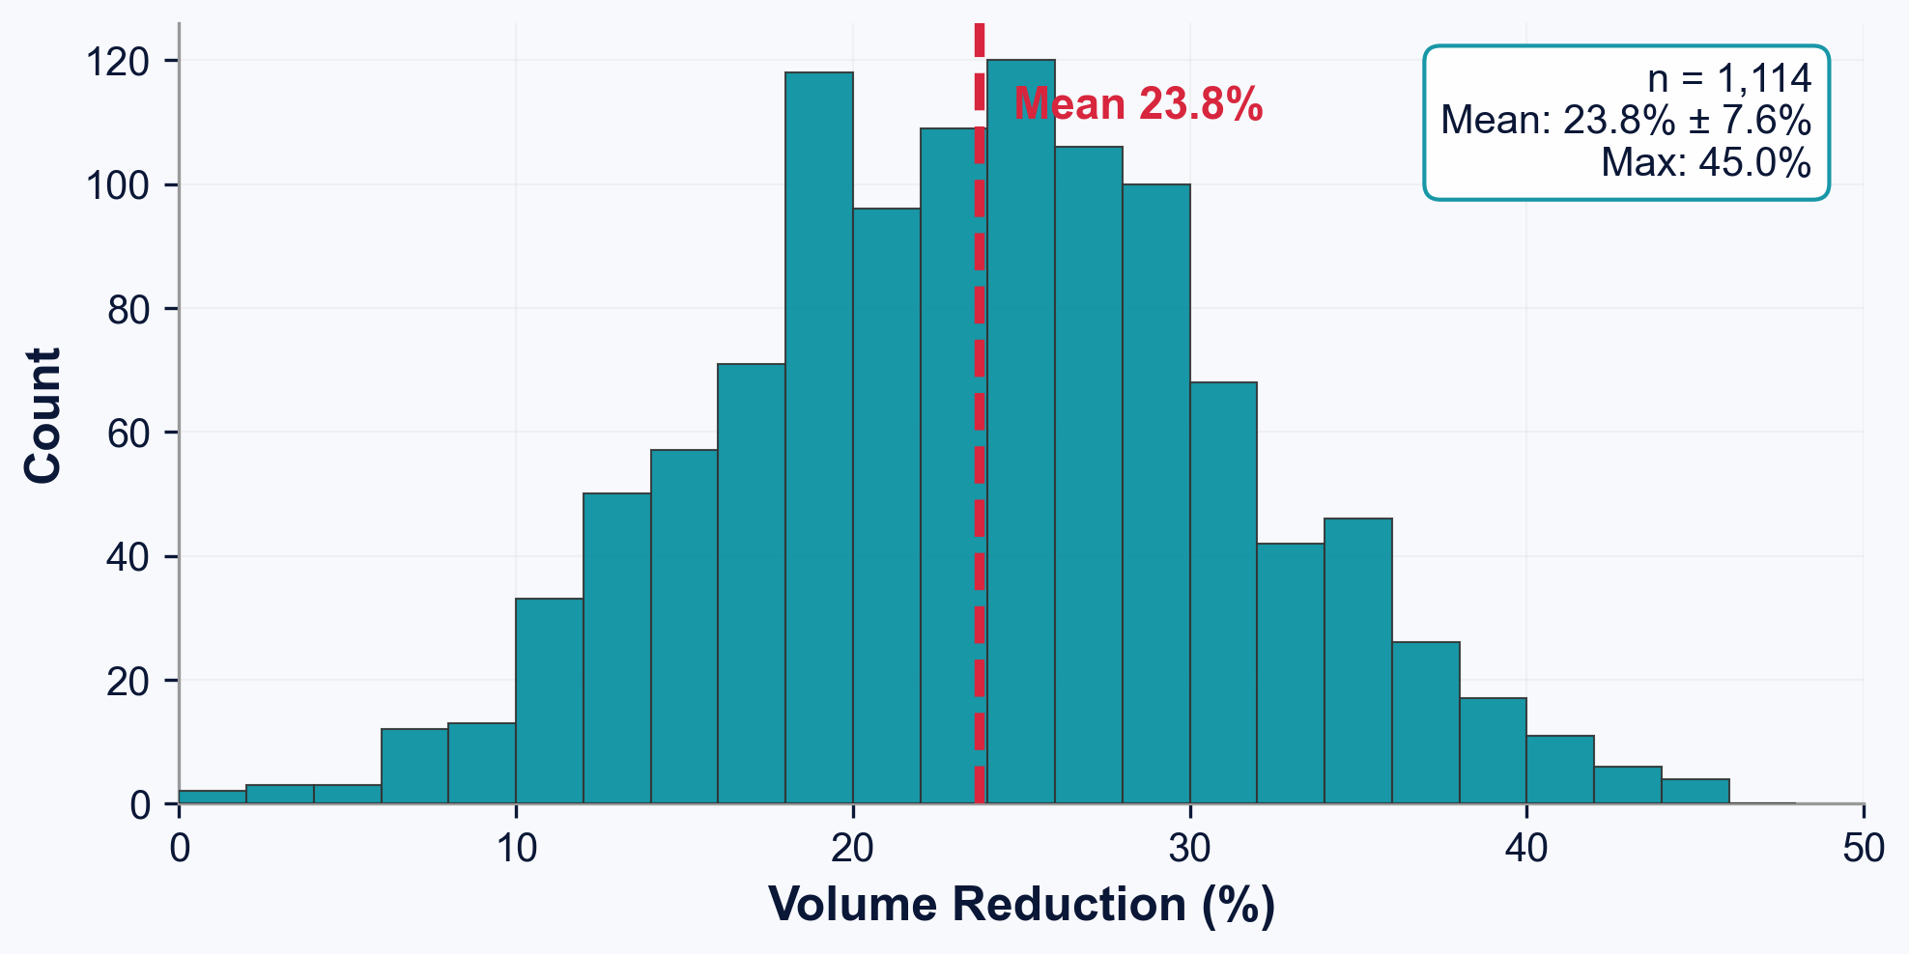
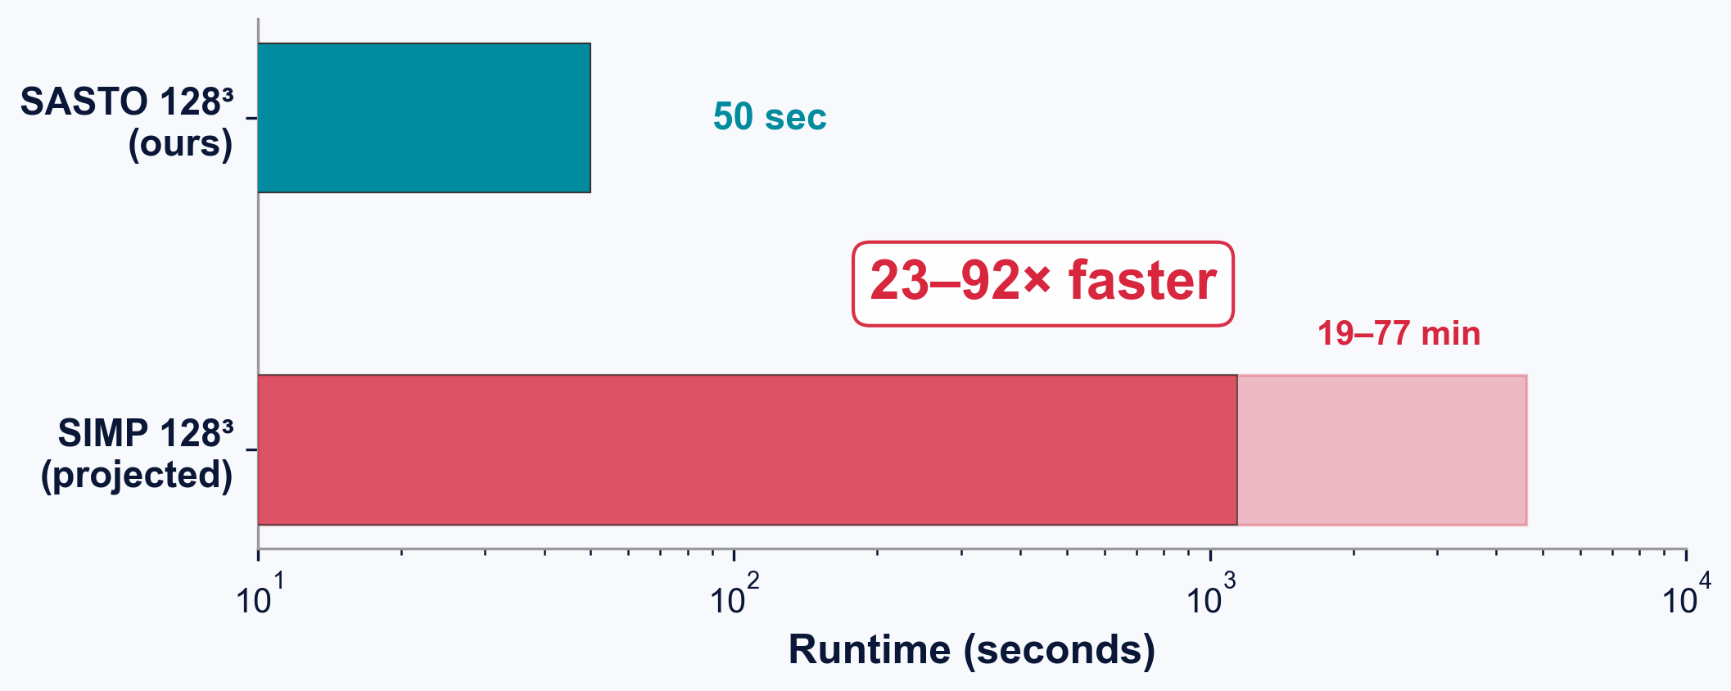
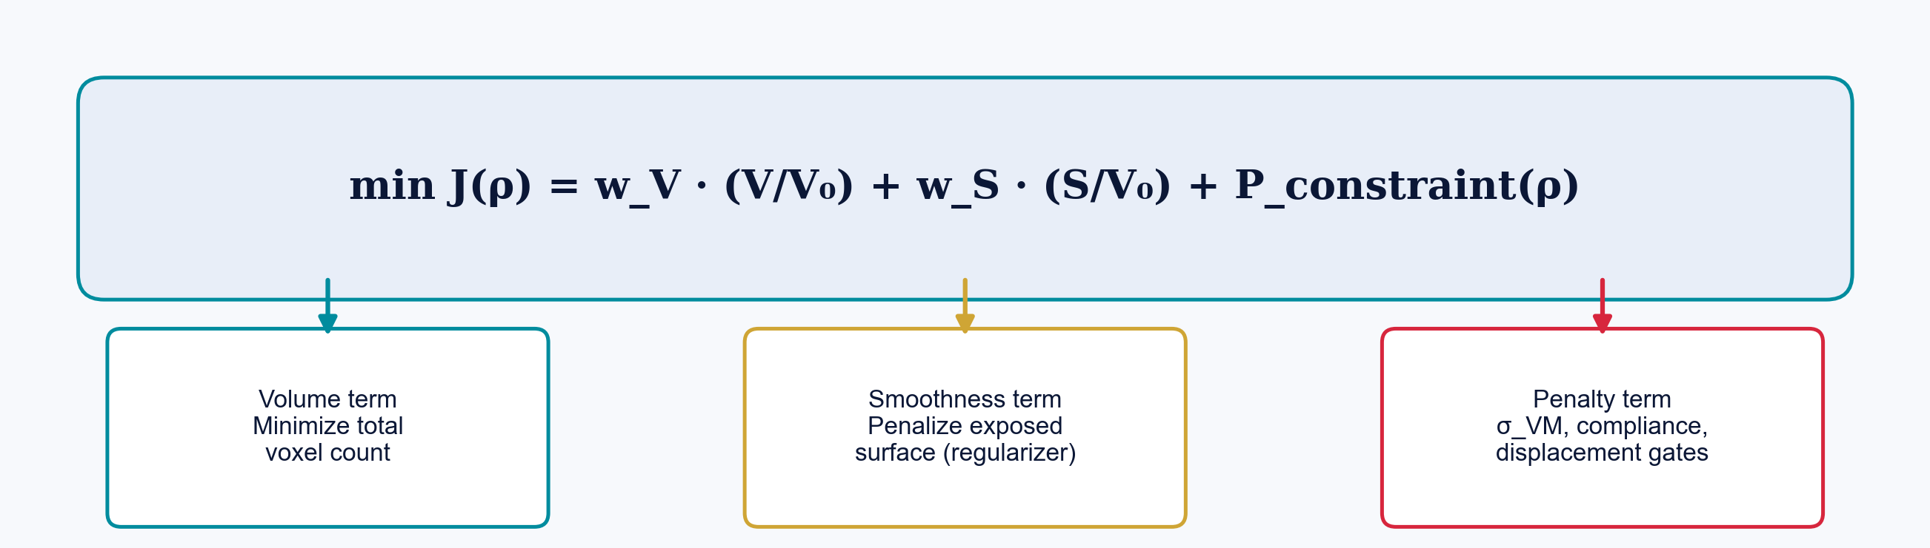
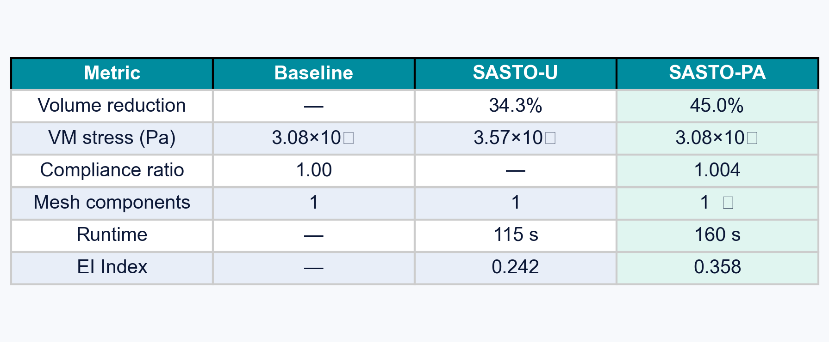
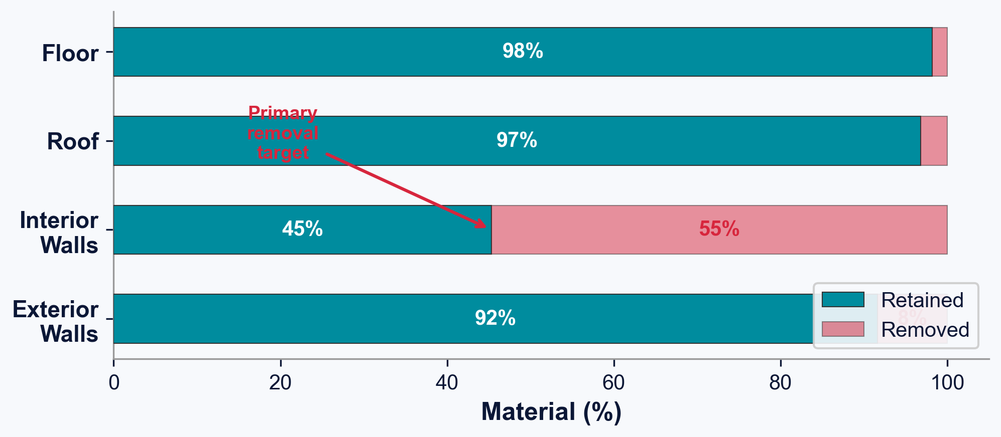
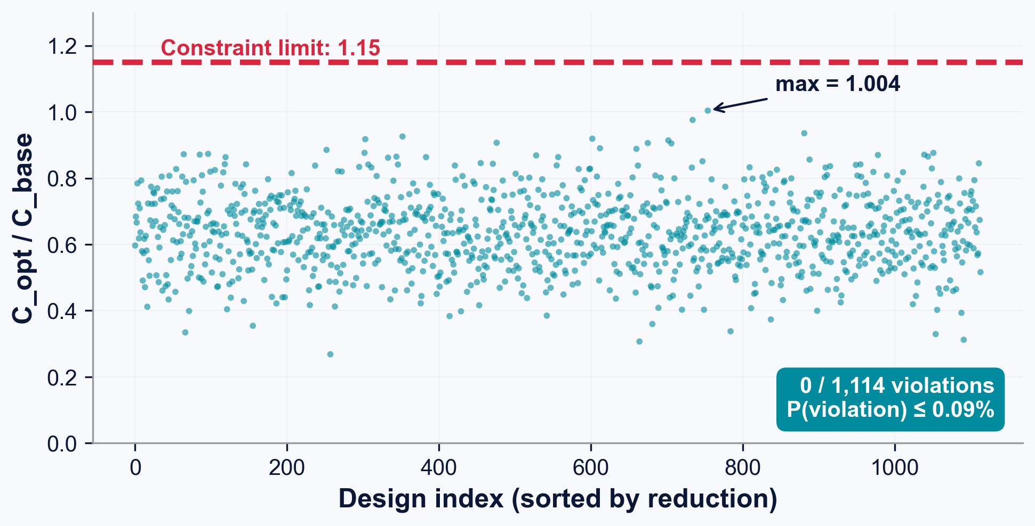
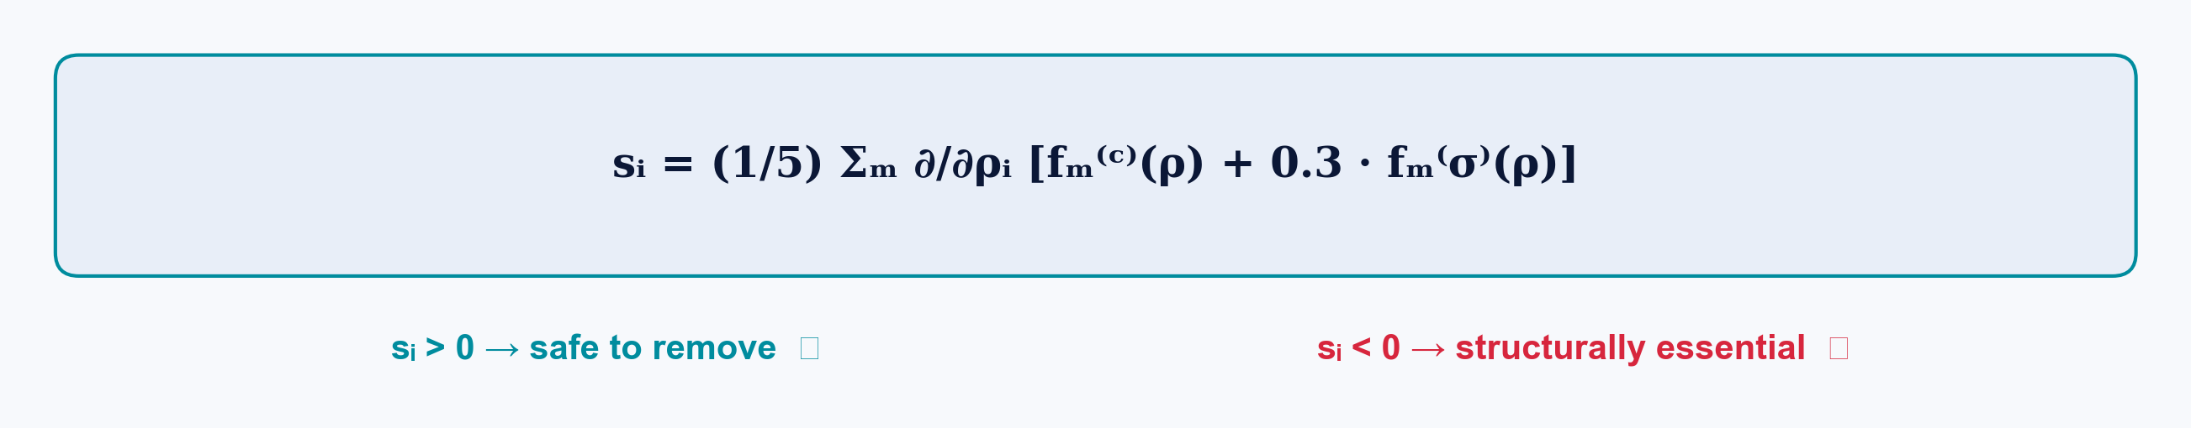
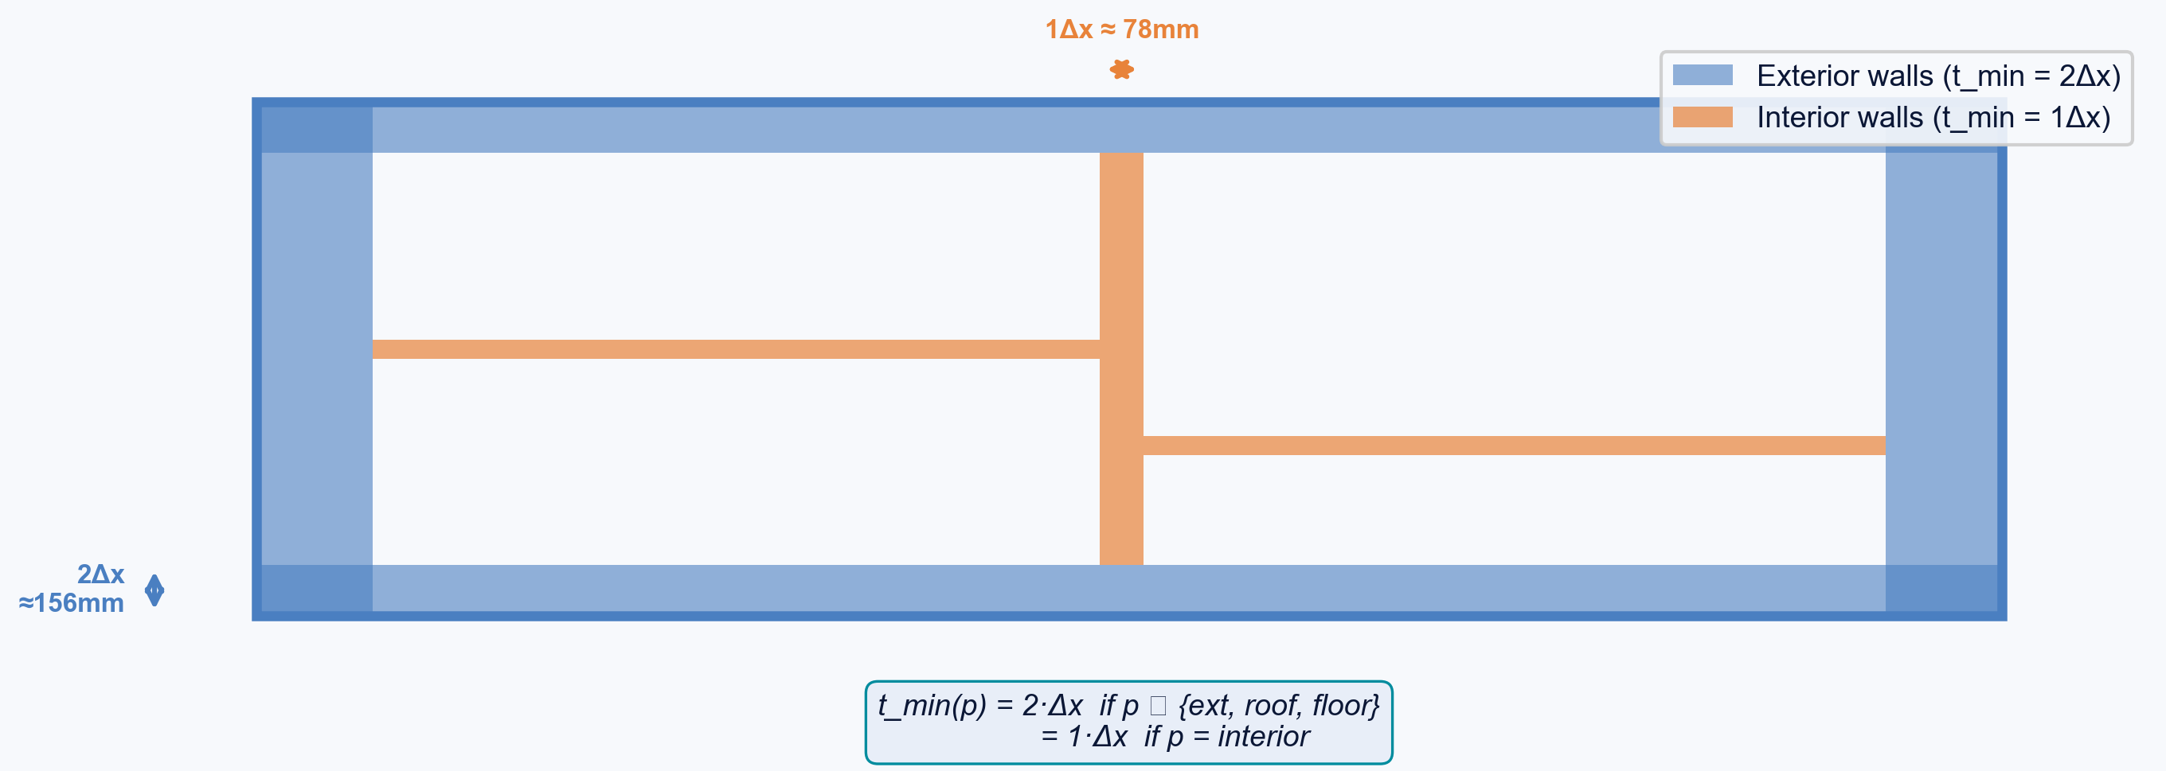
SURROGATE-ACCELERATED STRUCTURAL OPTIMIZATION
Intel ISEF 2026 - Engineering Mechanics
Credit Line of Origin
References & data in references below.
Images denoted with an asterisk (*) are from
public-domain or adapted from publicly available
sources. All other figures, tables, and images
created by Eric Hou, 2026.
Additive Manufacturing: Harnessing FEA to Optimize Material Efficiency
Eric Hou
VISUAL ABSTRACT
ENGINEERING METHODOLOGY
STATISTICAL ANALYSIS
Dataset Generation Pipeline
Deep Ensemble Surrogate (5x8.76M params)
Surrogate Model Performance
x5 ENSEMBLE
Ranking accuracy (Spearman rho), not pointwise prediction, drives optimization safety. Compliance rho=0.948 -> correct voxel ordering for removal.
Optimization Convergence
Fig. 6. 14,293 wireframes -> 11,178 FEA sims -> 128^3 voxel grids
Split | n | Targets
Train | 8,943 | sigma_VM, u_max, C
Validation | 1,121 | --
Test | 1,114 | Ground-truth FEA
Fig. 1. SASTO pipeline: two-column workflow overview
Pipeline: (1) 3DWire wireframe -> volumetric parts via extrusion (ext walls 4 voxels ~316 mm, int walls 2 voxels ~158 mm); (2) boolean fusion via FreeCAD; (3) tetrahedral meshing via Gmsh (50k-200k elements); (4) SfePy FEA under ASCE 7-22 ASD loads; (5) voxelization onto 128^3 grid. Data filtering: 3,115/14,293 (21.8%) rejected for diverged displacement (>1.0 m), degenerate compliance (<1e-6 J), or invalid stress (<=0 Pa). Retained data spans 4.9 orders of magnitude in stress and 7.7 orders in compliance.
Fig. 7. Dual pooling -> 512-d -> 3 scalar outputs per member
Left: user workflow — input building wireframe, run SASTO optimization (~50s), output watertight STL with 23.5% less material. Right: model creation — dataset generation, FEA, deep ensemble training, and conformal calibration.
Parameter | Value
Ensemble size | M=5 (43.8M total)
Input | 7-ch 128^3 + 10-d feature
Regularization | dropout 0.15, WD 1e-4
Normalization | log(1+|y|) -> z-score
Outputs | peak sigma_VM, max u, C
Fig. 14. SASTO-PA (teal) vs. SASTO-U (gold)
SASTO-PA converges to 45.0% reduction vs SASTO-U at 34.3%. Phase 1 removes >99% of material in large batches; Phases 2-3 squeeze remaining feasible voxels.
INTRODUCTION
k-Factor Sensitivity (Pareto Frontier)
CONCRETE & CO2 CRISIS
Concrete production accounts for ~8% of global CO2 emissions [IEA 2021]. In conventional construction, walls are built at uniform thickness - a practice driven by formwork constraints, not structural need. Interior partitions bear negligible loads compared to exterior shear walls, creating a substantial opportunity for material reduction.
ADDITIVE MANUFACTURING
Large-scale 3D printing (ICON, COBOD, Apis Cor) can realize arbitrary wall profiles at no marginal tooling cost. However, exploiting this geometric freedom requires optimized 3D models that minimize volume, satisfy structural constraints under ASCE 7-22 load cases, and produce watertight meshes compatible with printer toolpath generation.
COMPUTATIONAL BOTTLENECK
Classical SIMP requires hundreds-thousands of FEA evaluations, each costing minutes-hours at building scale. Voxel-based implementations using 26-connectivity produce disconnected floating fragments incompatible with AM.
SASTO CONTRIBUTION
SASTO replaces FEA with a deep ensemble surrogate, achieving 23-92x speedup. A 6-connectivity criterion eliminates floating fragments. Part-aware thickness enables differential thinning. Across 1,114 geometries: 23.5% +/- 7.8% mean reduction, zero violations.
Architecture: 4 conv stages (128->64->32->16->8), 3 SE-ResBlocks with squeeze-excitation, dual pooling (avg+max) -> 512-d embed + 128-d feature MLP. Head: 640->512->256->3 with skip. Training: Huber loss, AdamW lr=5e-4, cosine anneal, EMA 0.999, AMP, grad clip ||.||<=1. Aug: 90 deg rot, flips, noise sigma=0.02. Dropout 0.15, stochastic depth 0-0.1.
k=1.0 Operating Point
Fig. 15. Non-monotonic Pareto: both gate stringency and budget depend on k
SASTO Algorithm - Sensitivity-Guided Erosion
Topology: 6-Connectivity Guarantee
k<0.5: under-conservative, risks violations. k>2.0: over-conservative, less removal. k=1.0 achieves Pareto-optimal: max reduction with zero violations.
Conformal Prediction & UQ
Fig. 16. Uncertainty bands. Gamma_D ~ 0.184 (sub-linear)
Fig. 9. 6-conn eliminates floating fragments incompatible with AM toolpaths
Ensemble disagreement D(phi) tracks distribution shift as material is removed. Gamma_D ~ 0.184 = sub-linear growth. Distribution-free conformal: P(violation) <= 0.09% (Clopper-Pearson, alpha=0.05, n=1,114). Ensemble residuals heavier-tailed than Gaussian.
Fig. 8. Three-phase optimization. Phase 1 removes >99% of material.
Proposition: A binary voxel field with exactly one 6-connected foreground component yields a single-component marching-cubes surface mesh.
Phase 1: Sensitivity-Guided Erosion
6-Simple Point Test (Kong & Rosenfeld 1989)
Sort by descending s_i; batch-remove 6-simple-points; if violated -> undo, halve B -> max(B/2,10). >99% of removal.
SP6(v) = 1 iff |C6(rho' & N26(v))| = 1 AND |C26(rho_bar' & N26(v) U {v})| = 1
Uniform vs. SASTO*
Phase 2: Fine-Grained Endgame
Foreground uses 6-connectivity; background uses complementary 26-connectivity. This (6,26) pairing prevents diagonal-only attachments that violate marching cubes assumptions. Standard (26,6) pairing produces thousands of floating fragments.
Re-run Phase 1 with B in {5, 1} to squeeze remaining feasible removals near constraint boundary.
Phase 3: Swap Refinement
RESEARCH OBJECTIVES
Thick interior voxels (dist >= 3) swapped with removed neighbors; accept if volume decreases & constraints hold.
1
SPEED
23-92x speedup via deep ensemble surrogate replacing FEA during optimization
Post-processing: fill enclosed air pockets (<=50 voxels), remove shard voxels (<2 face-neighbors), SDF -> marching cubes -> Laplacian smoothing -> watertight STL.
CONCLUSIONS
2
PRINTABILITY
6-connected topology -> single-mesh watertight STL for AM toolpath
3
EFFICIENCY
23.5% +/- 7.8% mean material reduction (up to 45.0%) across 1,114 geometries
1
SASTO achieves 23.5% +/- 7.8% mean material reduction across 1,114 held-out geometries, up to 45.0% on individual designs - the first surrogate-accelerated, topology-preserving optimizer at building scale.
4
SAFETY
0/1,114 FEA violations; conformal P(violation) <= 0.09%
Data Generation
->
Surrogate Training
->
SASTO Optimize
->
Validate & Certify
2
Deep ensemble surrogate (5x8.76M params) provides 23-92x speedup vs SIMP: median 50s on consumer GPU vs 19-77 min for SIMP.
PROBLEM FRAMING
RESULTS & IN-SILICO VALIDATION
3
6-connectivity criterion eliminates thousands of floating mesh fragments produced by standard 26-connectivity, guaranteeing watertight single-component STLs for AM.
Material & Design Constraints
Reference Case (Sample 00472)
1,114-Geometry Generalization
Speedup vs. SIMP
4
Part-aware thickness yields 10.7pp more reduction than uniform baseline by permitting 1-voxel (78 mm) interior walls while protecting 2-voxel (156 mm) load-bearing exteriors.
Parameter | Value | Source
E (Young's modulus) | 25 GPa | Isotropic concrete
v (Poisson's ratio) | 0.20 | --
f'c (compressive) | 30 MPa | Standard mix
sigma_VM,allow | 5.0 MPa | f'c / (gamma_m * gamma_f)
Dead load | Self-weight | ASCE 7-22 ASD
Live load | 1.92 kPa | ASCE 7-22 Table 4-1
Wind load | 0.96 kPa lateral | ASCE 7-22 Ch. 26-30
5
Independent FEA re-analysis: zero violations across all 1,114 designs (max C_opt/C_base = 1.004 vs 1.15 limit). Conformal: P(violation) <= 0.09%.
sigma_VM,allow = f'c / (gamma_m x gamma_f) = 30 / (3.0 x 2.0) = 5.0 MPa
Fig. 12. SIMP 64^3: 94s vs SASTO 128^3: 50s
-45.0% material
Fig. 10. Volume reduction | n=1,114 | mu=23.5%+/-7.8%
SASTO at 128^3 (median 50s, consumer GPU) vs. SIMP at 64^3 (94s) and 128^3 (77 min).
Conservative bound: mu_sigma + k*sigma_sigma, k=1.0 -> P(violation) <= 0.09%
Across all 1,114 held-out test geometries, SASTO-PA achieves mean 23.5% +/- 7.8% material reduction. Maximum 45.0% on individual designs.
Independent FEA Re-analysis (n=1,114)
Impact: 8% of global CO2 = cement. 23.5% less concrete per house -> millions of tons saved.
Optimization Objective
Before/after 3D renders
0/1,114 violations
FUTURE WORK
P(violation) <= 0.09%
1
FEA-IN-THE-LOOP ACTIVE LEARNING
Sensitivity via Surrogate Backpropagation
When ensemble Gamma_D > threshold tau, trigger ground-truth FEA mid-optimization -> self-correcting safety net.
2
NONLINEAR FEA SPOT CHECKS
Fig. 11. Per-part retention: load-bearing >91%
Fig. 13. All C_opt/C_base <= 1.15. Max: 1.004
Concrete damaged plasticity (CDP) on 5 representative designs to assess tension cracking, compression softening, and buckling.
SASTO-PA achieves 10.7pp more reduction than SASTO-U (34.3%) by permitting 1-voxel interior walls.
Exterior walls and roof retain >91% of material (load-bearing). Interior walls are the primary target, consistent with non-structural classification.
Same-method FEA reanalysis on all 1,114 optimized designs: zero violations. Max compliance ratio = 1.004 (vs 1.15 limit). Confirms surrogate conservatism.
3
PHYSICAL PRINT VALIDATION
Part-Aware Thickness Constraint
1:10 scale print of optimized house. Compression testing + digital image correlation (DIC) for full-field strain mapping.
Optimized STL
->
3D Print 1:10
->
Compression + DIC
KEY REFERENCES
1. Bendsoe & Sigmund (2003). Topology Optimization. Springer.
2. Lakshminarayanan et al. (2017). Deep ensembles. NeurIPS.
3. Kong & Rosenfeld (1989). Digital topology. CVGIP 48(3).
4. ASCE (2022). ASCE/SEI 7-22 Min Design Loads.
5. Buswell et al. (2018). 3D printing concrete. Cem Concr Res 112.
6. Sigmund & Maute (2013). Topology optimization. SMO 48.
7. Lin et al. (2024). 3DWire dataset. KAUST VCC.
8. IEA (2021). Global Status Report for Buildings.
9. Lorensen & Cline (1987). Marching Cubes. SIGGRAPH.
10. Vovk et al. (2005). Algorithmic Learning. Springer.
Fig. 5. Part-aware: 86.8% interior wall removal, no exterior degradation

