Slide 1

Wingman
Your agent goes on the first date.
LOS GATOS HACKS
Notes:
We're Wingman. Your agent goes on the first date.
(8 seconds. Then move.)

Slide 2
ROLL THE AD
We made a commercial. It is short.
DROP THE VIDEO HERE
Notes:
We made a commercial.
(Play it. Say nothing over it. ~30 seconds.)

Slide 3
THE PROBLEM
You are judging a whole person from six photos and "I love to travel."
Swipe apps rank profiles. A profile is the least interesting thing about anybody.
Notes:
Right now you are judging a whole person off six photos and “I love to travel.”
Every dating app ranks profiles. A profile is the least interesting thing about anyone.
(14 seconds.)

Slide 4
HOW IT WORKS
Your agent does the awkward part first.
01
02
03
04
Connect
Rehearse
Swipe
Reveal
Your agent reads your ChatGPT or Claude export. It learns you, not your bio.
Before you see a card, your agent talks to theirs. Four turns, consent-scoped.
The deck is ranked by how the rehearsal went, not by profile similarity.
After a mutual match, you both get to read what the agents said.
Notes:
Four steps.
Connect: your agent reads your ChatGPT or Claude export, so it learns you and not your bio.
Rehearse: before you ever see a card, your agent has already had the conversation with theirs.
Swipe: the deck is ranked by how that rehearsal went.
Reveal: if you both like each other, you both get to read it.
(28 seconds. Land hard on Rehearse.)

Slide 5
THE MOMENT
Two AIs talked about you behind your back.
HER AGENT
They both cook to decompress, not to impress.
HIS AGENT
Agreed. Open question: she is free most evenings, he is not.
Opener → "What is the last thing you cooked that went badly?"
Every line cites a field they each approved. Nothing else leaves the phone.
Notes:
Two AIs talked about you behind your back, and now you get to read it.
Every line cites a field you approved. That is what makes it feel fair instead of creepy.
(22 seconds.)

Slide 6
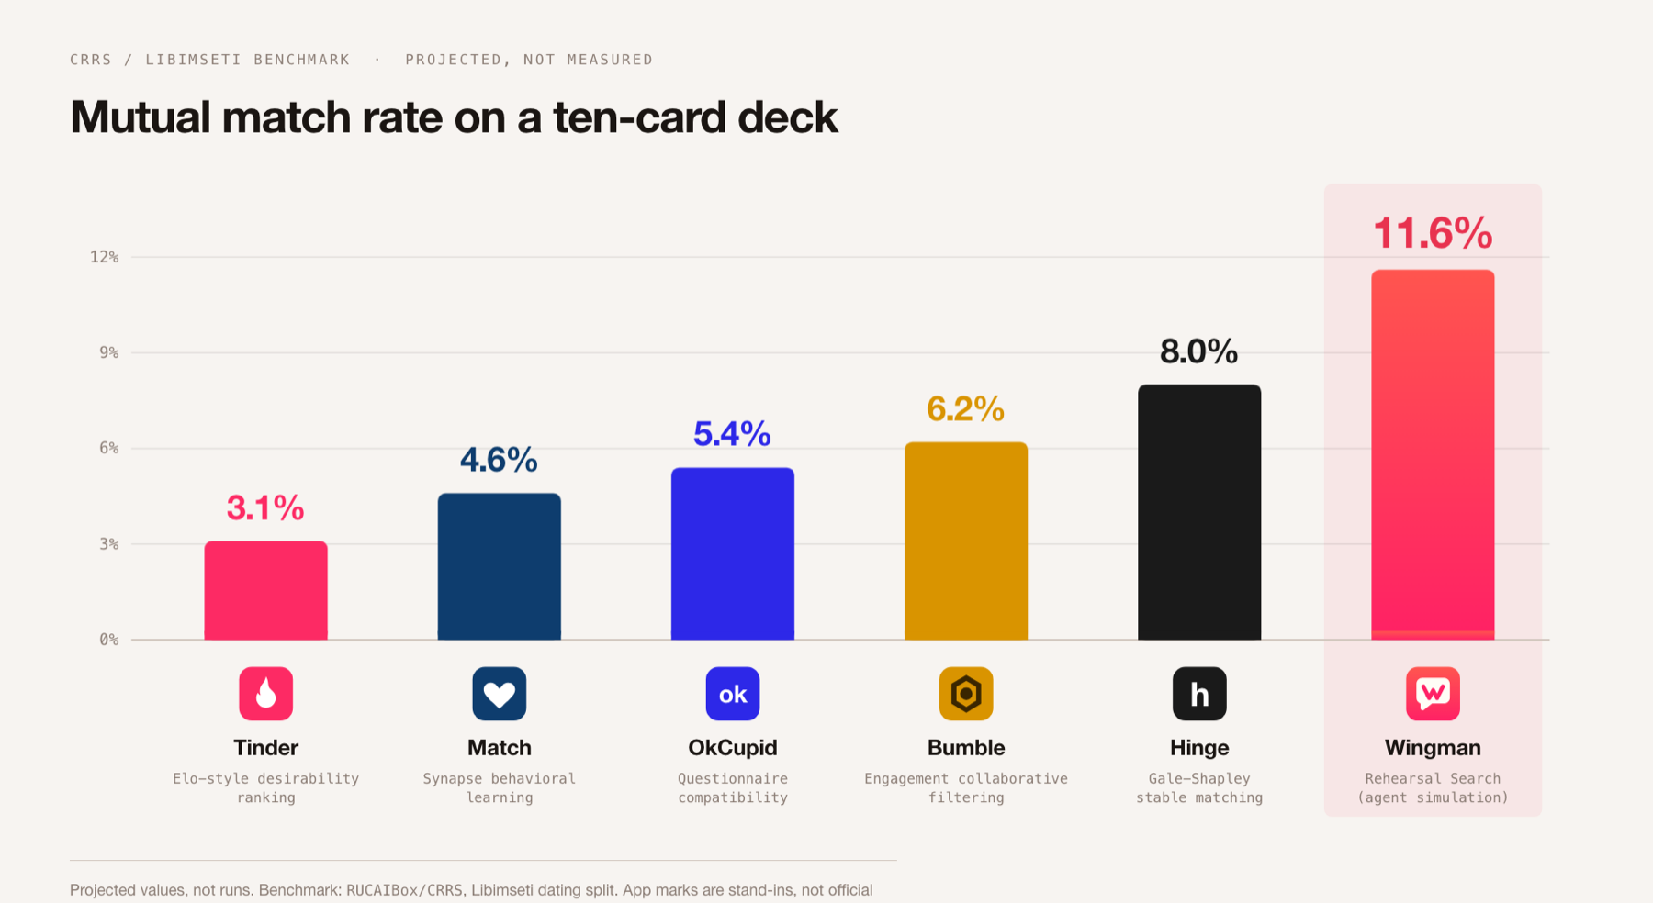
HOW IT SCORES
We rank by the weaker direction, not the average.
Notes:
One design choice. We rank by the weaker direction, not the average.
A ten-to-two match loses to a six-to-six. That is why the number moves.
(13 seconds. If asked: these are projected, not measured. The benchmark is CRRS on the Libimseti split and it is what we would run next. Do not claim you ran it.)

Slide 7
WHERE IT IS
Everyone else sorts profiles. We rehearse the conversation.
SHIPPED
NEXT
TRY IT
iOS app, agent gateway,
live profile sync
Rehearsal inside the deck,
Match Reveal
Come find us.
Bring your ChatGPT export.
Notes:
Everyone else sorts profiles. We rehearse the conversation.
The iOS app and the gateway are live. Come find us, and bring your ChatGPT export.
(10 seconds.)

