Slide 1
BCB 503 Advanced Geospatial analysis workshop Advanced Geospatial Analysis: Autocorrelation, Kriging, Spatially weighted Regression Spring 2022

Slide 2
Advanced Geo Analysis
1. Advanced Geospatial Analysis
Spatial Autocorrelation
Kriging
Spatially Weighted Regression

Slide 3
Spatial randomness
1. Advanced Geospatial Analysis
Spatial randomness – no pattern
If spatial randomness is rejected, then there is a spatial structure
Value at one location does not depend on values at other neighboring locations

Slide 4
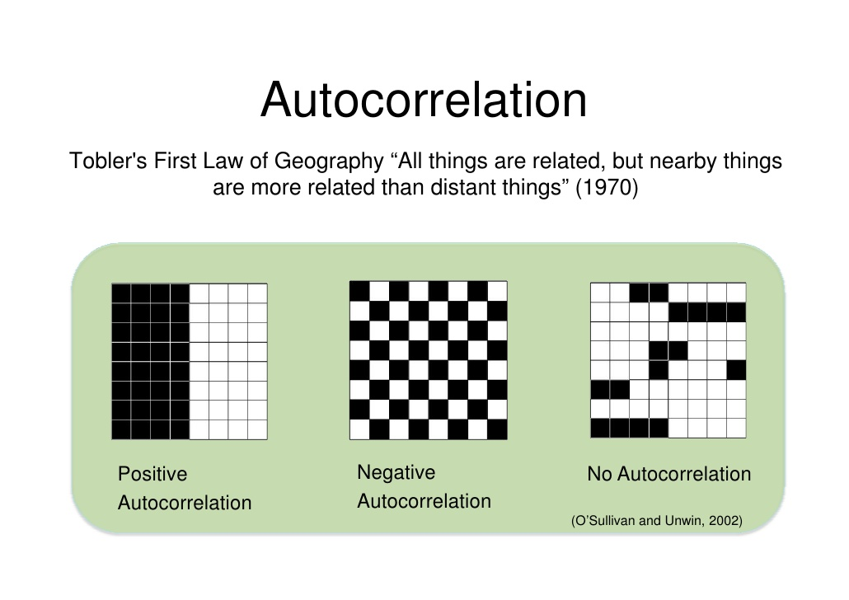
Spatial Autocorrelation
1. Spatial Autocorrelation
A measure of the degree to which a set of spatial features and their associated data values tend to be clustered together in space (positive spatial autocorrelation) or dispersed (negative spatial autocorrelation). Cliff and Ord 1973, 1981
Random – no autocorrelation – Null Hypothesis
If Null is rejected, the alternative hypotheses are:
Clustered – above zero Alternative Hypothesis
Dispersed – below zero Alternative Hypothesis
Notes:
Autocorrelation – correlation of the variable with itself, across space. Eg. How are crime rates correlated to other crime rates in space

Slide 5
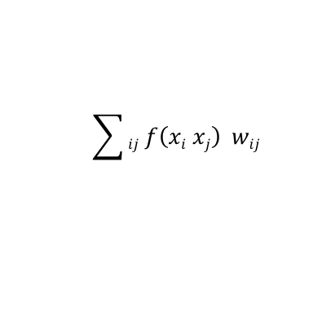
Quantifying SAC
1. Spatial Autocorrelation
$$\sum{ij f\left(xi xj\right) wij}$$
Statistical testing (using a test statistic)
How likely is the test statistic value if it had occurred under the null hypothesis (spatial randomness)
When unlikely – the null is rejected (low p value)
For SAC – we are most interested in capturing/combining
Attribute similarity – summary of similarity/dissimilarity of observations of a variable at differing locations f(x_{i}, x_{j})
Locational similarity – formalizing the notion of neighbors. Construction of spatial weights w_{ij}
f(x_{i}x_{j}) is attribute similarity between i and j for x
w_{ij} is spatial weight between i and j
Notes:
Test statistic: calculated from the data and compared to a reference distribution
Spatial weights: 1) formal expression of locational similarity
2) Spatial autocorrelation is about interaction
3) Meant to constrain the number of neighbors (ie only those that share a border)

Slide 6
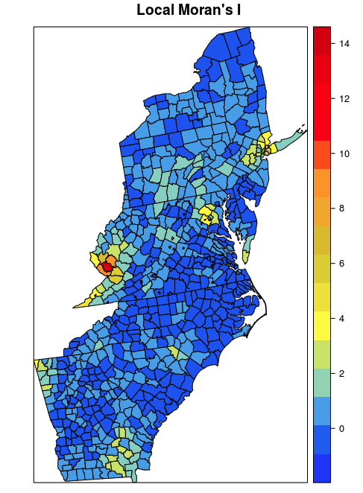
Morans I
1. Spatial Autocorrelation
Moran’s I is an inferential statistic, which means that the results of the analysis are always interpreted within the context of its null hypothesis.
Like a correlation coefficient, values of Moran’s I range from +1 meaning strong positive spatial autocorrelation to 0 meaning a random pattern to -1 indicating strong negative spatial autocorrelation.
Global Moran’s I provides a one single value, which is the average across the dimensional space.
Local Moran’s I statistic was suggested in Anselin (1995) as a way to identify local clusters and spatial outliers.

Slide 7
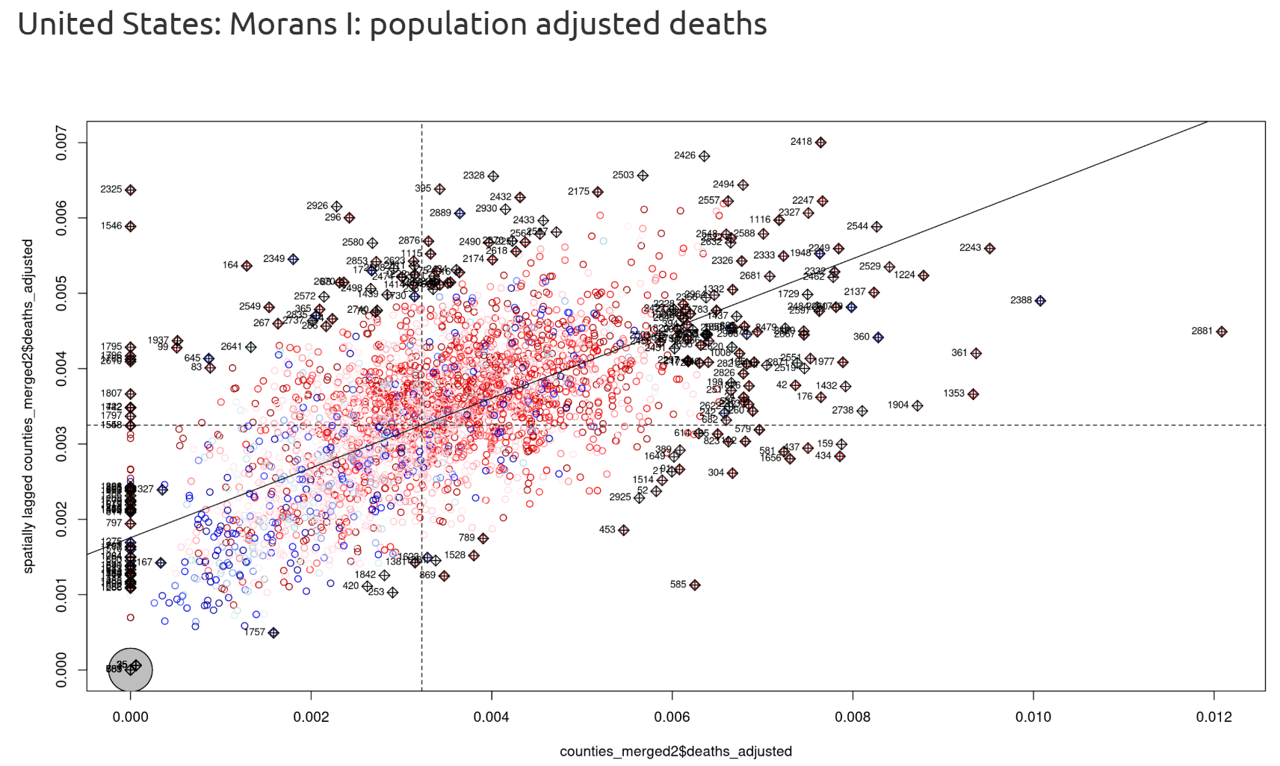

Slide 8
Gearys C
1. Spatial Autocorrelation
Gearys C determines if adjacent observations of the same attributes are correlated in multi- or bi-directional ways.
The value of Geary’s C lies between 0 and some general value greater than 1. Values significantly lower than one demonstrate increasing positive spatial autocorrelation, while values significantly higher than one illustrate increasing negative spatial autocorrelation.
Geary’s C is inversely related to Moran’s I, but it is not identical. Moran’s I is a measure of global spatial autocorrelation, while Geary’s C is more sensitive to local spatial autocorrelation.
Geary’s test for spatial autocorrelation using a spatial weights matrix in weights list form. The assumptions underlying the test are sensitive to the form of the graph of neighbour relationships and other factors, and results may be checked against those of the geary.mc permutation

Slide 9
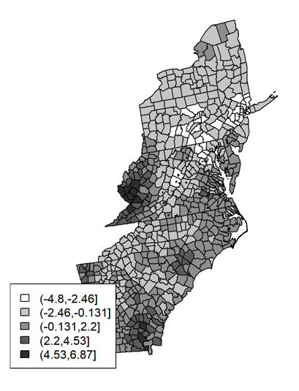
Getis-Ord GI*
1. Spatial Autocorrelation
Hotspot analysis using Getis-Ord Gi* statistic (sometimes referred to as GI-star) uses spatial vectors to identify the locations of statistically significant hot spots and cold spots in data. The z-scores and p-values indicates where features with either high or low values cluster spatially.

Slide 10
Introduction to kriging
2. Kriging
Kriging is a group of geostatistical techniques to interpolate the value of a random field at an un-sampled location from known observations of its value at nearby locations.
The main statistical assumption behind kriging is one of stationarity which means that statistical properties (such as mean and variance) do not depend on the exact spatial locations, so the mean and variance of a variable at one location is equal to the mean and variance at another location.

Slide 11
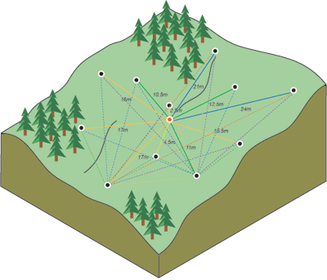
Variogram/semivariogram
1. Spatial Autocorrelation
Fitting a model, or spatial modeling, is also known as structural analysis, or variography. In spatial modeling of the structure of the measured points, you begin with a graph of the empirical semivariogram, computed with the following equation for all pairs of locations separated by distance h:
Semivariogram(distance_{h}) = 0.5 * average((value_{i} – value_{j})²)
The formula involves calculating the difference squared between the values of the paired locations.
Notes:
The nugget effect can be attributed to measurement errors or spatial sources of variation at distances smaller than the sampling interval or both.
Measurement error occurs because of the error inherent in measuring devices. Natural phenomena can vary spatially over a range of scales.
Variation at microscales smaller than the sampling distances will appear as part of the nugget effect. Before collecting data, it is important to gain some understanding of the scales of spatial variation.
Therefore - the nugget effect is simply the sum of measurement error and microscale variation and, since either component can be zero, the nugget effect can be composed wholly of one or the other. The distance at which the semivariogram levels off to the sill is called the range.

Slide 12
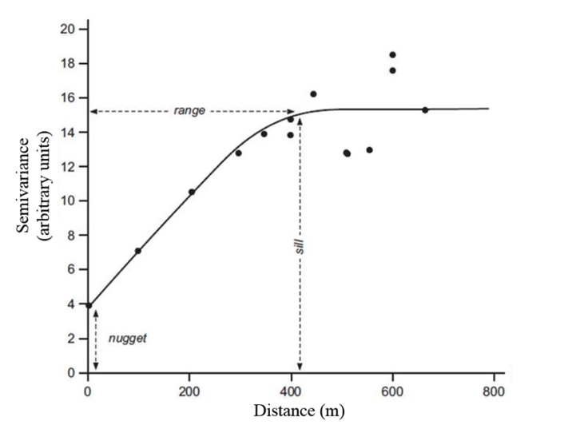
Variogram/semivariogram
1. Spatial Autocorrelation
The semivariogram depicts the spatial autocorrelation of the measured sample points. Once each pair of locations is plotted, a model is fit through them. There are certain characteristics that are commonly used to describe these models.
The Semivariogram and covariance both measure the strength of statistical correlation as a function of distance.
Notes:
The nugget effect can be attributed to measurement errors or spatial sources of variation at distances smaller than the sampling interval or both.
Measurement error occurs because of the error inherent in measuring devices. Natural phenomena can vary spatially over a range of scales.
Variation at microscales smaller than the sampling distances will appear as part of the nugget effect. Before collecting data, it is important to gain some understanding of the scales of spatial variation.
Therefore - the nugget effect is simply the sum of measurement error and microscale variation and, since either component can be zero, the nugget effect can be composed wholly of one or the other. The distance at which the semivariogram levels off to the sill is called the range.

Slide 13
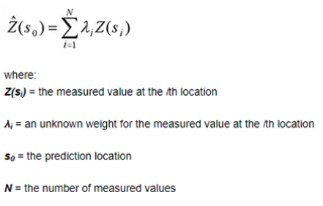
Introduction to kriging
2. Kriging
Kriging predicts the value at a given point by computing a weighted average of the known values of the function in the neighborhood of the point. Unlike other deterministic interpolation methods such as inverse distance weighting (IDW) & Splining, kriging is based on the statistical relationships among the measured points to interpolate the values in the spatial field.

Slide 14
Introduction to kriging
2. Kriging
Kriging produces a prediction surface with uncertainty. Although stationarity (constant mean and variance) and isotropy (uniformity in all directions) are the two main assumptions for kriging to provide best linear unbiased prediction, there is flexibility of these assumptions for various forms and methods of kriging
In IDW, the weight depends solely on the distance to the prediction location. However, with the kriging method, the weights are based not only on the distance between the measured points and the prediction location but also on the overall spatial arrangement of the measured points

Slide 15
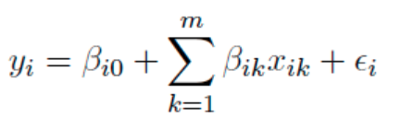
Geo Weighted Regression
3. Geographically Weighted Regression
Geographically weighted regression (GWR) is a useful tool for exploring spatial heterogeneity in the relationships between variables where non-stationarity is taking place on the space, that is where locally weighted regression coefficients move away from their global values.
It allows us to understand changes in importance of different variables over space. First In GWR, the appropriate bandwidth needs to be selected for an isotropic spatial weights kernel (typically a Gaussian kernel), with a fixed bandwidth chosen by leave-one-out cross-validation.
Where:
yi is the dependent variable as location i;
xik is the value of the kth independent variable @ location i;
m is the number of independent variables;
Bio is the intercept at location i;
Bik is the local regression coefficient for the kth independent variable at location i
Ei is the random error at location i
Notes:
GWR evaluates a local model of the variable or process you are trying to understand or predict by fitting a regression equation to every feature in the dataset. GWR constructs these separate equations by incorporating the dependent and explanatory variables of the features falling within the neighborhood of each target feature.
Recall a kernel expresses a measure of similarity between vectors. The RBF kernel represents this similarity as a decaying function of the distance between the vectors (i.e. the squared-norm of their distance). That is, if the two vectors are close together then, kx − x 0 k will be small. Then, so long as γ > 0, it follows that −γ kx − x 0 k 2 will be larger. Thus, closer vectors have a larger RBF kernel value than farther vectors. This function is of the form of a bell-shaped curve.

Slide 16
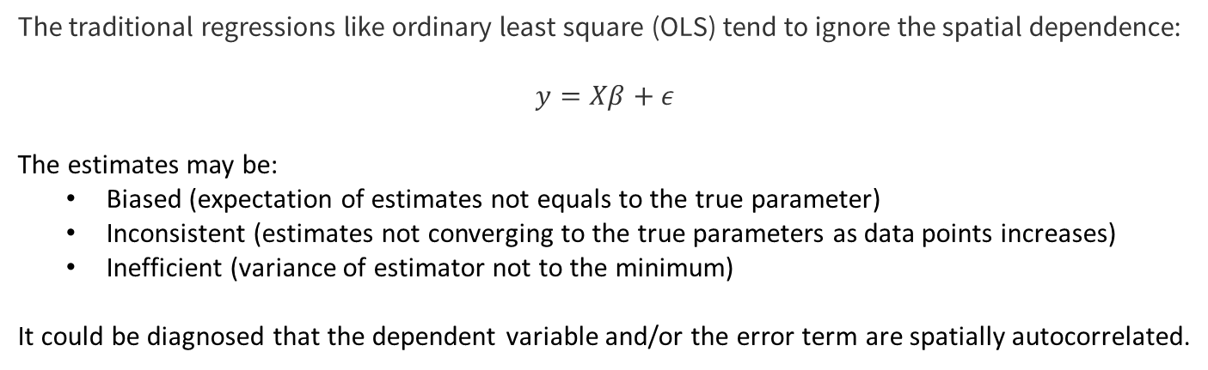
Geo Weighted Regression
3. Geographically Weighted Regression
The traditional regressions like ordinary least square (OLS) tend to ignore the spatial dependence:
$$y=Xβ+ε$$
The estimates may be:
Biased (expectation of estimates not equals to the true parameter)
Inconsistent (estimates not converging to the true parameters as data points increases)
Inefficient (variance of estimator not to the minimum)
It could be diagnosed that the dependent variable and/or the error term are spatially autocorrelated.

Slide 17
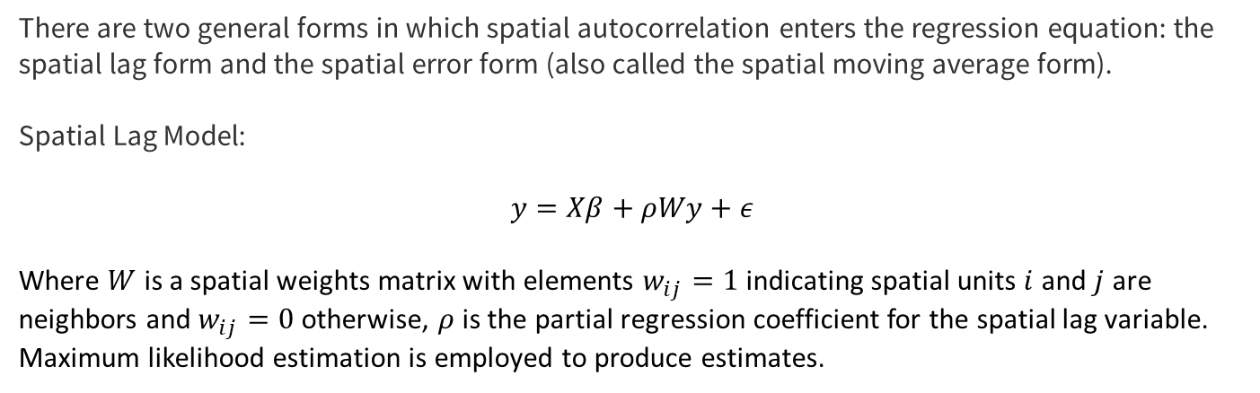
Geo Weighted Regression
3. Geographically Weighted Regression
There are two general forms in which spatial autocorrelation enters the regression equation: the spatial lag form and the spatial error form (also called the spatial moving average form).
Spatial Lag Model:
$$y=Xβ+ρWy+ε$$
Where $W$ is a spatial weights matrix with elements $w_{ij}=1$ indicating spatial units $i$ and $j$ are neighbors and $w_{ij}=0$ otherwise, $ρ$ is the partial regression coefficient for the spatial lag variable. Maximum likelihood estimation is employed to produce estimates.

Slide 18
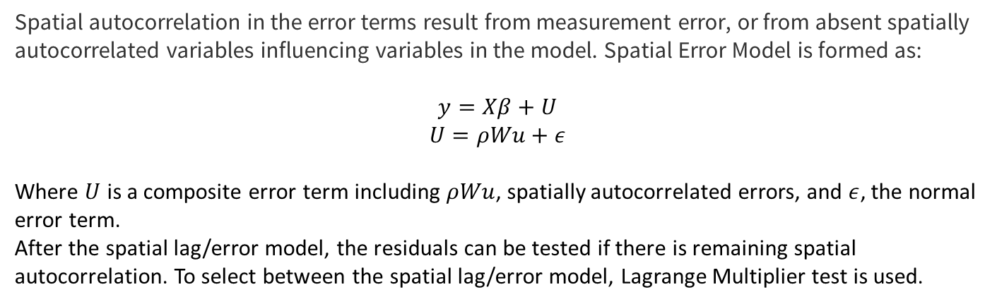
Geo Weighted Regression
3. Geographically Weighted Regression
Spatial autocorrelation in the error terms result from measurement error, or from absent spatially autocorrelated variables influencing variables in the model. Spatial Error Model is formed as:
$$y=Xβ+U$$
$$U=ρWu+ε$$
Where $U$ is a composite error term including $ρWu$, spatially autocorrelated errors, and $ε$, the normal error term.
After the spatial lag/error model, the residuals can be tested if there is remaining spatial autocorrelation. To select between the spatial lag/error model, Lagrange Multiplier test is used.

Slide 19
EXTRA Readings
Cliff, A. D., & Ord, J. K. (1981). Spatial processes: models & applications. Taylor & Francis.
Anselin, L. (1988). Spatial Econometrics: Methods and Models (Vol. 4). Springer Science & Business Media.
Fotheringham, A. S., Brunsdon, C., & Charlton, M. (2003). Geographically weighted regression: the analysis of spatially varying relationships. John Wiley & Sons.

