Slide 1
BCB 503 Advanced Geospatial analysis workshop Overall Workshop introduction & Introduction to raster data Spring 2022

Slide 2
BCB503 Geospatial Workshop
erichs@uidaho.edu
208.310.2140
WElcome
Overview
Welcome to the quarantine zone!
Instructor Introductions
Zoom technical issues and setup
Logistics and schedule

Slide 3
BCB503 Geospatial Workshop
erichs@uidaho.edu
208.310.2140
WElcome
Overview
Relax and let’s have fun! We aren’t testing you. This is about gaining knowledge you can use as a scientist.
Be respectful, professional and kind. No inappropriate language or visuals.
Get to know each other exercise – In the chat, put: your first name, department, one unique thing about yourself

Slide 4
Additional preparations
BCB503 Geospatial Workshop
R and RStudio should be installed, with appropriate libraries
Able to follow along with lessons from class web site (using a web browser)
https://imci-idaho.github.io/2021-04-20-uidaho-AdvGeospatial/
Be prepared for technical snafus. It’s going to happen. Let’s try to roll with it.

Slide 5
Miscellaneous
BCB503 Geospatial Workshop
Introductory exercises in basics of R in /src/introductory folder
Extra exercises in differing geospatial topics in /src/additional_exercises
Package install issues can be annoying. /src/day1-00-prep-librarytest.R
Class website has links to the data carpentry exercises that are for day 1 and 2 (Tues, April 20 and Thurs April 22)
Use Zoom for chat communications
We are recording the workshop via zoom and will post it after completion

Slide 6
miscellaneous
BCB503 Geospatial Workshop
This workshop is modified from the original data carpentry geospatial analysis workshop:
We are skipping over the introductory R components, how to use Rstudio, how to use ggplot
We have minimized, but have still included, components on manipulating raster and vector data
We have added more explicit geospatial analysis/modeling, which includes: spatial autocorrelation, kriging, spatially weighted regression, and geographically associated random forest modeling

Slide 7
Data download if you have an issue with github:
https://drive.google.com/file/d/1gm2aWOFBUSC6FiBcXN2WRCA--6eq5_ZG/view?usp=sharing

Slide 8
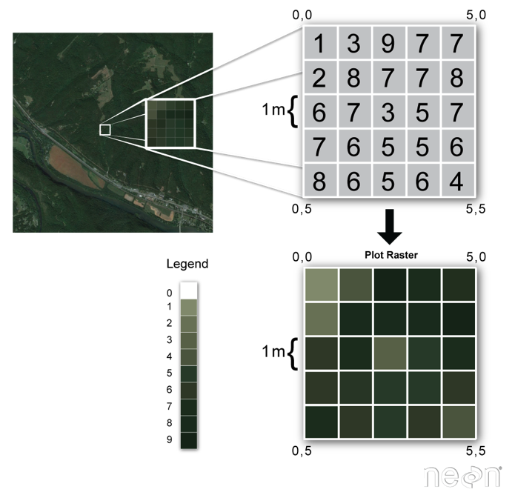
Introduction to Raster data
1. Intro to Geospatial Concepts - Raster
The two primary types of geospatial data are raster and vector data.
Raster data is stored as a grid of values which are rendered on a map as pixels. Each pixel value represents an area on the Earth’s surface.
Vector data structures represent specific features on the Earth’s surface and assign attributes to those features.

Slide 9
Introduction to Raster data
1. Intro to Geospatial Concepts - Raster
Raster data is any pixelated (or gridded) data where each pixel is associated with a specific geographical location.
The value of a pixel can be continuous (e.g. elevation) or categorical (e.g. land use).

Slide 10
Introduction to Raster data
1. Intro to Geospatial Concepts - Raster
A geospatial raster is only different from a digital photo in that it is accompanied by spatial information that connects the data to a particular location.
This includes items such as a raster’s extent and cell size, the number of rows and columns, its projection and coordinate reference system (or CRS), as well as any associated attribute information.

Slide 11
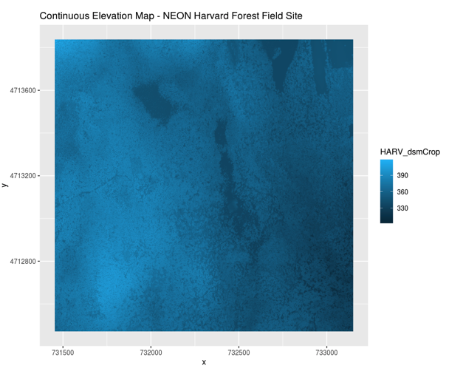
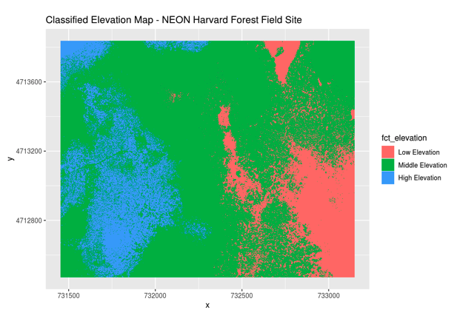
Continuous vs categorical
1. Intro to Geospatial Concepts - Raster

Slide 12
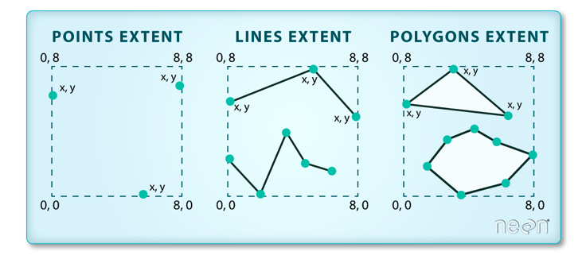
Important aspects to rasters
1. Intro to Geospatial Concepts - Raster
Spatial extent
Resolution
We will focus on spatial resolution, but there are other forms of resolution, including spectral, temporal, and radiometric

Slide 13
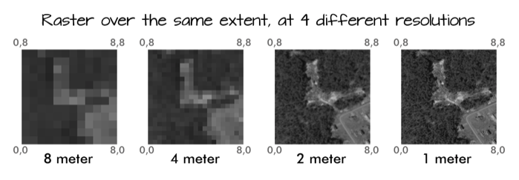
Important aspects to rasters
1. Intro to Geospatial Concepts - Raster
Spatial extent
Resolution
We will focus on spatial resolution, but there are other forms of resolution, including spectral, temporal, and radiometric

Slide 14
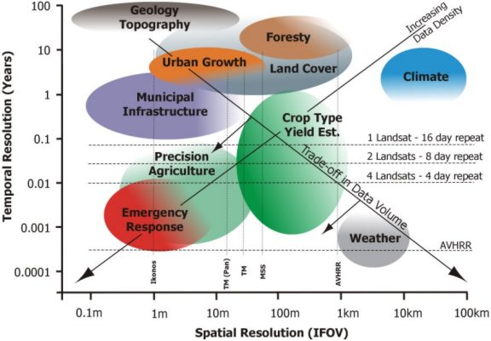
Important aspects to rasters
1. Intro to Geospatial Concepts - Raster
Spatial extent
Resolution
We will focus on spatial resolution, but there are other forms of resolution, including spectral, temporal, and radiometric

Slide 15
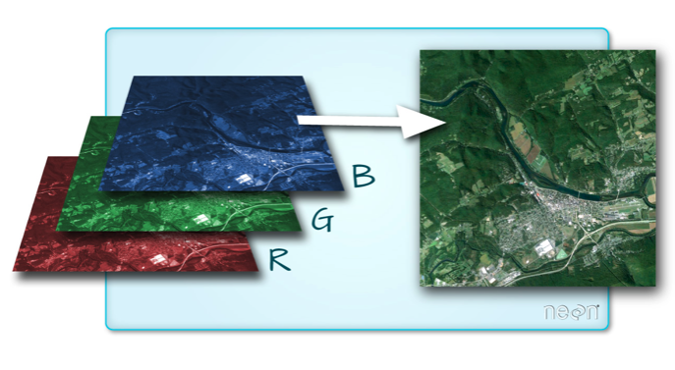
Multi-band/multi-spectral data
1. Intro to Geospatial Concepts - Raster
A raster can contain one or more bands.
One type of multi-band raster dataset that is familiar to many of us is a color image.
A basic color image consists of three bands: red, green, and blue. Each band represents light reflected from the red, green or blue portions of the electromagnetic spectrum.

Slide 16
Coordinate Reference Systems
3. Intro to Geospatial Concepts - CRS
The CRS associated with a dataset tells your mapping software (for example R) where the raster/vector is located in geographic space.
It also tells the mapping software what method (projection) should be used to flatten or project the raster in geographic space.
Key components of a CRS are:
Datum – a model of the shape of the earth (ex. WGS84, NAD83)
Projection – mathematical transform of angular measurements from spheroidal to flat. May include a zonal information if UTM
Ellipsoid - mathematical surface obtained by revolving an ellipse about the earth’s polar axis. Selected to give a good fit to the geoid

Slide 17
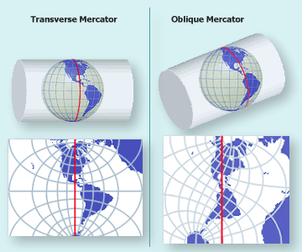
Coordinate Reference Systems
3. Intro to Geospatial Concepts - CRS
Map Projections: to convert geodetic positions of a portion of the earth’s surface to plane rectangular coordinates, points are projected mathematically from the ellipsoid to some imaginary developable surface - plane that can be rolled out flat
Coordinate Reference Systems: quantitative coordinate systems - based on mathematical projection models, often a cartesian coordinate system (i.e. x, y axes) representing relative positions within a particular map projection

Slide 18
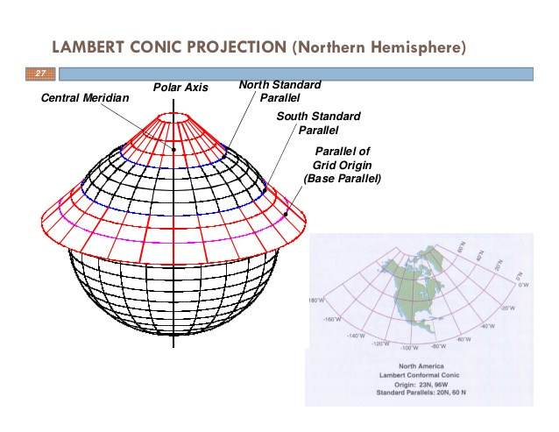
Coordinate Reference Systems
3. Intro to Geospatial Concepts - CRS
Map Projections: to convert geodetic positions of a portion of the earth’s surface to plane rectangular coordinates, points are projected mathematically from the ellipsoid to some imaginary developable surface - plane that can be rolled out flat
Coordinate Reference Systems: quantitative coordinate systems - based on mathematical projection models, often a cartesian coordinate system (i.e. x, y axes) representing relative positions within a particular map projection

Slide 19
Coordinate Reference Systems
3. Intro to Geospatial Concepts - CRS
PROJ is an open-source library for storing, representing and transforming CRS information. PROJ.5 has been recently released, but PROJ.4 was in use for 25 years so you will still mostly see PROJ referred to as PROJ.4. PROJ represents CRS information as a text string of key-value pairs, which makes it easy to customize (and with a little practice, easy to read and interpret).
A PROJ4 string includes the following information:
proj=: the projection of the data
zone=: the zone of the data (this is specific to the UTM projection)
datum=: the datum use
units=: the units for the coordinates of the data
ellps=: the ellipsoid (how the earth’s roundness is calculated) for the data
Note that the zone is unique to the UTM projection. Not all CRSs will have a zone.

