Slide 1
BCB 503 Advanced Geospatial analysis workshop Introduction to vector data Spring 2022

Slide 2
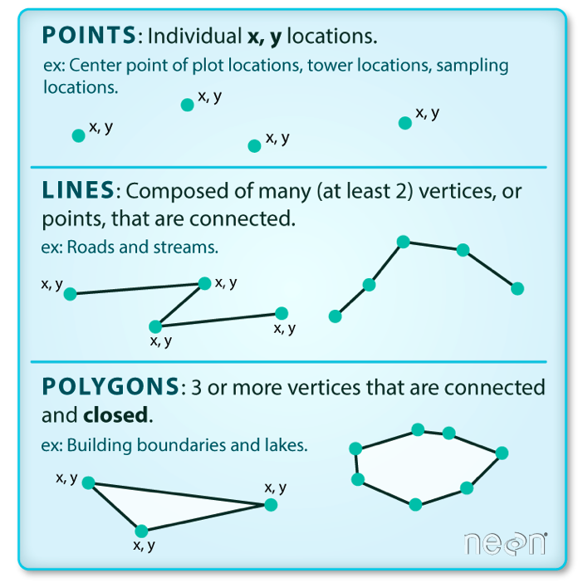
Intro to vector data
2. Intro to Geospatial Concepts - Vector
Vector data structures represent specific features on the Earth’s surface, and assign attributes to those features.
Vectors are composed of discrete geometric locations (x, y values) known as vertices that define the shape of the spatial object.
The organization of the vertices determines the type of vector that we are working with: point, line or polygon.

Slide 3
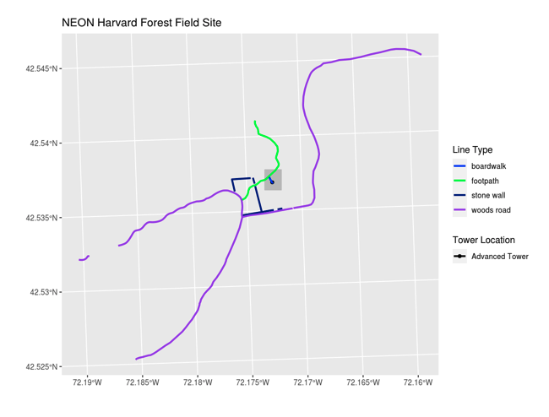
Intro to vector data
2. Intro to Geospatial Concepts - Vector
Vector data has some important advantages:
The geometry itself contains information about what the dataset creator thought was important
Each geometry feature can carry multiple attributes instead of just one, e.g. a database of cities can have attributes for name, country, population, etc.
Data storage can be very efficient compared to rasters

Slide 4
Intro to vector data
2. Intro to Geospatial Concepts - Vector
The downsides of vector data include:
potential loss of detail compared to raster
potential bias in datasets - what didn’t get recorded?
Calculations involving multiple vector layers need to do math on the geometry as well as the attributes, so can be slow compared to raster math.

Slide 5
Intro to vector data
2. Intro to Geospatial Concepts - Vector
Like raster data, vector data can also come in many different formats. For this workshop, we will use the Shapefile format which has the extension .shp. A .shp file stores the geographic coordinates of each vertice in the vector, as well as metadata including:
Extent, Object type, and the Coordinate reference system (CRS), and Other attributes: for example, a line shapefile that contains the locations of streams, might contain the name of each stream.
Shapefiles are an atomic collection (multiple files)

