Slide 1
BCB 503 Advanced Geospatial analysis workshop Introduction to vector data Spring 2022

Slide 2
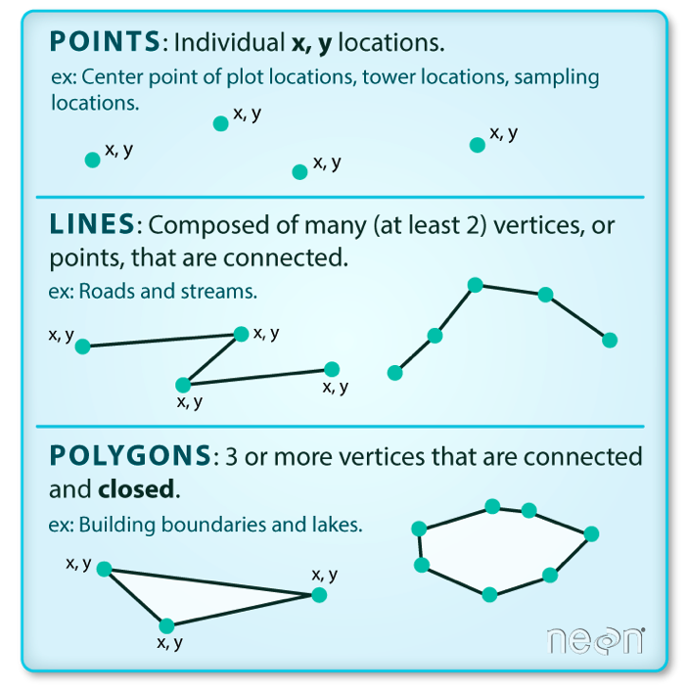
Intro to vector data
2. Intro to Geospatial Concepts - Vector
Vector data structures represent specific features on the Earth’s surface, and assign attributes to those features.
Vectors are composed of discrete geometric locations (x, y values) known as vertices that define the shape of the spatial object.
The organization of the vertices determines the type of vector that we are working with: point, line or polygon.

Slide 3
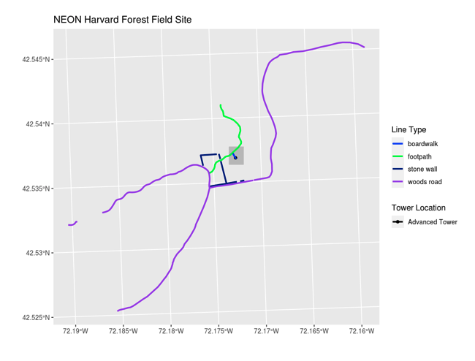
Intro to vector data
2. Intro to Geospatial Concepts - Vector
Vector data has some important advantages:
The geometry itself contains information about what the dataset creator thought was important
Each geometry feature can carry multiple attributes instead of just one, e.g. a database of cities can have attributes for name, country, population, etc.
Data storage can be very efficient compared to rasters

Slide 4
Intro to vector data
2. Intro to Geospatial Concepts - Vector
The downsides of vector data include:
potential loss of detail compared to raster
potential bias in datasets - what didn’t get recorded?
Calculations involving multiple vector layers need to do math on the geometry as well as the attributes, so can be slow compared to raster math.

Slide 5
Intro to vector data
2. Intro to Geospatial Concepts - Vector
Like raster data, vector data can also come in many different formats. For this workshop, we will use the Shapefile format which has the extension .shp. A .shp file stores the geographic coordinates of each vertice in the vector, as well as metadata including:
Extent, Object type, and the Coordinate reference system (CRS), and Other attributes: for example, a line shapefile that contains the locations of streams, might contain the name of each stream.
Shapefiles are an atomic collection (multiple files)

Slide 6
Coordinate Reference Systems
3. Intro to Geospatial Concepts - CRS
The CRS associated with a dataset tells your mapping software (for example R) where the raster/vector is located in geographic space.
It also tells the mapping software what method (projection) should be used to flatten or project the raster in geographic space.
Key components of a CRS are:
Datum – a model of the shape of the earth (ex. WGS84, NAD83)
Projection – mathematical transform of angular measurements from spheroidal to flat. May include a zonal information if UTM
Ellipsoid - mathematical surface obtained by revolving an ellipse about the earth’s polar axis. Selected to give a good fit to the geoid

Slide 7
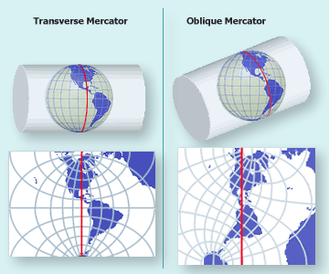
Coordinate Reference Systems
3. Intro to Geospatial Concepts - CRS
Map Projections: to convert geodetic positions of a portion of the earth’s surface to plane rectangular coordinates, points are projected mathematically from the ellipsoid to some imaginary developable surface - plane that can be rolled out flat
Coordinate Reference Systems: quantitative coordinate systems - based on mathematical projection models, often a cartesian coordinate system (i.e. x, y axes) representing relative positions within a particular map projection

Slide 8
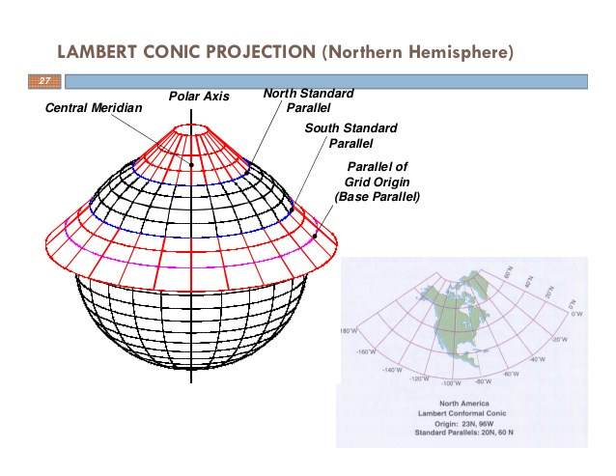
Coordinate Reference Systems
3. Intro to Geospatial Concepts - CRS
Map Projections: to convert geodetic positions of a portion of the earth’s surface to plane rectangular coordinates, points are projected mathematically from the ellipsoid to some imaginary developable surface - plane that can be rolled out flat
Coordinate Reference Systems: quantitative coordinate systems - based on mathematical projection models, often a cartesian coordinate system (i.e. x, y axes) representing relative positions within a particular map projection

Slide 9
Coordinate Reference Systems
3. Intro to Geospatial Concepts - CRS
PROJ is an open-source library for storing, representing and transforming CRS information. PROJ.5 has been recently released, but PROJ.4 was in use for 25 years so you will still mostly see PROJ referred to as PROJ.4. PROJ represents CRS information as a text string of key-value pairs, which makes it easy to customise (and with a little practice, easy to read and interpret).
A PROJ4 string includes the following information:
proj=: the projection of the data
zone=: the zone of the data (this is specific to the UTM projection)
datum=: the datum use
units=: the units for the coordinates of the data
ellps=: the ellipsoid (how the earth’s roundness is calculated) for the data
Note that the zone is unique to the UTM projection. Not all CRSs will have a zone.

Slide 10
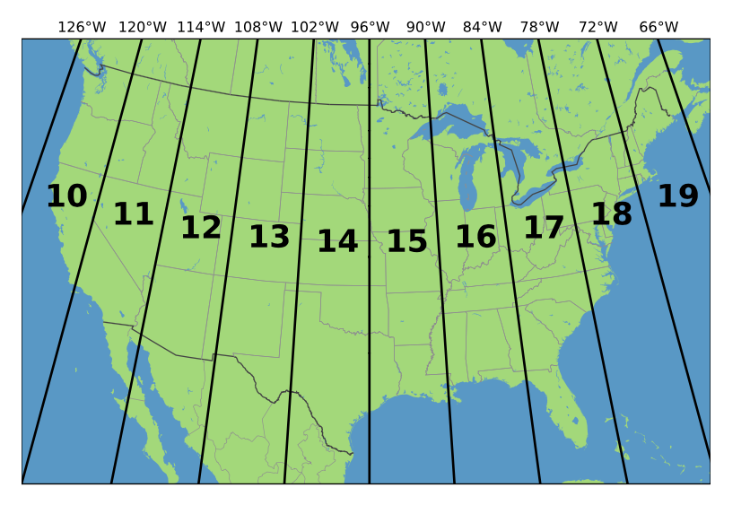
Coordinate Reference Systems
3. Intro to Geospatial Concepts - CRS
UTM Zones
+proj=utm +zone=18 +datum=WGS84 +units=m +no_defs +ellps=WGS84 +towgs84=0,0,0

Slide 11
Coordinate Reference Systems
3. Intro to Geospatial Concepts - CRS
+proj=utm +zone=18 +datum=WGS84 +units=m +no_defs +ellps=WGS84 +towgs84=0,0,0

Slide 12

Coordinate Reference Systems
3. Intro to Geospatial Concepts - CRS
GDAL is a set of software tools that translate between almost any geospatial format in common use today (and some not so common ones).
GDAL also contains tools for editing and manipulating both raster and vector files, including reprojecting data to different CRSs.
http://gdal.org

Slide 13
GEOSPATIAL LANDSCAPE
4. Intro to Geospatial Concepts – Geospatial Landscape
Commercial
Open source
ESRI
MAPINFO
Manifold
Smallworld
QGIS
GRASS
GDAL
PostGIS/Postgres
Cloud
Google Earth Engine
ArcGIS Online

Slide 14
GEOSPATIAL LANDSCAPE
4. Intro to Geospatial Concepts – Geospatial Landscape
Geospatial Libraries: R: sf, sp, gdal, spplot, leaflet, spacetime, ncdf4
Geospatial Libraries: Python: shapely, geopandas, rasterio, gdal, rasterstats
Modeling: R: caret, mlr
Modeling: Python: tensorflow, keras, sci-kit learn, numpy/scipy, Pytorch
Visualization: R: ggplot2, ggpubr, seaborn, plotly
Visualization: Python: matplotlib
https://cran.r-project.org/web/views/Spatial.html

