Slide 1
BCB 503 Advanced Geospatial analysis workshop Advanced Geospatial modeling: Random forest models Spring 2021

Slide 2
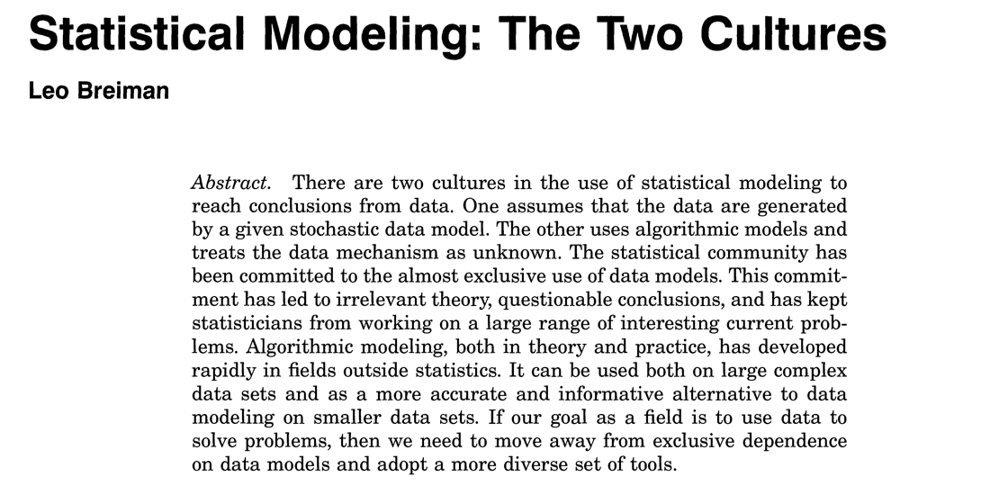
Expanded spatially modeling approaches
1. Random Forest Modeling
Random Forest
http://staff.pubhealth.ku.dk/~tag/Teaching/share/material/Breiman-two-cultures.pdf

Slide 3
TERMS
1. Random Forest Modeling
Geospatial modeling
Machine learning
Train – validation – test models
Cross validation
Ensembling
Bootstrap aggregation (“bagging”)

Slide 4
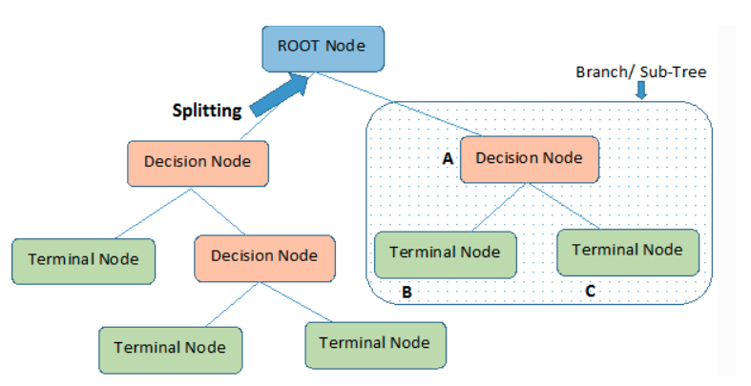
DECISION TREES
1. Random Forest Modeling
Random Forest model is an ensemble of single decision trees
Let’s initially talk about a decision tree
DT based on recursive partitioning
Notes:
Decision trees are built using a heuristic called recursive partitioning. This approach is also commonly known as divide and conquer because it splits the data into subsets, which are then split repeatedly into even smaller subsets, and so on and so forth until the process stops when the algorithm determines the data within the subsets are sufficiently homogenous, or another stopping criterion has been met.

Slide 5
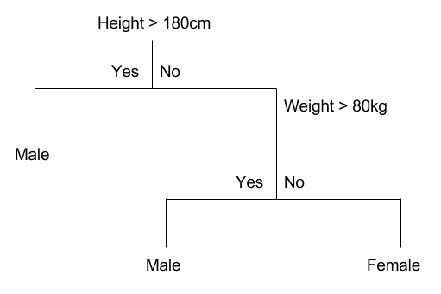
DECISION TREES
1. Random Forest Modeling
Random Forest model is an ensemble of single decision trees
Let’s initially talk about a decision tree
DT based on recursive partitioning
classification
Notes:
Here we are looking at a classification tree - which is partitioning data values based on height and weight. Given that in this instance, we are looking at categorical data, the method is attempting to split variables based on the the maximum homogeneity.

Slide 6
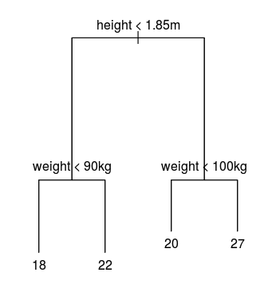
Decision trees
1. Random Forest Modeling
Random Forest model is an ensemble of single decision trees
Let’s initially talk about a decision tree
DT based on recursive partitioning
regression
Notes:
For a regression tree, we use a different approach to determining homogeneity of groups, and thus

Slide 7

Classification: splitting
1. Random Forest Modeling
Gini index. Assists in determining which split provides the most homogeneous sub nodes. Can only perform binary splits. The lower the Gini value, the higher the homogeneity
Information Gain: Measures disorganization (entropy)

Slide 8
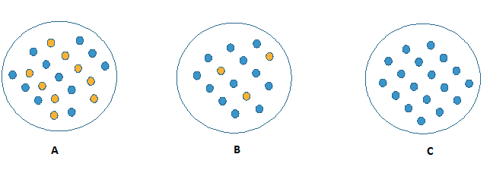

Classification: splitting
1. Random Forest Modeling
Gini index. Assists in determining which split provides the most homogeneous sub nodes. Can only perform binary splits. The higher the Gini value, the higher the homogeneity
Information Gain: Measures disorganization (entropy)

Slide 9

regression: splitting
1. Random Forest Modeling
Reduction in Variance: This algorithm uses the standard formula of variance to choose the best split. The split with lower variance is selected as the criteria to split the population
Calculate variance for each node.
Calculate variance for each split as weighted average of each node variance.

Slide 10
Steps to a decision tree
1. Random Forest Modeling
we start at the tree root and split the data on the feature that results in the smallest GINI or the largest information gain (reduction in uncertainty towards the final decision).
we can then repeat this splitting procedure at each child node until the leaves are pure. This means that the samples at each leaf node all belong to the same class.
In practice, we may set a limit on the depth of the tree to prevent overfitting. We compromise on purity here somewhat as the final leaves may still have some impurity.
Notes:
In pruning, you trim off the branches of the tree, i.e., remove the decision nodes starting from the leaf node such that the overall accuracy is not disturbed. This is done by segregating the actual training set into two sets: training data set, D and validation data set, V. Prepare the decision tree using the segregated training data set, D. Then continue trimming the tree accordingly to optimize the accuracy of the validation data set, V.

Slide 11
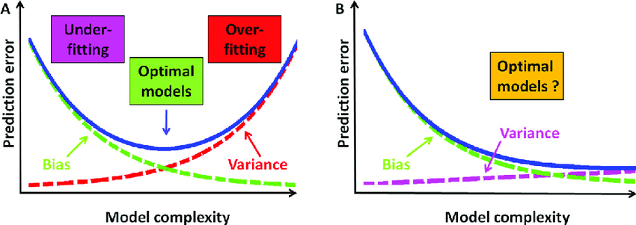
Bias/variance tradeoff
1. Random Forest Modeling

Slide 12
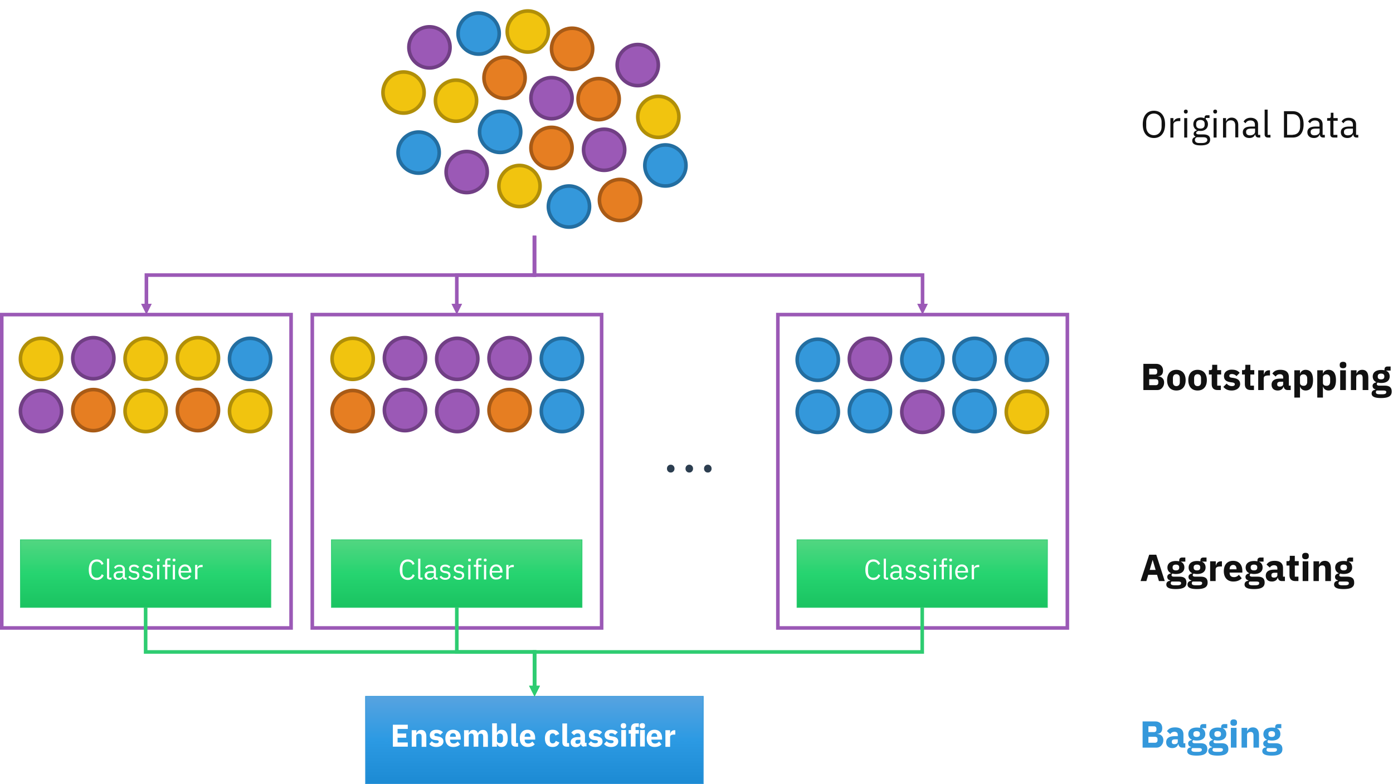
Ensembled Decision Trees
1. Random Forest Modeling
Random Forest model is an ensemble of single decision trees (bagged decision trees)
Leo Breiman - Statistical Modeling: The Two Cultures
Bagged = bootstrapped aggregation

Slide 13
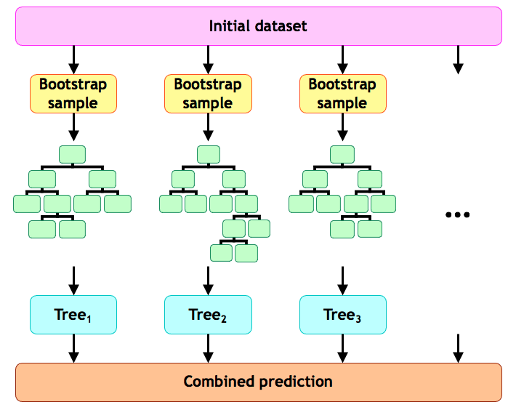
ENSEMBLED DECISION TREES
1. Random Forest Modeling
Random Forest model is an ensemble of single decision trees (bagged decision trees)
Leo Breiman - Statistical Modeling: The Two Cultures

Slide 14
Advantages to Random forest
1. Random Forest Modeling
RF models are robust to overfitting/bias issues
There is no need in pre-selection of variables.
RF has its own reliable procedure for estimation of predictive ability of model.
RF allows for estimation of variable importance
RF method is very fast and effective in working with large datasets

Slide 15
Geo Weighted RF
1. Random Forest Modeling
Geographical Random Forest (GRF) is a spatial analysis method using a local version of the Random Forest Regression Model.
It allows for the investigation of the existence of spatial non-stationarity, in the relationship between a dependent and a set of independent variables. The latter is possible by fitting a sub-model for each observation in space, taking into account the neighbouring observations. This technique adopts the idea of the Geographically Weighted Regression, Kalogirou (2003).

Slide 16
GEO Weighted RF
1. Random Forest Modeling
The main difference between a tradition (linear) GWR and GRF is that we can model non-stationarity coupled with a flexible non-linear model which is very hard to overfit due to its bootstrapping nature, thus relaxing the assumptions of traditional Gaussian statistics.
Essentially it was designed to be a bridge between machine learning and geographical models, combining inferential and explanatory power. Additionally, it is suited for datasets with numerous predictors, due to the robust nature of the random forest algorithm in high dimensionality. (Fotheringham et al. 2003)

