Slide 1

AI Powered Learning Project
EDSC Project

Slide 2



Quick Icebreaker
Where you’re from
Your college major
A personal or academic burning interest

Slide 3
Intro
EDSC member responsible – Emily Cao
Mentor – Dr. Comstra
Communication & project scheme
Team
Dr. Comstra
Biology teaching faculty meeting
Talk to CS/QTM Faculty about continuing project
Team manager
Is it cool?
It it cool?

Slide 4
Basic Information
Adaptive Learning: Tailors the learning experience to the individual needs and pace of each student, focusing on areas that require more attention.
Scalability and Accessibility: Can easily incorporate new resources and adapt to different subjects, levels, and learning standards, making it a versatile tool across educational settings.

Slide 5


Primary Deliverables
Backend (2-3 people)
Automated generation of the substance of the app
Frontend (2-3 people)
A usable tool that non-technical individuals can use

Slide 6
Backend Formal Problem
Problem: Given a set of resources (videos, textbooks) and learning objectivess, draw edges between & within the resources and learning objects.
Txt
Cell biology
?
Vid
Ecology
Vid

Slide 7
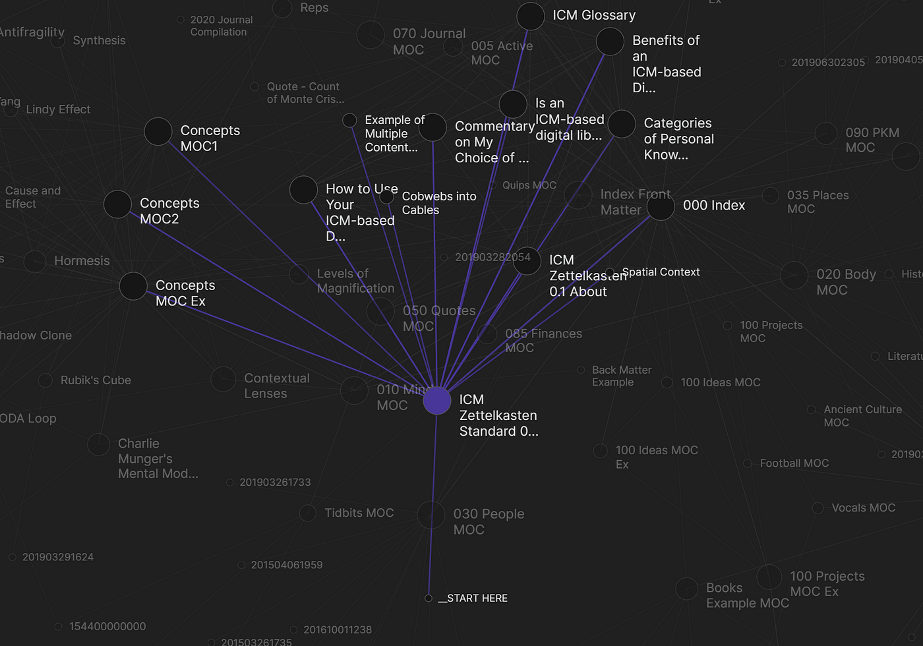
Frontend Formal Problem
Obsidian UI
Problem: Given a graph database of information and a set of learning objectives, display these in an interactive and easy way.
Txt
How can we display this information to a user?
Cell biology
Vid
Ecology
Vid
Like obsidian?

Slide 8
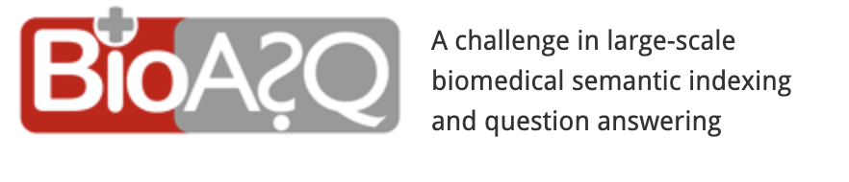
Reach Goal
Implement the knowledge graph with Retrieval augmented generation where we essentially give the local LLM some degree of context.
Run a benchmark on BioSaq.

Slide 9

Dreamer Goal
A modular and adaptive learning app that generates questions based on resources and keeps tracks of users’ scores in order to provide them with slowly harder levels of questions & depth of understanding.
Concept of adaptive testing and building “levels” of competency

Slide 10

Technical Information
For running LLMs locally we can utilize llama.cpp
For turning videos into text, we can utilize whisper.cpp (from OpenAI)
For drawing edges, use NetworkX and methods like co-occurrence, semantic similarity, or contextual linkage.

Slide 11
Initial Tasks => Go into notion page
Logistics
Assign tasks—who is interested in what.
Front end
Create the toy knowledge graph from wikidata
Figure out what platform we want to build it on—tkinter? Retrieval.
Draft up initial UI on pen and paper. Implement.
Back End
Set up youtube API such that we can have this pipeline: search, filter, download, demucs (remove music), transcribe
Research different methods to draw edges.
Textbook processing.

Slide 12
Data Sources
Dr. Comstra has provided us with learning objectives and powerpoints which we can parse
We have videos
Biology curriculum textbook
We can use Minstral models—stick to 70b models if computer can run.

