Slide 1


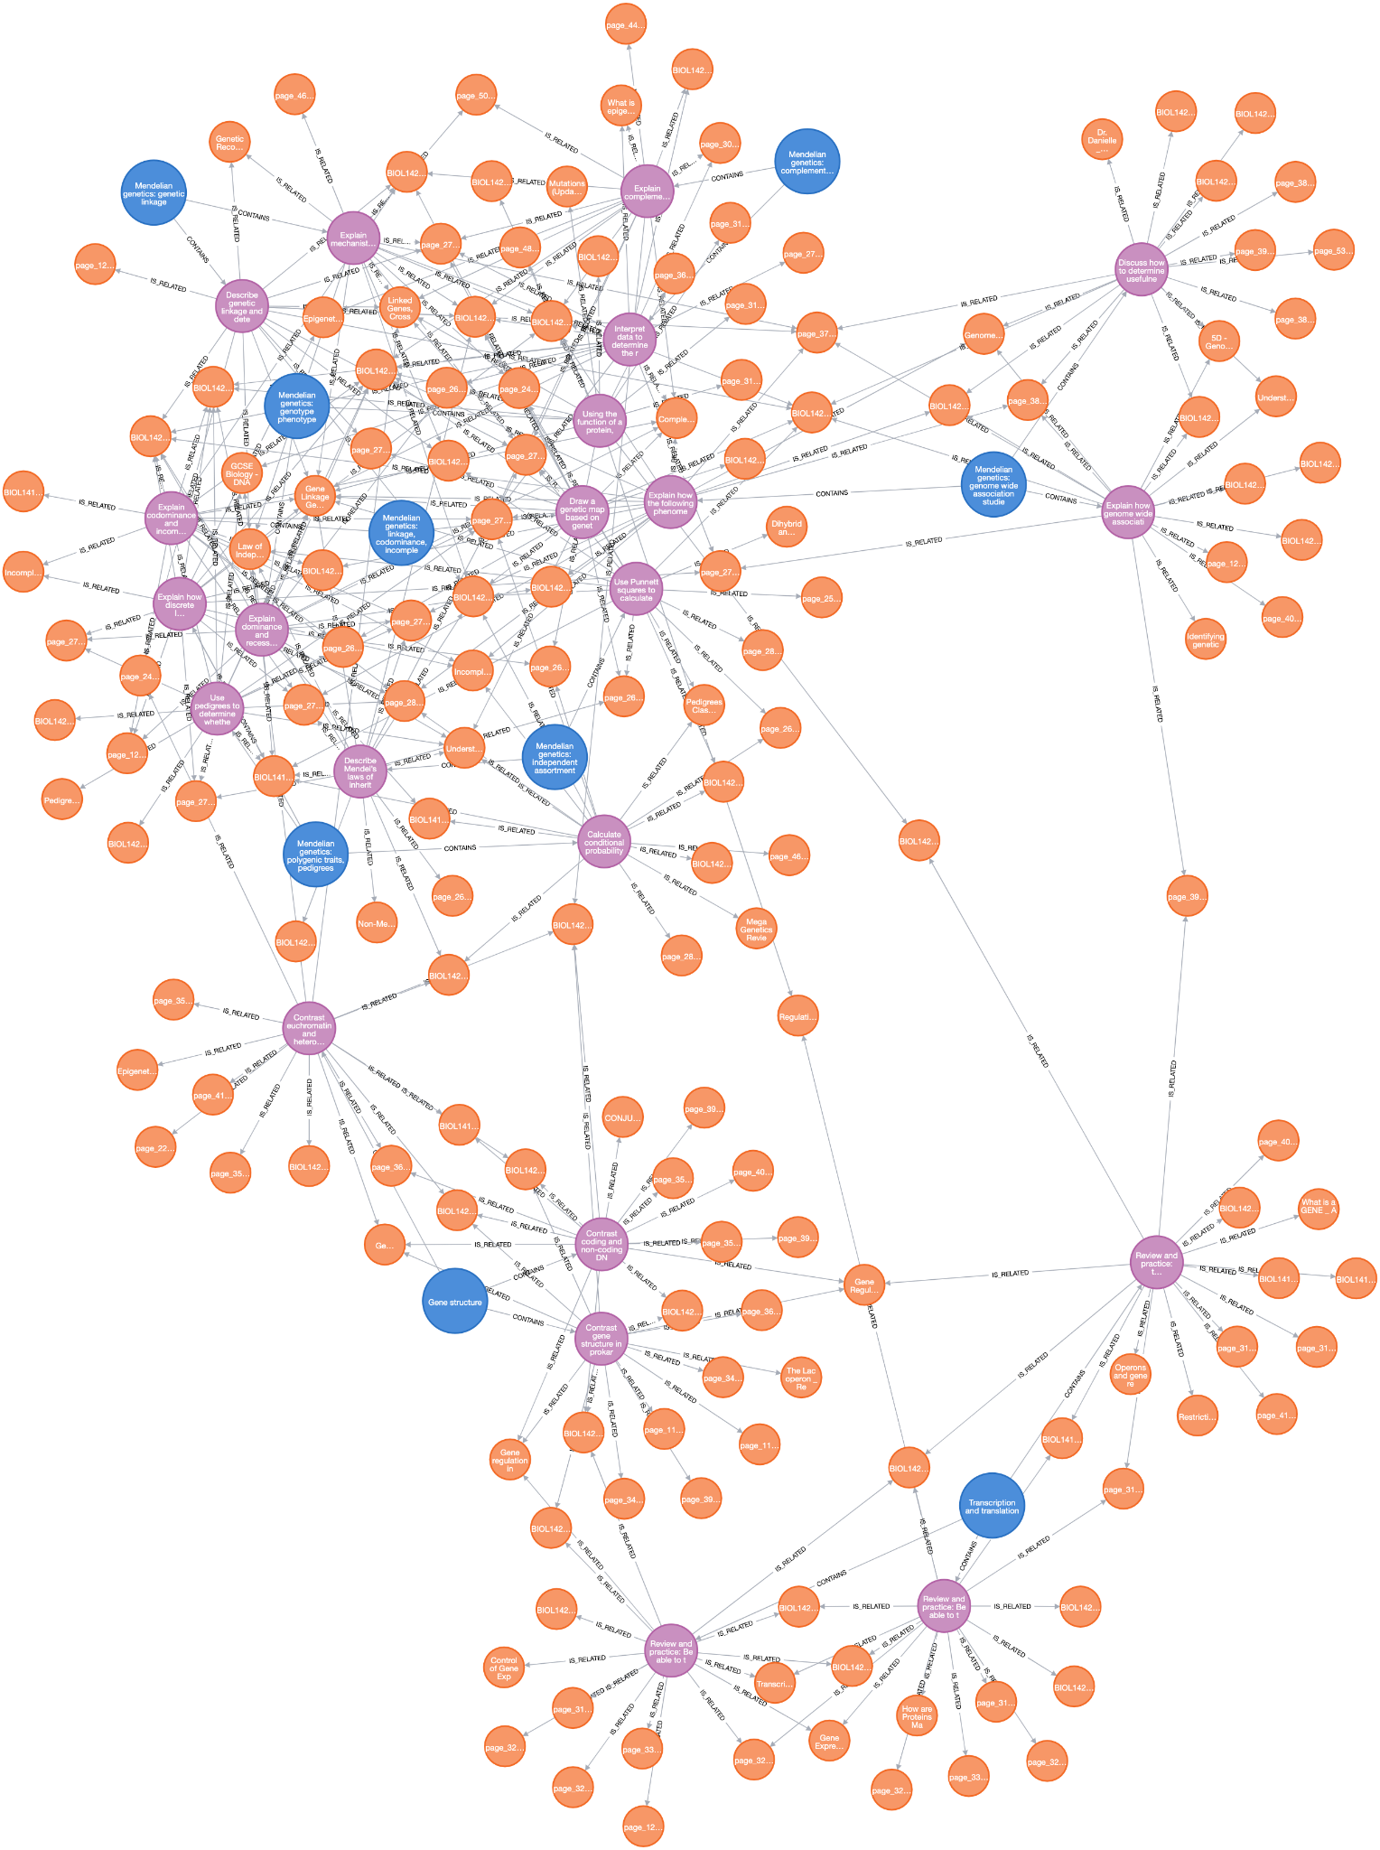
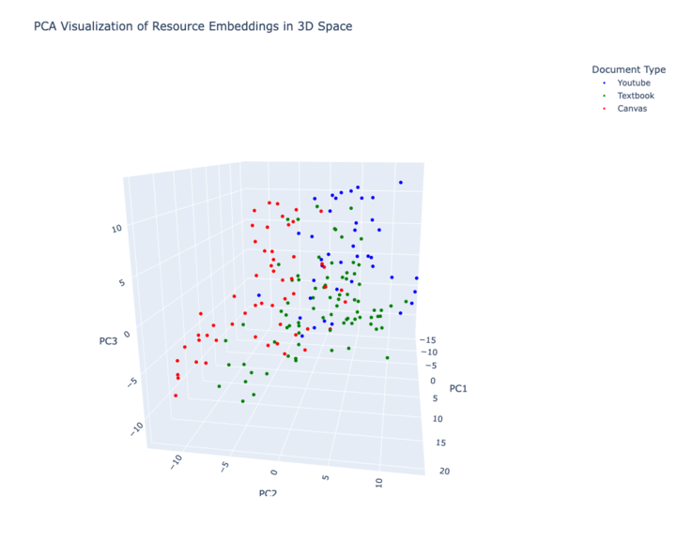
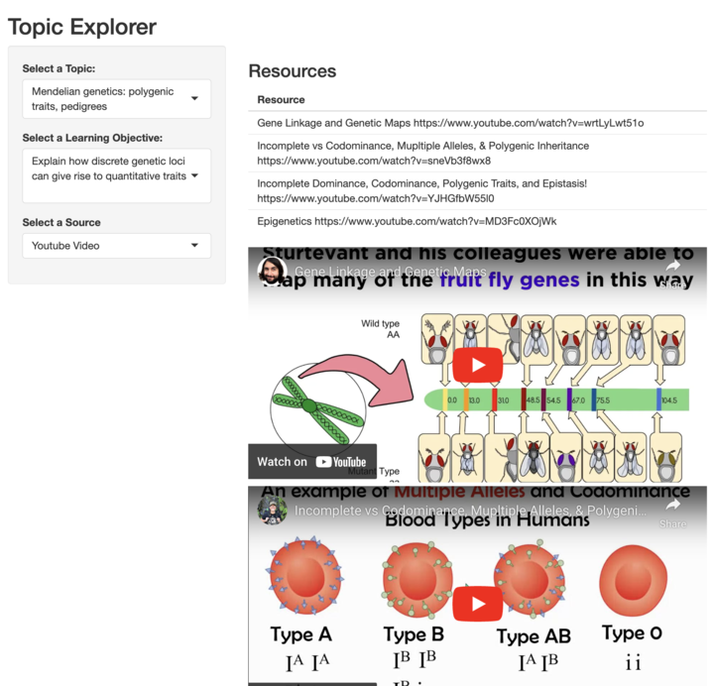
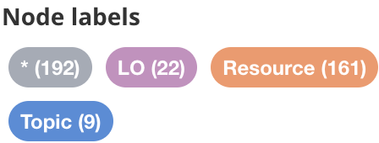
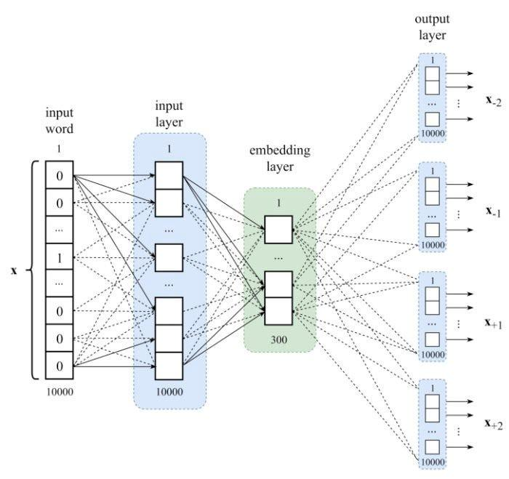
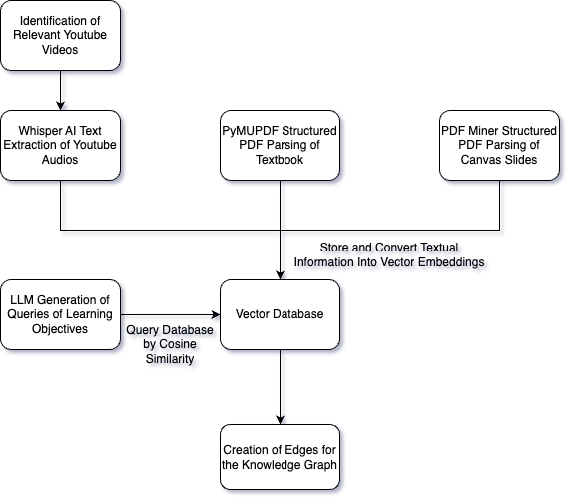
LLM Based Solution for Low Level Learning Objectives
Christopher Wang, Eric Steinberg, Rayvant Sahni, Sam Liu, Sam Wang, Zach Daube
Emory University
Abstract & Introduction
Figure 3: Neo4j Visualization of Knowledge Graph
Discussion & Results
In the current landscape of educational technology, we observe that there exists a problem in allocating learning resources to low-level learning objectives. Professors and instructors often lack the time and resources to cater to all learning objectives, especially given the variation in content and objectives across different institutions. The format of conventional course materials such as textbooks and slides is antiquated, and challenging to navigate. And finding high quality, relevant online sources can present a challenge due to the abundance of low quality content and misinformation.
In this project, we pursued three strategies to address these issues:
1. To expand the scope of knowledge of classroom materials from external resources by creating a database of resources extracted from the broader internet.
2. To create a more cohesive and personalized learning experience for individuals to learn, which can adapt to their learning pace
3. To provide a centralized platform or tool for individuals to access and interact with these materials.
We applied a Large Language Model to automate the mapping of learning objectives to both internal and external educational content, visualized through a knowledge graph. This system, piloted on a foundational Biology course, BIO 141 and BIO 142 at Emory University, enhances material relevance and personalizes the learning experience to meet individual student needs. The pilot implementation demonstrated the platform's capacity to significantly enhance educational access and outcomes with more relevant, personalized content. We propose that this tool can greatly improve educational efficiency and adaptability, offering a scalable solution that could transform educational practices across various disciplines and institutions.
Our program, accessible through a web app (Figure 1) was overall highly effective and efficient at matching relevant learning resources to the questions we generated based off of the course learning objectives. We represented these relationships by producing a knowledge graph (Figure 3). Although this program is currently limited to Emory’s Bio 141 and Bio 142 courses, it should be easily scalable to more courses and institutions. Through PCA analysis, we identified the top three dimensions representing the greatest variance in our document embeddings. We observed that learning resources cluster by type—textbooks with formal language, YouTube videos with conversational style, and Canvas slides with discretized learning—indicating that these resources are primarily categorized by their language style.
Figure 4: Top 3 Components after PCA Decomposition
Figure 5: Front-end Web App for Students
Figure 3: Neo4j visualization of knowledge graph connecting topics with learning objectives and resources
Figure 1: Embedding Transformer Model
Figure 2: Workflow Diagram
Conclusions
Our LLM-based system offers a promising solution to some prevalent challenges in education. While it is currently limited in scope, we have identified potential solutions to expand the system’s capability:
From a front-end perspective, future developments include integrating multimedia resources such as videos and textbook pages in PDF format, along with Canvas resources, into our existing R Shiny interface, so that students can interact more efficiently with the materials. Additionally, we plan to enhance the program’s indexing of Canvas slides by employing an LLM to analyze images and provide concise descriptions, enriching the content's accessibility and comprehension.
On the backend, we aim to improve question generation by deploying a more advanced LLM capable of formulating precise queries that enhance search accuracy. In terms of document retrieval, our approach currently links the knowledge graph to the top four documents matching the learning objectives–this number could easily be expanded. We also intend to investigate mechanisms that assess cosine similarity individually between documents to establish a threshold for relevance, rather than relying on repetition.
Finally, we aim to refine the use of the LLM in labeling edges within the knowledge graph by implementing automatic edge detection, a process that automates the creation of connections between nodes in the knowledge graph based on the relationships derived from the content. This feature is expected to enhance the richness and utility of the knowledge graph, making it a more powerful tool for educational purposes. However, while automatic edge generation can significantly enhance the functionality of our knowledge graph, it also carries risks such as the potential for introducing misinformation through inaccuracies in representing real-world relationships between entities. These risks, stemming from biases, errors, or limitations in the algorithm’s understanding of context and nuance, will be carefully managed to safeguard the integrity of the educational content provided.
Methods and Materials
A Large Language Model (LLM) is an advanced neural network trained on large datasets of texts from diverse internet sources. The pre-trained LLM is highly effective at predicting subsequent tokens (next words) with precision by examining the context of previous text sequences and establishing implicit connections within the information. For our project, we employed a fine-tuned LLM (utilizing Llama CPP local) to specifically link educational resources based off of BIO 141 and BIO 142’s learning objectives. The model was prompted to generate questions tailored to each learning objective.
We decided on three sources of data we believed to be the most informative for answering these queries: the course textbook, the course slides from the Canvas page, and a search algorithm for finding relevant YouTube videos. Using PyMuPDF, we processed the textbook's PDF to omit images and captions, segmented it page-by-page, and converted it into .txt format. Course slides were similarly extracted and transformed into .txt files, each labeled with its slide number. Finally, utilizing the YouTube API, we identified relevant educational videos aligned with the learning objectives, saved them, and parsed their audio to a transcript using Whisper, OpenAI’s audio-to-text tool.
These text outputs were then transformed into vector embeddings using the 'instructor-xl' model. We constructed a vector database from these embeddings, querying it with the previously generated questions derived from the learning objectives to identify the most relevant documents based on cosine similarity; the top-4 documents were selected. We then built a detailed knowledge graph using Neo4J to visualize the connections between learning objectives and these educational resources through vector-based nodes linked by directed edges. All data processing and integration of the model were conducted using Python..
Finally, we engineered an R Shiny GUI to enhance the functionality and scalability of our system, streamlining user interactions and data visualization. This interface is specifically tailored for introductory biology students to effortlessly access educational resources online by specifying topics, learning objectives, and desired resource types. It supports dynamic querying to fetch and display relevant resources, such as videos and texts, with plans to expand to other content forms.
Contact
References
Dagan, Ido, et al. "Models of Word Cooccurrence Probabilities." Consensus, 1998, https://consensus.app/papers/models-word-cooccurrence-probabilities-dagan/05ff7471bf0b56bca2961ac80a465ff4/
Zhao, W., et al. "ReLSTM: A Memory Network Similarity Algorithm Based on Word Embedding." Consensus, 2022, https://consensus.app/papers/relstm-memory-network-similarity-algorithm-based-word-zhao/28f989f256e958a4b0c6e4c369260c27/
Erkan, Günes, and Dragomir R. Radev. "LexRank: Graph-Based Centrality as Salience in Text Summarization." Consensus, 2004, https://consensus.app/papers/lexrank-graphbased-centrality-salience-text-erkan/7cc795173695568e9cbe6d9403ec567b/
Figure 1: https://medium.com/@RobinVetsch/nlp-from-word-embedding-to-transformers-76ae124e6281
Christopher Wang, Eric Steinberg, Rayvant Sahni, Sam Liu, Sam Wang, Zach Daube
Emory Data Science Club
PoC: christopher.wang@emory.edu
Phone: +1(908) 420-0105
Hogan, Aidan, et al. "Knowledge Graphs." arXiv, 21 Sept. 2020, https://arxiv.org/pdf/2009.11564.pdf.
Wang, Jiapeng, and Yihong Dong. "Measurement of Text Similarity: A Survey." Consensus, 2020, https://consensus.app/papers/measurement-text-similarity-survey-wang/9993b38dcc185037aec2a42197d7eb34/
Zhang, Peiying, et al. "Similarity Computing Model Based on Multi-Model Fine-Grained." Consensus, 2022, https://consensus.app/papers/similarity-computing-model-based-multi-model-finegrained-zhang/5837439540bc588a823e3c3e4f1b44c4/
Pawar, Atish, and Vijay K. Mago. "Challenging Boundaries with Unsupervised Learning for Semantic Similarity." Consensus, 2019, https://consensus.app/papers/challenging-boundaries-unsupervised-learning-semantic-pawar/9d2edd74d9ea5819b3791e603e036cd9/

