Slide 1
Introduction to Lab #2 Hexadecimal and Tables
José Nelson Amaral

Slide 2
Hexadecimal Code
0 | 0000 | 4 | 0100 | 8 | 1000 | c | 1100
1 | 0001 | 5 | 0101 | 9 | 1001 | d | 1101
2 | 0010 | 6 | 0110 | a | 1010 | e | 1110
3 | 0011 | 7 | 0111 | b | 1011 | f | 1111

Slide 3
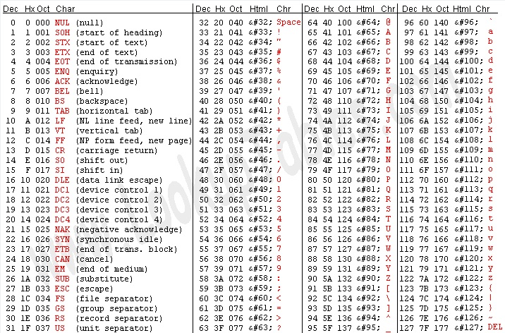
American Standard Code for Information Interchange (ASCII)

Slide 4
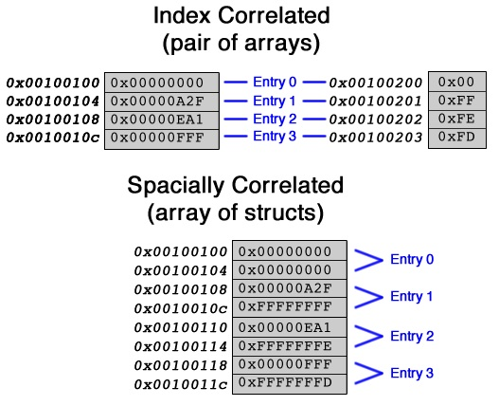
Tables in Assembly

Slide 5
Assignment: readHex
Parameter:
$a0
Address of string of eight ASCII characters
‘f’
‘E’
‘d’
‘8’
‘0’
‘D’
‘5’
‘A’
Return Value:
$v1 = 1: a non-hexadecimal character found in the string.
$v1 = 0: valid hexadecimal number; return value in $v0.

Slide 6
Assignment: printHex
Parameter:
$a0
Integer value
Output:
Print ASCII characters for hexadecimal representation
Return Value: None

Slide 7
Assignment: CreateCountTable
Parameter: None
Execution:
Create a table to track at most 200 distinct counters.
Each counter will count at most up to 255.
Return Value: None

Slide 8
Assignment: CountIntegerAccess
Parameter:
$a0
Integer value
Return Value:
$v0: The number of time this integer value
has been accessed (including this one).
Execution:
Is integer value in table?
Yes: increment counter
No: Add value to table, set counter to 1.

Slide 9
What to Submit?
A single file, called lab2.s.
Make sure the file does not contain a main procedure.

