Slide 1
Lab ARM Introduction
José Nelson Amaral

Slide 2
Assignment
MIPStoARM:
Arguments:
$a0 = pointer to memory containing a MIPS function that ends with the word 0x FFFF FFFF
Return Values:
$v0 = The number of ARM instructions generated
$v1 = A pointer to the first ARM instruction that is stored in memory space that you allocate.

Slide 3
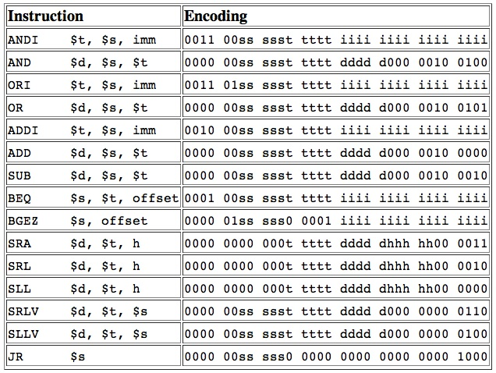
MIPS Instructions to Translate

Slide 4
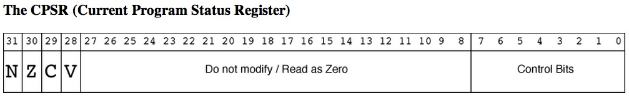
The ARM Status Register
Instructions that have a status bit on change the
condition codes in the status register
Set if signed operation resulted in Overflow
Set if operation produced a Carry bit
Set if operation result was Zero
Set if operation result was Negative

Slide 5
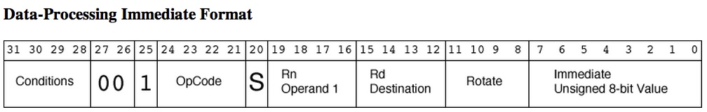
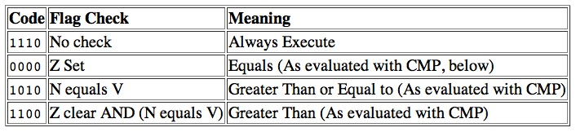
ARM Instruction Formats

Slide 6
ARM Instruction Formats
Destination register.
First operand register.
Status indicate if condition codes in CPSR should change.
0: Operands are two registers
Immediate
1: Operands are a register and immediate value

Slide 7
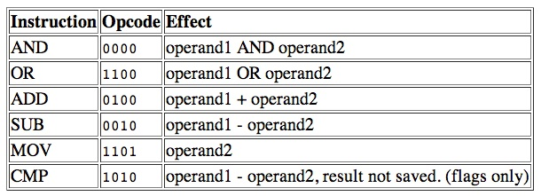
ARM Instruction Formats

Slide 8
ARM Instruction Formats
The instruction has a 32-bit immediate value that is formed by:
Immediate 8-bit value
Rotated to the right by 2 times Rotate with wrap-around over 32 bits.
Example:
8-bit immediate: 0110 1101
Rotate: 1110₂ = 14₁₀
32-bit immediate: 0000 0000 0000 0000 0000 0110 1101 0000

Slide 9
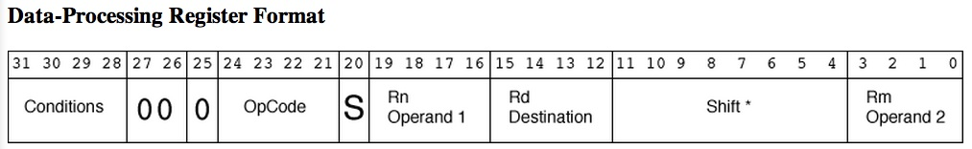
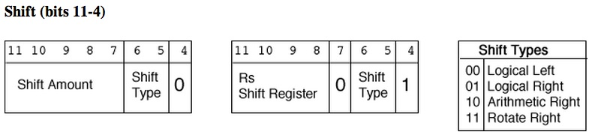
ARM Instruction Formats
The second operand is the content of Rm shifted as per Shift:
Rotate Right 0 shifts Rm one to the right and places Carry Flag from CPSR in bit 31.

Slide 10
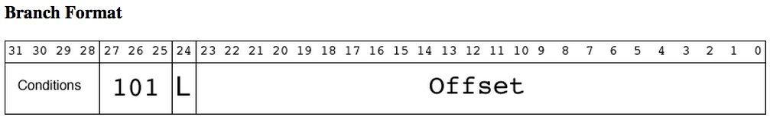
ARM Instruction Formats
Indicates if address of next instruction should be stored into
the link register (R14).
Shifted left by two and sign-extended.
ARM prefetches two instructions in advance, thus PC is set to the
address of the branch instruction +8.

Slide 11
ARM Instruction Formats
A single conditional branch in MIPS may require two ARM
instructions:
One to set the condition
Another for the branch
→ Changes in the offset of all branches

Slide 12
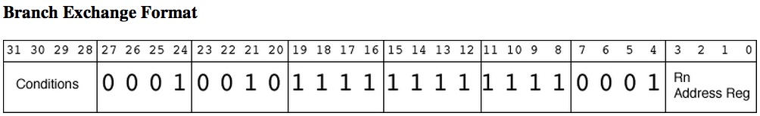
ARM Instruction Formats
Equivalent to the jr instruction in MIPS
Specifies the register for the relative jump

Slide 13
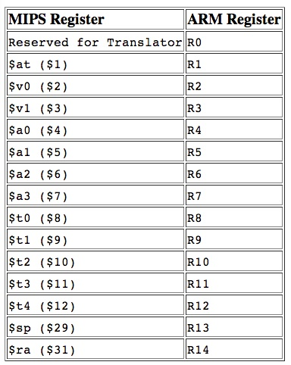
Register Translation

Slide 14
Suggested Algorithm to Translate Branches
MIPS Binary (shown disassembled)
MIPS-to-ARM Table
Branch Table
0x00100100 | addi $2, $2, -1
0x00100104 | addi $1, $1, 1
0x00100108 | bgez $2, -12
0x0010010c | beq $1, $1, -4
0x00100100 | 0x2042FFFF
0x00100104 | 0x20210000
0x00100108 | 0x0441FFF4
0x0010010c | 0x0421FFFC
0x00100200 | 0x00100400
0x00100204 | 0x00100404
0x00100208 | 0x0010040c
0x0010020c | 0x00100414
0x00100300 | 0
0x00100304 | 0
0x00100308 | 0x00100200
0x0010030c | 0x0010020c
ARM Instructions
0x00100400 | SUB R2, R2, 1
0x00100404 | ADD R1, R1, 1
0x00100408 | CMP S R2, 0
0x0010040c | BGE 0
0x00100410 | CMP S R1, R1
0x00100414 | BEQ 0
First pass is over the MIPS
instruction binary codes

Slide 15
Incorrect Suggested Algorithm to Translate Branches
MIPS Binary (shown disassembled)
MIPS-to-ARM Table
Branch Table
0x00100100 | addi $2, $2, -1
0x00100104 | addi $1, $1, 1
0x00100108 | bgez $2, -12
0x0010010c | beq $1, $1, -4
0x00100200 | 0x00100400
0x00100204 | 0x00100404
0x00100208 | 0x0010040c
0x0010020c | 0x00100414
0x00100300 | 0
0x00100304 | 0
0x00100308 | 0x00100200
0x0010030c | 0x0010020c
Target Instr. Address
0x00100400
Branch Instr. Address
– 0x0010040c
ARM Instructions
– 0x0000000c
0x00100400 | SUB R2, R2, 1
0x00100404 | ADD R1, R1, 1
0x00100408 | CMP S R2, 0
0x0010040c | BGE 0
0x00100410 | CMP S R1, R1
0x00100414 | BEQ 0
PC Offset
– 0x00000008
-20
Target Instr. Address
0x00100414
-20
Branch Instr. Address
– 0x00100414
– 0x00000000
PC Offset
– 0x00000008
-8
-8

Slide 16
Problem with previous solution
The offset generated for the last branch in the segment is incorrect because the branch target is the branch instruction itself (a weird program that creates an infinite loop).
A simple solution is to store in the MIPS-to-ARM table the address of the ARM branch (instead of the address of the ARM compare instruction as in the previous solution).
Now the address calculation has to compensate for the existence of the CMP instruction by adding 4 to the address found in the MIPS-to-ARM table before subtracting from the target instruction address.

Slide 17
Limitation
One limitation of this new solution (shown in the next slide) is that it assumes that every MIPS branch will be translated into two ARM instructions.
If that is not the case, then another single-bit table can be used to indicate for each branch if the branch got translated to a single or to two instruction and then do the correct computation of the offset accordingly.

Slide 18
Correction to Suggested Algorithm to Translate Branches (assumes that every MIPS branch is translated to two ARM instructions)
MIPS Binary (shown disassembled)
MIPS-to-ARM Table
Branch Table
0x00100100 | addi $2, $2, -1
0x00100104 | addi $1, $1, 1
0x00100108 | bgez $2, -12
0x0010010c | beq $1, $1, -4
0x00100200 | 0x00100400
0x00100204 | 0x00100404
0x00100208 | 0x00100408
0x0010020c | 0x00100410
0x00100300 | 0
0x00100304 | 0
0x00100308 | 0x00100200
0x0010030c | 0x0010020c
Target Instr. Address
0x00100400
Branch Instr. Address
– 0x0010040c # 0x00100408 + 4
ARM Instructions
– 0x0000000c
0x00100400 | SUB R2, R2, 1
0x00100404 | ADD R1, R1, 1
0x00100408 | CMP S R2, 0
0x0010040c | BGE 0
0x00100410 | CMP S R1, R1
0x00100414 | BEQ 0
PC Offset
– 0x00000008
-20
Target Instr. Address
0x00100410
-20
Branch Instr. Address
– 0x00100414 # 0x00100410 + 4
– 0x00000004
PC Offset
– 0x00000008
-12
-12

