Slide 1
Principal Components Analysis (PCA)
SYS 4021/6021
Laura Barnes and Julianne Quinn

Slide 2
Organization of lecture
What is principal components analysis (PCA) and why would we want to do it?
Simple illustration of PCA for two variables
Extension of PCA to multiple variables
Mathematics behind PCA

Slide 3
Motivation for Principal Components Analysis (PCA)
Visualizing and modeling data in more than 2 dimensions is conceptually difficult.
Can we collapse our data into a lower number of dimensions (principal components) that still contain most of the information?
What might be some of the benefits of doing this?
Reveal otherwise “hidden” patterns in the data.
Compress our data into a smaller set of transformed variables without losing much information.

Slide 4
Motivation for PCA
If we want to transform our data into a smaller number of variables with almost as much as information, we need a measure of “information” we want to maximize.
One measure of information we will use throughout this class is variability. If we want to predict stock prices, we need to know how they will vary – when will they be high vs. low?
The goal of PCA is to find linear combinations of our original data variables that maximize the variance of the data. This can only be applied to quantitative data variables.

Slide 5
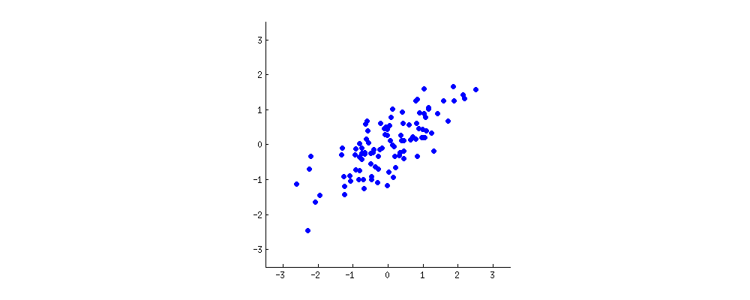


Example in two dimensions
First we transform our data by “centering” it:
$X_{1}^{′}=X_{1}−\overline{X_{1}}$, $X_{2}^{′}=X_{2}−\overline{X_{2}}$
X’₂ = Rate of O₂ consumption anomaly
$\vec{u}$₁ = w₁X’₁ + w₂X’₂
What is the direction of greatest variability?
w₂
w₁
X’₁ = Heart rate anomaly
https://stats.stackexchange.com/questions/2691/making-sense-of-principal-component-analysis-eigenvectors-eigenvalues

Slide 6

Example in two dimensions
We want to find w₁ and w₂ that maximizes the variance in the direction u₁.
X’₂ = Rate of O₂ consumption anomaly
$\vec{u}$₁ = w₁X’₁ + w₂X’₂
What is the direction of greatest variability?
w₂
w₁
X’₁ = Heart rate anomaly
https://stats.stackexchange.com/questions/2691/making-sense-of-principal-component-analysis-eigenvectors-eigenvalues

Slide 7
Example in two dimensions
We want to find w₁ and w₂ that maximizes the variance in the direction u₁. This is the variance of the blue points along the axis u₁ when they are projected onto it.
X’₂ = Rate of O₂ consumption anomaly
$\vec{u}$₁ = w₁X’₁ + w₂X’₂
What is the direction of greatest variability?
w₂
w₁
X’₁ = Heart rate anomaly
https://stats.stackexchange.com/questions/2691/making-sense-of-principal-component-analysis-eigenvectors-eigenvalues

Slide 8
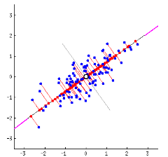
Example in two dimensions
We want to find w₁ and w₂ that maximizes the variance in the direction u₁
X’₂ = Rate of O₂ consumption anomaly
X’₁ = Heart rate anomaly
https://stats.stackexchange.com/questions/2691/making-sense-of-principal-component-analysis-eigenvectors-eigenvalues

Slide 9

Example in two dimensions
This also minimizes the sum of the squared distances between each original variable (blue point) and the line u₁
X’₂ = Rate of O₂ consumption anomaly
$\vec{u}$₁ = w₁X’₁ + w₂X’₂
X’₁ = Heart rate anomaly
https://stats.stackexchange.com/questions/2691/making-sense-of-principal-component-analysis-eigenvectors-eigenvalues

Slide 10
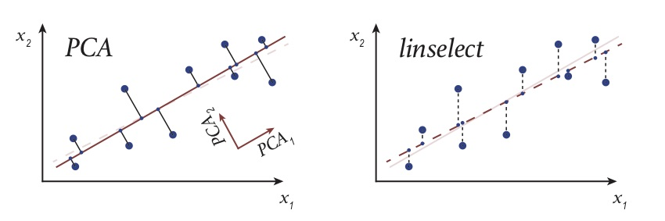
Example in two dimensions
Note, this is likely not the same as the line you would find in a regression. That line minimizes the sum of squared errors, which are perpendicular to x₁, not u₁.
https://sunjackson.github.io/2018/08/11/f3e62855f7613e1b98f4f550ee51ad9a/

Slide 11
Example in two dimensions
We now have a new variable u₁ that is a weighted sum (i.e. linear combination) of the original variables:
u₁ = w₁x’₁ + w₂x’₂
u₁ is called the 1st principal component (PC).
The 2nd PC, u₂, is the direction of second greatest variability, conditional on being orthogonal to u₁.

Slide 12

Example in two dimensions
If we have only two dimensions, there is only one option for the second PC.
X’₂ = Rate of O₂ consumption anomaly
$\vec{u}$₁ = w₁X’₁ + w₂X’₂
v₂
$\vec{u}$₂ = v₁X’₁ + v₂X’₂
v₁
X’₁ = Heart rate anomaly
https://stats.stackexchange.com/questions/2691/making-sense-of-principal-component-analysis-eigenvectors-eigenvalues

Slide 13
Example in two dimensions
With PCA, the centered data variables located at (x₁,x₂) in the original coordinate system are given new coordinates (u₁,u₂) in a rotated coordinate system
What do these new variables represent?
(x₁,x₂)
(u₁,u₂)

Slide 14

Example in two dimensions
Recall u₁ is a weighted sum of the original variables. Those weights, called “loadings” tell us the relative importance of the original data variables and their relationship.
$\vec{u}$₁ = w₁X’₁ + w₂X’₂
w₂
w₁

Slide 15
Example in two dimensions
If w₁ > w₂, x₁ explains more of the dataset’s variability than x₂ and vice versa.
$\vec{u}$₁ = w₁X’₁ + w₂X’₂
w₂
w₁

Slide 16




Example in two dimensions
If w₁ > w₂, x₁ explains more of the dataset’s variability than x₂ and vice versa.
If w₁ and w₂ are both positive, or both negative, x₁ and x₂ are positively correlated.
If one is positive and the other is negative, those variables are negatively correlated.
$\vec{u}$₁ = w₁X’₁ + w₂X’₂
w₂
$\vec{u}$₁ = -w₁X’₁ – w₂X’₂
w₁
-w₂
-w₁
$\vec{u}$₁ = w₁X’₁ + w₂X’₂
w₂
w₁
-w₂
$\vec{u}$₁ = -w₁X’₁ – w₂X’₂
-w₁

Slide 17


Example in two dimensions
If w₁ > w₂, x₁ explains more of the dataset’s variability than x₂ and vice versa.
If w₁ and w₂ are both positive, or both negative, x₁ and x₂ are positively correlated.
If one is positive and the other is negative, those variables are negatively correlated.
-w₁
$\vec{u}$₁ = -w₁X’₁ + w₂X’₂
w₂
$\vec{u}$₁ = -w₁X’₁ + w₂X’₂
-w₁
w₂

Slide 18
Second Principal Component
X’₂ = Rate of O₂ consumption anomaly
The weights on each variable in the 2nd PC show their relative importance (magnitude) and relationship (sign), but in the direction of 2nd greatest variability (i.e. after we’ve removed their primary relationship in the direction of greatest variability).
v₂
w₂
-v₁
w₁
X’₁ = Heart rate anomaly

Slide 19
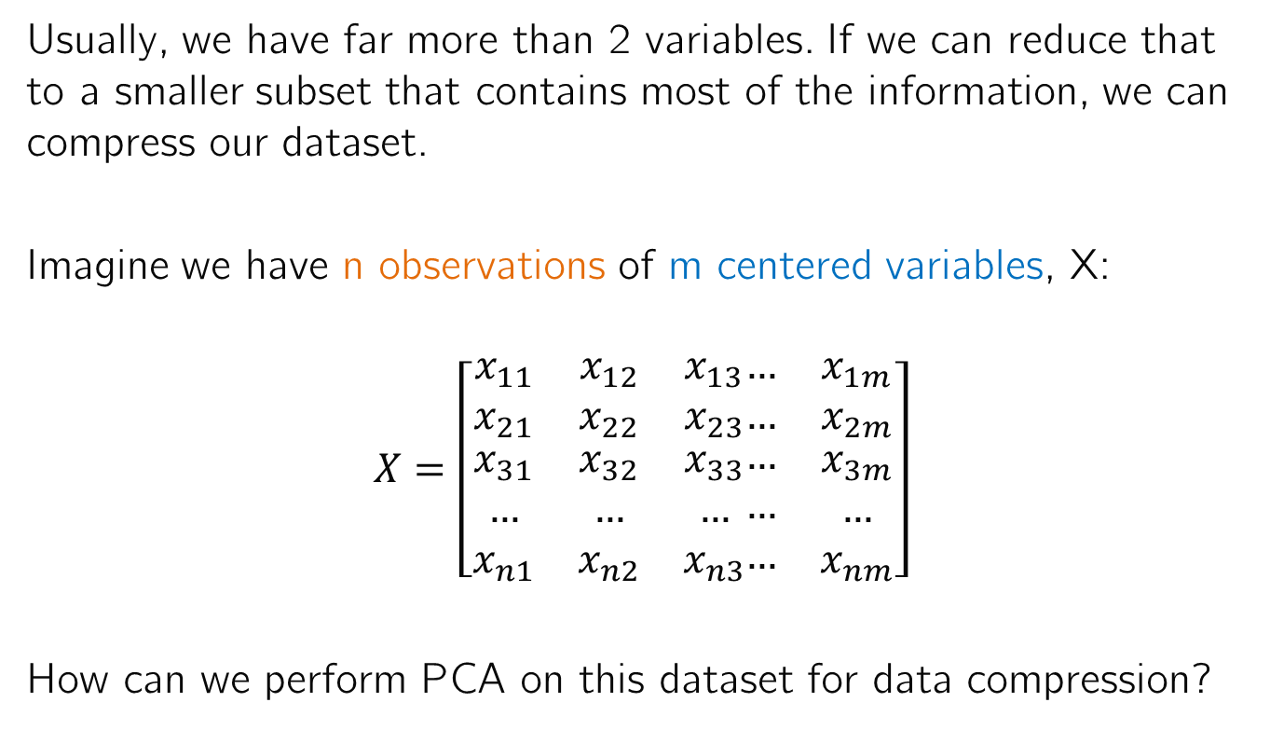
Extending this to multiple dimensions
Usually, we have far more than 2 variables. If we can reduce that to a smaller subset that contains most of the information, we can compress our dataset.
Imagine we have n observations of m centered variables, X:
$$X=\left[\begin{matrix}x_{11} & x_{12} & x_{13} \\ x_{21} & x_{22} & x_{23} \\ \begin{aligned}x_{31} \\ … \\ x_{n1}\end{aligned} & \begin{aligned}x_{32} \\ … \\ x_{n2}\end{aligned} & \begin{aligned}x_{33} \\ … \\ x_{n3}\end{aligned}\end{matrix}\begin{matrix}… & x_{1m} \\ … & x_{2m} \\ \begin{aligned}… \\ … \\ …\end{aligned} & \begin{aligned}x_{3m} \\ … \\ x_{nm}\end{aligned}\end{matrix}\right]$$
How can we perform PCA on this dataset for data compression?
Speed Weight #Cars … Damages
Accident 1
Accident 2
Accident 3
…
Accident n

Slide 20
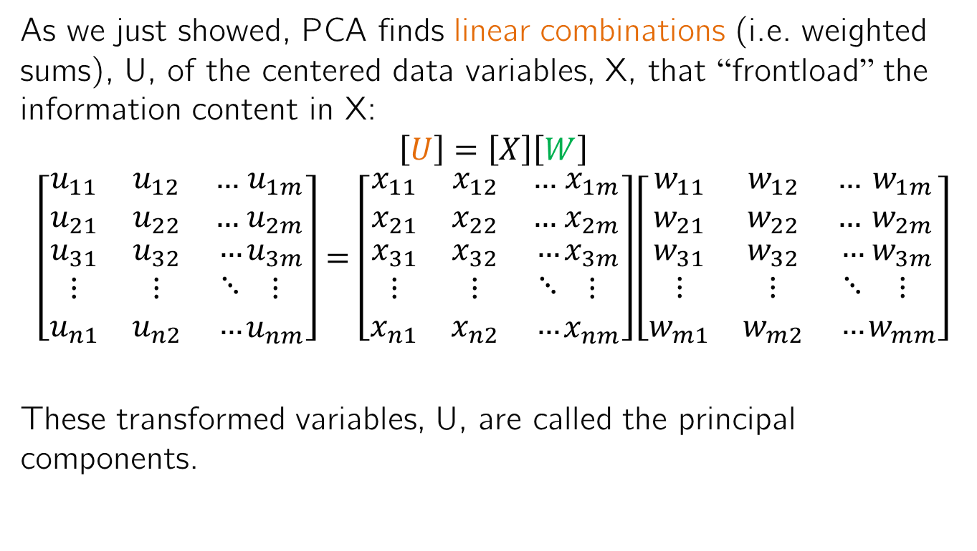
Extending this to multiple dimensions
As we just showed, PCA finds linear combinations (i.e. weighted sums), U, of the centered data variables, X, that “frontload” the information content in X:
$$\left[U\right]=\left[X\right]\left[W\right]$$
$$\left[\begin{matrix}u_{11} & u_{12} & … \\ u_{21} & u_{22} & … \\ \begin{aligned}u_{31} \\ ⋮ \\ u_{n1}\end{aligned} & \begin{aligned}u_{32} \\ ⋮ \\ u_{n2}\end{aligned} & \begin{aligned}… \\ ⋱ \\ …\end{aligned}\end{matrix}\begin{matrix}u_{1m} \\ u_{2m} \\ \begin{aligned}u_{3m} \\ ⋮ \\ u_{nm}\end{aligned}\end{matrix}\right]=\left[\begin{matrix}x_{11} & x_{12} & … \\ x_{21} & x_{22} & … \\ \begin{aligned}x_{31} \\ ⋮ \\ x_{n1}\end{aligned} & \begin{aligned}x_{32} \\ ⋮ \\ x_{n2}\end{aligned} & \begin{aligned}… \\ ⋱ \\ …\end{aligned}\end{matrix}\begin{matrix}x_{1m} \\ x_{2m} \\ \begin{aligned}x_{3m} \\ ⋮ \\ x_{nm}\end{aligned}\end{matrix}\right]\left[\begin{matrix}w_{11} & w_{12} & … \\ w_{21} & w_{22} & … \\ \begin{aligned}w_{31} \\ ⋮ \\ w_{m1}\end{aligned} & \begin{aligned}w_{32} \\ ⋮ \\ w_{m2}\end{aligned} & \begin{aligned}… \\ ⋱ \\ …\end{aligned}\end{matrix}\begin{matrix}w_{1m} \\ w_{2m} \\ \begin{aligned}w_{3m} \\ ⋮ \\ w_{mm}\end{aligned}\end{matrix}\right]$$
These transformed variables, U, are called the principal components.

Slide 21

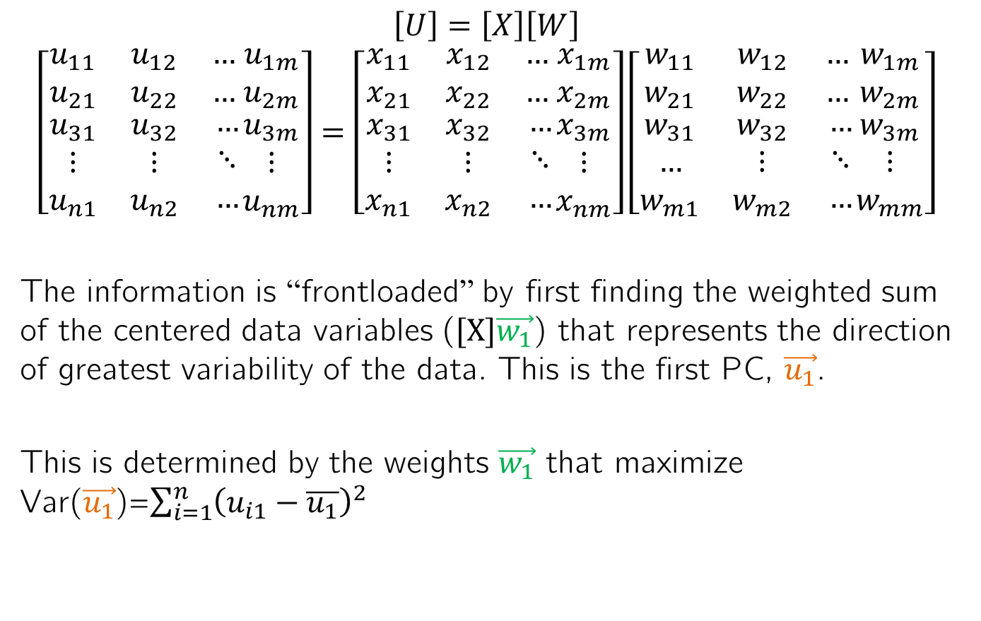

Extending this to multiple dimensions
$$\vec{u_{1}}$$
$$\vec{w_{1}}$$
$$\left[U\right]=\left[X\right]\left[W\right]$$
$$\left[\begin{matrix}u_{11} & u_{12} & … \\ u_{21} & u_{22} & … \\ \begin{aligned}u_{31} \\ ⋮ \\ u_{n1}\end{aligned} & \begin{aligned}u_{32} \\ ⋮ \\ u_{n2}\end{aligned} & \begin{aligned}… \\ ⋱ \\ …\end{aligned}\end{matrix}\begin{matrix}u_{1m} \\ u_{2m} \\ \begin{aligned}u_{3m} \\ ⋮ \\ u_{nm}\end{aligned}\end{matrix}\right]=\left[\begin{matrix}x_{11} & x_{12} & … \\ x_{21} & x_{22} & … \\ \begin{aligned}x_{31} \\ ⋮ \\ x_{n1}\end{aligned} & \begin{aligned}x_{32} \\ ⋮ \\ x_{n2}\end{aligned} & \begin{aligned}… \\ ⋱ \\ …\end{aligned}\end{matrix}\begin{matrix}x_{1m} \\ x_{2m} \\ \begin{aligned}x_{3m} \\ ⋮ \\ x_{nm}\end{aligned}\end{matrix}\right]\left[\begin{matrix}w_{11} & w_{12} & … \\ w_{21} & w_{22} & … \\ \begin{aligned}w_{31} \\ … \\ w_{m1}\end{aligned} & \begin{aligned}w_{32} \\ ⋮ \\ w_{m2}\end{aligned} & \begin{aligned}… \\ ⋱ \\ …\end{aligned}\end{matrix}\begin{matrix}w_{1m} \\ w_{2m} \\ \begin{aligned}w_{3m} \\ ⋮ \\ w_{mm}\end{aligned}\end{matrix}\right]$$
The information is “frontloaded” by first finding the weighted sum of the centered data variables ($[X]\vec{w_{1}}$) that represents the direction of greatest variability of the data. This is the first PC, $\vec{u_{1}}$.
This is determined by the weights $\vec{w_{1}}$ that maximize Var($\vec{u_{1}}$)=$\sum_{i=1}^{n}{{\left(u_{i1}−\overline{u_{1}}\right)}^{2}}$

Slide 22

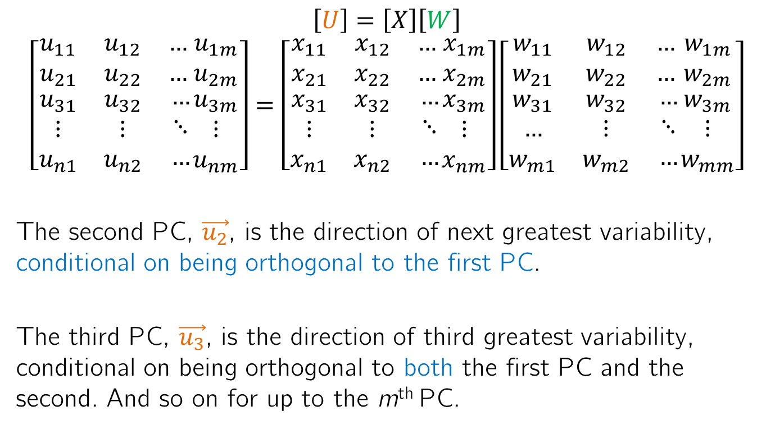

Extending this to multiple dimensions
$$\vec{u_{2}}$$
$$\vec{w_{2}}$$
$$\left[U\right]=\left[X\right]\left[W\right]$$
$$\left[\begin{matrix}u_{11} & u_{12} & … \\ u_{21} & u_{22} & … \\ \begin{aligned}u_{31} \\ ⋮ \\ u_{n1}\end{aligned} & \begin{aligned}u_{32} \\ ⋮ \\ u_{n2}\end{aligned} & \begin{aligned}… \\ ⋱ \\ …\end{aligned}\end{matrix}\begin{matrix}u_{1m} \\ u_{2m} \\ \begin{aligned}u_{3m} \\ ⋮ \\ u_{nm}\end{aligned}\end{matrix}\right]=\left[\begin{matrix}x_{11} & x_{12} & … \\ x_{21} & x_{22} & … \\ \begin{aligned}x_{31} \\ ⋮ \\ x_{n1}\end{aligned} & \begin{aligned}x_{32} \\ ⋮ \\ x_{n2}\end{aligned} & \begin{aligned}… \\ ⋱ \\ …\end{aligned}\end{matrix}\begin{matrix}x_{1m} \\ x_{2m} \\ \begin{aligned}x_{3m} \\ ⋮ \\ x_{nm}\end{aligned}\end{matrix}\right]\left[\begin{matrix}w_{11} & w_{12} & … \\ w_{21} & w_{22} & … \\ \begin{aligned}w_{31} \\ … \\ w_{m1}\end{aligned} & \begin{aligned}w_{32} \\ ⋮ \\ w_{m2}\end{aligned} & \begin{aligned}… \\ ⋱ \\ …\end{aligned}\end{matrix}\begin{matrix}w_{1m} \\ w_{2m} \\ \begin{aligned}w_{3m} \\ ⋮ \\ w_{mm}\end{aligned}\end{matrix}\right]$$
The second PC, $\vec{u_{2}}$, is the direction of next greatest variability, conditional on being orthogonal to the first PC.
The third PC, $\vec{u_{3}}$, is the direction of third greatest variability, conditional on being orthogonal to both the first PC and the second. And so on for up to the m^{th} PC.

Slide 23
What do we get out of this?
We said PCA could achieve two things:
Reveal otherwise “hidden” patterns in the data.
Compress our data into a small set of (transformed) variables without losing much information.
The loadings or weights can help reveal “hidden patterns” in our data, viewing the relationships between multiple variables simultaneously in different directions/“modes” of variability
And since the information/variance of our original data is “frontloaded” in the PCs, we can keep just the first K PCs (K of M columns of [U]) and still retain most of the information
So how do we find these weights?
And how do we decide on how many PCs to retain?

Slide 24
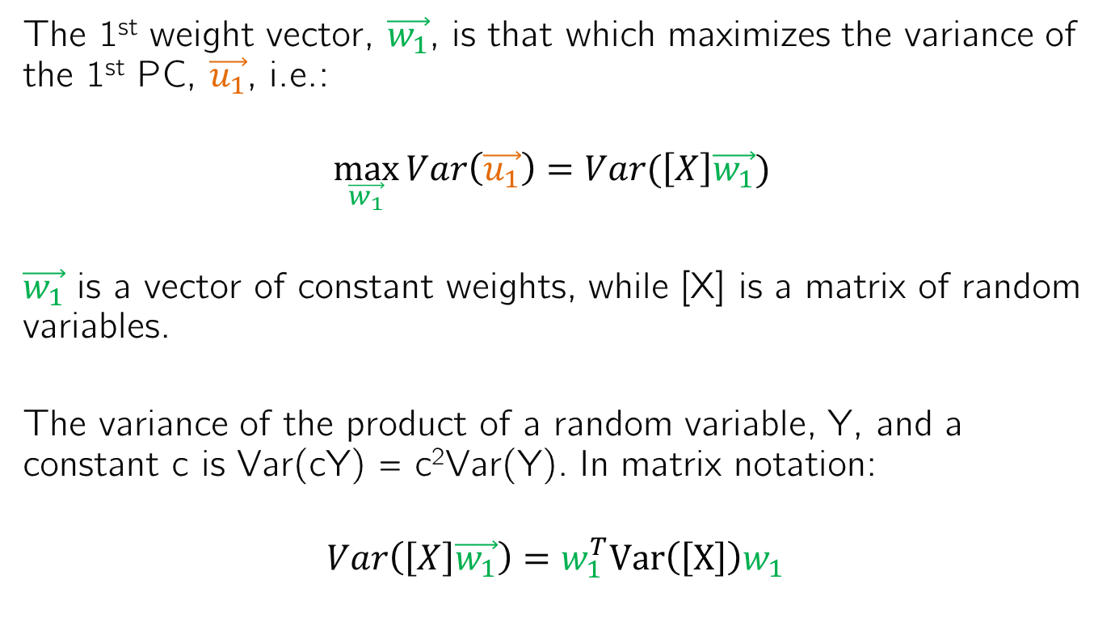
Solving for PCA weight matrix
The 1st weight vector, $\vec{w_{1}}$, is that which maximizes the variance of the 1st PC, $\vec{u_{1}}$, i.e.:
$$\max_{\vec{w_{1}}}{Var\left(\vec{u_{1}}\right)=Var(\left[X\right]\vec{w_{1}}) }$$
$\vec{w_{1}}$ is a vector of constant weights, while [X] is a matrix of random variables.
The variance of the product of a random variable, Y, and a constant c is Var(cY) = c²Var(Y). In matrix notation:
$$Var\left(\left[X\right]\vec{w_{1}}\right)={w_{1}^{T}Var\left(\left[X\right]\right)w}_{1}$$

Slide 25

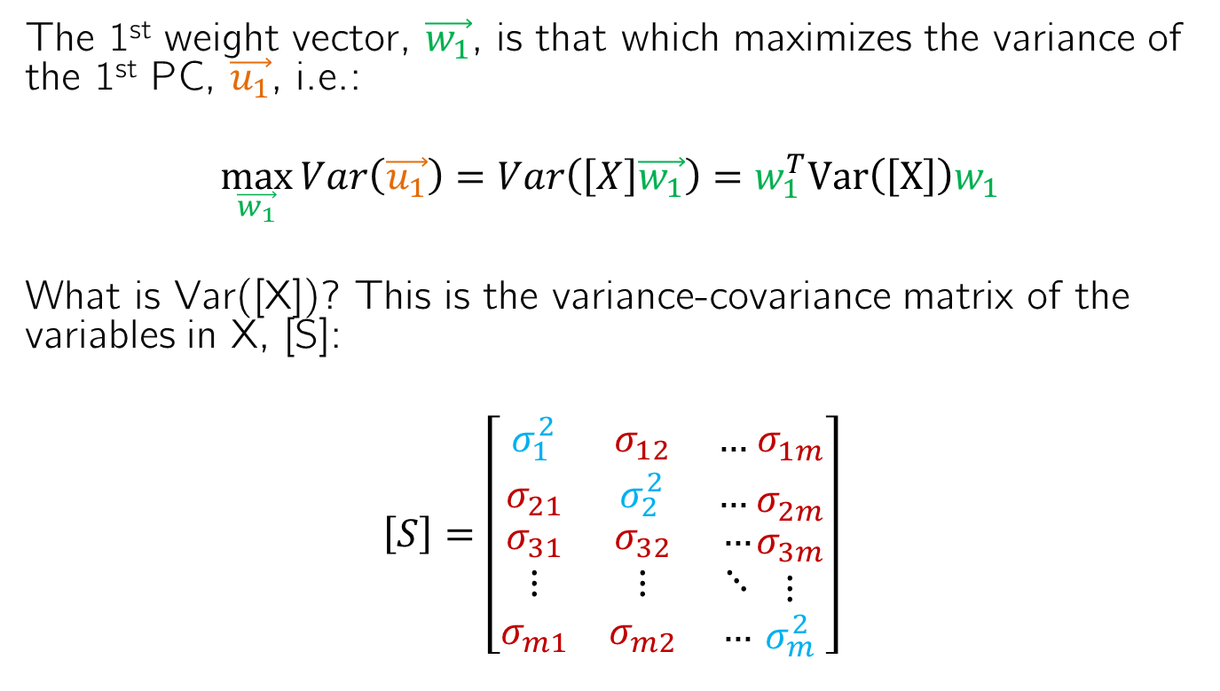

Solving for PCA weight matrix
The 1st weight vector, $\vec{w_{1}}$, is that which maximizes the variance of the 1st PC, $\vec{u_{1}}$, i.e.:
$$\max_{\vec{w_{1}}}{Var\left(\vec{u_{1}}\right)=Var\left(\left[X\right]\vec{w_{1}}\right)={w_{1}^{T}Var\left(\left[X\right]\right)w}_{1}}$$
What is Var([X])? This is the variance-covariance matrix of the variables in X, [S]:
$$\left[S\right]=\left[\begin{matrix}σ_{1}^{2} & σ_{12} & … \\ σ_{21} & σ_{2}^{2} & … \\ \begin{aligned}σ_{31} \\ ⋮ \\ σ_{m1}\end{aligned} & \begin{aligned}σ_{32} \\ ⋮ \\ σ_{m2}\end{aligned} & \begin{aligned}… \\ ⋱ \\ …\end{aligned}\end{matrix}\begin{matrix}σ_{1m}^{} \\ σ_{2m}^{} \\ \begin{aligned}σ_{3m} \\ ⋮ \\ σ_{m}^{2}\end{aligned}\end{matrix}\right]$$
$$σ_{i}^{2}=Var(X_{i})$$
$$σ_{ij}=σ_{ji}=Cov(X_{i},X_{j})$$

Slide 26

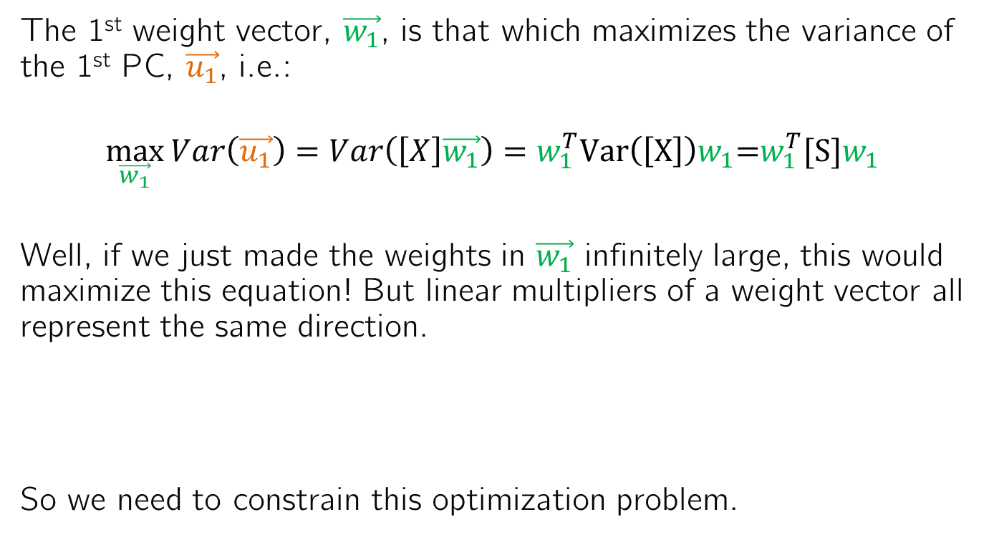

Solving for PCA weight matrix
The 1st weight vector, $\vec{w_{1}}$, is that which maximizes the variance of the 1st PC, $\vec{u_{1}}$, i.e.:
$$\max_{\vec{w_{1}}}{Var\left(\vec{u_{1}}\right)=Var\left(\left[X\right]\vec{w_{1}}\right)={w_{1}^{T}Var\left(\left[X\right]\right)w}_{1}\text{=}{w_{1}^{T}[S]w}_{1}}$$
Well, if we just made the weights in $\vec{w_{1}}$ infinitely large, this would maximize this equation! But linear multipliers of a weight vector all represent the same direction.
So we need to constrain this optimization problem.
$$\vec{2u_{1}}$$
$$\vec{u_{1}}$$
2w₂₁
w₂₁
w₁₁
2w₁₁

Slide 27
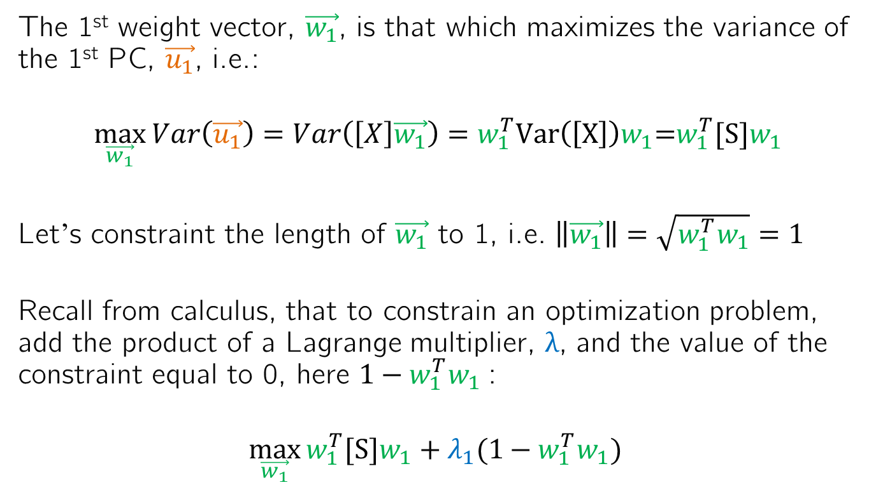
Solving for PCA weight matrix
The 1st weight vector, $\vec{w_{1}}$, is that which maximizes the variance of the 1st PC, $\vec{u_{1}}$, i.e.:
$$\max_{\vec{w_{1}}}{Var\left(\vec{u_{1}}\right)=Var\left(\left[X\right]\vec{w_{1}}\right)={w_{1}^{T}Var\left(\left[X\right]\right)w}_{1}\text{=}{w_{1}^{T}[S]w}_{1}}$$
Let’s constraint the length of $\vec{w_{1}}$ to 1, i.e. $\left\|\vec{w_{1}}\right\|=\sqrt{{w_{1}^{T}w}_{1}}=1$
Recall from calculus, that to constrain an optimization problem, add the product of a Lagrange multiplier, λ, and the value of the constraint equal to 0, here ${{1−w}_{1}^{T}w}_{1}$:
$$\max_{\vec{w_{1}}}{{w_{1}^{T}[S]w}_{1}+λ_{1}({1−w_{1}^{T}w}_{1}) }$$

Slide 28
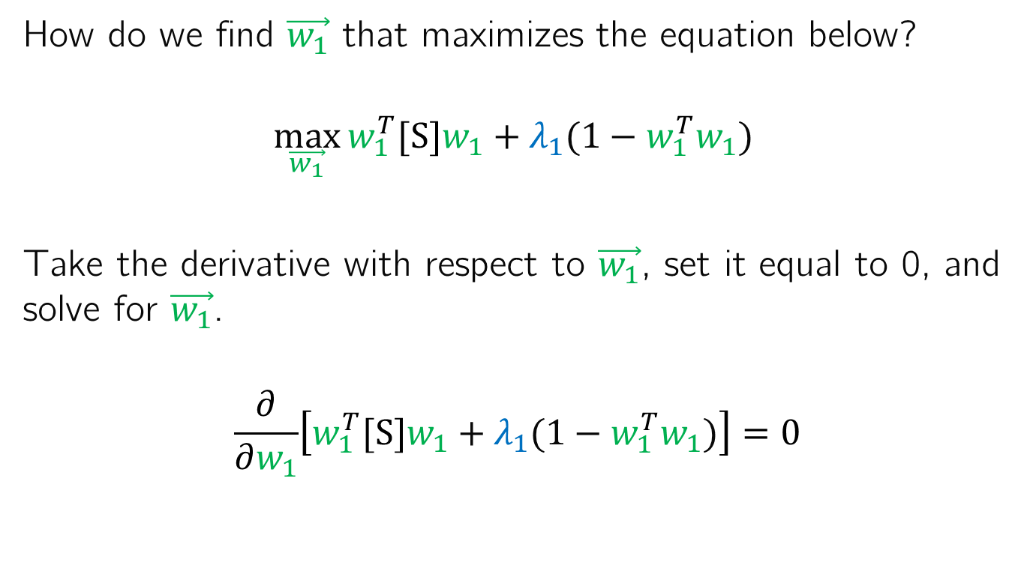
Solving for PCA weight matrix
How do we find $\vec{w_{1}}$ that maximizes the equation below?
$$\max_{\vec{w_{1}}}{{w_{1}^{T}[S]w}_{1}+λ_{1}({1−w_{1}^{T}w}_{1}) }$$
Take the derivative with respect to $\vec{w_{1}}$, set it equal to 0, and solve for $\vec{w_{1}}$.
$$\frac{∂}{∂w_{1}}\left[{w_{1}^{T}[S]w}_{1}+λ_{1}({1−w_{1}^{T}w}_{1})\right]=0$$

Slide 29
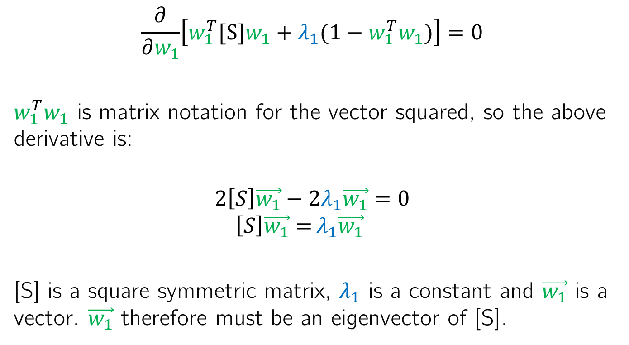
Solving for PCA weight matrix
$$\frac{∂}{∂w_{1}}\left[{w_{1}^{T}[S]w}_{1}+λ_{1}({1−w_{1}^{T}w}_{1})\right]=0$$
${w_{1}^{T}w}_{1}$ is matrix notation for the vector squared, so the above derivative is:
$$2\left[S\right]\vec{w_{1}}−{2λ}_{1}\vec{w_{1}}{=0}$$
$$\left[S\right]\vec{w_{1}}={λ_{1}\vec{w_{1}}}$$
[S] is a square symmetric matrix, $λ_{1}$ is a constant and $\vec{w_{1}}$ is a vector. $\vec{w_{1}}$ therefore must be an eigenvector of [S].

Slide 30
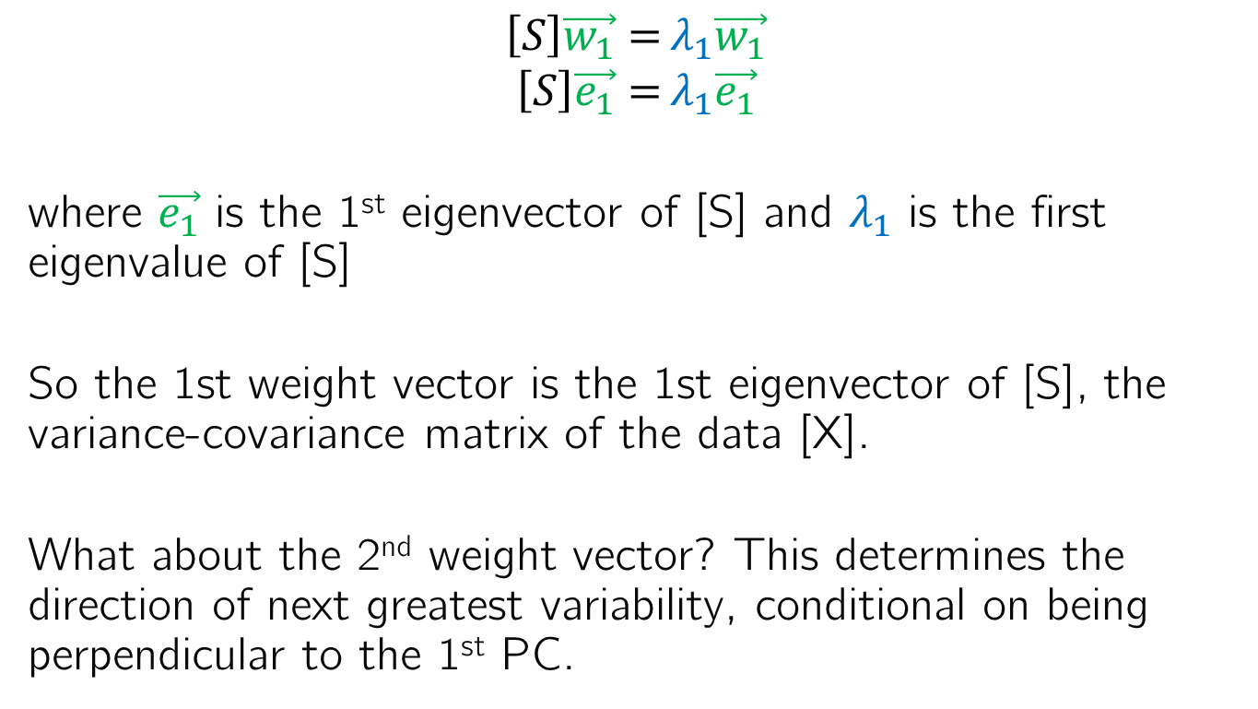
Solving for PCA weight matrix
$$\left[S\right]\vec{w_{1}}={λ_{1}\vec{w_{1}}}$$
$$\left[S\right]\vec{e_{1}}={λ_{1}\vec{e_{1}}}$$
where $\vec{e_{1}}$ is the 1st eigenvector of [S] and $λ_{1}$ is the first eigenvalue of [S]
So the 1st weight vector is the 1st eigenvector of [S], the variance-covariance matrix of the data [X].
What about the 2nd weight vector? This determines the direction of next greatest variability, conditional on being perpendicular to the 1st PC.

Slide 31
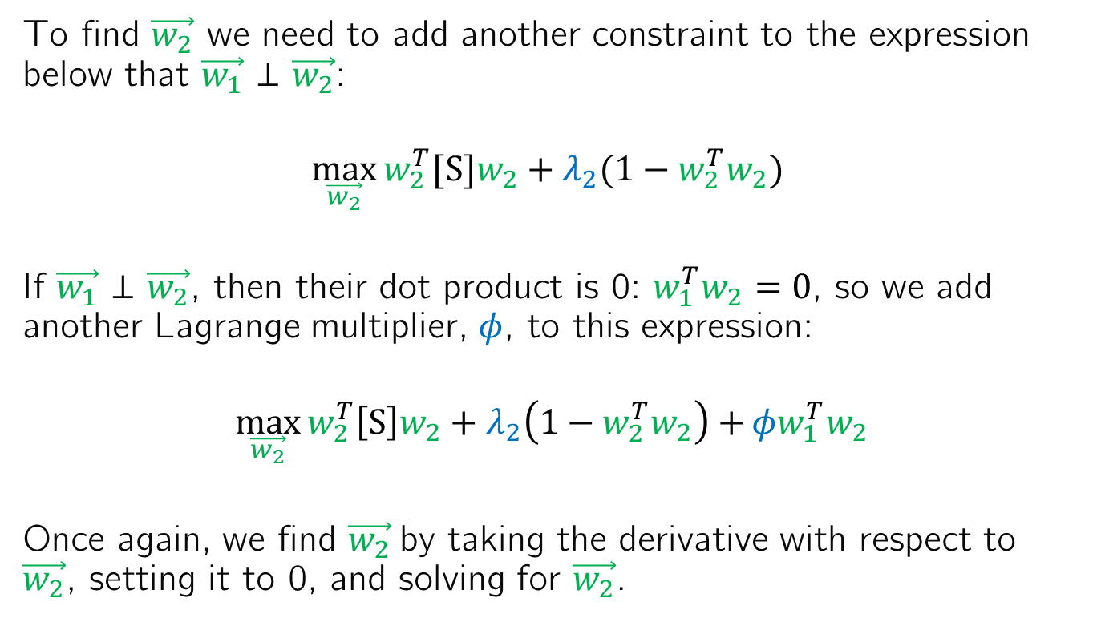
Solving for PCA weight matrix
To find $\vec{w_{2}}$ we need to add another constraint to the expression below that $\vec{w_{1}}$ ⊥ $\vec{w_{2}}$:
$$\max_{\vec{w_{2}}}{{w_{2}^{T}[S]w}_{2}+λ_{2}({1−w_{2}^{T}w}_{2}) }$$
If $\vec{w_{1}}$ ⊥ $\vec{w_{2}}$, then their dot product is 0: ${w_{1}^{T}w}_{2}=0$, so we add another Lagrange multiplier, $φ$, to this expression:
$$\max_{\vec{w_{2}}}{{w_{2}^{T}\left[S\right]w}_{2}+λ_{2}\left({1−w_{2}^{T}w}_{2}\right)+}φ{w_{1}^{T}w}_{2}$$
Once again, we find $\vec{w_{2}}$by taking the derivative with respect to $\vec{w_{2}}$, setting it to 0, and solving for $\vec{w_{2}}$.

Slide 32
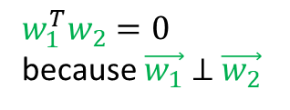
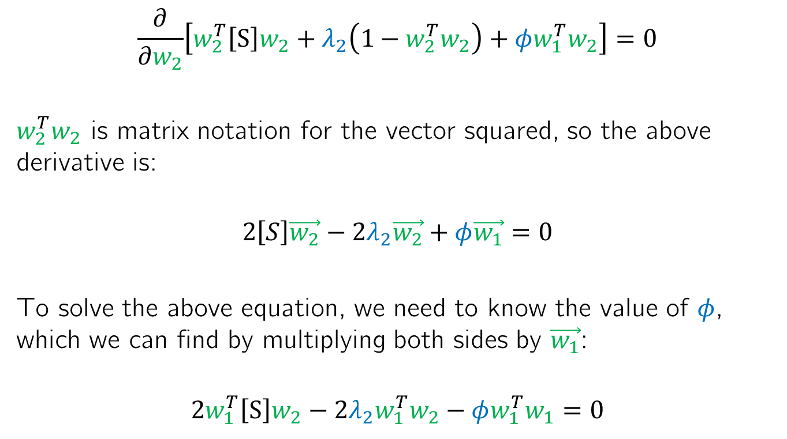
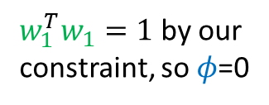
Solving for PCA weight matrix
$$\frac{∂}{∂w_{2}}\left[{w_{2}^{T}\left[S\right]w}_{2}+λ_{2}\left({1−w_{2}^{T}w}_{2}\right)+φ{w_{1}^{T}w}_{2}\right]=0$$
${w_{2}^{T}w}_{2}$ is matrix notation for the vector squared, so the above derivative is:
$$2\left[S\right]\vec{w_{2}}−{2λ}_{2}\vec{w_{2}}+φ\vec{w_{1}}{=0}$$
To solve the above equation, we need to know the value of $φ$, which we can find by multiplying both sides by $\vec{w_{1}}$:
$$2{w_{1}^{T}\left[S\right]w}_{2}−{2λ}_{2}{w_{1}^{T}w}_{2}−φ{w_{1}^{T}w}_{1}{=0}$$
0
0
${w_{1}^{T}w}_{2}=0$ because $\vec{w_{1}}$ ⊥ $\vec{w_{2}}$
${w_{1}^{T}w}_{1}=1$ by our constraint, so $φ$=0

Slide 33
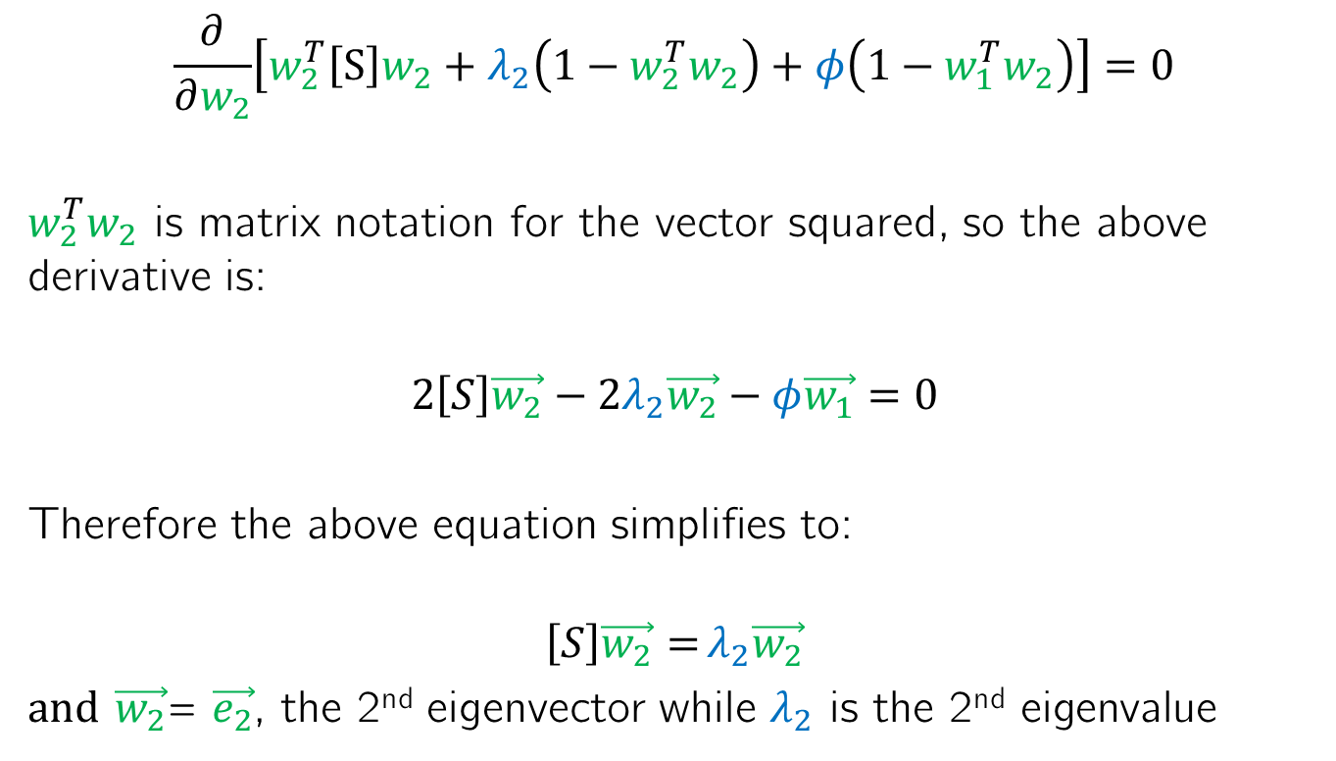
Solving for PCA weight matrix
$$\frac{∂}{∂w_{2}}\left[{w_{2}^{T}\left[S\right]w}_{2}+λ_{2}\left({1−w_{2}^{T}w}_{2}\right)+φ\left({1−w_{1}^{T}w}_{2}\right)\right]=0$$
${w_{2}^{T}w}_{2}$ is matrix notation for the vector squared, so the above derivative is:
$$2\left[S\right]\vec{w_{2}}−{2λ}_{2}\vec{w_{2}}−φ\vec{w_{1}}{=0}$$
Therefore the above equation simplifies to:
$$\left[S\right]\vec{w_{2}}={λ_{2}\vec{w_{2}}}$$
and $\vec{w_{2}}$= $\vec{e_{2}}$, the 2nd eigenvector while $λ_{2}$ is the 2nd eigenvalue

Slide 34

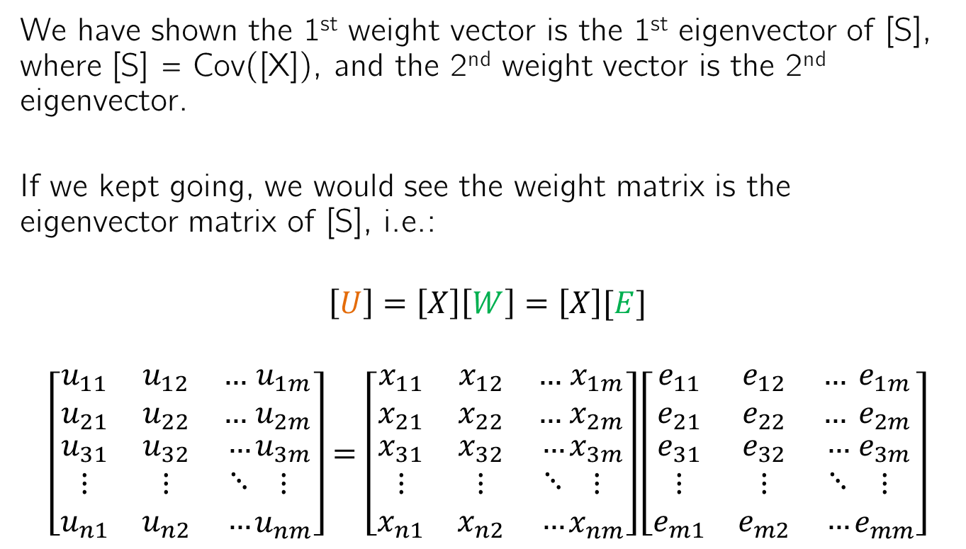

Extending this to multiple dimensions
We have shown the 1st weight vector is the 1st eigenvector of [S], where [S] = Cov([X]), and the 2nd weight vector is the 2nd eigenvector.
If we kept going, we would see the weight matrix is the eigenvector matrix of [S], i.e.:
$$\left[U\right]=\left[X\right]\left[W\right]=\left[X\right][E]$$
$$\left[\begin{matrix}u_{11} & u_{12} & … \\ u_{21} & u_{22} & … \\ \begin{aligned}u_{31} \\ ⋮ \\ u_{n1}\end{aligned} & \begin{aligned}u_{32} \\ ⋮ \\ u_{n2}\end{aligned} & \begin{aligned}… \\ ⋱ \\ …\end{aligned}\end{matrix}\begin{matrix}u_{1m} \\ u_{2m} \\ \begin{aligned}u_{3m} \\ ⋮ \\ u_{nm}\end{aligned}\end{matrix}\right]=\left[\begin{matrix}x_{11} & x_{12} & … \\ x_{21} & x_{22} & … \\ \begin{aligned}x_{31} \\ ⋮ \\ x_{n1}\end{aligned} & \begin{aligned}x_{32} \\ ⋮ \\ x_{n2}\end{aligned} & \begin{aligned}… \\ ⋱ \\ …\end{aligned}\end{matrix}\begin{matrix}x_{1m} \\ x_{2m} \\ \begin{aligned}x_{3m} \\ ⋮ \\ x_{nm}\end{aligned}\end{matrix}\right]\left[\begin{matrix}e_{11} & e_{12} & … \\ e_{21} & e_{22} & … \\ \begin{aligned}e_{31} \\ ⋮ \\ e_{m1}\end{aligned} & \begin{aligned}e_{32} \\ ⋮ \\ e_{m2}\end{aligned} & \begin{aligned}… \\ ⋱ \\ …\end{aligned}\end{matrix}\begin{matrix}e_{1m} \\ e_{2m} \\ \begin{aligned}e_{3m} \\ ⋮ \\ e_{mm}\end{aligned}\end{matrix}\right]$$
$$\vec{u_{1}}$$
$$\vec{e_{1}}$$

Slide 35


Extending this to multiple dimensions
We have shown the 1st weight vector is the 1st eigenvector of [S], where [S] = Cov([X]), and the 2nd weight vector is the 2nd eigenvector.
If we kept going, we would see the weight matrix is the eigenvector matrix of [S], i.e.:
$$\left[U\right]=\left[X\right]\left[W\right]=\left[X\right][E]$$
$$\left[\begin{matrix}u_{11} & u_{12} & … \\ u_{21} & u_{22} & … \\ \begin{aligned}u_{31} \\ ⋮ \\ u_{n1}\end{aligned} & \begin{aligned}u_{32} \\ ⋮ \\ u_{n2}\end{aligned} & \begin{aligned}… \\ ⋱ \\ …\end{aligned}\end{matrix}\begin{matrix}u_{1m} \\ u_{2m} \\ \begin{aligned}u_{3m} \\ ⋮ \\ u_{nm}\end{aligned}\end{matrix}\right]=\left[\begin{matrix}x_{11} & x_{12} & … \\ x_{21} & x_{22} & … \\ \begin{aligned}x_{31} \\ ⋮ \\ x_{n1}\end{aligned} & \begin{aligned}x_{32} \\ ⋮ \\ x_{n2}\end{aligned} & \begin{aligned}… \\ ⋱ \\ …\end{aligned}\end{matrix}\begin{matrix}x_{1m} \\ x_{2m} \\ \begin{aligned}x_{3m} \\ ⋮ \\ x_{nm}\end{aligned}\end{matrix}\right]\left[\begin{matrix}e_{11} & e_{12} & … \\ e_{21} & e_{22} & … \\ \begin{aligned}e_{31} \\ ⋮ \\ e_{m1}\end{aligned} & \begin{aligned}e_{32} \\ ⋮ \\ e_{m2}\end{aligned} & \begin{aligned}… \\ ⋱ \\ …\end{aligned}\end{matrix}\begin{matrix}e_{1m} \\ e_{2m} \\ \begin{aligned}e_{3m} \\ ⋮ \\ e_{mm}\end{aligned}\end{matrix}\right]$$
$$\vec{u_{2}}$$
$$\vec{e_{2}}$$

Slide 36
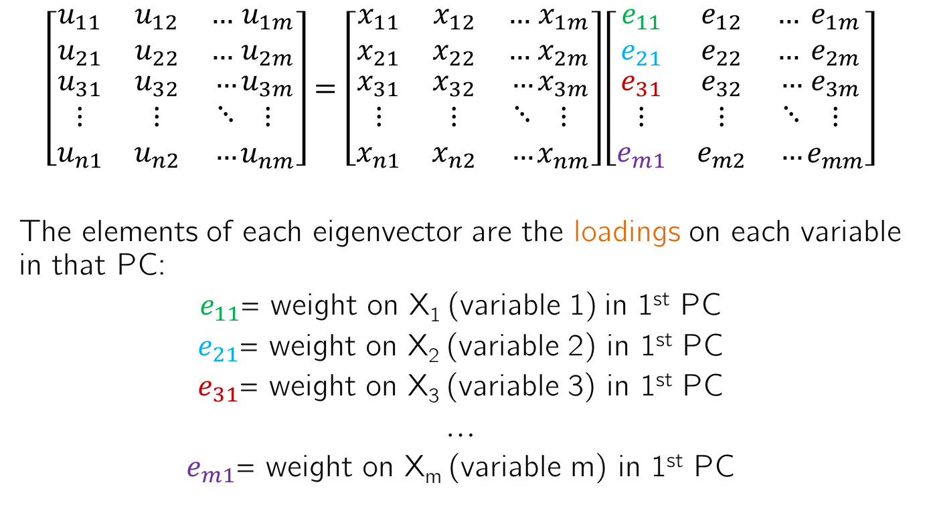
Understanding the eigenvector elements
$$\left[\begin{matrix}u_{11} & u_{12} & … \\ u_{21} & u_{22} & … \\ \begin{aligned}u_{31} \\ ⋮ \\ u_{n1}\end{aligned} & \begin{aligned}u_{32} \\ ⋮ \\ u_{n2}\end{aligned} & \begin{aligned}… \\ ⋱ \\ …\end{aligned}\end{matrix}\begin{matrix}u_{1m} \\ u_{2m} \\ \begin{aligned}u_{3m} \\ ⋮ \\ u_{nm}\end{aligned}\end{matrix}\right]=\left[\begin{matrix}x_{11} & x_{12} & … \\ x_{21} & x_{22} & … \\ \begin{aligned}x_{31} \\ ⋮ \\ x_{n1}\end{aligned} & \begin{aligned}x_{32} \\ ⋮ \\ x_{n2}\end{aligned} & \begin{aligned}… \\ ⋱ \\ …\end{aligned}\end{matrix}\begin{matrix}x_{1m} \\ x_{2m} \\ \begin{aligned}x_{3m} \\ ⋮ \\ x_{nm}\end{aligned}\end{matrix}\right]\left[\begin{matrix}e_{11} & e_{12} & … \\ e_{21} & e_{22} & … \\ \begin{aligned}e_{31} \\ ⋮ \\ e_{m1}\end{aligned} & \begin{aligned}e_{32} \\ ⋮ \\ e_{m2}\end{aligned} & \begin{aligned}… \\ ⋱ \\ …\end{aligned}\end{matrix}\begin{matrix}e_{1m} \\ e_{2m} \\ \begin{aligned}e_{3m} \\ ⋮ \\ e_{mm}\end{aligned}\end{matrix}\right]$$
The elements of each eigenvector are the loadings on each variable in that PC:
$e_{11}$= weight on X₁ (variable 1) in 1st PC
$e_{21}$= weight on X₂ (variable 2) in 1st PC
$e_{31}$= weight on X₃ (variable 3) in 1st PC
…
$e_{m1}$= weight on X_{m} (variable m) in 1st PC

Slide 37
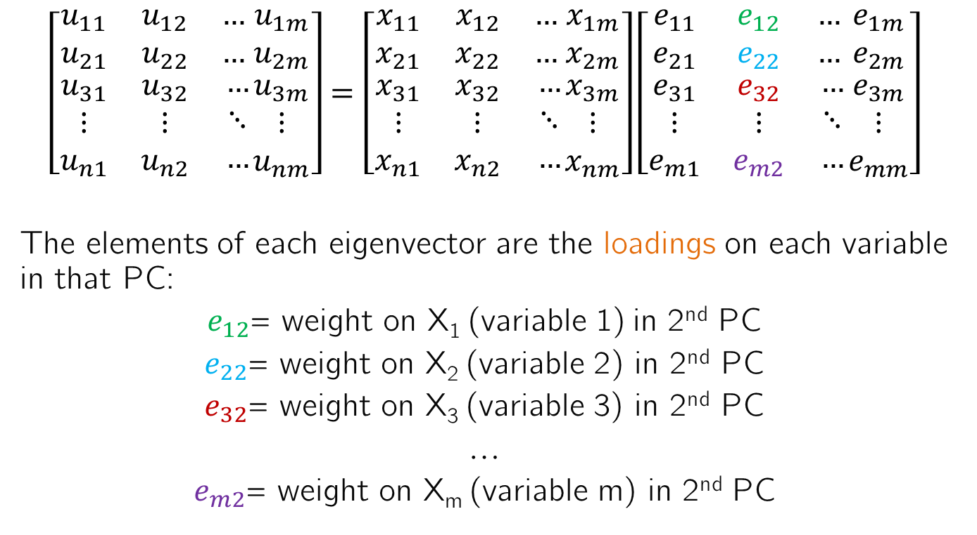
Understanding the eigenvector elements
$$\left[\begin{matrix}u_{11} & u_{12} & … \\ u_{21} & u_{22} & … \\ \begin{aligned}u_{31} \\ ⋮ \\ u_{n1}\end{aligned} & \begin{aligned}u_{32} \\ ⋮ \\ u_{n2}\end{aligned} & \begin{aligned}… \\ ⋱ \\ …\end{aligned}\end{matrix}\begin{matrix}u_{1m} \\ u_{2m} \\ \begin{aligned}u_{3m} \\ ⋮ \\ u_{nm}\end{aligned}\end{matrix}\right]=\left[\begin{matrix}x_{11} & x_{12} & … \\ x_{21} & x_{22} & … \\ \begin{aligned}x_{31} \\ ⋮ \\ x_{n1}\end{aligned} & \begin{aligned}x_{32} \\ ⋮ \\ x_{n2}\end{aligned} & \begin{aligned}… \\ ⋱ \\ …\end{aligned}\end{matrix}\begin{matrix}x_{1m} \\ x_{2m} \\ \begin{aligned}x_{3m} \\ ⋮ \\ x_{nm}\end{aligned}\end{matrix}\right]\left[\begin{matrix}e_{11} & e_{12} & … \\ e_{21} & e_{22} & … \\ \begin{aligned}e_{31} \\ ⋮ \\ e_{m1}\end{aligned} & \begin{aligned}e_{32} \\ ⋮ \\ e_{m2}\end{aligned} & \begin{aligned}… \\ ⋱ \\ …\end{aligned}\end{matrix}\begin{matrix}e_{1m} \\ e_{2m} \\ \begin{aligned}e_{3m} \\ ⋮ \\ e_{mm}\end{aligned}\end{matrix}\right]$$
The elements of each eigenvector are the loadings on each variable in that PC:
$e_{12}$= weight on X₁ (variable 1) in 2nd PC
$e_{22}$= weight on X₂ (variable 2) in 2nd PC
$e_{32}$= weight on X₃ (variable 3) in 2nd PC
…
$e_{m2}$= weight on X_{m} (variable m) in 2nd PC

Slide 38
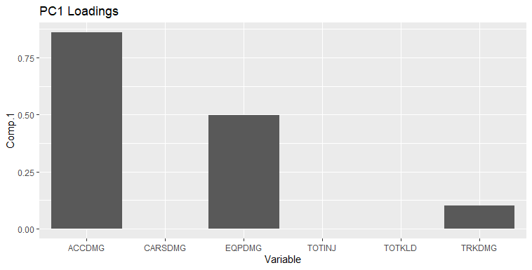
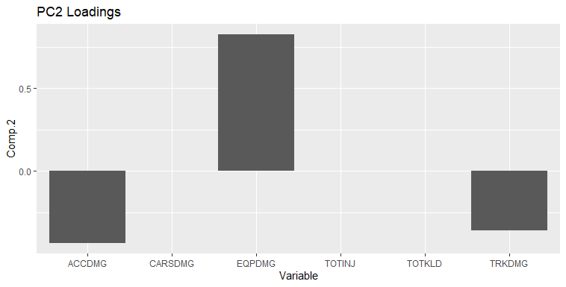
PCA for data visualization through the loadings
Viewing the loadings allows us to see relationships between multiple variables at once in different “modes” (PCs) of variability
In the 1st PC, ACCDMG > EQPDMG > TRKDMG > CARSDMG, TOTINJ and TOTKLD and they all vary in the same direction
In the 2nd PC, EQPDMG > ACCDMG > TRKDMG > CARSDMG, TOTINJ and TOTKLD. EQPDMG varies opposite ACCDMG and TRKDMG

Slide 39
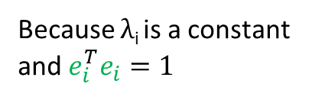
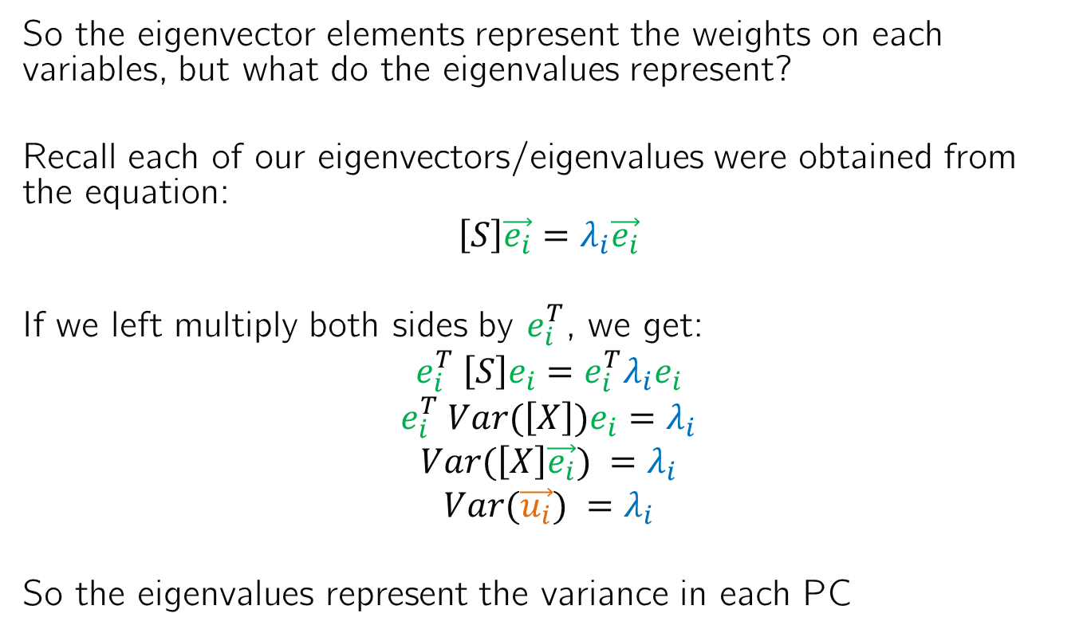
What are the eigenvalues?
So the eigenvector elements represent the weights on each variables, but what do the eigenvalues represent?
Recall each of our eigenvectors/eigenvalues were obtained from the equation:
$$\left[S\right]\vec{e_{i}}=λ_{i}\vec{e_{i}}$$
If we left multiply both sides by $e_{i}^{T}$, we get:
$$e_{i}^{T} \left[S\right]e_{i}={e_{i}^{T}λ}_{i}e_{i}$$
$$e_{i}^{T} Var(\left[X\right])e_{i}=λ_{i}$$
$$Var(\left[X\right]\vec{e_{i}}) =λ_{i}$$
$$Var(\vec{u_{i}}) =λ_{i}$$
So the eigenvalues represent the variance in each PC
Because λ_{i} is a constant and $e_{i}^{T}e_{i}=1$

Slide 40
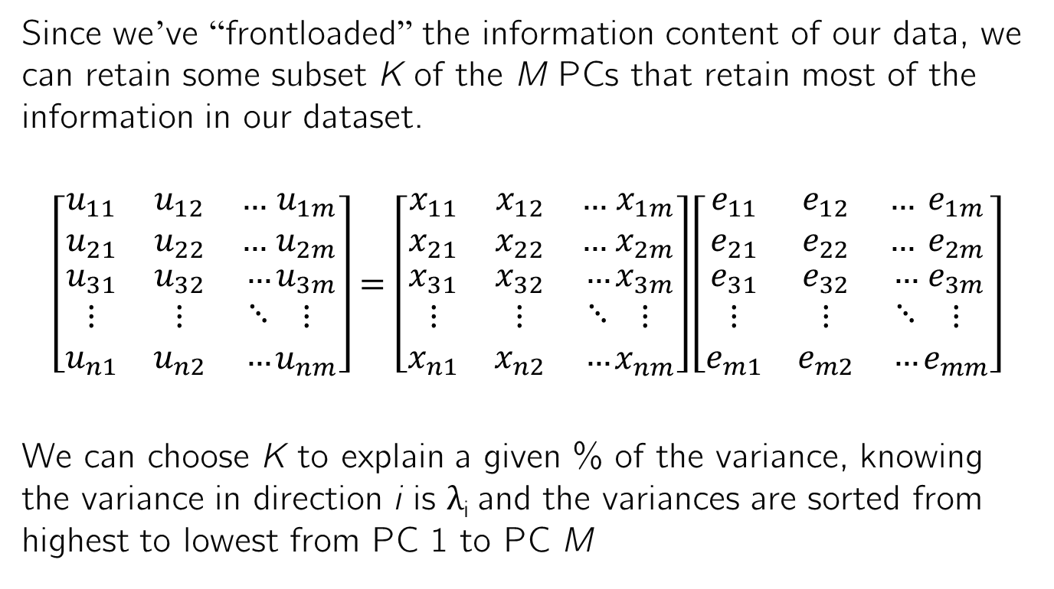
How are the eigenvalues informative?
Since we’ve “frontloaded” the information content of our data, we can retain some subset K of the M PCs that retain most of the information in our dataset.
$$\left[\begin{matrix}u_{11} & u_{12} & … \\ u_{21} & u_{22} & … \\ \begin{aligned}u_{31} \\ ⋮ \\ u_{n1}\end{aligned} & \begin{aligned}u_{32} \\ ⋮ \\ u_{n2}\end{aligned} & \begin{aligned}… \\ ⋱ \\ …\end{aligned}\end{matrix}\begin{matrix}u_{1m} \\ u_{2m} \\ \begin{aligned}u_{3m} \\ ⋮ \\ u_{nm}\end{aligned}\end{matrix}\right]=\left[\begin{matrix}x_{11} & x_{12} & … \\ x_{21} & x_{22} & … \\ \begin{aligned}x_{31} \\ ⋮ \\ x_{n1}\end{aligned} & \begin{aligned}x_{32} \\ ⋮ \\ x_{n2}\end{aligned} & \begin{aligned}… \\ ⋱ \\ …\end{aligned}\end{matrix}\begin{matrix}x_{1m} \\ x_{2m} \\ \begin{aligned}x_{3m} \\ ⋮ \\ x_{nm}\end{aligned}\end{matrix}\right]\left[\begin{matrix}e_{11} & e_{12} & … \\ e_{21} & e_{22} & … \\ \begin{aligned}e_{31} \\ ⋮ \\ e_{m1}\end{aligned} & \begin{aligned}e_{32} \\ ⋮ \\ e_{m2}\end{aligned} & \begin{aligned}… \\ ⋱ \\ …\end{aligned}\end{matrix}\begin{matrix}e_{1m} \\ e_{2m} \\ \begin{aligned}e_{3m} \\ ⋮ \\ e_{mm}\end{aligned}\end{matrix}\right]$$
We can choose K to explain a given % of the variance, knowing the variance in direction i is λ_{i} and the variances are sorted from highest to lowest from PC 1 to PC M
K=2 PCs

Slide 41
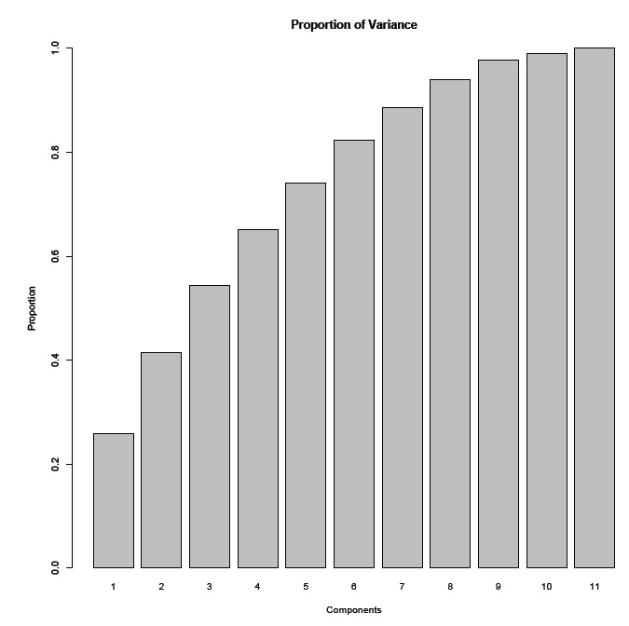
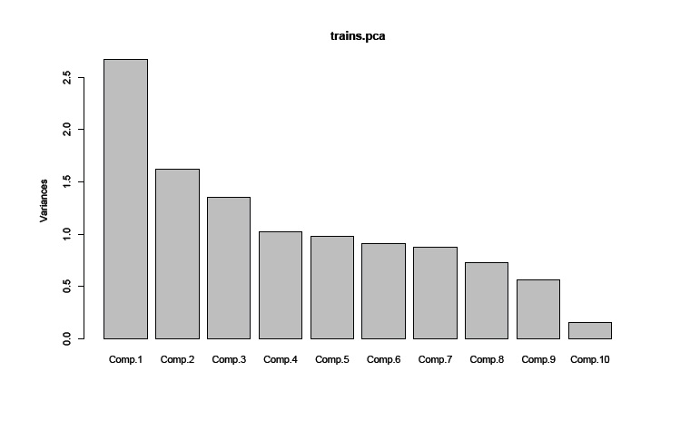
Scree plot
One common approach is to plot the variance in each component on a scree plot and choose as many PCs before a “kink” in the plot. This is somewhat arbitrary, and there may not always be a kink.
Another approach is to choose as many PCs as needed to retain y% of the variance, where the user chooses y.

Slide 42
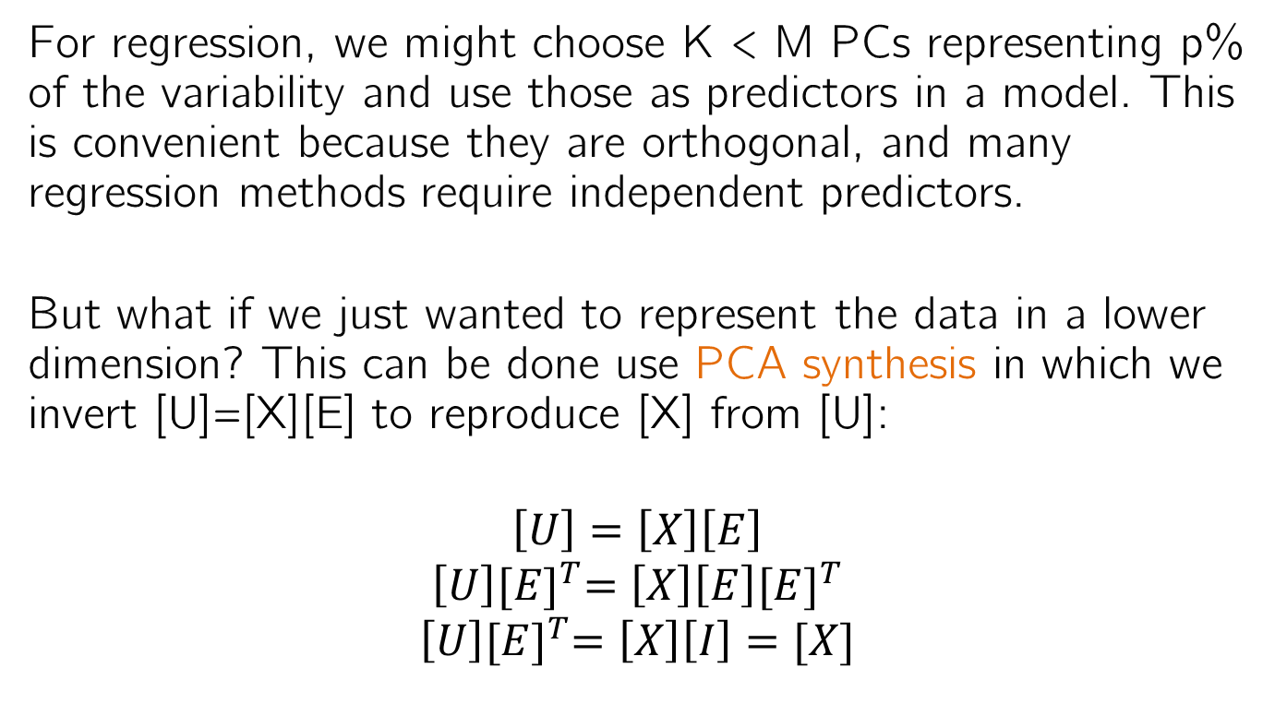
PCA for data compression
For regression, we might choose K < M PCs representing p% of the variability and use those as predictors in a model. This is convenient because they are orthogonal, and many regression methods require independent predictors.
But what if we just wanted to represent the data in a lower dimension? This can be done use PCA synthesis in which we invert [U]=[X][E] to reproduce [X] from [U]:
$$\left[U\right]=\left[X\right]\left[E\right]$$
$$\left[U\right]{[E]}^{T}=\left[X\right]\left[E\right]{[E]}^{T}$$
$$\left[U\right]{[E]}^{T}=\left[X\right]\left[I\right]=[X]$$

Slide 43
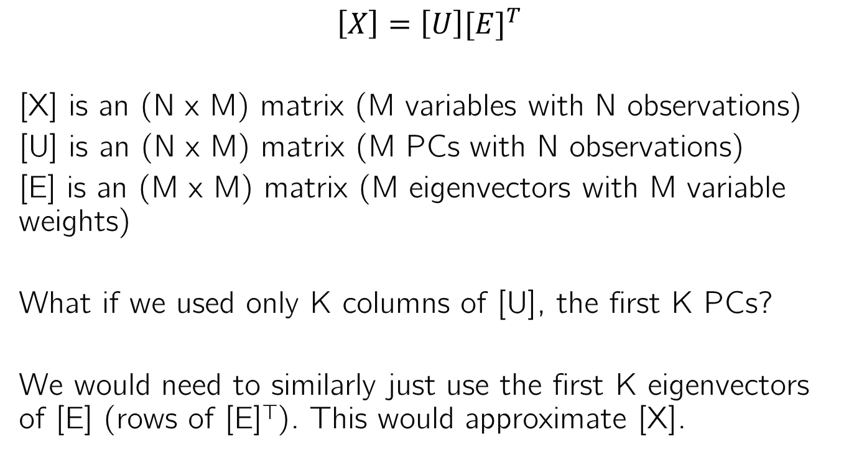
PCA for data compression
$$\left[X\right]=\left[U\right]{[E]}^{T}$$
[X] is an (N x M) matrix (M variables with N observations)
[U] is an (N x M) matrix (M PCs with N observations)
[E] is an (M x M) matrix (M eigenvectors with M variable weights)
What if we used only K columns of [U], the first K PCs?
We would need to similarly just use the first K eigenvectors of [E] (rows of [E]^{T}). This would approximate [X].

Slide 44
Recap
PCA finds weighted sums of the original data variables that represent the orthogonal directions of greatest sequential variability
The weights are determined by the eigenvectors ([E])
The variances in each direction are the eigenvalues (λ)
But what are the PCs? ([U])

Slide 45
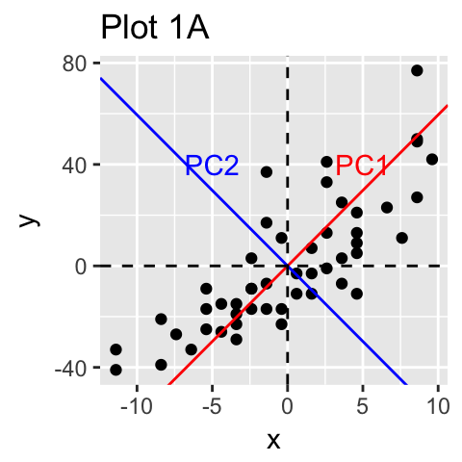
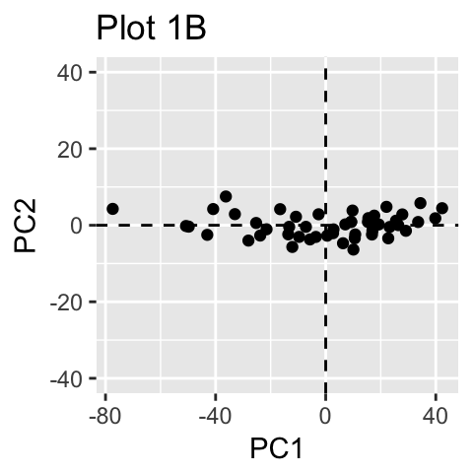
What do the PCs themselves represent?
The PCs are weighted sums of the original variables. They also represent a new, rotated coordinate system in which we can view the data: (u₁, u₂) instead of (x₁, x₂).
A plot of the data in the (u₁, u₂) plane is called a biplot. In this case, the biplot shows no pattern because almost all of the information is explained in the 1st 2 PCs.
http://www.sthda.com/english/articles/31-principal-component-methods-in-r-practical-guide/112-pca-principal-component-analysis-essentials/

Slide 46
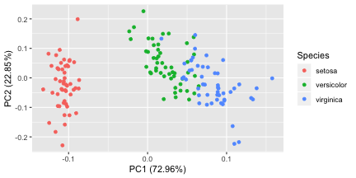
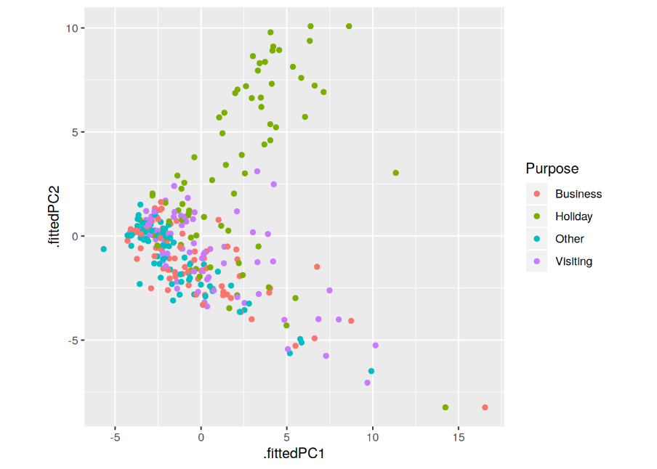
What do the PCs themselves represent?
The PCs are weighted sums of the original variables. They also represent a new, rotated coordinate system in which we can view the data: (u₁, u₂) instead of (x₁, x₂).
But sometimes the first 2 PCs separate the data into clusters, or reveal additional modes of variability beyond the 1st 2 PCs.
https://cran.r-project.org/web/packages/ggfortify/vignettes/plot_pca.html
https://www.r-bloggers.com/feature-based-time-series-analysis/

Slide 47
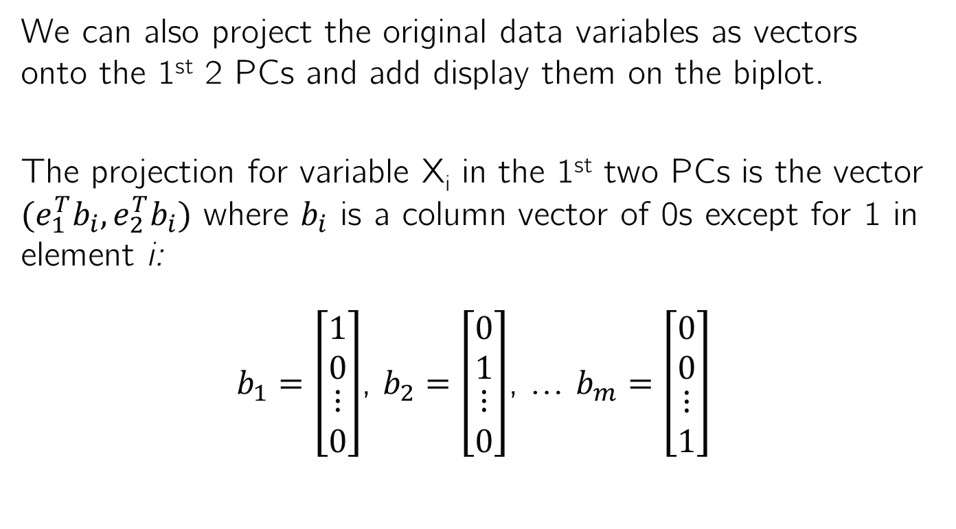
Additional features of the biplot
We can also project the original data variables as vectors onto the 1st 2 PCs and add display them on the biplot.
The projection for variable X_{i} in the 1st two PCs is the vector $(e_{1}^{T}b_{i},e_{2}^{T}b_{i})$ where $b_{i}$ is a column vector of 0s except for 1 in element i:
$b_{1}=\left[\begin{matrix}1 \\ 0 \\ \begin{matrix}⋮ \\ 0\end{matrix}\end{matrix}\right]$, $b_{2}=\left[\begin{matrix}0 \\ 1 \\ \begin{matrix}⋮ \\ 0\end{matrix}\end{matrix}\right]$, … $b_{m}=\left[\begin{matrix}0 \\ 0 \\ \begin{matrix}⋮ \\ 1\end{matrix}\end{matrix}\right]$

Slide 48
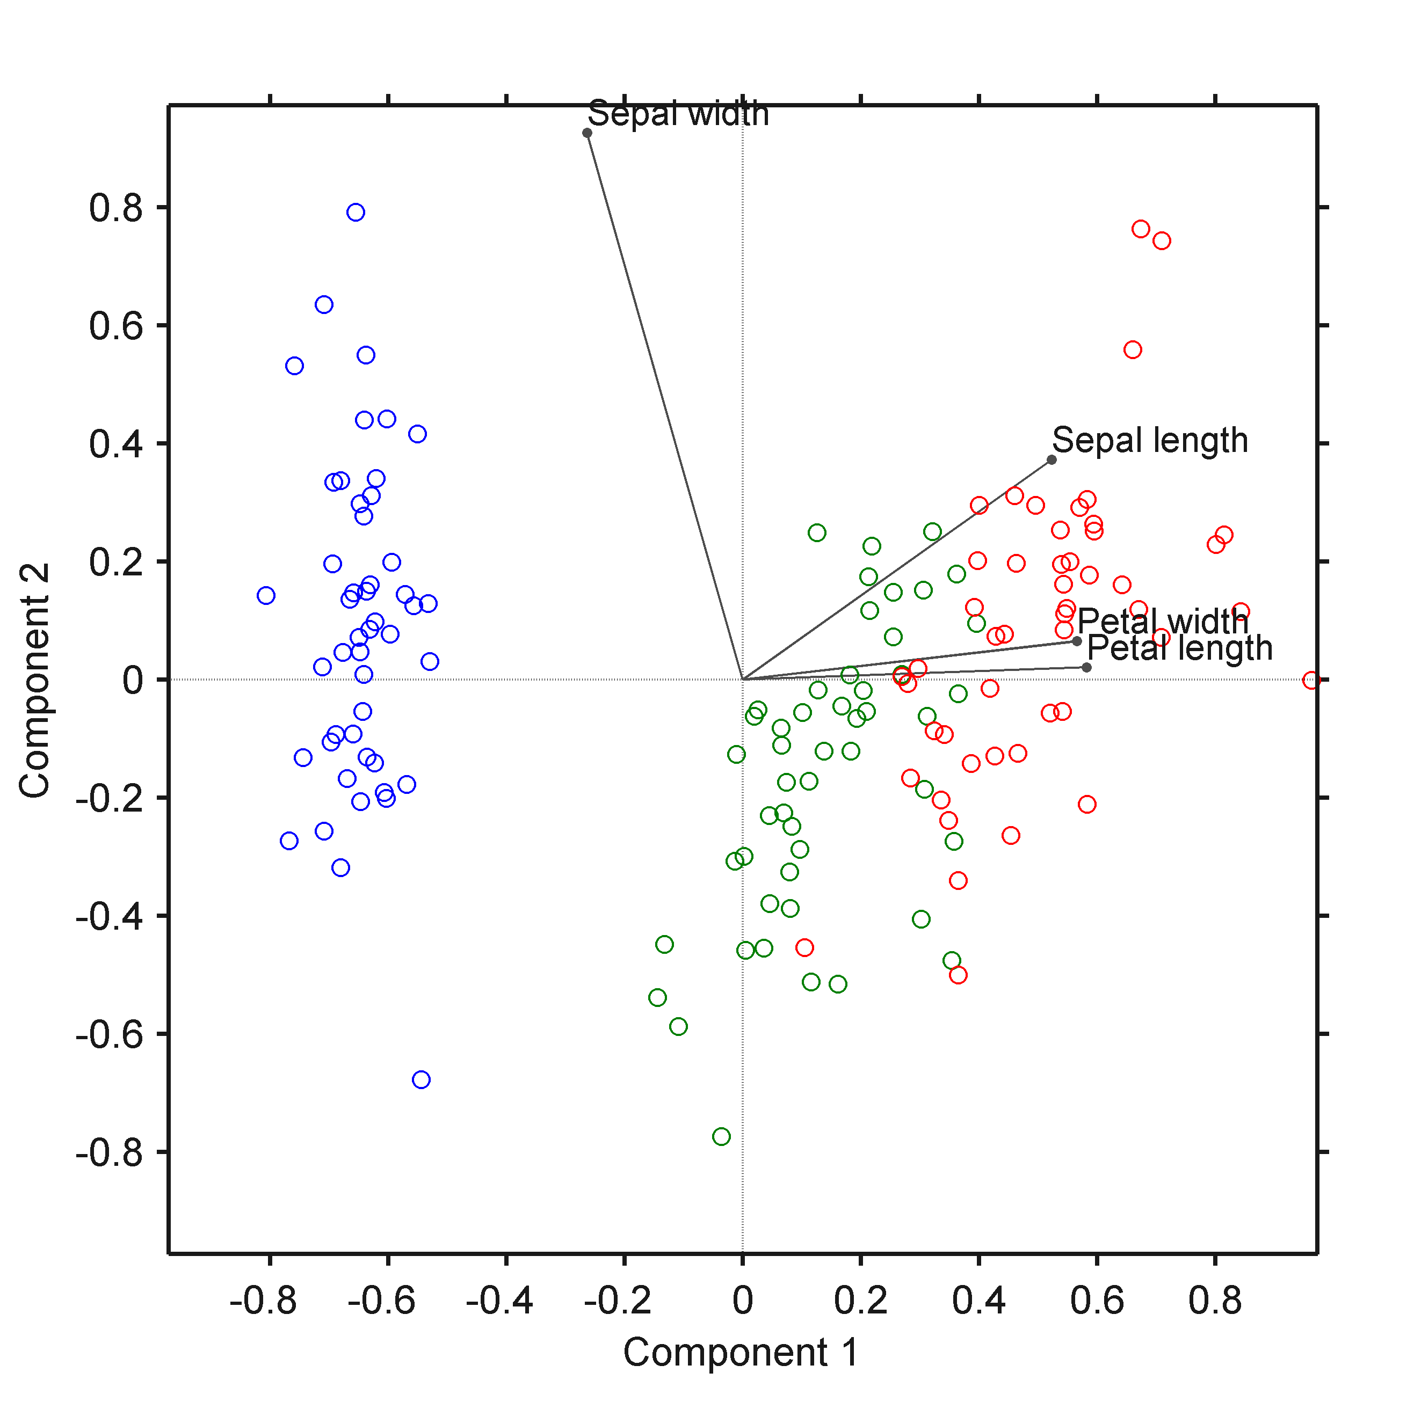
Projecting the original data variables onto the biplot
Similar to the loadings plot, the length of the vector indicates the importance of that variable, and the extent to which variables point in the same direction indicates their correlation in the first 2 modes of variability
https://iaisidro.wordpress.com/2015/10/09/biplotg/

Slide 49
Summary
You will not need to know how to derive the weight vector for PCA, but you should know what comes out of that derivation:
The PCs represent the directions of greatest variability of the data, conditional on them all being orthogonal.
The PCs are weighted sums of the original data variables. The weights for each PC are the elements of the corresponding eigenvector. These weights are called loadings.
The variance in the direction of each PC is equal to the corresponding eigenvalue.
We plot the 1st 2 PCs on a biplot
We plot the loadings on bar plots
We plot the eigenvalues on a scree plot or cumulative variance plot

