Slide 1
Principal Components Analysis 2 (PCA)
SYS 4021/6021
Laura Barnes and Julianne Quinn

Slide 2





Extending this to multiple dimensions
$$\vec{u_{1}}$$
$$\vec{u_{2}}$$
$$\vec{w_{1}}$$
$$\vec{w_{2}}$$
$$\left[U\right]=\left[X\right]\left[W\right]$$
$$\left[\begin{matrix}u_{11} & u_{12} & … \\ u_{21} & u_{22} & … \\ \begin{aligned}u_{31} \\ ⋮ \\ u_{n1}\end{aligned} & \begin{aligned}u_{32} \\ ⋮ \\ u_{n2}\end{aligned} & \begin{aligned}… \\ ⋱ \\ …\end{aligned}\end{matrix}\begin{matrix}u_{1m} \\ u_{2m} \\ \begin{aligned}u_{3m} \\ ⋮ \\ u_{nm}\end{aligned}\end{matrix}\right]=\left[\begin{matrix}x_{11} & x_{12} & … \\ x_{21} & x_{22} & … \\ \begin{aligned}x_{31} \\ ⋮ \\ x_{n1}\end{aligned} & \begin{aligned}x_{32} \\ ⋮ \\ x_{n2}\end{aligned} & \begin{aligned}… \\ ⋱ \\ …\end{aligned}\end{matrix}\begin{matrix}x_{1m} \\ x_{2m} \\ \begin{aligned}x_{3m} \\ ⋮ \\ x_{nm}\end{aligned}\end{matrix}\right]\left[\begin{matrix}w_{11} & w_{12} & … \\ w_{21} & w_{22} & … \\ \begin{aligned}w_{31} \\ … \\ w_{m1}\end{aligned} & \begin{aligned}w_{32} \\ ⋮ \\ w_{m2}\end{aligned} & \begin{aligned}… \\ ⋱ \\ …\end{aligned}\end{matrix}\begin{matrix}w_{1m} \\ w_{2m} \\ \begin{aligned}w_{3m} \\ ⋮ \\ w_{mm}\end{aligned}\end{matrix}\right]$$
The first PC, $\vec{u_{1}}$, is the direction of greatest variability.
The second PC, $\vec{u_{2}}$, is the direction of next greatest variability, conditional on being orthogonal to the first PC.
The third PC, $\vec{u_{3}}$, is the direction of third greatest variability, conditional on being orthogonal to both the first PC and the second. And so on for up to the m^{th} PC.
So how do we find these weights?
And how do we decide on how many PCs to retain?

Slide 3
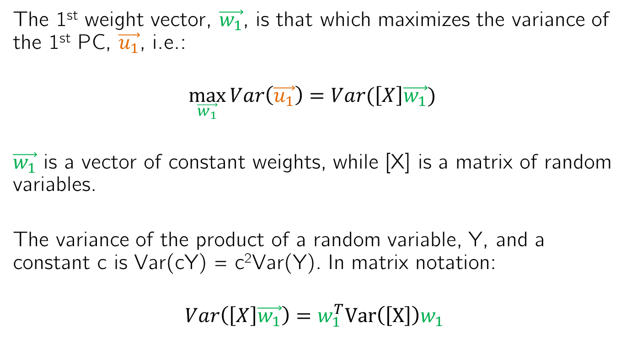
Solving for PCA weight matrix
The 1st weight vector, $\vec{w_{1}}$, is that which maximizes the variance of the 1st PC, $\vec{u_{1}}$, i.e.:
$$\max_{\vec{w_{1}}}{Var\left(\vec{u_{1}}\right)=Var(\left[X\right]\vec{w_{1}}) }$$
$\vec{w_{1}}$ is a vector of constant weights, while [X] is a matrix of random variables.
The variance of the product of a random variable, Y, and a constant c is Var(cY) = c²Var(Y). In matrix notation:
$$Var\left(\left[X\right]\vec{w_{1}}\right)={w_{1}^{T}Var\left(\left[X\right]\right)w}_{1}$$

Slide 4

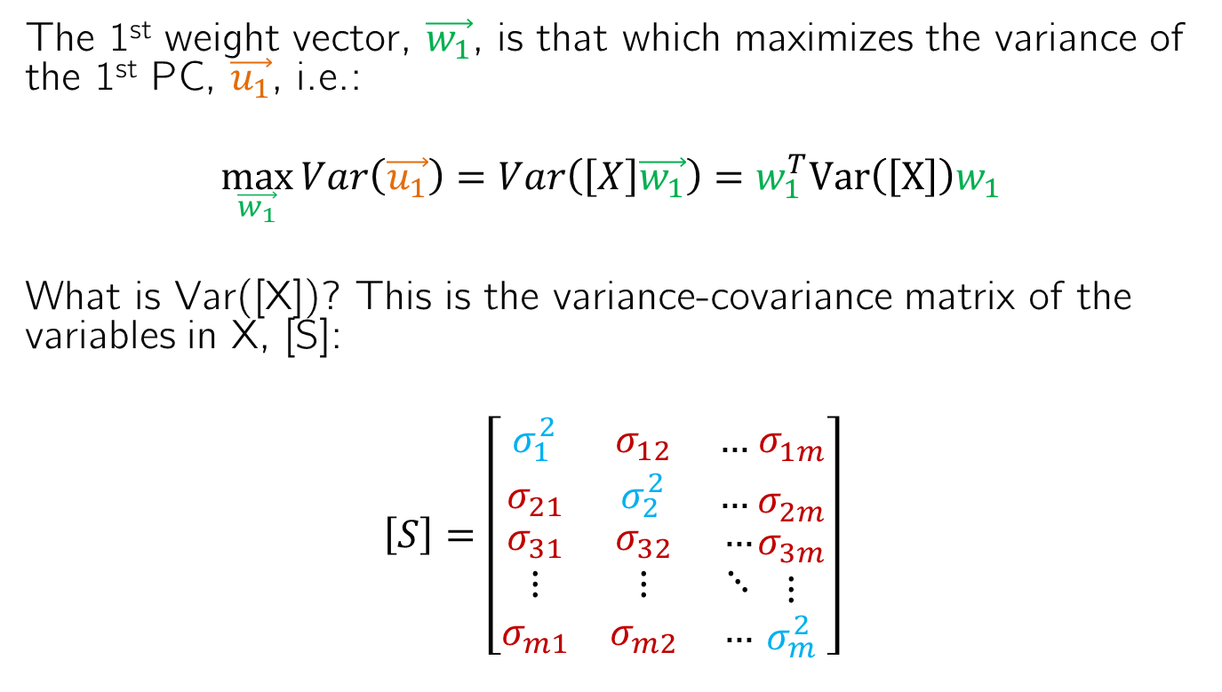

Solving for PCA weight matrix
The 1st weight vector, $\vec{w_{1}}$, is that which maximizes the variance of the 1st PC, $\vec{u_{1}}$, i.e.:
$$\max_{\vec{w_{1}}}{Var\left(\vec{u_{1}}\right)=Var\left(\left[X\right]\vec{w_{1}}\right)={w_{1}^{T}Var\left(\left[X\right]\right)w}_{1}}$$
What is Var([X])? This is the variance-covariance matrix of the variables in X, [S]:
$$\left[S\right]=\left[\begin{matrix}σ_{1}^{2} & σ_{12} & … \\ σ_{21} & σ_{2}^{2} & … \\ \begin{aligned}σ_{31} \\ ⋮ \\ σ_{m1}\end{aligned} & \begin{aligned}σ_{32} \\ ⋮ \\ σ_{m2}\end{aligned} & \begin{aligned}… \\ ⋱ \\ …\end{aligned}\end{matrix}\begin{matrix}σ_{1m}^{} \\ σ_{2m}^{} \\ \begin{aligned}σ_{3m} \\ ⋮ \\ σ_{m}^{2}\end{aligned}\end{matrix}\right]$$
$$σ_{i}^{2}=Var(X_{i})$$
$$σ_{ij}=σ_{ji}=Cov(X_{i},X_{j})$$

Slide 5

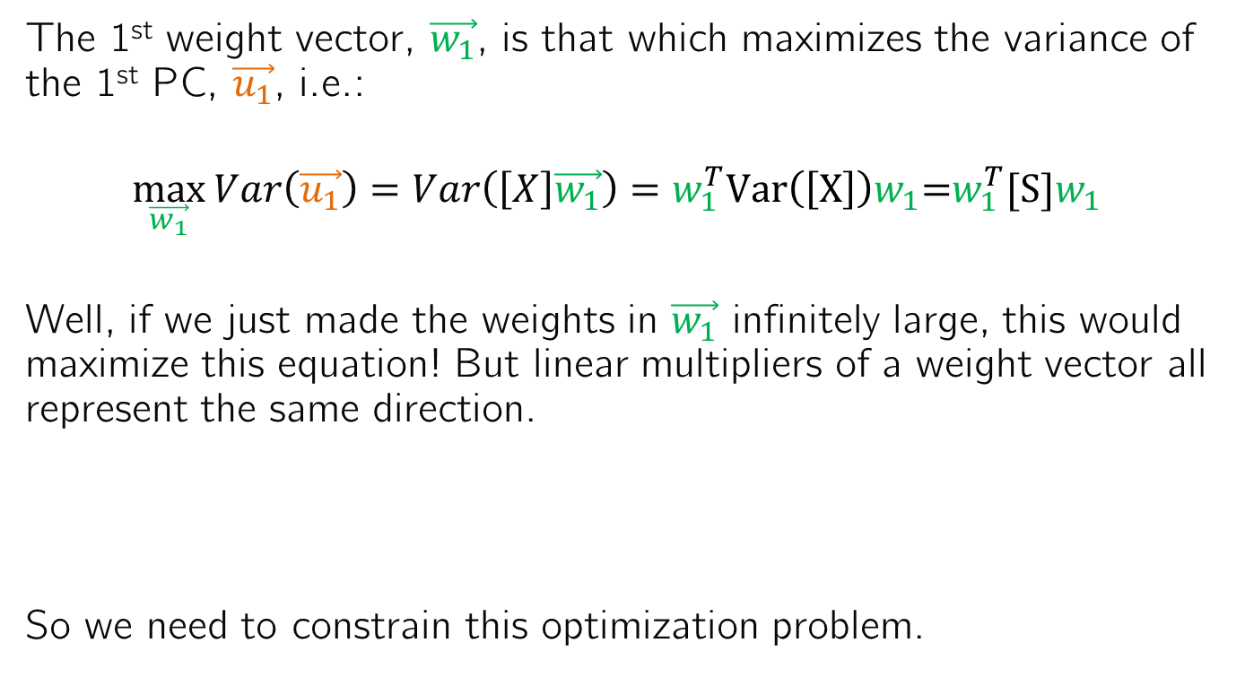

Solving for PCA weight matrix
The 1st weight vector, $\vec{w_{1}}$, is that which maximizes the variance of the 1st PC, $\vec{u_{1}}$, i.e.:
$$\max_{\vec{w_{1}}}{Var\left(\vec{u_{1}}\right)=Var\left(\left[X\right]\vec{w_{1}}\right)={w_{1}^{T}Var\left(\left[X\right]\right)w}_{1}\text{=}{w_{1}^{T}[S]w}_{1}}$$
Well, if we just made the weights in $\vec{w_{1}}$ infinitely large, this would maximize this equation! But linear multipliers of a weight vector all represent the same direction.
So we need to constrain this optimization problem.
$$\vec{2u_{1}}$$
$$\vec{u_{1}}$$
2w₂₁
w₂₁
w₁₁
2w₁₁

Slide 6
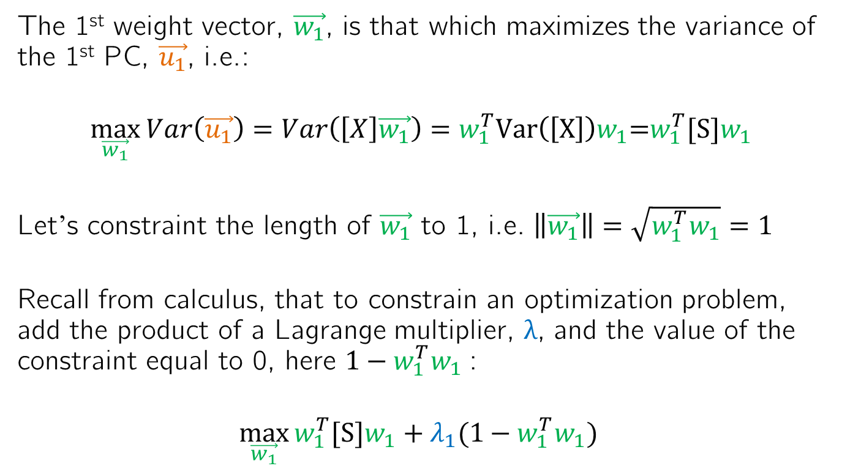
Solving for PCA weight matrix
The 1st weight vector, $\vec{w_{1}}$, is that which maximizes the variance of the 1st PC, $\vec{u_{1}}$, i.e.:
$$\max_{\vec{w_{1}}}{Var\left(\vec{u_{1}}\right)=Var\left(\left[X\right]\vec{w_{1}}\right)={w_{1}^{T}Var\left(\left[X\right]\right)w}_{1}\text{=}{w_{1}^{T}[S]w}_{1}}$$
Let’s constraint the length of $\vec{w_{1}}$ to 1, i.e. $\left\|\vec{w_{1}}\right\|=\sqrt{{w_{1}^{T}w}_{1}}=1$
Recall from calculus, that to constrain an optimization problem, add the product of a Lagrange multiplier, λ, and the value of the constraint equal to 0, here ${{1−w}_{1}^{T}w}_{1}$:
$$\max_{\vec{w_{1}}}{{w_{1}^{T}[S]w}_{1}+λ_{1}({1−w_{1}^{T}w}_{1}) }$$

Slide 7
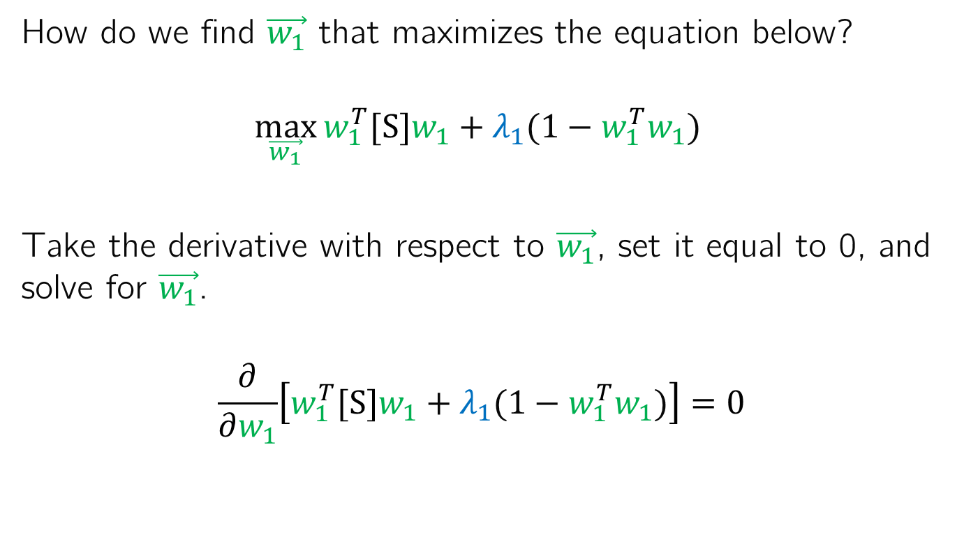
Solving for PCA weight matrix
How do we find $\vec{w_{1}}$ that maximizes the equation below?
$$\max_{\vec{w_{1}}}{{w_{1}^{T}[S]w}_{1}+λ_{1}({1−w_{1}^{T}w}_{1}) }$$
Take the derivative with respect to $\vec{w_{1}}$, set it equal to 0, and solve for $\vec{w_{1}}$.
$$\frac{∂}{∂w_{1}}\left[{w_{1}^{T}[S]w}_{1}+λ_{1}({1−w_{1}^{T}w}_{1})\right]=0$$

Slide 8
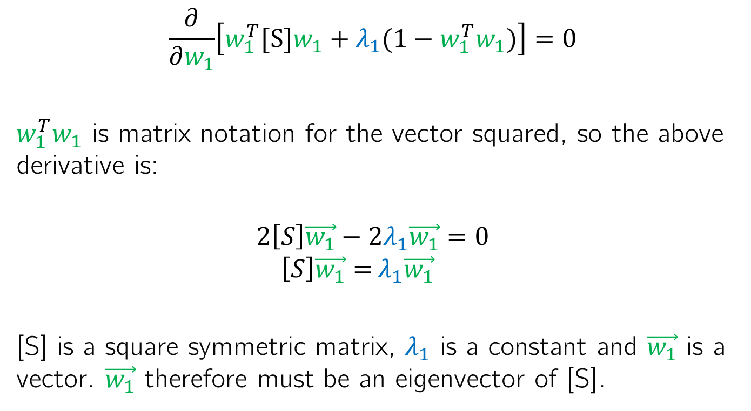
Solving for PCA weight matrix
$$\frac{∂}{∂w_{1}}\left[{w_{1}^{T}[S]w}_{1}+λ_{1}({1−w_{1}^{T}w}_{1})\right]=0$$
${w_{1}^{T}w}_{1}$ is matrix notation for the vector squared, so the above derivative is:
$$2\left[S\right]\vec{w_{1}}−{2λ}_{1}\vec{w_{1}}{=0}$$
$$\left[S\right]\vec{w_{1}}={λ_{1}\vec{w_{1}}}$$
[S] is a square symmetric matrix, $λ_{1}$ is a constant and $\vec{w_{1}}$ is a vector. $\vec{w_{1}}$ therefore must be an eigenvector of [S].

Slide 9
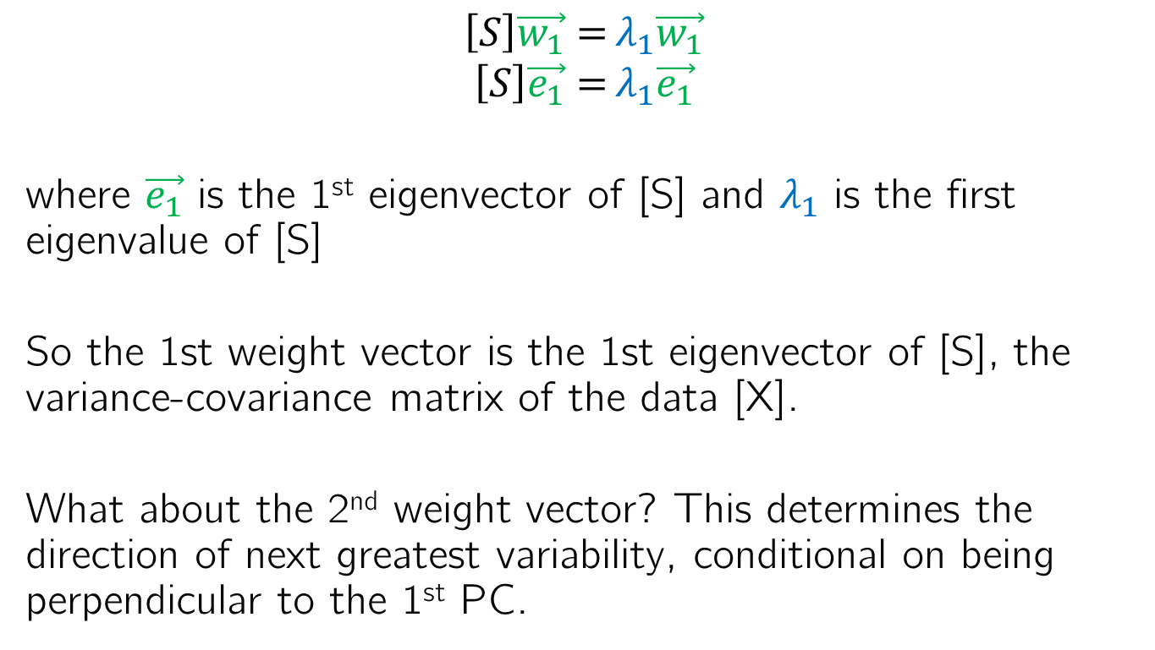
Solving for PCA weight matrix
$$\left[S\right]\vec{w_{1}}={λ_{1}\vec{w_{1}}}$$
$$\left[S\right]\vec{e_{1}}={λ_{1}\vec{e_{1}}}$$
where $\vec{e_{1}}$ is the 1st eigenvector of [S] and $λ_{1}$ is the first eigenvalue of [S]
So the 1st weight vector is the 1st eigenvector of [S], the variance-covariance matrix of the data [X].
What about the 2nd weight vector? This determines the direction of next greatest variability, conditional on being perpendicular to the 1st PC.

Slide 10
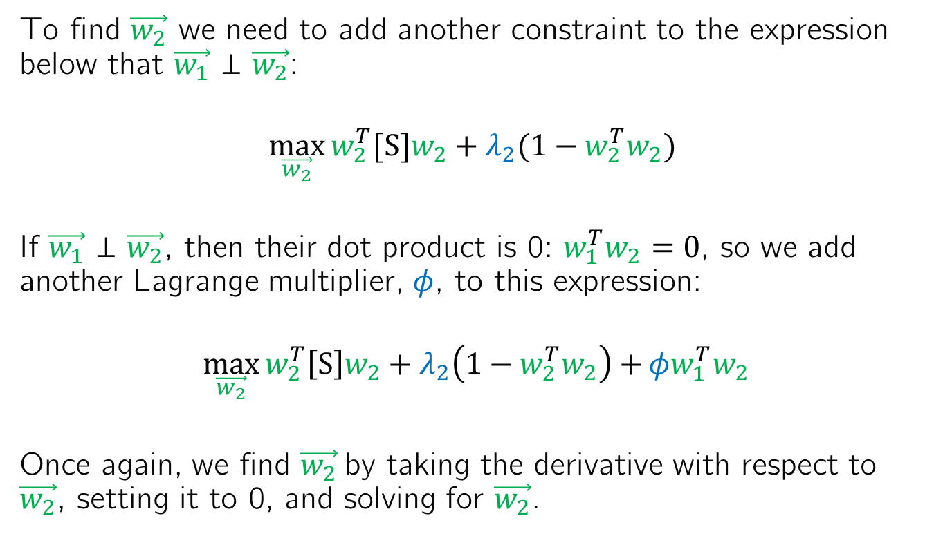
Solving for PCA weight matrix
To find $\vec{w_{2}}$ we need to add another constraint to the expression below that $\vec{w_{1}}$ ⊥ $\vec{w_{2}}$:
$$\max_{\vec{w_{2}}}{{w_{2}^{T}[S]w}_{2}+λ_{2}({1−w_{2}^{T}w}_{2}) }$$
If $\vec{w_{1}}$ ⊥ $\vec{w_{2}}$, then their dot product is 0: ${w_{1}^{T}w}_{2}=0$, so we add another Lagrange multiplier, $φ$, to this expression:
$$\max_{\vec{w_{2}}}{{w_{2}^{T}\left[S\right]w}_{2}+λ_{2}\left({1−w_{2}^{T}w}_{2}\right)+}φ{w_{1}^{T}w}_{2}$$
Once again, we find $\vec{w_{2}}$by taking the derivative with respect to $\vec{w_{2}}$, setting it to 0, and solving for $\vec{w_{2}}$.

Slide 11
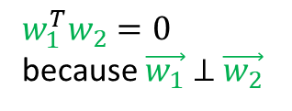
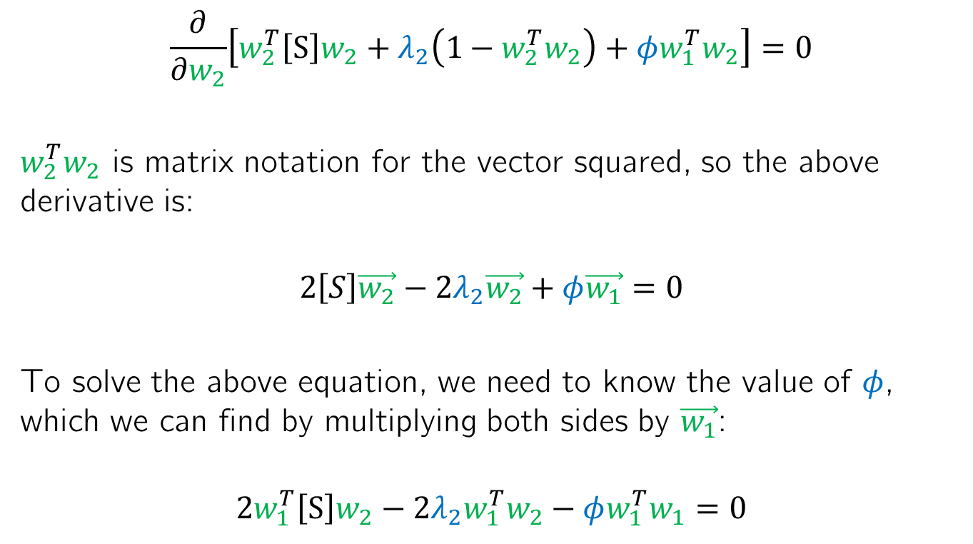
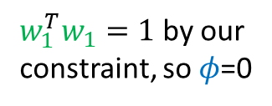
Solving for PCA weight matrix
$$\frac{∂}{∂w_{2}}\left[{w_{2}^{T}\left[S\right]w}_{2}+λ_{2}\left({1−w_{2}^{T}w}_{2}\right)+φ{w_{1}^{T}w}_{2}\right]=0$$
${w_{2}^{T}w}_{2}$ is matrix notation for the vector squared, so the above derivative is:
$$2\left[S\right]\vec{w_{2}}−{2λ}_{2}\vec{w_{2}}+φ\vec{w_{1}}{=0}$$
To solve the above equation, we need to know the value of $φ$, which we can find by multiplying both sides by $\vec{w_{1}}$:
$$2{w_{1}^{T}\left[S\right]w}_{2}−{2λ}_{2}{w_{1}^{T}w}_{2}−φ{w_{1}^{T}w}_{1}{=0}$$
0
0
${w_{1}^{T}w}_{2}=0$ because $\vec{w_{1}}$ ⊥ $\vec{w_{2}}$
${w_{1}^{T}w}_{1}=1$ by our constraint, so $φ$=0

Slide 12
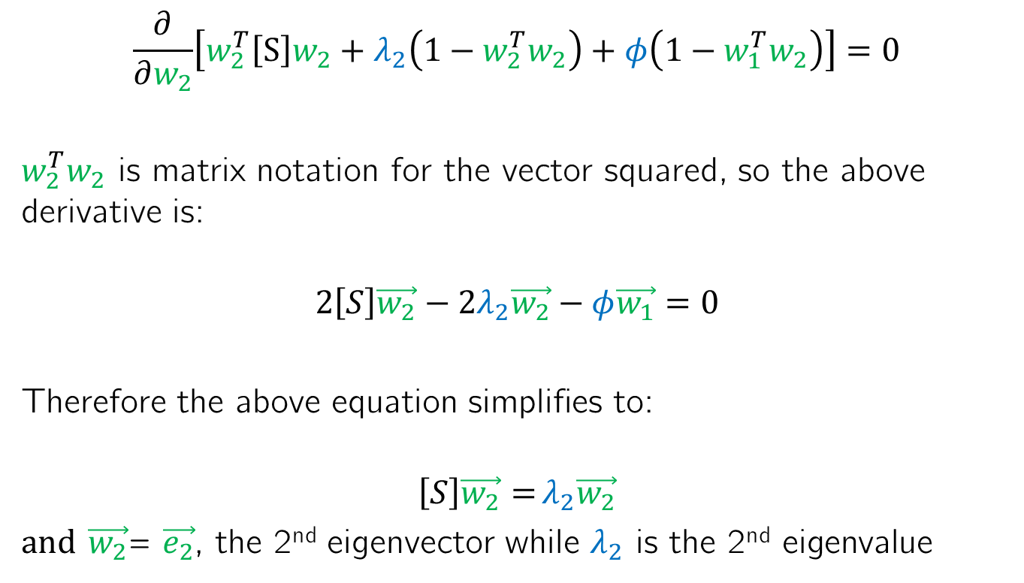
Solving for PCA weight matrix
$$\frac{∂}{∂w_{2}}\left[{w_{2}^{T}\left[S\right]w}_{2}+λ_{2}\left({1−w_{2}^{T}w}_{2}\right)+φ\left({1−w_{1}^{T}w}_{2}\right)\right]=0$$
${w_{2}^{T}w}_{2}$ is matrix notation for the vector squared, so the above derivative is:
$$2\left[S\right]\vec{w_{2}}−{2λ}_{2}\vec{w_{2}}−φ\vec{w_{1}}{=0}$$
Therefore the above equation simplifies to:
$$\left[S\right]\vec{w_{2}}={λ_{2}\vec{w_{2}}}$$
and $\vec{w_{2}}$= $\vec{e_{2}}$, the 2nd eigenvector while $λ_{2}$ is the 2nd eigenvalue

Slide 13

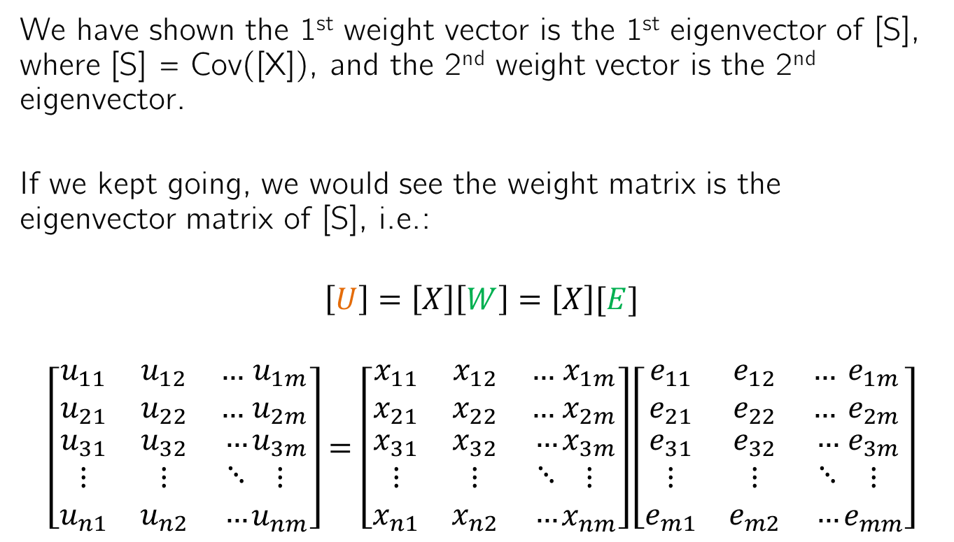

Extending this to multiple dimensions
We have shown the 1st weight vector is the 1st eigenvector of [S], where [S] = Cov([X]), and the 2nd weight vector is the 2nd eigenvector.
If we kept going, we would see the weight matrix is the eigenvector matrix of [S], i.e.:
$$\left[U\right]=\left[X\right]\left[W\right]=\left[X\right][E]$$
$$\left[\begin{matrix}u_{11} & u_{12} & … \\ u_{21} & u_{22} & … \\ \begin{aligned}u_{31} \\ ⋮ \\ u_{n1}\end{aligned} & \begin{aligned}u_{32} \\ ⋮ \\ u_{n2}\end{aligned} & \begin{aligned}… \\ ⋱ \\ …\end{aligned}\end{matrix}\begin{matrix}u_{1m} \\ u_{2m} \\ \begin{aligned}u_{3m} \\ ⋮ \\ u_{nm}\end{aligned}\end{matrix}\right]=\left[\begin{matrix}x_{11} & x_{12} & … \\ x_{21} & x_{22} & … \\ \begin{aligned}x_{31} \\ ⋮ \\ x_{n1}\end{aligned} & \begin{aligned}x_{32} \\ ⋮ \\ x_{n2}\end{aligned} & \begin{aligned}… \\ ⋱ \\ …\end{aligned}\end{matrix}\begin{matrix}x_{1m} \\ x_{2m} \\ \begin{aligned}x_{3m} \\ ⋮ \\ x_{nm}\end{aligned}\end{matrix}\right]\left[\begin{matrix}e_{11} & e_{12} & … \\ e_{21} & e_{22} & … \\ \begin{aligned}e_{31} \\ ⋮ \\ e_{m1}\end{aligned} & \begin{aligned}e_{32} \\ ⋮ \\ e_{m2}\end{aligned} & \begin{aligned}… \\ ⋱ \\ …\end{aligned}\end{matrix}\begin{matrix}e_{1m} \\ e_{2m} \\ \begin{aligned}e_{3m} \\ ⋮ \\ e_{mm}\end{aligned}\end{matrix}\right]$$
$$\vec{u_{1}}$$
$$\vec{e_{1}}$$

Slide 14


Extending this to multiple dimensions
We have shown the 1st weight vector is the 1st eigenvector of [S], where [S] = Cov([X]), and the 2nd weight vector is the 2nd eigenvector.
If we kept going, we would see the weight matrix is the eigenvector matrix of [S], i.e.:
$$\left[U\right]=\left[X\right]\left[W\right]=\left[X\right][E]$$
$$\left[\begin{matrix}u_{11} & u_{12} & … \\ u_{21} & u_{22} & … \\ \begin{aligned}u_{31} \\ ⋮ \\ u_{n1}\end{aligned} & \begin{aligned}u_{32} \\ ⋮ \\ u_{n2}\end{aligned} & \begin{aligned}… \\ ⋱ \\ …\end{aligned}\end{matrix}\begin{matrix}u_{1m} \\ u_{2m} \\ \begin{aligned}u_{3m} \\ ⋮ \\ u_{nm}\end{aligned}\end{matrix}\right]=\left[\begin{matrix}x_{11} & x_{12} & … \\ x_{21} & x_{22} & … \\ \begin{aligned}x_{31} \\ ⋮ \\ x_{n1}\end{aligned} & \begin{aligned}x_{32} \\ ⋮ \\ x_{n2}\end{aligned} & \begin{aligned}… \\ ⋱ \\ …\end{aligned}\end{matrix}\begin{matrix}x_{1m} \\ x_{2m} \\ \begin{aligned}x_{3m} \\ ⋮ \\ x_{nm}\end{aligned}\end{matrix}\right]\left[\begin{matrix}e_{11} & e_{12} & … \\ e_{21} & e_{22} & … \\ \begin{aligned}e_{31} \\ ⋮ \\ e_{m1}\end{aligned} & \begin{aligned}e_{32} \\ ⋮ \\ e_{m2}\end{aligned} & \begin{aligned}… \\ ⋱ \\ …\end{aligned}\end{matrix}\begin{matrix}e_{1m} \\ e_{2m} \\ \begin{aligned}e_{3m} \\ ⋮ \\ e_{mm}\end{aligned}\end{matrix}\right]$$
$$\vec{u_{2}}$$
$$\vec{e_{2}}$$

Slide 15
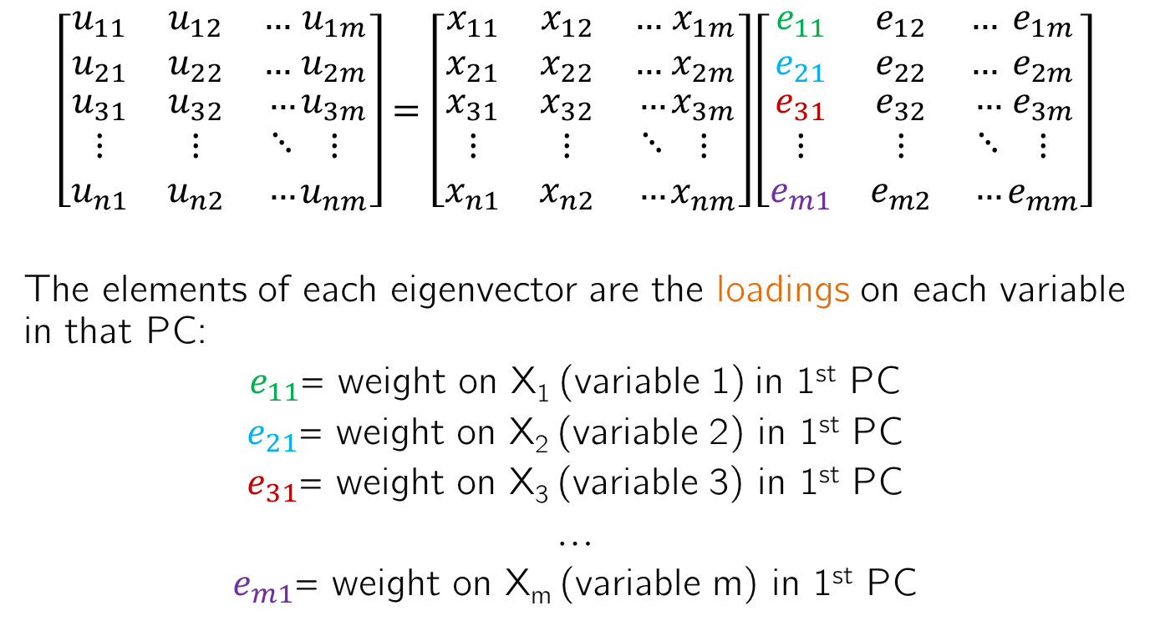
Understanding the eigenvector elements
$$\left[\begin{matrix}u_{11} & u_{12} & … \\ u_{21} & u_{22} & … \\ \begin{aligned}u_{31} \\ ⋮ \\ u_{n1}\end{aligned} & \begin{aligned}u_{32} \\ ⋮ \\ u_{n2}\end{aligned} & \begin{aligned}… \\ ⋱ \\ …\end{aligned}\end{matrix}\begin{matrix}u_{1m} \\ u_{2m} \\ \begin{aligned}u_{3m} \\ ⋮ \\ u_{nm}\end{aligned}\end{matrix}\right]=\left[\begin{matrix}x_{11} & x_{12} & … \\ x_{21} & x_{22} & … \\ \begin{aligned}x_{31} \\ ⋮ \\ x_{n1}\end{aligned} & \begin{aligned}x_{32} \\ ⋮ \\ x_{n2}\end{aligned} & \begin{aligned}… \\ ⋱ \\ …\end{aligned}\end{matrix}\begin{matrix}x_{1m} \\ x_{2m} \\ \begin{aligned}x_{3m} \\ ⋮ \\ x_{nm}\end{aligned}\end{matrix}\right]\left[\begin{matrix}e_{11} & e_{12} & … \\ e_{21} & e_{22} & … \\ \begin{aligned}e_{31} \\ ⋮ \\ e_{m1}\end{aligned} & \begin{aligned}e_{32} \\ ⋮ \\ e_{m2}\end{aligned} & \begin{aligned}… \\ ⋱ \\ …\end{aligned}\end{matrix}\begin{matrix}e_{1m} \\ e_{2m} \\ \begin{aligned}e_{3m} \\ ⋮ \\ e_{mm}\end{aligned}\end{matrix}\right]$$
The elements of each eigenvector are the loadings on each variable in that PC:
$e_{11}$= weight on X₁ (variable 1) in 1st PC
$e_{21}$= weight on X₂ (variable 2) in 1st PC
$e_{31}$= weight on X₃ (variable 3) in 1st PC
…
$e_{m1}$= weight on X_{m} (variable m) in 1st PC

Slide 16
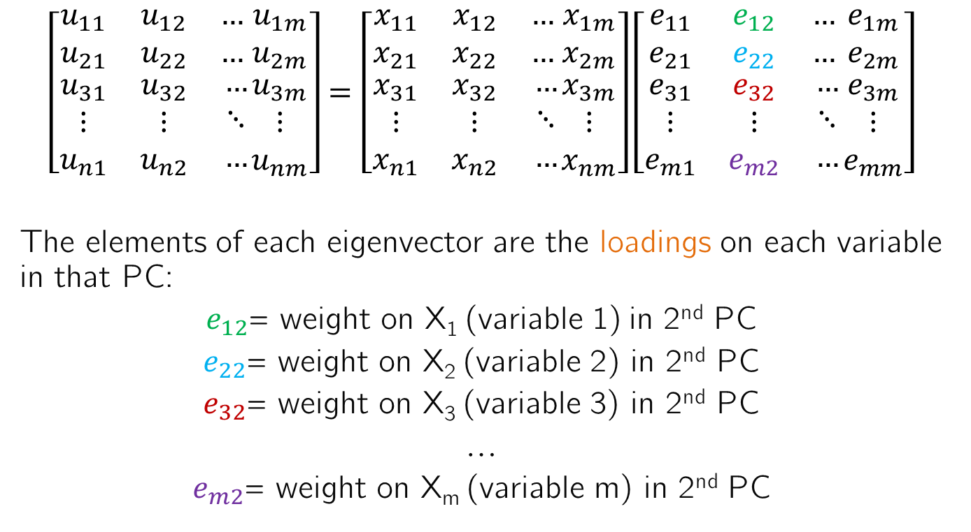
Understanding the eigenvector elements
$$\left[\begin{matrix}u_{11} & u_{12} & … \\ u_{21} & u_{22} & … \\ \begin{aligned}u_{31} \\ ⋮ \\ u_{n1}\end{aligned} & \begin{aligned}u_{32} \\ ⋮ \\ u_{n2}\end{aligned} & \begin{aligned}… \\ ⋱ \\ …\end{aligned}\end{matrix}\begin{matrix}u_{1m} \\ u_{2m} \\ \begin{aligned}u_{3m} \\ ⋮ \\ u_{nm}\end{aligned}\end{matrix}\right]=\left[\begin{matrix}x_{11} & x_{12} & … \\ x_{21} & x_{22} & … \\ \begin{aligned}x_{31} \\ ⋮ \\ x_{n1}\end{aligned} & \begin{aligned}x_{32} \\ ⋮ \\ x_{n2}\end{aligned} & \begin{aligned}… \\ ⋱ \\ …\end{aligned}\end{matrix}\begin{matrix}x_{1m} \\ x_{2m} \\ \begin{aligned}x_{3m} \\ ⋮ \\ x_{nm}\end{aligned}\end{matrix}\right]\left[\begin{matrix}e_{11} & e_{12} & … \\ e_{21} & e_{22} & … \\ \begin{aligned}e_{31} \\ ⋮ \\ e_{m1}\end{aligned} & \begin{aligned}e_{32} \\ ⋮ \\ e_{m2}\end{aligned} & \begin{aligned}… \\ ⋱ \\ …\end{aligned}\end{matrix}\begin{matrix}e_{1m} \\ e_{2m} \\ \begin{aligned}e_{3m} \\ ⋮ \\ e_{mm}\end{aligned}\end{matrix}\right]$$
The elements of each eigenvector are the loadings on each variable in that PC:
$e_{12}$= weight on X₁ (variable 1) in 2nd PC
$e_{22}$= weight on X₂ (variable 2) in 2nd PC
$e_{32}$= weight on X₃ (variable 3) in 2nd PC
…
$e_{m2}$= weight on X_{m} (variable m) in 2nd PC

Slide 17
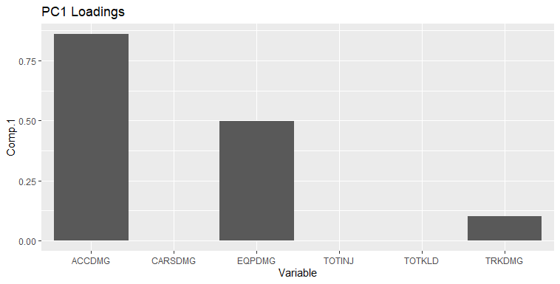
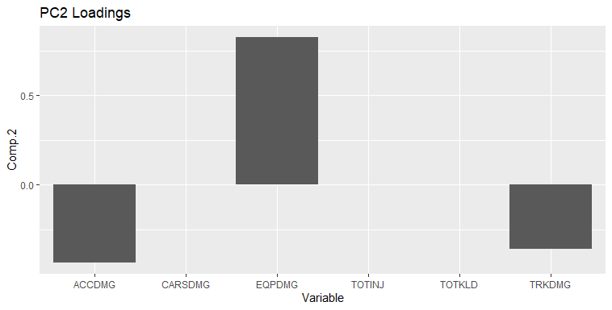
PCA for data visualization through the loadings
Viewing the loadings allows us to see relationships between multiple variables at once in different “modes” (PCs) of variability
In the 1st PC, ACCDMG > EQPDMG > TRKDMG > CARSDMG, TOTINJ and TOTKLD and they all vary in the same direction
In the 2nd PC, EQPDMG > ACCDMG > TRKDMG > CARSDMG, TOTINJ and TOTKLD. EQPDMG varies opposite ACCDMG and TRKDMG

Slide 18

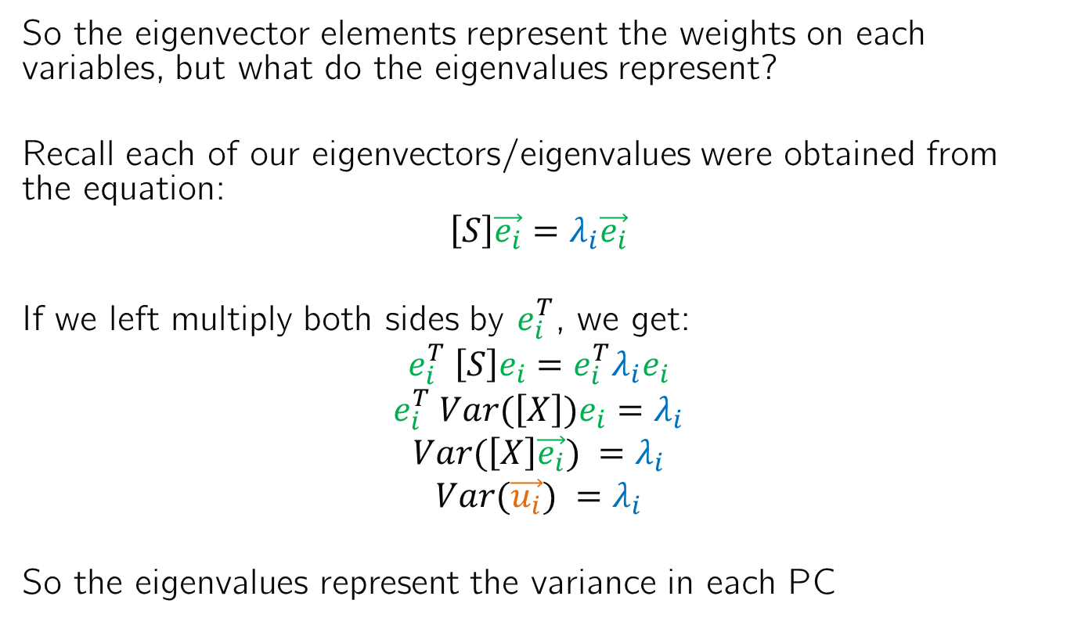
What are the eigenvalues?
So the eigenvector elements represent the weights on each variables, but what do the eigenvalues represent?
Recall each of our eigenvectors/eigenvalues were obtained from the equation:
$$\left[S\right]\vec{e_{i}}=λ_{i}\vec{e_{i}}$$
If we left multiply both sides by $e_{i}^{T}$, we get:
$$e_{i}^{T} \left[S\right]e_{i}={e_{i}^{T}λ}_{i}e_{i}$$
$$e_{i}^{T} Var(\left[X\right])e_{i}=λ_{i}$$
$$Var(\left[X\right]\vec{e_{i}}) =λ_{i}$$
$$Var(\vec{u_{i}}) =λ_{i}$$
So the eigenvalues represent the variance in each PC
Because λ_{i} is a constant and $e_{i}^{T}e_{i}=1$

Slide 19
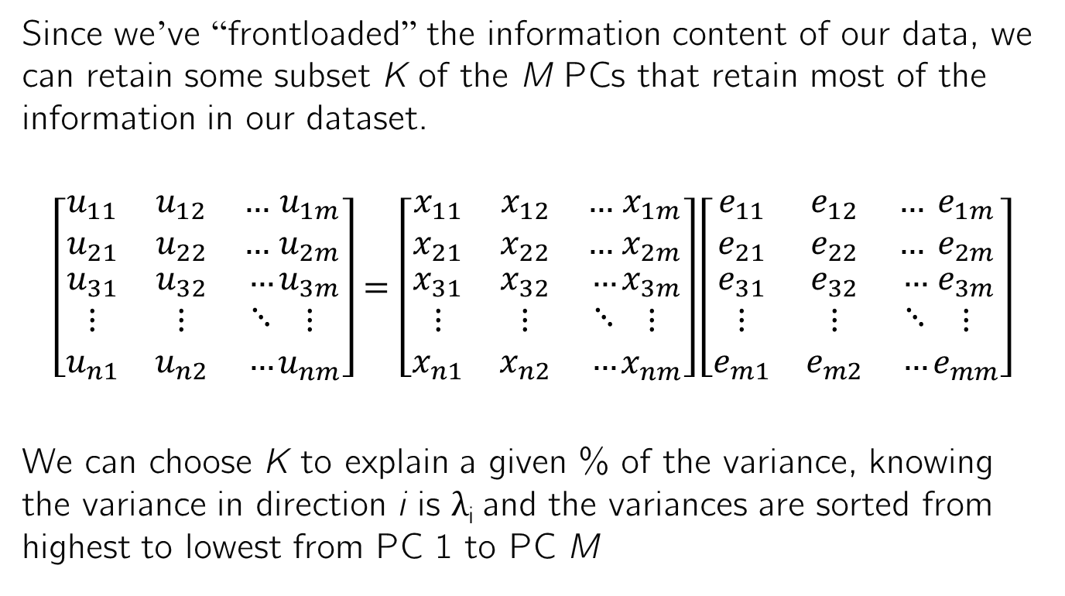
How are the eigenvalues informative?
Since we’ve “frontloaded” the information content of our data, we can retain some subset K of the M PCs that retain most of the information in our dataset.
$$\left[\begin{matrix}u_{11} & u_{12} & … \\ u_{21} & u_{22} & … \\ \begin{aligned}u_{31} \\ ⋮ \\ u_{n1}\end{aligned} & \begin{aligned}u_{32} \\ ⋮ \\ u_{n2}\end{aligned} & \begin{aligned}… \\ ⋱ \\ …\end{aligned}\end{matrix}\begin{matrix}u_{1m} \\ u_{2m} \\ \begin{aligned}u_{3m} \\ ⋮ \\ u_{nm}\end{aligned}\end{matrix}\right]=\left[\begin{matrix}x_{11} & x_{12} & … \\ x_{21} & x_{22} & … \\ \begin{aligned}x_{31} \\ ⋮ \\ x_{n1}\end{aligned} & \begin{aligned}x_{32} \\ ⋮ \\ x_{n2}\end{aligned} & \begin{aligned}… \\ ⋱ \\ …\end{aligned}\end{matrix}\begin{matrix}x_{1m} \\ x_{2m} \\ \begin{aligned}x_{3m} \\ ⋮ \\ x_{nm}\end{aligned}\end{matrix}\right]\left[\begin{matrix}e_{11} & e_{12} & … \\ e_{21} & e_{22} & … \\ \begin{aligned}e_{31} \\ ⋮ \\ e_{m1}\end{aligned} & \begin{aligned}e_{32} \\ ⋮ \\ e_{m2}\end{aligned} & \begin{aligned}… \\ ⋱ \\ …\end{aligned}\end{matrix}\begin{matrix}e_{1m} \\ e_{2m} \\ \begin{aligned}e_{3m} \\ ⋮ \\ e_{mm}\end{aligned}\end{matrix}\right]$$
We can choose K to explain a given % of the variance, knowing the variance in direction i is λ_{i} and the variances are sorted from highest to lowest from PC 1 to PC M
K=2 PCs

Slide 20
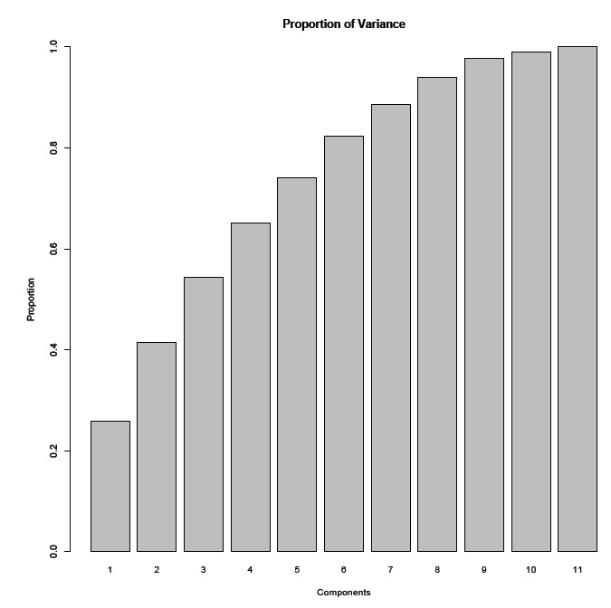
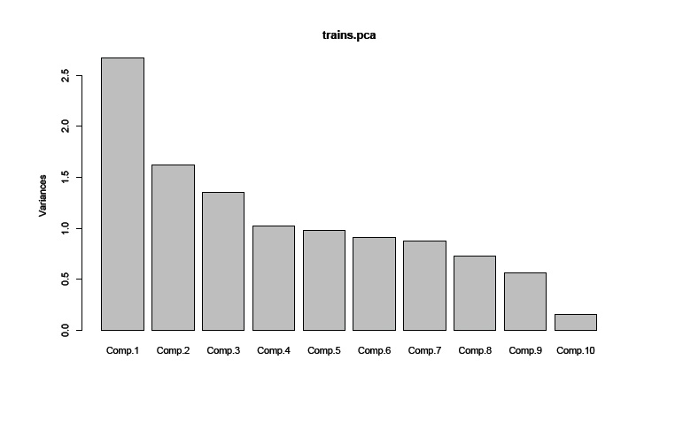
Scree plot
One common approach is to plot the variance in each component on a scree plot and choose as many PCs before a “kink” in the plot. This is somewhat arbitrary, and there may not always be a kink.
Another approach is to choose as many PCs as needed to retain y% of the variance, where the user chooses y.

Slide 21
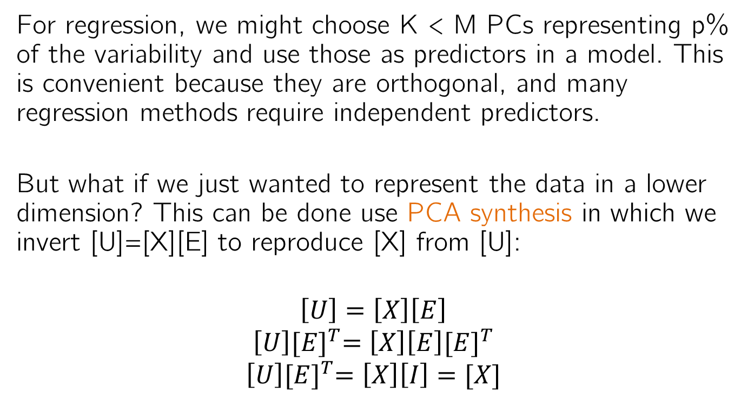
PCA for data compression
For regression, we might choose K < M PCs representing p% of the variability and use those as predictors in a model. This is convenient because they are orthogonal, and many regression methods require independent predictors.
But what if we just wanted to represent the data in a lower dimension? This can be done use PCA synthesis in which we invert [U]=[X][E] to reproduce [X] from [U]:
$$\left[U\right]=\left[X\right]\left[E\right]$$
$$\left[U\right]{[E]}^{T}=\left[X\right]\left[E\right]{[E]}^{T}$$
$$\left[U\right]{[E]}^{T}=\left[X\right]\left[I\right]=[X]$$

Slide 22
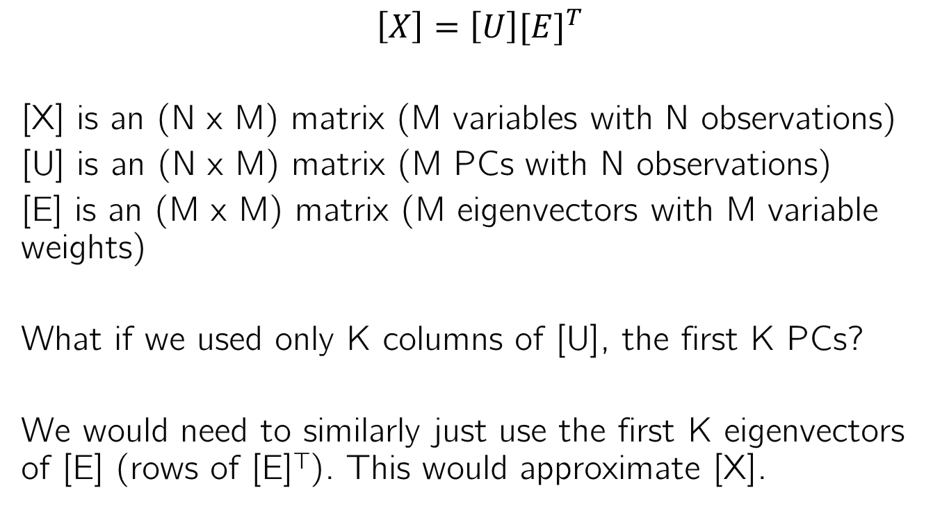
PCA for data compression
$$\left[X\right]=\left[U\right]{[E]}^{T}$$
[X] is an (N x M) matrix (M variables with N observations)
[U] is an (N x M) matrix (M PCs with N observations)
[E] is an (M x M) matrix (M eigenvectors with M variable weights)
What if we used only K columns of [U], the first K PCs?
We would need to similarly just use the first K eigenvectors of [E] (rows of [E]^{T}). This would approximate [X].

Slide 23
Recap
PCA finds weighted sums of the original data variables that represent the orthogonal directions of greatest sequential variability
The weights are determined by the eigenvectors ([E])
The variances in each direction are the eigenvalues (λ)
But what are the PCs? ([U])

Slide 24
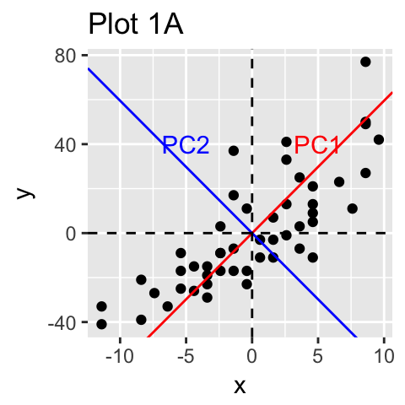
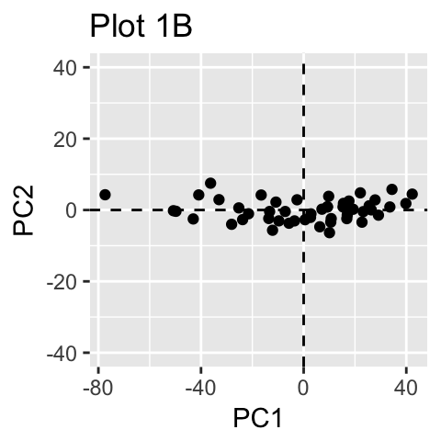
What do the PCs themselves represent?
The PCs are weighted sums of the original variables. They also represent a new, rotated coordinate system in which we can view the data: (u₁, u₂) instead of (x₁, x₂).
A plot of the data in the (u₁, u₂) plane is called a biplot. In this case, the biplot shows no pattern because almost all of the information is explained in the 1st 2 PCs.
http://www.sthda.com/english/articles/31-principal-component-methods-in-r-practical-guide/112-pca-principal-component-analysis-essentials/

Slide 25
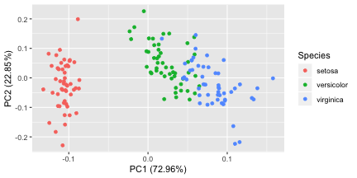
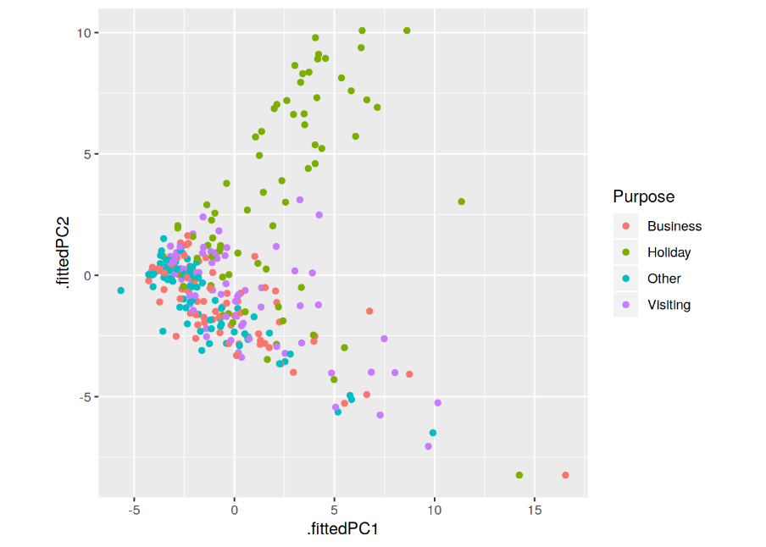
What do the PCs themselves represent?
The PCs are weighted sums of the original variables. They also represent a new, rotated coordinate system in which we can view the data: (u₁, u₂) instead of (x₁, x₂).
But sometimes the first 2 PCs separate the data into clusters, or reveal additional modes of variability beyond the 1st 2 PCs.
https://cran.r-project.org/web/packages/ggfortify/vignettes/plot_pca.html
https://www.r-bloggers.com/feature-based-time-series-analysis/

Slide 26
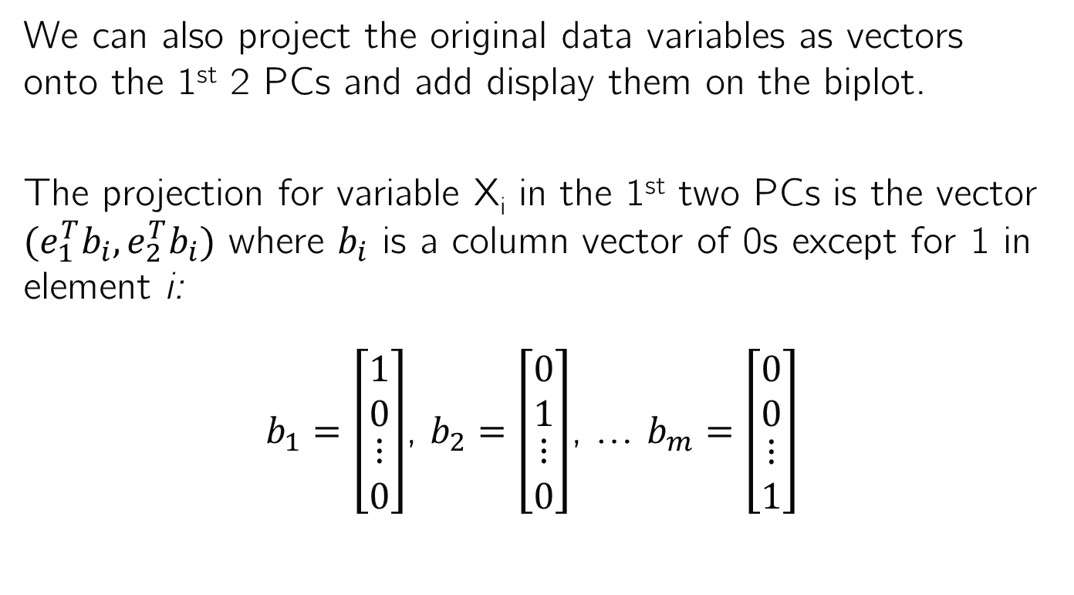
Additional features of the biplot
We can also project the original data variables as vectors onto the 1st 2 PCs and add display them on the biplot.
The projection for variable X_{i} in the 1st two PCs is the vector $(e_{1}^{T}b_{i},e_{2}^{T}b_{i})$ where $b_{i}$ is a column vector of 0s except for 1 in element i:
$b_{1}=\left[\begin{matrix}1 \\ 0 \\ \begin{matrix}⋮ \\ 0\end{matrix}\end{matrix}\right]$, $b_{2}=\left[\begin{matrix}0 \\ 1 \\ \begin{matrix}⋮ \\ 0\end{matrix}\end{matrix}\right]$, … $b_{m}=\left[\begin{matrix}0 \\ 0 \\ \begin{matrix}⋮ \\ 1\end{matrix}\end{matrix}\right]$

Slide 27
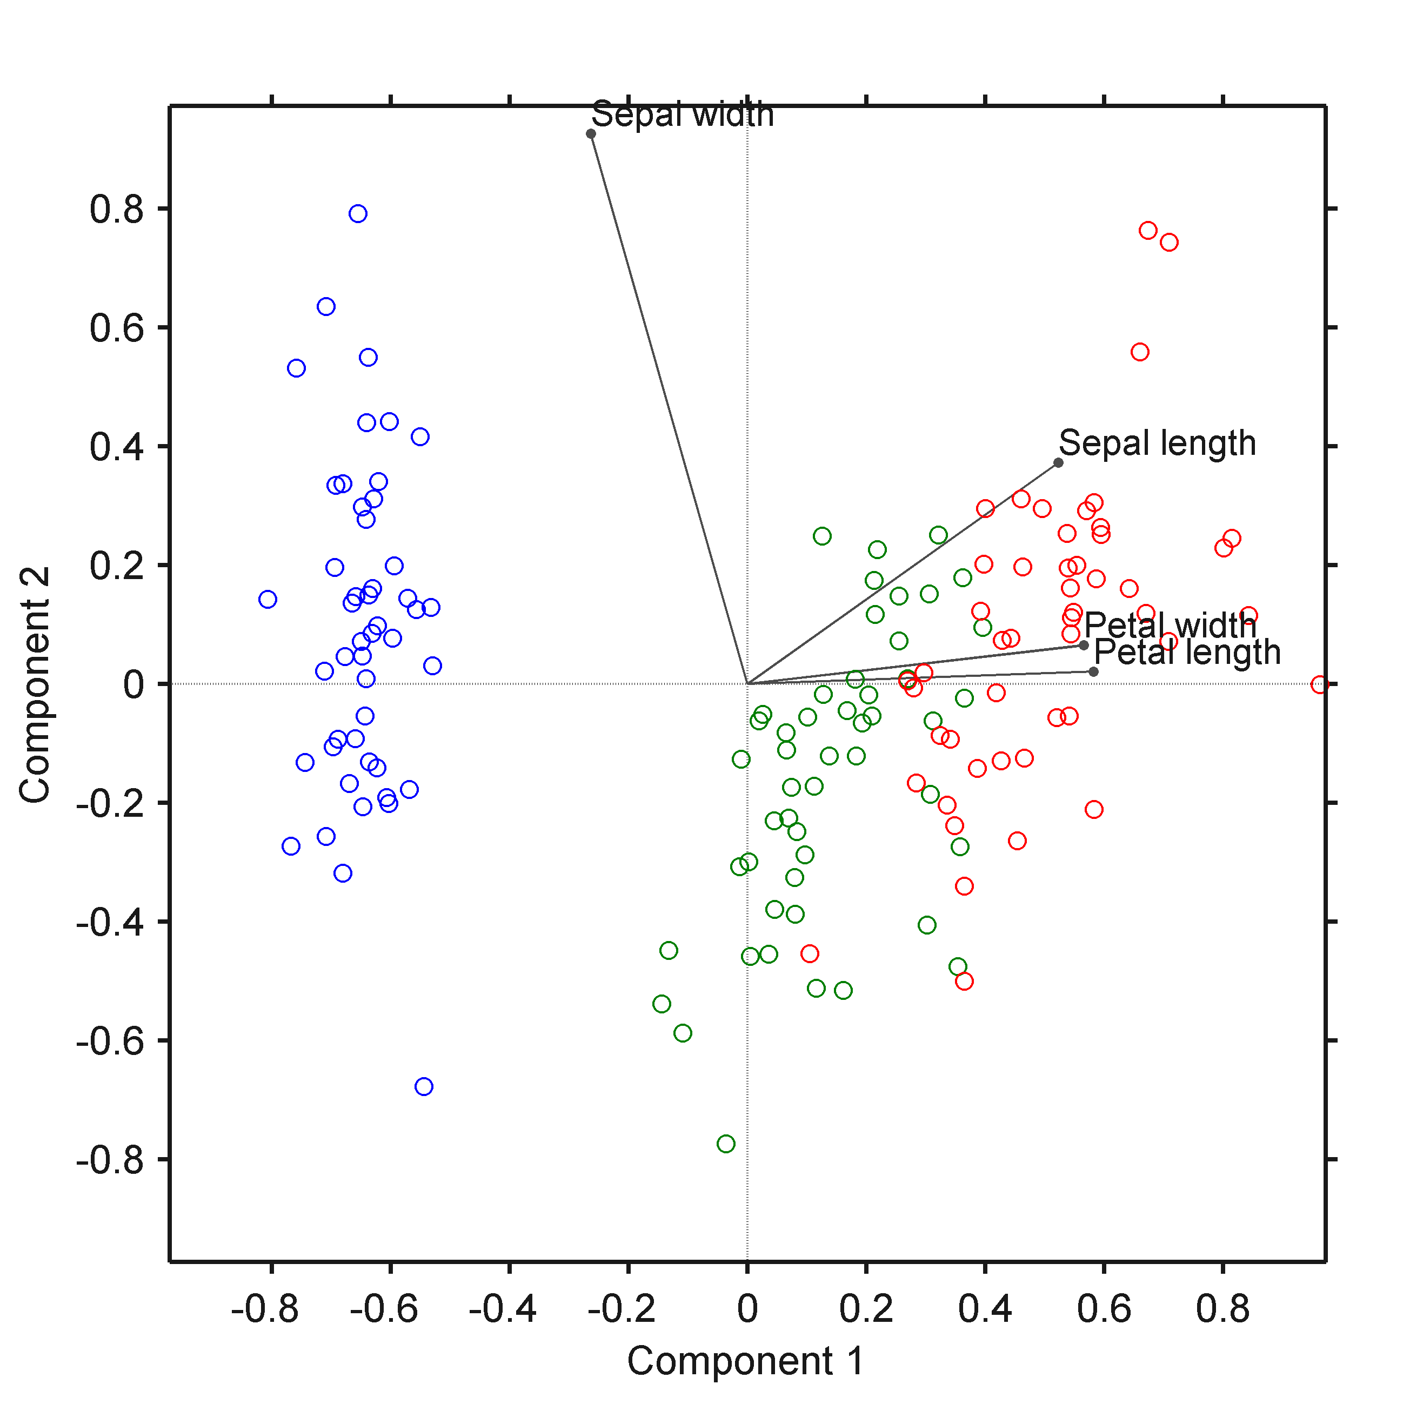
Projecting the original data variables onto the biplot
Similar to the loadings plot, the length of the vector indicates the importance of that variable, and the extent to which variables point in the same direction indicates their correlation in the first 2 modes of variability
https://iaisidro.wordpress.com/2015/10/09/biplotg/

Slide 28
Summary
You will not need to know how to derive the weight vector for PCA, but you should know what comes out of that derivation:
The PCs represent the directions of greatest variability of the data, conditional on them all being orthogonal.
The PCs are weighted sums of the original data variables. The weights for each PC are the elements of the corresponding eigenvector. These weights are called loadings.
The variance in the direction of each PC is equal to the corresponding eigenvalue.
We plot the 1st 2 PCs on a biplot
We plot the loadings on bar plots
We plot the eigenvalues on a scree plot or cumulative variance plot

