Slide 1
Principal Components Analysis 3 (PCA)
SYS 4021/6021
Laura Barnes and Julianne Quinn

Slide 2
Organization of lecture
Recap:
What is PCA?
How does it work?
Alternative approaches to PCA
Covariance vs. correlation matrix
Eigen-decomposition vs. singular value decomposition

Slide 3
Recap: What is PCA?
Visualizing and modeling data in more than 2 dimensions is conceptually difficult.
PCA transforms our data into a new variables (principal components) that sequentially maximize the information content (variance) of the original data.
The principal components (PCs) are orthogonal, linear projections of the original variables that represent the directions of greatest variability of the data.
We can use a subset of these PCs to compress our data and view it in an alternative coordinate system.

Slide 4
Recap: What is PCA?
What are some of the benefits of these properties of PCA?
The PCs are orthogonal
Regression models require independent predictors. Since the PCs are orthogonal, we can use them as predictors in a regression model rather than the original variables.
The PCs are linear projections
The PCs are weighted sums of the original variables, and these weights (loadings) reveal the importance and relationship between the original data variables in different modes of variability.
The PCs represent the directions of greatest variability
We can retain the first K < M PCs rather than all M variables without losing much information.

Slide 5
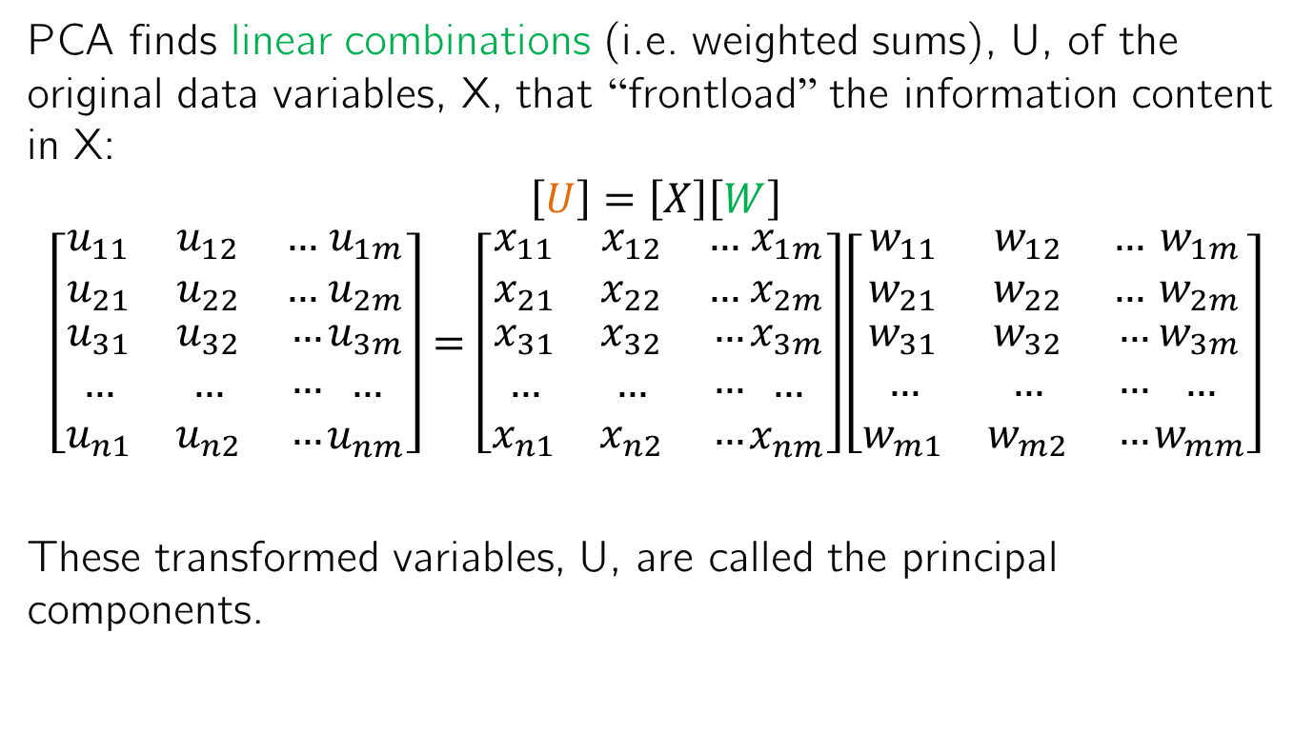
Recap: How does PCA work?
PCA finds linear combinations (i.e. weighted sums), U, of the original data variables, X, that “frontload” the information content in X:
$$\left[U\right]=\left[X\right]\left[W\right]$$
$$\left[\begin{matrix}u_{11} & u_{12} & … \\ u_{21} & u_{22} & … \\ \begin{aligned}u_{31} \\ … \\ u_{n1}\end{aligned} & \begin{aligned}u_{32} \\ … \\ u_{n2}\end{aligned} & \begin{aligned}… \\ … \\ …\end{aligned}\end{matrix}\begin{matrix}u_{1m} \\ u_{2m} \\ \begin{aligned}u_{3m} \\ … \\ u_{nm}\end{aligned}\end{matrix}\right]=\left[\begin{matrix}x_{11} & x_{12} & … \\ x_{21} & x_{22} & … \\ \begin{aligned}x_{31} \\ … \\ x_{n1}\end{aligned} & \begin{aligned}x_{32} \\ … \\ x_{n2}\end{aligned} & \begin{aligned}… \\ … \\ …\end{aligned}\end{matrix}\begin{matrix}x_{1m} \\ x_{2m} \\ \begin{aligned}x_{3m} \\ … \\ x_{nm}\end{aligned}\end{matrix}\right]\left[\begin{matrix}w_{11} & w_{12} & … \\ w_{21} & w_{22} & … \\ \begin{aligned}w_{31} \\ … \\ w_{m1}\end{aligned} & \begin{aligned}w_{32} \\ … \\ w_{m2}\end{aligned} & \begin{aligned}… \\ … \\ …\end{aligned}\end{matrix}\begin{matrix}w_{1m} \\ w_{2m} \\ \begin{aligned}w_{3m} \\ … \\ w_{mm}\end{aligned}\end{matrix}\right]$$
These transformed variables, U, are called the principal components.

Slide 6

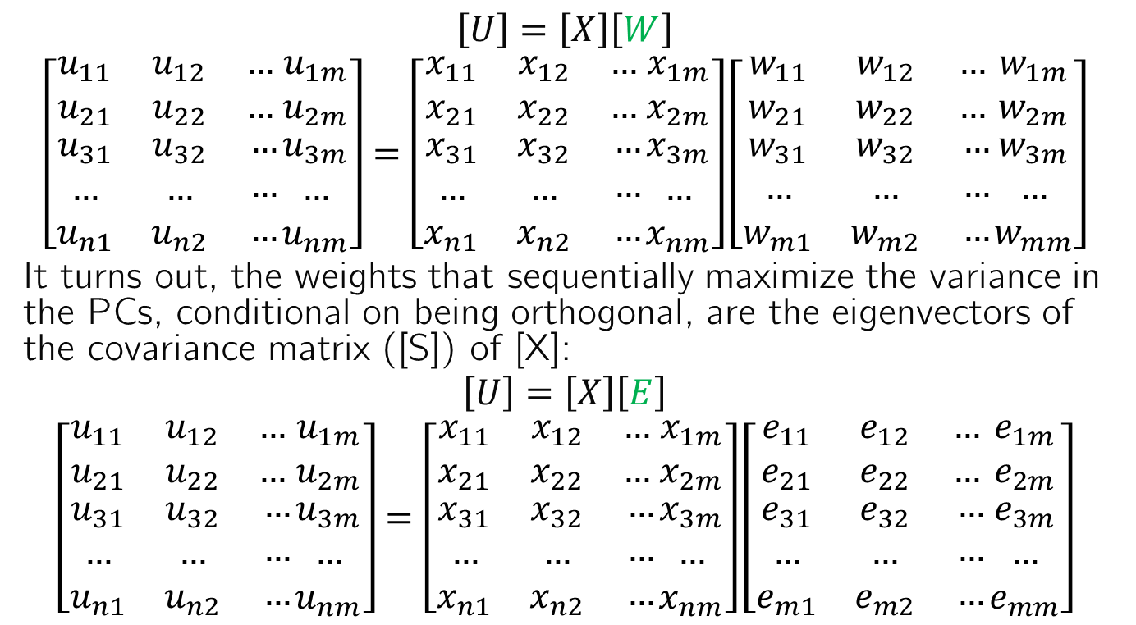


Recap: How does PCA work?
$$\left[U\right]=\left[X\right]\left[W\right]$$
$$\left[\begin{matrix}u_{11} & u_{12} & … \\ u_{21} & u_{22} & … \\ \begin{aligned}u_{31} \\ … \\ u_{n1}\end{aligned} & \begin{aligned}u_{32} \\ … \\ u_{n2}\end{aligned} & \begin{aligned}… \\ … \\ …\end{aligned}\end{matrix}\begin{matrix}u_{1m} \\ u_{2m} \\ \begin{aligned}u_{3m} \\ … \\ u_{nm}\end{aligned}\end{matrix}\right]=\left[\begin{matrix}x_{11} & x_{12} & … \\ x_{21} & x_{22} & … \\ \begin{aligned}x_{31} \\ … \\ x_{n1}\end{aligned} & \begin{aligned}x_{32} \\ … \\ x_{n2}\end{aligned} & \begin{aligned}… \\ … \\ …\end{aligned}\end{matrix}\begin{matrix}x_{1m} \\ x_{2m} \\ \begin{aligned}x_{3m} \\ … \\ x_{nm}\end{aligned}\end{matrix}\right]\left[\begin{matrix}w_{11} & w_{12} & … \\ w_{21} & w_{22} & … \\ \begin{aligned}w_{31} \\ … \\ w_{m1}\end{aligned} & \begin{aligned}w_{32} \\ … \\ w_{m2}\end{aligned} & \begin{aligned}… \\ … \\ …\end{aligned}\end{matrix}\begin{matrix}w_{1m} \\ w_{2m} \\ \begin{aligned}w_{3m} \\ … \\ w_{mm}\end{aligned}\end{matrix}\right]$$
It turns out, the weights that sequentially maximize the variance in the PCs, conditional on being orthogonal, are the eigenvectors of the covariance matrix ([S]) of [X]:
$$\left[U\right]=\left[X\right]\left[E\right]$$
$$\left[\begin{matrix}u_{11} & u_{12} & … \\ u_{21} & u_{22} & … \\ \begin{aligned}u_{31} \\ … \\ u_{n1}\end{aligned} & \begin{aligned}u_{32} \\ … \\ u_{n2}\end{aligned} & \begin{aligned}… \\ … \\ …\end{aligned}\end{matrix}\begin{matrix}u_{1m} \\ u_{2m} \\ \begin{aligned}u_{3m} \\ … \\ u_{nm}\end{aligned}\end{matrix}\right]=\left[\begin{matrix}x_{11} & x_{12} & … \\ x_{21} & x_{22} & … \\ \begin{aligned}x_{31} \\ … \\ x_{n1}\end{aligned} & \begin{aligned}x_{32} \\ … \\ x_{n2}\end{aligned} & \begin{aligned}… \\ … \\ …\end{aligned}\end{matrix}\begin{matrix}x_{1m} \\ x_{2m} \\ \begin{aligned}x_{3m} \\ … \\ x_{nm}\end{aligned}\end{matrix}\right]\left[\begin{matrix}e_{11} & e_{12} & … \\ e_{21} & e_{22} & … \\ \begin{aligned}e_{31} \\ … \\ e_{m1}\end{aligned} & \begin{aligned}e_{32} \\ … \\ e_{m2}\end{aligned} & \begin{aligned}… \\ … \\ …\end{aligned}\end{matrix}\begin{matrix}e_{1m} \\ e_{2m} \\ \begin{aligned}e_{3m} \\ … \\ e_{mm}\end{aligned}\end{matrix}\right]$$
$$\vec{e_{1}}$$
$$\vec{e_{2}}$$
$$\vec{e_{m}}$$

Slide 7
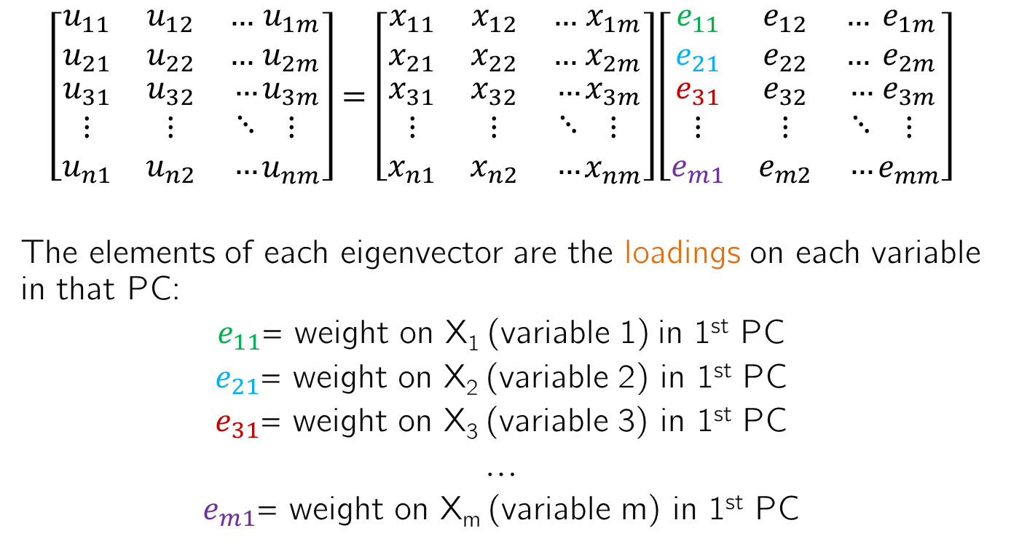
Understanding the eigenvector elements
$$\left[\begin{matrix}u_{11} & u_{12} & … \\ u_{21} & u_{22} & … \\ \begin{aligned}u_{31} \\ ⋮ \\ u_{n1}\end{aligned} & \begin{aligned}u_{32} \\ ⋮ \\ u_{n2}\end{aligned} & \begin{aligned}… \\ ⋱ \\ …\end{aligned}\end{matrix}\begin{matrix}u_{1m} \\ u_{2m} \\ \begin{aligned}u_{3m} \\ ⋮ \\ u_{nm}\end{aligned}\end{matrix}\right]=\left[\begin{matrix}x_{11} & x_{12} & … \\ x_{21} & x_{22} & … \\ \begin{aligned}x_{31} \\ ⋮ \\ x_{n1}\end{aligned} & \begin{aligned}x_{32} \\ ⋮ \\ x_{n2}\end{aligned} & \begin{aligned}… \\ ⋱ \\ …\end{aligned}\end{matrix}\begin{matrix}x_{1m} \\ x_{2m} \\ \begin{aligned}x_{3m} \\ ⋮ \\ x_{nm}\end{aligned}\end{matrix}\right]\left[\begin{matrix}e_{11} & e_{12} & … \\ e_{21} & e_{22} & … \\ \begin{aligned}e_{31} \\ ⋮ \\ e_{m1}\end{aligned} & \begin{aligned}e_{32} \\ ⋮ \\ e_{m2}\end{aligned} & \begin{aligned}… \\ ⋱ \\ …\end{aligned}\end{matrix}\begin{matrix}e_{1m} \\ e_{2m} \\ \begin{aligned}e_{3m} \\ ⋮ \\ e_{mm}\end{aligned}\end{matrix}\right]$$
The elements of each eigenvector are the loadings on each variable in that PC:
$e_{11}$= weight on X₁ (variable 1) in 1st PC
$e_{21}$= weight on X₂ (variable 2) in 1st PC
$e_{31}$= weight on X₃ (variable 3) in 1st PC
…
$e_{m1}$= weight on X_{m} (variable m) in 1st PC

Slide 8
What might be a shortcoming of this?
Let X₁ = People’s height in meters
X₂ = People’s weight in pounds
Which variable do you think would have a higher loading? What if we changed the units of X₁ to millimeters?
In the first case, X₂ would likely be more importance, while in the second case X₁ would be. But in reality, the variables are the same in both cases!
Using the covariance matrix of the data for PCA will show the variables with the greatest magnitudes explain the most variability, when the magnitude depends on the data units.

Slide 9
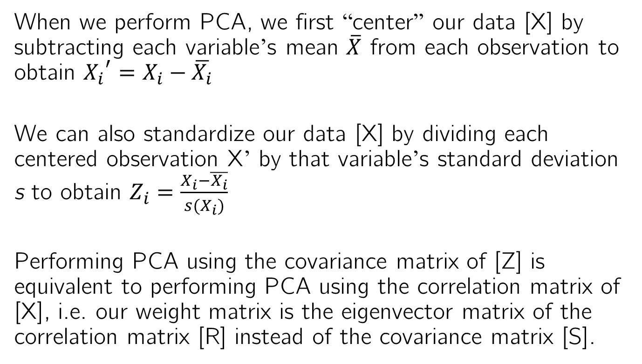
Overcoming this shortcoming
When we perform PCA, we first “center” our data [X] by subtracting each variable’s mean $\overline{X}$ from each observation to obtain ${X_{i}}^{′}=X_{i}−\overline{X_{i}}$
We can also standardize our data [X] by dividing each centered observation X’ by that variable’s standard deviation s to obtain $Z_{i}=\frac{X_{i}−\overline{X_{i}}}{s(X_{i})}$
Performing PCA using the covariance matrix of [Z] is equivalent to performing PCA using the correlation matrix of [X], i.e. our weight matrix is the eigenvector matrix of the correlation matrix [R] instead of the covariance matrix [S].

Slide 10
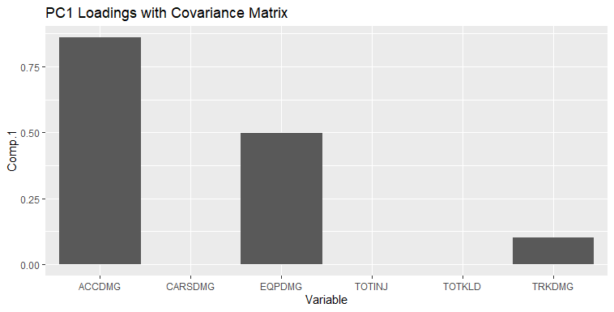
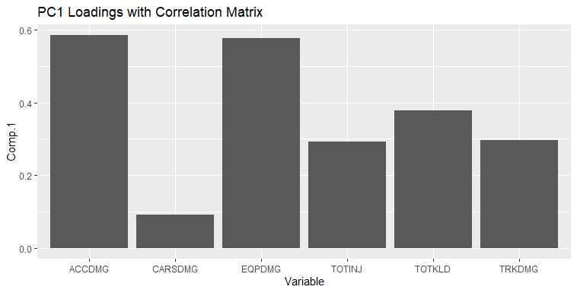
PCA w/ the correlation vs. covariance matrix
Using the covariance matrix, ACCDMG dominates everything because it encompasses the other damages. TOTKLD and TOTINJ are extremely small because they’re different units ($ vs. people)
Using the correlation matrix, TOTKLD and TOTINJ become more significant. And EQPDMG is almost as important as ACCDMG, suggesting that is most of the damages.

Slide 11
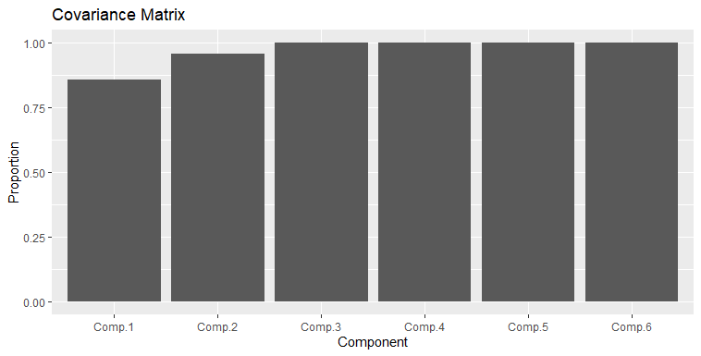
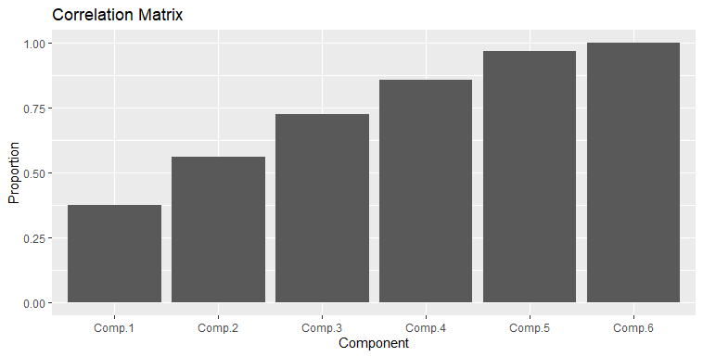
PCA w/ the correlation vs. covariance matrix
Using the covariance matrix, almost all of the information is explained by the first PC, which is dominated by ACCDMG.
Using the correlation matrix, several PCs are needed to explain the variability, as TOTKLD and TOTINJ are more important, and vary in different ways than ACCDMG.

Slide 12
PCA w/ covariance vs. correlation matrix
If multiple variables with widely different magnitudes are used for PCA, it is generally best to use the correlation matrix to remove this influence
But if the data consists of the same variable at multiple locations, the covariance matrix might be preferred even if the magnitudes across locations vary
Examples of data like this include gridded spatial data and images

Slide 13
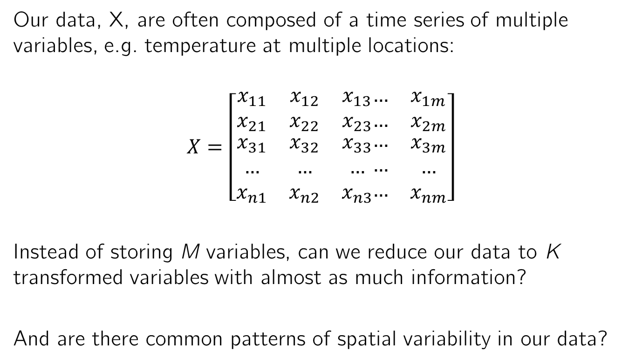
How do you perform PCA on gridded data?
Our data, X, are often composed of a time series of multiple variables, e.g. temperature at multiple locations:
$$X=\left[\begin{matrix}x_{11} & x_{12} & x_{13} \\ x_{21} & x_{22} & x_{23} \\ \begin{aligned}x_{31} \\ … \\ x_{n1}\end{aligned} & \begin{aligned}x_{32} \\ … \\ x_{n2}\end{aligned} & \begin{aligned}x_{33} \\ … \\ x_{n3}\end{aligned}\end{matrix}\begin{matrix}… & x_{1m} \\ … & x_{2m} \\ \begin{aligned}… \\ … \\ …\end{aligned} & \begin{aligned}x_{3m} \\ … \\ x_{nm}\end{aligned}\end{matrix}\right]$$
Instead of storing M variables, can we reduce our data to K transformed variables with almost as much information?
And are there common patterns of spatial variability in our data?
Pixel 1 Pixel 2 Pixel 3 … Pixel m
Year 1
Year 2
Year 3
…
Year n

Slide 14
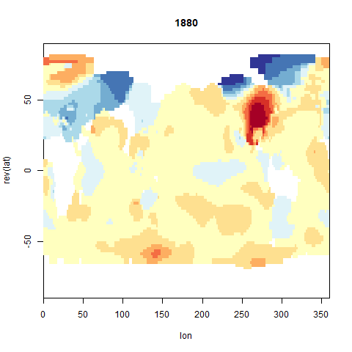
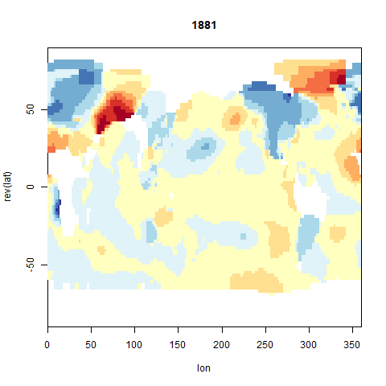
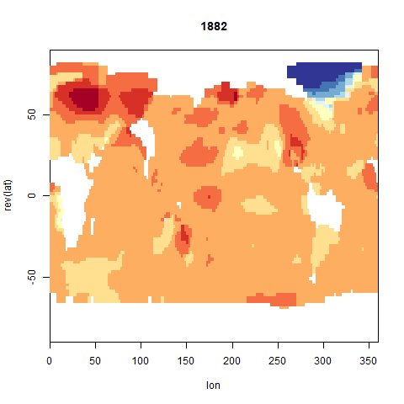
PCA on global temperature data
Are there common patterns of global variability in 78 years of annual temperatures at 13,253 locations?

Slide 15
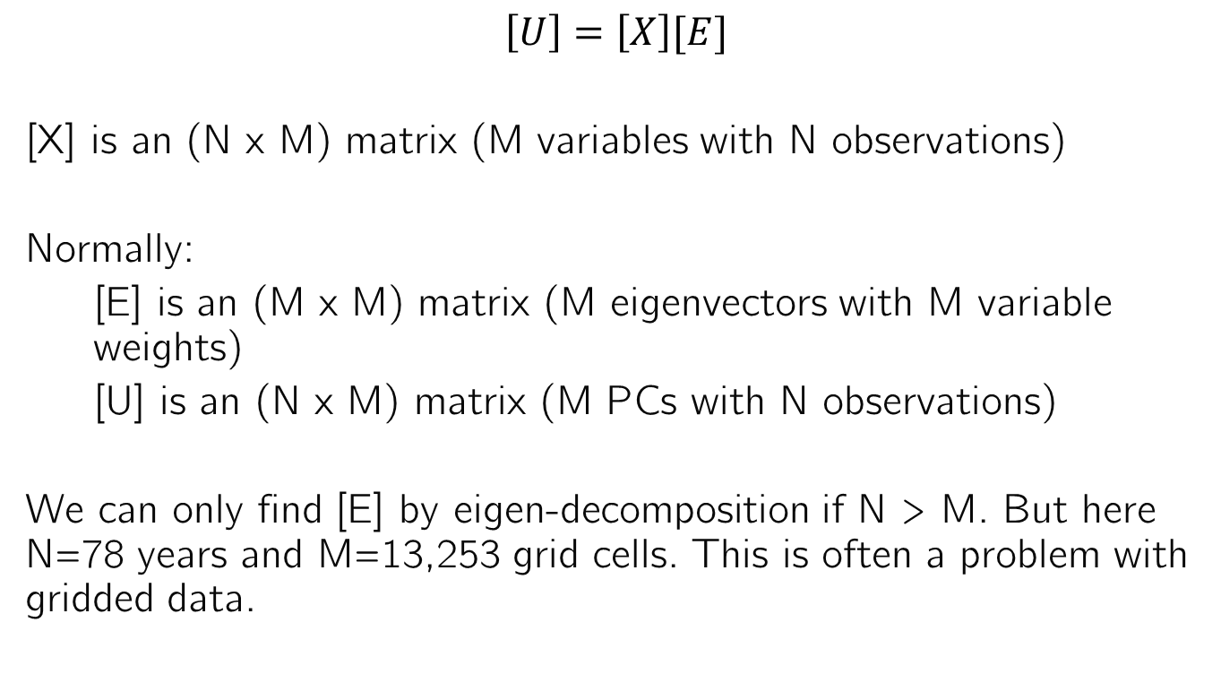
PCA on gridded data
$$\left[U\right]=\left[X\right][E]$$
[X] is an (N x M) matrix (M variables with N observations)
Normally:
[E] is an (M x M) matrix (M eigenvectors with M variable weights)
[U] is an (N x M) matrix (M PCs with N observations)
We can only find [E] by eigen-decomposition if N > M. But here N=78 years and M=13,253 grid cells. This is often a problem with gridded data.

Slide 16
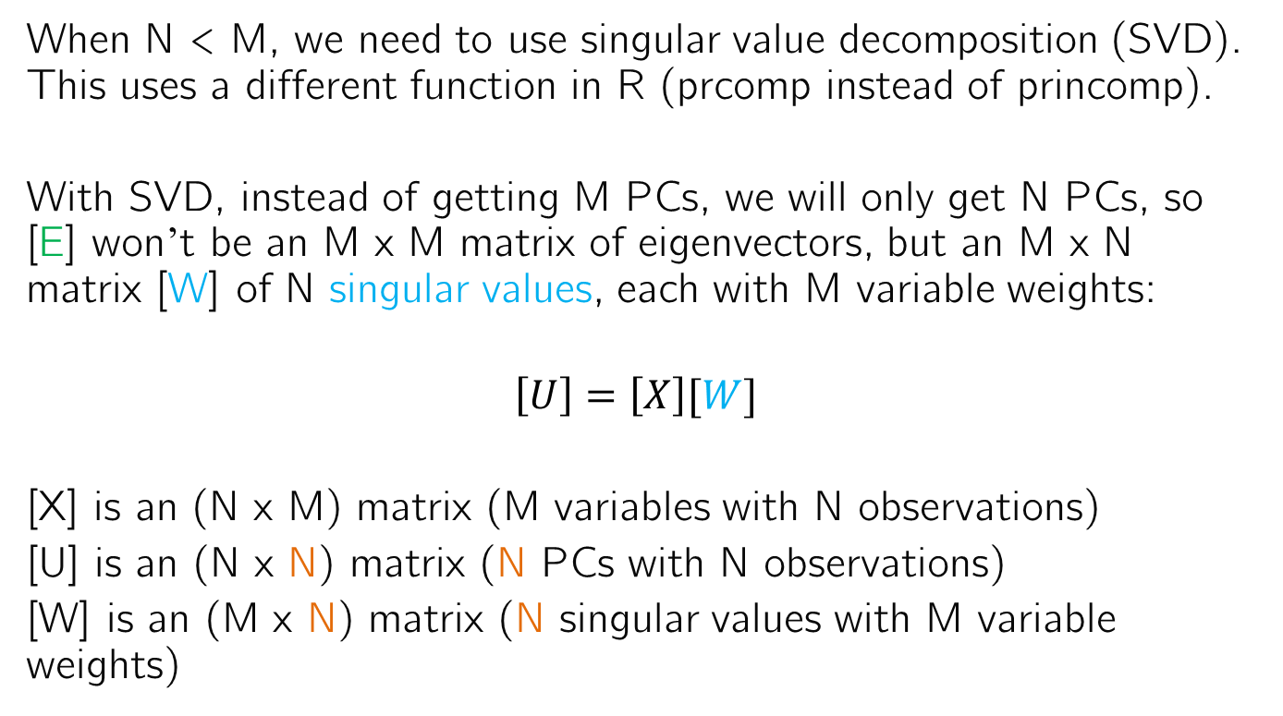
PCA when N < M
When N < M, we need to use singular value decomposition (SVD). This uses a different function in R (prcomp instead of princomp).
With SVD, instead of getting M PCs, we will only get N PCs, so [E] won’t be an M x M matrix of eigenvectors, but an M x N matrix [W] of N singular values, each with M variable weights:
$$\left[U\right]=\left[X\right][W]$$
[X] is an (N x M) matrix (M variables with N observations)
[U] is an (N x N) matrix (N PCs with N observations)
[W] is an (M x N) matrix (N singular values with M variable weights)

Slide 17
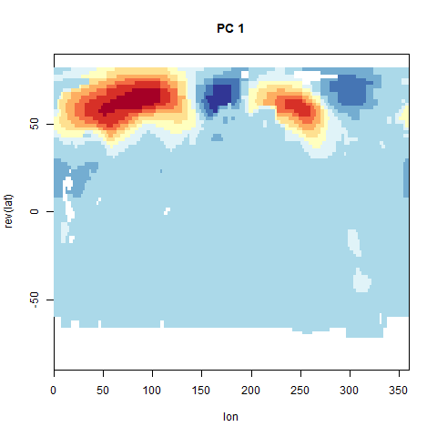
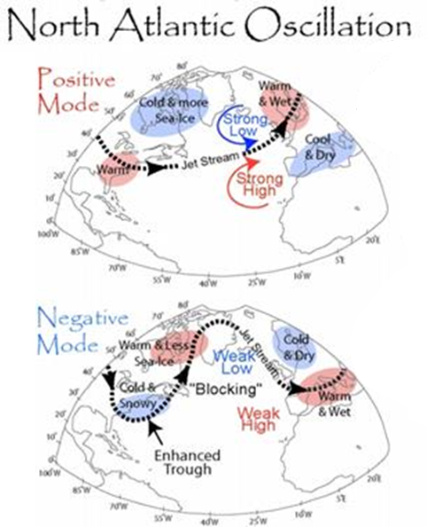
PCA loadings on a map
Since each variable is a grid cell, for each singular value, we can plot the weights/loadings associated with each grid cell on a map.
Here, this reveals common patterns of global variability in annual temperature.

Slide 18
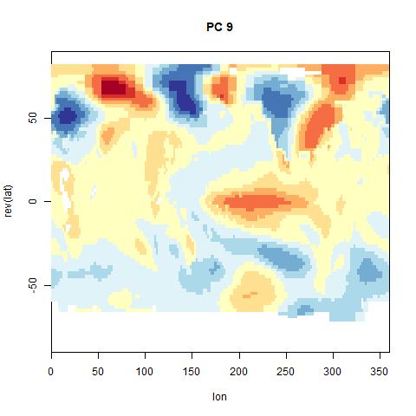
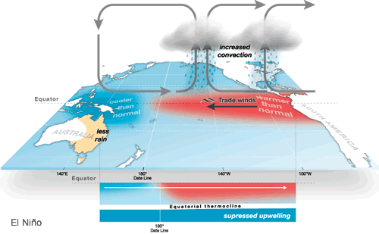
PCA loadings on a map
Since each variable is a grid cell, for each singular value, we can plot the weights/loadings associated with each grid cell on a map.
Here, this reveals common patterns of global variability in annual temperature.
El Nino Southern Oscillations

Slide 19
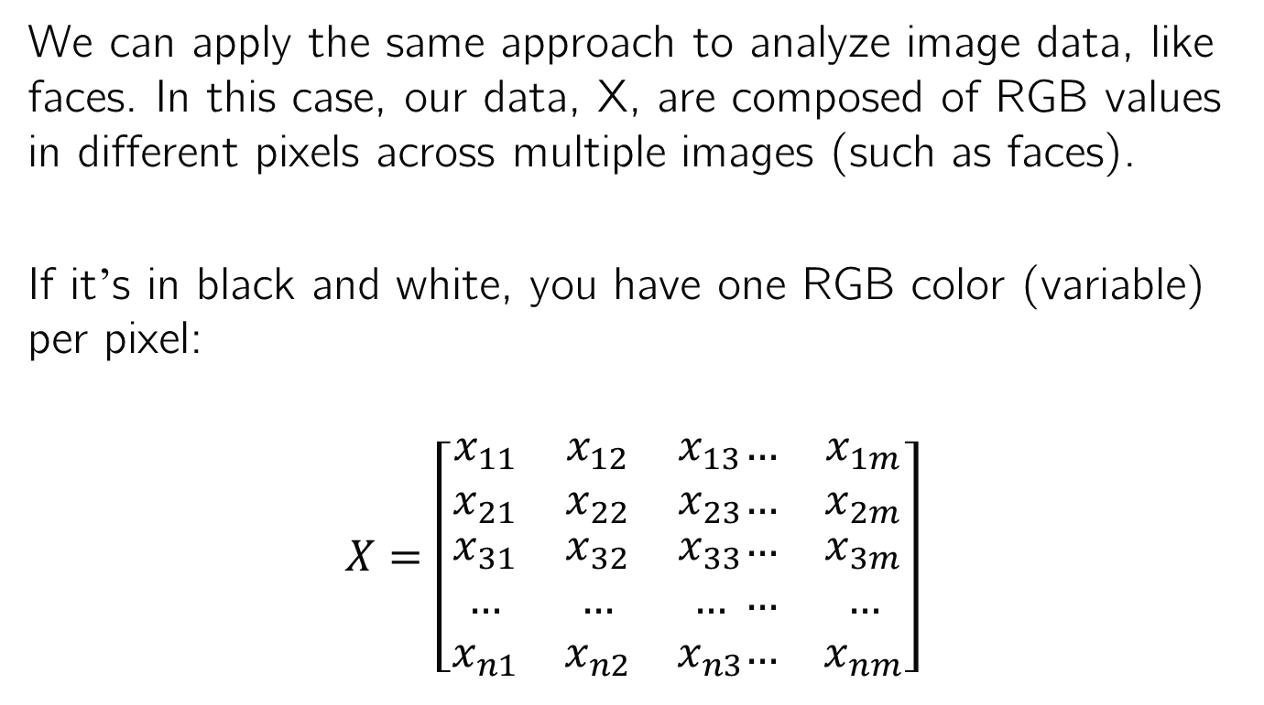
Analyzing images with PCA
We can apply the same approach to analyze image data, like faces. In this case, our data, X, are composed of RGB values in different pixels across multiple images (such as faces).
If it’s in black and white, you have one RGB color (variable) per pixel:
$$X=\left[\begin{matrix}x_{11} & x_{12} & x_{13} \\ x_{21} & x_{22} & x_{23} \\ \begin{aligned}x_{31} \\ … \\ x_{n1}\end{aligned} & \begin{aligned}x_{32} \\ … \\ x_{n2}\end{aligned} & \begin{aligned}x_{33} \\ … \\ x_{n3}\end{aligned}\end{matrix}\begin{matrix}… & x_{1m} \\ … & x_{2m} \\ \begin{aligned}… \\ … \\ …\end{aligned} & \begin{aligned}x_{3m} \\ … \\ x_{nm}\end{aligned}\end{matrix}\right]$$
Pixel 1 Pixel 2 Pixel 3 … Pixel m
Image 1
Image 2
Image 3
…
Image n

Slide 20
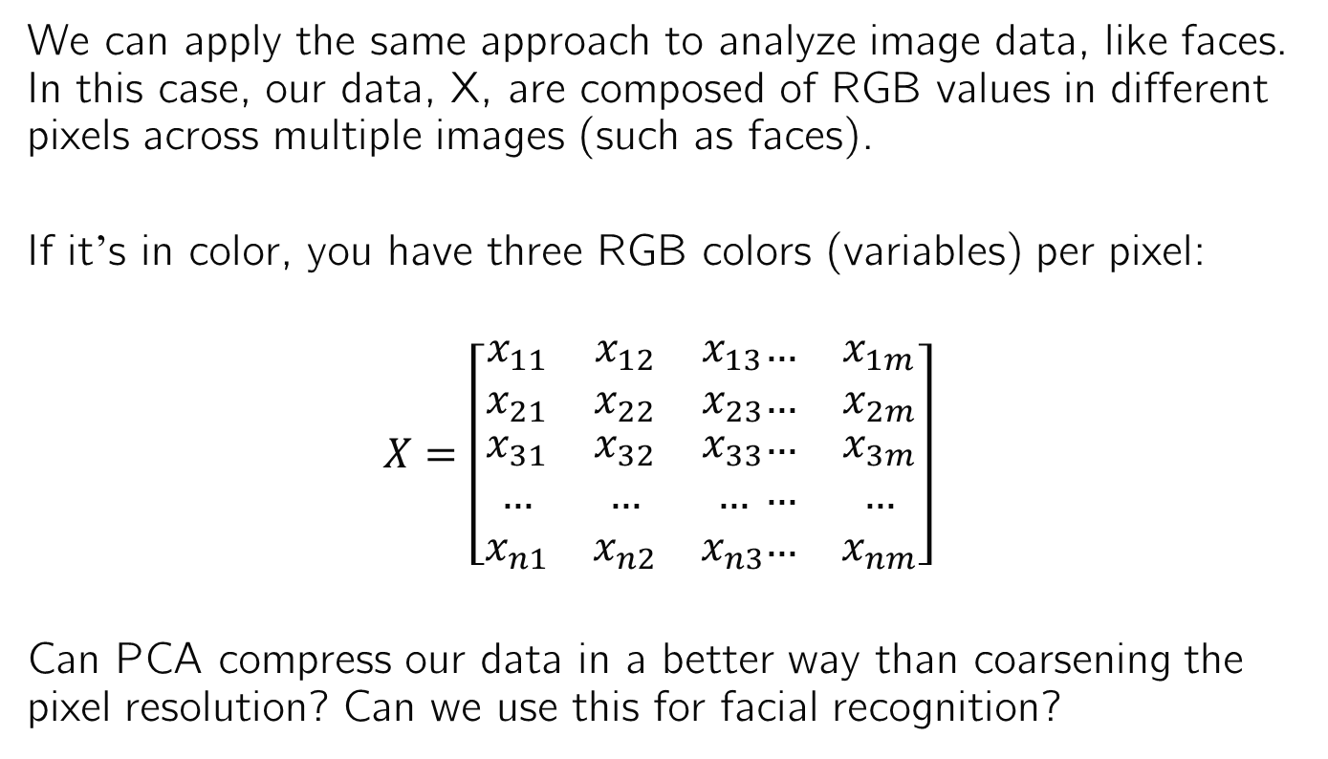
Analyzing images with PCA
We can apply the same approach to analyze image data, like faces. In this case, our data, X, are composed of RGB values in different pixels across multiple images (such as faces).
If it’s in color, you have three RGB colors (variables) per pixel:
$$X=\left[\begin{matrix}x_{11} & x_{12} & x_{13} \\ x_{21} & x_{22} & x_{23} \\ \begin{aligned}x_{31} \\ … \\ x_{n1}\end{aligned} & \begin{aligned}x_{32} \\ … \\ x_{n2}\end{aligned} & \begin{aligned}x_{33} \\ … \\ x_{n3}\end{aligned}\end{matrix}\begin{matrix}… & x_{1m} \\ … & x_{2m} \\ \begin{aligned}… \\ … \\ …\end{aligned} & \begin{aligned}x_{3m} \\ … \\ x_{nm}\end{aligned}\end{matrix}\right]$$
Can PCA compress our data in a better way than coarsening the pixel resolution? Can we use this for facial recognition?
Pixel 1R Pixel 1G Pixel 1B … Pixel (m/3)B
Image 1
Image 2
Image 3
…
Image n

Slide 21
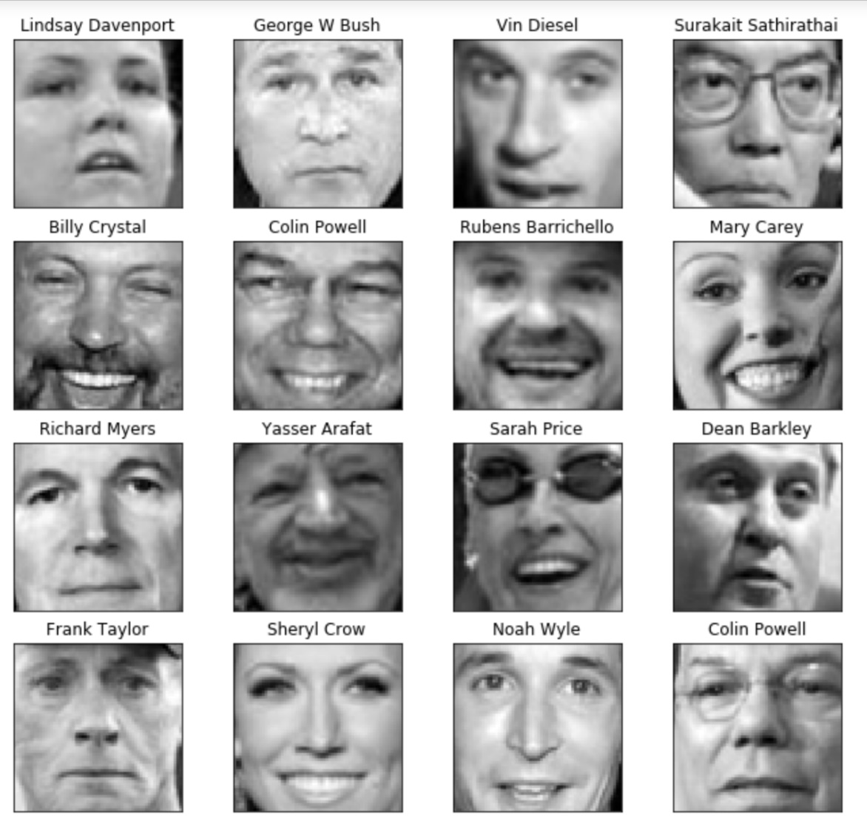
Facial image compression with PCA
Consider n=1000 faces like those at the right.
Each is composed of 64x64 pixels = 4096 variables.
Can we store approximations of these faces with < 4096 variables?

Slide 22
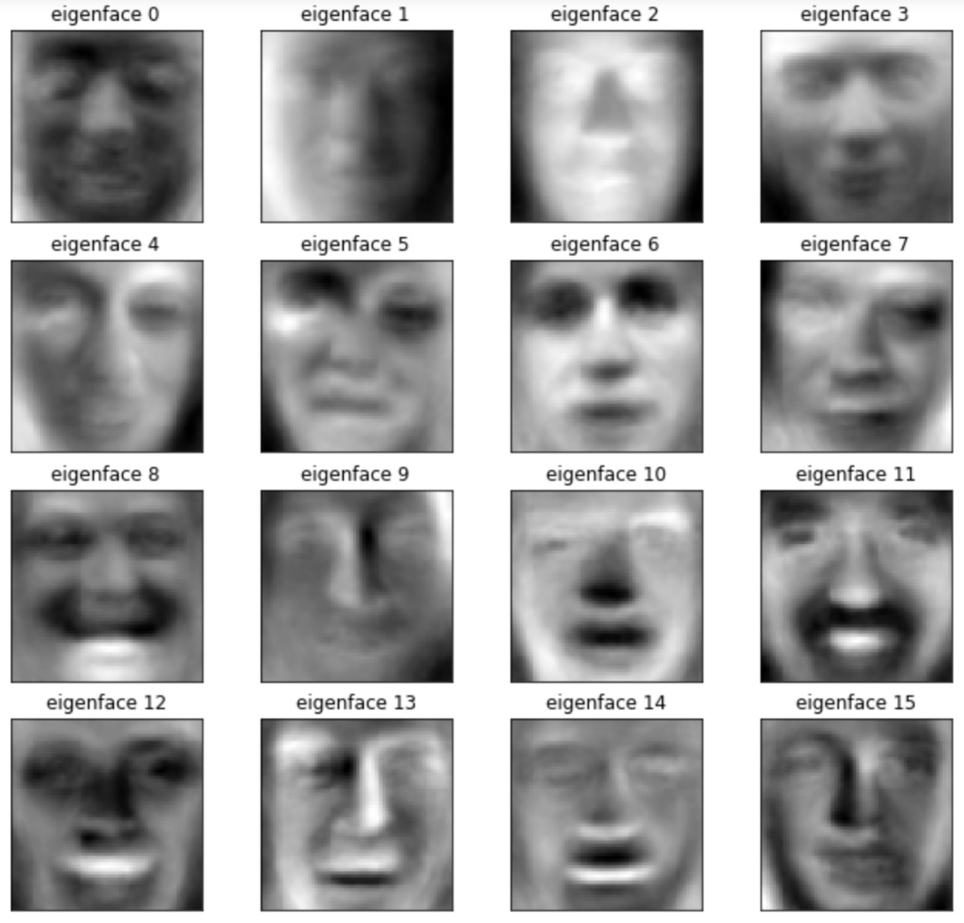
Loadings when using PCA on images
Again, for each singular value, we can plot the loadings associated with each of our pixels at that pixel location. These are called “eigenfaces.”

Slide 23
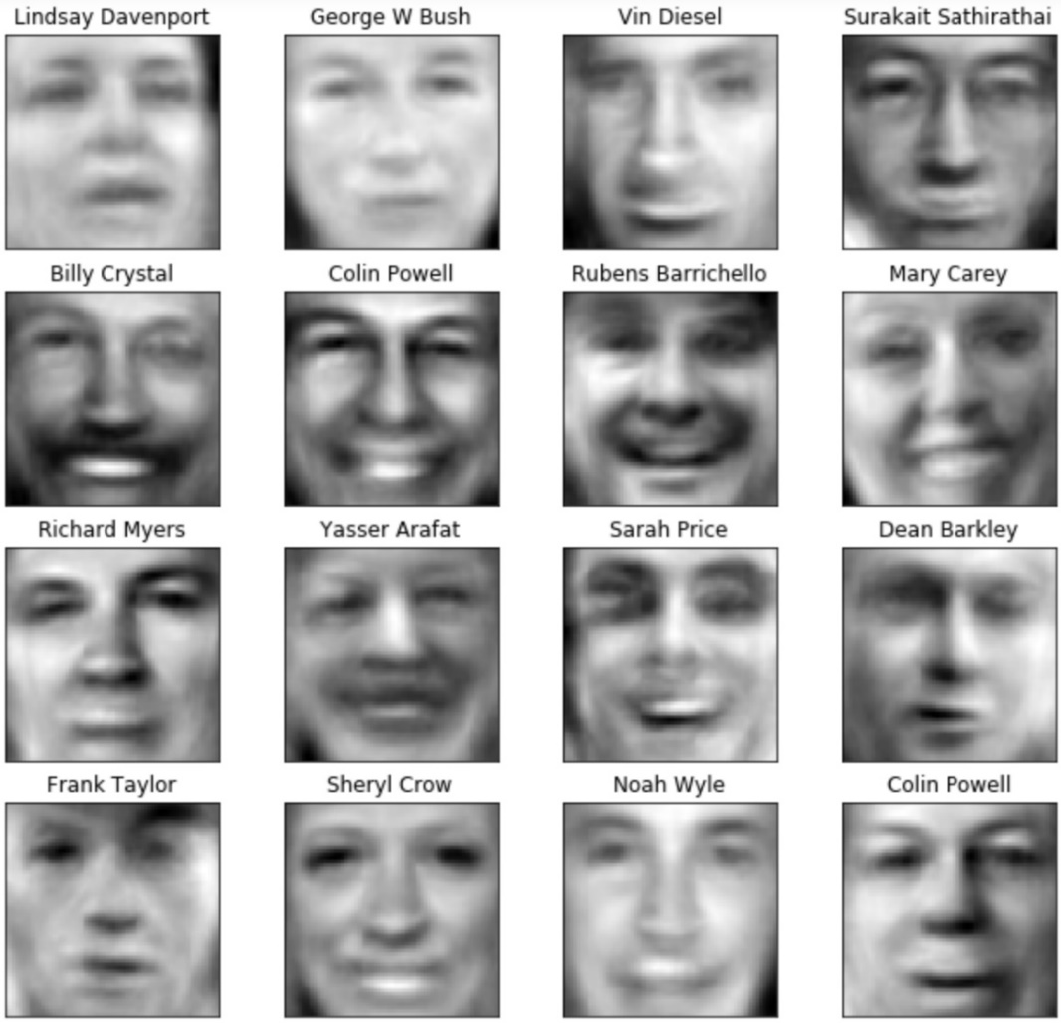
Image compression with PCA
We can reconstruct the faces with a subset K < N of the PCs and singular values. This is what it looks like for K=50:

Slide 24
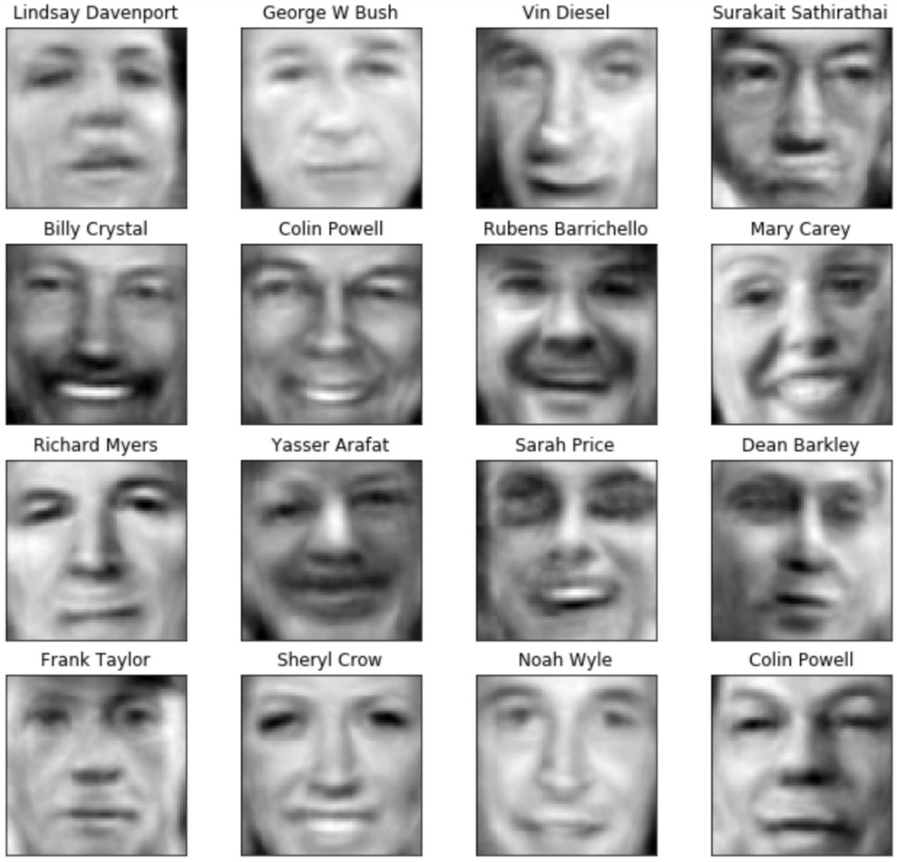
Image compression with PCA
We can reconstruct the faces with a subset K < N of the PCs and singular values. This is what it looks like for K=100:

Slide 25
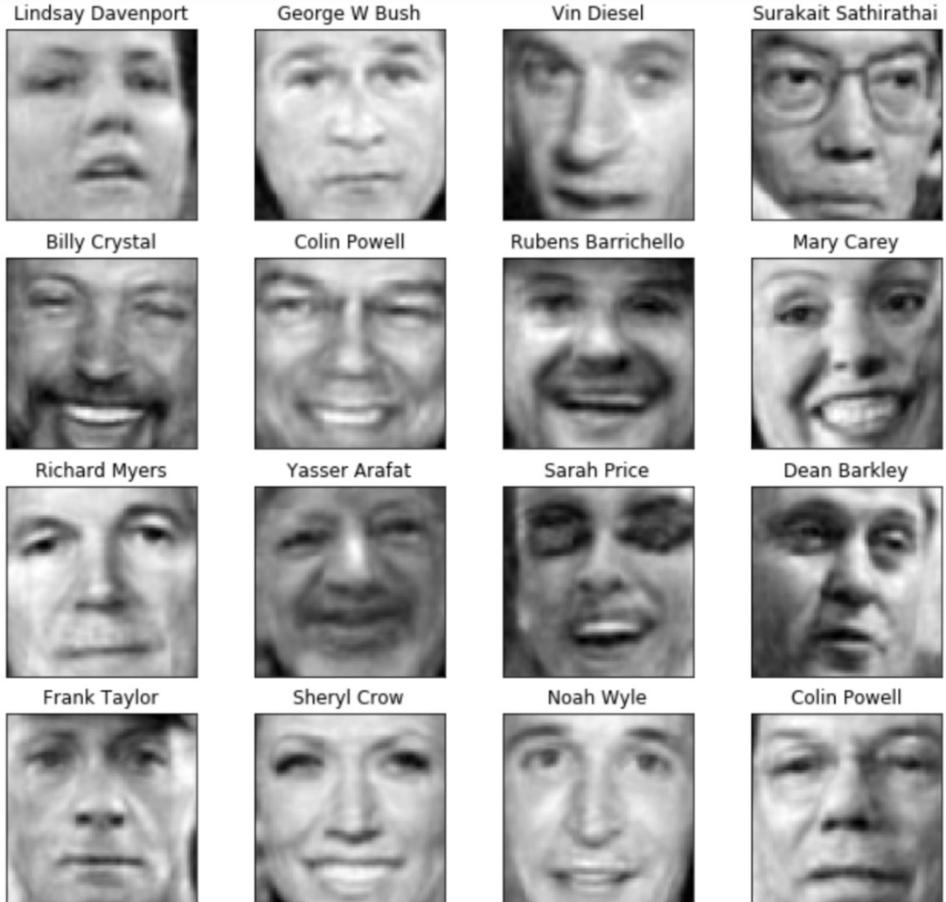
Image compression with PCA
We can reconstruct the faces with a subset K < N of the PCs and singular values. This is what it looks like for K=250:
With only 250 PCs, we can reproduce the 4096 variables quite well!

Slide 26
Facial recognition with PCA
PCA can be used as part of facial recognition algorithms as well, not just image compression.
Just as we can use the PCs as predictors in a regression, we can use them in predictors in classifying faces.
In the above example with images of different people, we would be using it to identify a face from other objects.
If we wanted to recognize one face as opposed to other faces, we would use multiple images of the same face.

Slide 27
Summary
PCA is a useful tool for visualization and data compression, especially for geographic and image data.
But we should be careful about how we perform it.
If our data variables are all different magnitudes and units, it is best to use the correlation matrix.
If our data variables are different magnitudes but of the same variable at different locations/pixels, use the covariance matrix.
If we have more variables than observations, we need to use singular value decomposition rather than eigen decomposition.

