Slide 1
Generalized Linear Models 1 (GLM)
SYS 4021/6021
Laura Barnes and Julianne Quinn

Slide 2
Organization of lecture
Review of linear regression assumptions and what we can do if they are not met.
Non-linear relationships
Non-Gaussian residuals
What if we have a categorical response variable?
Introduction to Generalized Linear Models

Slide 3
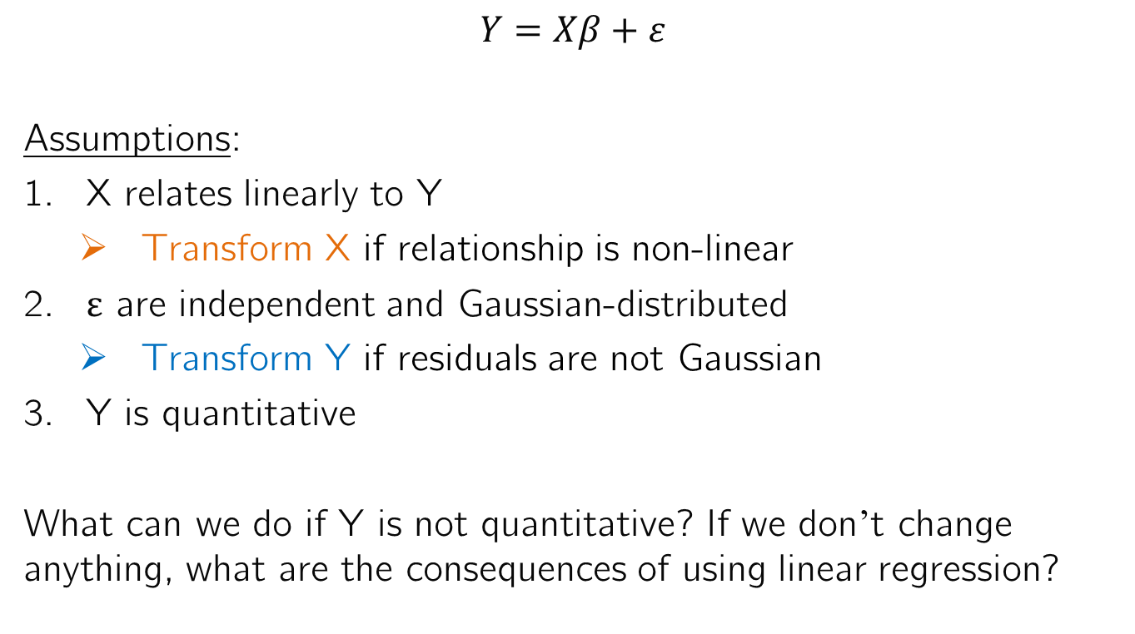
Assumptions of Multivariate Linear Regression
$$Y=Xβ+ε$$
Assumptions:
X relates linearly to Y
Transform X if relationship is non-linear
ε are independent and Gaussian-distributed
Transform Y if residuals are not Gaussian
Y is quantitative
What can we do if Y is not quantitative? If we don’t change anything, what are the consequences of using linear regression?

Slide 4
Example of Categorical Y Response
On Jan 28, 1986, the space shuttle Challenger exploded shortly after liftoff. All astronauts on board were lost, including a grade school teacher.
Before the launch, the engineers from Morton Thiokol, the makers of the solid rocket boosters on the shuttle, gave NASA managers a briefing on the association between temperature and O-ring failure.
The analysis had no visual displays and no statistical models. NASA managers were unconvinced and decided to launch. What if they had built a statistical model?

Slide 5
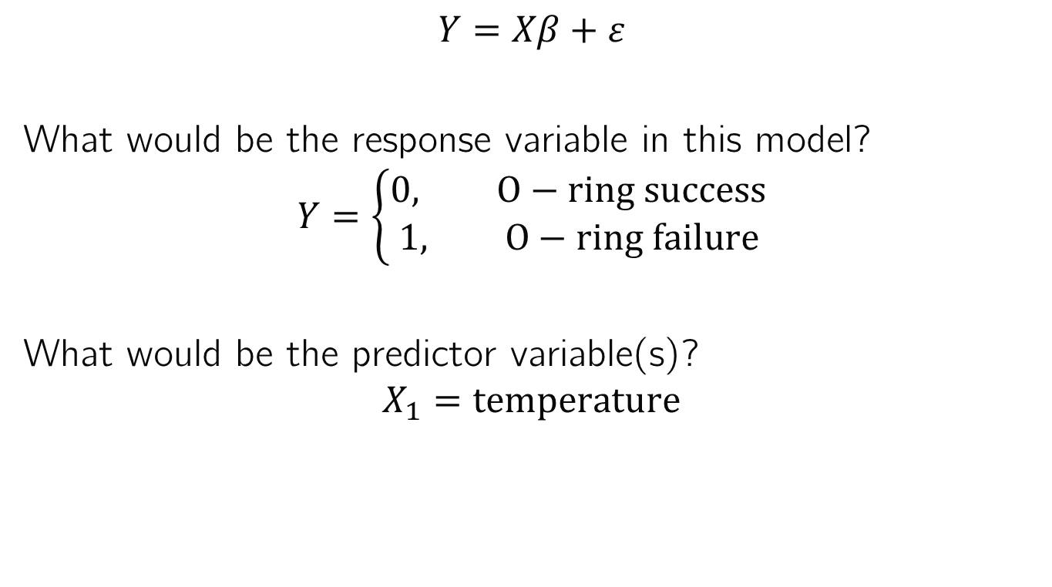
Challenger Example
$$Y=Xβ+ε$$
What would be the response variable in this model?
$$Y=\left\{\begin{aligned}0, O−ring success \\ 1, O−ring failure\end{aligned}\right.$$
What would be the predictor variable(s)?
$$X_{1}=temperature$$

Slide 6
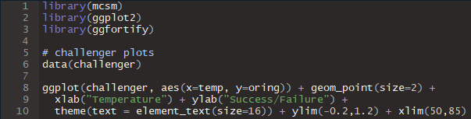
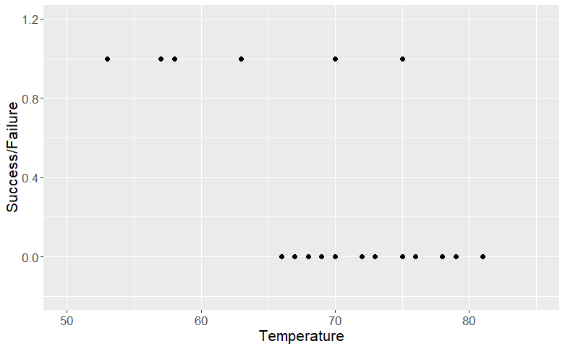
Challenger Example

Slide 7
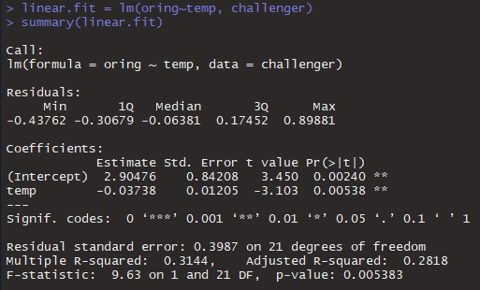
Challenger Example
Even though the response is categorical, we can still fit a model and find temperature is significant. But is it a reasonable model?

Slide 8
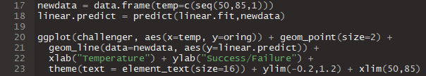
Challenger Example

Slide 9
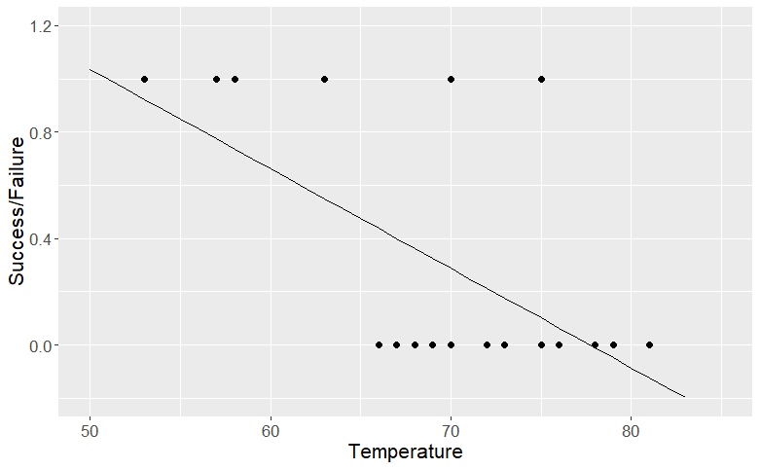
Challenger Example

Slide 10
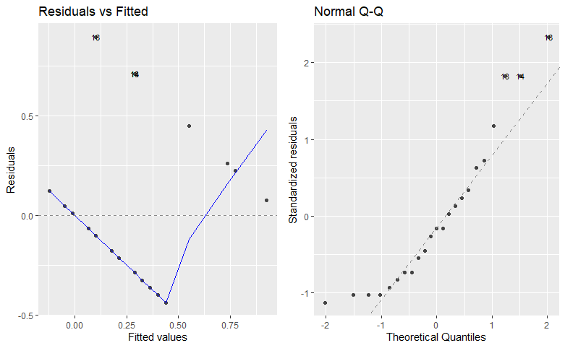
Challenger Example

Slide 11
Problems with this regression model
Predicts values of the response outside of its range, and between discrete values.

Slide 12
Problems with this regression model
Predicts values of the response outside of its range, and between discrete values.
Non-Gaussian distribution of Y results in non-Gaussian distribution of ε, and binary values of Y result in a pattern in the residuals vs. fitted plot.

Slide 13
Problems with this regression model
These problems will arise whenever we have a non-continuous response variable. For example:
Binary response (e.g. success/failure)
Categorical response (e.g. species of flowers)
Countable response (e.g. casualties)
Are there ways around this?
If Y is skewed, we can use a log or Box-Cox transformation to make it normal. Are there other transformations that can make categorical variables continuous?

Slide 14
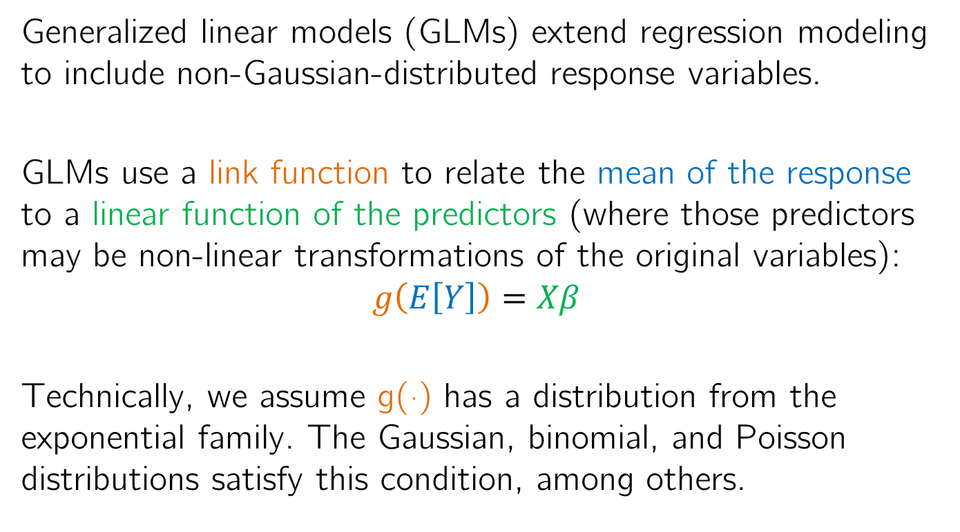
Generalized Linear Models (GLMs)
Generalized linear models (GLMs) extend regression modeling to include non-Gaussian-distributed response variables.
GLMs use a link function to relate the mean of the response to a linear function of the predictors (where those predictors may be non-linear transformations of the original variables):
$$g\left(E\left[Y\right]\right)=Xβ$$
Technically, we assume g(·) has a distribution from the exponential family. The Gaussian, binomial, and Poisson distributions satisfy this condition, among others.

Slide 15
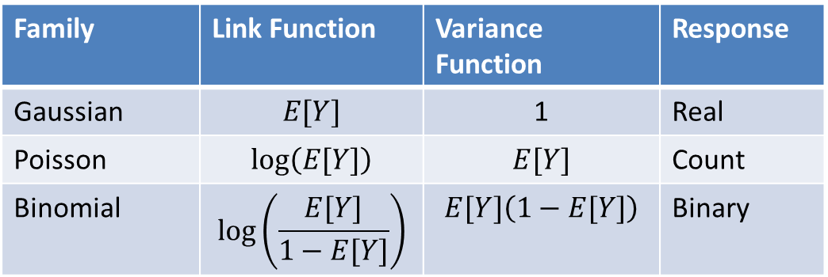

Generalized Linear Models
GLM families include:
$E[Y]=Xβ+ε$ where $Var\left(ε\right)$ is constant and independent of $E[Y]$
Family | Link Function | Variance Function | Response
Gaussian | $$E[Y]$$ | 1 | Real
Poisson | $$log⁡\left(E[Y]\right)$$ | $$E[Y]$$ | Count
Binomial | $$log⁡\left(\frac{E[Y]}{1−E[Y]}\right)$$ | $$E[Y]\left(1−E[Y]\right)$$ | Binary

Slide 16

Generalized Linear Models
GLM families include:
$log⁡\left(E[Y]\right) =Xβ$ → $E\left[Y\right]=exp\left(Xβ\right)+ε$ where $Var\left(ε\right)=E[Y]$
This is distinct from linear regression with a log transformation of Y because it assumes a different distribution of the residuals.
Family | Link Function | Variance Function | Response
Gaussian | $$E[Y]$$ | 1 | Real
Poisson | $$log⁡\left(E[Y]\right)$$ | $$E[Y]$$ | Count
Binomial | $$log⁡\left(\frac{E[Y]}{1−E[Y]}\right)$$ | $$E[Y]\left(1−E[Y]\right)$$ | Binary

Slide 17

Generalized Linear Models
GLM families include:
$\log\left(\frac{E\left[Y\right]}{1−E\left[Y\right]}\right)=$ $Xβ$ → $E\left[Y\right]=\frac{exp\left(Xβ\right)}{1+exp\left(Xβ\right)}+ε$ where $Var\left(ε\right)=E[Y]\left(1−E[Y]\right)$
What is $E[Y]$for a binary variable?
Family | Link Function | Variance Function | Response
Gaussian | $$E[Y]$$ | 1 | Real
Poisson | $$log⁡\left(E[Y]\right)$$ | $$E[Y]$$ | Count
Binomial | $$log⁡\left(\frac{E[Y]}{1−E[Y]}\right)$$ | $$E[Y]\left(1−E[Y]\right)$$ | Binary

Slide 18

Generalized Linear Models
GLM families include:
$\log\left(\frac{E\left[Y\right]}{1−E\left[Y\right]}\right)=$ $Xβ$ → $E\left[Y\right]=\frac{exp\left(Xβ\right)}{1+exp\left(Xβ\right)}+ε$ where $Var\left(ε\right)=E[Y]\left(1−E[Y]\right)$
What is $E[Y]$for a binary variable? E[Y] = P(Y=1)
Family | Link Function | Variance Function | Response
Gaussian | $$E[Y]$$ | 1 | Real
Poisson | $$log⁡\left(E[Y]\right)$$ | $$E[Y]$$ | Count
Binomial | $$log⁡\left(\frac{E[Y]}{1−E[Y]}\right)$$ | $$E[Y]\left(1−E[Y]\right)$$ | Binary

Slide 19

Generalized Linear Models
GLM families include:
$\log\left(\frac{E\left[Y\right]}{1−E\left[Y\right]}\right)=$ $Xβ$ → $E\left[Y\right]=\frac{exp\left(Xβ\right)}{1+exp\left(Xβ\right)}+ε$ where $Var\left(ε\right)=E[Y]\left(1−E[Y]\right)$
Therefore $\log\left(\frac{E\left[Y\right]}{1−E\left[Y\right]}\right)=\log\left(\frac{P(Y=1)}{1−P(Y=1)}\right)=\log\left(\frac{P(Y=1)}{P(Y=0)}\right)$.
Family | Link Function | Variance Function | Response
Gaussian | $$E[Y]$$ | 1 | Real
Poisson | $$log⁡\left(E[Y]\right)$$ | $$E[Y]$$ | Count
Binomial | $$log⁡\left(\frac{E[Y]}{1−E[Y]}\right)$$ | $$E[Y]\left(1−E[Y]\right)$$ | Binary
This is called the logit or logistic function.

Slide 20
Generalized Linear Models
GLM families include:
$\log\left(\frac{E\left[Y\right]}{1−E\left[Y\right]}\right)=$ $Xβ$ → $E\left[Y\right]=\frac{exp\left(Xβ\right)}{1+exp\left(Xβ\right)}+ε$ where $Var\left(ε\right)=E[Y]\left(1−E[Y]\right)$
Therefore $\log\left(\frac{E\left[Y\right]}{1−E\left[Y\right]}\right)=\log\left(\frac{P(Y=1)}{1−P(Y=1)}\right)=\log\left(\frac{P(Y=1)}{P(Y=0)}\right)$.
Family | Link Function | Variance Function | Response
Gaussian | $$E[Y]$$ | 1 | Real
Poisson | $$log⁡\left(E[Y]\right)$$ | $$E[Y]$$ | Count
Binomial | $$log⁡\left(\frac{E[Y]}{1−E[Y]}\right)$$ | $$E[Y]\left(1−E[Y]\right)$$ | Binary
It is the log of the odds of the event Y=1

Slide 21
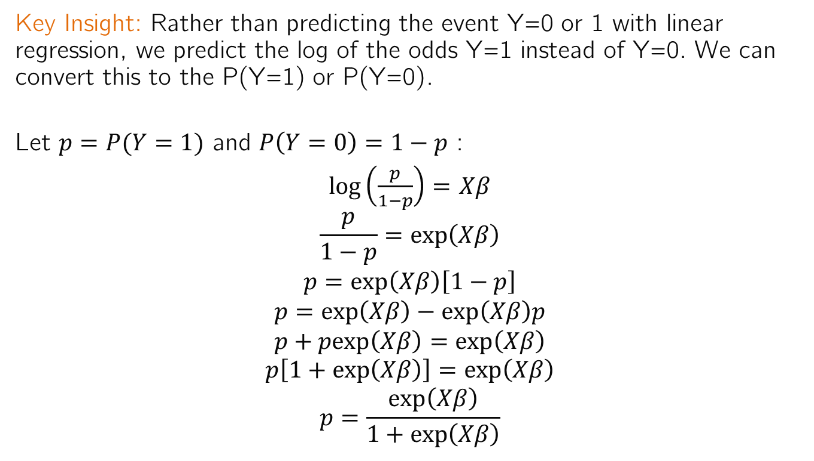
Generalized Linear Models
Key Insight: Rather than predicting the event Y=0 or 1 with linear regression, we predict the log of the odds Y=1 instead of Y=0. We can convert this to the P(Y=1) or P(Y=0).
Let $p=P(Y=1)$ and $P\left(Y=0\right)=1−p$ :
$\log\left(\frac{p}{1−p}\right)=$ $Xβ$
$$\frac{p}{1−p}=exp\left(Xβ\right)$$
$$p=exp\left(Xβ\right)\left[1−p\right]$$
$$p=exp\left(Xβ\right)−exp\left(Xβ\right)p$$
$$p+pexp\left(Xβ\right)=exp\left(Xβ\right)$$
$$p\left[1+exp\left(Xβ\right)\right]=exp\left(Xβ\right)$$
$$p=\frac{exp\left(Xβ\right)}{1+exp\left(Xβ\right)}$$
What does this function look like?

Slide 22
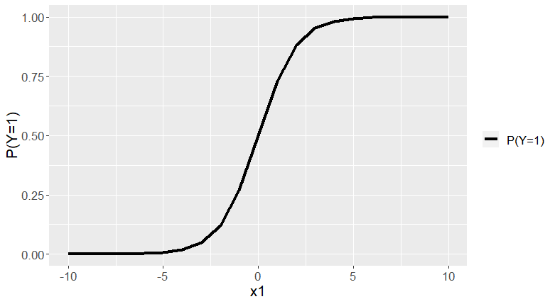
Logistic Function for P(Y=1)

Slide 23
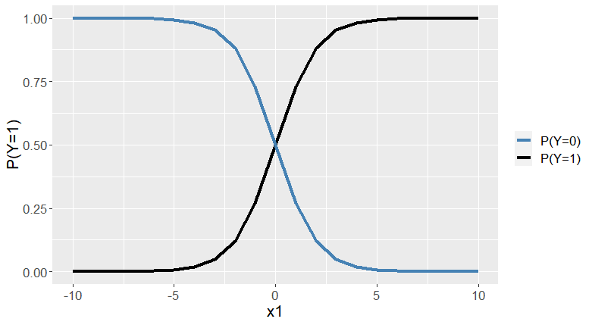
Logistic Function for P(Y=1) and P(Y=0)

Slide 24
Properties of Logistic Function
The S-shape of the logistic function has many convenient properties over a linear function:
The domain of the predictions for Y is (0,1), the same as the observations of Y.
The response function is smooth unlike a piecewise linear function.
The predicted values between 0 and 1 can be interpreted as probabilities, so we don’t need a binary classification.
But we can choose a probability threshold (such as P(Y=1)>0.5) to create a binary classification if we want.

Slide 25
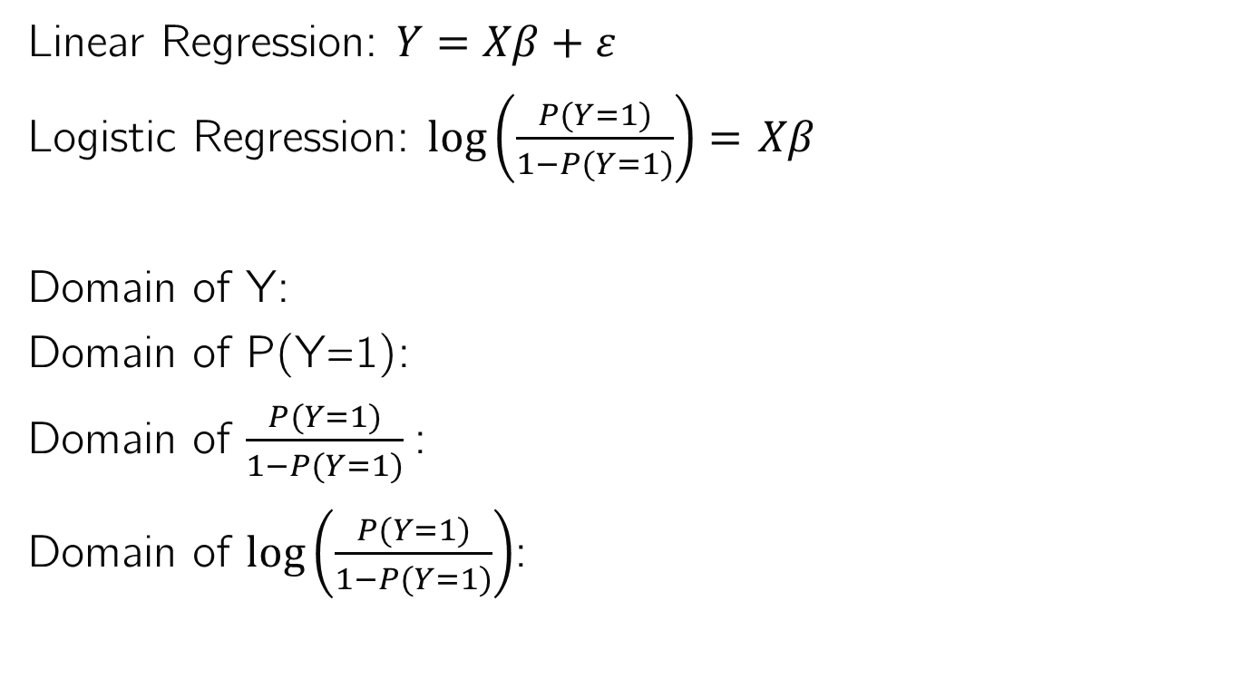
Why does this work?
Linear Regression: $Y=Xβ+ε$
Logistic Regression: $\log\left(\frac{P(Y=1)}{1−P(Y=1)}\right)=$ $Xβ$
Domain of Y:
Domain of P(Y=1):
Domain of $\frac{P(Y=1)}{1−P(Y=1)}$:
Domain of $\log\left(\frac{P(Y=1)}{1−P(Y=1)}\right)$:

Slide 26
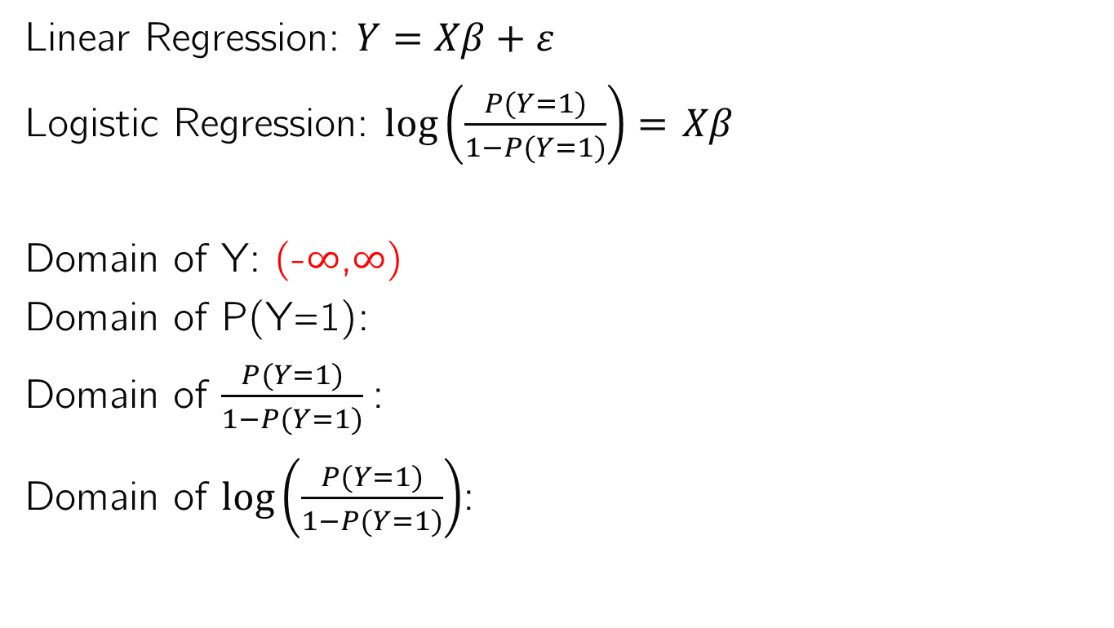
Why does this work?
Linear Regression: $Y=Xβ+ε$
Logistic Regression: $\log\left(\frac{P(Y=1)}{1−P(Y=1)}\right)=$ $Xβ$
Domain of Y: (-$∞$,$∞$)
Domain of P(Y=1):
Domain of $\frac{P(Y=1)}{1−P(Y=1)}$:
Domain of $\log\left(\frac{P(Y=1)}{1−P(Y=1)}\right)$:

Slide 27
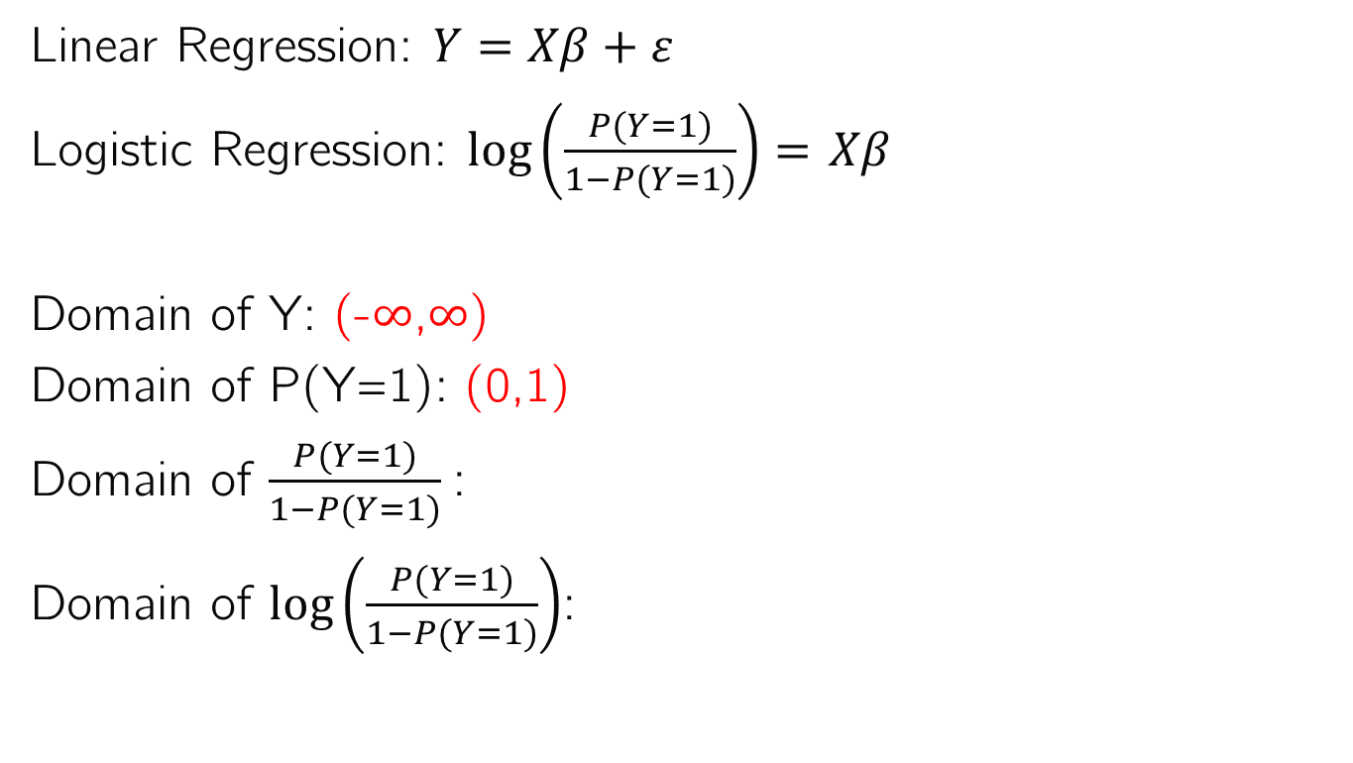
Why does this work?
Linear Regression: $Y=Xβ+ε$
Logistic Regression: $\log\left(\frac{P(Y=1)}{1−P(Y=1)}\right)=$ $Xβ$
Domain of Y: (-$∞$,$∞$)
Domain of P(Y=1): (0,1)
Domain of $\frac{P(Y=1)}{1−P(Y=1)}$:
Domain of $\log\left(\frac{P(Y=1)}{1−P(Y=1)}\right)$:

Slide 28
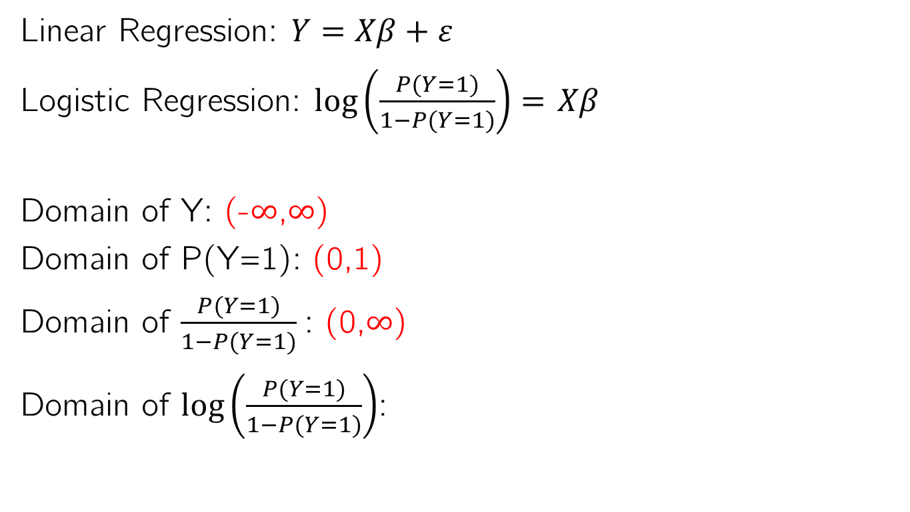
Why does this work?
Linear Regression: $Y=Xβ+ε$
Logistic Regression: $\log\left(\frac{P(Y=1)}{1−P(Y=1)}\right)=$ $Xβ$
Domain of Y: (-$∞$,$∞$)
Domain of P(Y=1): (0,1)
Domain of $\frac{P(Y=1)}{1−P(Y=1)}$: (0,$∞$)
Domain of $\log\left(\frac{P(Y=1)}{1−P(Y=1)}\right)$:

Slide 29
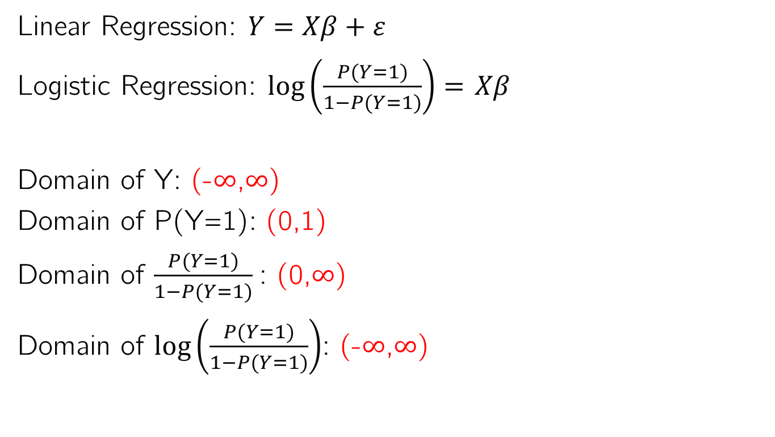
Why does this work?
Linear Regression: $Y=Xβ+ε$
Logistic Regression: $\log\left(\frac{P(Y=1)}{1−P(Y=1)}\right)=$ $Xβ$
Domain of Y: (-$∞$,$∞$)
Domain of P(Y=1): (0,1)
Domain of $\frac{P(Y=1)}{1−P(Y=1)}$: (0,$∞$)
Domain of $\log\left(\frac{P(Y=1)}{1−P(Y=1)}\right)$: (-$∞$,$∞$)

Slide 30
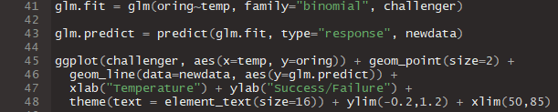
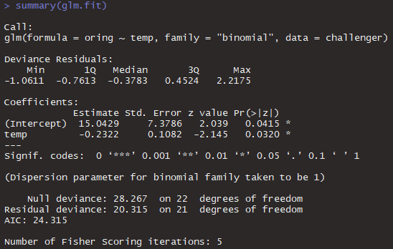
Logistic regression on the Challenger dataset

Slide 31
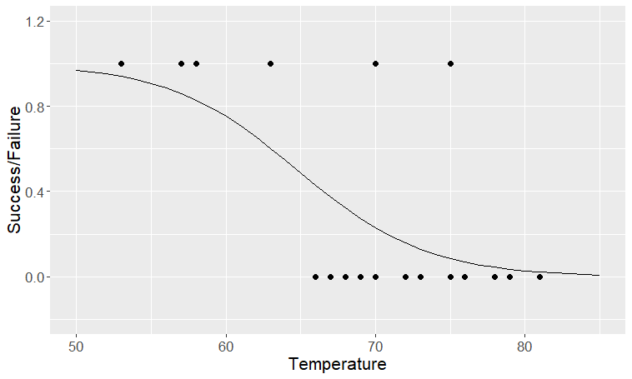
Logistic regression on the Challenger dataset

Slide 32
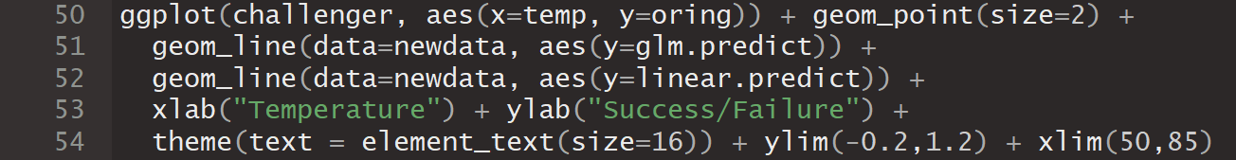
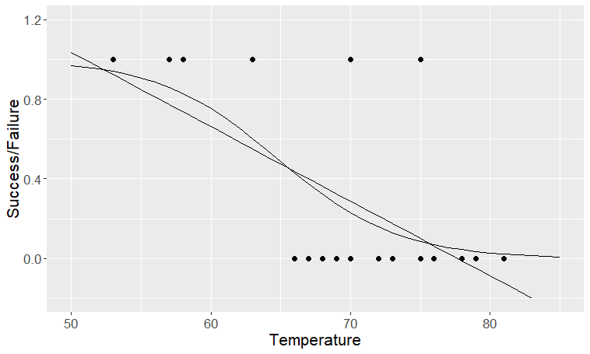
Logistic regression on the Challenger dataset

Slide 33
Summary
Linear regression is inappropriate for predicting binary or categorical response variables.
Generalized Linear Models allow us to build linear models of a function of the response, transforming a binary or categorical variable onto the real numbers.
For binary responses, a logit or logistic function of the log of the odds of the event is modeled as a linear function of the predictors. This can be re-arranged to predict the probability of the event’s occurrence.

