Slide 1
Generalized Linear Models 2 (GLM)
SYS 4021/6021
Laura Barnes and Julianne Quinn

Slide 2
Organization of lecture
Review of generalized linear models and logistic regression.
Parameter estimation for logistic regression models.
Interpreting coefficients in logistic regression models and testing their statistical significance.

Slide 3
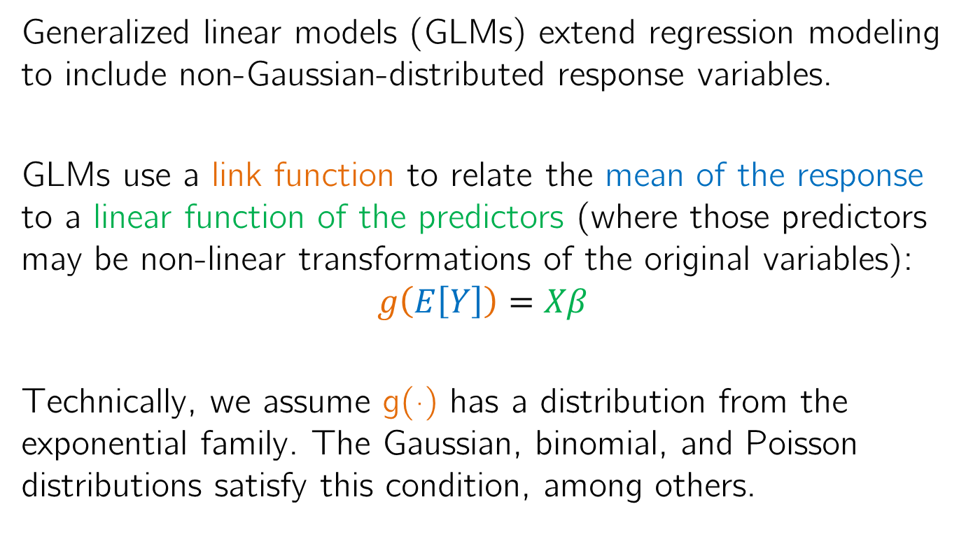
Review of Generalized Linear Models (GLMs)
Generalized linear models (GLMs) extend regression modeling to include non-Gaussian-distributed response variables.
GLMs use a link function to relate the mean of the response to a linear function of the predictors (where those predictors may be non-linear transformations of the original variables):
$$g\left(E\left[Y\right]\right)=Xβ$$
Technically, we assume g(·) has a distribution from the exponential family. The Gaussian, binomial, and Poisson distributions satisfy this condition, among others.

Slide 4
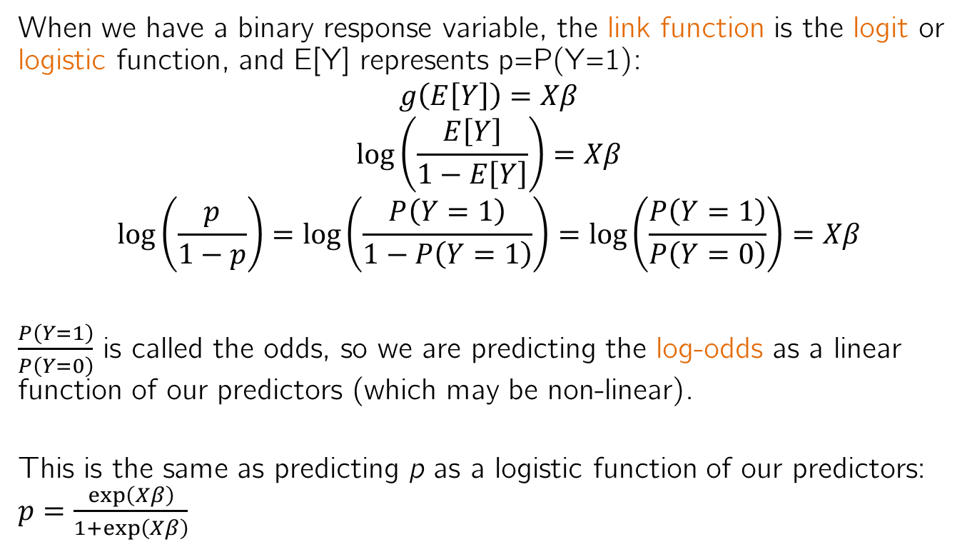
Logistic Regression
When we have a binary response variable, the link function is the logit or logistic function, and E[Y] represents p=P(Y=1):
$$g\left(E\left[Y\right]\right)=Xβ$$
$$log⁡\left(\frac{E\left[Y\right]}{1−E\left[Y\right]}\right)=Xβ$$
$$\log\left(\frac{p}{1−p}\right)=log\left(\frac{P\left(Y=1\right)}{1−P\left(Y=1\right)}\right)=\log\left(\frac{P\left(Y=1\right)}{P\left(Y=0\right)}\right)=Xβ$$
$\frac{P\left(Y=1\right)}{P\left(Y=0\right)}$ is called the odds, so we are predicting the log-odds as a linear function of our predictors (which may be non-linear).
This is the same as predicting p as a logistic function of our predictors: $p=\frac{exp\left(Xβ\right)}{1+exp\left(Xβ\right)}$

Slide 5
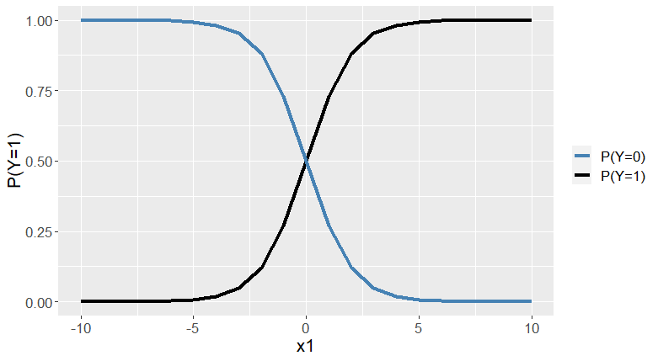
Logistic Function for P(Y=1) and P(Y=0)

Slide 6
Parameter estimation
How do we estimate the parameters β for logistic regression?
How do we estimate them for linear regression?
Find the values which minimize the sum of squared errors
What are our errors in logistic regression?
We’re predicting a probability of occurrence, but we don’t observe the probability, we only observe a binary 0/1 response.
If we don’t know the true probability, we can’t compute a residual, and therefore can’t minimize the sum of squared errors.

Slide 7
Parameter estimation
In logistic regression we need to use a different objective function for parameter estimation.
Rather than finding the parameters that minimize the sum of squared errors, we find the parameters under which we would be most likely to observe the binary responses we did.
This is called maximum likelihood estimation (MLE).

Slide 8
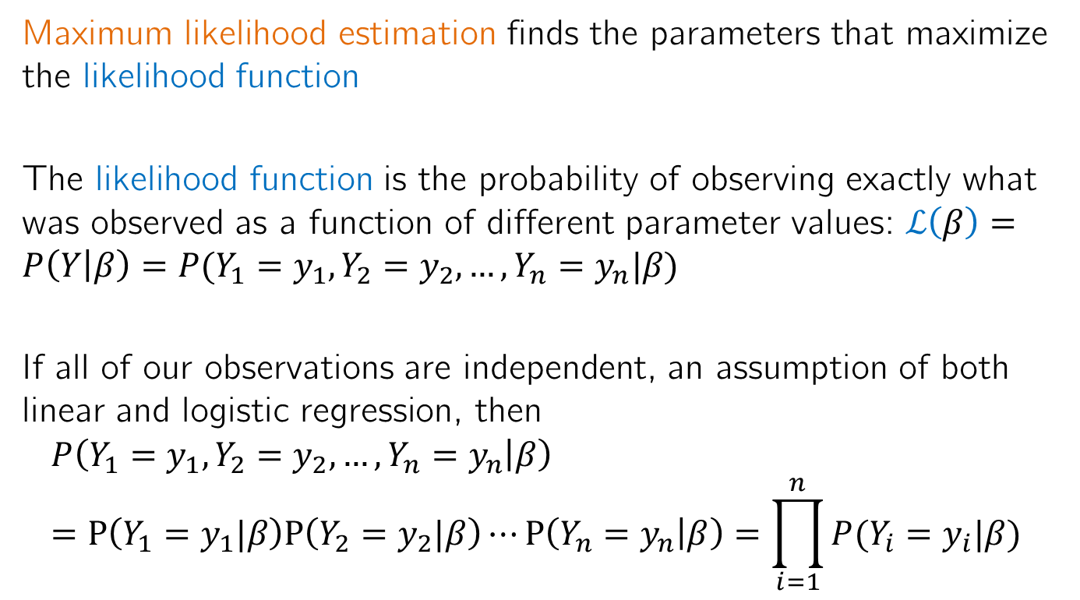
Maximum likelihood estimation (MLE)
Maximum likelihood estimation finds the parameters that maximize the likelihood function
The likelihood function is the probability of observing exactly what was observed as a function of different parameter values: $ℒ\left(β\right)=P\left(Y | β\right)=P(Y_{1}=y_{1},Y_{2}=y_{2},…,Y_{n}=y_{n}|β)$
If all of our observations are independent, an assumption of both linear and logistic regression, then
$$P\left(Y_{1}=y_{1},Y_{2}=y_{2},…,Y_{n}=y_{n} | β\right)=P\left(Y_{1}=y_{1}|β\right)P\left(Y_{2}=y_{2}|β\right)⋯P\left(Y_{n}=y_{n} | β\right)=\prod_{i=1}^{n}{P(Y_{i}=y_{i}|β)}$$

Slide 9
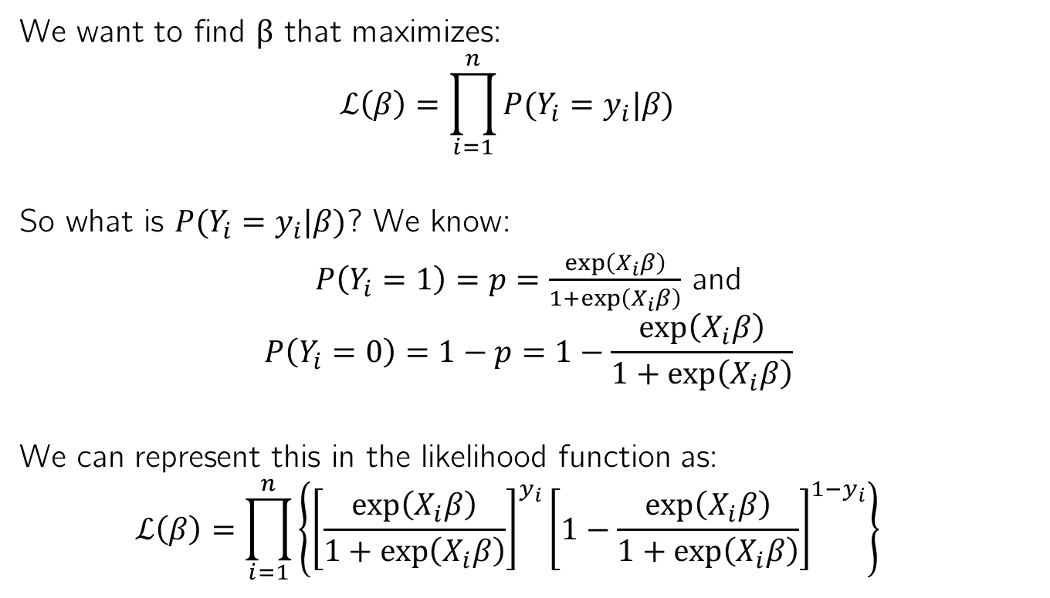
Maximum likelihood estimation
We want to find β that maximizes:
$$ℒ\left(β\right)=\prod_{i=1}^{n}{P(Y_{i}=y_{i}|β)}$$
So what is $P(Y_{i}=y_{i}|β)$? We know:
$P\left(Y_{i}=1\right)=p=\frac{exp\left(X_{i}β\right)}{1+exp\left(X_{i}β\right)}$ and
$$P\left(Y_{i}=0\right)=1−p=1−\frac{exp\left(X_{i}β\right)}{1+exp\left(X_{i}β\right)}$$
We can represent this in the likelihood function as:
$$ℒ\left(β\right)=\prod_{i=1}^{n}{\left\{{\left[\frac{exp\left(X_{i}β\right)}{1+exp\left(X_{i}β\right)}\right]}^{y_{i}}{\left[1−\frac{exp\left(X_{i}β\right)}{1+exp\left(X_{i}β\right)}\right]}^{{1−y}_{i}}\right\}}$$

Slide 10
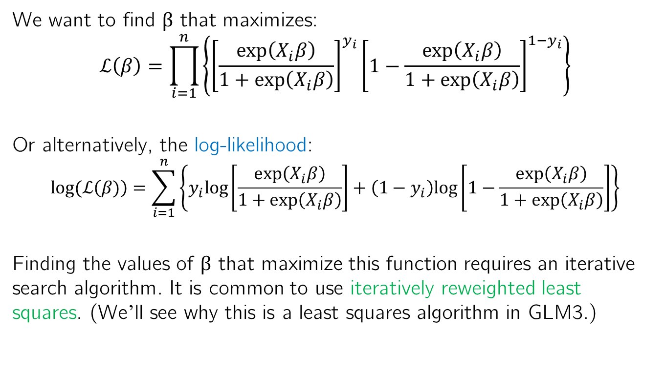
Maximum likelihood estimation
We want to find β that maximizes:
$$ℒ\left(β\right)=\prod_{i=1}^{n}{\left\{{\left[\frac{exp\left(X_{i}β\right)}{1+exp\left(X_{i}β\right)}\right]}^{y_{i}}{\left[1−\frac{exp\left(X_{i}β\right)}{1+exp\left(X_{i}β\right)}\right]}^{{1−y}_{i}}\right\}}$$
Or alternatively, the log-likelihood:
$$log⁡(ℒ\left(β)\right)=\sum_{i=1}^{n}{\left\{y_{i}log⁡\left[\frac{exp\left(X_{i}β\right)}{1+exp\left(X_{i}β\right)}\right]+\left(1−y_{i}\right)log⁡\left[1−\frac{exp\left(X_{i}β\right)}{1+exp\left(X_{i}β\right)}\right]\right\}}$$
Finding the values of β that maximize this function requires an iterative search algorithm. It is common to use iteratively reweighted least squares. (We’ll see why this is a least squares algorithm in GLM3.)

Slide 11
Example logistic regression problem
Companies compete for road projects in Florida. They submit a proposal with a project cost and the state department of transportation awards contracts based on these proposals.
Sometimes the companies cheat by colluding on the bids.
Can we build a system to help Florida detect collusion?
For each project, they know the number of bidders and the difference between the proposed cost and the DOT’s estimate of the costs provided by one of their engineers.

Slide 12
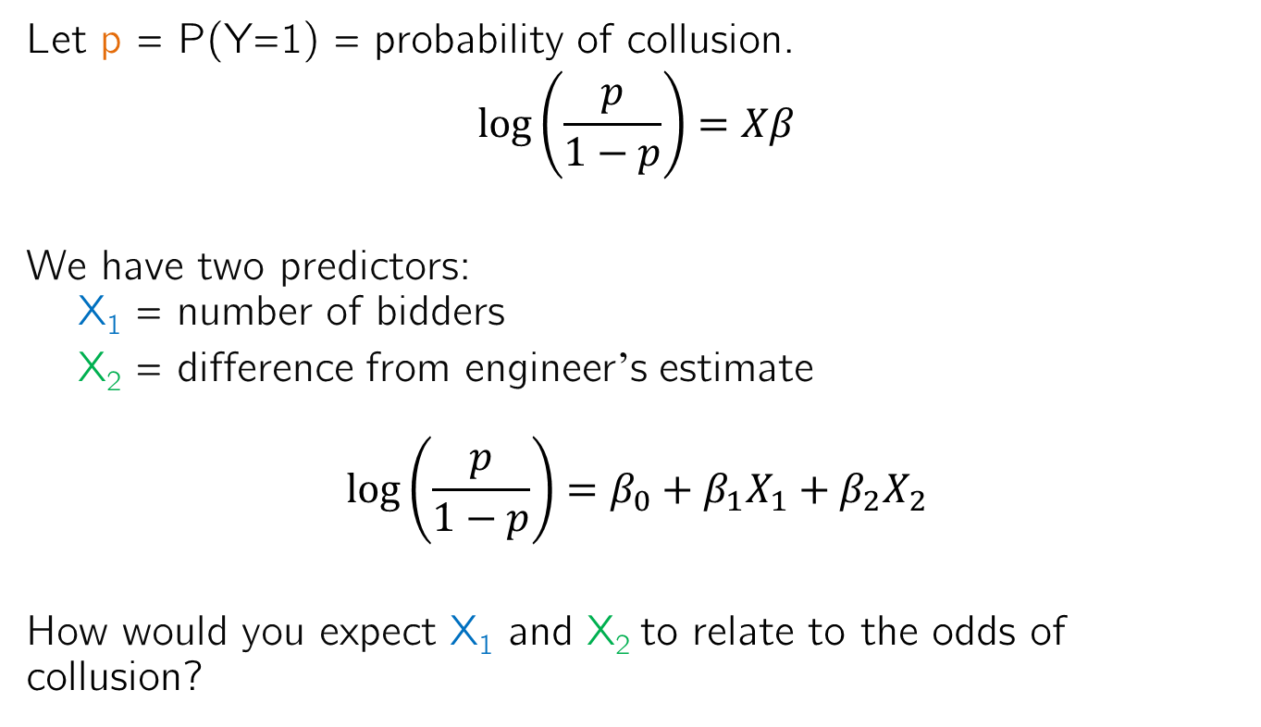
Road bid collusion problem
Let p = P(Y=1) = probability of collusion.
$$log⁡\left(\frac{p}{1−p}\right)=Xβ$$
We have two predictors: X₁ = number of bidders
X₂ = difference from engineer’s estimate
$$\log\left(\frac{p}{1−p}\right)=β_{0}+β_{1}X_{1}+β_{2}X_{2}$$
How would you expect X₁ and X₂ to relate to the odds of collusion?

Slide 13
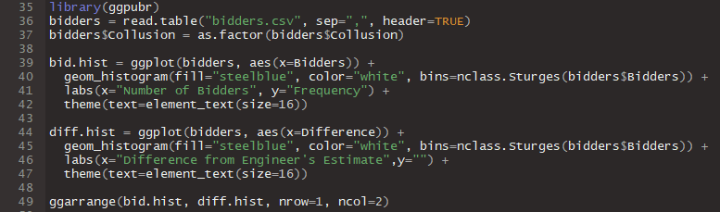
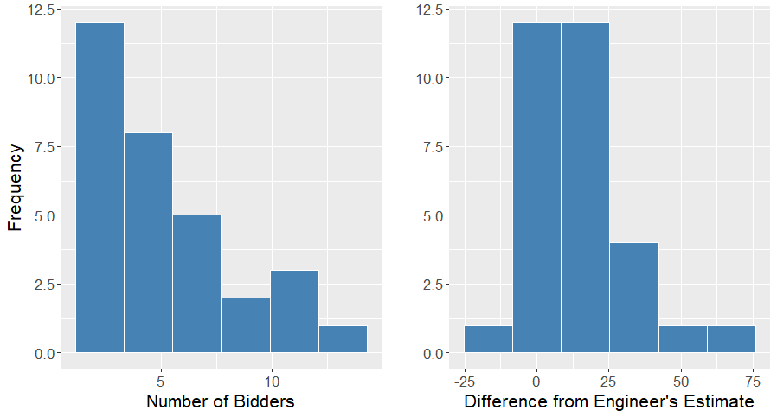
Road bid collusion problem

Slide 14
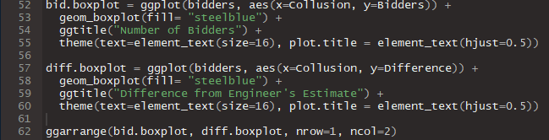
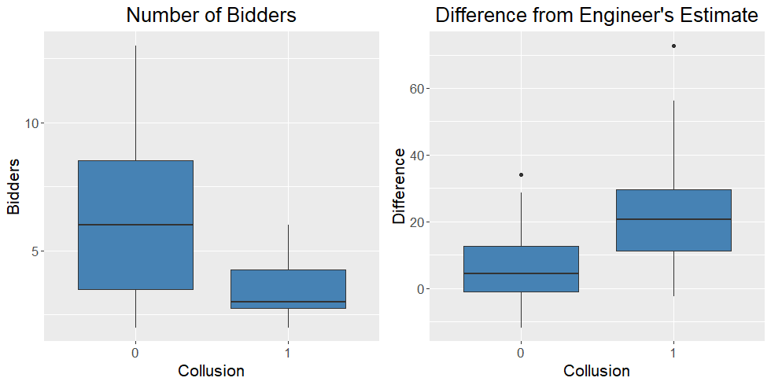
Road bid collusion problem

Slide 15

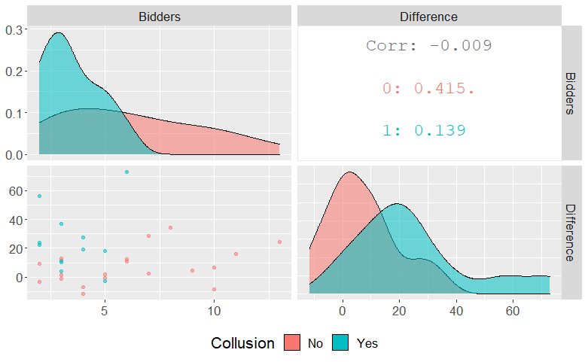
Road bid collusion problem

Slide 16
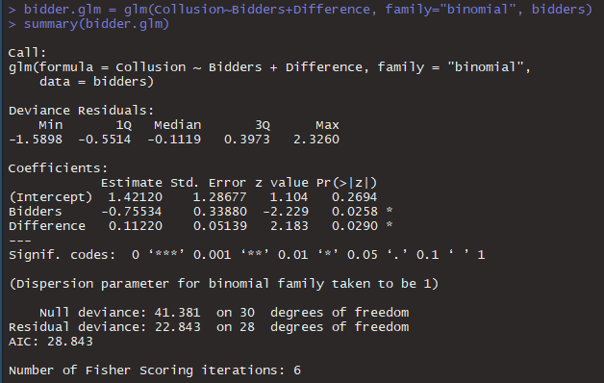
Fitting the GLM

Slide 17
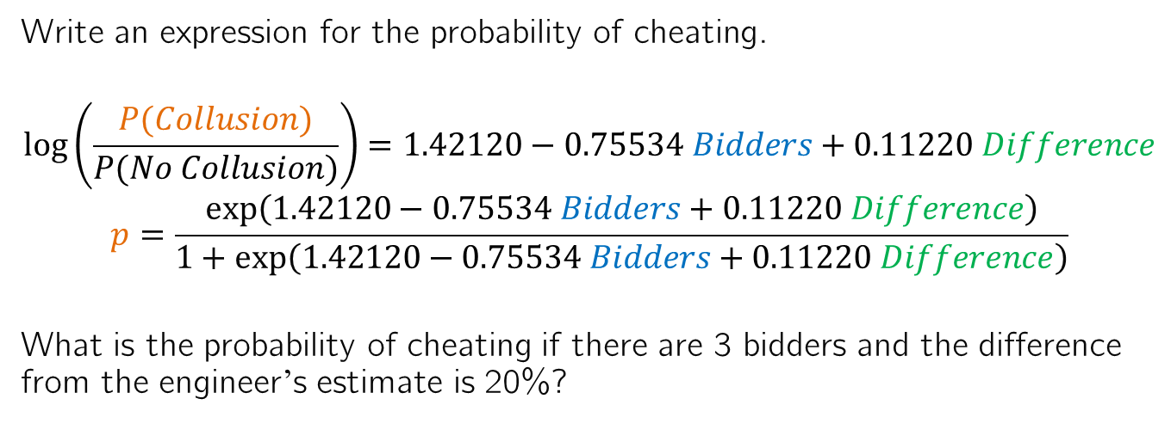
Interpreting the logistic regression model
Write an expression for the probability of cheating.
$$\log\left(\frac{P(Collusion)}{P(No Collusion)}\right)=1.42120−0.75534 Bidders+0.11220 Difference$$
$$p=\frac{exp\left(1.42120−0.75534 Bidders+0.11220 Difference\right)}{1+exp\left(1.42120−0.75534 Bidders+0.11220 Difference\right)}$$
What is the probability of cheating if there are 3 bidders and the difference from the engineer’s estimate is 20%?

Slide 18
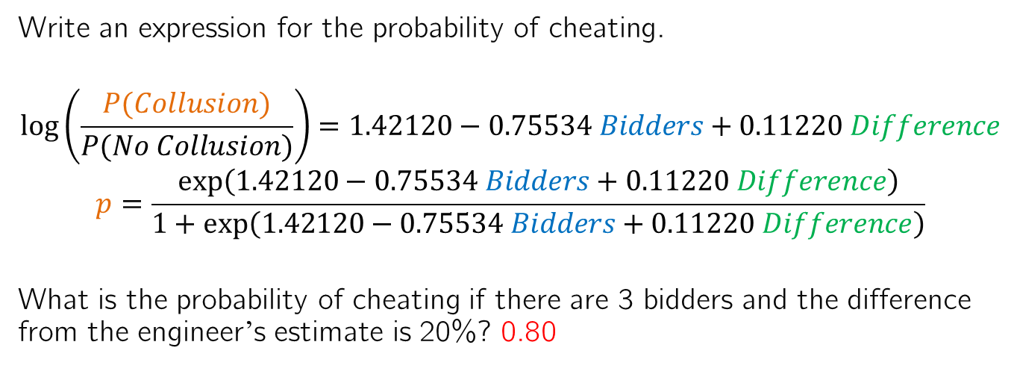
Interpreting the logistic regression model
Write an expression for the probability of cheating.
$$\log\left(\frac{P(Collusion)}{P(No Collusion)}\right)=1.42120−0.75534 Bidders+0.11220 Difference$$
$$p=\frac{exp\left(1.42120−0.75534 Bidders+0.11220 Difference\right)}{1+exp\left(1.42120−0.75534 Bidders+0.11220 Difference\right)}$$
What is the probability of cheating if there are 3 bidders and the difference from the engineer’s estimate is 20%? 0.80

Slide 19
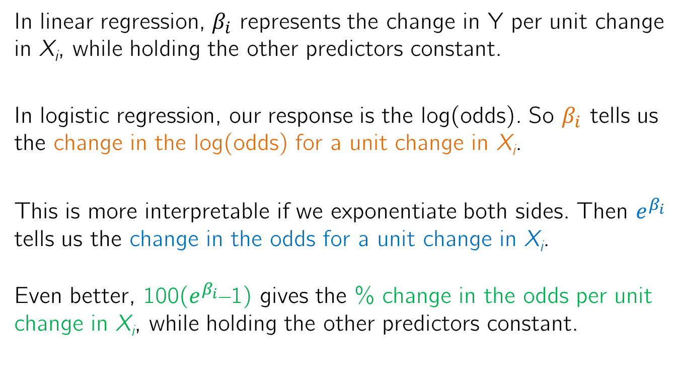
Interpreting the logistic regression model
In linear regression, $β_{i}$ represents the change in Y per unit change in X_{i}, while holding the other predictors constant.
In logistic regression, our response is the log(odds). So $β_{i}$ tells us the change in the log(odds) for a unit change in X_{i}.
This is more interpretable if we exponentiate both sides. Then $e^{β_{i}}$ tells us the change in the odds for a unit change in X_{i}.
Even better, 100($e^{β_{i}}$‒1) gives the % change in the odds per unit change in X_{i}, while holding the other predictors constant.

Slide 20
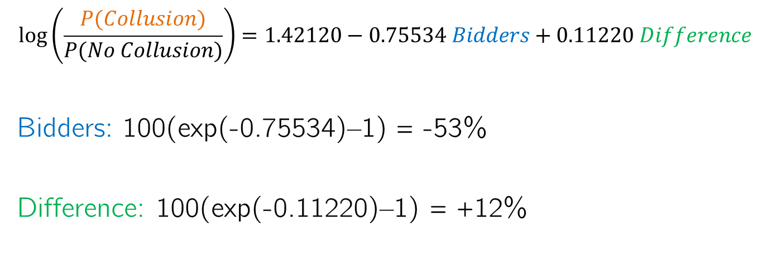
Interpreting logistic regression coefficients
$$\log\left(\frac{P(Collusion)}{P(No Collusion)}\right)=1.42120−0.75534 Bidders+0.11220 Difference$$
Bidders: 100(exp(-0.75534)‒1) = -53%
Difference: 100(exp(-0.11220)‒1) = +12%

Slide 21
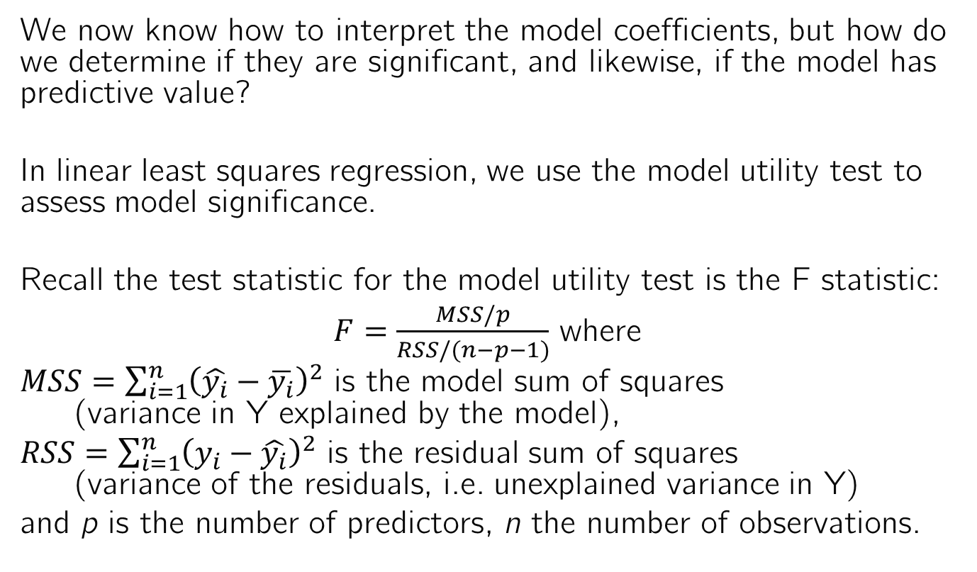
Model and Coefficient Significance
We now know how to interpret the model coefficients, but how do we determine if they are significant, and likewise, if the model has predictive value?
In linear least squares regression, we use the model utility test to assess model significance.
Recall the test statistic for the model utility test is the F statistic:
$F=\frac{MSS/p}{RSS/(n−p−1)}$ where
$MSS=\sum_{i=1}^{n}{{\left(\hat{y_{i}}−\overline{y_{i}}\right)}^{2}}$ is the model sum of squares (variance in Y explained by the model),
$RSS=\sum_{i=1}^{n}{{\left(y_{i}−\hat{y_{i}}\right)}^{2}}$ is the residual sum of squares (variance of the residuals, i.e. unexplained variance in Y)
and p is the number of predictors, n the number of observations.

Slide 22
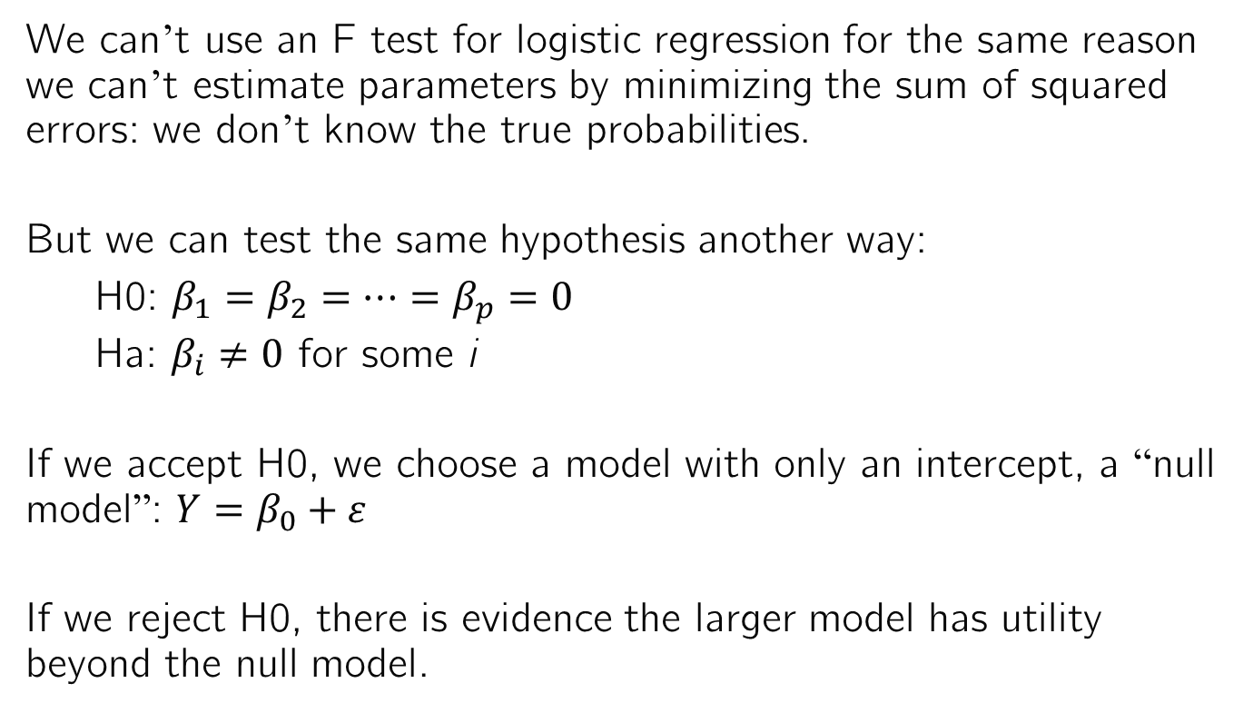
Model utility test for logistic regression
We can’t use an F test for logistic regression for the same reason we can’t estimate parameters by minimizing the sum of squared errors: we don’t know the true probabilities.
But we can test the same hypothesis another way:
H0: $β_{1}=β_{2}=…=β_{p}=0$
Ha: $β_{i}≠0$ for some i
If we accept H0, we choose a model with only an intercept, a “null model”: ${Y=β}_{0}+ε$
If we reject H0, there is evidence the larger model has utility beyond the null model.

Slide 23
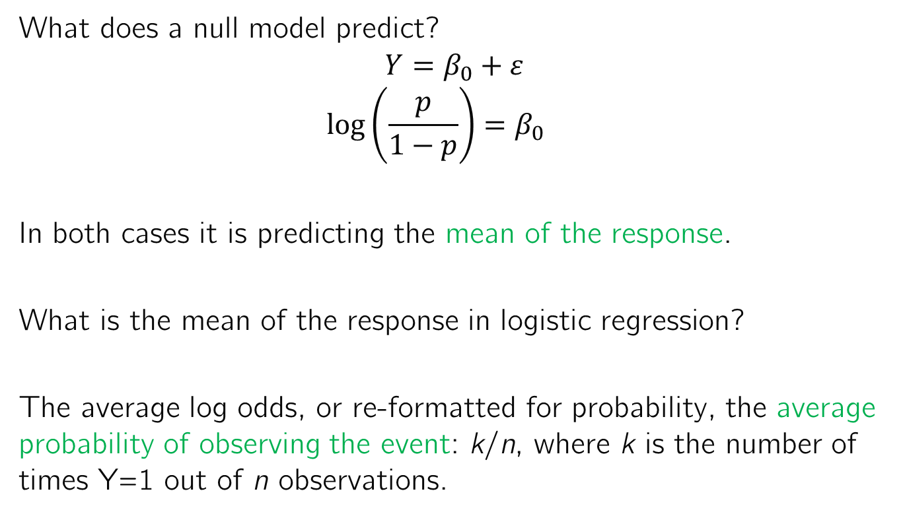
Model utility for logistic regression
What does a null model predict?
$$Y=β_{0}+ε$$
$$log⁡\left(\frac{p}{1−p}\right)=β_{0}$$
In both cases it is predicting the mean of the response.
What is the mean of the response in logistic regression?
The average log odds, or re-formatted for probability, the average probability of observing the event: k/n, where k is the number of times Y=1 out of n observations.

Slide 24
Model utility for logistic regression
Both parameter estimation and model utility are based on sum of squared errors for linear regression.
Parameter estimation for logistic regression is based on the likelihood function. Guess what? So is model utility.
In logistic regression we compare the likelihood of the null model to the likelihood of the larger model to see if we can reject H0 in favor of the more complex model.
The test statistic is not an F statistic, but the deviance.

Slide 25
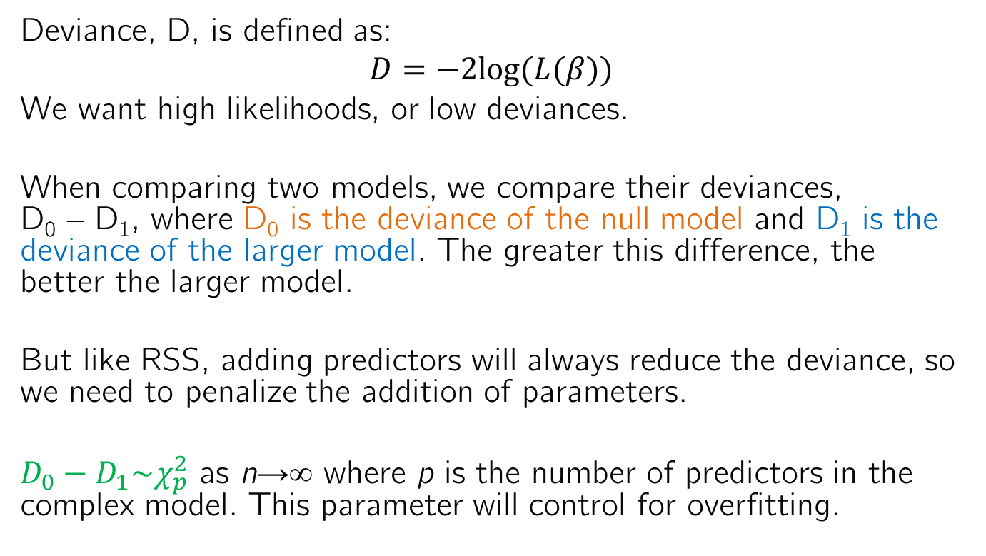
Deviance test statistic
Deviance, D, is defined as:
$$D=−2log⁡(L(β))$$
We want high likelihoods, or low deviances.
When comparing two models, we compare their deviances, D₀ – D₁, where D₀ is the deviance of the null model and D₁ is the deviance of the larger model. The greater this difference, the better the larger model.
But like RSS, adding predictors will always reduce the deviance, so we need to penalize the addition of parameters.
$D_{0}−D_{1}\sim χ_{p}^{2}$ as n→∞ where p is the number of predictors in the complex model. This parameter will control for overfitting.

Slide 26
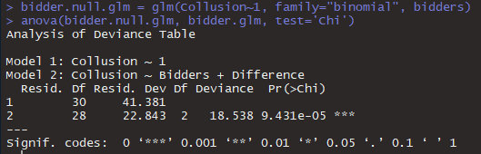
Deviance test for model utility
To implement the deviance test (aka likelihood test) for model utility in R, we need to build a null model.
We can then compare the null and complex models using the anova function with the argument test=“Chi” to indicate our test-statistic has a Chi-Squared distribution, not an F distribution like in a partial F test.

Slide 27
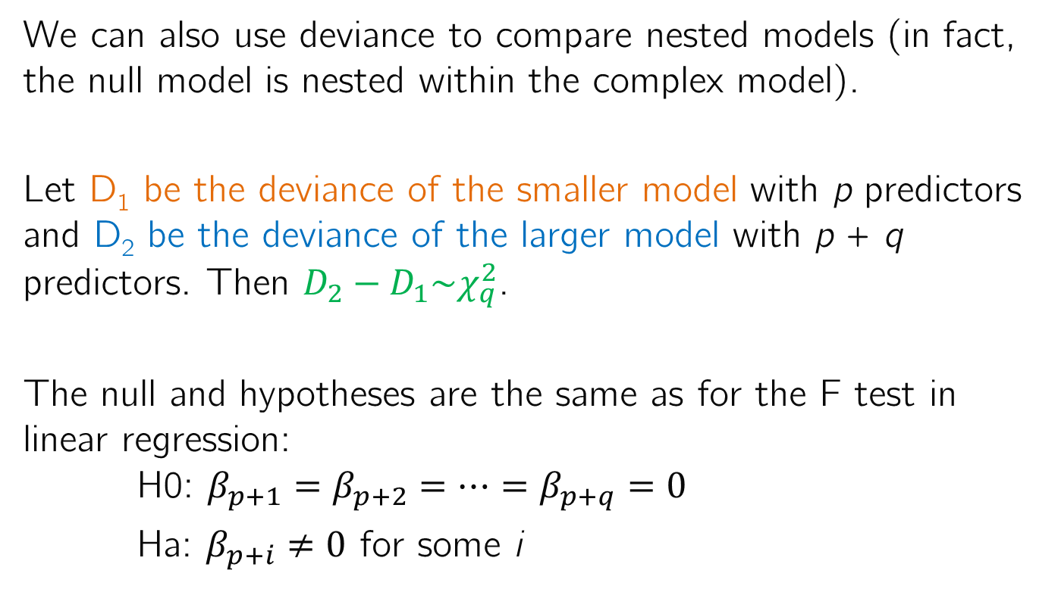
Deviance to compare nested models
We can also use deviance to compare nested models (in fact, the null model is nested within the complex model).
Let D₁ be the deviance of the smaller model with p predictors and D₂ be the deviance of the larger model with p + q predictors. Then $D_{2}−D_{1}\sim χ_{q}^{2}$.
The null and hypotheses are the same as for the F test in linear regression: H0: $β_{p+1}=β_{p+2}=…=β_{p+q}=0$
Ha: $β_{p+i}≠0$ for some i

Slide 28
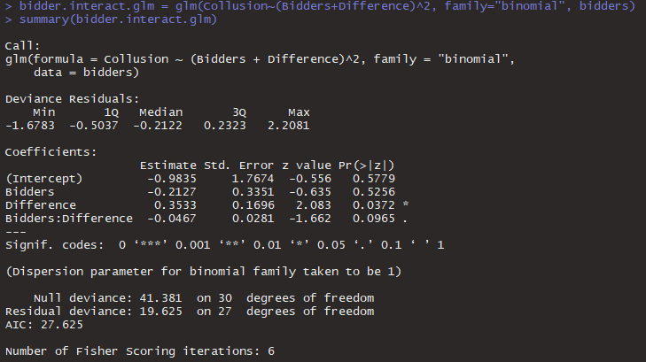
Comparing a main effects and interaction model

Slide 29
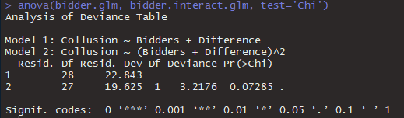
Comparing a main effects and interaction model
In this case, we reject H0 at the 10% level, but not at the 5% level.

Slide 30
Deviance test for coefficient significance
Since we can use the deviance test to compare nested models, we can therefore use it to test the significance of particular coefficients by adding or dropping a single predictor from one model to the next and comparing their deviances.
If the model with one additional predictor has a statistically lower deviance, that predictor is significant.
This approach is called a partial deviance, or partial likelihood test.

Slide 31
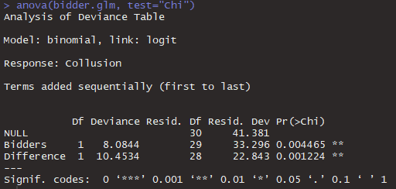
Parameter significance
If we call the anova function with the argument test=“Chi” but only pass one model, it will tell us the significance of each predictor’s coefficient. This test is adding them one at a time to the null model.

Slide 32
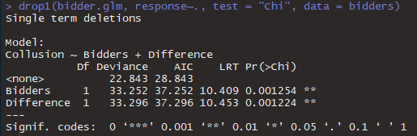
Parameter significance
If we use the drop1 function with the argument test=“Chi”, it will tell us the significance of each coefficient based on the deviance of the full model compared to the model with all but that predictor.
The numbers aren’t the same for Bidders, but that’s because the prior case is giving us its significance in the model with only Bidders as a predictor. This is their significance in the full model.

Slide 33
Summary
Logistic regression allows us to predict the probability of a binary response using a logistic function of the predictors.
Parameter estimation for logistic regression models must be performed using maximum likelihood estimation, since the true probability is unknown to compute a residual.
The likelihood, or deviance, can also be used to test model utility against a null model. Partial likelihood can be used to assess parameter significance.

