Slide 1
Generalized Linear Models 3 (GLM)
SYS 4021/6021
Laura Barnes and Julianne Quinn

Slide 2
Organization of lecture
Model evaluation for generalized linear models
Diagnostics
Variable selection
Decision functions to map probabilities to classifications
Types of classification error
Receiver Operator Characteristic (ROC) curves of classification errors for different decision functions
Principal Components Regression (PCR).

Slide 3
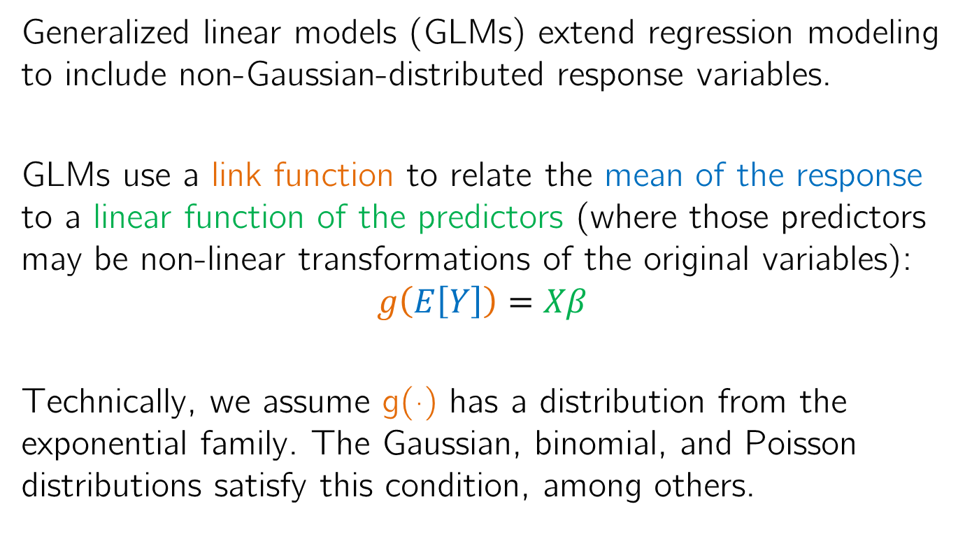
Review of Generalized Linear Models (GLMs)
Generalized linear models (GLMs) extend regression modeling to include non-Gaussian-distributed response variables.
GLMs use a link function to relate the mean of the response to a linear function of the predictors (where those predictors may be non-linear transformations of the original variables):
$$g\left(E\left[Y\right]\right)=Xβ$$
Technically, we assume g(·) has a distribution from the exponential family. The Gaussian, binomial, and Poisson distributions satisfy this condition, among others.

Slide 4
Diagnostics in logistic regression
In linear regression, we assume the residuals are independent and Gaussian-distributed with a constant mean of 0 and constant variance.
In generalized linear models, and specifically logistic regression models, do we make these same assumptions?
What are the residuals in a logistic regression model?

Slide 5
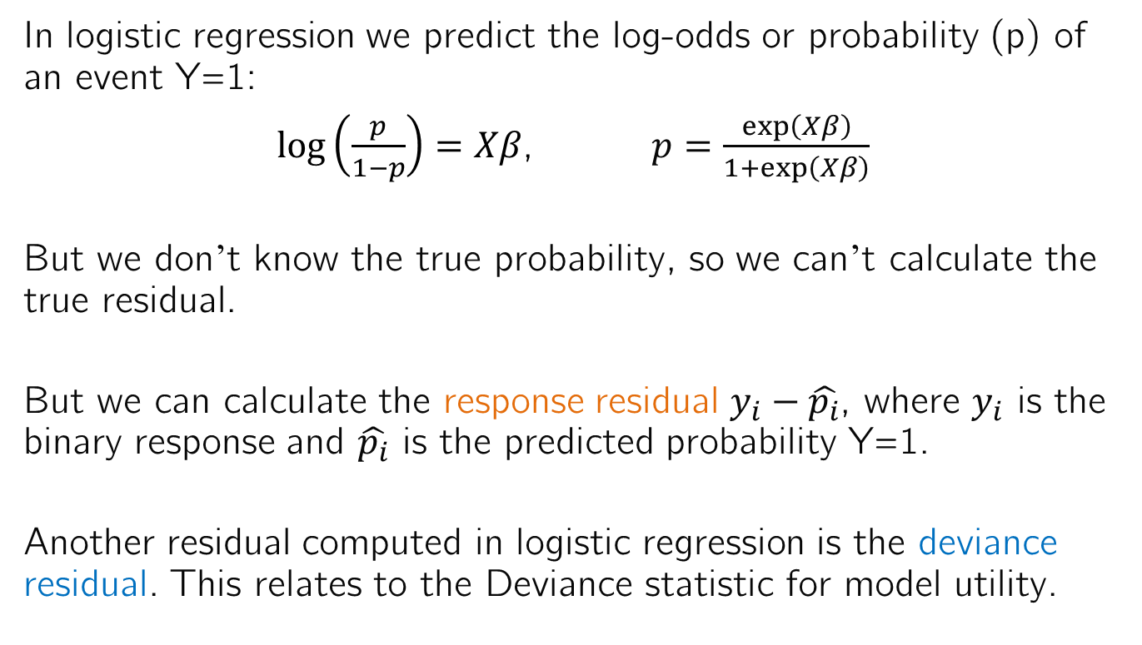
Residuals in logistic regression
In logistic regression we predict the log-odds or probability (p) of an event Y=1:
$\log\left(\frac{p}{1−p}\right)=Xβ$, $p=\frac{exp\left(Xβ\right)}{1+exp\left(Xβ\right)}$
But we don’t know the true probability, so we can’t calculate the true residual.
But we can calculate the response residual $y_{i}−\hat{p_{i}}$, where $y_{i}$ is the binary response and $\hat{p_{i}}$ is the predicted probability Y=1.
Another residual computed in logistic regression is the deviance residual. This relates to the Deviance statistic for model utility.

Slide 6
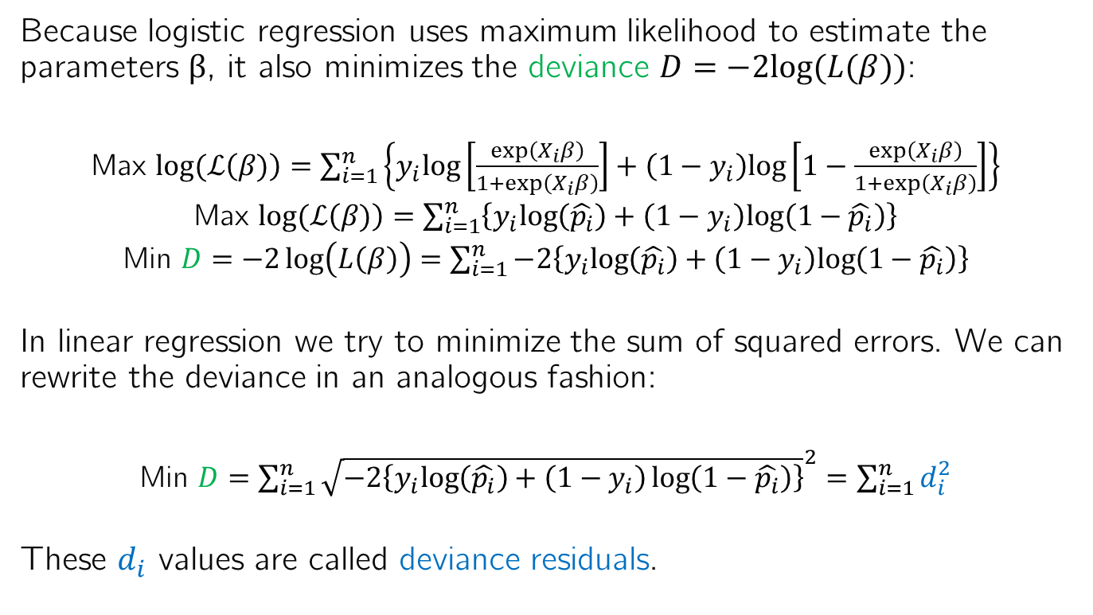
Deviance as an analogy to least squares
Because logistic regression uses maximum likelihood to estimate the parameters β, it also minimizes the deviance $D=−2log⁡(L(β))$:
Max $log⁡(ℒ\left(β)\right)=\sum_{i=1}^{n}{\left\{y_{i}log⁡\left[\frac{exp\left(X_{i}β\right)}{1+exp\left(X_{i}β\right)}\right]+\left(1−y_{i}\right)log⁡\left[1−\frac{exp\left(X_{i}β\right)}{1+exp\left(X_{i}β\right)}\right]\right\}}$
Max $log⁡(ℒ\left(β)\right)=\sum_{i=1}^{n}{\left\{y_{i}log\left(\hat{p_{i}}\right)+\left(1−y_{i}\right)log⁡\left(1−\hat{p_{i}}\right)\right\}}$
Min $D=−2\log\left(L\left(β\right)\right)=\sum_{i=1}^{n}{−2\left\{y_{i}log\left(\hat{p_{i}}\right)+\left(1−y_{i}\right)log⁡\left(1−\hat{p_{i}}\right)\right\}}$
In linear regression we try to minimize the sum of squared errors. We can rewrite the deviance in an analogous fashion:
Min $D=\sum_{i=1}^{n}{{\sqrt{−2\left\{y_{i}log\left(\hat{p_{i}}\right)+\left(1−y_{i}\right)\log\left(1−\hat{p_{i}}\right)\right\}}}^{2}}=\sum_{i=1}^{n}{d_{i}^{2}}$
These $d_{i}$ values are called deviance residuals.

Slide 7
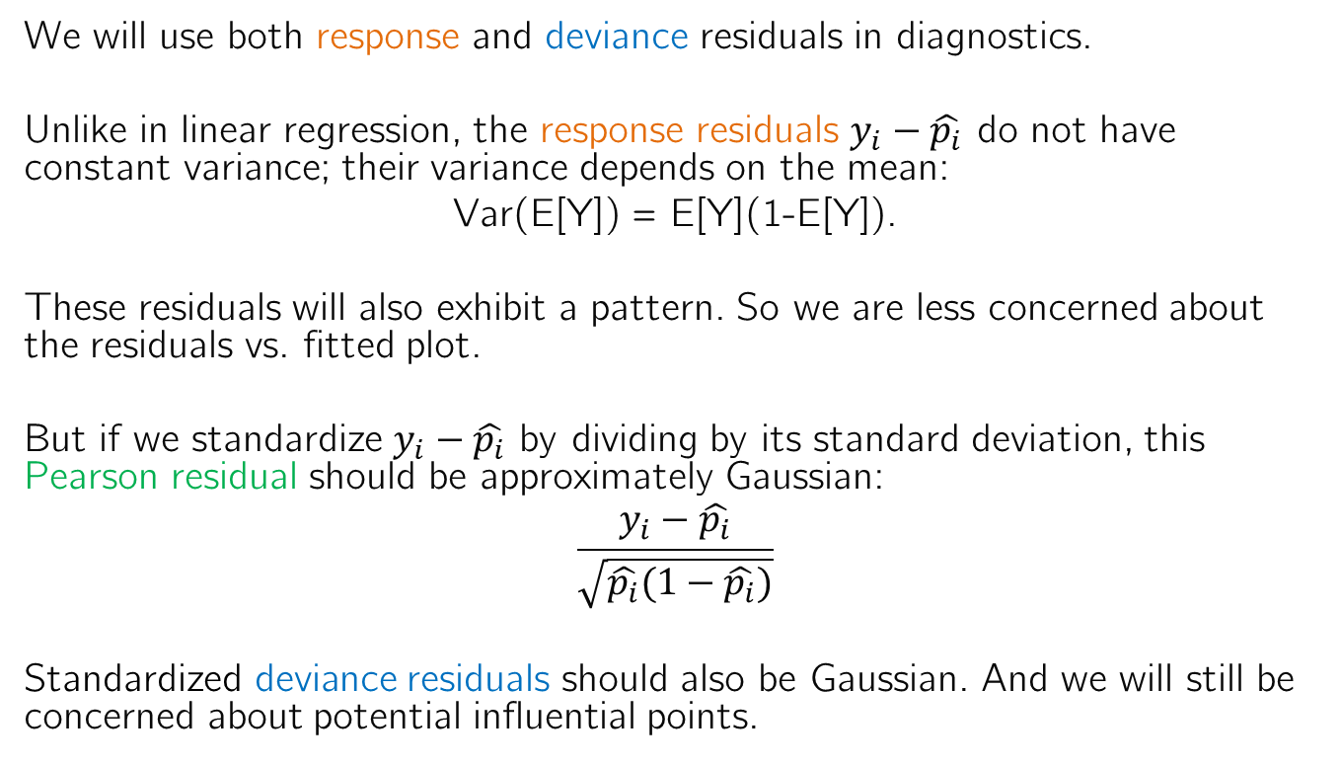
Residuals in logistic regression
We will use both response and deviance residuals in diagnostics.
Unlike in linear regression, the response residuals $y_{i}−\hat{p_{i}}$ do not have constant variance; their variance depends on the mean:
Var(E[Y]) = E[Y](1-E[Y]).
These residuals will also exhibit a pattern. So we are less concerned about the residuals vs. fitted plot.
But if we standardize $y_{i}−\hat{p_{i}}$ by dividing by its standard deviation, this Pearson residual should be approximately Gaussian:
$$\frac{y_{i}−\hat{p_{i}}}{\sqrt{\hat{p_{i}}(1−\hat{p_{i}})}}$$
Standardized deviance residuals should also be Gaussian. And we will still be concerned about potential influential points.

Slide 8
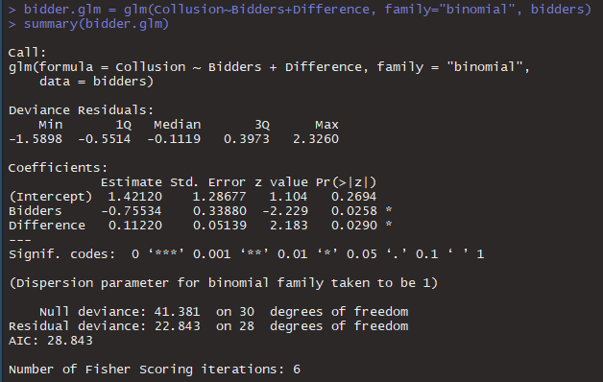
Consider again the road bid collusion problem

Slide 9
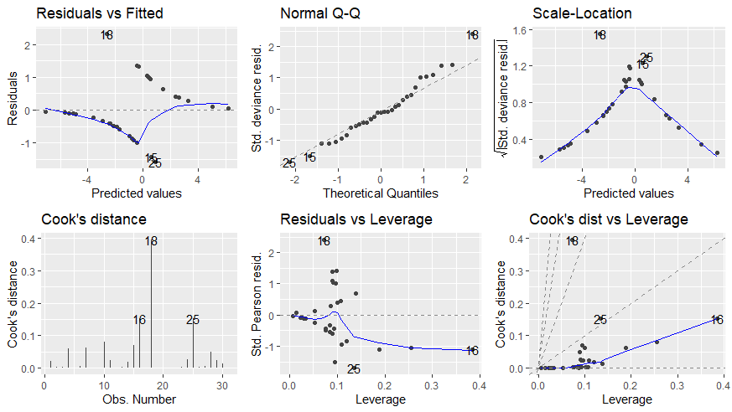
Regression diagnostics
We see an expected pattern
The residuals are fairly Gaussian
Some potentially influential points

Slide 10
Variable selection in logistic regression
Variable selection in logistic regression is similar to variable selection in linear regression.
We can use a partial likelihood test to determine significance, but this isn’t ideal for the same reason a t-test isn’t: test multiplicity.
Criterion based metrics still apply, and we can still use automated selection methods.
But test sets and cross-validation are even more important for logistic regression because we care more about prediction out of sample than inference on model coefficients.

Slide 11
Test sets for logistic regression
Similar to linear regression, we split our data into ~2/3 for training and ~1/3 for testing.
In linear regression, we use pMSE on the test set as our evaluation metric. What should it be for logistic regression?
Since we care about classification into binary categories, we need a decision function to map probabilities to categories.
Based on the decision function, we can count our total misclassification errors: false positives + false negatives

Slide 12
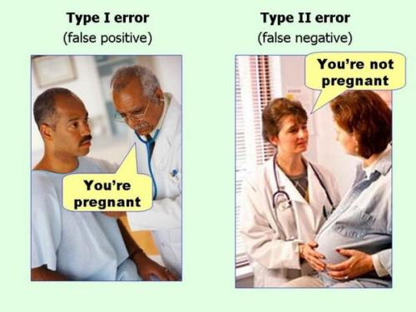
Types of errors

Slide 13
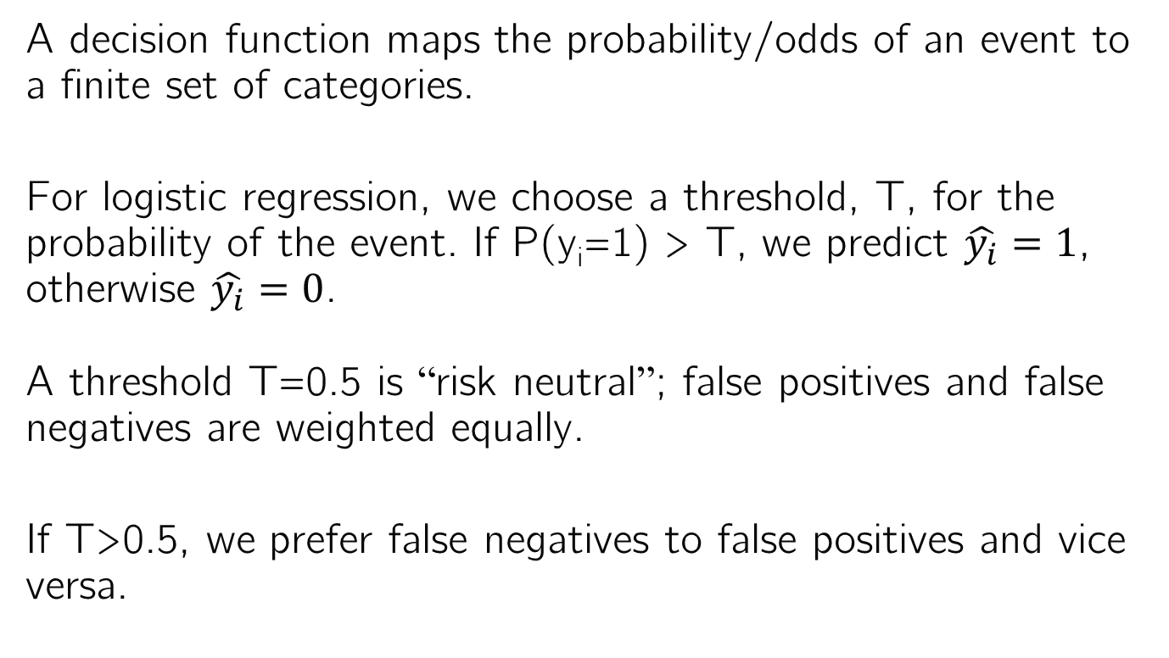
Decision function
A decision function maps the probability/odds of an event to a finite set of categories.
For logistic regression, we choose a threshold, T, for the probability of the event. If P(y_{i}=1) > T, we predict $\hat{y_{i}}=1$, otherwise $\hat{y_{i}}=0$.
A threshold T=0.5 is “risk neutral”; false positives and false negatives are weighted equally.
If T>0.5, we prefer false negatives to false positives and vice versa.

Slide 14
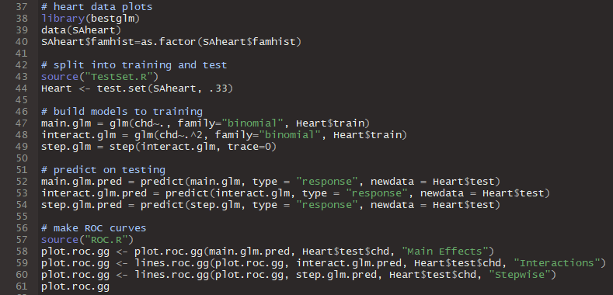
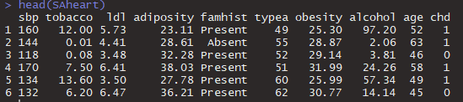
Example classification problem
The R package bestglm has a dataset on heart disease in a heart disease-high region of South Africa.
We want to predict whether an individual will have coronary heart disease (chd) as a function of their personal and family health history.

Slide 15
Comparing heart disease models in testing
We will compare the performance of 3 models in testing:
Main effects
Main effects + interactions
Stepwise from main effects + interactions

Slide 16
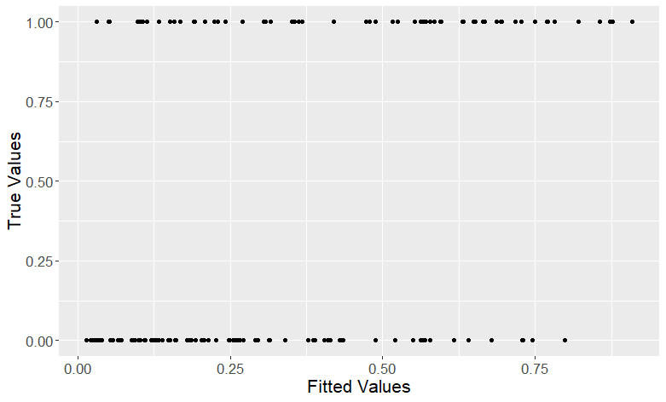


Main effects true vs. fitted plot
T=0.5
False Negatives
True Positives
Predict $\hat{y_{i}}=$0
Predict $\hat{y_{i}}=1$
True Negatives
False Positives

Slide 17


Main effects true vs. fitted plot
T=0.6
False Negatives
True Positives
Predict $\hat{y_{i}}=$0
Predict $\hat{y_{i}}=1$
True Negatives
False Positives

Slide 18


Main effects true vs. fitted plot
T=0.4
False Negatives
True Positives
Predict $\hat{y_{i}}=$0
Predict $\hat{y_{i}}=1$
True Negatives
False Positives

Slide 19
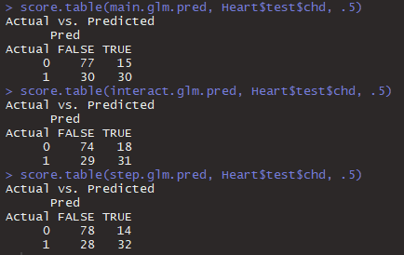
Comparing models
We can compare the true and false positives and negatives across models in a confusion matrix or score table.
Threshold T

Slide 20
Comparing models
We can compare the true and false positives and negatives across models in a confusion matrix or score table.
False positives

Slide 21
Comparing models
We can compare the true and false positives and negatives across models in a confusion matrix or score table.
False negatives

Slide 22
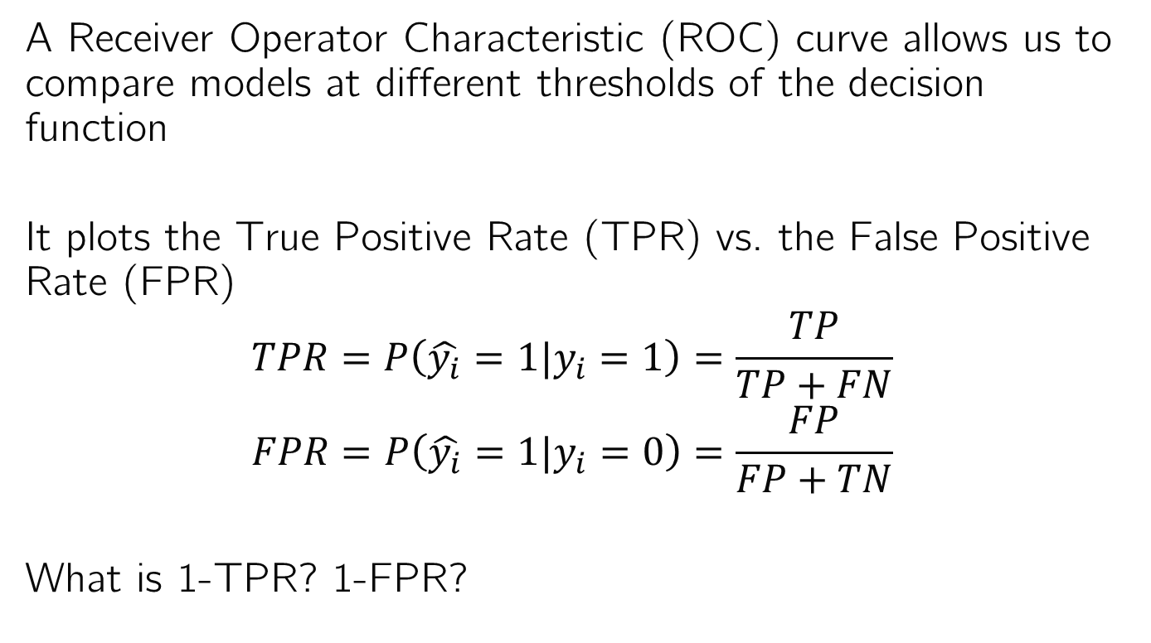
What if we changed the threshold?
A Receiver Operator Characteristic (ROC) curve allows us to compare models at different thresholds of the decision function
It plots the True Positive Rate (TPR) vs. the False Positive Rate (FPR)
$$TPR=P\left(\hat{y_{i}}=1|y_{i}=1\right)=\frac{TP}{TP+FN}$$
$$FPR=P\left(\hat{y_{i}}=1|y_{i}=0\right)=\frac{FP}{FP+TN}$$
What is 1-TPR? 1-FPR?

Slide 23

Understanding True/False Positive/Negative Rates
$$TPR=P\left(\hat{y_{i}}=1|y_{i}=1\right)=\frac{TP}{TP+FN}$$
What is 1-TPR?
$$1−TPR=1−P\left(\hat{y_{i}}=1|y_{i}=1\right)$$
$$1−TPR =P\left(\hat{y_{i}}=0|y_{i}=1\right)$$
$$1−TPR=\frac{FN}{TP+FN}$$

Slide 24

Understanding True/False Positive/Negative Rates
$$TPR=P\left(\hat{y_{i}}=1|y_{i}=1\right)=\frac{TP}{TP+FN}$$
What is 1-TPR? False Negative Rate
$$1−TPR=1−P\left(\hat{y_{i}}=1|y_{i}=1\right)$$
$$1−TPR =P\left(\hat{y_{i}}=0|y_{i}=1\right)$$
$$1−TPR=\frac{FN}{TP+FN}$$
$$1−TPR=FNR$$

Slide 25

Understanding True/False Positive/Negative Rates
$$FPR=P\left(\hat{y_{i}}=1|y_{i}=0\right)=\frac{FP}{FP+TN}$$
What is 1-FPR?
$$1−FPR=1−P\left(\hat{y_{i}}=1|y_{i}=0\right)$$
$$1−FPR=P\left(\hat{y_{i}}=0|y_{i}=0\right)$$
$$1−FPR=\frac{TN}{FP+TN}$$

Slide 26

Understanding True/False Positive/Negative Rates
$$FPR=P\left(\hat{y_{i}}=1|y_{i}=0\right)=\frac{FP}{FP+TN}$$
What is 1-FPR? True Negative Rate
$$1−FPR=1−P\left(\hat{y_{i}}=1|y_{i}=0\right)$$
$$1−FPR=P\left(\hat{y_{i}}=0|y_{i}=0\right)$$
$$1−FPR=\frac{TN}{FP+TN}$$
$$1−FPR=TNR$$

Slide 27
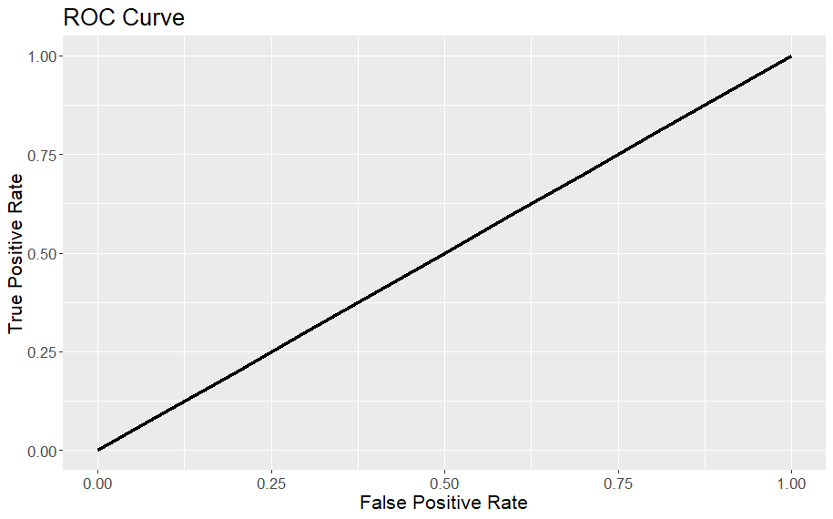
ROC Curve
The ROC curve plots TPR vs. FPR
What’s the ideal point?

Slide 28
ROC Curve
The ROC curve plots TPR vs. FPR
How do we get FPR=0? TPR=1?
Label everything positive (T=0)
Label everything negative (T=1)
T =1→0

Slide 29

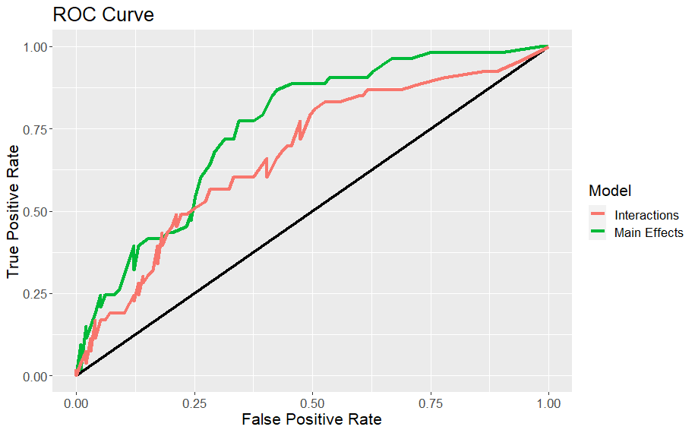
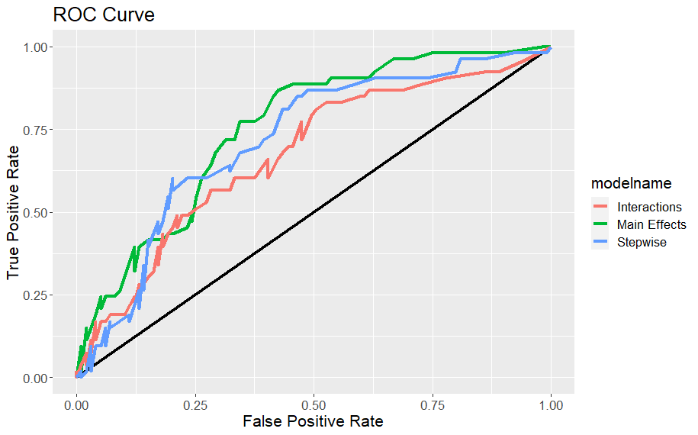
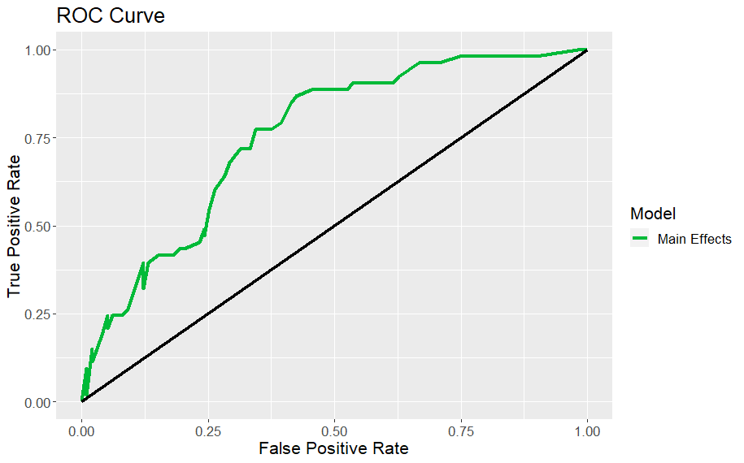
ROC curve for coronary heart disease models

Slide 30
Principal Components Regression
Another way to select variables to try to improve classification is to combine them. This can also reduce multicollinearity. We can use PCs for this.
The first step is to perform PCA using all quantitative predictor variables.
We then select a subset of the PCs that explain p% of the variance. The modeler can use variable selection methods to decide on p.
The PCs then become the predictors instead of the variables themselves. While this decreases interpretability, we’re more concerned about prediction than inference for classification.

Slide 31

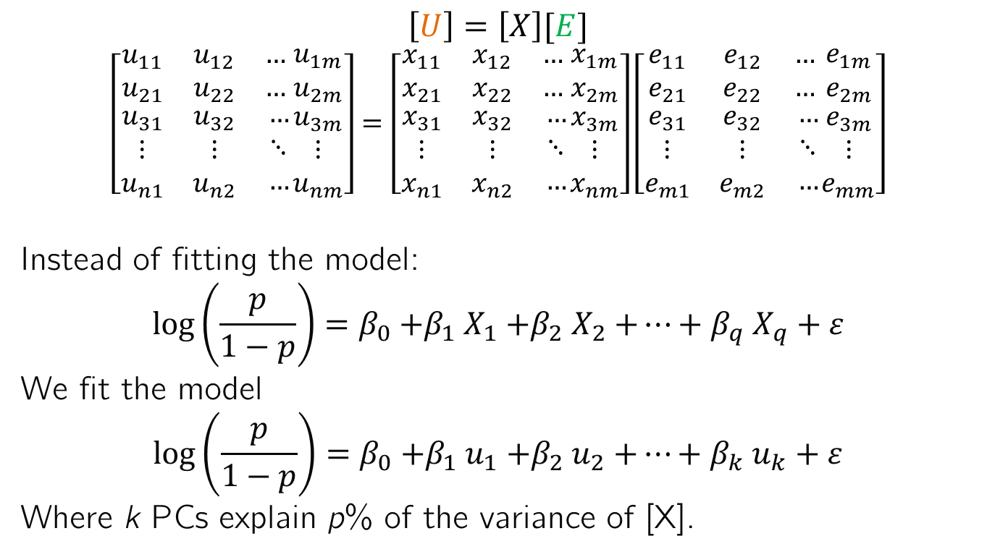



Principal Components Regression
$$…$$
$$\left[U\right]=\left[X\right][E]$$
$$\left[\begin{matrix}u_{11} & u_{12} & … \\ u_{21} & u_{22} & … \\ \begin{aligned}u_{31} \\ ⋮ \\ u_{n1}\end{aligned} & \begin{aligned}u_{32} \\ ⋮ \\ u_{n2}\end{aligned} & \begin{aligned}… \\ ⋱ \\ …\end{aligned}\end{matrix}\begin{matrix}u_{1m} \\ u_{2m} \\ \begin{aligned}u_{3m} \\ ⋮ \\ u_{nm}\end{aligned}\end{matrix}\right]=\left[\begin{matrix}x_{11} & x_{12} & … \\ x_{21} & x_{22} & … \\ \begin{aligned}x_{31} \\ ⋮ \\ x_{n1}\end{aligned} & \begin{aligned}x_{32} \\ ⋮ \\ x_{n2}\end{aligned} & \begin{aligned}… \\ ⋱ \\ …\end{aligned}\end{matrix}\begin{matrix}x_{1m} \\ x_{2m} \\ \begin{aligned}x_{3m} \\ ⋮ \\ x_{nm}\end{aligned}\end{matrix}\right]\left[\begin{matrix}e_{11} & e_{12} & … \\ e_{21} & e_{22} & … \\ \begin{aligned}e_{31} \\ ⋮ \\ e_{m1}\end{aligned} & \begin{aligned}e_{32} \\ ⋮ \\ e_{m2}\end{aligned} & \begin{aligned}… \\ ⋱ \\ …\end{aligned}\end{matrix}\begin{matrix}e_{1m} \\ e_{2m} \\ \begin{aligned}e_{3m} \\ ⋮ \\ e_{mm}\end{aligned}\end{matrix}\right]$$
Instead of fitting the model:
$$log\left(\frac{p}{1−p}\right)=β_{0}{+β}_{1}X_{1}{+β}_{2}X_{2}{+…+β}_{q}X_{q}+ε$$
We fit the model
$$log\left(\frac{p}{1−p}\right)=β_{0}{+β}_{1}u_{1}{+β}_{2}u_{2}{+…+β}_{k}u_{k}+ε$$
Where k PCs explain p% of the variance of [X].
$$\vec{u_{1}}$$
$$\vec{u_{2}}$$
$$\vec{u_{k}}$$

Slide 32
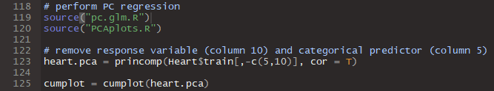
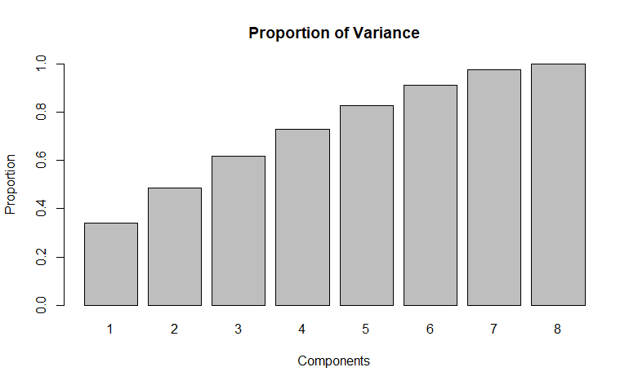
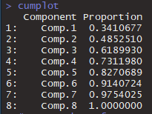
Principal Components Regression

Slide 33
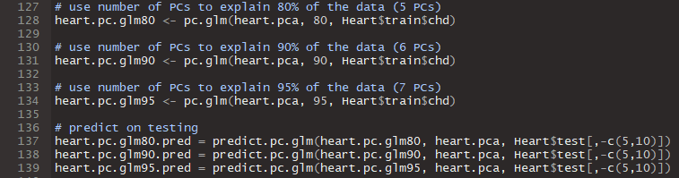
Principal Components Regression
We test three logistic regression models using the PCs that explain:
80% of the variability
90% of the variability
95% of the variability

Slide 34
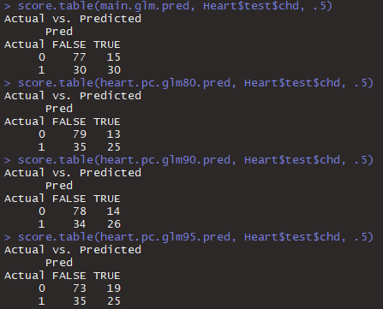
Confusion Matrices
Main effects vs. three PC regression models
Using 80% of the PCs results in the lowest False Positives

Slide 35
Confusion Matrices
Main effects vs. three PC regression models
The main effects model has the lowest False Negatives
But the highest False Negatives

Slide 36

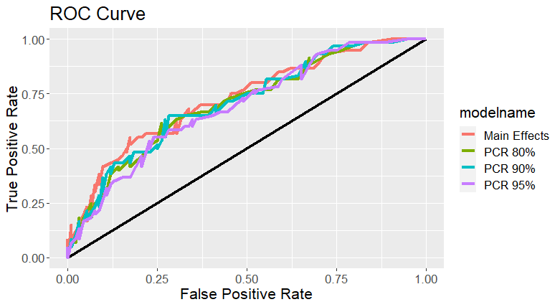
ROC Curves of PC regression models

Slide 37
Summary
Model diagnostics are less crucial for GLMs.
We expect to see patterns and non-constant variance in the residuals vs. fitted plot.
Pearson and deviance residuals should be normal.
We don’t want influential points.
Decision functions allow us to map probabilities to classifications to compute false positives and false negatives.
Receiver Operator Characteristic (ROC) curves allow us to compare models’ errors across decision function thresholds.
Principal Components Regression (PCR) can be useful for prediction in logistic regression models.

