Slide 1
Political Persuadability
As seen through Twitter
Eric Miller

Slide 2
The Question
Can we predict how persuadable a person is politically only using the information publicly available through a free Twitter developer account?

Slide 3
Twitter Data Sources
Twitter Developer Account (free)
Highly Detailed Information
You get to choose the data
Strongly rate-limited
Archive.org Collection of “Spritzer” Stream
Contains a random sampling of 1% of all public tweets, with user information
Huge quantity of data (~40 TB over 8 years)
Must be downloaded in bulk and then parsed
Twitter Follower Network (scraped by Haewoon Kwak, et al.)
Complete information about every user’s follower/friends lists
From 2009

Slide 4
Other Data Sources
US Census Bureau American Community Survey (5-year)
Contains demographic information on nearly every city or town in America
Extremely detailed (more than 66,000 variables)
RESTful API with no rate limits
Contains a small amount of bad data
United States Cities Database (simplemaps.com)
Clean and easy to use CSV
Includes geographic information such as land area

Slide 5
Project Flow
2010 Twitter Network
Archive.org
Twitter Developer Account
Twitter User
Location
Politicians
Calculate user’s political persuasion in 2010 by who they are following
Demographics from US Census
Calculate user’s political persuasion in 2019 by who they are following

Slide 6
The Tools
Hardware
Software
Home Desktop PC
Intel Core I5-6500 (4 x 3.20GHz)
NVidia GTX 970 GPU
16 GB 2133 MHz RAM
256 GB SSD, 2 TB 9000RPM HDD
Windows 7 / Ubuntu 18.04 dual boot
Personal Laptop
AMD Ryzen 5 CPU
8 GB 1600 MHz RAM
Windows 10
Amazon Web Services
1 “micro” (free) ec2 instance
Python v3.8
Data cleaning and Machine Learning
Pandas, Numpy, Tweepy
Scikit-Learn
Tensorflow
Seaborn and Matplotlib
Julia v1.2
Numerical computation
Linear Algebra
Sparse matrix multiplication
Eigenvector decomposition
External merge sort
Data parsing (Twitter Network)

Slide 7
Analyzing the Twitter Graph from 2009
0.5
1
0
1
1.5
1.56
+0.5
+0
-0.61
2
+1
0
0.25
2
0
+1
+1
+1
-1
42 Million Users - 1.5 Billion Connections

Slide 8
Analyzing the Twitter Graph from 2009 (cont)
Interest in politics overall
Direct partisanship
Partisan influence of friends network
Influence of specific politicians
“Virtual Politicians” via eigenvector decomposition

Slide 9
2019 Twitter Data is Similar
But…
Incomplete information only lets us calculate the direct partisanship of each user

Slide 10
The Quest for User Locations
Twitter free developer account lets you get 5 users’ profiles per minute
Don’t know if user has valid location without making API request
190 years to scrape every user’s location
Location field manually filled out by user
Sacramento, CA
Sacramento
Sactown
Dublin
The Moon
BUTTZ

Slide 11
The Archive.org Twitter Stream Archive
Download each year of the “Spritzer” stream (1% of all public tweets)
400 GB compressed per year (4 TB uncompressed)
For each tweet, get the user’s ID and location
Parse location and compare to US cities list to ensure veracity
Grab demographic information from US Census
Compile final list of unique users

Slide 12
Due to time and space constraints, I chose to only download one year of data (2015)
49 million tweets with identifiable US locations
6.4 million unique user IDs
629 thousand users with data from 2009 network
227 thousand users with some interest in politics

Slide 13
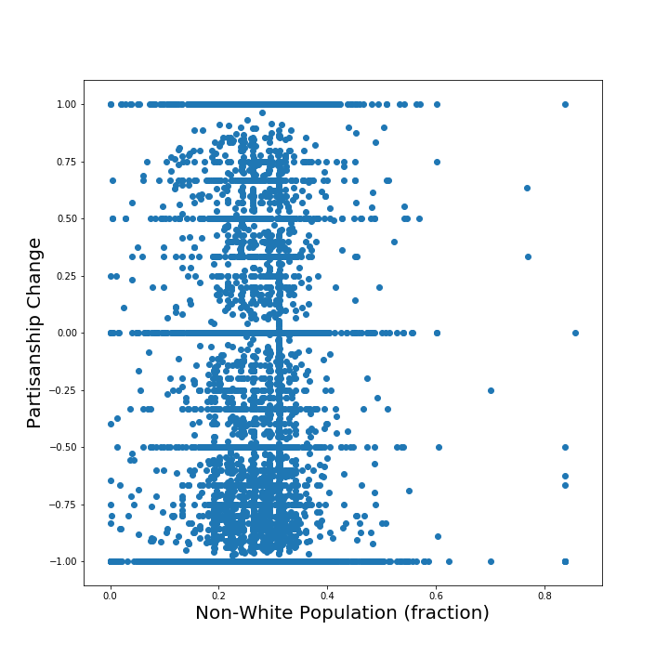
Interesting Data Features
Bimodal distribution with discrete spectral lines
Indicates that a classifier might be a good idea
Classify into 3 categories:
Moved Democrat
Moved Republican
No Change

Slide 14
Random Forest Classifier
scikit-learn
Classified every user (R,D,N)
Random Forest with 250 estimators
Used feature permutation to identify key features
Random guess has 33% accuracy
RFC with only demographics has 41.2% accuracy
RFC without twitter network eigenvectors has 44% accuracy
RFC with twitter network information has 48.5% accuracy
RFC with twitter network and bad feature removal has 49.5% accuracy

Slide 15
Predicting Partisan Shift using Neural Nets
Drop “bad” columns from data (from previous step)
Shift and scale data
Balance dataset for equal Republican/Democrat bias
Densely-connected neural net with 5 layers:
310 node layer w/ rectified linear activation
155 node layer w/ exponential linear activation
64 node layer w/ linear activation
16 node layer w/ linear activation
1 node output layer w/ hyperbolic tangent activation (outputs between -1 and 1)

Slide 16
Neural Network Results
Trained for 500 epochs using GPU-accelerated tensorflow
Achieved Mean Average Error (MAE) = 0.46
Maximum error in one measurement is 2.0 - ~75% accuracy
Standard Deviation in data is 0.77 - 94% better than random
Correctly identified direction of partisan shift in 75.3% of cases

Slide 17
Conclusions
It is possible to guess the direction of a person’s partisan shift over time using Twitter data freely available on the internet
Twitter network analysis provides a significant boost to basic demographic models
However…
Many assumptions had to be made to enable this analysis.
Partisanship can be measured via Twitter friends/followers
Users input location truthfully
2009 Twitter data isn’t too biased to be useful (newness of Twitter at the time)

