Slide 1
Git Workshop for Turner Group
Eliot Kim, Eric Mei

Slide 2
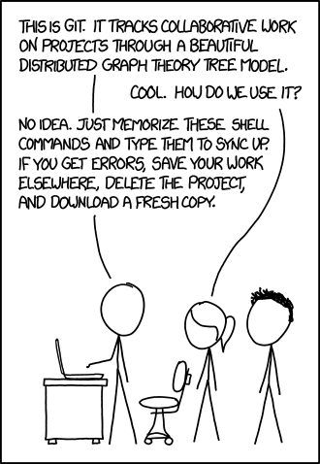
Why git?
Version control: Saves prior code versions, can revert if needed
Collaboration: Team members can edit same codebase in parallel
Accountability: Write code that others can read, run, and edit!

Slide 3
Why git?
Version control: Saves prior code versions, can revert if needed
Collaboration: Team members can edit same codebase in parallel
Accountability: Write code that others can read, run, and edit!
*Git vs. GitHub
Git: local software for managing repositories
GitHub: Web service with graphical interface for hosting repositories

Slide 4
Why git?
Version control: Saves prior code versions, can revert if needed
Collaboration: Team members can edit same codebase in parallel
Accountability: Write code that others can read, run, and edit!
*Git vs. GitHub
Git: local software for managing repositories
GitHub: Web service with graphical interface for hosting repositories
Future Career: Many industry jobs request links to GitHub profiles!

Slide 5
How does git work?
Repositories: Where the codebase is stored
README: Directions to run code
.gitignore: Species filetypes to ignore when pushing changes to codebase from local machine
Branches:
Main
Commits:
Pull Requests:

Slide 6
How to get, edit, and save code?
git clone <REPO LINK>
git status
git add <FILEPATH>
git commit –m <MESSAGE>
git push
git pull

Slide 7
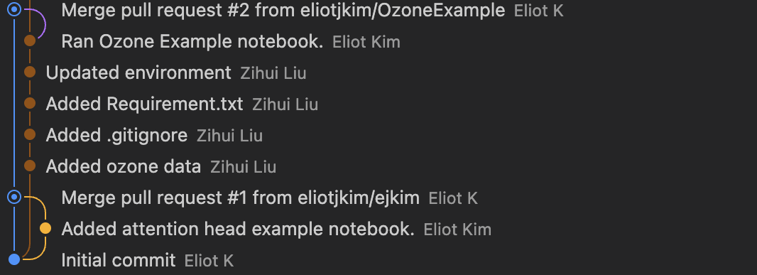
How to collaborate using GitHub?
git branch
git branch <BRANCH NAME>
git checkout <BRANCH NAME>
Pull Requests

Slide 8
Group Exercise!
Clone repo!
Tasks
James: add
Iana: subtract
Sydney: divide
Alex: multiply
Eric: exponent
Eliot: mod

