Slide 1
Intro to Git for Turner Group
Eliot Kim, Eric Mei
August 27th, 2025

Slide 2
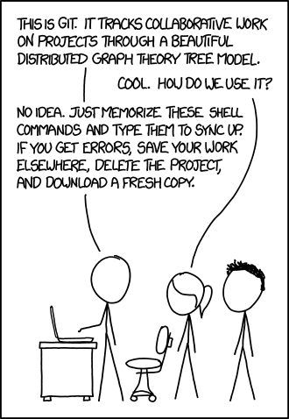
Why git?

Slide 3
Why git?
Version control: Saves prior code versions, can revert if needed
Collaboration: Team members can edit same codebase in parallel
Accountability: Write code that others can read, run, and edit!

Slide 4
Why git?
Version control: Saves prior code versions, can revert if needed
Collaboration: Team members can edit same codebase in parallel
Accountability: Write code that others can read, run, and edit!
*Git vs. GitHub
Git: Software for managing LOCAL repositories
GitHub: Web service with graphical interface for hosting REMOTE repositories

Slide 5
Why git?
Version control: Saves prior code versions, can revert if needed
Collaboration: Team members can edit same codebase in parallel
Accountability: Write code that others can read, run, and edit!
*Git vs. GitHub
Git: Software for managing LOCAL repositories
GitHub: Web service with graphical interface for hosting REMOTE repositories
Future Career: Many industry jobs request links to GitHub profiles!

Slide 6
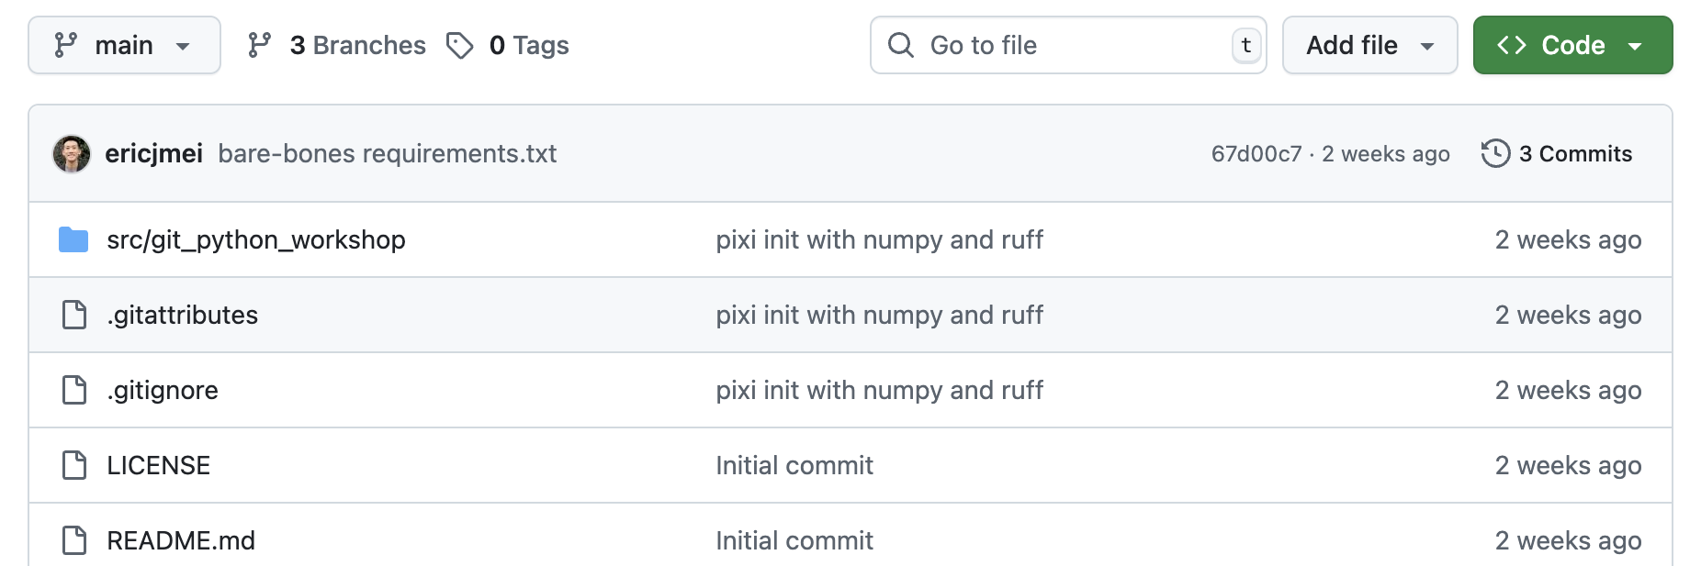
How does git work?
Repositories: Where the code is stored
README: Directions to run code
.gitignore: Specific filetypes to ignore when updating the repo
Branches: Make parallel edits to codebase, i.e. adding a new feature
Main: The “production” branch
Commits: Repo edit history — “versions”
Pull Requests: Merging edits made in a branch with the “main” branch

Slide 7
How to get, edit, and save code?
git clone <REPO LINK>
Copy repo to LOCAL
git status
Check which files have been changed / unstaged / staged
git add <FILEPATH>
Stage file(s)
git commit –m <MESSAGE>
Add staged file(s) to repo’s commit LOCAL history
git push
Update REMOTE codebase with committed file(s)
git pull
Get codebase updates from REMOTE to LOCAL

Slide 8
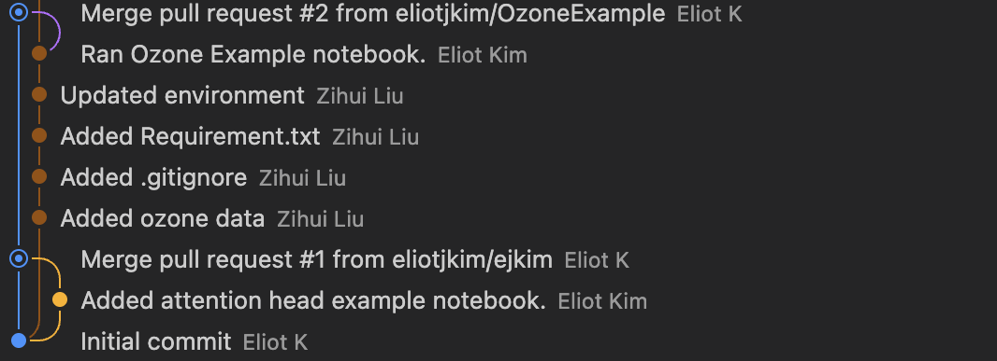
How to collaborate using GitHub?
git branch
Check current branch and other available branches
git branch <BRANCH NAME>
Make a new branch
git checkout <BRANCH NAME>
Hop to the desired branch

Slide 9
Group Exercise!
Clone repo!
github.com/ericjmei/git_python_workshop
Make a branch (include your name / username in branch name)!
Write and push edits to a function in git_intro.py
James: add
Iana: subtract
Sydney: divide
Alex: multiply
Eric: exponent
Eliot: mod
Create a pull request for your branch!
Merge the pull requests into the main branch (as a group)

