Slide 1
Git Workshop for Turner Group
Eliot Kim, Eric Mei

Slide 2
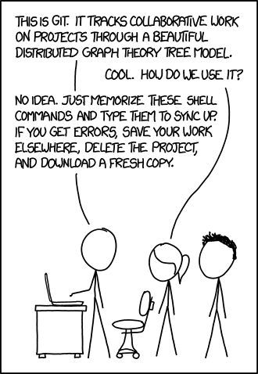
Why git?
Version control
Collaboration
Accountability
git vs. GitHub

Slide 3
How does git work?
Repositories
README
.gitignore
Branches
Main
Pull Requests
Commit history

Slide 4
How to get, edit, and push?
git clone <REPO LINK>
git status
git add <FILEPATH>
git commit –m <MESSAGE>
git push
git pull

Slide 5
How to collaborate using GitHub?
git branch
git checkout
Pull Requests

Slide 6
Group Exercise!
Team
James
Iana
Sydney
Laura
Alex

