Slide 1

Predicting Congestive Heart Failure
Group “Naive BAEs”
Data Science Bootcamp, Summer 2019
Haoyun Zhang
Eric Meyers
Maite Herrero Gorostiza

Slide 2

Agenda for today
Introduction
The what, the why and the how
Data
Source & Mining
Modeling
Classification, Risks and Obstacles
Conclusion
And future Work

Slide 3
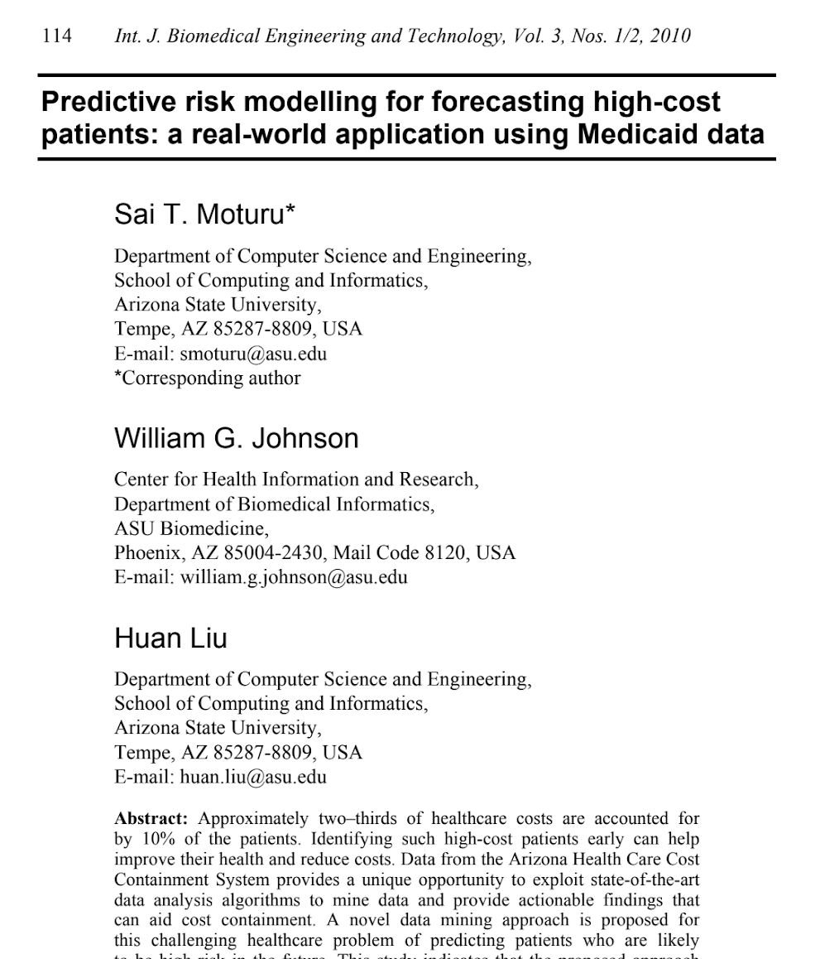
Why healthcare analytics?
Introduction
1
Growth | Working Opportunity
USD 14.0 billion in 2019
CAGR 28.3% USD 50.5 billion by 2024.
Public | International Perspective
Cost-effectiveness focus
(A) Healthcare spending
(B) Increasing number of patient registries
2
3
Notes:
More info: Browse 231 market data Tables and 43 Figures spread through 259 Pages and in-depth TOC on "Healthcare Analytics Market by Type (Predictive, Prescriptive, Cognitive) Application (Clinical, RCM, Claim, Fraud, Waste, Supply Chain, PHM) Component (Service, Software) Delivery (On-demand, Cloud) End User (Payer, Hospital) - Global Forecast to 2024"
Growth | Labor Opportunity
The global Healthcare Analytics Market is estimated to be valued at USD 14.0 billion in 2019. This market is projected to grow at a CAGR of 28.3% during the forecast period to reach USD 50.5 billion by 2024.
Public and International Perspective
The growing adoption of data-driven decision-making and the implementation of initiatives to increase EHR adoption by governments in several countries are the major factors driving the growth of this market.
Cost-effectiveness focus
Some of the other major factors supporting market growth include the emergence of big data in healthcare, rising pressure to reduce healthcare spending while improving patient outcomes, and the increasing number of patient registries.

Slide 4
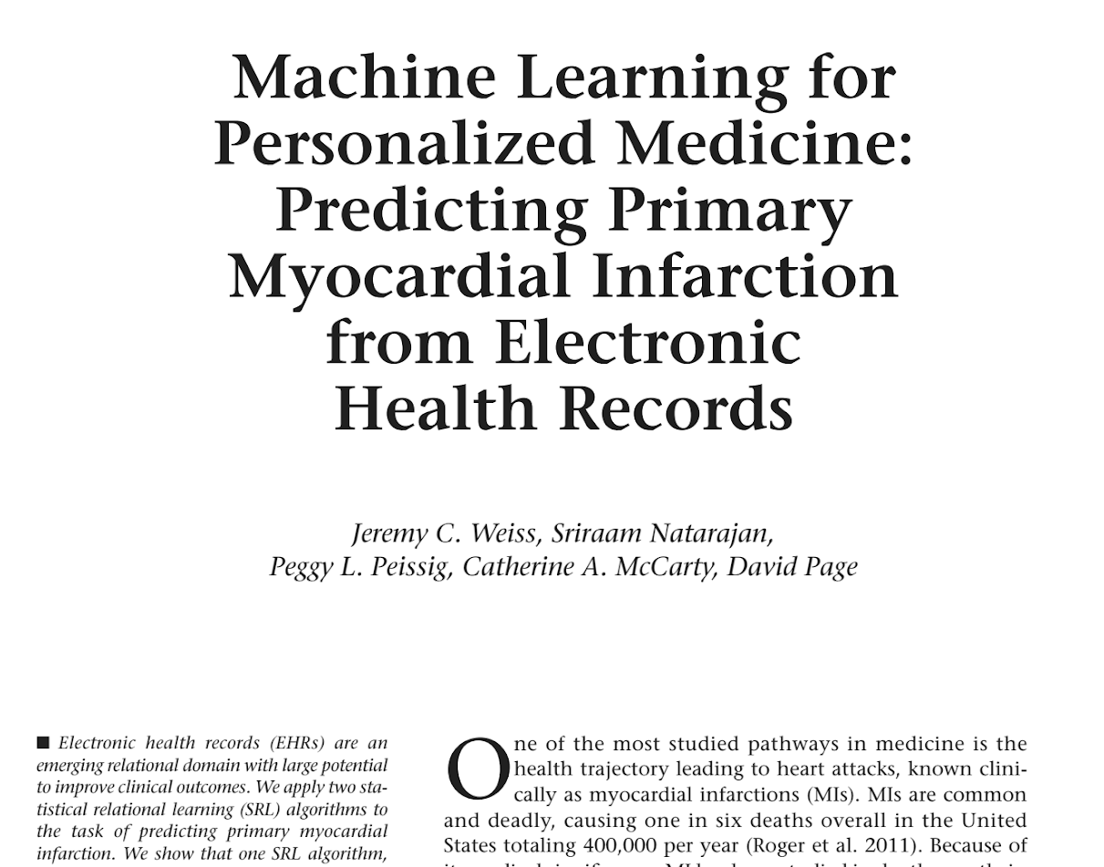
Why predicting congestive heart failure CHF?
Introduction
1
High cost
50% of patients are dead at an interval of 4 years
High variability
(A) Prognosis of individual patients differs considerably
(B) Trial data does not often give an adequate direction.
Momentum
2
3
Notes:
More info: Heart failure–concepts and significance. Birth of a prognostic model
C Sinescu and L Axente
High cost
Heart failure (HF) is a syndrome characterized by high prevalence in society, frequent hospitalization, reduced quality of life and high mortality (overall, 50% of patients are dead at an interval of 4 years, annual mortality varying from 5% to 75%)
High variability
Outcomes in heart failure are highly variable, prognosis of individual patients differs considerably and trial data, though valuable, does not often give an adequate direction.
Momentum
Taking into account the high prevalence of heart failure in society and its complexity physicians need a model to predict the risk of death, to estimate the survival of heart failure patients.

Slide 5
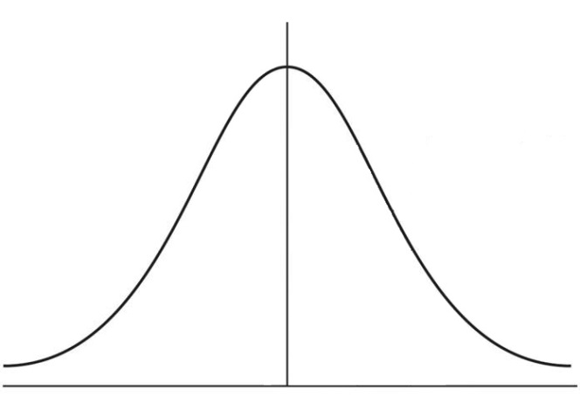
CHF: Main Test Indicators
Introduction
Non-Laboratory | Laboratory
Electrocardiogram Chest X-Ray | Blood Gas (6 measures) Chemistry (12 measures) Hematology (12 measures)
Family History
Gender
Age
Ethnicity
Income

Slide 6

Agenda for today
Introduction
The what, the why and the how
Data
Source & Mining
Modeling
Classification, Risks and Obstacles
Conclusion
And future Work

Slide 7
Our Database
Introduction
1
Rich Base...
38,550 Adult Patients (26% diagnosed with CHF)
115 Features (Pre-Dummification, 160 Post)
...for a Goal
Optimize sensitivity according to demographic Variables
MIMIC - III
26 tables
2
June 2001 - October 2012
Notes:
MIMIC-III on Physionet
WHAT IS IT?
MIMIC-III (Medical Information Mart for Intensive Care III) is a large, freely-available database comprising de-identified health-related data associated with over forty thousand patients who stayed in critical care units of the Beth Israel Deaconess Medical Center between 2001 and 2012. It was developed by the MIT Lab for Computational Physiology, and includes demographics, vital signs, laboratory tests, medications, and more.
Description:
- 26 Tables
- Dates of Study: June 2001 - October 2012
- Requirements: Human Subjects Training, HIPAA compliance, Specimen Research Training, and Access Approval
Data:
38,550 Adult Patients (Observations)
115 Features (Pre-dummification, 160 post-dummification)
9,829 Diagnosed Patients with Congestive Heart Failure (25.5% of Adults)
Baseline Accuracy: 74.5%
Goal: Optimize Sensitivity

Slide 8
Extracting
Data
Patients
Admissions
Diagnosis (ICD-9 Code*)
Diagnosis Dictionary
Labevents
LabItems Dictionary
Chartevents
Complications | Solutions
Many measurements, conditions and stays per individual Size of the Tables De-identification of PHI scrambled key dates | Joins for DAYS (reduce bandwidth) Groupby Aggregation of blood measurements Pivot on SUBJECT_ID Selecting Target (CHF)
MIMIC - III
26 tables
Notes:
InExtracting the Data:
Key Tables:
- Patients (Gender, DOB, Expiration)
- Admissions (Demographics, Admission Details (Start/End of stay), Purpose of Visit)
- Diagnosis (ICD-9 Code*)
- Diagnosis Dictionary (Details of Diagnosis)
- Labevents (Blood Tests, Urine Tests, etc.)
- LabItems Dictionary (Descriptors of Labevents & Chartevents measurement types)
- Chartevents (Vitals on hourly basis, Bedside descriptions, etc.)
Complications
- Potentially Multiple Conditions to one individual
- Difference of Admissions Diagnosis vs. Subject Diagnosis
- Potentially different Stays to individuals
- Size of Tables!! Labevents (27M rows/ 1.85 GB) & Chartevents (330M rows / 35.21 GB)
- Many measurements to individuals
- De-identification of PHI scrambled key dates
Solutions:
- Joins for DAYS (carefully)
- Filtering for most common blood measurements (reduce bandwidth)
- Groupby Aggregation of blood measurements (max, min, mean, std)
- Pivot on SUBJECT_ID
- Selecting Target (Congestive Heart Failure)
troduction

Slide 9
Cleaning & Assumptions
Data
To Do’s:
Removing bias of death
Remove percentage metrics from mean and std aggregations
Calculating Age of Patients (Protections of 15 < Age < 85)
Recategorization of Demographics (Language, Marital Status, Religion)
Considering that:
Missing At Random (MAR)
U.S. Health System and tendency to overtest
If results are NA, measurement value should be assumed to be “normal”, NOT hospital population mean
~100 Blood Fields to impute:
5 measurements (20 fields) ~ 10,000 rows
Remainder 100 - 4000 NAs
Notes:
Data Cleaning:
- Removing bias of death (DOD, Expire Flag)
- Remove percentage metrics from mean and std aggregations
- Calculating Age of Patients (Protections of 15 < Age < 85)
- Recategorization of Demographics (Language, Marital Status, Religion)
Data Imputation:
- Assumptions:
- Missing At Random (MAR)
- U.S. Health System and tendency to overtest
- If results are NA, measurement value should be assumed to be “normal”, NOT hospital population mean
Blood Measurements:
- ~100 Fields to impute:
- 5 measurements (20 fields) ~ 10,000 rows
- Remainder 100 - 4000 NAs
- Logistic Imputation VS. RF Imputation
Logistic Imputation methods:
- RELY ON MEDICAL RESEARCH AS MUCH AS POSSIBLE!
- Three buckets:
- No research available: Impute DB population mean
- Research available: Impute healthy max/min/mean/std for global population
- Research available, gender differences: Impute healthy metrics per gender based on global population
Tree Model based imputation methods
- VALUE feature in LAB_EVENT contains some information but VALUENUM treats them as NAN, impute boundary values,
E.g. ‘LARGER THAN 10’ —> impute as 10, ‘< 1.0’ impute as 1.0
- All std missing values are imputed with 0
- All min/max/mean missing values are imputed by research record
- Age NAN means they are children, then impute with 0

Slide 10
Data
Logistic Imputation | Tree Model Imputation
RELY ON MEDICAL RESEARCH AS MUCH AS POSSIBLE! Three buckets: No research available: Impute DB population mean Research available: Impute healthy max/min/mean/std for global population Research available, gender differences: Impute healthy metrics per gender based on global population | VALUE feature in LAB_EVENT contains some information but VALUENUM treats them as NAN, impute boundary values, E.g. ‘LARGER THAN 10’ —> impute as 10, ‘< 1.0’ impute as 1.0 All std missing values are imputed with 0 All min/max/mean missing values are imputed by research record Age NAN means they are children, then impute with 0
Notes:
Logistic Imputation methods:
- RELY ON MEDICAL RESEARCH AS MUCH AS POSSIBLE!
- Three buckets:
- No research available: Impute DB population mean
- Research available: Impute healthy max/min/mean/std for global population
- Research available, gender differences: Impute healthy metrics per gender based on global population
Tree Model based imputation methods
- VALUE feature in LAB_EVENT contains some information but VALUENUM treats them as NAN, impute boundary values,
E.g. ‘LARGER THAN 10’ —> impute as 10, ‘< 1.0’ impute as 1.0
- All std missing values are imputed with 0
- All min/max/mean missing values are imputed by research record
- Age NAN means they are children, then impute with 0

Slide 11
Agenda for today
Introduction
The what, the why and the how
Data
Source & Mining
Modeling
Classification, Risks and Obstacles
Conclusion
And future Work

Slide 12
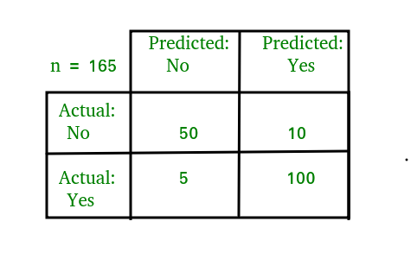
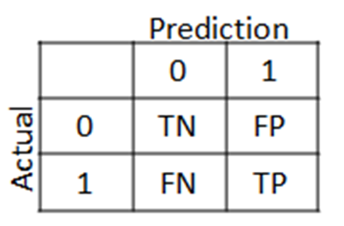
Confusion Matrix and Model Prep
Modeling
Default Parameters | Modeling Data Prep
80.1% Accuracy 42.3% Sensitivity | Dummification of Categorical Normalization of Blood Features
Notes:
Baseline Model (Default Parameters):
80.1% Accuracy
42.3% Sensitivity
Modeling Data Prep:
- Dummification of Categorical Features: Gender, Insurance, Language, Religion, Marital Status, Ethnicity
- Normalization of Blood Measurement Features

Slide 13
Model Optimization
Modeling
Regularization | Grid Search
Parameter “C” and Penalization L2 Regularization (High C / Low Penalization) L1 Regularization (Low C / High Penalization) | Scoring: ROC-AUC (NOT Accuracy) Refining optimal C 5-folds cross-validation
Notes:
Regularization
- Parameter “C” and Penalization
- L2 Regularization (High C / Low Penalization)
- L1 Regularization (Low C / High Penalization)
GridSearch
- Scoring: ROC-AUC (NOT Accuracy)
- Refining optimal C
- 5-folds cross validation

Slide 14
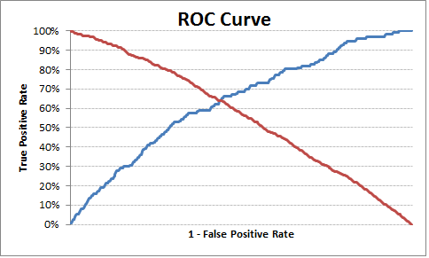
Modeling
Reg + Grid Results | Changing Cut-Off Value
Optimal Model: L1 regularization (C = 500) Accuracy 82 %, Sensitivity 43% Improved Accuracy by 2% and Sensitivity by 1% | - Default 50%/50% Shifting Probability Threshold to 26.3% - Accuracy decreases 0.5pp to 79.6% - Sensitivity increases 42.3pp to 75.0%!
Notes:
Regularization & GridSearch Results:
- Optimal Model:
- L1 regularization (C = 500)
- Accuracy 82 %, Sensitivity 43%
- Improved Accuracy by 2% and Sensitivity by 1%
Changing Cutoff Value
(Insert https://i.stack.imgur.com/UzN2X.png)
(Insert Eric’s ROC curve image)
- Default 50%/50%
- Shifting Probability Threshold to 26.3%
- Results:
- Accuracy decreases 0.5pp to 79.6%
- Sensitivity increases 42.3pp to 75.0%! (from Baseline 42.3%)
Feature Importance:
(Insert Eric’s Logistic Feature Importance Image)
- Red Blood Cells
- Magnesium
- Potassium
- MCH
- Calcium
Logistic Regression: Balancing the Dataset with NearMiss
- NearMiss: module that rebalances dataset by under-sampling majority class
- Optimal Model:
- L1-Regularization, (C = 210)
- Cutoff Threshold of 45%
Best Sensitivity of all Logistic Models: 79.7%
Stochastic Gradient Descent:
- Parameters:
- Alpha (Same as linear regression) (Alpha = 0.0001 = no penalization)
- Penalty = L1/L2/ElasticNet
- Loss = Log
- Results:
- Accuracy decreases 1.6pp to 78.5% (from Baseline 80.1%)
- Sensitivity increases 30.6pp to 72.9%! (from Baseline 42.3%)

Slide 15
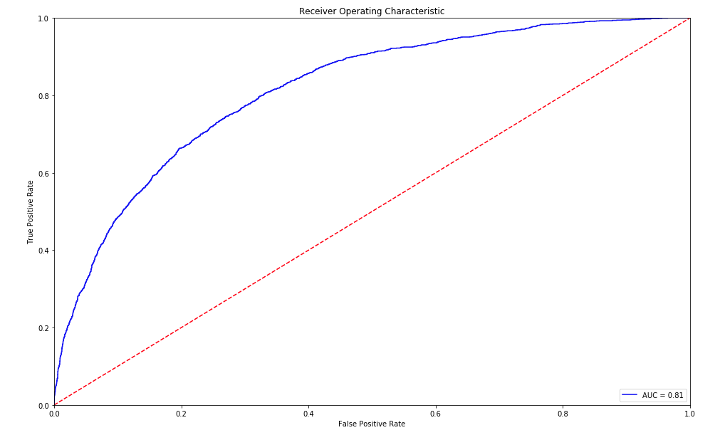
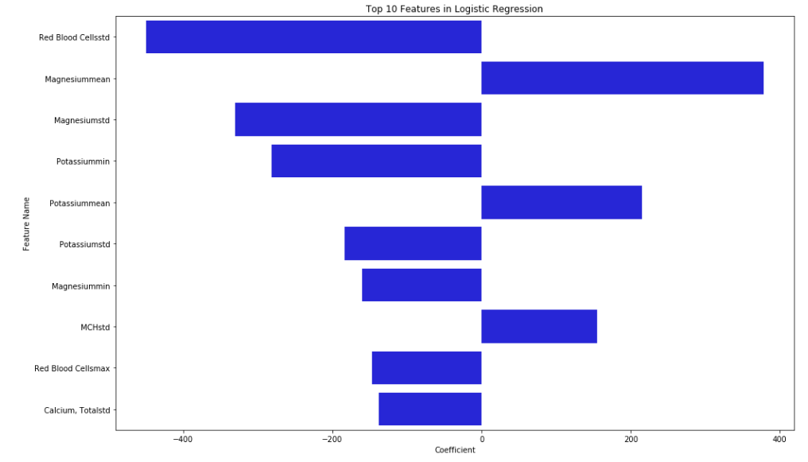
Modeling
ROC Curve | Feature Importance
 | -
Notes:
Feature Importance:
- Red Blood Cells
- Magnesium
- Potassium
- MCH
- Calcium
Logistic Regression: Balancing the Dataset with NearMiss
- NearMiss: module that rebalances dataset by under-sampling majority class
- Optimal Model:
- L1-Regularization, (C = 210)
- Cutoff Threshold of 45%
Best Sensitivity of all Logistic Models: 79.7%

Slide 16
Modeling
Stochastic Gradient Descent | Re-balancing the Dataset
Parameters: - Alpha = 0.0001 = No penalization - (Alpha: same as linear regression) - Penalty = L1/L2/ElasticNet - Loss = Log Optimal SGD Results: Accuracy decreases 1.6pp to 78.5% Sensitivity increases 30.6pp to 72.9% | NearMiss: Module that rebalances dataset by under-sampling majority class. Optimal NearMiss Logistic Results: - L1-Regularization, (C = 210) Cutoff Threshold of 45% Accuracy decreases to 56.8% Sensitivity is Best of Logistic Models: 79.7%
Notes:
Fe
Logistic Regression: Balancing the Dataset with NearMiss
- NearMiss: module that rebalances dataset by under-sampling majority class
- Optimal Model:
- L1-Regularization, (C = 210)
- Cutoff Threshold of 45%
Best Sensitivity of all Logistic Models: 79.7%
Stochastic Gradient Descent:
- Parameters:
- Alpha (Same as linear regression) (Alpha = 0.0001 = no penalization)
- Penalty = L1/L2/ElasticNet
- Loss = Log
- Results:
- Accuracy decreases 1.6pp to 78.5% (from Baseline 80.1%)
- Sensitivity increases 30.6pp to 72.9%! (from Baseline 42.3%)

Slide 17
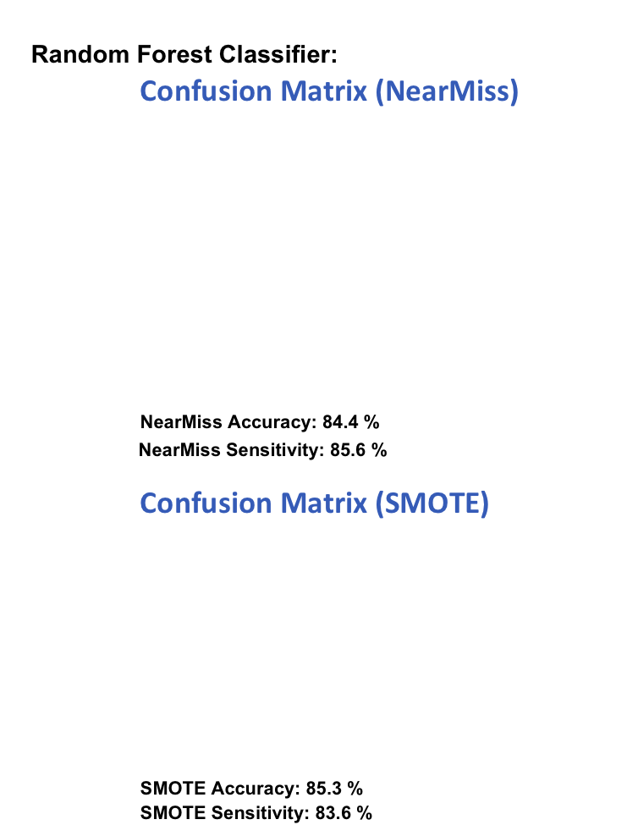
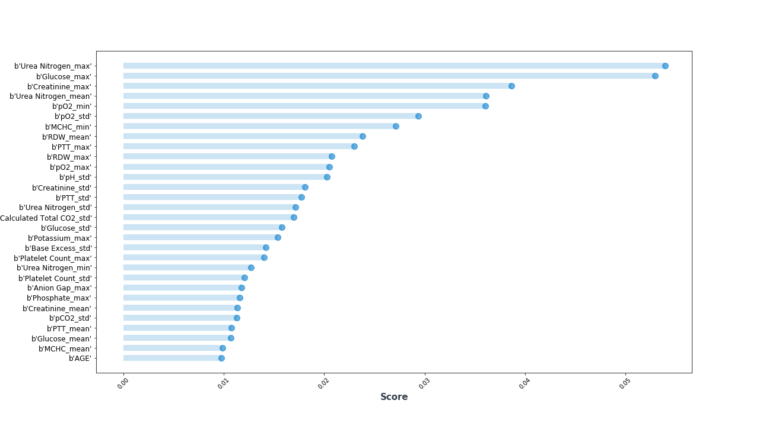
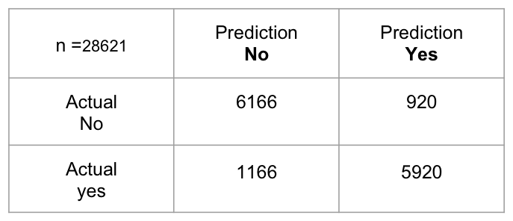
Modeling
Optimized Hyperparameters: criterion='gini'，max_features=8, min_samples_leaf=4, min_samples_split=3, n_estimators=100.
n = 7812 | Prediction No | Prediction Yes
Actual No | 1688 | 334
Actual yes | 296 | 1726
Feature Importance
Notes:
Tree models:
Simple Tree:
Random Foreset:
- applied imblearn to balance the target feature(SMOTE, NearMiss)
- randomly choose 1/5 as test dataset
- GridSearchCV(cv = 5) based on the rest of 4/5 dataset
- Parameters: criterion='gini',
max_features=8,
min_samples_leaf=4,
min_samples_split=4,
n_estimators=100,
- Results:
- Accuracy: 0.8442
- Sensitivity: 0.8536
GBoosting Classifier:
XGBoosting Classifier:
RISKS:
- Missing Chart Events
- False Negatives and Misdiagnosis
- Assumptions on Blood Measurements
- Excluding Children
- Adults > 65
- Pregnant Women
- Compound Conditions
(and more?)

Slide 18
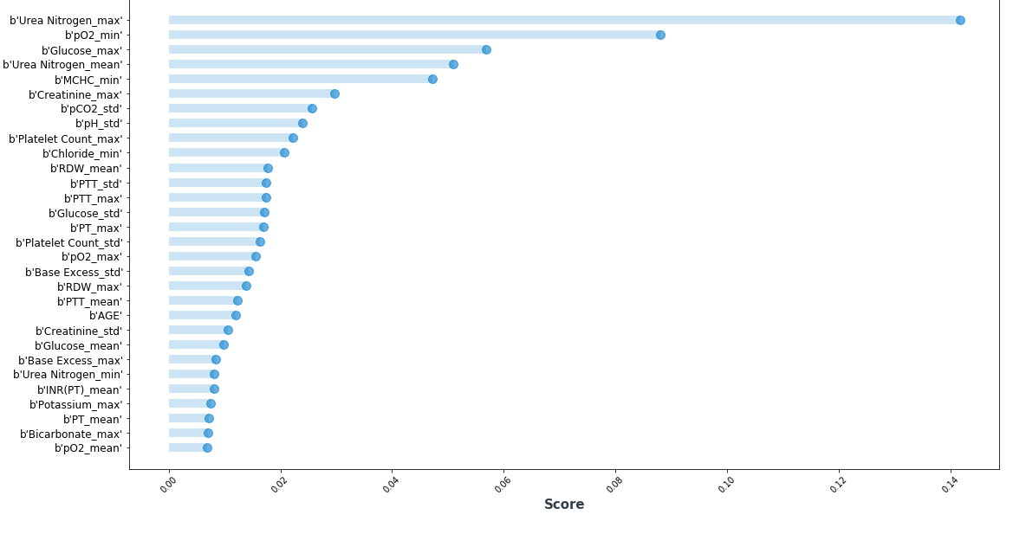
Modeling
Gradient Boosting Classifier
Confusion Matrix (NearMiss)
NearMiss Accuracy: 85.9 %
NearMiss Sensitivity: 85.6 %
Optimized Hyperparameters: criterion='friedman_mse', learning_rate=0.05,loss='deviance', max_depth=6,
max_features='sqrt', min_samples_leaf=14, min_samples_split=2, n_estimators=500
Feature Importance
n = 7812 | Prediction No | Prediction Yes
Actual No | 1737 | 285
Actual yes | 287 | 1735
Notes:
Tree models:
Simple Tree:
Random Foreset:
- applied imblearn to balance the target feature(SMOTE, NearMiss)
- randomly choose 1/5 as test dataset
- GridSearchCV(cv = 5) based on the rest of 4/5 dataset
- Parameters: criterion='gini',
max_features=8,
min_samples_leaf=4,
min_samples_split=4,
n_estimators=100,
- Results:
- Accuracy: 0.8442
- Sensitivity: 0.8536
GBoosting Classifier:
XGBoosting Classifier:
RISKS:
- Missing Chart Events
- False Negatives and Misdiagnosis
- Assumptions on Blood Measurements
- Excluding Children
- Adults > 65
- Pregnant Women
- Compound Conditions
(and more?)

Slide 19
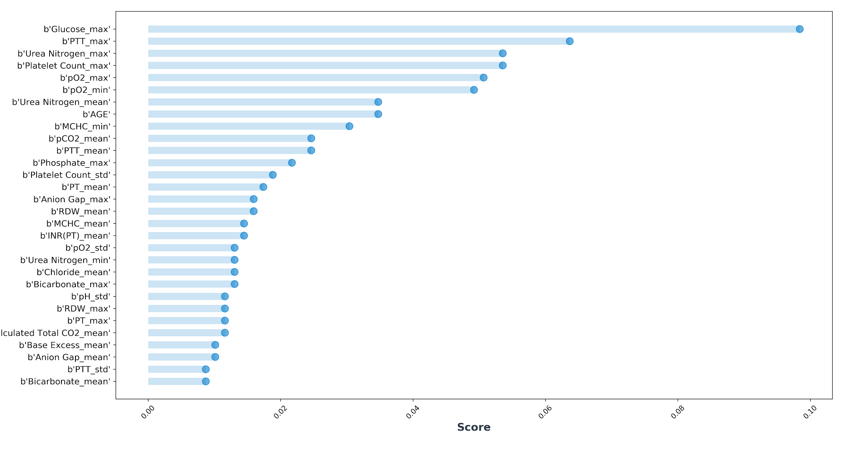
Modeling
XGBoosting Classifier
Confusion Matrix (NearMiss)
NearMiss Accuracy: 85.76%
NearMiss Sensitivity: 86.10%
Optimized Hyperparameters: criterion=friedman_mse, learning_rate=0.05, loss=deviance, max_depth=6, reg_alpha=0.25,colsample_bytree:0.4,
reg_lamb= 0.01 , min_child_weight=1.7817, subsample=0.3, n_estimators=100
Feature Importance
n = 7812 | Prediction No | Prediction Yes
Actual No | 1727 | 295
Actual yes | 281 | 1741
Notes:
Tree models:
Simple Tree:
Random Foreset:
- applied imblearn to balance the target feature(SMOTE, NearMiss)
- randomly choose 1/5 as test dataset
- GridSearchCV(cv = 5) based on the rest of 4/5 dataset
- Parameters: criterion='gini',
max_features=8,
min_samples_leaf=4,
min_samples_split=4,
n_estimators=100,
- Results:
- Accuracy: 0.8442
- Sensitivity: 0.8536
GBoosting Classifier:
XGBoosting Classifier:
RISKS:
- Missing Chart Events
- False Negatives and Misdiagnosis
- Assumptions on Blood Measurements
- Excluding Children
- Adults > 65
- Pregnant Women
- Compound Conditions
(and more?)

Slide 20
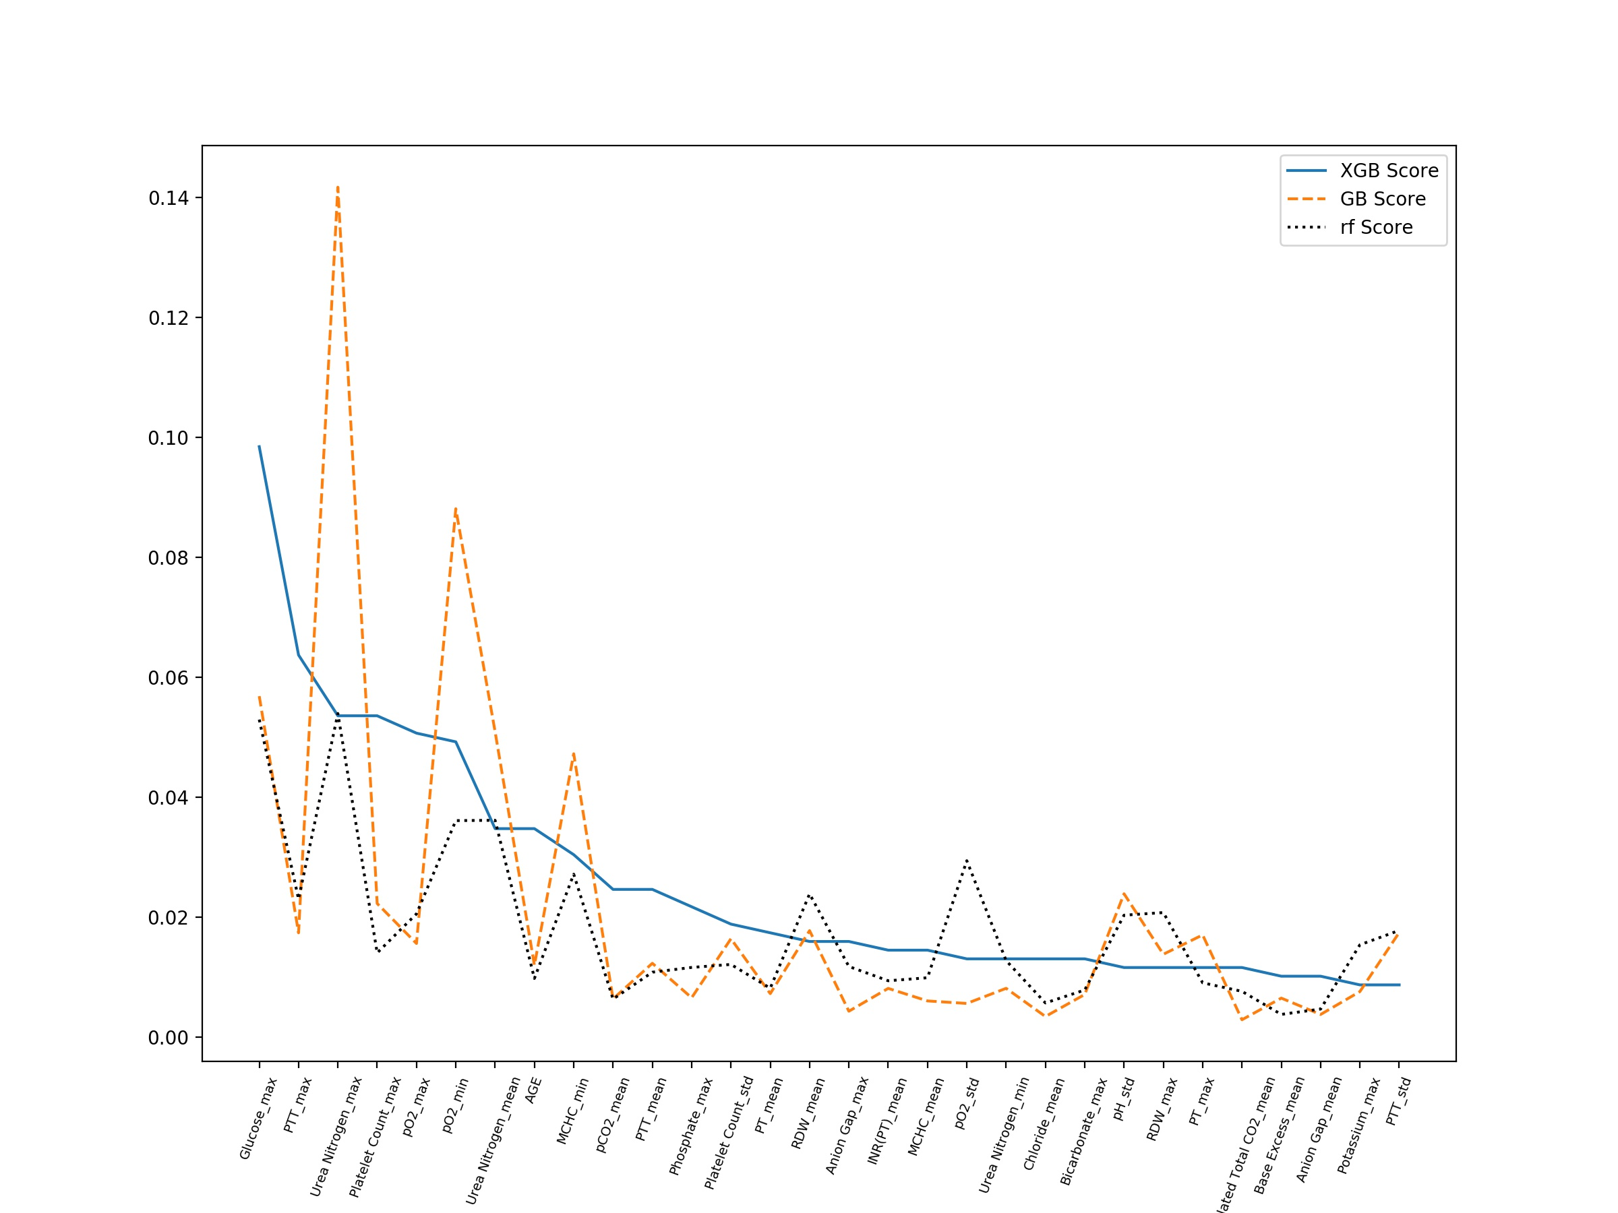
Modeling
Feature Importance Comparison

Slide 21
Agenda for today
Introduction
The what, the why and the how
Data
Source & Mining
Modeling
Classification, Risks and Obstacles
Conclusion
And future Work

Slide 22
Bare the risks...
Conclusion
1
This is just the beginning...
Timeline 6mon - 1 year
Research will be Key
Modeling Techniques:
(A) Feature Engineering
(B) Support Vector Machine Classifier
(C) Build All-Disease Prediction Engine (Not just CHF)
(D) Modularize all Cleaning/Imputation Methods
Missing Chart Events
False Negatives and Misdiagnosis
Assumptions on Blood Measurements
Excluding Children
Adults > 65
Pregnant Women
Compound Conditions
2
3
Notes:
Future Work:
- This is just the beginning!! (This project could easily take 6 months - 1 year)
- Research and identify all of risks and assumptions; adapt imputation and modeling accordingly
- Modeling techniques:
- Support Vector Machine Classifier
- Build All-Disease Prediction Engine (Not just CHF)
- Modularize all Cleaning/Imputation Methods

Slide 23
Source Citation
Data Source:
MIMIC-III Database v1.4 (Published Sept. 4, 2016):
URL: https://alpha.physionet.org/content/mimiciii/1.4/
MIMIC-III resource citation:
  Johnson, A., Pollard, T., Mark, R. (2016). MIMIC-III Clinical Database. PhysioNet. doi:10.13026/C2XW26
Original publication:
  Johnson, A. E. W., Pollard, T. J., Shen, L., Lehman, L. H., Feng, M., Ghassemi, M., Moody, B., Szolovits, P., Celi, L. A., & Mark, R. G. (2016). MIMIC-III, a freely accessible critical care database. Scientific Data, 3, 160035.
Standard citation for PhysioNet:
  Goldberger AL, Amaral LAN, Glass L, Hausdorff JM, Ivanov PCh, Mark RG, Mietus JE, Moody GB, Peng C-K, Stanley HE. PhysioBank, PhysioToolkit, and PhysioNet: Components of a New Research Resource for Complex Physiologic Signals (2003). Circulation. 101(23):e215-e220.

Slide 24
Thank You!

