Slide 1


Eric Meyers

Slide 2

Purpose
Case: Type II Diabetes Mellitus
Web Scraping: Scrapy
Research Questions
Exploratory Data Analysis
Recommendations
Future Work
Questions

Slide 3

Career Goal: extend life expectancy with early indicators of medical conditions.
Project:
  Scrape medication reviews from WebMD.
  Create value & insights for consumers, WebMD, and pharmaceutical companies.
Save lives!

Slide 4


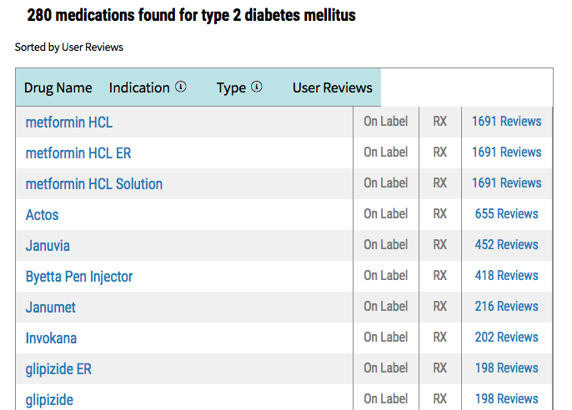
Condition:
  Hereditary & Adult Onset
  Pancreas & Insulin
  Blood Sugar/Glucose
Symptoms:
  Weight gain/loss
  Hunger/Thirst & Fatigue
  Frequent Urination
  More…
Treatments:
  Healthy Eating & Exercise
  Oral Medication (Pills) ➔
  Insulin Injection ➔
Source:
American Diabetes Association
Source:
WebMD

Slide 5

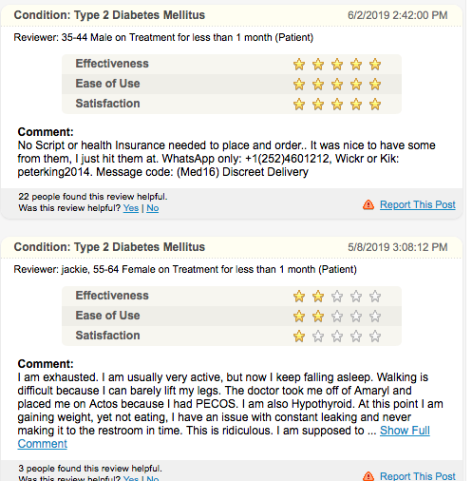
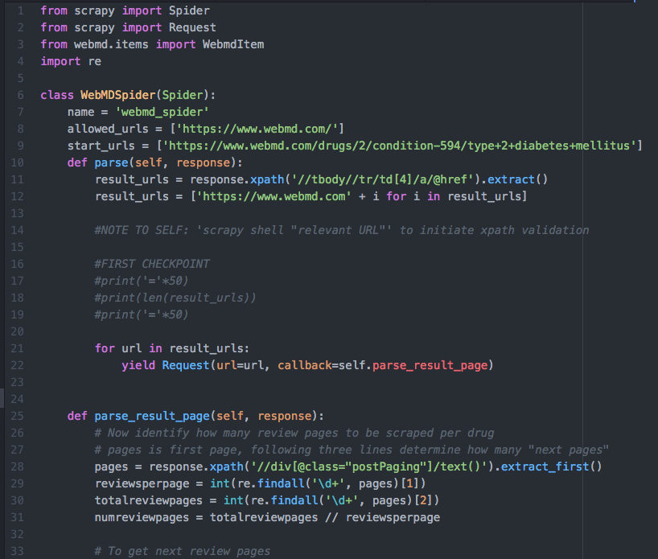
WebMD Reviews
Atom: webmd_spider

Slide 6

Site Structure:
  Multiple medications to multiple conditions
  Counts: Reviews and medications groupings
  Pseudo URL’s on first review pages
  Reviewer field not standardized
Spider Bugs in QA:
  Comment fields duplicated or nulls
  Helpful vote counter

Slide 7

Which drugs are rated “Most Effective”? “Most Satisfactory”? “Easiest to Use”?
Are there relationships between rating types?
Any relationship between length of comments and their helpfulness?
Significant difference in effectiveness between Top 5 Most Effective Drugs?

Slide 8

Modules & Libraries Used:
  Numpy
  Pandas
  Matplotlib
  Seaborn
  SciPy

Slide 9

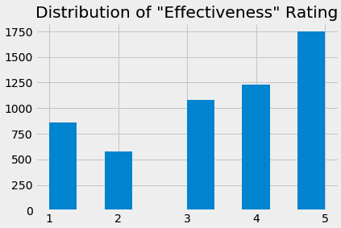
Fields:
  Review DateTime
  Reviewer (Optional A/S/L)
  Condition
  Medication
  Review Comment
  Rating: Effectiveness (Int)
  Rating: Satisfaction (Int)
  Rating: Ease of Use (Int)
  Up-vote: Helpful (Int)

Slide 10

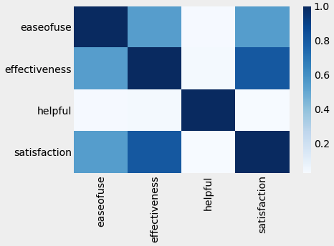

Slide 11

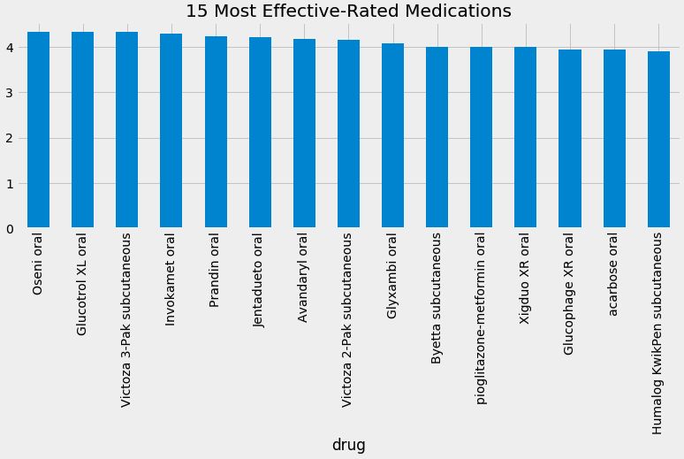

Slide 12

Consumers: Most Effective Medications
  (> 4) Oseni, Glucotrol, Victoza, Invokamet, Prandin
Pharmaceuticals:
  81% Correlation btwn Effectiveness & Satisfaction!
  54% Correlation btwn Ease of Use & Eff/Satis
WebMD:
  Moderate (33%) Correlation btwn comment length & helpfulness
Consumers & Pharmaceuticals:
  No significance in effectiveness across top 5 (ANOVA)*
    Pvalue = 13.7%*
  *ANOVA performed for experiment purposes ONLY, assumptions not verified

Slide 13

NLP on review comments:
  Reviewer info: Age, Gender, “Sub-conditions”
Time Series:
  Within particular drugs, has sentiment changed?
Verify assumptions for ANOVA
Genetic modeling & early indicators

Slide 14

Any Questions?

