Slide 1
Integrated NTD Database
Training
2014

Slide 2
Course overview
Introduction
Installation
Opening screen
Getting started
A tour of the tool
Data entry: Form by form
Data entry: Bulk importing
Updating for a new year
Redistricting
Reports
Setting up a file for your program
2

Slide 3
Introduction
The Integrated NTD Database was designed to strengthen the capacity of national NTD programs to store, manage, analyze, and report their data.

Slide 4
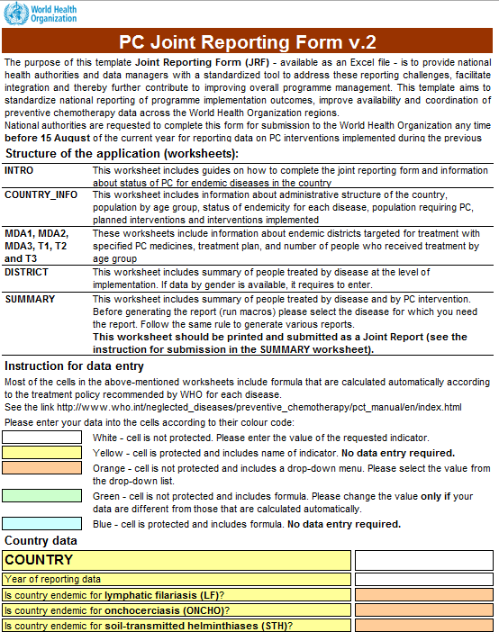
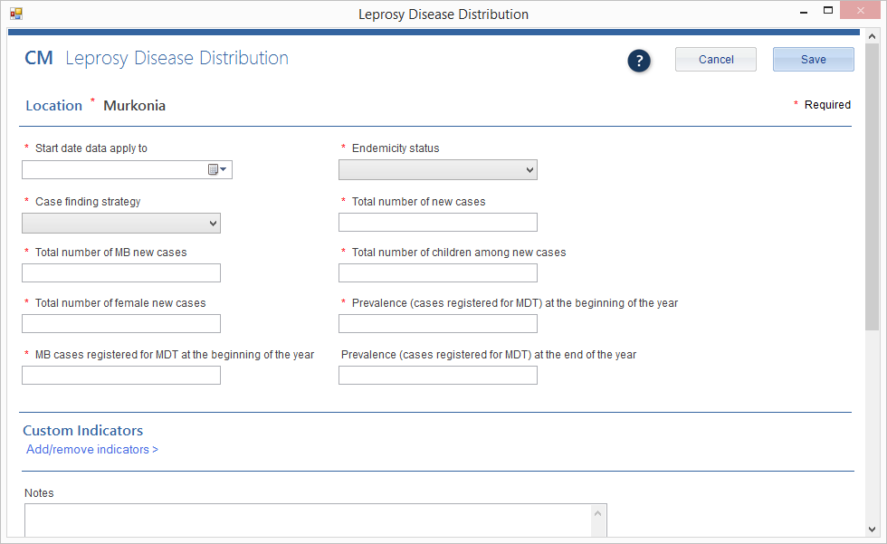
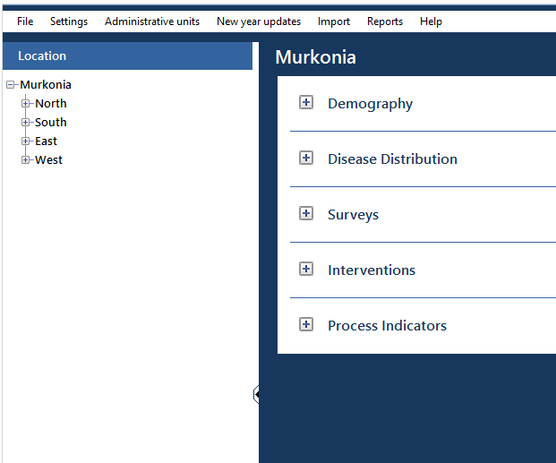
Primary functions
The Integrated NTD Database provides a convenient way for NTD programs to:
Store and analyze data
Demography
Disease Distribution
Surveys
Interventions
Process Indicators
Serious Adverse Events
Generate reports
WHO/Partner reports
Standard reports
Custom reports

Slide 5
Partners and contributors
The development of the template was a collaborative effort in 2013 across multiple partners, including:
WHO HQ
AFRO
APOC
SEARO
WPRO
RTI/ENVISION
CNTD
To ensure the database meets the needs of national NTD programs, Ministries of Health were actively involved in the development process.

Slide 6
Goals of the system
1
To store large volumes of M&E data generated by Neglected Tropical Disease programs over time
To assist with data management and analysis at the country level, thereby supporting programmatic decision-making
To strengthen the capacity for data sharing between countries, WHO, and partners
2
3

Slide 7
How and when the tool can be used
The Integrated NTD Database can be used in a variety of scenarios, including:
To store treatment data as it becomes available
As surveys are implemented and results are available
To prepare for annual data review meetings
To provide feedback to sub-national levels
To guide work planning, e.g. by reviewing administrative units that need mapping or measuring performance over time.
To compile national reports
To report to the WHO and partners as data are requested or reports are due
To complete the TAS Eligibility and Reporting Form
To complete elimination dossiers
To fill ad hoc requests for data

Slide 8
Primary users
National-level NTD program managers
M&E specialists
Data managers
The database is:
For NTD programs.
Each database system belongs to national NTD program offices, not partners or funders. There is no automatic data sharing.
Customizable.
NTD programs can tailor the database system to fit their country’s context and data management needs.
Optional.
The Integrated NTD Database is not required. National NTD programs can opt to use it or not.

Slide 9
Data management
The Integrated NTD Database manages the following types of data for NTDs:
Demography
Disease Distribution
Surveys
Interventions
Process Indicators
Serious Adverse Events

Slide 10
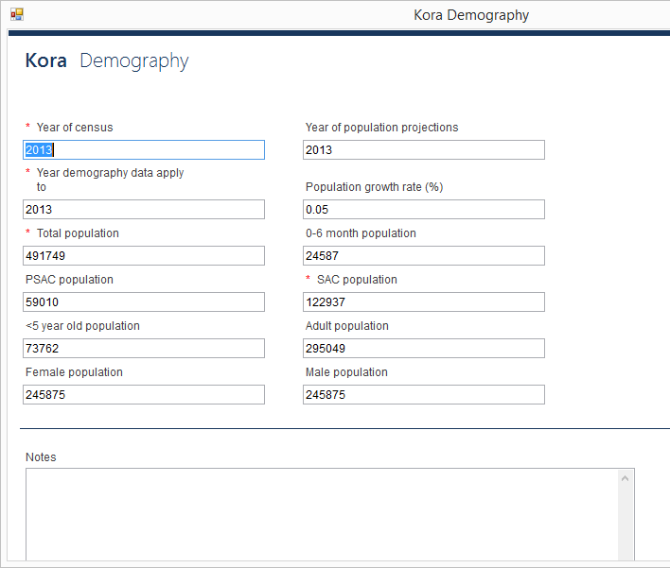
Demography
data management
Country-wide demography information is tracked for every year.

Slide 11
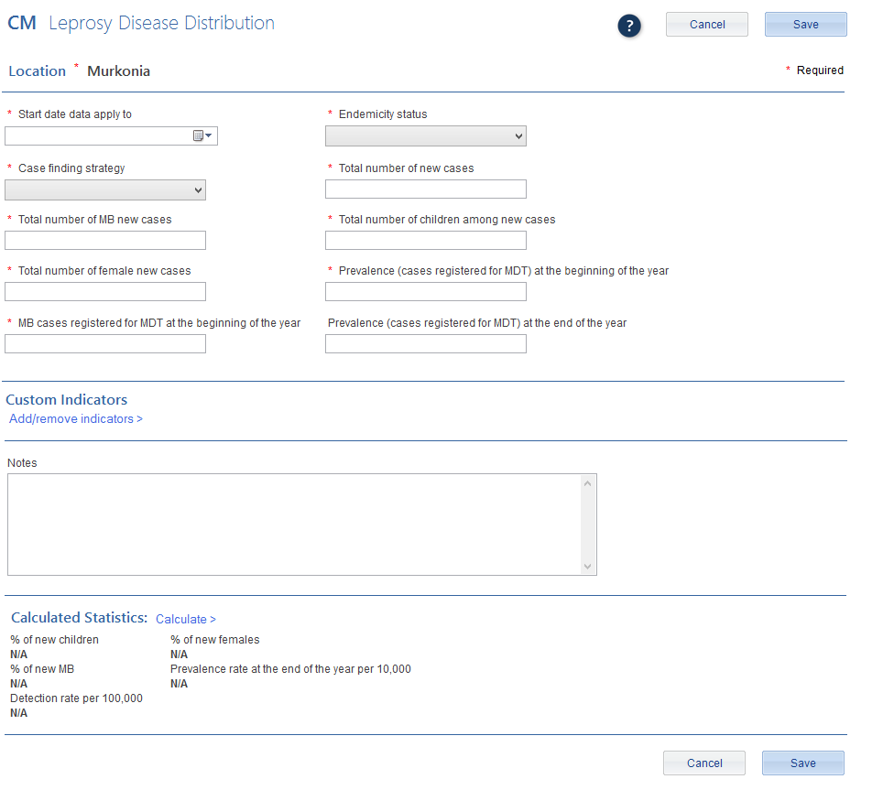
Disease Distribution
data management
Disease distribution information for NTDs is recorded for every year.

Slide 12
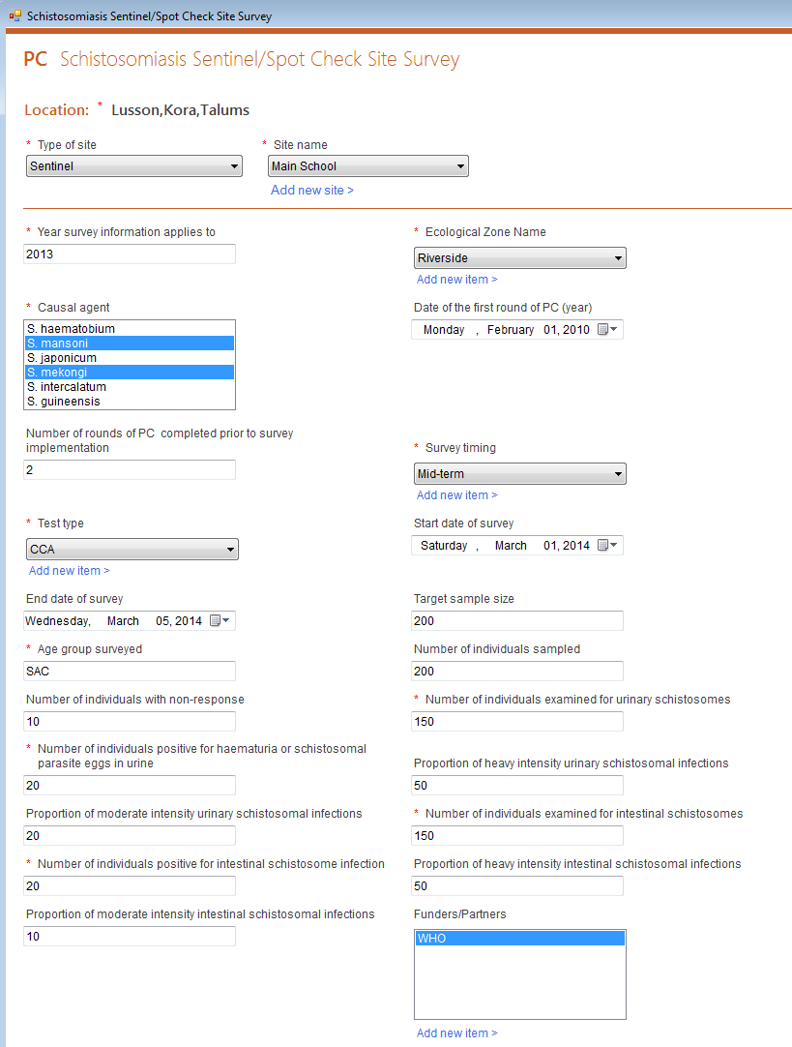
Surveys
data management
Users can enter survey data into the Integrated NTD Database. This includes mapping, baseline, midterm, TAS, and other surveys.

Slide 13
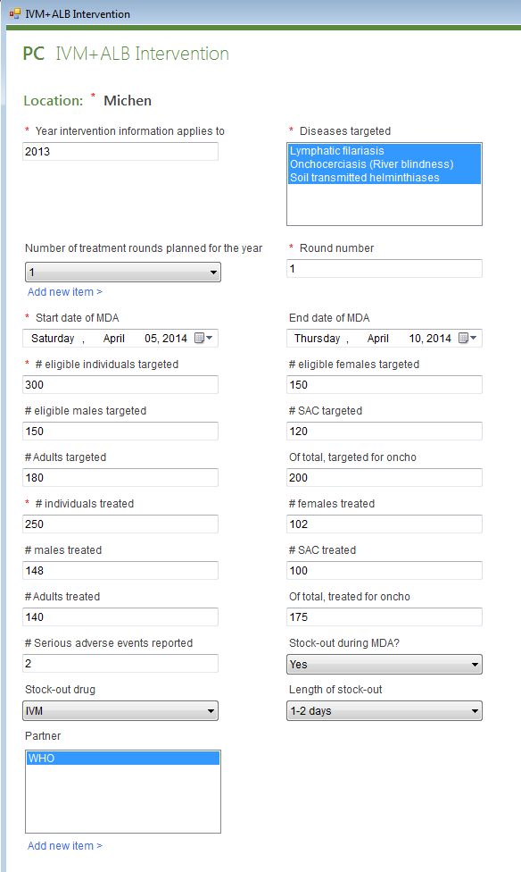
Interventions
data management
Users can enter intervention data into the Integrated NTD Database. This includes MDAs, morbidity management, and other information.

Slide 14
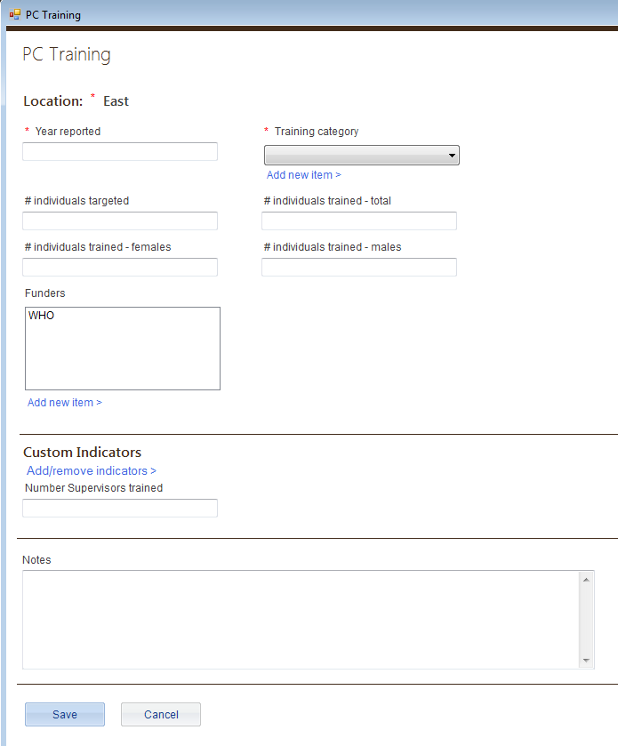
Process Indicators
data management
Users can enter process indicator data into the National Database. This includes training and supply chain management.

Slide 15
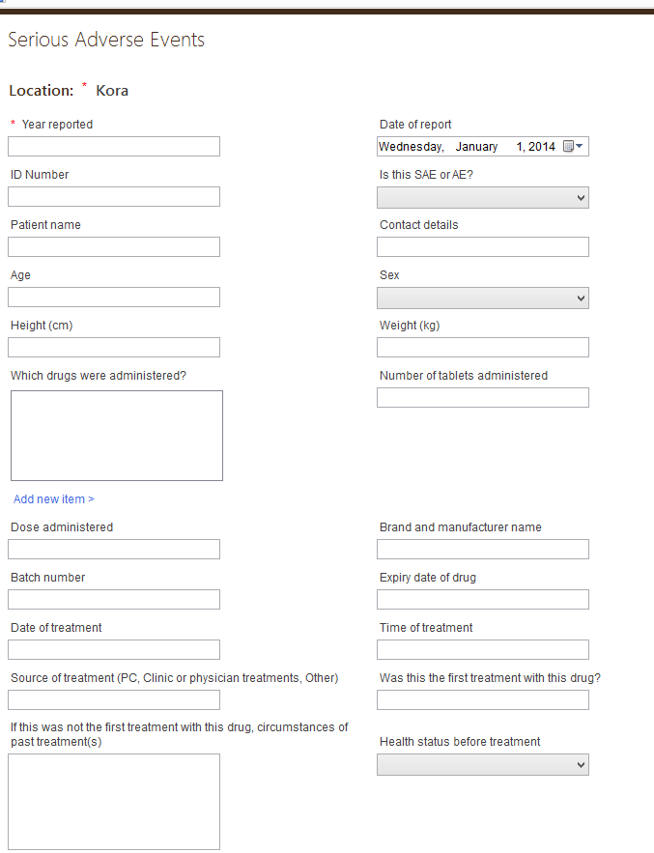
Severe Adverse Events
data management
Users can store SAE data in the National Database.
SAE forms can be found under Process Indicators

Slide 16
Convenient Features
data management
Import data in large batches using Excel
Create custom indicators for any form
Create custom forms for any module
Export data to an Excel worksheet
Collect historical data for multi-year analysis
Create reports using any data entered

Slide 17
Reports
The Integrated NTD Database provides three types of report functions:
WHO/Partner reports
Standard reports
Custom reports

Slide 18
WHO/Partner Reports
reports
The Integrated NTD Database can generate both the CM Joint Reporting Form and the PC Joint Reporting Form, as well as other partner reports.

Slide 19
Standard Reports
reports
The Integrated NTD Database can generate these standard reports with just a few clicks:
Progress toward elimination
Mapping report (coming soon)
M&E assessments (coming soon)
Districts treated (coming soon)
Coverage performance (coming soon)
Training report (coming soon)

Slide 20
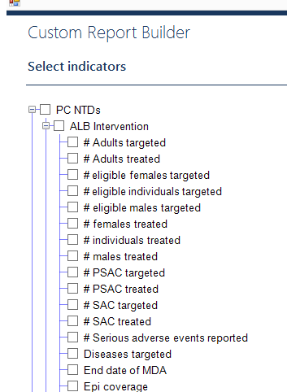
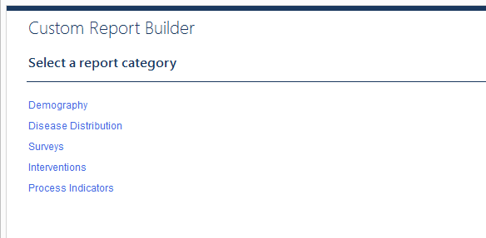
Custom Reports
reports
With the custom report builder, users can create reports using any data in the database.

Slide 21
Additional system features
Updates automatically with an Internet connection for bug fixes or when new features are added.
Backs up automatically with an option to revert to last version.

Slide 22
Installation
The first step is installing the Integrated NTD Database on your computer.

Slide 23
Installation steps
There are two steps to running the Integrated NTD Database on your computer:
Install the Access DB Engine32 bit
Install the Integrated NTD Database

Slide 24
Install the Access DB Engine32 bit
installation steps
To install the Access DB Engine32 bit:
Go to http://www.microsoft.com/en-us/ download/details.aspx?id=13255
Download and install the Access engine
Restart your computer
Important note: If you cannot download the Access Engine because you get a message that you already have it on your computer, that is fine. Just proceed to the next step.

Slide 25
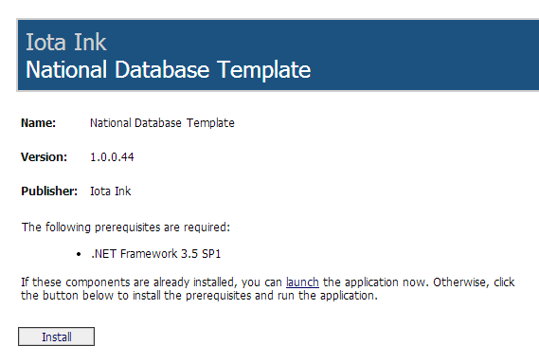
Install the Integrated NTD Database
installation steps
To install the Integrated NTD Database:
Go to http://apps.who.int/neglected_diseases/ntddata/ntd_database/ or for 64-bit users http://apps.who.int/neglected_diseases/ntddata/ntd_database/x64
Click Install

Slide 26
The opening screen
When you open the Integrated NTD Database program, you will first encounter the opening screen before you enter your file or data.

Slide 27
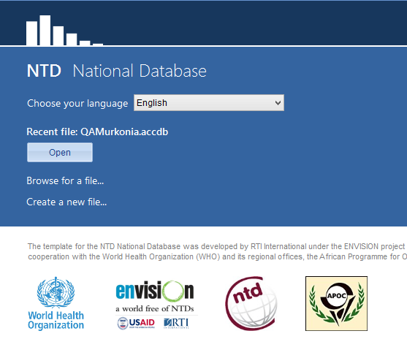
The opening screen
This is the first screen you see when opening the Integrated NTD Database tool each time.
It includes:
Choose your language
Recent file name
Open button
Browse for a file link
Create a new file link

Slide 28
Choose your language
the opening screen
There are four languages currently included in the Integrated NTD Database:
English, French, Portuguese, and Bahasa
You can choose your preferred language from the drop down menu.
Important note: Number formats differ by country. Be sure to enter numbers in the format your computer regional settings are set to, no matter which language is showing on the screen. For example, if your settings are set to:
English (United States), you must enter numbers as 1,000.00
French (France), you must enter numbers as 1 000,00.
Notes:
Trainer – the other languages besides English are coming soon.

Slide 29
Recent file
the opening screen
The Integrated NTD Database will always list the most recent file on the opening screen.
To open the most recent file, just press the Open button.

Slide 30
Browse
the opening screen
You can open an existing file that was previously created from the opening screen as well.
Click on the Browse for a file… link to access your files.
Important note: You should always open the Integrated NTD Database first, then your file. Do not try to open your file alone from the saved location on your computer. You must always open your file from within the Integrated NTD Database program or it will not work properly.

Slide 31
New file
the opening screen
To start a new Integrated NTD Database, select Create new file… and a browser window will open and prompt you to save your file.

Slide 32
Create a new file
Select Create a new file…
Name your new file Murkonia
Save the file on your computer

Slide 33
Getting Started
When you create a new Integrated NTD Database file, you go through a series of steps to set up the file specifically for your country.

Slide 34
Getting started
The steps to setting up the Integrated NTD Database for the first time are:
Sign in
Enter country information
Choose diseases
Edit or add administrative levels

Slide 35
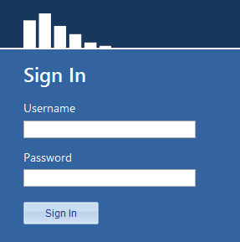
Sign in
getting started
The first time you use the tool, the user name will be blank and the password field will be blank.
Just press the Sign In button.

Slide 36
Sign in
Ensure user name is blank
Password should be blank
Press the Sign In button
You will change the password later in this presentation.

Slide 37
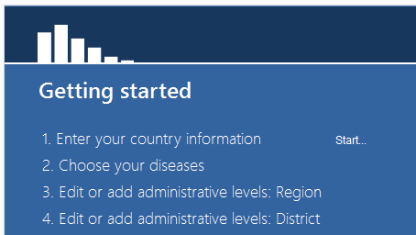
Enter your country information
getting started
Next you will need to enter your country information, including:
Country name
Administrative levels
Population statistics
Click on the Start link to begin.

Slide 38
Enter Murkonia country information
Enter Country name: Murkonia
Select view to access the Region administrative level information
Change the name from Region to Province
Click Save
Click Add administrative level type >
Enter Name: Village
Click Save
Click Next

Slide 39
Enter Murkonia country settings
Year of census: 2010
Population growth rate (%): 4
Age range for SAC: 5-14
% PSAC of total population: 12
% <5 years old of total population: 15
% female of total population: 49
% rural of total population: 30
Start date data applies to: January 1 2014
Age range for PSAC: 2-4
% 0-6 months of total population: 3
% SAC of total population: 25
% adults of total population: 60
% male of total population: 51
When finished, click Next

Slide 40
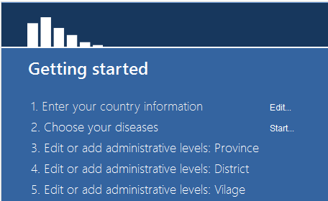
Choose your diseases
getting started
Next you will choose the diseases included in the country’s program.
Click on the Start link to begin.

Slide 41
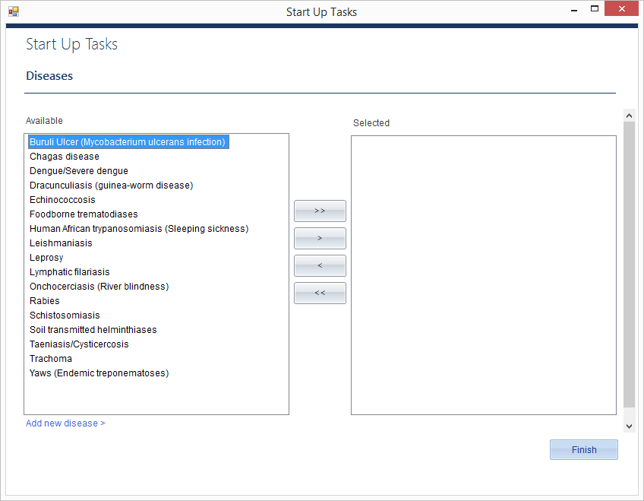
Choose your diseases
getting started
The Integrated NTD Database uses the following convention to select diseases:
>>
Moves all items from the box on the left to the box on the right.
>
Moves only selected items from the box on the left to the box on the right.
<
Moves only selected items from the box on the right back to the box on the left.
<<
Moves all items from the box on the right back to the box on the left.
Add new disease allows you to add another disease to the list.

Slide 42
Choose Murkonia diseases
Assume Murkonia’s NTD program includes all 17 diseases. Practice using all the arrows to move diseases from one box to another.
Once you have tested all four arrow options, move all diseases to the box on the right and click Finish.
Quick Tip
You can select several diseases at the same time by holding down the ctrl key while clicking on the disease names. Once the names are highlighted, click on the single arrow button > to move the selected diseases to the box on the right.

Slide 43
Adding administrative levels
getting started
Demography is added to the Integrated NTD Database via Excel spreadsheets in three steps for each level.
The steps are:
Download the import file
Fill in the import file with country data
Upload the import file
Important note: You must use the import files downloaded from the database. You should enter or cut and paste your country data into the import files.

Slide 44
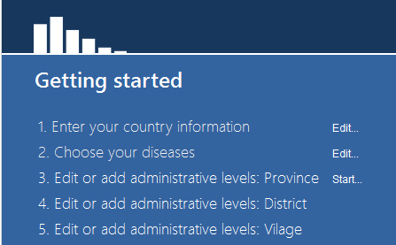
Add data for administrative levels: Provinces
At the getting started screen, click Start next to Edit or add administrative levels: Province
Number to import: 4
Click Download import file
Rename and save the import file. The import file will open in Excel on your computer.

Slide 45
Enter data for 4 sample provinces into your file. You can put in any information you want – it does not need to be real data.
Close the file.
Choose Upload import file. The database will let you know if there are any problems with the import. Fix any errors and try again.
Once the file imports correctly, Click Next.
Important note: Because district is the aggregating level, there are no population values required at the province or country level.

Slide 46
Add data for administrative levels: Districts
Number to import: 25
Download import file.
Rename and save the import file. The import file will open in Excel on your computer.

Slide 47
Enter data for 25 sample districts into your file. You can put in any information you want – it does not need to be real data.
Close the file.
Upload import file. The database will let you know if there are any problems with the import. Fix any errors and try again.
Once the file imports correctly, click Next.

Slide 48
Add data for administrative levels: Villages
Create import for one of your districts
Number to import: 13
Download import file.
Rename and save the import file. The import file will open in Excel on your computer.
Notes:
Trainer: Talk about how to add villages for different regions before moving on.

Slide 49
Add information for 13 sample villages of your choice into your file. You can put in any information you want – it does not need to be real data.
Close the file.
Upload import file. The database will let you know if there are any problems with the import. Fix any errors and try again.
Once the file imports correctly, click Next.
Important note: Since district is the aggregating level, all population information is required and will be totaled to fill in population information for Provinces and the Country.

Slide 50
Backing up
getting started
It is important to regularly back up your database file. You should regularly save your file to an external drive.
Important note: The Integrated NTD Database saves automatically. If you make a large mistake, you should revert to the last opened version of your file by going to:
Main menu > Settings > Edit settings > Database > Restore.
You will lose any changes made since opening the file.

Slide 51
Documentation
getting started
It is a good idea to keep a record of the following information about your Integrated NTD Database:
Names of individuals involved in compilation of historical data stored in database, including title and organization
Primary source(s) of data for historical demography data entered in database
Primary source(s) of data for historical disease distribution data entered in database
Primary source(s) of data for historical survey data entered in database
Primary source(s) of data for historical intervention data entered in database
Primary source(s) of data for historical process indicator data entered in database
Notes about any missing information
Notes about assumptions made

Slide 52
A tour of the tool
Now that you have finished entering the start up data, you are ready to start entering the program data in the tool.

Slide 53
A tour of the tool
There are three main parts to the Integrated NTD Database:
The Main Menu across the top
The Location Tree
The Activity Dashboard

Slide 54
The Main Menu
a tour of the tool
The Main Menu has six functions:
File
Settings
Administrative units
Import
Reports
Help

Slide 55
File
a tour of the tool : main menu
From the File menu, you can do the following actions:
Start a new file
Open an existing file
Exit your Integrated NTD Database
Quick tips:
Exiting: you can use the red X at the top, right to exit your program at any time.
Saving: you never need to save your file. Your database file updates in real time, meaning any changes you make are automatically saved.
Opening a new file: If you do choose to either start a new file or open an existing file, the file you are currently working in will automatically close.

Slide 56
Settings
a tour of the tool : main menu
Edit Settings option allows you to:
Edit settings. You can change the country settings, diseases selected, and users. This is also where you can create a copy of the error log from your file and restore you database to the backup copy saved at last login.
Country statistics. Enter yearly population statistics for your country here.

Slide 57
Settings
a tour of the tool : main menu
Edit Settings option allows you to:
Change country settings and diseases. These first two tabs are from the set up wizard and work the same as the first time you set up a new file.
Edit users. There are three types of users in the Integrated NTD Database.
Administrators
Edit country settings
Add diseases
View, add, edit users
View, add edit data
Run reports
Data enterers
View, add, edit data
Run reports
Data viewers
View data
Run reports

Slide 58
Add a new user
Select Add new user
Set user name: Program manager
Set password: (your choice, but write it down)
Select roles:
Administrator
Data enterer
Data viewer
Press Save
Use the Dashboard button to return to the dashboard

Slide 59
Settings
a tour of the tool : main menu
Database option allows you to:
Create a copy of the error log file. If you encounter any bugs while using the Integrated NTD Database, you should save this log and send it to the appropriate parties.
Restore database to backup copy saved at last login. If you make a large mistake while using your file, you can click Restore to revert to the older version.

Slide 60
Settings
a tour of the tool : main menu
Country statistics is where you update your country level population data each year such as percentages for different age groups and the growth rate.

Slide 61
Administrative units
a tour of the tool : main menu
The Administrative units option allows you to:
Add administrative units
Delete administrative units
Split administrative units
Merge administrative units
Split/combine administrative units

Slide 62
Add an administrative unit
Select Add administrative units
Name: London
Latitude (if applicable): 51
Longitude (if applicable): 0.1275
Select a Province for London
Press Save
Find London on the Administrative unit tree

Slide 63
Delete an administrative unit
Select Delete administrative units
Find London and click “Delete”
Click Yes
Click Done
Notice London is no longer on the administrative unit tree

Slide 64
Administrative units
a tour of the tool : main menu
Add administrative unit option allows you to add new locations, such as:
Provinces
Districts
Villages
Communities
Up to seven administrative levels are allowed in the tool.
Important note: If you add a new location, you need to go to the Demography activity to enter population information.

Slide 65
Administrative units
a tour of the tool : main menu
Delete administrative unit option allows you to permanently delete locations.
Important note: You can only delete an administrative unit if there are no units below it on the tree.

Slide 66
Import and Reports
a tour of the tool : main menu
Import option will enable you to bulk import data.
Reports option will provide an interface to run custom and standard reports.
An overview of both of these sections will be covered later in this tutorial.

Slide 67
Help feature
a tour of the tool : main menu
There are three selections under the help option:
View help. Takes you to the help feature in the tool. Click here to look up definitions of terms or get information on different topics.
Check for updates. If you are connected to the Internet, you can click here to check if a new version is available.
Updated versions include bug fixes and new features.
The Integrated NTD Database also checks for updates each time you open it, but if you decline to download a new version at that time, you can click here later to download the update.
About. Provides information about the tool.

Slide 68
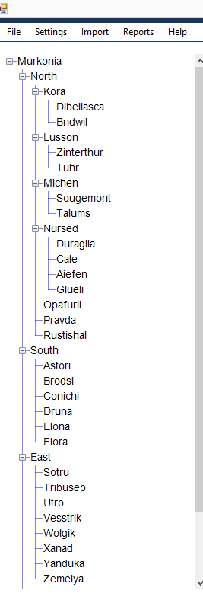
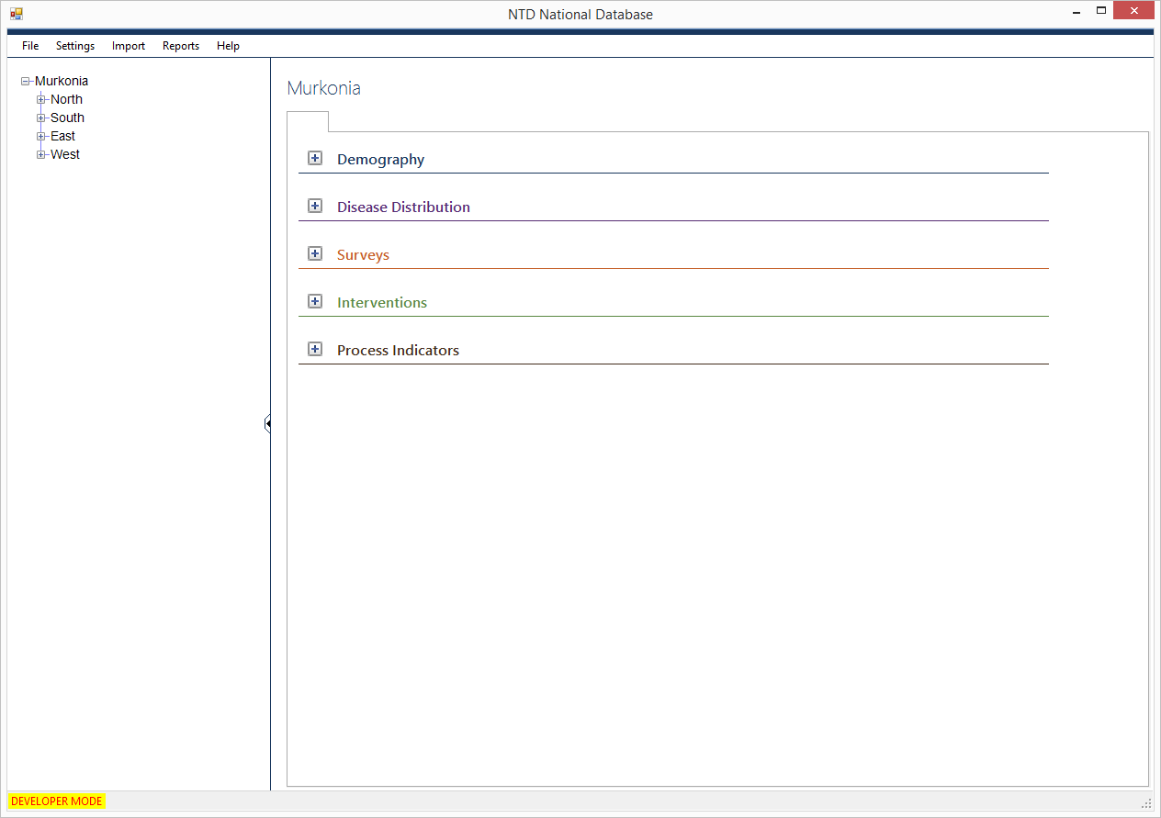
The Administrative Unit Tree
a tour of the tool
Your Administrative unit tree should look like this:
Click on the icon to expand a location. If expanded completely, it will look like this:

Slide 69
Expand the Administrative unit tree
Use the + and – controls to expand and contract the location tree.

Slide 70
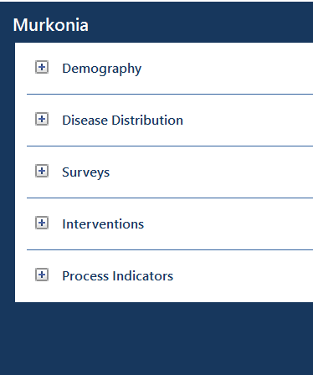
The Activity Dashboard
a tour of the tool
The Dashboard shows all of the data modules that can be entered into the Integrated NTD Database, organized by the following activities:
Demography
Disease Distribution
Surveys
Interventions
Process Indicators
Notes:
Trainer – SAEs are in Process Indicators now, but will be in their own module soon,.

Slide 71
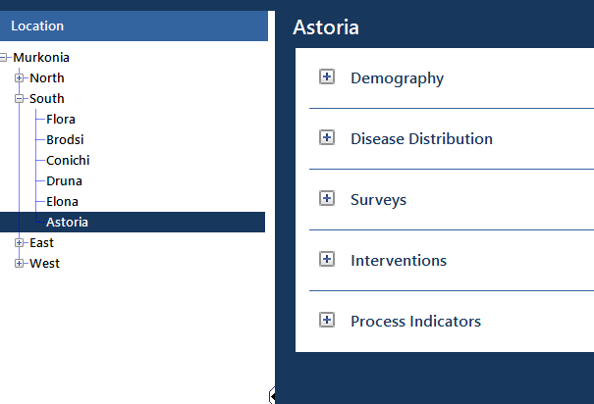
Important feature of the Dashboard
a tour of the tool : activity dashboard
The data and information showing for the specific activities on the Activity Dashboard will always apply to the location selected on the Administrative unit tree.

Slide 72
Explore the Activity Dashboard
Use the+ and – controls to expand and contract the activities on the Dashboard.
Select different locations from within the Location Tree.

Slide 73
Data entry: Form by form
The Integrated NTD Database is organized by administrative units. In the data entry section, you can enter and analyze data for NTD activities that take place in each region, district, community, or other location.

Slide 74
Data entry: Form by form
There are six data entry modules in the Integrated NTD Database:
Demography
Disease Distribution
Surveys
Interventions
Process Indicators
Important note: Any data you enter in the system will be stored. Therefore you should be careful not to enter duplicate data – there is no automatic check to ensure you don’t.

Slide 75
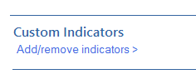
Data entry features
data entry : form by form
Custom indicators and forms
The Integrated NTD Database contains default indicators for each data entry form.
You can add custom indicators to any form or even add entirely new forms altogether.
These new indicators and forms will automatically show up in the custom report builder.

Slide 76
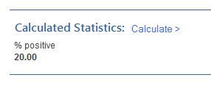
Calculated fields
data entry : form by form : data entry features
There are numerous calculations provided at the bottom of the data entry forms to help you analyze your program.
These calculated fields are also included in the custom report builder.

Slide 77
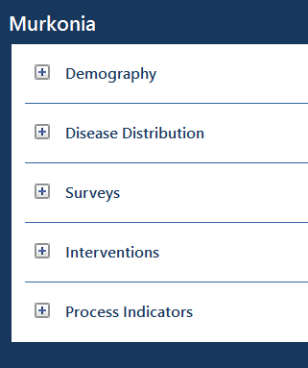
Demography
data entry : form by form
The Integrated NTD Database stores the demography that you enter in the tool.
You can edit demography from the dashboard from the aggregating level down, but for higher levels you can only view data, since these numbers are summed for you.

Slide 78
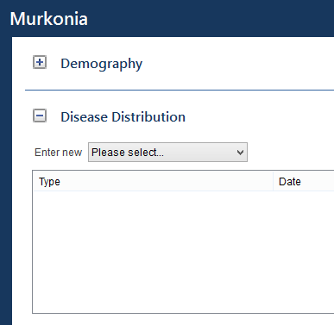
Disease Distribution
data entry : form by form
The Integrated NTD Database automatically creates disease distribution forms for every disease in the tool.
Most of these forms have default indicators provided by WHO.

Slide 79
Enter Disease Distribution - Leprosy
Select Kora (in North Region) from the Administrative unit tree.
Choose Leprosy from the Disease Distribution drop down list.
Enter the data listed below into the form.
Start date data apply to: March 1 2014
Case finding strategy: Active
Total number of MB new cases: 100
Total number of female new cases: 40
MB Cases registered for MDT at the beginning of the year: 10
Endemicity status: High
Total number of new cases: 120
Total number of children among new cases: 30
Prevalence (cases registered for MDT) at the beginning of the year: 20
Prevalence (cases registered for MDT) at the end of the year : 35
When finished, click Next
Notes:
changed

Slide 80
Surveys
data entry : form by form
The survey module is where you record the surveys that took place in your country.
Includes mapping, baseline, mid-term, among others
Allows you to choose multiple locations that encompass an Ecological Zone, Evaluation Unit, or Sub-districts.
When applicable, an extra data entry screen gives you the option to choose multiple locations from different levels.
Enables you to add sentinel sites to your tool, giving you the option to choose the same site again in the future.
Important note: You can only add sentinel sites, but cannot edit or delete them at this time. Therefore if you make a typo when entering one, you should enter another.
Notes:
The survey module is where you record the surveys that took place in your country, including mapping, baseline, mid-term, among others.
Unlike disease distribution, surveys oftentimes entail choosing more than location and encompass an Ecological Zone, an Evaluation Unit, or Sub-districts. To allow for this, there is an extra data entry screen for many surveys where you can choose multiple locations from different levels.
In addition, you can add sentinel sites to your tool so that you can come back and choose the same site again in the future.

Slide 81
Enter Schistosomiasis Sentinel/Spot Check Site Survey
Select Lusson from the Administrative unit tree.
Choose Schistosomiasis Sentinel/Spot Check Site Survey from the Survey drop down list
Choose District for Level of implementation
Select the following districts for the survey:
Kora (in North Province)
Lusson (in North Province)
Click Select button
Enter type of site: Sentinel
Click Add new site >
Site name: Main School
Latitude: 10
Longitude: 20
Click Save and continue to enter data from the next slide.
Notes:
Review how to use the ctrl button for multi-select

Slide 82
Date data applies to: February 1 2014
Casual agent: S. mansoni and S. mekongi
Number of rounds of PC completed prior to survey implementation: 2
Test type: CCA
End date of survey: 5 March 2013
Age group surveyed: SAC
Number of individuals with non-response: 10
Number of individuals positive for haematuria or schistosomal parasite eggs in urine: 20
Proportion of moderate intensity urinary schistosomal infections: 20
Number of individuals positive for intestinal schistosome infection: 10
Proportion of moderate intensity intestinal schistosomal infections: 50
Ecological Zone Description: Riverside
Date of first round of PC (year): 2010
Survey timing: Mid-term
Start date of survey: 1 March 2013
Target sample size: 200
Number of individuals sampled: 200
Number of individuals examined for urinary schistosomes: 150
Proportion of heavy intensity urinary schistosomal infections: 50
Number of individuals examined for intenstinal schistosomes: 150
Proportion of heavy intensity intestinal schistosomal infections: 50
Funders/Partners: WHO (add)
When finished, click Save
Find the survey form you just entered in the survey list box for Kora, Lusson, and Talums

Slide 83
Interventions
data entry : form by form
The Interventions module is where you record the interventions that took place in your country.
Includes MDA, morbidity management, and others.
PC-MDA interventions are organized by the drugs delivered during the intervention.
Quick tip:
You can add new custom indicators to the bottom of any form, below the default indicators.
Once you add a custom indicator, it will always appear on that form in the future unless you disable it.

Slide 84
Create a custom indicator for IVM+ALB Intervention
Select Michen (in North Region) from the location tree.
Select IVM+ALB Intervention.
Under Custom indicators, click Add/remove indicators.
Click Add/remove indicator on custom indicator screen.
Custom indicator name: Number of community health workers
Data type: Number
Click Done.
Continue to enter the data from the following slide.

Slide 85
Date data applies to: December 10 2013
Number of treatment rounds planned for the year: 1
Start date of MDA: 5 April 2013
# eligible individuals targeted: 300
# eligible males targeted: 150
# Adults targeted: 180
Of total, # males targeted for Oncho: 100
# individuals treated: 250
# males treated: 148
# Adults treated: 140
Of total, # males treated for Oncho: 75
Diseases targeted: LF, Oncho, STH
Round number: 1
End date of MDA: 10 April 2013
# eligible females targeted: 150
# SAC targeted: 120
Of total, # females targeted for Oncho: 100
Of total, targeted for oncho: 200
# females treated: 102
# SAC treated: 100
Of total, # females treated for Oncho: 100
Of total, treated for oncho: 175

Slide 86
# Serious adverse events reported: 2
Upper confidence interval of surveyed coverage: 95
Stock-out during MDA?: Yes
Length of stock-out: 1-2 days
Number of community health workers: 15 Surveyed coverage: Yes
Lower confidence interval of surveyed coverage: 93
Stock-out drug: IVM
Partner: WHO (add)
When finished, click Save
Find the intervention form you just entered in the intervention list box for Kora, Lusson, and Talums

Slide 87
Process Indicators
data entry: form by form
Process indicators can include many types of data that you want to track.
Currently includes SAEs, training, and supply chain management forms.
Quick tip:
You can create a new, custom form (with all custom indicators) for Survey, Interventions, and Process Indicator modules.
From a module drop down list, choose Add new type.
Notes:
Process indicators can include many types of data that you want to track. Presently, there are both training and supply chain management forms in the database.
If you would like to add a whole custom form (rather than just a custom indicator), choose Add new type from the drop down list.
You can add custom forms to the surveys, interventions, and process indicator modules.

Slide 88
Add a custom Process Indicator form
Select East from the Location Tree.
Select Add new type from Process Indicators drop down list.
Name: Alternative Strategies: Water, Sanitation and Hygiene
Click Add/remove indicators.
Add 2-5 custom indicators to your Water, Sanitation and Hygiene form. Try out the different data types.
Click Save.
Fill in the data on the form.
Save the data on your new form.
When finished, click Save.
Find the Process Indicator form you just entered in the survey list box East.

Slide 89
Data entry: Bulk importing
The second way to enter information into the database is through bulk importing.

Slide 90
Data entry: Bulk importing
Rather than entering information into the database form by form for activities, you can also bulk import your data.
There are three steps to bulk importing:
Create the import file
Fill in the import file
Upload the import file
Bulk importing is intended to save you time and effort.
Important note: Only data that is entered for individual administrative units can be imported. If your surveys take place in more than one administrative unit at a time, e.g. STH Mapping Surveys in an Ecological Zone, they must be entered form by form.

Slide 91
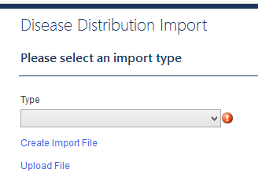
Create the import file
data entry : bulk importing
The first step to bulk importing is to create the import file:
Choose Import from the Main Menu
Select the activity
Select the type of form to import from the drop down list
Click on Create Import File
Select the administrative units to include

Slide 92
Create an import form for an Intervention
Select Interventions from the Import menu option
Type: LF Morbidity Management
Click Create Import File
Level of implementation: District
Select the following Districts (from the South Region):
Astori
Brodsi
Conichi
Druna
Elona
Flora
Click Next
Save the import file on your computer

Slide 93
Import data for a LF Morbidity Management Intervention
Enter sample data into the LF Morbidity Management worksheet that opened on your computer. Use any numbers you want, they do not need to be accurate.
Save and Close the import file.
Choose Upload Import File. The database will let you know if there are any problems with the import. Fix any errors and try again.
Once the file imports correctly, Click Next.
Find the intervention forms you just imported in the intervention list boxes for Astori, Brodsi, Conichi, Druna, Elona, and Flora.

Slide 94
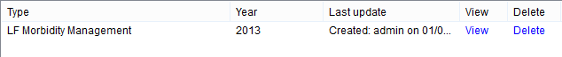
Reviewing/Editing imported data
data entry : bulk importing
Once data has successfully imported, you may need to review for accuracy, add missing data, or change inaccurate or updated data at a later date.
From the Dashboard, first select the location.
Select the imported form you wish to review by clicking on the view link next to the name of the form from the appropriate activity data module.
This will take you to the screen where you can review, add, and/or change data.
Click Save if you changed anything.

Slide 95
Updating for a new year
The Integrated NTD Database can help you update your information for a new year.

Slide 96
Updating for a new year
There are two sets of information in the Integrated NTD Database that need to be updated yearly.
Demography
Disease distribution
Quick tip:
These methods can also be used to enter historical information for past years.

Slide 97
Demography
updating for a new year
To update demography for a new year or to enter historical data, go to:
Main menu -> Imports -> Demography
You will need to enter data by administrative level for the aggregating level. It is a good idea to also enter demography data for all lower levels, as well.
Important note: It could be helpful to generate a demography report from the custom report builder for a past year to help calculate values to enter in the import form.

Slide 98
Disease Distribution
updating for a new year
To update disease distribution for a new year or to enter historical data, go to:
Main menu -> Imports -> Disease Distribution
You will need to enter data by administrative level for each disease in your program.
Important note: It could be helpful to generate a disease distribution report from the custom report builder for a past year to help calculate values to enter in the import form.

Slide 99
Redistricting
The Integrated NTD Database can reallocate data when administrative units in the country change.

Slide 100
Redistricting
The Integrated NTD Database provides three ways to reallocate administrative units:
Split administrative units
Merge administrative units
Split and combine administrative units

Slide 101
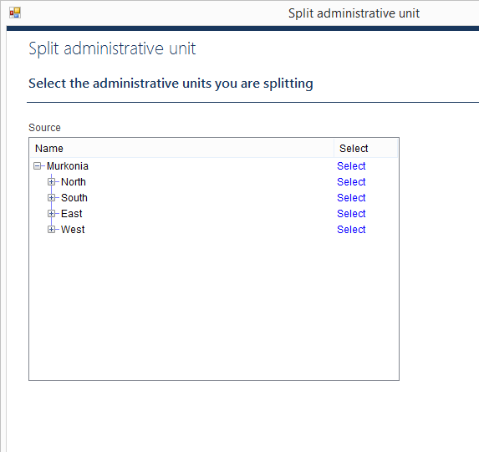
Split administrative units
redistricting
You can split one administrative unit into multiple administrative units at the same level.
You can choose how to allocate lower level administrative units.
Indicators will be allocated automatically, but you can review and make changes to them.

Slide 102
Split administrative units
Select Administrative units -> Split administrative unit from the Main Menu
Backup your database
Select Kora district to split
How many administrative units would you like to split Kora into: 3
Click Next
Click Add new…
Name: Kora East, Latitude: 5, Longitude: 10
Highlight North Province
Click Save
Repeat steps 4-8 to add the following two districts:
Kora South, Latitude: 5.1, Longitude: 10.5
Kora West, Latitude: 5.8, Longitude: 11

Slide 103
Allocate the Percentage of population:
Kora East: 20
Kora South: 30
Kora West: 50
Click Next
Move Bndwil to Kora East and click Next
Move Dibellasca to Kora South and click Next
Click Next
Click Next to review each type

Slide 104
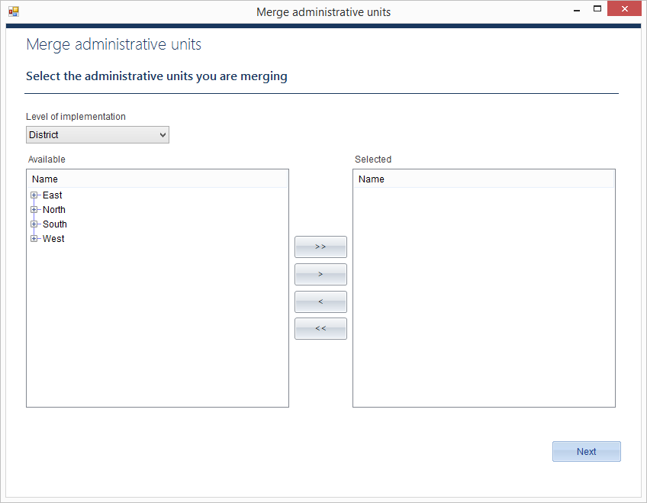
Merge administrative units
redistricting
You can merge any number of administrative units at the same level into a new administrative unit.

Slide 105
Merge administrative units
Select Administrative units -> Merge administrative units from the Main Menu
Backup your database
Select calendar year
Click Next
Level of implementation: District
Select Lusson and Michen districts to merge.
Click Next
Name: Luchen
Highlight the North Province
Click Next
Click Next to review

Slide 106
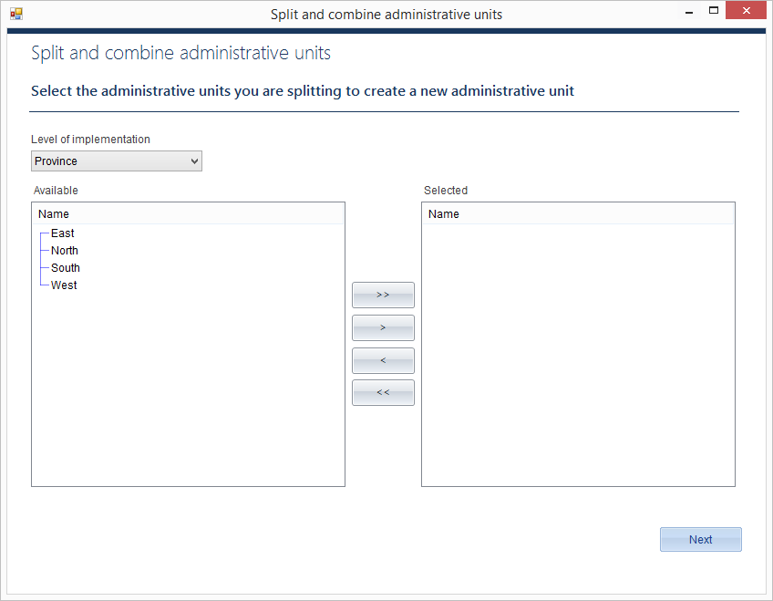
Split and combine administrative units
redistricting
You can split multiple administrative unit to create a new administrative unit from parts of the original units.

Slide 107
Split and combine administrative units
Select Administrative units -> Split and combine administrative units from the Main Menu
Backup your database
Level of implementation: District
Select Nursed and Opafuril districts to split
Click Next
Name: Nurfuril
Highlight North Province
Click Next
Enter Percentage of population:
Nursed: 40
Opafuril: 20
Click Next

Slide 108
Move the following villages from Nursed to Nurfuril
Cale
Duraglia
Click Next
Move the following villages from Opafuril to Nurfuril
Kutomala
Nyereli
Click Next
Review and confirm.
Click Next
Click Next to review

Slide 109
Reports
The Integrated NTD Database can generate a wide variety of reports to help you analyze your program, share data, and plan for the future.

Slide 110
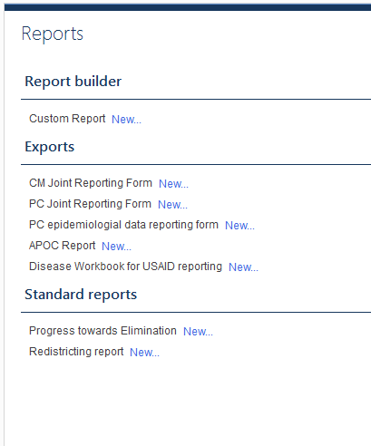
Reports
The Integrated NTD Database provides three types of report functions:
A custom report builder
WHO/Partner reports
Standard reports

Slide 111
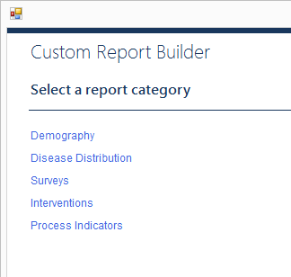
Custom report builder
reports
The custom report builder is a flexible tool. You can use it to review, analyze, and report data of your choice.
Quick tip:
Use the custom report builder to generate Excel worksheets that can be uploaded into other tools
Notes:
Talk about aggregation level

Slide 112
Generate an LF Morbidity Management Report
Select Reports -> New from the Main Menu
Click Custom Report New…
Click Interventions
Use the + to expand the options for the LF Morbidity Management report
Check the boxes to select:
# hydrocele cases
# hydrocele cases treated
# lymphoedema patients
# lymphoedema patients treated
Click Next
Dates: Jan 1 2014 – Dec 31 2014
Aggregate by: List all
Click Next
Click Finish
Notes:
Trainer: show how you can use the shift and space bar to select all the options at once.

Slide 113
Review your data on the screen.
Try exporting the data to Excel
Try editing report options and running the same report, but aggregated by country.
Try editing report options and running the same report, but aggregated to administrative level.
Try saving your report options and rerunning the report again from the Reports menu.
Notes:
Trainer: show how you can sort by clicking on the column heads

Slide 114
WHO/Partner reports
reports
WHO/Partner reports are listed under Available exports.
When it is time to submit reports to WHO, you can use the National Database Template to generate these reports with the click of a button.

Slide 115
Generate a WHO Joint Reporting Form
Select Reports -> New from the Main Menu
Try generating one of the Joint Reporting Forms.

Slide 116
Standard reports
reports
The Integrated NTD Database includes Standard reports. These are some of the typical tables and graphs helpful in analyzing NTD programs.
Standard reports include:
Progress toward elimination
Mapping report (coming soon)
M&E assessment (coming soon)
Districts treated (coming soon)
Persons treated (coming soon)
Coverage performance (coming soon)

Slide 117
Setting up a Integrated NTD Database for your program
It’s time to set up a Integrated NTD Database file for your country.

Slide 118
Setting up a file for your program
You can start a new Integrated NTD Database file at any time, although you will probably want to store all the data for your country in just one file.
Quick tip:
You can share this file with others via:
email
flash drive
Dropbox
other similar method to transfer files

Slide 119
Start a Integrated NTD Database for your program
Select File - > New from the Main Menu
Select Create a new file…
Save the file on your computer
Sign in (there is no login or password yet)
Click Enter your country information Start…
Enter country settings for your program, including adding more administrative levels. You can have up to seven total.
Click Next
Enter the Country Settings population numbers
Click Finish
Click Select Diseases Start…
Use the arrows to select diseases that are included in your program. Use the Add new diseases… link to add any additional diseases to the list.
Click Finish
Click Start to Edit or add administrative levels for all your levels.
Click Finish
Select Settings from the Main Menu.
Click the Users tab and set users and passwords.
You are now ready to enter data into your Integrated NTD Database.

Slide 120
The Integrated NTD Database was developed by RTI International under the ENVISION project with funding from the United States Agency for International Development in collaboration with the World Health Organization (WHO) and its regional offices (AFR, SEAR, WPR), the African Programme for Onchocerciasis Control and the Centre for Neglected Tropical Diseases.
The Integrated NTD Database was developed by Iota Ink:
Jennifer Einberg, Project Manager; Eric Olson, Developer; Jennifer Fox, Graphic Designer; Nick Cherf, QA Specialist; Michelle Fellows, Technical Writer

Slide 121





acknowledgements
The Integrated NTD Database was developed in collaboration with:

