Slide 1
The Integrated NTD Database

Slide 2
Introduction
The Integrated NTD Database was designed to strengthen the capacity of national NTD programs to store, manage, analyze, and report their data.

Slide 3
Course overview
Introduction
Installation
Opening screen
Getting started
A tour of the tool
Data entry: Form by form
Data entry: Bulk importing
Updating for a new year
Redistricting
Reports
Setting up a file for your program
3

Slide 4

Context
A situation analysis conducted in 2012 showed that many national programs do not have an integrated NTD database.
In Feb 2013, the fourth NTD M&E Working Group Meeting recommended the development of Integrated NTD Database
Notes:
NEW SLIDE
A large volume of data is generated from Monitoring and Evaluation activities for NTDs. A situational analysis conducted in 2012 showed that many national programs do not have an integrated NTD database. Some countries had partner-specific database or disease-specific database but there was no standardized database. A database is necessary for effective storage and management of data. Access to and use of data is required for effective program implementation. In addition, with the goal of elimination and control of NTDs by 2020, historical data is required for preparing elimination dossiers. Therefore, in February 2013, the fourth NTD STAG Global Working Group Meeting on M&E recommended the development of an integrated NTD database, in order to facilitate integrated data storage, management, and analysis by national programs.

Slide 5
Partners and contributors
The development of the template was a collaborative effort in 2013 across multiple partners, including:
WHO HQ
AFRO
APOC
SEARO
WPRO
RTI/ENVISION
FPSU (formerly CNTD)
To ensure the database meets the needs of national NTD programs, Ministries of Health were actively involved in the development process.

Slide 6
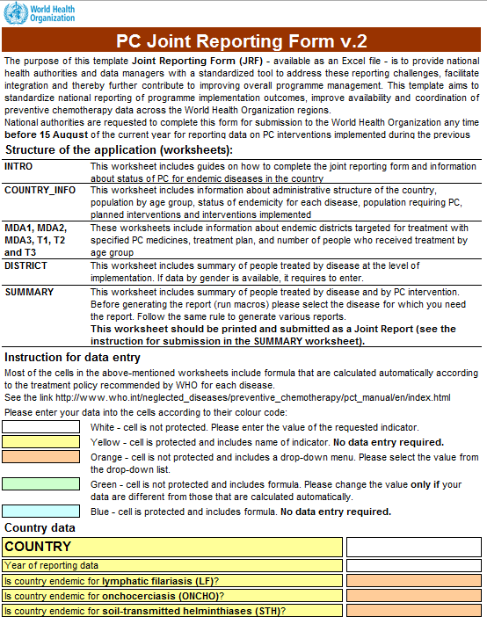
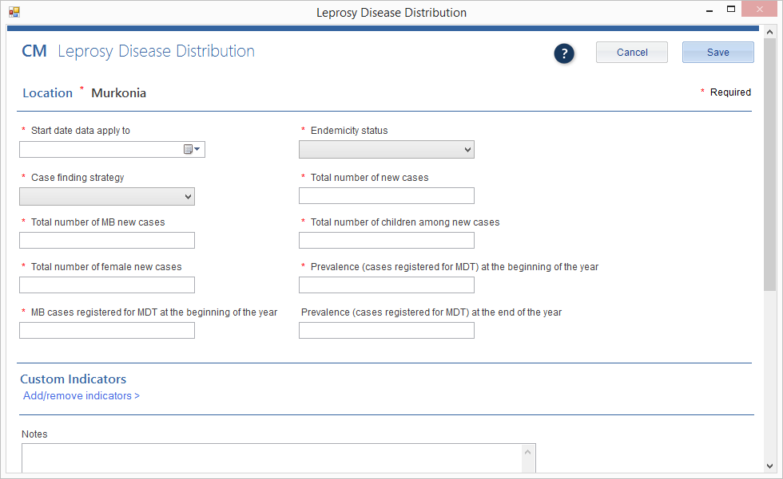
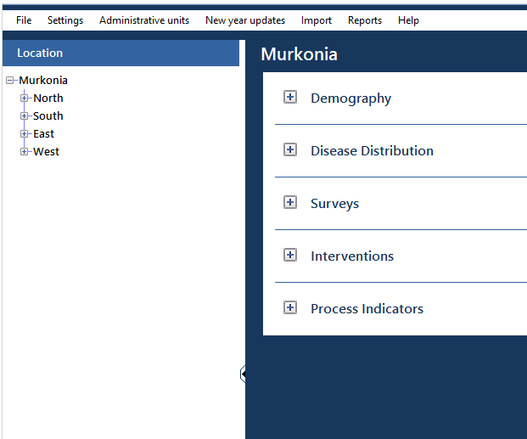
Primary functions
The Integrated NTD Database provides a convenient way for NTD programs to:
Store and analyze data
Demography
Disease Distribution
Surveys
Interventions
Process Indicators
Generate reports
WHO/Partner reports
Standard reports
Custom reports

Slide 7
Goals of the system
1
To store large volumes of M&E data generated by Neglected Tropical Disease programs over time
To assist with data management and analysis at the country level, thereby supporting programmatic decision-making
To strengthen the capacity for data sharing between countries, WHO, and partners
2
3

Slide 8
How and when the tool can be used
The database can be used in a variety of scenarios
Data storage
Treatment data
Survey data
Supply chain management
Training data
Other interventions
Review and analysis
Review meetings
Feedback to sub-national levels
Guide work planning
Reporting
National reports
Ad hoc data requests
WHO (JRF, TAS Eligibility Form, elimination dossier)
Partners
Notes:
NEW SLIDE

Slide 9
Primary users
National-level NTD program managers
M&E specialists
Data managers
The database is:
For NTD programs.
Each database system belongs to national NTD program offices, not partners or funders. There is no automatic data sharing.
Customizable.
NTD programs can tailor the database system to fit their country’s context and data management needs.
Optional.
The Integrated NTD Database is not required. National NTD programs can opt to use it or not.

Slide 10
Data management
The Integrated NTD Database manages the following types of data for NTDs:
Demography
Disease Distribution
Surveys
Interventions
Process Indicators
Notes:
Deleted “SAEs’ from the list

Slide 11
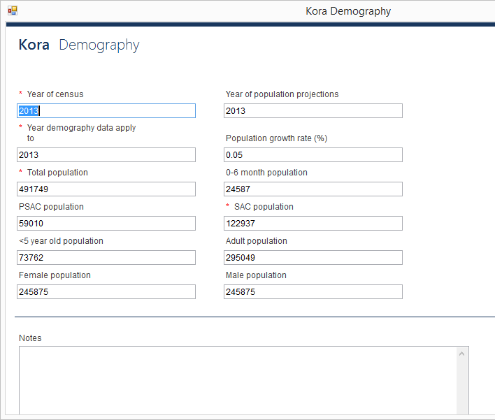
Demography
data management
Country-wide demography information is tracked for every year.

Slide 12
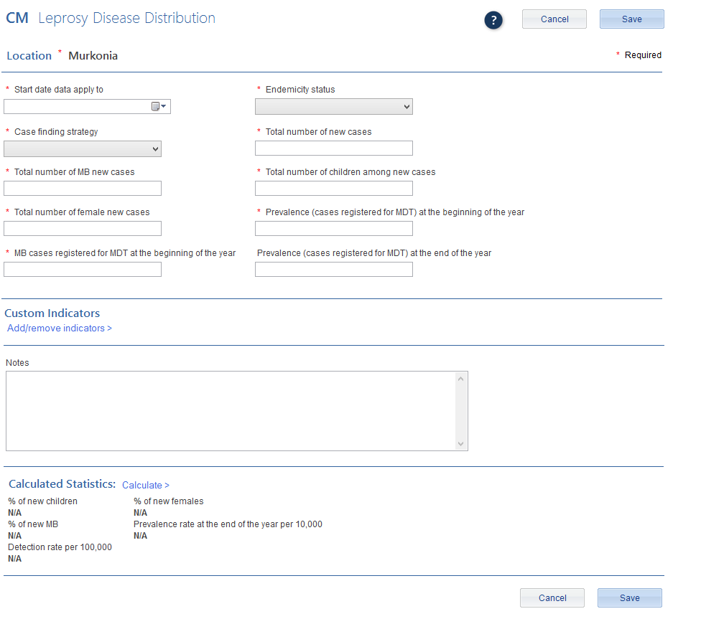
Disease Distribution
data management
Disease distribution information for NTDs is recorded for every year.

Slide 13
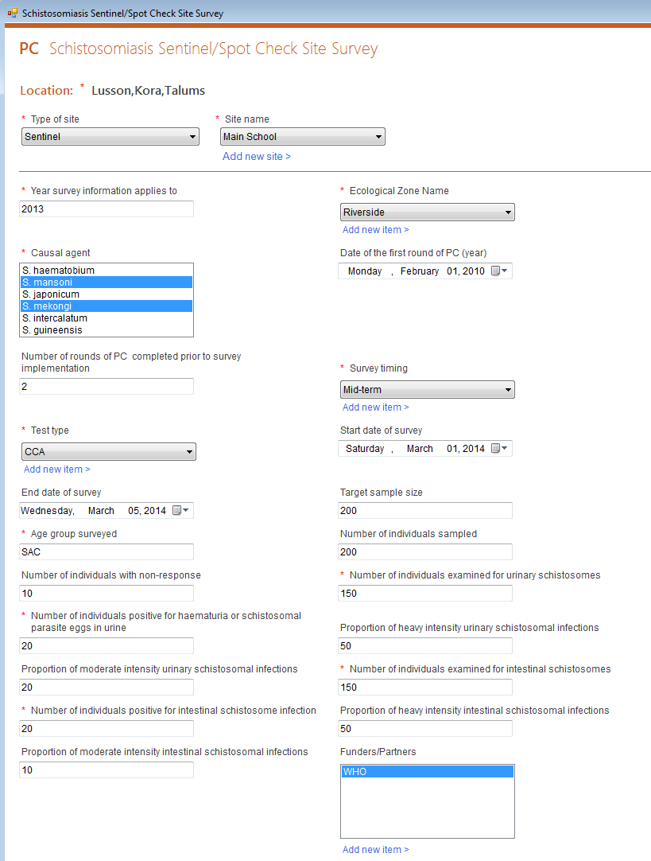
Surveys
data management
Users can enter survey data into the Integrated NTD Database. This includes mapping, baseline, midterm, TAS, and other surveys.

Slide 14
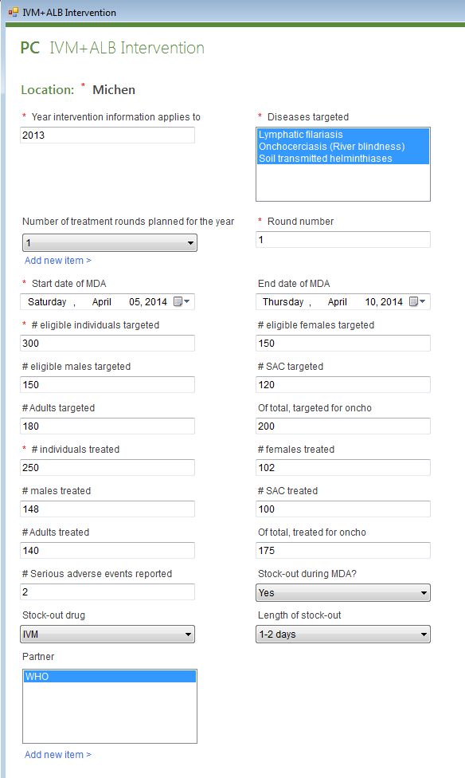
Interventions
data management
Users can enter intervention data into the Integrated NTD Database. This includes MDAs, morbidity management, and other information.

Slide 15
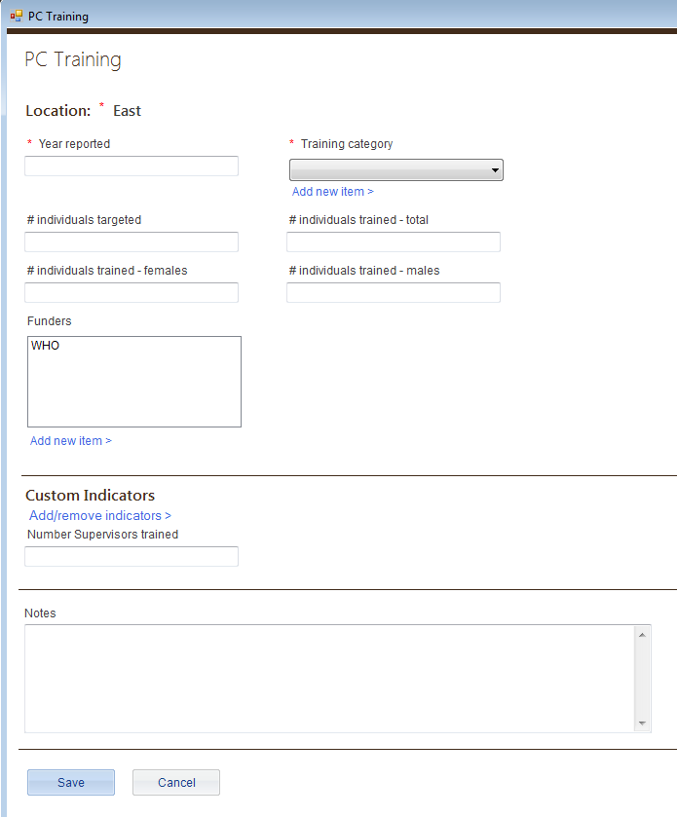
Process Indicators
data management
Users can enter process indicator data into the National Database. This includes training, serious adverse events, and supply chain management.
Notes:
Added SAEs and deleted the slide for SAEs

Slide 16
Reports
The Integrated NTD Database provides three types of report functions:
WHO/Partner reports
Standard reports
Custom reports

Slide 17
WHO/Partner Reports
reports
The Integrated NTD Database can generate both the CM Joint Reporting Form and the PC Joint Reporting Form, as well as other partner reports.
WHO
Case Management Joint Reporting Form
PC Joint Reporting Form
PC epidemiological data reporting form
APOC report
Leishmaniasis report (Coming soon)
LF Elimination Dossier (Coming soon)
TEMF (Coming soon)
Partner
Disease Workbook for USAID reporting
Notes:
Revised slide

Slide 18
Joint Reporting Form
reports
Let’s generate a Joint Reporting Form now from an Integrated NTD Database populated with sample data.
By the end of this week, you should all be able to generate one once your country’s data is entered into the tool.
Notes:
NEW SLIDE

Slide 19
Standard Reports
reports
The Integrated NTD Database can generate these standard reports with just a few clicks:
Available reports
Progress toward elimination
Redistricting report
Coming soon
Coverage performance
Mapping report
M&E assessments
Districts treated
Training report
Notes:
Revised slide

Slide 20
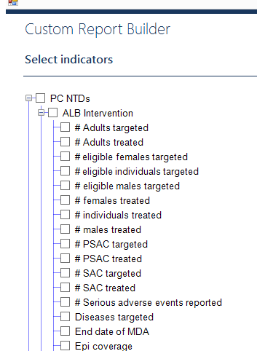
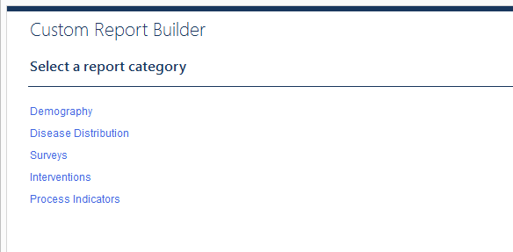
Custom Reports
reports
With the custom report builder, users can create reports using any data in the database.

Slide 21
Convenient Features
data management
Import data in large batches using Excel
Update automatically when connected to internet
Create custom indicators for any form
Create custom forms for any module
Add other diseases and custom indicators
Export data to an Excel worksheet
Collect historical data for multi-year analysis
Create reports using any data entered
Multiple languages (English, French, Portuguese, Bahasa)
Automatic backup with an option to revert to last version
Notes:
Revised slide (combined 2 slides into one)

Slide 22
Installation
The first step is installing the Integrated NTD Database on your computer.

Slide 23
Installation steps
There are two steps to running the Integrated NTD Database on your computer:
Install the Access DB Engine32 bit
Install the Integrated NTD Database

Slide 24
Install the Access DB Engine32 bit
installation steps
To install the Access DB Engine32 bit:
Go to https://www.microsoft.com/en-us/download/details.aspx?id=13255
Download and install the Access engine
Restart your computer
Important note: If you cannot download the Access Engine because you get a message that you already have it on your computer, that is fine. Just proceed to the next step.

Slide 25
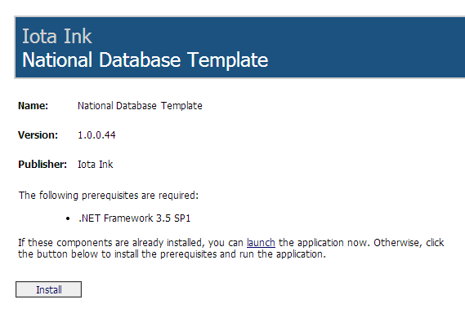
Install the Integrated NTD Database
installation steps
To install the Integrated NTD Database:
Go to http://apps.who.int/neglected_diseases/ntddata/ntd_database/ or for 64-bit users http://apps.who.int/neglected_diseases/ntddata/ntd_database/x64
Click Install

Slide 26
The opening screen
When you open the Integrated NTD Database program, you will first encounter the opening screen before you enter your file or data.

Slide 27
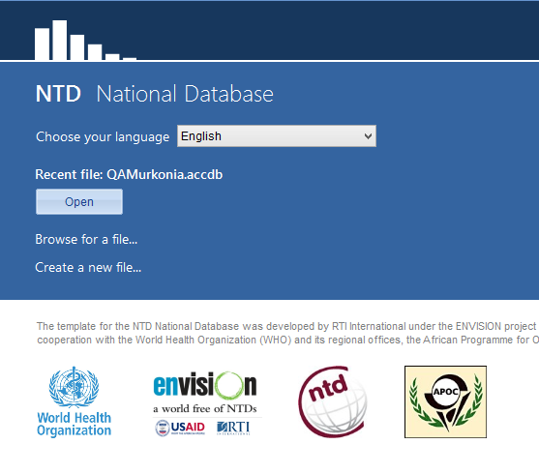
The opening screen
This is the first screen you see when opening the Integrated NTD Database tool each time.
It includes:
Choose your language
Recent file name
Open button
Browse for a file link
Create a new file link

Slide 28
Choose your language
the opening screen
There are four languages currently included in the Integrated NTD Database:
English, French, Portuguese, and Bahasa
You can choose your preferred language from the drop down menu.
Important note: Number formats differ by country. Be sure to enter numbers in the format your computer regional settings are set to, no matter which language is showing on the screen. For example, if your settings are set to:
English (United States), you must enter numbers as 1,000.00
French (France), you must enter numbers as 1 000,00.
Notes:
Trainer – the other languages besides English are coming soon.

Slide 29
Recent file
the opening screen
The Integrated NTD Database will always list the most recent file on the opening screen.
To open the most recent file, just press the Open button.

Slide 30
Browse
the opening screen
You can open an existing file that was previously created from the opening screen as well.
Click on the Browse for a file… link to access your files.
Important note: You should always open the Integrated NTD Database first, then your file. Do not try to open your file alone from the saved location on your computer. You must always open your file from within the Integrated NTD Database program or it will not work properly.

Slide 31
New file
the opening screen
To start a new Integrated NTD Database, select Create new file… and a browser window will open and prompt you to save your file.

Slide 32
Create a new file
Select Create a new file…
Name your new file Murkonia
Save the file on your computer

Slide 33
Getting Started
When you create a new Integrated NTD Database file, you go through a series of steps to set up the file specifically for your country.

Slide 34
Getting started
The steps to setting up the Integrated NTD Database for the first time are:
Sign in
Enter country information
Choose diseases
Edit or add administrative levels

Slide 35
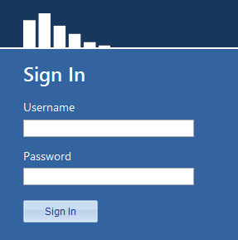
Sign in
getting started
The first time you use the tool, the user name will be blank and the password field will be blank.
Just press the Sign In button.

Slide 36
Sign in
Ensure user name is blank
Password should be blank
Press the Sign In button
You will change the password later in this presentation.

Slide 37
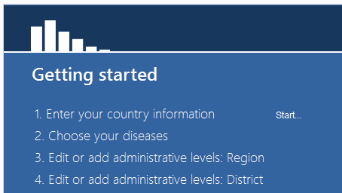
Enter your country information
getting started
Next you will need to enter your country information, including:
Country name
Administrative levels
Population statistics
Click on the Start link to begin.

Slide 38
Enter Murkonia country information
Enter Country name: Murkonia
Select view to access the Region administrative level information
Change the name from Region to Province
Click Save
Click Add administrative level type >
Enter Name: Village
Click Save
Click Next

Slide 39
Enter Murkonia country settings
Year of census: 2010
Population growth rate (%): 4
Age range for SAC: 5-14
% PSAC of total population: 12
% <5 years old of total population: 15
% female of total population: 49
% rural of total population: 30
Start date data applies to: January 1 2014
Age range for PSAC: 2-4
% 0-6 months of total population: 3
% SAC of total population: 25
% adults of total population: 60
% male of total population: 51
When finished, click Finish

Slide 40
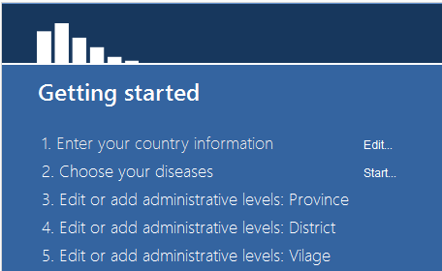
Choose your diseases
getting started
Next you will choose the diseases included in the country’s program.
Click on the Start link to begin.

Slide 41
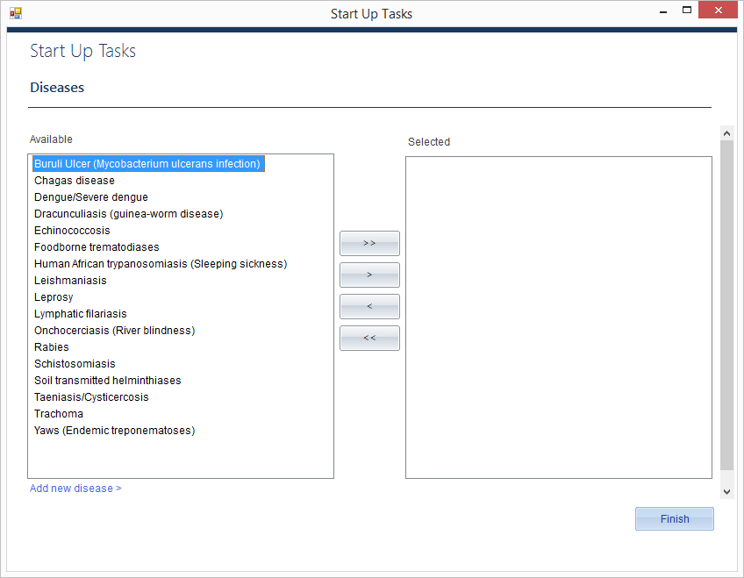
Choose your diseases
getting started
The Integrated NTD Database uses the following convention to select diseases:
>>
Moves all items from the box on the left to the box on the right.
>
Moves only selected items from the box on the left to the box on the right.
<
Moves only selected items from the box on the right back to the box on the left.
<<
Moves all items from the box on the right back to the box on the left.
Add new disease allows you to add another disease to the list.

Slide 42
Choose Murkonia diseases
Assume Murkonia’s NTD program includes all 17 diseases. Practice using all the arrows to move diseases from one box to another.
Once you have tested all four arrow options, move all diseases to the box on the right and click Finish.
Quick Tip
You can select several diseases at the same time by holding down the ctrl or shift key while clicking on the disease names. Once the names are highlighted, click on the single arrow button > to move the selected diseases to the box on the right.

Slide 43
Adding administrative levels
getting started
Demography is added to the Integrated NTD Database via Excel spreadsheets in three steps for each level.
The steps are:
Download the import file
Fill in the import file with country data
Upload the import file
Important note: You must use the import files downloaded from the database. You should enter or cut and paste your country data into the import files.

Slide 44
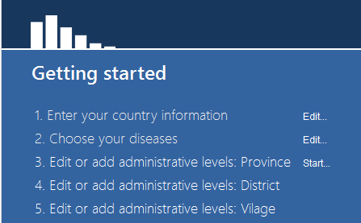
Add data for administrative levels: Provinces
At the getting started screen, click Start next to Edit or add administrative levels: Province
Number to import: 4
Click Download import file
Rename and save the import file. The import file will open in Excel on your computer.

Slide 45
Enter data for 4 sample provinces into your file. Use the data from the Murkonia Province file.
Close the file.
Choose Upload import file. The database will let you know if there are any problems with the import. Fix any errors and try again.
Once the file imports correctly, Click Next.
Important note: Because district is the aggregating level, there are no population values required at the province or country level.

Slide 46
Add data for administrative levels: Districts
Number to import: 25
Download import file.
Rename and save the import file. The import file will open in Excel on your computer.

Slide 47
Enter data for 25 sample districts into your file. Use the data from the Murkonia District file.
Close the file.
Upload import file. The database will let you know if there are any problems with the import. Fix any errors and try again.
Once the file imports correctly, click Next.

Slide 48
Add data for administrative levels: Villages
Create import for one of your provinces
Number to import: 13
Download import file.
Rename and save the import file. The import file will open in Excel on your computer.
Notes:
Trainer: Talk about how to add villages for different regions before moving on.

Slide 49
Add information for 13 sample villages of your choice into your file. Use the data from the Murkonia Village file.
Close the file.
Upload import file. The database will let you know if there are any problems with the import. Fix any errors and try again.
Once the file imports correctly, click Finish.
Important note: Since district is the aggregating level, all population information is required and will be totaled to fill in population information for Provinces and the Country.

Slide 50
Backing up
getting started
It is important to regularly back up your database file. You should regularly save your file to an external drive.
Important note: The Integrated NTD Database saves automatically. If you make a large mistake, you should revert to the last opened version of your file by going to:
Main menu > Settings > Edit settings > Database > Restore.
You will lose any changes made since opening the file.

Slide 51
Documentation
getting started
It is a good idea to keep a record of the following information about your Integrated NTD Database:
Names of individuals involved in compilation of historical data stored in database, including title and organization
Primary source(s) of data for historical demography data entered in database
Primary source(s) of data for historical disease distribution data entered in database
Primary source(s) of data for historical survey data entered in database
Primary source(s) of data for historical intervention data entered in database
Primary source(s) of data for historical process indicator data entered in database
Notes about any missing information
Notes about assumptions made
Notes:
NEW SLIDE

Slide 52
A tour of the tool
Now that you have finished entering the start up data, you are ready to start entering the program data in the tool.

Slide 53
A tour of the tool
There are three main parts to the Integrated NTD Database:
The Administrative Unit Tree
The Main Menu across the top
The Activity Dashboard

Slide 54
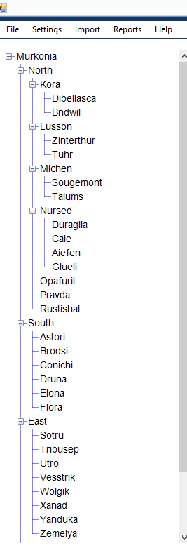
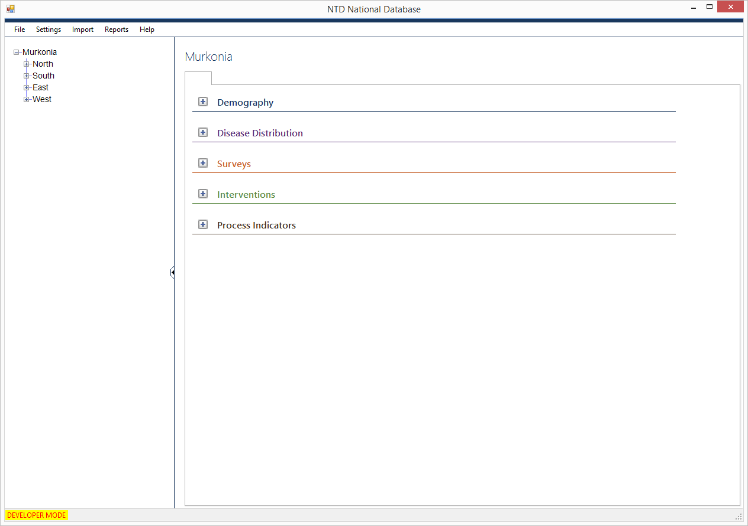
The Administrative Unit Tree
a tour of the tool
Your Administrative unit tree should look like this:
Click on the icon to expand a location. If expanded completely, it will look like this:

Slide 55
Expand the Administrative Unit Tree
Use the + and – controls to expand and contract the location tree.

Slide 56
The Main Menu
a tour of the tool
The Main Menu has six functions:
File
Settings
Administrative units
Import
Reports
Help

Slide 57
File
a tour of the tool : main menu
From the File menu, you can do the following actions:
Start a new file
Open an existing file
Exit your Integrated NTD Database
Quick tips:
Exiting: you can use the red X at the top, right to exit your program at any time.
Saving: you never need to save your file. Your database file updates in real time, meaning any changes you make are automatically saved.
Opening a new file: If you do choose to either start a new file or open an existing file, the file you are currently working in will automatically close.

Slide 58
Settings
a tour of the tool : main menu
Edit Settings option allows you to:
Edit settings. You can change the country settings, country statistics, diseases, and users. This is also where you can create a copy of the error log from your file and restore your database to the backup copy saved at last login. The first three tabs are from the set up wizard and work the same as the first time you set up a new file.
Notes:
NEW SLIDE

Slide 59
Settings
a tour of the tool : main menu
Edit Settings option allows you to:
Change country settings, statistics and diseases. These first three tabs are from the set up wizard and work the same as the first time you set up a new file.
Notes:
NEW SLIDE

Slide 60
Settings
a tour of the tool : main menu
Edit Users. There are four types of users in the Integrated NTD Database.
Database Administrators
Edit country settings
Add diseases
View, add, edit users
View, add edit data
Run reports
Indicator management
Administrators
Edit country settings
Add diseases
View, add, edit users
View, add edit data
Run reports
Data enterers
View, add, edit data
Run reports
Data viewers
View data
Run reports
Notes:
NEW SLIDE

Slide 61
Add a new user
Click Settings – Edit settings
Click on the Users tab
Select Add new user
Set user name: Program manager
Set password: (your choice, but write it down)
Select roles:
Administrator
Data enterer
Data viewer
Press Save
Use the Dashboard button to return to the settings dashboard

Slide 62
Settings
a tour of the tool : main menu
Database option allows you to:
Create a copy of the error log file. If you encounter any bugs while using the Integrated NTD Database, you should save this log and send it to the appropriate parties.
Restore database to backup copy saved at last login. If you make a large mistake while using your file, you can click Restore to revert to the older version.

Slide 63
Settings
a tour of the tool : main menu
Country statistics is where you update your country level population data each year such as percentages for different age groups and the growth rate.

Slide 64
Administrative units
a tour of the tool : main menu
The Administrative units option allows you to:
Add administrative units
Delete administrative units
Order administrative units
Split administrative units
Merge administrative units

Slide 65
Administrative units
a tour of the tool : main menu
Add administrative unit option allows you to add new locations, such as:
Provinces
Districts
Villages
Communities
Up to seven administrative levels are allowed in the tool.
Important note: If you add a new location, you need to go to the Demography activity to enter population information.

Slide 66
Add an administrative unit
Click Administrative units
Select Add administrative units
Name: London
Latitude (if applicable): 51
Longitude (if applicable): 0.1275
Select a Province for London
Press Save
Find London on the Administrative unit tree

Slide 67
Administrative units
a tour of the tool : main menu
Delete administrative unit option allows you to permanently delete locations.
Important note: You can only delete an administrative unit if there are no units below it on the tree.

Slide 68
Delete an administrative unit
Click Administrative units
Select Delete administrative units
Find London and click “Delete”
Click Yes
Click Done
Notice London is no longer on the administrative unit tree

Slide 69
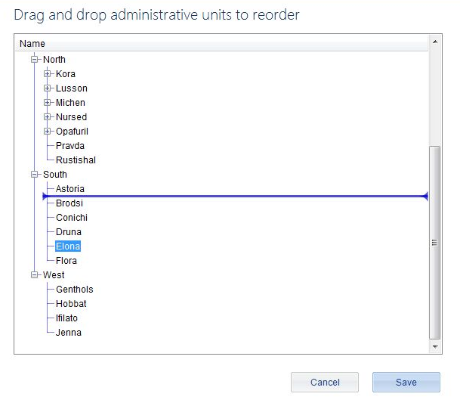
Administrative Units
a tour of the tool: main menu
Order administrative units option allows you to change the order that the administrative units appear on the tree.
Notes:
NEW SLIDE

Slide 70
Administrative Units
a tour of the tool: main menu
Split administrative units option allows you to split administrative units into multiple new units.
Merge administrative units option allows you to merge multiple administrative units into a single new unit.
These two redistricting items will be covered later in this training.

Slide 71
Import and Reports
a tour of the tool : main menu
Import option will enable you to bulk import data.
Reports option will provide an interface to run custom and standard reports.
An overview of both of these sections will be covered later in this tutorial.

Slide 72
Help feature
a tour of the tool : main menu
There are three selections under the help option:
View help. Takes you to the help feature in the tool. Click here to look up definitions of terms or get information on different topics.
View PowerPoint tutorial. View this tutorial
Check for updates. If you are connected to the Internet, you can click here to check if a new version is available.
Updated versions include bug fixes and new features.
The Integrated NTD Database also checks for updates each time you open it, but if you decline to download a new version at that time, you can click here later to download the update.
About. Provides information about the tool.

Slide 73
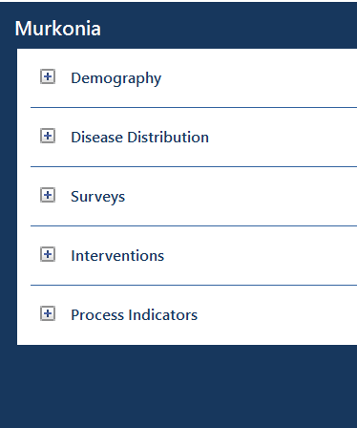
The Activity Dashboard
a tour of the tool
The Dashboard shows all of the data modules that can be entered into the Integrated NTD Database, organized by the following activities:
Demography
Disease Distribution
Surveys
Interventions
Process Indicators
Notes:
Trainer – SAEs are in Process Indicators now, but will be in their own module soon,.

Slide 74
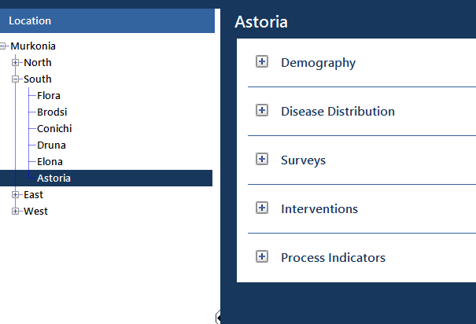
Important feature of the Dashboard
a tour of the tool : activity dashboard
The data and information showing for the specific activities on the Activity Dashboard will always apply to the location selected on the Administrative unit tree.

Slide 75
Explore the Activity Dashboard
Use the+ and – controls to expand and contract the activities on the Dashboard.
Select different locations from within the Location Tree.

Slide 76
Data entry: Form by form
The Integrated NTD Database is organized by administrative units. In the data entry section, you can enter and analyze data for NTD activities that take place in each region, district, community, or other location.

Slide 77
Data entry: Form by form
There are six data entry modules in the Integrated NTD Database:
Demography
Disease Distribution
Surveys
Interventions
Process Indicators
Important note: Any data you enter in the system will be stored. Therefore you should be careful not to enter duplicate data – there is no automatic check to ensure you don’t.

Slide 78
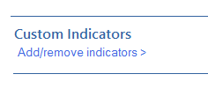
Data entry features
data entry : form by form
Custom indicators and forms
The Integrated NTD Database contains default indicators for each data entry form.
You can add custom indicators to any form or even add entirely new forms altogether.
These new indicators and forms will automatically show up in the custom report builder.

Slide 79
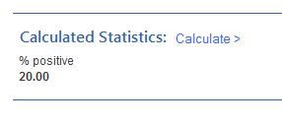
Calculated fields
data entry : form by form : data entry features
There are numerous calculations provided at the bottom of the data entry forms to help you analyze your program.
To computer these values, click ‘Calculate’
These calculated fields are also included in the custom report builder.

Slide 80
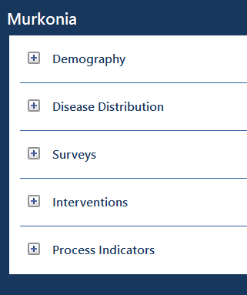
Demography
data entry : form by form
The Integrated NTD Database stores the demography that you enter in the tool.
You can edit demography from the dashboard from the aggregating level down, but for higher levels you can only view data, since these numbers are summed for you.

Slide 81
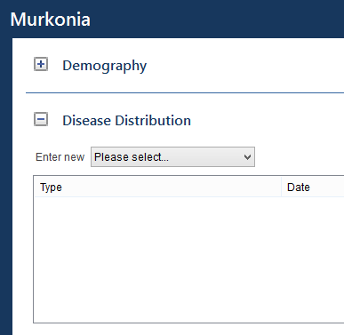
Disease Distribution
data entry : form by form
The Integrated NTD Database automatically creates disease distribution forms for every disease in the tool.
Most of these forms have default indicators provided by WHO.

Slide 82
Enter Disease Distribution - Leprosy
Select Kora (in North Region) from the Administrative unit tree.
Choose Leprosy from the Disease Distribution drop down list.
Enter the data listed below into the form.
Start date data apply to: March 1 2014
Case finding strategy: Active
Total number of MB new cases: 100
Total number of female new cases: 40
MB Cases registered for MDT at the beginning of the year: 10
Endemicity status: High
Total number of new cases: 120
Total number of children among new cases: 30
Prevalence (cases registered for MDT) at the beginning of the year: 20
Prevalence (cases registered for MDT) at the end of the year : 35
When finished, click Save
Notes:
changed

Slide 83
Surveys
data entry : form by form
The survey module is where you record the surveys that took place in your country.
Includes mapping, baseline, mid-term, among others
Allows you to choose multiple locations that encompass an Ecological Zone, Evaluation Unit, or Sub-districts.
Enables you to add sentinel sites to your tool, giving you the option to choose the same site again in the future.
Important note: You can only add sentinel sites, but cannot edit or delete them at this time. Therefore if you make a typo when entering one, you should enter another.
Notes:
The survey module is where you record the surveys that took place in your country, including mapping, baseline, mid-term, among others.
Unlike disease distribution, surveys oftentimes entail choosing more than location and encompass an Ecological Zone, an Evaluation Unit, or Sub-districts. To allow for this, there is an extra data entry screen for many surveys where you can choose multiple locations from different levels.
In addition, you can add sentinel sites to your tool so that you can come back and choose the same site again in the future.

Slide 84
Enter Schistosomiasis Sentinel/Spot Check Site Survey
Select Lusson from the Administrative unit tree.
Choose Schistosomiasis Sentinel/Spot Check Site Survey from the Survey drop down list
Choose District for Level of implementation
Select the following districts for the survey:
Kora (in North Province)
Lusson (in North Province)
Click Select button
Enter type of site: Sentinel
Click Add new site >
Site name: Main School
Latitude: 10
Longitude: 20
Click Save and continue to enter data from the next slide.
Notes:
Review how to use the ctrl button for multi-select

Slide 85
Will need to add new item
Start date data applies to: February 1 2014
Casual agent: S. mansoni and S. mekongi
Date of most recent PC: August 1 2013
Survey timing: Mid-term
Type of site: School
Start date of survey: 1 March 2013
Target sample size: 200
Number of individuals with non-response: 10
Number of individuals positive for haematuria in urine: 20
Number of heavy intensity urinary schistosomal infections: 10
Number of individuals examined for intestinal schistosomes: 150
Number of heavy intensity intestinal schistosomal infections: 10
Ecological Zone Description: Riverside (add)
Date of first round of PC (year): 2010
Number of rounds of PC completed prior to survey implementation: 2
Is this survey a part of cohort study? No
Test type: CCA
End date of survey: 5 March 2013
Age group surveyed: SAC
Number of individuals examined for urinary schistosomes: 150
Number of individuals positive for schistosomal parasite eggs in urine: 50
Number of moderate urinary schistosomal infections: 15
Number of individuals positive for intestinal schistosome infection: 20
Number of moderate intensity intestinal schistosomal infections: 15
Funders/Partners: WHO (add)
When finished, click Save
Find the survey form you just entered in the survey list box for Kora and Lusson

Slide 86
Interventions
data entry : form by form
The Interventions module is where you record the interventions that took place in your country.
Includes MDA, morbidity management, and others.
PC-MDA interventions are organized by the drugs delivered during the intervention.
Quick tip:
You can add new custom indicators to the bottom of any form, below the default indicators.
Once you add a custom indicator, it will always appear on that form in the future unless you disable it.

Slide 87
Create a custom indicator for IVM+ALB Intervention
Select Michen (in North Region) from the location tree.
Select IVM+ALB Intervention.
Under Custom indicators, click Add/remove indicators.
Click Add/remove indicator on custom indicator screen.
Custom indicator name: Number of community health workers
Data type: Number
Click Save.
Continue to enter the data from the following slide.

Slide 88
Start date data applies to: December 10 2013
Number of treatment rounds planned for the year: 1
Mode of distribution: Community-based
End date of MDA: 10 April 2013
# eligible females targeted: 150
# SAC targeted: 120
Of total, # females targeted for Oncho: 100
Of total, targeted for oncho: 200
# females treated: 102
# SAC treated: 100
# males treated: 148
Of total, # females treated for Oncho: 100
Of total, treated for oncho: 175
Diseases targeted: LF, Oncho, STH
Round number: 1
Start date of MDA: 5 April 2013
# eligible individuals targeted: 300
# eligible males targeted: 150
# Adults targeted: 180
Of total, # males targeted for Oncho: 100
# individuals treated: 250
# males treated: 148
# Adults treated: 140
Of total, # males treated for Oncho: 75
Batch reference number (drug and batch numbers): 123456

Slide 89
# Serious adverse events reported: 2
Upper confidence interval of surveyed coverage: 95
Stock-out during MDA?: Yes
Length of stock-out: 1-2 days
Number of community health workers: 15 Surveyed coverage: 94
Lower confidence interval of surveyed coverage: 93
Stock-out drug: IVM
Partner: WHO (add)
When finished, click Save
Find the intervention form you just entered in the intervention list box for Michen

Slide 90
Process Indicators
data entry: form by form
Process indicators can include many types of data that you want to track.
Currently includes SAEs, training, and supply chain management forms.
Quick tip:
You can create a new, custom form (with all custom indicators) for Survey, Interventions, and Process Indicator modules.
From a module drop down list, choose Add new type.
Notes:
Process indicators can include many types of data that you want to track. Presently, there are both training and supply chain management forms in the database.
If you would like to add a whole custom form (rather than just a custom indicator), choose Add new type from the drop down list.
You can add custom forms to the surveys, interventions, and process indicator modules.

Slide 91
Add a custom Process Indicator form
Select East from the Location Tree.
Select Add new type from Process Indicators drop down list.
Name: Alternative Strategies: Water, Sanitation and Hygiene
Click Add/remove indicators.
Add 2-5 custom indicators to your Water, Sanitation and Hygiene form. Try out the different data types.
Click Save.
Fill in the data on the form.
Save the data on your new form.
When finished, click Save.
Find the Process Indicator form you just entered in the survey list box East.

Slide 92
Data entry: Bulk importing
The second way to enter information into the database is through bulk importing.

Slide 93
Data entry: Bulk importing
Rather than entering information into the database form by form for activities, you can also bulk import your data.
There are three steps to bulk importing:
Create the import file
Fill in the import file
Upload the import file
Bulk importing is intended to save you time and effort.
Important note: Only data that is entered for individual administrative units can be imported. If your surveys take place in more than one administrative unit at a time, e.g. STH Mapping Surveys in an Ecological Zone, they must be entered form by form.

Slide 94
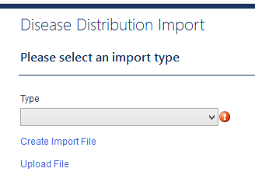
Create the import file
data entry : bulk importing
The first step to bulk importing is to create the import file:
Choose Import from the Main Menu
Select the activity
Select the type of form to import from the drop down list
Click on Create Import File
Select the administrative units to include

Slide 95
Bulk importing
redistricting
The Excel import file will list each indicator as a column. Administrative units will be listed as rows. Once you are done entering data, save the file, and close it. The file must be closed before you can import it.

Slide 96
Create an import form for an Intervention
Select Interventions from the Import menu option
Type: LF Morbidity Management
Click Create Import File
Level of implementation: District
Select the following Districts (from the South Region):
Astori
Brodsi
Conichi
Druna
Elona
Flora
Click Next
Save the import file on your computer

Slide 97
Import data for a LF Morbidity Management Intervention
Enter sample data into the LF Morbidity Management worksheet that opened on your computer. Use any numbers you want, they do not need to be accurate.
Save and Close the import file.
Choose Upload Import File. The database will let you know if there are any problems with the import. Fix any errors and try again.
Once the file imports correctly, Click Finish.
Find the intervention forms you just imported in the intervention list boxes for Astori, Brodsi, Conichi, Druna, Elona, and Flora.

Slide 98
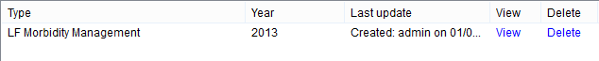
Reviewing/Editing imported data
data entry : bulk importing
Once data has successfully imported, you may need to review for accuracy, add missing data, or change inaccurate or updated data at a later date.
From the Dashboard, first select the location.
Select the imported form you wish to review by clicking on the view link next to the name of the form from the appropriate activity data module.
This will take you to the screen where you can review, add, and/or change data.
Click Save if you changed anything.

Slide 99
Updating for a new year
The Integrated NTD Database can help you update your information for a new year.

Slide 100
Updating for a new year
There are two sets of information in the Integrated NTD Database that need to be updated yearly.
Demography
Disease distribution
Quick tip:
These methods can also be used to enter historical information for past years.
Notes:
NEW SLIDE

Slide 101
Demography
updating for a new year
To update demography for a new year or to enter historical data, go to:
Main menu -> Imports -> Demography
You will need to enter data by administrative level for the aggregating level. It is a good idea to also enter demography data for all lower levels, as well.
Important note: It could be helpful to generate a demography report from the custom report builder for a past year to help calculate values to enter in the import form.
Notes:
NEW SLIDE

Slide 102
Disease Distribution
updating for a new year
To update disease distribution for a new year or to enter historical data, go to:
Main menu -> Imports -> Disease Distribution
You will need to enter data by administrative level for each disease in your program.
Important note: It could be helpful to generate a disease distribution report from the custom report builder for a past year to help calculate values to enter in the import form.
Notes:
NEW SLIDE

Slide 103
Redistricting
The Integrated NTD Database can reallocate data when administrative units in the country change.

Slide 104
Redistricting
The Integrated NTD Database provides two ways to reallocate administrative units:
Split administrative units
Merge administrative units

Slide 105
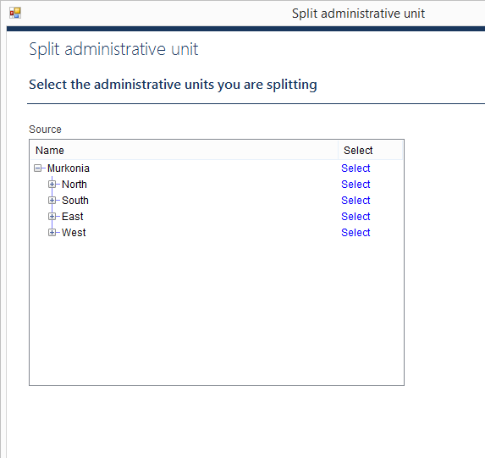
Split administrative units
redistricting
You can split one administrative unit into multiple administrative units at the same level.
You can choose how to allocate lower level administrative units.
Indicators values will be allocated automatically, but you can review and make changes to them.

Slide 106
Split administrative units
Select Administrative units -> Split administrative unit from the Main Menu
Backup your database
Set redistricting rules for custom indicators
Add “Date redistricting occurred”: December 31 2014
Select Kora district to split
How many administrative units would you like to split Kora into: 3
Click Next
Click Add new…
Name: Kora East, Latitude: 5, Longitude: 10
Highlight North Province
Click Save
Repeat steps 4-8 to add the following two districts:
Kora South, Latitude: 5.1, Longitude: 10.5
Kora West, Latitude: 5.8, Longitude: 11

Slide 107
Allocate the Percentage of population:
Kora East: 20
Kora South: 30
Kora West: 50
Click Next
Move Bndwil to Kora East and click Next
Move Dibellasca to Kora South and click Next
Click Next
Click Next to review each type

Slide 108
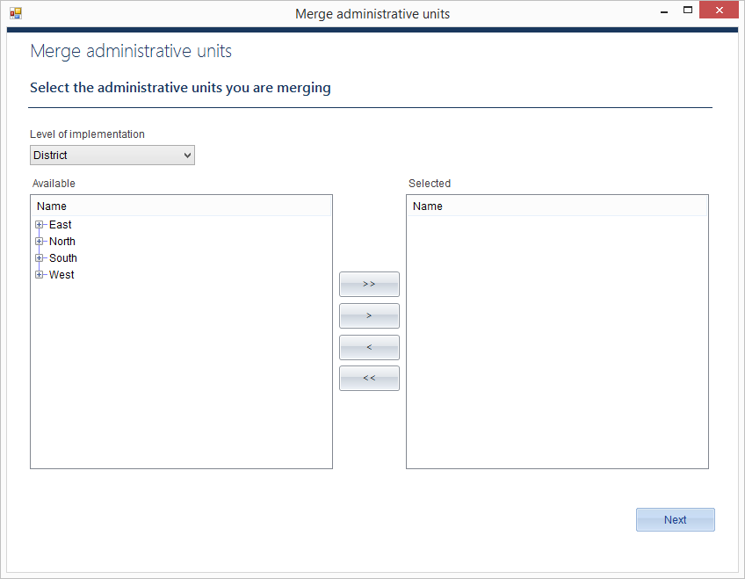
Merge administrative units
redistricting
You can merge any number of administrative units at the same level into a new administrative unit.

Slide 109
Merge administrative units
Select Administrative units -> Merge administrative units from the Main Menu
Backup your database
Set redistricting rules for custom indicators
Add “Date redistricting occurred”: December 31 2014
Select calendar year
Click Next
Level of implementation: District
Select Lusson and Michen districts to merge.
Click Next
Name: Luchen
Highlight the North Province
Click Next
Click Next to review

Slide 110
Reports
The Integrated NTD Database can generate a wide variety of reports to help you analyze your program, share data, and plan for the future.

Slide 111
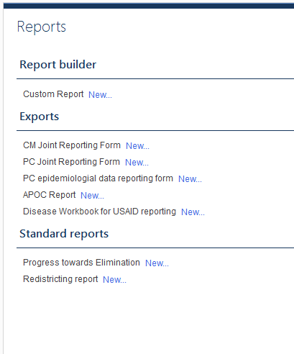
Reports
The Integrated NTD Database provides three types of report functions:
A custom report builder
WHO/Partner reports
Standard reports

Slide 112
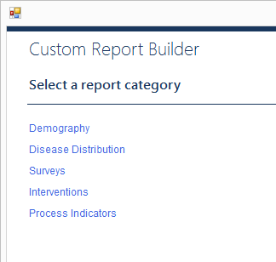
Custom report builder
reports
The custom report builder is a flexible tool. You can use it to review, analyze, and report data of your choice.
To save your custom reports, click ‘Save report options.’ This makes it easy to run common reports in the future.
Quick tip:
Use the custom report builder to generate Excel worksheets that can be uploaded into other tools
Notes:
Talk about aggregation level

Slide 113
Generate an LF Morbidity Management Report
Select Reports -> New from the Main Menu
Click Custom Report New…
Click Interventions
Use the + to expand the options for the LF Morbidity Management report
Check the boxes to select:
# hydrocele cases
# hydrocele cases treated
# lymphoedema patients
# lymphoedema patients treated
Click Next
Dates: Jan 1 2014 – Dec 31 2014
Start month of reporting year: January
Aggregate by: List all
Click Next
Click Finish
Notes:
Trainer: show how you can use the shift and space bar to select all the options at once.

Slide 114
Review your data on the screen.
Try exporting the data to Excel
Try editing report options and running the same report, but aggregated by country.
Try editing report options and running the same report, but aggregated to administrative level.
Try saving your report options and rerunning the report again from the Reports menu.
Notes:
Trainer: show how you can sort by clicking on the column heads

Slide 115
WHO/Partner reports
reports
WHO/Partner reports are listed under Available exports.
When it is time to submit reports to WHO, you can use the National Database Template to generate these reports with the click of a button.

Slide 116
Generate a WHO Joint Reporting Form
Select Reports -> Run reports from the Main Menu
Try generating one of the Joint Reporting Forms.

Slide 117
Standard reports
reports
The Integrated NTD Database includes Standard reports. These are some of the typical tables and graphs helpful in analyzing NTD programs.
Standard reports include:
Progress toward elimination
Redistricting report
Mapping report (coming soon)
M&E assessment (coming soon)
Districts treated (coming soon)
Persons treated (coming soon)
Coverage performance (coming soon)
Notes:
Revised?

Slide 118
Setting up a Integrated NTD Database for your program
It’s time to set up a Integrated NTD Database file for your country.

Slide 119
Setting up a file for your program
You can start a new Integrated NTD Database file at any time, although you will probably want to store all the data for your country in just one file.
Quick tip:
You can share this file with others via:
email
flash drive
Dropbox
other similar method to transfer files

Slide 120
Start a Integrated NTD Database for your program
Select File - > New from the Main Menu
Select Create a new file…
Save the file on your computer
Sign in (there is no login or password yet)
Click Enter your country information Start…
Enter country settings for your program, including adding more administrative levels. You can have up to seven total.
Click Next
Enter the Country Settings population numbers
Click Finish
Click Select Diseases Start…
Use the arrows to select diseases that are included in your program. Use the Add new diseases… link to add any additional diseases to the list.
Click Finish
Click Start to Edit or add administrative levels for all your levels.
Click Finish
Select Settings from the Main Menu.
Click the Users tab and set users and passwords.
You are now ready to enter data into your Integrated NTD Database.

Slide 121
Historical Data Entry Plan
Let’s plan how to collect, clean, review, analyze, and enter data into the database.
Notes:
In this section, we are going to cover what you need to know to plan the database implementation in your country.

Slide 122
General
Historical data entry plan
Location
Where is the database housed?
What equipment/software is needed for housing the database?
Access to users (share drive, dropbox, LAN)
Integrated vs disease-specific
Security
Password protection
Who will have the password?
Backup
Automatic vs manual
Alternate hard drives?
Who is responsible for backing up?
What will the frequency be for backing up?

Slide 123
User access
Historical data entry plan
Users
Admin
Data enterer
Data viewer
Restrictions
Limited users during historical data entry phase
Review of access and privileges upon completion of the database

Slide 124
User responsibilities
Historical data entry plan
Identify and assign privileges to different users
Identify and agree on the indicators to be included in the database including custom indicators/forms
Collect data from agreed sources
Collaborate with coordinators at different levels to collect historical data not available at the MoH/partners
Download and upload data entry Excel sheets
Verify the data entered/uploaded into the database

Slide 125
User responsibilities (continued)
Historical data entry plan
Develop a plan for saving raw data and hard copies
Record technical difficulties and communicate to the developers
Review adherence to the specified timeline
Supervise the overall process

Slide 126
Type of data
Historical data entry plan
Diseases
PC-Diseases
LF
Oncho
Schisto
STH
Trachoma
Non-PC Diseases
Modules
Demography
Disease Distribution
Survey
Intervention (MDA, Morbidity management)
Training
Supply chain management
SAEs

Slide 127
Sources of data
Historical data entry plan
MoH
Census bureau
Disease-specific data/program managers
Different admin units
Partners
WHO
In-country NGOs (including those funded by USAID and DFID)
Drug donation programs

Slide 128
Quality control of data
Historical data entry plan
Data discrepancy
Across different partners
Across different data sources
Data entry errors
Report generation
Supervisor’s involvement

Slide 129
Timeline for data entry
Historical data entry plan
Options for data entry
By year
By module
By disease
If redistricting:
By year only!

Slide 130
Criteria/Assumptions
Historical data entry plan
Data unavailable for required indicators
Text field
Number field
Date field
Indicators definition
Endemicity
Total population
Population at-risk
Population targeted

Slide 131
Documentation
Historical data entry plan
Soft copies
Hard copies

Slide 132
Budget
Historical data entry plan
Computer
External hard drive(s)
Anti-virus software
Internet
Phone
Phone recharge card
Consultant
LOE of MOH and implementing partners providing technical assistance

Slide 133
The Integrated NTD Database was developed by RTI International under the ENVISION project with funding from the United States Agency for International Development in collaboration with the World Health Organization (WHO) and its regional offices (AFR, SEAR, WPR), the African Programme for Onchocerciasis Control and the Centre for Neglected Tropical Diseases.
The Integrated NTD Database was developed by Iota Ink:
Jennifer Einberg, Project Manager; Eric Olson, Developer; Jennifer Fox, Graphic Designer; Nick Cherf, QA Specialist; Michelle Fellows, Technical Writer

Slide 134





acknowledgements
The Integrated NTD Database was developed in collaboration with:

