Slide 1
National NTD Database Template
Training
Presenter name, organization | Presenter name, organization
Date

Slide 2
Course overview
Introduction
Installation
Opening screen
Getting started
A tour of the tool
Data entry: Form by form
Data entry: Bulk importing
Updating for a new year
Redistricting
Reports
Setting up a file for your program
National Database Template | Training | January 2, 2014
2

Slide 3
Introduction
The National Database Template was designed to strengthen the capacity of national NTD programs to store, manage, analyze, and report their data.
Overview

Slide 4
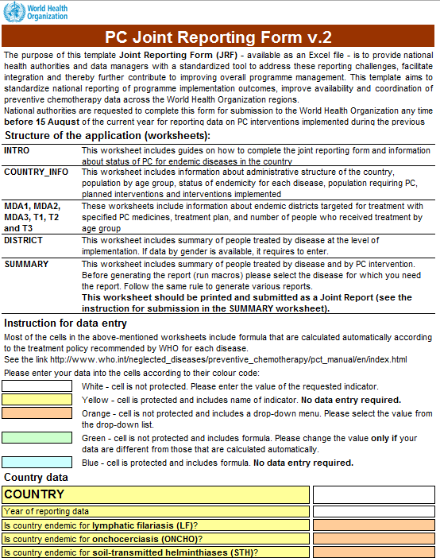
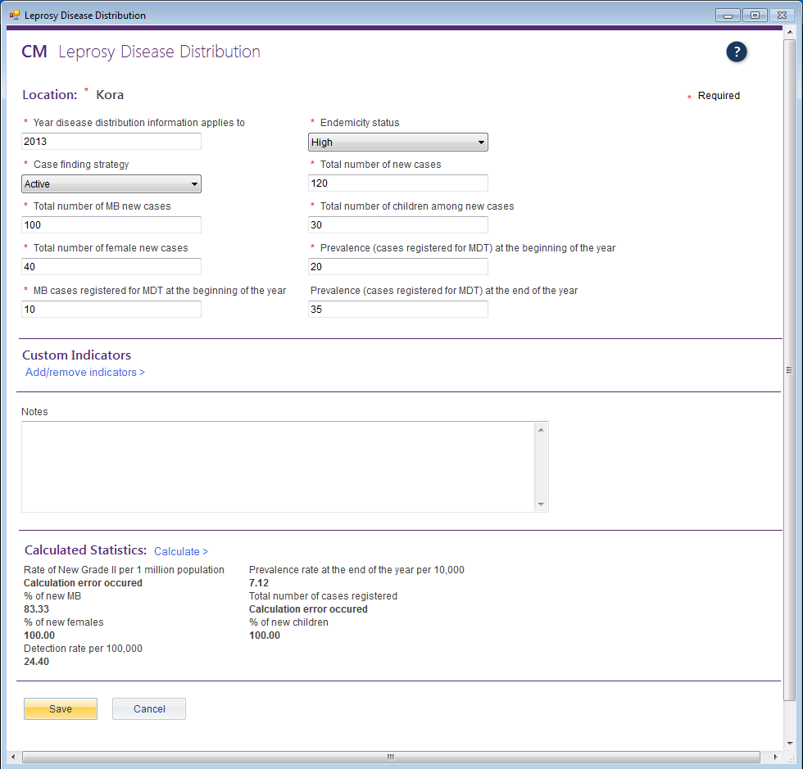
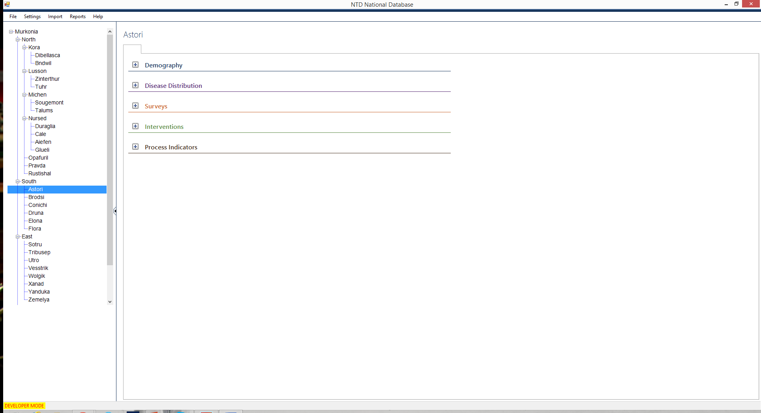
Primary functions
The National Database Template provides a convenient way for NTD programs to:
Store and analyze data
Demography
Disease Distribution
Surveys
Interventions
Process Indicators
Serious Adverse Events
Generate reports
WHO/Partner reports
Standard reports
Custom reports

Slide 5
Partners and contributors
The development of the template was a collaborative effort in 2013 across multiple partners, including:
WHO HQ
AFRO
APOC
SEARO
WPRO
RTI/ENVISION
CNTD
To ensure the database meets the needs of national NTD programs, Ministries of Health were actively involved in the development process.

Slide 6
Goals of the system
1
To store large volumes of M&E data generated by Neglected Tropical Disease programs over time
To assist with data management and analysis at the country level, thereby supporting programmatic decision-making
To strengthen the capacity for data sharing between countries, WHO, and partners
2
3

Slide 7

Primary users
National-level NTD program managers
M&E specialists
Data managers
The database is:
For NTD programs. Each database system belongs to national NTD program offices, not partners or funders. There is no automatic data sharing.
Customizable. NTD programs can tailor the database system to fit their country’s context and data management needs.
Optional. The National Database Template is not required. National NTD programs can opt to use it or not.

Slide 8
Data management
The National Database Template manages the following types of data for NTDs:
Demography
Disease Distribution
Surveys
Interventions
Process Indicators
Serious Adverse Events

Slide 9
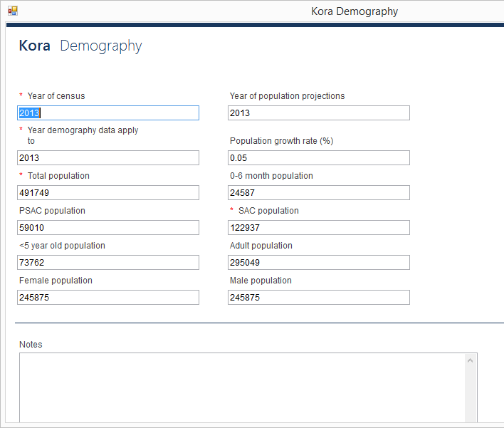
Demography
data management
Country-wide demography information is tracked for every year.

Slide 10
Disease Distribution
data management
Disease distribution information for NTDs is recorded for every year.

Slide 11
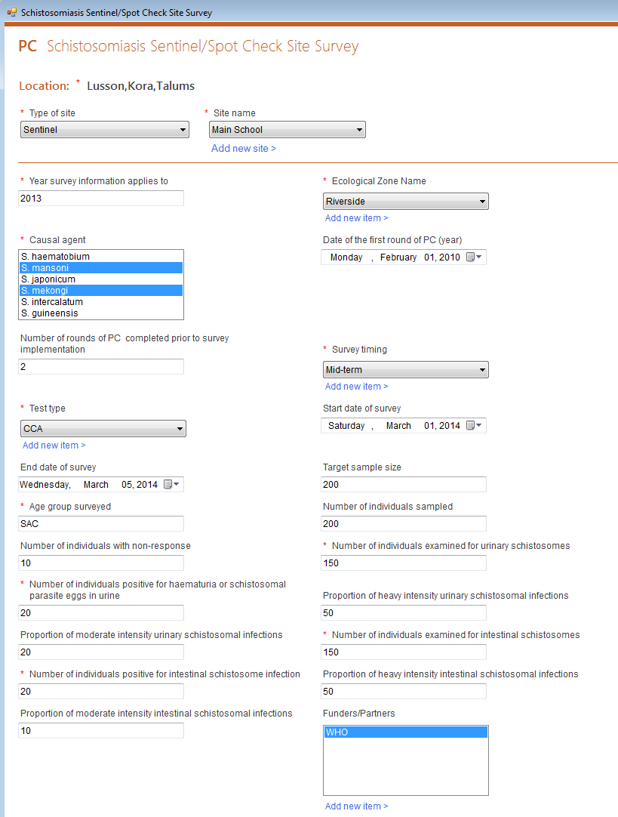
Surveys
data management
Users can enter survey data into the National Database Template. This includes mapping, baseline, midterm, TAS, and other surveys.

Slide 12
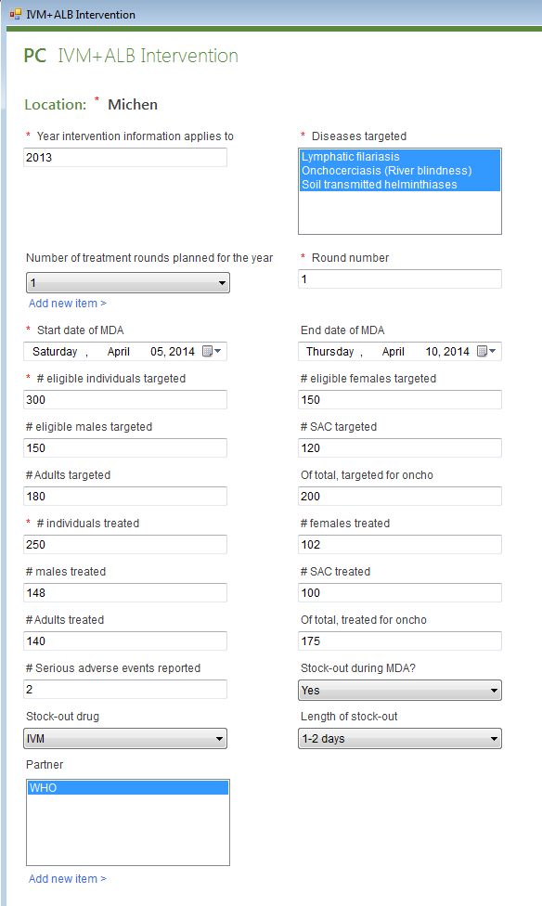
Interventions
data management
Users can enter intervention data into the National Database Template. This includes MDAs, morbidity management, and other information.

Slide 13
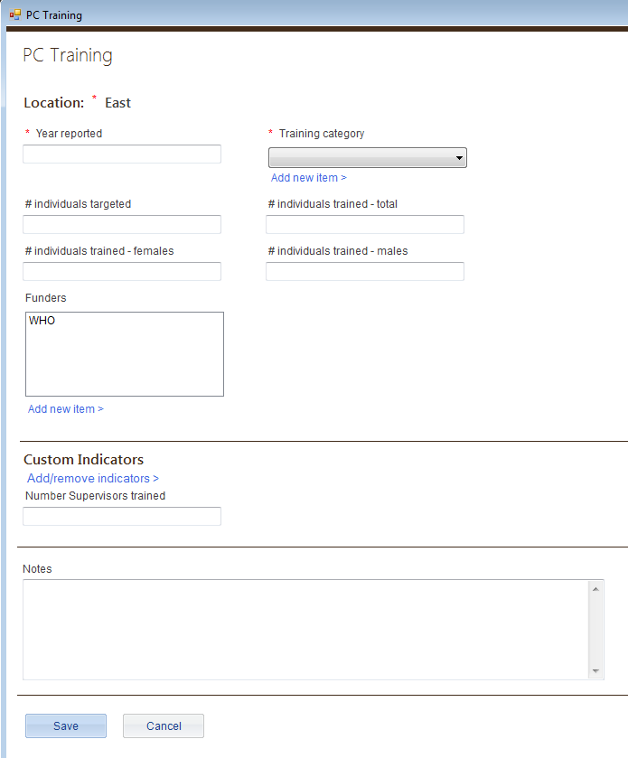
Process Indicators
data management
Users can enter process indicator data into the National Database. This includes training and supply chain management.

Slide 14
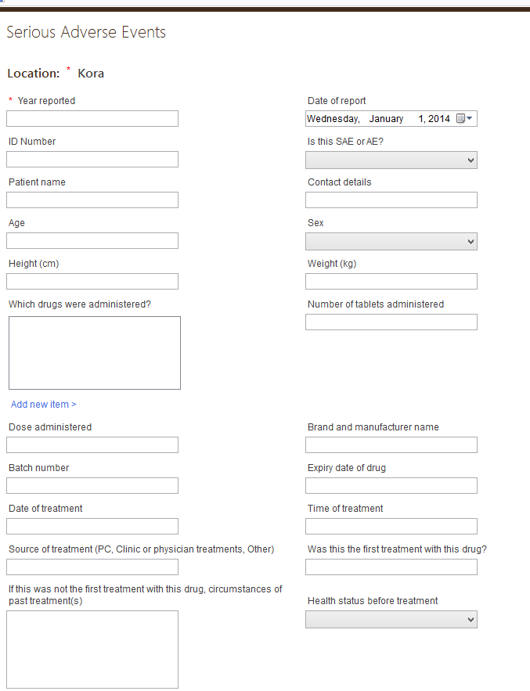
Serious Adverse Events
data management
Users can store SAE data in the National Database.

Slide 15
Convenient features
data management
Import data in large batches using Excel
Create custom indicators for any form
Create custom forms for any module
Export data to an Excel worksheet
Collect historical data for multi-year analysis
Create reports using any data entered

Slide 16
Reports
The National Database Template provides three types of report functions:
WHO/Partner reports
Standard reports
Custom reports

Slide 17
WHO/Partner reports
reports
The National Database Template can generate both the CM Joint Reporting Form and the PC Joint Reporting Form, as well as other partner reports.

Slide 18
Standard reports
reports
The National Database Template can generate these standard reports with just a few clicks (coming soon):
Progress toward elimination
Mapping report
M&E assessments
Districts treated
Coverage performance
Training report

Slide 19
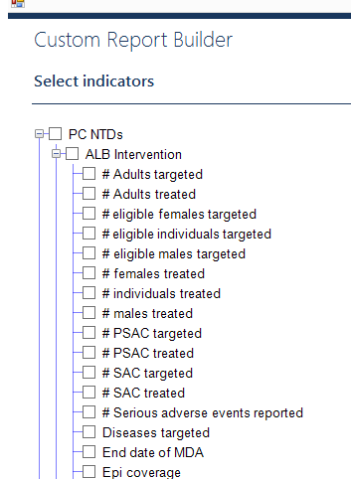
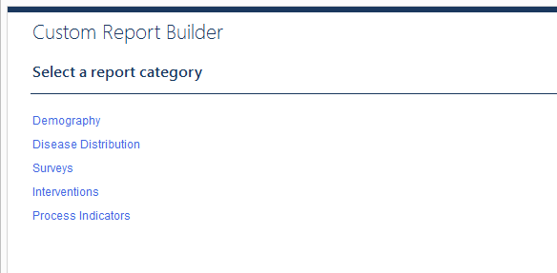
Custom reports
reports
With the custom report builder, users can create reports using any data in the database.

Slide 20
Additional system features
Updates automatically with an Internet connection for bug fixes or when new features are added.
Backs up automatically with an option to revert to last version.

Slide 21
Installation
The first step is installing the National Database Template on your computer.

Slide 22
Installation steps
There are two steps to running the National Database Template on your computer:
Install the Access DB Engine32 bit
Install the National Database Template

Slide 23
Install the Access DB Engine32 bit
installation steps
To install the Access DB Engine32 bit:
Go to http://www.microsoft.com/en-us/ download/details.aspx?id=13255
Download and install the Access engine
Restart your computer

Slide 24
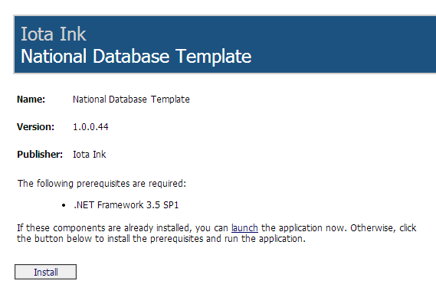
Install the National Database Template
installation steps
To install the National Database Template:
Go to http://www.who.int/neglected_diseases/ntddata/ntd_database
Click Install

Slide 25
The opening screen
When you open the National Database Template program, you will first encounter the opening screen before you enter your file or data.

Slide 26
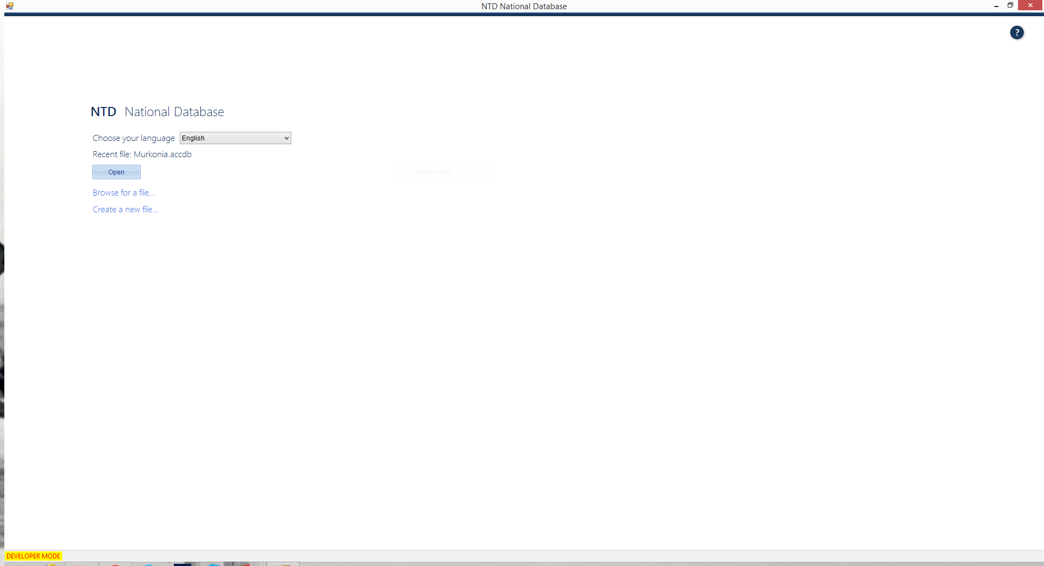
The opening screen
This is the first screen you see when opening the National Database Template tool each time.
It includes:
Choose your language
Recent file name
Open button
Browse for a file link
Create a new file link

Slide 27
Choose your language
the opening screen
There are four languages currently included in the National Database Template:
English, French, Spanish, and Portuguese
You can choose your preferred language from the drop down menu.
Important note: Number formats differ by country. Be sure to enter numbers in the format your computer regional settings are set to, no matter which language is showing on the screen. For example, if your settings are set to:
English (United States), you must enter numbers as 1,000.00
French (France), you must enter numbers as 1 000,00.
Notes:
Trainer – the other languages besides English are coming soon.

Slide 28
Recent file
the opening screen
The National Database Template will always list the most recent file on the opening screen.
To open the most recent file, just press the Open button.

Slide 29
Browse
the opening screen
You can open an existing file that was previously created from the opening screen as well.
Click on the Browse for a file… link to access your files.
Important note: You should always open the National Database Template first, then your file. Do not try to open your file alone from the saved location on your computer. You must always open your file from within the National Database Template program or it will not work properly.

Slide 30
New file
the opening screen
To start a new National Database Template, select Create new file… and a browser window will open and prompt you to save your file.

Slide 31
Create a new file
Select Create a new file…
Name your new file Murkonia
Save the file on your computer

Slide 32
Getting Started
When you create a new National Database Template file, you go through a series of steps to set up the file specifically for your country.

Slide 33
Getting started
The steps to setting up the National Database Template for the first time are:
Sign in
Enter country information
Choose diseases
Edit or add administrative levels

Slide 34
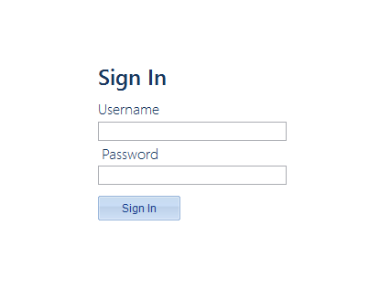
Sign in
getting started
The first time you use the tool, the user name will be blank and the password field will be blank.
Just press the Sign In button.

Slide 35
Sign in
Ensure user name is blank
Password should be blank
Press the Sign In button
You will change the password later in this presentation.

Slide 36
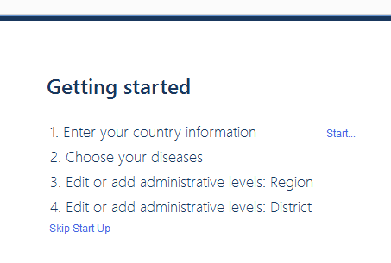
Enter your country information
getting started
Next you will need to enter your country information, including:
Country name
Administrative levels
Population statistics
Click on the Start link to begin.

Slide 37
Enter Murkonia country information
Enter Country name: Murkonia
Select view to access the Region administrative level information
Change the name from Region to Province
Click Save
Click Add administrative level type >
Enter Name: Village
Click Save
Click Next

Slide 38
Enter Murkonia country settings
Year of census: 2010
Year demography data applies to: 2014
Age range for PSAC: 2-4
% 0-6 months of total population: 3
% SAC of total population: 25
% female of total population: 49
% adults of total population: 60
Year of population projections: 2012
Population growth rate (%): 4
Age range for SAC: 5-14
% PSAC of total population: 12
% <5 years old of total population: 15
% male of total population: 51
% rural of total population: 30
When finished, click Next

Slide 39
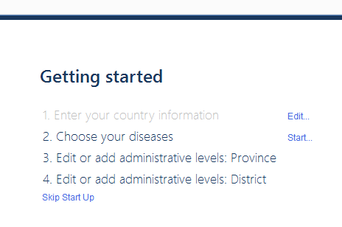
Choose your diseases
getting started
Next you will choose the diseases included in the country’s program.
Click on the Start link to begin.

Slide 40
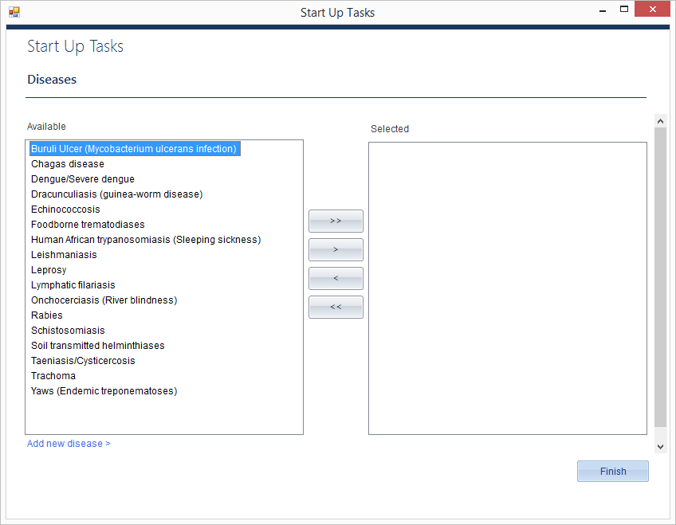
getting started : choose your diseases
The National Database Template uses the following convention to select diseases:
>>
Moves all items from the box on the left to the box on the right.
>
Moves only selected items from the box on the left to the box on the right.
<
Moves only selected items from the box on the right back to the box on the left.
<<
Moves all items from the box on the right back to the box on the left.
Add new disease allows you to add another disease to the list.

Slide 41
Choose Murkonia diseases
Assume Murkonia’s NTD program includes all 17 diseases. Practice using all the arrows to move diseases from one box to another.
Once you have tested all four arrow options, move all diseases to the box on the right and click Finish.
Quick Tip
You can select several diseases at the same time by holding down the ctrl key while clicking on the disease names. Once the names are highlighted, click on the single arrow button > to move the selected diseases to the box on the right.

Slide 42
Adding administrative levels
getting started
Demography is added to the National Database Template via Excel spreadsheets in three steps for each level.
The steps are:
Download the import file
Fill in the import file with country data
Upload the import file
Important note: You must use the import files downloaded from the database. You should enter or cut and paste your country data into the import files.

Slide 43
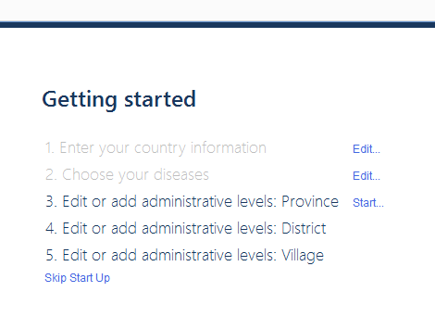
Add data for administrative levels: Provinces
At the getting started screen, click Start next to Edit or add administrative levels: Province
Number to import: 4
Click Download import file
Rename and save the import file. The import file will open in Excel on your computer.
continued on next slide…

Slide 44
continued from previous slide…
There is a file included with this training which contains all the data needed for your import. Open this file and copy/paste the information from the worksheet titled: Murkonia_Provinces into the import file file.
Close the file.
Choose Upload import file. The database will let you know if there are any problems with the import. Fix any errors and try again.
Once the file imports correctly, Click Next.
Important note: Since district is the aggregating level, there is no population information required at the Province level.
Once district population information is filled in fill in population information for Provinces and the Country.

Slide 45
Add data for administrative levels: Districts
Number to import: 25
Year demography data applies to: 2014
Download import file.
Rename and save the import file. The import file will open in Excel on your computer.
continued on next slide…

Slide 46
continued from previous slide…
Using the same provided data file as you did for Provinces, paste the information from the worksheet titled: Murkonia_Districts into the import file.
Look over the file to see what information is required.
Close the file.
Upload import file. The database will let you know if there are any problems with the import. Fix any errors and try again.
Once the file imports correctly, click Next.
continued on next slide…

Slide 47
Add data for administrative levels: Villages
Create import for: North
Number to import: 10
Year demography data applies to: 2014
Download import file.
Rename and save the import file. The import file will open in Excel on your computer.
continued on next slide…
Notes:
Trainer: Talk about how to add villages for different regions before moving on.

Slide 48
continued from previous slide…
Using the same provided data file as you did for Provinces and regions, paste the information from the worksheet titled: Murkonia_Villages into the import file.
Look over the file to see what information is required.
Close the file.
Upload import file. The database will let you know if there are any problems with the import. Fix any errors and try again.
Once the file imports correctly, click Next.
Important note: Since district is the aggregating level, all population information is required and will be totaled to fill in population information for Provinces and the Country.

Slide 49
A tour of the tool
Now that you have finished entering the start up data, you are ready to start entering the program data in the tool.

Slide 50
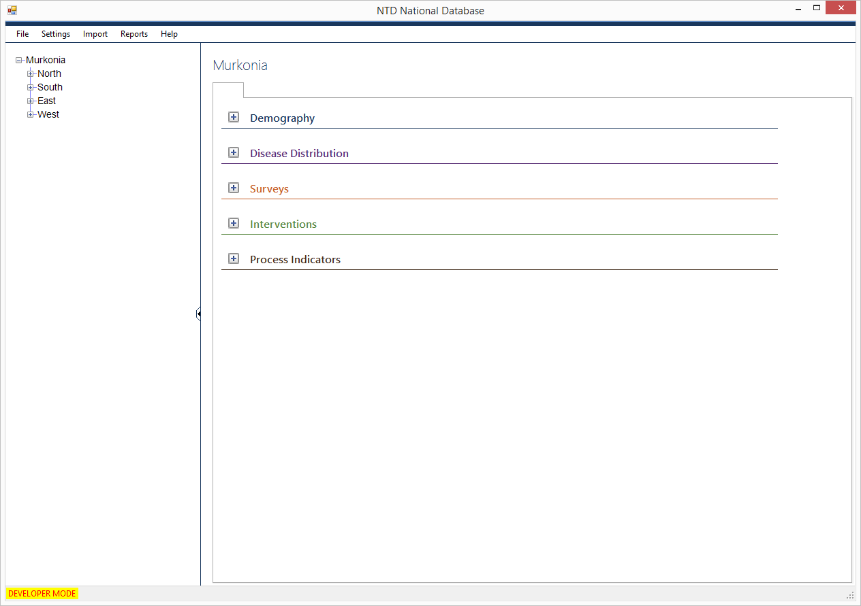
A tour of the tool
There are three main parts to the National Database Template:
The Main Menu across the top
The Location Tree
The Activity Dashboard

Slide 51
The Main Menu
a tour of the tool
The Main Menu has five functions:
File
Settings
Import
Reports
Help

Slide 52
File
a tour of the tool : main menu
From the File menu, you can do the following actions:
Start a new file
Open an existing file
Exit your National Database Template
Quick tips:
Exiting: you can use the red X at the top, right to exit your program at any time.
Saving: you never need to save your file. Your database file updates in real time, meaning any changes you make are automatically saved.
Opening a new file: If you do choose to either start a new file or open an existing file, the file you are currently working in will automatically close.

Slide 53
Settings
a tour of the tool : main menu
Edit Settings option allows you to:
Change country settings and diseases. These first two tabs are from the set up wizard and work the same as the first time you set up a new file.
Edit users. There are three types of users in the National Database Template.
Administrators
Edit country settings
Add diseases
View, add, edit users
View, add edit data
Run reports
Data enterers
View, add, edit data
Run reports
Data viewers
View data
Run reports

Slide 54
Add a new user
Select Add new user
Set user name: Administrator
Set password: (your choice, but write it down)
Select roles:
Administrator
Data enterer
Data viewer
Press Save
Use the Dashboard button to return to the dashboard

Slide 55
Settings
a tour of the tool : main menu
Add administrative unit option allows you to add new locations, such as:
Provinces
Districts
Villages
Communities
Important note: If you add a new location, you need to go to the Demography activity to enter population information.

Slide 56
Settings
a tour of the tool : main menu
Add demography for a new year and Add disease distribution for a new year options allows you to update your database in a new year.
Split/combine district option allows you to update the National Database Template when districts change.

Slide 57
Import and Reports
a tour of the tool : main menu
Import option will enable you to bulk import data.
Reports option will provide an interface to run custom and standard reports.
An overview of both of these sections will be covered later in this tutorial.

Slide 58
Help feature
a tour of the tool : main menu
There are three selections under the help option:
View help. Takes you to the help feature in the tool. Click here to look up definitions of terms or get information on different topics.
Check for updates. If you are connected to the Internet, you can click here to check if a new version is available.
Updated versions include bug fixes and new features.
The National Database Template also checks for updates each time you open it, but if you decline to download a new version at that time, you can click here later to download the update.
About. Provides information about the tool.

Slide 59
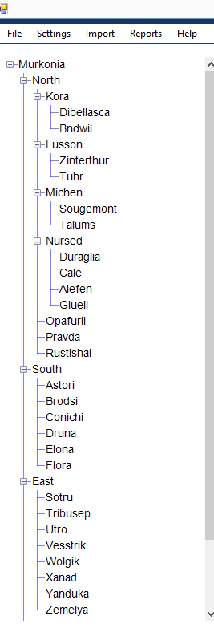
The Location Tree
a tour of the tool
Your Location Tree should look like this:
Click on the icon to expand a location. If expanded completely, it will look like this:

Slide 60
Expand the Location tree
Use the + and – controls to expand and contract the location tree.

Slide 61
The Activity Dashboard
a tour of the tool
The Dashboard shows all of the data modules that can be entered into the National Database Template, organized by the following activities:
Demography
Disease Distribution
Surveys
Interventions
Process Indicators
Serious Adverse Events
Notes:
Trainer – SAEs are in Process Indicators now, but will be in their own module soon,.

Slide 62
Important feature of the Dashboard
a tour of the tool : activity dashboard
The data and information showing for the specific activities on the Activity Dashboard will always apply to the location selected on the Location Tree.

Slide 63
Explore the Activity Dashboard
Use the+ and – controls to expand and contract the activities on the Dashboard.
Select different locations from within the Location Tree.

Slide 64
Data entry: Form by form
The National Database Template is organized by administrative units. In the data entry section, you can enter and analyze data for NTD activities that take place in each region, district, community, or other location.

Slide 65
Data entry: Form by form
There are six data entry modules in the National Database Template:
Demography
Disease Distribution
Surveys
Interventions
Process Indicators
SAEs

Slide 66
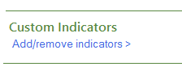
Data entry features
data entry: form by form
Custom indicators and forms
The National Database Template contains default indicators for each data entry form.
You can add custom indicators to any form or even add entirely new forms altogether.
These new indicators and forms will automatically show up in the custom report builder.

Slide 67
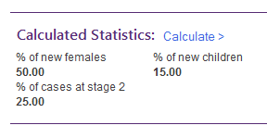
Calculated fields
Data entry: form by form : data entry features
There are numerous calculations provided at the bottom of the data entry forms to help you analyze your program.
These calculated fields are also included in the custom report builder.

Slide 68
Demography
data entry: form by form
The National Database Template stores the demography that you enter in the tool.
You can edit demography from the dashboard from the aggregating level down, but for higher levels you can only view data, since these numbers are summed for you.

Slide 69
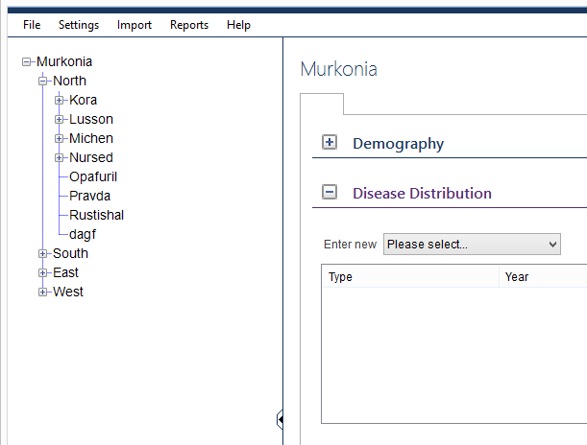
Disease Distribution
data entry: form by form
The National Database Template automatically creates disease distribution forms for every disease in the tool.
Most of these forms have default indicators provided by WHO.

Slide 70
Enter Disease Distribution - Leprosy
Select Kora (in North Region) from the Location Tree.
Choose Leprosy from the Disease Distribution drop down list.
Enter the data listed on the next slide into the form.
Year disease distribution information applies to: 2014
Case finding strategy: Active
Total number of MB new cases: 100
Total number of female new cases: 40
MB Cases registered for MDT at the beginning of the year: 10
Endemicity status: High
Total number of new cases: 120
Total number of children among new cases: 30
Prevalence (cases registered for MDT) at the beginning of the year: 20
Prevalence (cases registered for MDT) at the end of the year : 35
When finished, click Next
Find the distribution you just entered in the disease distribution list box for Kora

Slide 71
Surveys
data entry: form by form
The survey module is where you record the surveys that took place in your country.
Includes mapping, baseline, mid-term, among others
Allows you to choose multiple locations that encompass an Ecological Zone, Evaluation Unit, or Sub-districts.
When applicable, an extra data entry screen gives you the option to choose multiple locations from different levels.
Enables you to add sentinel sites to your tool, giving you the option to choose the same site again in the future.
Notes:
The survey module is where you record the surveys that took place in your country, including mapping, baseline, mid-term, among others.
Unlike disease distribution, surveys oftentimes entail choosing more than location and encompass an Ecological Zone, an Evaluation Unit, or Sub-districts. To allow for this, there is an extra data entry screen for many surveys where you can choose multiple locations from different levels.
In addition, you can add sentinel sites to your tool so that you can come back and choose the same site again in the future.

Slide 72
Enter Schistosomiasis Sentinel/Spot Check Site Survey
Select Lusson from the Location Tree
Choose Schistosomiasis Sentinel/Spot Check Site Survey from the Survey drop down list
Choose District for Level of implementation
Select the following districts for the survey:
Kora (in North Province)
Lusson (in North Province)
Click Select button
Enter type of site: Sentinel
Click Add new site >
Site name: Main School
Latitude: 10
Longitude: 20
Click Save and continue to enter data from the next slide.
continued on next slide…
Notes:
Review how to use the ctrl button for multi-select

Slide 73
continued from previous slide…
Year survey information applies to: 2014
Casual agent: S. mansoni and S. mekongi
Number of rounds of PC completed prior to survey implementation: 2
Test type: CCA
End date of survey: 5 March 2013
Age group surveyed: SAC
Number of individuals with non-response: 10
Number of individuals positive for haematuria or schistosomal parasite eggs in urine: 20
Proportion of moderate intensity urinary schistosomal infections: 20
Number of individuals positive for intestinal schistosome infection: 10
Proportion of moderate intensity intestinal schistosomal infections: 50
Ecological Zone Name: Riverside (add)
Date of first round of PC (year): 2010
Survey timing: Mid-term
Start date of survey: 1 March 2013
Target sample size: 200
Number of individuals sampled: 200
Number of individuals examined for urinary schistosomes: 150
Proportion of heavy intensity urinary schistosomal infections: 50
Number of individuals examined for intenstinal schistosomes: 150
Proportion of heavy intensity intestinal schistosomal infections: 50
Funders/Partners: WHO (add)
When finished, click Save
Find the survey form you just entered in the survey list box for Kora, Lusson, and Talums

Slide 74
Interventions
data entry: form by form
The Interventions module is where you record the interventions that took place in your country.
Includes MDA, morbidity management, and others.
PC-MDA interventions are organized by the drugs delivered during the intervention.
Quick tip:
You can add new custom indicators to the bottom of any form, below the default indicators.
Once you add a custom indicator, it will always appear on that form in the future unless you disable it.

Slide 75
Create a custom indicator for IVM+ALB Intervention
Select Michen (in North Region) from the location tree.
Select IVM+ALB Intervention.
Under Custom indicators, click Add/remove indicators.
Click Add/remove indicator on custom indicator screen.
Custom indicator name: Number of community health workers
Data type: Number
Click Done.
Continue to enter the data from the following slide.
continued on next slide…

Slide 76
continued from previous slide…
Year survey information applies to: 2014
Number of treatment rounds planned for the year: 1
Start date of MDA: 5 April 2013
# eligible individuals targeted: 300
# eligible males targeted: 150
# Adults targeted: 180
# individuals treated: 250
# males treated: 148
# Adults treated: 140
# Serious adverse events reported: 2
Stock-out drug: IVM
Partner: WHO
Number of community health workers: 14
Diseases targeted: LF, Oncho, STH
Round number: 1
End date of MDA: 10 April 2013
# eligible females targeted: 150
# SAC targeted: 120
Of total, targeted for oncho: 200
# females treated: 102
# SAC treated: 100
Of total, treated for oncho: 175
Stock-out during MDA?: Yes
Length of stock-out: 1-2 days
When finished, click Save
Find the intervention form you just entered in the intervention list box for Kora, Lusson, and Talums

Slide 77
Process Indicators
data entry: form by form
Process indicators can include many types of data that you want to track.
Currently includes training and supply chain management forms.
Quick tip:
You can create a new, custom form (with all custom indicators) for Survey, Interventions, and Process Indicator modules.
From a module drop down list, choose Add new type.
Notes:
Process indicators can include many types of data that you want to track. Presently, there are both training and supply chain management forms in the database.
If you would like to add a whole custom form (rather than just a custom indicator), choose Add new type from the drop down list.
You can add custom forms to the surveys, interventions, and process indicator modules.

Slide 78
Add a custom Process Indicator form
Select East from the Location Tree.
Select Add new type from Process Indicators drop down list.
Name: Alternative Strategies: Water, Sanitation and Hygiene
Click Add/remove indicators.
Add 2-5 custom indicators to your Water, Sanitation and Hygiene form. Try out the different data types.
Click Save.
Fill in the data on the form.
Save the data on your new form.
When finished, click Save.
Find the Process Indicator form you just entered in the survey list box East.

Slide 79
Data entry: Bulk importing
The second way to enter information into the database is through bulk importing.

Slide 80
Data entry: Bulk importing
Rather than entering information into the database form by form for activities, you can also bulk import your data.
There are three steps to bulk importing:
Create the import file
Fill in the import file
Upload the import file
Bulk importing is intended to save you time and effort.

Slide 81
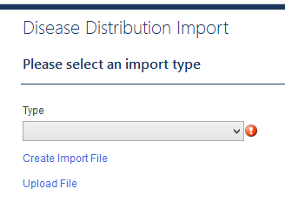
Create the import file
data entry: bulk importing
The first step to bulk importing is to create the import file:
Choose Import from the Main Menu
Select the activity
Select the type of form to import from the drop down list
Click on Create Import File
Select the administrative units to include

Slide 82
Create an import form for an Intervention
Select Interventions from the Import menu option
Type: LF Morbidity Management
Click Create Import File
Level of implementation: District
Select the following Districts (from the South Region):
Astori
Brodsi
Conichi
Druna
Elona
Flora
Click Next
Save the import file on your computer

Slide 83
Import data for a LF Morbidity Management Intervention
There is a file included with this training which contains all the data needed for your import. Open the file titled: LFMM and copy/paste the information from the worksheet into the import file you just created in the last exercise.
Save and Close the import file.
Choose Upload Import File. The database will let you know if there are any problems with the import. Fix any errors and try again.
Once the file imports correctly, Click Next.
Find the intervention forms you just imported in the intervention list boxes for Astori, Brodsi, Conichi, Druna, Elona, and Flora.

Slide 84
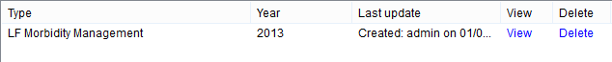
Reviewing/Editing imported data
data entry: bulk importing
Once data has successfully imported, you may need to review for accuracy, add missing data, or change inaccurate or updated data at a later date.
From the Dashboard, first select the location.
Select the imported form you wish to review by clicking on the view link next to the name of the form from the appropriate activity data module.
This will take you to the screen where you can review, add, and/or change data.
Click Save if you changed anything.

Slide 85
Updating for a new year
The National Database Template can help you update your information for a new year.

Slide 86
Updating for a new year
The National Database Template has two step-by-step wizards to help save you time when updating information for a new reporting year.
The Demography wizard
The Disease Distribution wizard
Quick tip:
These wizards can also be used to enter historical information for past years.

Slide 87
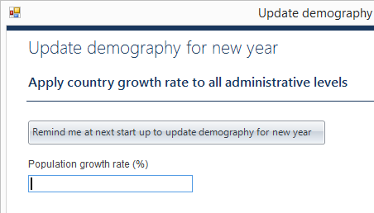
Demography wizard
updating for a new year
Most of the demography wizard works behind the scenes.
The steps are:
Designate a growth rate for the year.
The National Database Template automatically applies the growth rate to all demography indicators for all administrative units at all levels and adds the new year’s data to the database.
Review and change values for any administrative units by downloading the Excel worksheets, making any necessary changes, and uploading them back into the system. This step is optional.

Slide 88
Update demography for a new year
Select Settings -> Add demography for a new year…
Population growth rate percentage: 4
Select Next.
Review your demography by selecting Next again.
Select Download demography file.
Save the Excel file on your computer.
Review the Excel file.
Save and close the Excel file.
Select Upload import file and choose the Excel file.
Skip making changes to districts, so press Finish.
Find the new year’s demography information on the dashboard.

Slide 89
Redistricting
The National Database Template can reallocate data when administrative units in the country change.

Slide 90
Redistricting
The National Database Template provides three ways to reallocate administrative units:
Split administrative units
Merge administrative units
Split and combine administrative units

Slide 91
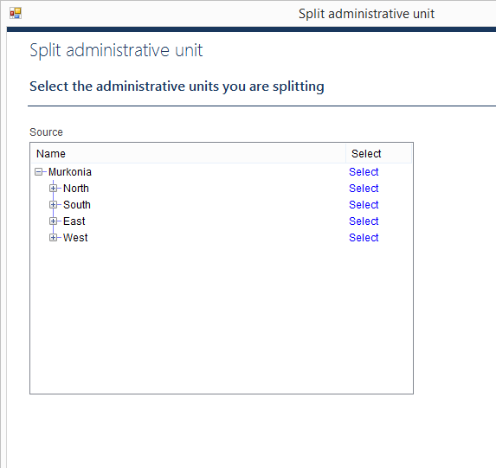
Split administrative units
Redistricting
You can split one administrative unit into multiple administrative units at the same level.
You can choose how to allocate lower level administrative units.
Indicators will be allocated automatically, but you can review and make changes to them.

Slide 92
Split administrative units
Select Settings -> Split administrative unit from the Main Menu
Select Kora district to split
How many: 3
Click Next
Click Select… next to the
Click New administrative level >
Name: Kora East
Highlight North Province
Click Save
Select Kora East
Repeat steps 4-10 to select the following two districts:
Kora South
Kora West
continued on next slide…

Slide 93
continued from previous slide…
Allocate the Percentage of population:
Kora East: 20
Kora South: 30
Kora West: 50
Click Next
Move Bndwil to Kora East and click Next
Move Dibellasca to Kora South and click Next
Click Next
Click Finish

Slide 94
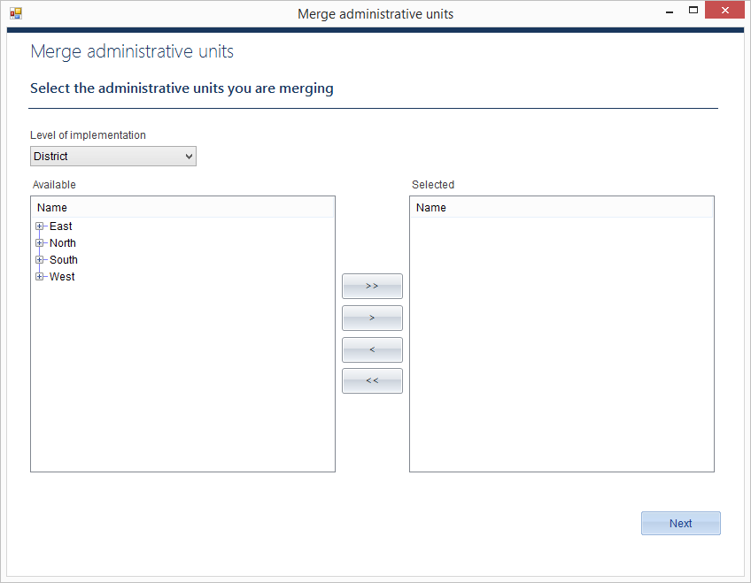
Merge administrative units
Redistricting
You can merge any number of administrative units at the same level into a new administrative unit.

Slide 95
Merge administrative units
Select Settings -> Merge administrative units from the Main Menu
Level of implementation: District
Select Lusson and Michen districts to merge.
Click Next
Name: Luchen
Highlight the North Province
Click Next
Click Finish

Slide 96
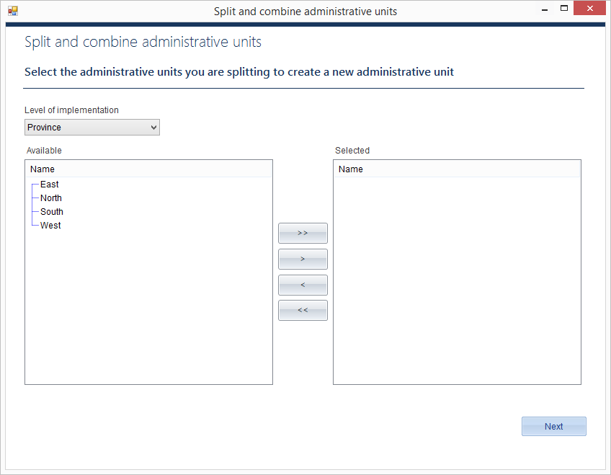
Split and combine administrative units
Redistricting
You can split multiple administrative unit to create a new administrative unit from parts of the original units.

Slide 97
Split and combine administrative units
Select Settings -> Split and combine administrative units from the Main Menu
Level of implementation: District
Select Nursed and Opafuril districts to split
Click Next
Name: Nurfuril
Highlight North Province
Click Next
Enter Percentage of population:
Nursed: 40
Opafuril: 20
Click Next
continued on next slide…

Slide 98
continued from previous slide…
Move the following villages from Nursed to Nurfuril
Cale
Duraglia
Click Next
Move the following villages from Opafuril to Nurfuril
Kutomala
Nyereli
Click Next
Review and confirm.
Click Next
Click Finish

Slide 99
Reports
The National Database Template can generate a wide variety of reports to help you analyze your program, share data, and plan for the future.

Slide 100
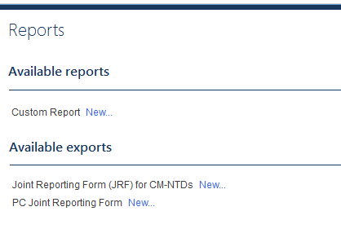
Reports
The National Database Template provides three types of report functions:
A custom report builder
WHO/Partner reports
Standard reports

Slide 101
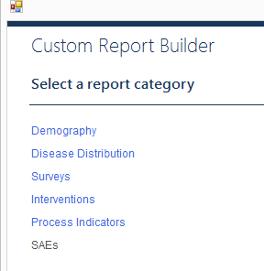
Custom report builder
reports
The custom report builder is a flexible tool. You can use it to review, analyze, and report data of your choice.
Quick tip:
Use the custom report builder to generate Excel worksheets that can be uploaded into other tools

Slide 102
Generate an LF Morbidity Management Report
Select Reports -> New from the Main Menu
Click Custom Report New…
Click Interventions
Use the + to expand the options for the LF Morbidity Management report
Check the boxes to select:
# hydrocele cases
# hydrocele cases treated
# lymphoedema patients
# lymphoedema patients treated
Click Next
Years: 2014
Aggregate by: List all
Click Next
Click Finish
continued on next slide…
Notes:
Trainer: show how you can use the shift and space bar to select all the options at once.

Slide 103
continued from previous slide…
Review your data on the screen.
Try exporting the data to Excel
Try editing report options and running the same report, but aggregated by country.
Try editing report options and running the same report, but aggregated to administrative level.
Notes:
Trainer: show how you can sort by clicking on the column heads

Slide 104
WHO/Partner reports
reports
WHO/Partner reports are listed under Available exports.
When it is time to submit reports to WHO, you can use the National Database Template to generate these reports with the click of a button.

Slide 105
Generate a WHO Joint Reporting Form
Select Reports -> New from the Main Menu
Try generating one of the Joint Reporting Forms.

Slide 106
Standard reports
reports
The National Database Template includes Standard reports. These are some of the typical tables and graphs helpful in analyzing NTD programs.
Standard reports include:
Mapping report
M&E assessment
Progress toward elimination
Districts treated
Persons treated
Coverage performance

Slide 107
Setting up a National Database Template for your program
It’s time to set up a National Database Template file for your country.

Slide 108
Setting up a file for your program
You can start a new National Database Template file at any time, although you will probably want to store all the data for your country in just one file.
Quick tip:
You can share this file with others via:
email
flash drive
Dropbox
other similar method to transfer files

Slide 109
Start a National Database Template for your program
Select File - > New from the Main Menu
Select Create a new file…
Save the file on your computer
Sign in (there is no login or password yet)
Click Enter your country information Start…
Enter country settings for your program, including adding more administrative levels. You can have up to seven total.
Click Next
Enter the Country Settings population numbers
Click Finish
Click Select Diseases Start…
Use the arrows to select diseases that are included in your program. Use the Add new diseases… link to add any additional diseases to the list.
Click Finish
Click Start to Edit or add administrative levels for all your levels.
Click Finish
Select Settings from the Main Menu.
Click the Users tab and set users and passwords.
You are now ready to enter data into your National Database Template.

Slide 110
The template for the NTD National Database was developed by RTI International under the ENVISION project with funding from the United States Agency for International Development in cooperation with the World Health Organization (WHO) and its regional offices, the African Programme for Onchocerciasis Control and the Centre for Neglected Tropical Diseases.
The National Database Template was developed by Iota Ink:
Jennifer Einberg, Project Manager; Eric Olson, Developer; Jennifer Fox, Graphic Designer; Michelle Fellows, Technical Writer

Slide 111








acknowledgments
The National Database Template was developed in collaboration with:

