Slide 1

Covid-19 US States Dashboard
Author: Eric Junkins
Systems Software Engineer (1740)

Slide 2
Motivation
Goal:
Help answer the question “are states taking appropriate action in response to COVID-19?”
Approach:
Design an interactive tool to explore COVID-19 data from each state
Both relative to all other states, and absolute scales
Monitor individual states responses (ie. Lockdown orders)
Allow sorting/filtering to view trends between states

Slide 3
Technology Used
Dashboard
Built in D3
Datasets
CovidTrackingProject - API
Johnhopkins University - API
US States lockdown orders - Manually gathered
Other relevant state datasets (population, political affliciation etc.)

Slide 4
Demo
https://ericjunkins.github.io/covid-19-us-states/dashboard.html

Slide 5
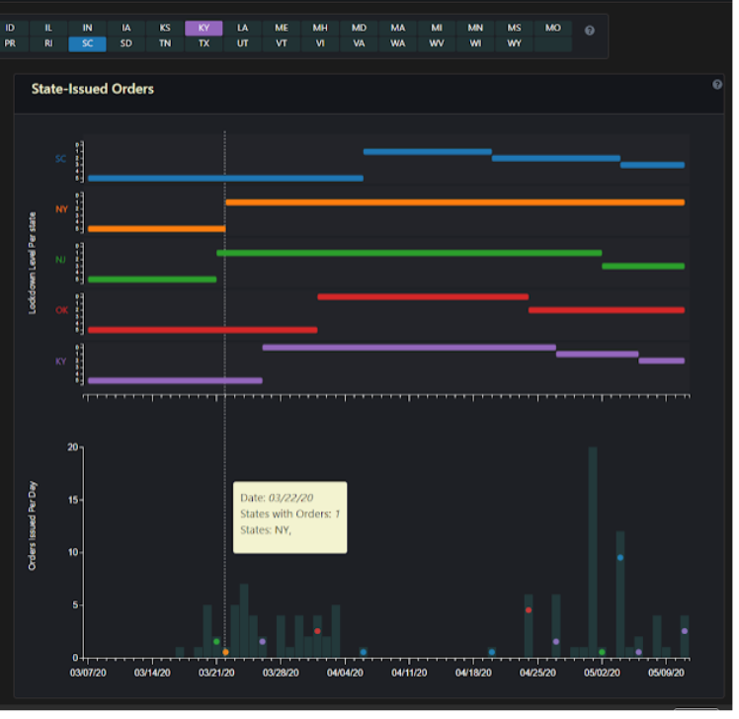
Examples/Conclusions
Compare what states released orders on what day
See each state’s lockdown level as a function of time

Slide 6
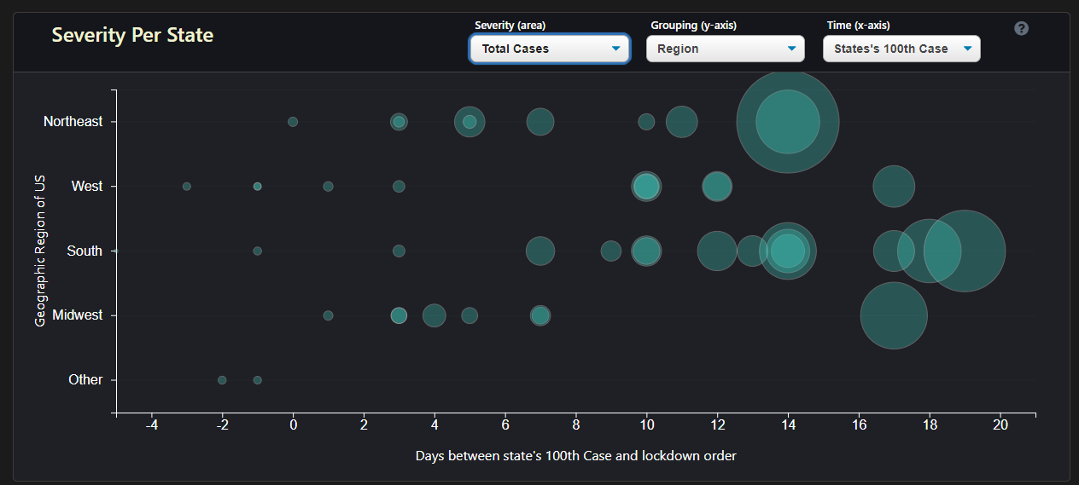
Examples/Conclusions
Southern states tended to wait longer, and get more severe before issues a lockdown order
Midwest states tended to respond quicker and didn’t get as severe

Slide 7
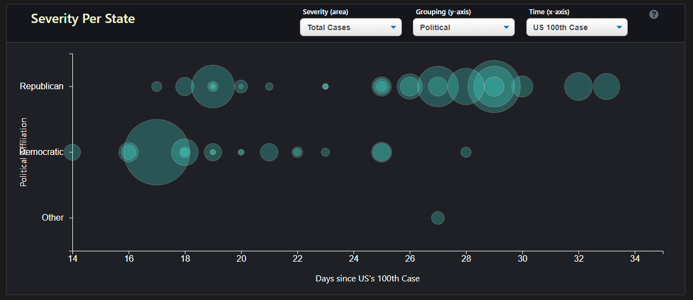
Examples/Conclusions
Democratic states responded quicker on average and didn’t get as severe (NY as outlier)

Slide 8
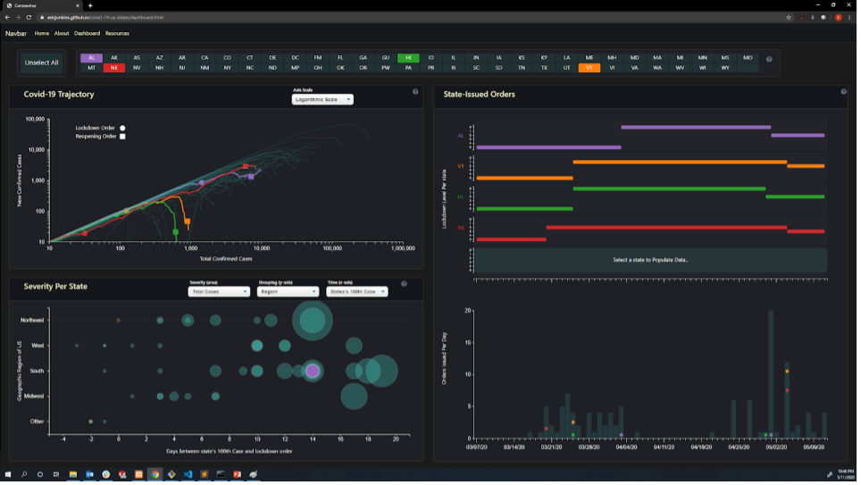
Examples/Conclusions
NE, AL are still increasing or spike after reopening order
VT and NE released reopening order to level “3” on the same day, despite drastic different conditions
HI, VT have done a great job “flattening curve”, downward curve after reopening order

Slide 9
Future Work
Modifications on current visualizations
Additional filtration criteria of displays
Better filtration, grouping, and selection to focus on trends between groups of states
Splash page information more clear, demo on how to use/understand dashboard
General clarity updates of charts, legends etc.
Additional visualizations
New tab of “current/up-to-date” data
US state map colored by selectable criteria (lockdown level, cases in last week, cases per capita etc.)
US State ranking based on selectable criteria

